Slide 1
Introduction & Hypothesis
Project: Computer Vision-Based Chess Training Tool
Aim:
Explore how chess players perceive the tool across skill levels
Identify which factors influence the adoption of the tool
Receive insights to help form the design and improve over-the-board computer vision chess training tools.
Hypothesis:
How do players of varying experience levels perceive the ease of use, accuracy, and training integration of the tool, and how do these perceptions influence their intention to adopt it?
Hypothesis created in-line with J.W Creswell’s guidelines on Qualitative Research Design, therefore implemented as an open-ended
question, rather than a directional hypothesis.

Slide 2
Methodologies Reviewed
Reviewed: Phenomenology, Grounded Theory, Case Study, Ethnographic, Narrative
Chosen: Case Study under Interpretivist Paradigm
Approach: Mono-method Qualitative, Cross-sectional
Justification: Rich, contextual, player-specific insights

Slide 3
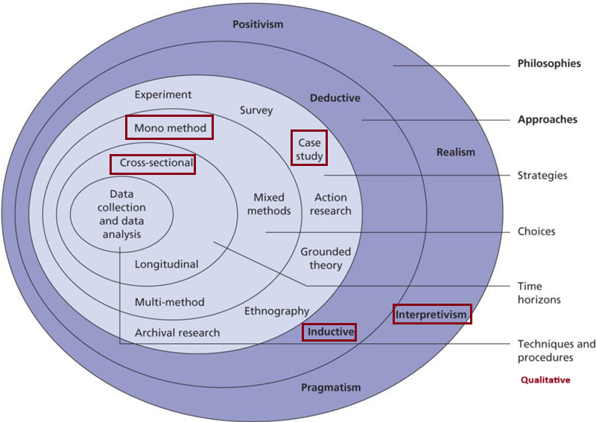
Research onion

Slide 4
Experiment Design & Data Collection
Participants:
- Beginner (700 Elo, Chess.com)
- Advanced (1600 Elo, FIDE Registered)
Method: Semi-structured interviews
Ethics: Consent, data protection, anonymization

Slide 5
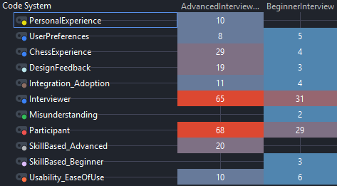
Data Analysis & Results
Thematic analysis using two-case model on MAXQDA
Key themes: Usability, Integration, Usefulness, Accuracy
Advanced player interview provided richer, critical feedback

Slide 6
Hypothesis Reflection
Both players perceived the tool to be easy to use
Both players considered how to integrate the tool into their own regime
Accuracy could not be directly addressed due to lack of working prototype.
Both players considered the adoption of the tool due to it’s easy to use and integrate nature.
Hypothesis:
How do players of varying experience levels perceive the ease of use, accuracy, and training integration of the tool, and how do these perceptions influence their intention to adopt it?

Slide 7
INTERESTING DESIGN FEEDBACK
Support for people with disabilities (Text-to-speech, Voice Recognition and Traversing)
Human vs Computer Mode
Treating the tool as a product, inclusion of a physical tri-pod with the product to help set up the required camera angle easier.

Slide 8

Conclusion & Future Research
Both users found the concept promising
Future work:
- Prototype development
- Larger sample size
- Quantitative triangulation
Qualitative research informs early tech design

Slide 9

Thank You
Lee Xerri
Research Design II – MCAST – 2025
Computer Vision-Based Chess Training Tool

