Slide 1

Search Driven Apps
with the Elastic Stack
Notes:
Joe Zack, long time dev, podcaster
Talking about search driven apps, focus on Elasticsearch
ElasticSearch is a highly scalable and feature-rich search engine that makes certain types of problems very easy to solve. I will show you how Elasticsearch approaches these problems and then demonstrate 3 different types apps that make good use of this approach.

Slide 2

The problem?
Lots of data
Hand-crafting relational queries
Ambiguous language
Typeos
Notes:
Search is a core tenet of the modern day internet experience.
Google obviously, but think about how other experiences are changing now Cortana on windows, Spotlight on mac, Hey Alexa
We’re people, we’re not good at exact.
Tons of data:
5B videos watched on YouTube every day: https://merchdope.com/youtube-statistics/
How are we inexact people searching?
Probably not relational db!
Don’t scale horizontally very well
Shredding is inefficient
Many types of applications built around searching and filtering. You can kinda do this by hand, but unless you're really careful with design this can spiral into a big ol' mess of dynamic sql code where ever schema change requires increasingly ugly code changes
So…why don’t we use a nosql implementation denormalize the heck out of, and then index the heck out of it, then map reduce the heck out of it – Well… you just described a reverse index search engine!
Amazon sells over 500M products
Splunk indexes 100’s of TB per day
Google servers 40k searches…per second
https://ardorseo.com/blog/how-many-google-searches-per-day-2018/
https://www.scrapehero.com/many-products-amazon-sell-january-2018/

Slide 3
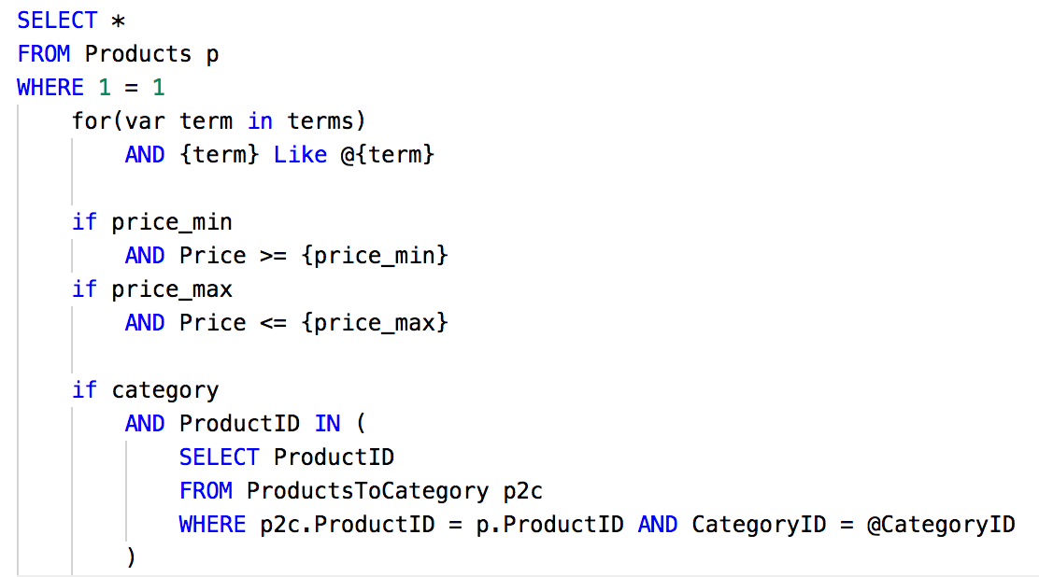
It starts out innocently enough
Notes:
Ever written code like this?
It starts out innocently enough, just a simple like search. Then you start searching other fields.
Keep adding if statements to the main query...
And anywhere you're doing aggregations
And any time you take batch action...

Slide 4
Reverse Index Search
NoSql DB: Horizontal Scaling
DeNormalize our data
Index everything!
Map/Reduce to search quickly
Declarative language
Notes:
So…why don’t we use a nosql implementation denormalize the heck out of, and then index the heck out of it, then map reduce the heck out of it – Well… you just described a reverse index search engine!

Slide 5
Reverse Index Search
Notes:
Ever written code like this?
Keep adding if statements to the main query...
And anywhere you're doing aggregations
And any time you take batch action...

Slide 6
Reverse Index Search Engines
Reverse Index Database
Slow to Write, Fast to Read
NoSql before it was called NoSql
Scale Super Well
Wicked Fast
Support Complex Filters

Slide 7
How well do search engines work?
Notes:
Google serves 40k search requests per second, Amazon has over 500B products. Companies like splunk index hundreds of terabytes a day.
Horizontally scalable
Ever written code like this?
Keep adding if statements to the main query...
And anywhere you're doing aggregations
And any time you take batch action...

Slide 8
English is complicated!
Stop words: “the”
Alias: PWA = “Progressive Web Apps”
Stemming: run, runs, ran, running
Notes:
Ever written code like this?
It starts out innocently enough, just a simple like search. Then you start searching other fields.
Keep adding if statements to the main query...
And anywhere you're doing aggregations
And any time you take batch action...

Slide 9




1-24 of over 80,000 results for “camera”

Slide 10







Elastic Stack
Notes:
Open source…ish
NoSQL before NoSQL

Slide 11
Complex Declarative Queries
REST API
Declarative Syntax

Slide 12
What can I build?
Free text search
Aggregation and Filtering
Logger/APM

Slide 13
Architecture

Slide 14
Search Driven Apps
with the Elastic Stack
Notes:
ElasticSearch is a highly scalable and feature-rich search engine that makes certain types of problems very easy to solve. I will show you how Elasticsearch approaches these problems and then demonstrate 3 different types apps that make good use of this approach.

Slide 15
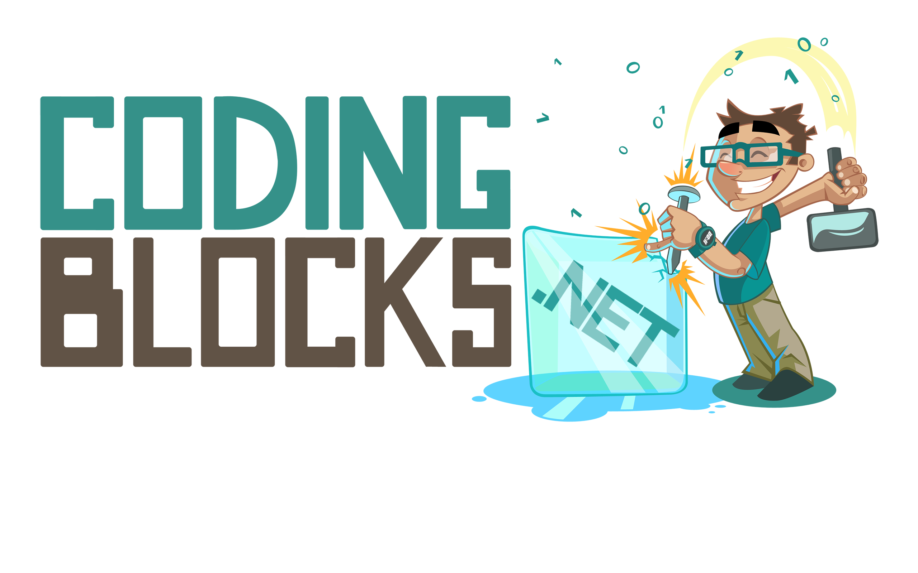
Like this talk? Check out the show!
Joe Zack
@codingblocks
Notes:
We speak with 10’s of thousands of programmers every month who want to get better
Take lessons from modern research and other fields and apply them to programming as yet another way to learn

