Slide 1
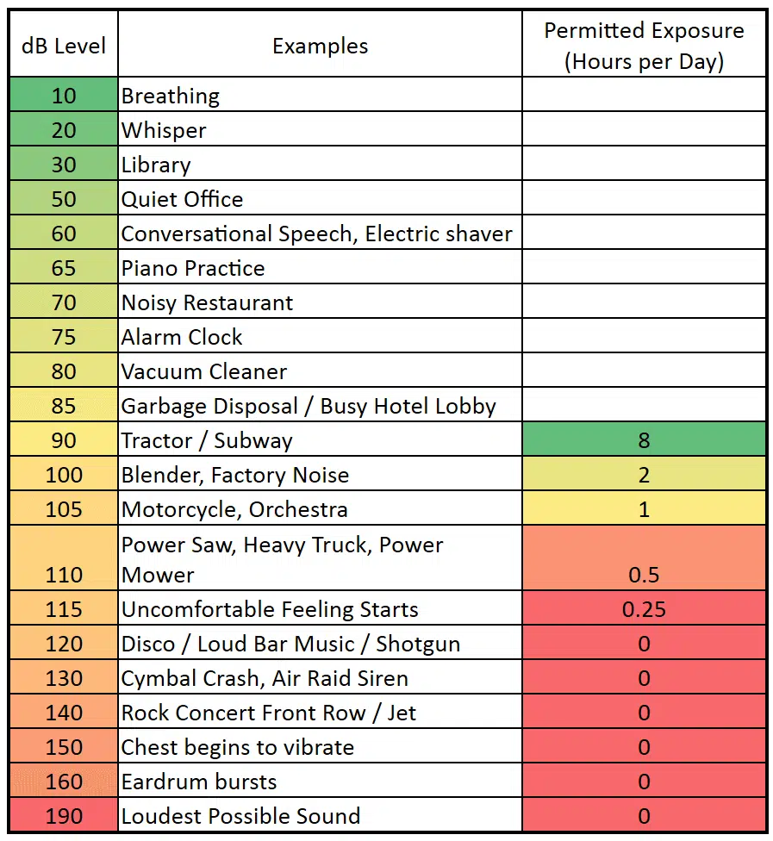

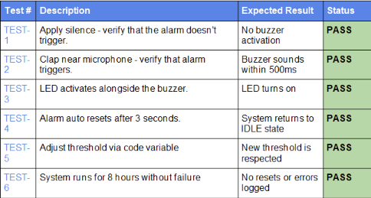
Where the problem is crucial:
Libraries and study areas
Hospital wards and care environments
Offices where constant noise have been shown to decrease productivity
Shared environments where noisy disputes are common.
Research:
A research by Bashner et al. published in The Lancet demonstrates that sustained noise exposure impairs cognitive performance and elevates stress. The World Health Organisation (WHO) recommends that indoors daytime noise levels should not exceed 35dB for good sleep and cognitive function.
Sound alarm Internet of Things Project
Lee Mckiernan, Balint Vaczi, Leo Doddy
Problem to be solved:
How can a low-power, inexpensive IoT device automatically detect when sound levels exceed a high threshold, and immediately notify people in a space so that noise can be reduced?
Conclusion:
Through certain tests it allowed us to grow our code too make it better and easier to follow. The code we have now has passed all these tests.
Summary of Project:
Our solution is an Arduino-based Sound Alarm that continuously listens to ambient sound levels using a microphone sensor module. When the detected sound levels exceed a certain predefined threshold, the system activates a buzzer alarm, lights an LED, and optionally logs event data on a cloud server or a database via a Wi-Fi-enabled module for later analysis.
Design and Price:
The device is designed to be compact, low-cost and straightforward to use with no need for professional instructions. It can be powered by a USB cable and does not require internet for its base alarm functionality, though network connectivity extends its capability.

