Slide 1

Customer Churn
Data cleaning to Karma 360
Peter Huang
Moo-Fon Lee
Dataset URL
Notes:
1

Slide 2
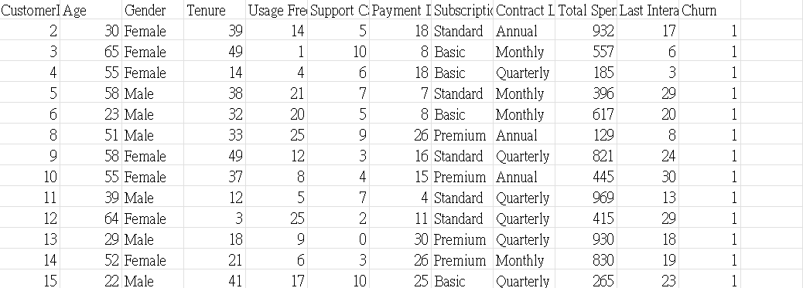
Original Dataset (450000 rows and 12 columns)
This data tracks the customer churn rate, indicating whether customers stop using the company's products or services within a specific period.
No missing values
Notes:
3

Slide 3
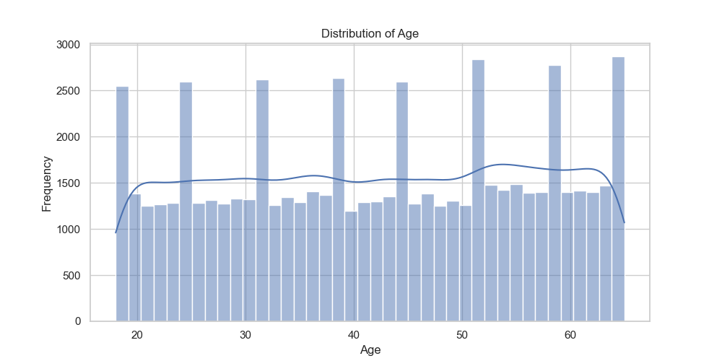
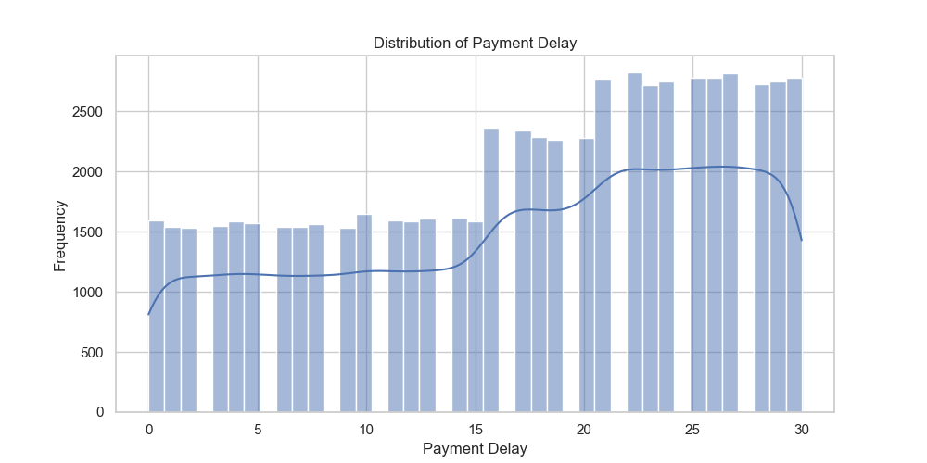
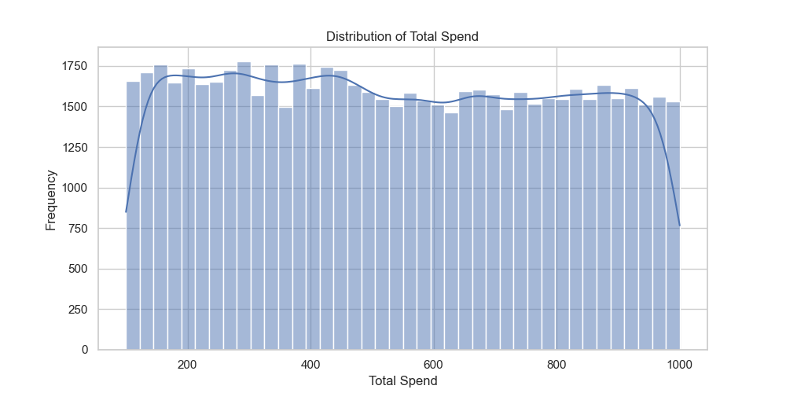
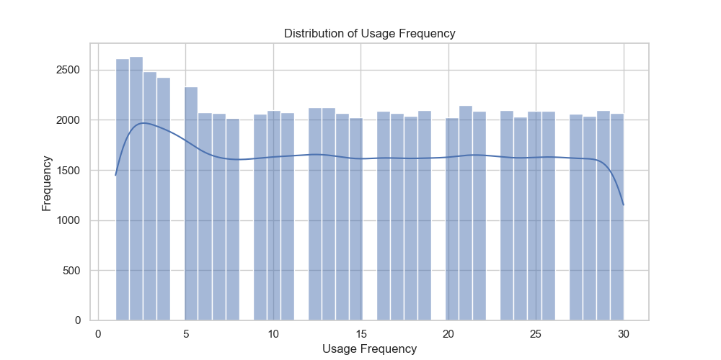
Distribution(take 60000 rows)
Age
Payment Delay
Total Spend
Usage Frequency
Notes:
3

Slide 4
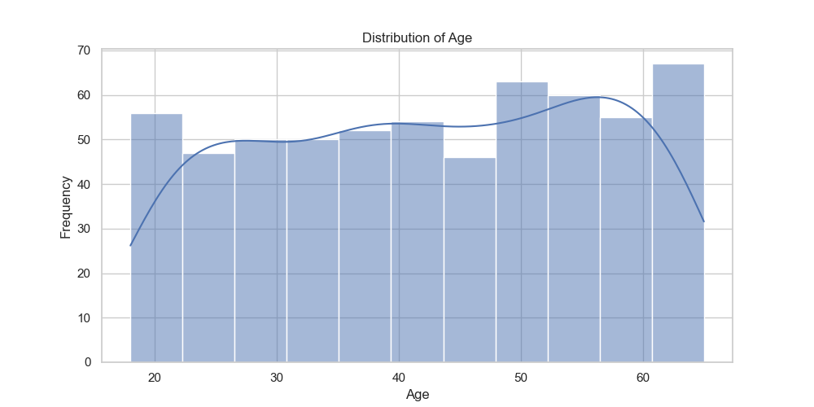
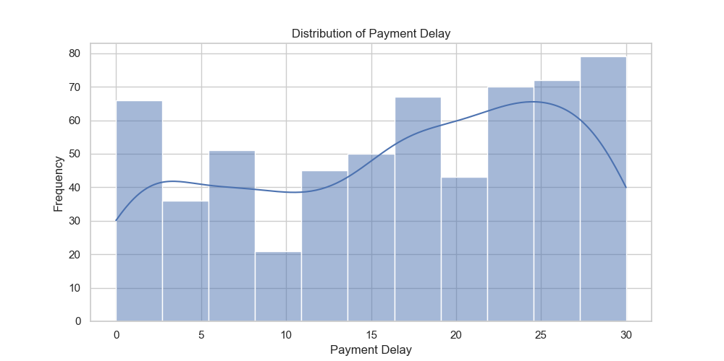
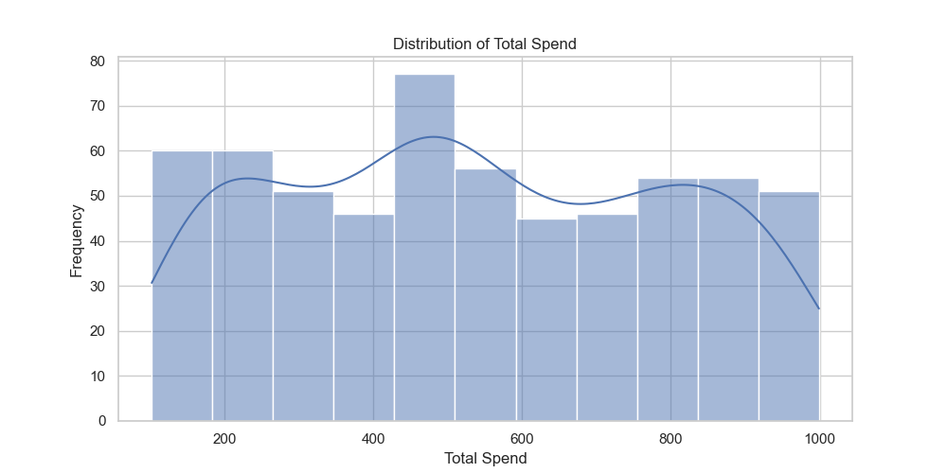
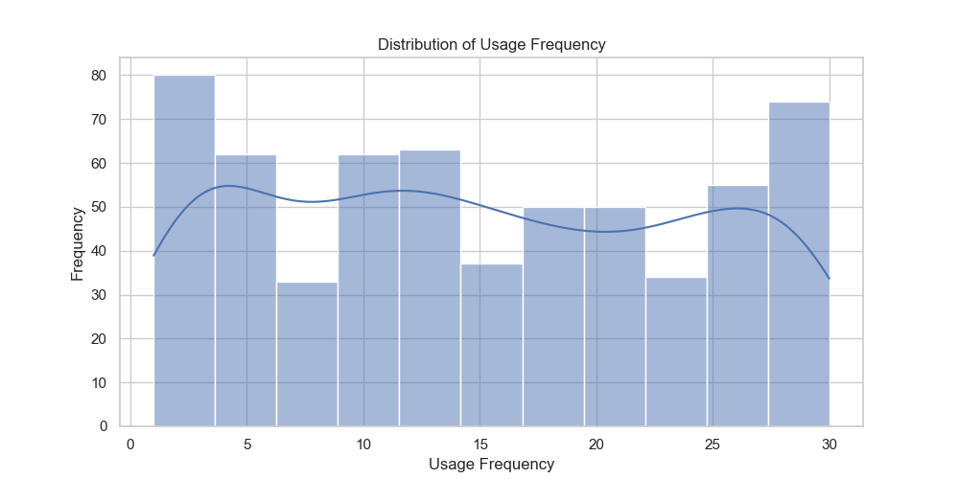
Distribution(take 600 rows)
Age
Payment Delay
Total Spend
Usage Frequency
Notes:
3

Slide 5
Data Cleaning
Encoding
1
1. One-Hot Encoding(imply 2 column, append 4 more column)
2. Ordinal Encoding(imply 2 column to numeric value 0,1,2)
Outliers
2
Use Q1 Q3 to judge outliers(No outliers)
Other
3
Randomly delete data to balance the target column "Churn".
2. Drop ID column
Notes:
3

Slide 6
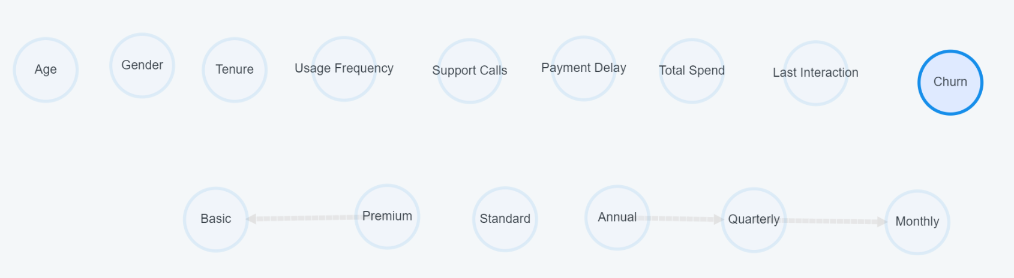
One-Hot vs Ordinal Encoding
Subscribtion Type→ Premium, Standard, Basic
Contract Length→ Monthly, Quarterly, Annual
One-Hot Encoding
Notes:
3

Slide 7
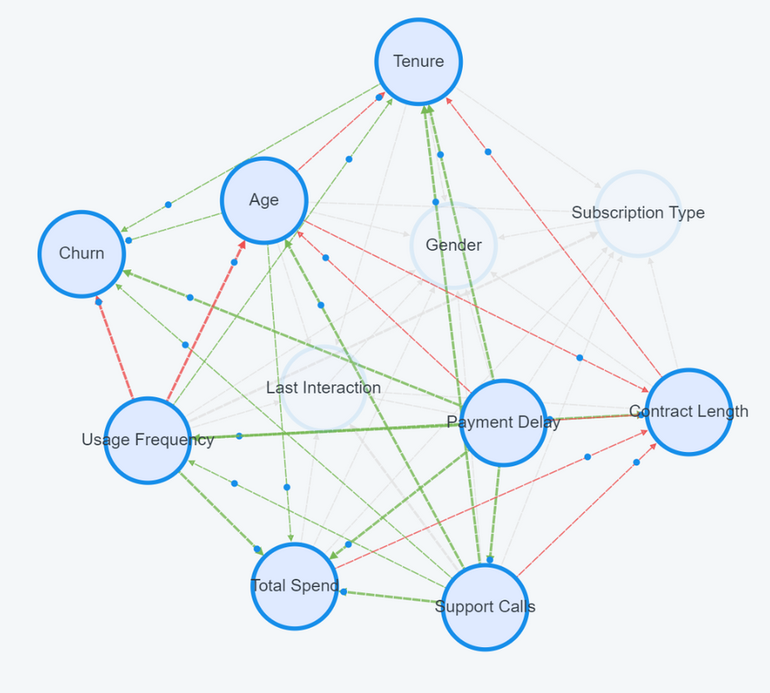
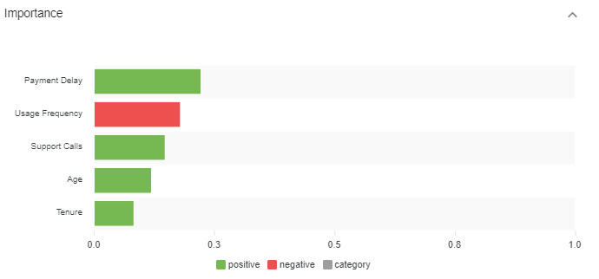
One-Hot vs Ordinal Encoding
Payment Delay: 0.223
Usage Frequency: -0.18
Support Calls: 0.148
Age: 0.12
Tenure: 0.083
Ordinal Encoding
Subscribtion Type and Contract Length → 0,1,2
Notes:
3

Slide 8
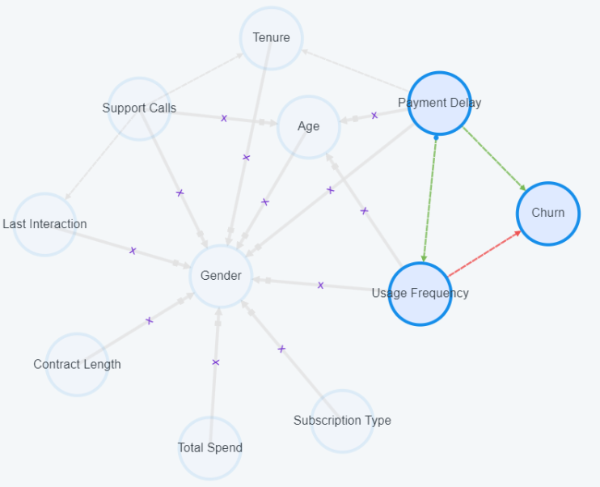
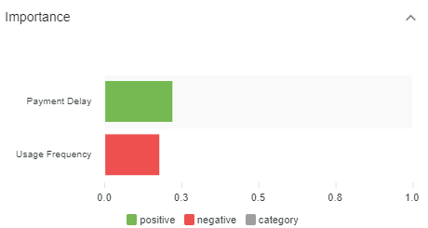
Imply Prior Knowledge
(There’s no factor that can change "age" and "gender")
Payment Delay: 0.223
Usage Frequency: -0.18
Notes:
3

Slide 9
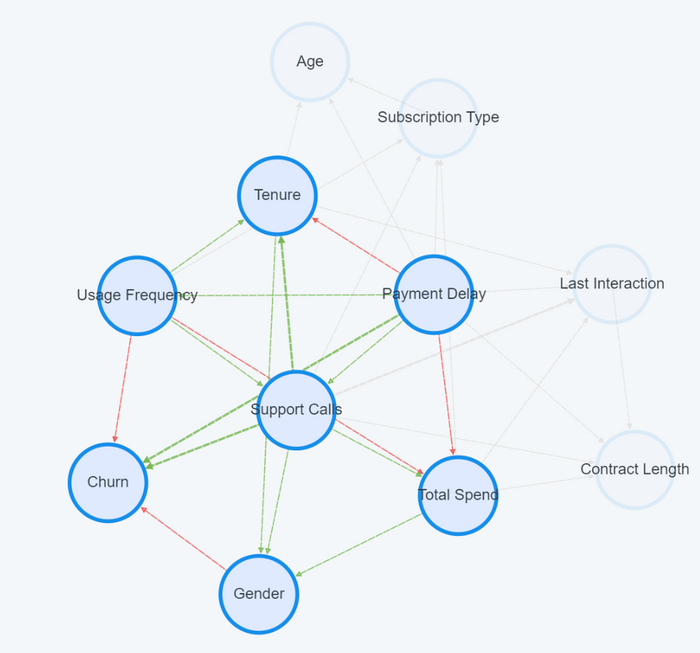
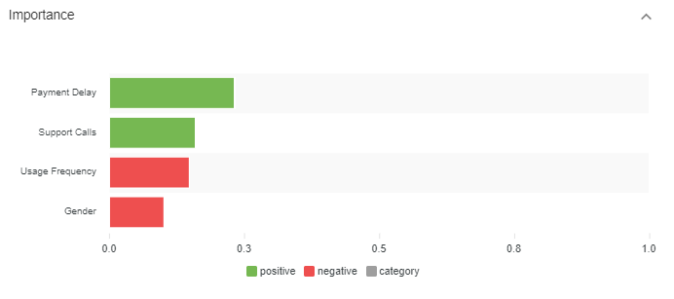
Ordinal Encoding(Churn: Int)
Payment Delay: 0.232
Support Calls: 0.159
Usage Frequency: 0.148
Gender: 0.101
Notes:
3

Slide 10
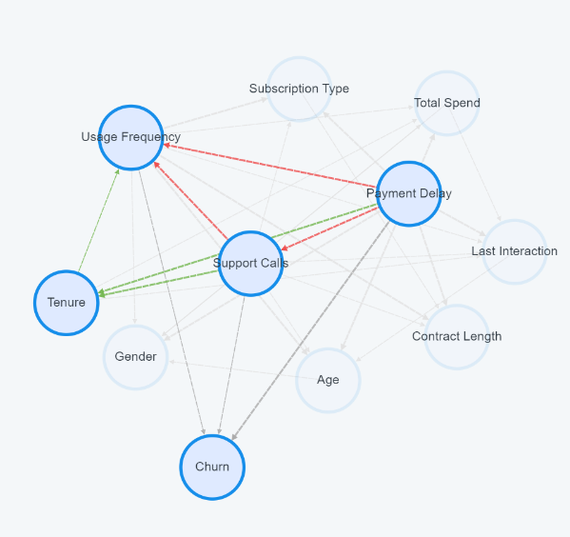
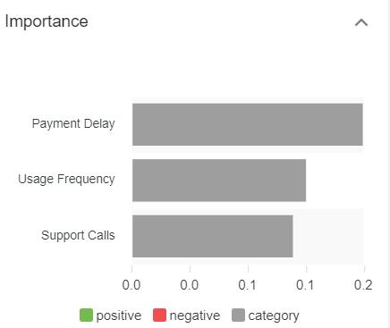
Ordinal Encoding(Churn: String)
Payment Delay: 0.159
Usage Frequency: 0.12
Support Calls: 0.111
Turn “Churn” into string(1→churn, 0 →stay)
Notes:
3

Slide 11
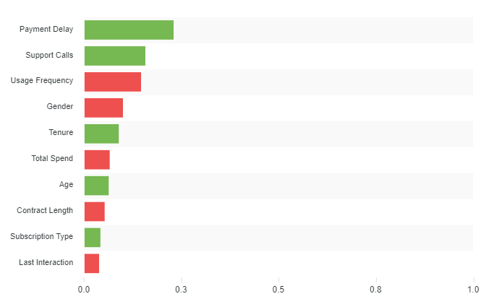
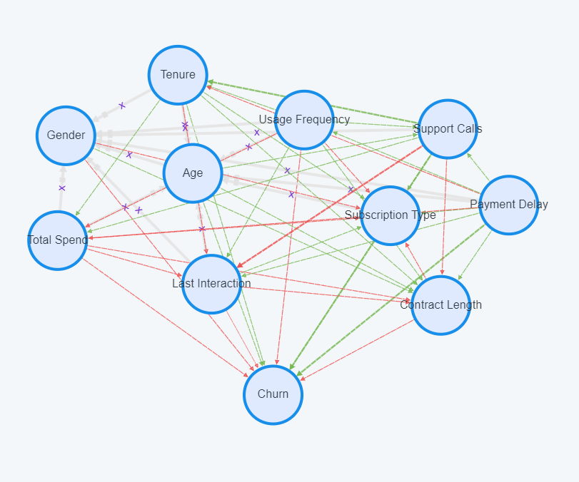
Imply Prior Knowledge(Best Result)
Payment Delay: 0.232
Support Calls: 0.159
Usage Frequency: -0.148
Gender: -0.101
Tenure: 0.091
Total Spend : -0.067
Ordinal Encoding (Churn: Int)
Age: 0.065
Contract Length: -0.054
Including All Factors
Subscription Type: 0.043
Last Interaction: -0.04
Notes:
3

Slide 12
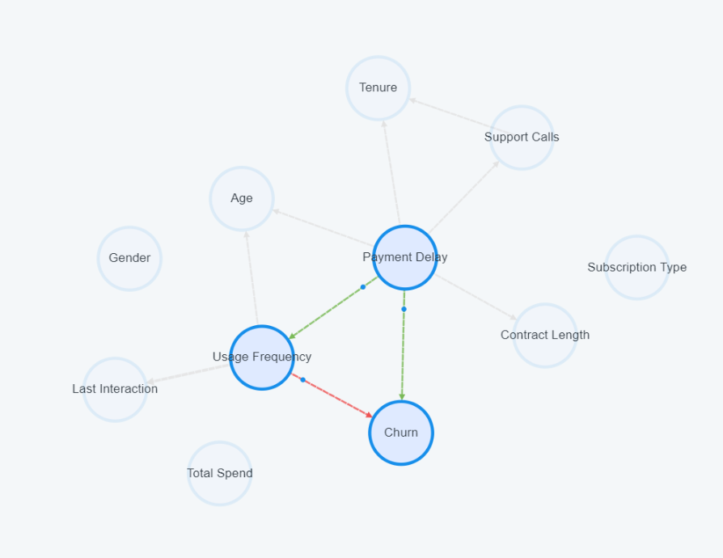
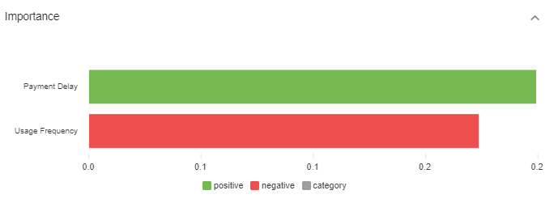
Big Size Training(60000 rows, training for 48hr)
Payment Delay: 0.241
Usage Frequency: 0.21
Ordinal Encoding, No prior knowledge
Notes:
3

Slide 13
Result
One-Hot Encoding
Ordinal Encoding
Ordinal Encoding, imply prior knowledge
Notes:
3

Slide 14
Result
Ordinal Encoding
imply prior knowledge
Ordinal Encoding
Notes:
3

Slide 15
Result
Ordinal Encoding (Churn: Int)
Ordinal Encoding (Churn: String)
Notes:
3

Slide 16
Result
600 rows data
60000 rows data
Notes:
3

Slide 17
Result
600 rows data
60000 rows data
Notes:
3

Slide 18
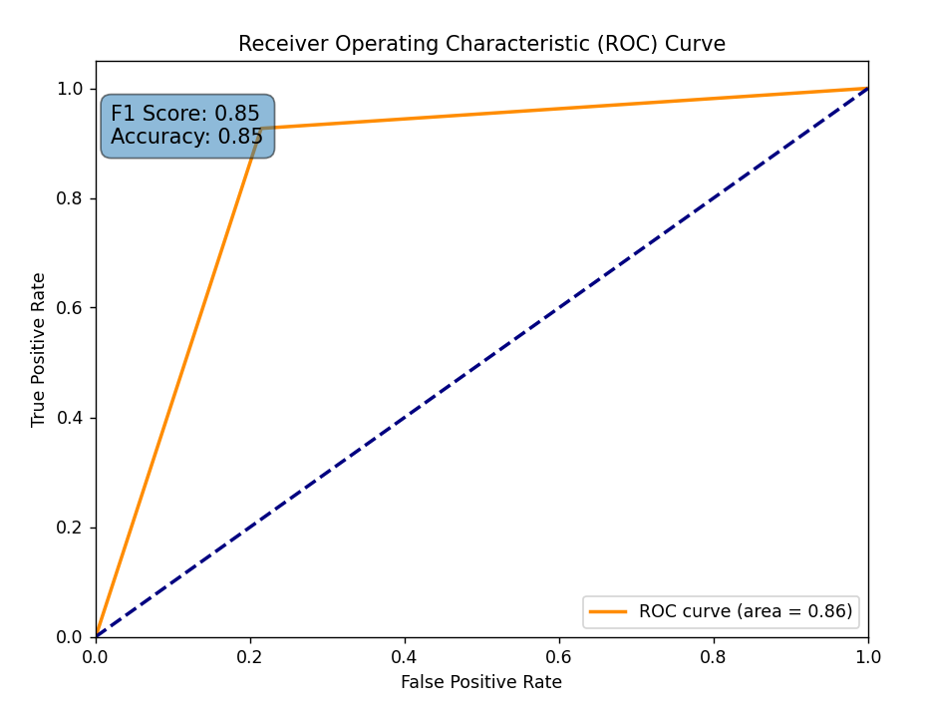
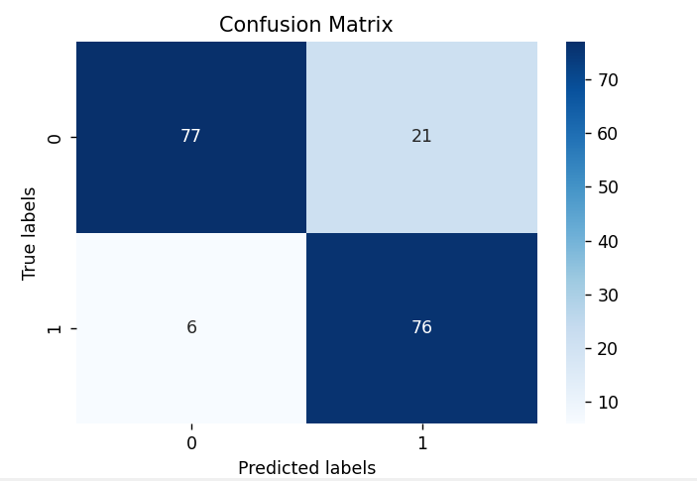
Accuracy(Causal Prediction)
Ordinal Encoding (Churn: Int). Balance data. Training with 70% of data (421)
Here I use 70% of data for training and input 30% of data for testing the target value – Churn. And The prediction is 85% correct. As the image above, The ROC Curve and Confusion Matrix indicate the model predict 181 piece of data and have 27 prediction errors.
Notes:
3

Slide 19
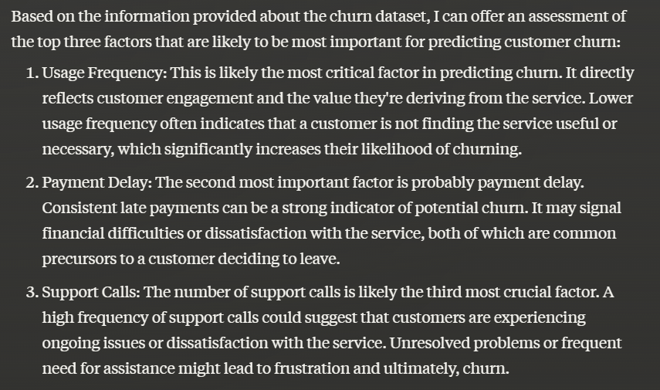
(Sort by Importance)
Operating with LLM
First Three Factors is Same
Notes:
3

Slide 20
Conclusion
1. If a factor has hierarchical levels (ex. month, quarter, annual), using Ordinal Encoding(turn category into number) or another method would be more effective.
2. In category data (ex. gender), using numeric data will have a better results than string data.
3. Using large amounts of data may make the results overly rigorous, making it difficult to determine the significance of less important factors.
Notes:
3

Slide 21
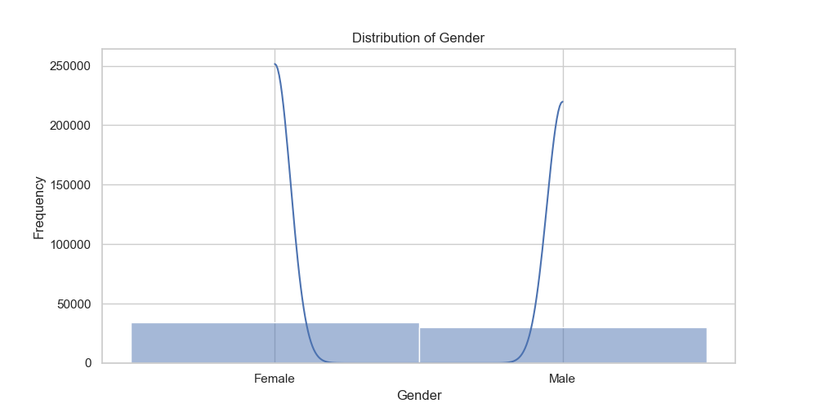
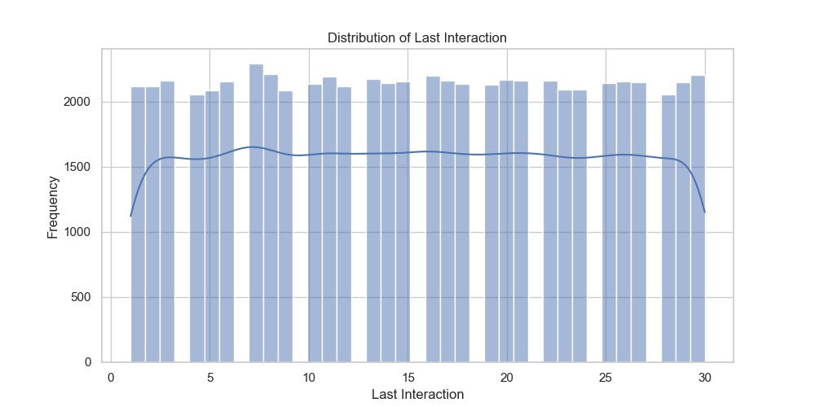
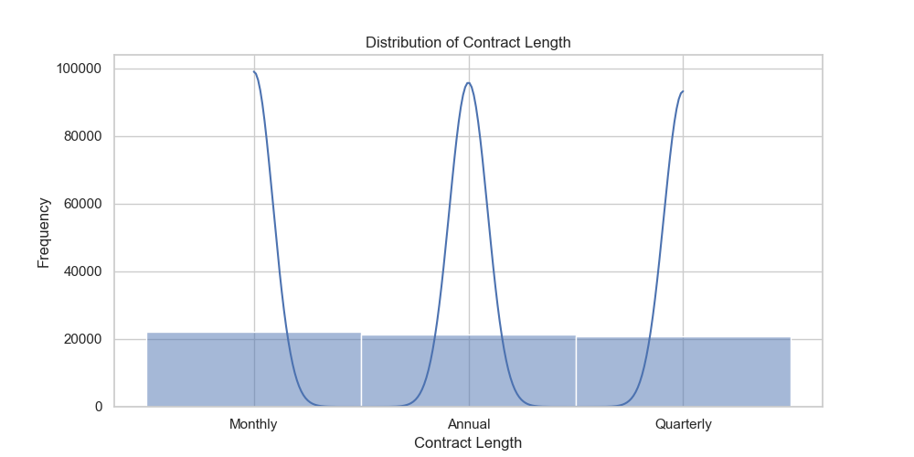
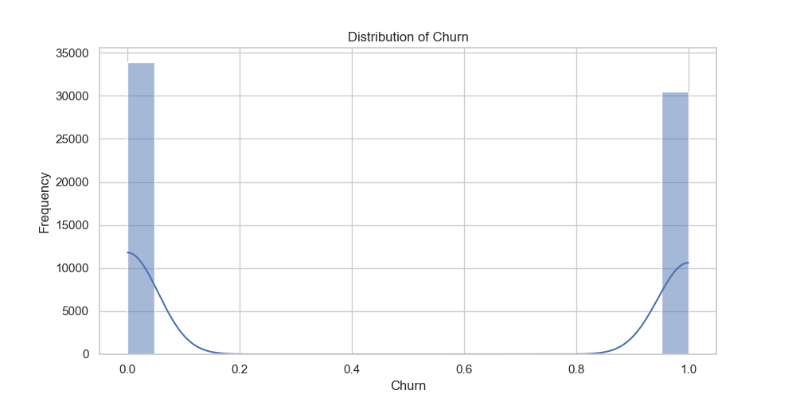
Appedix: Other Distribution(60000 rows)
Notes:
3

Slide 22
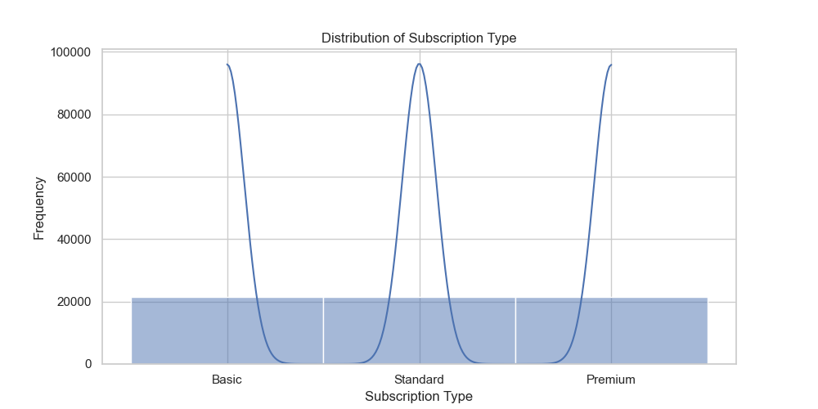
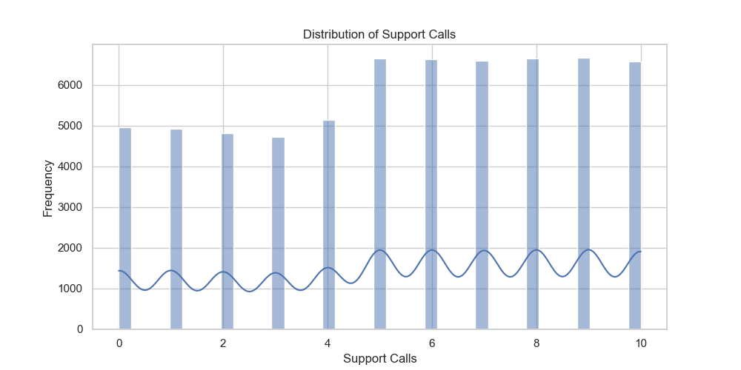
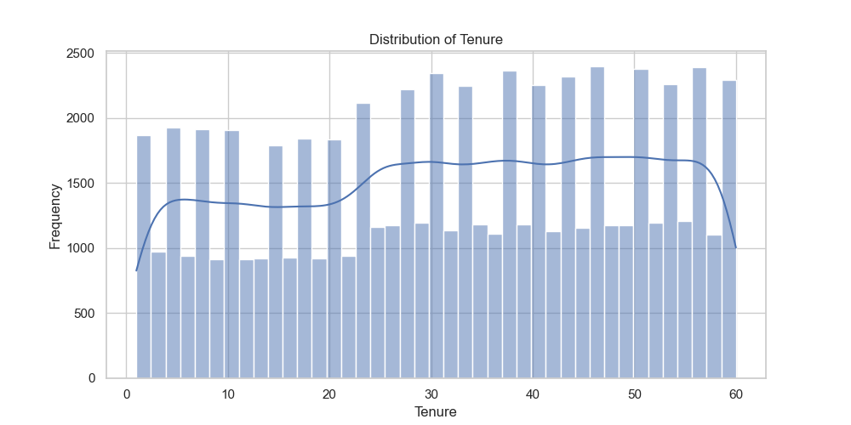
Notes:
3

Slide 23
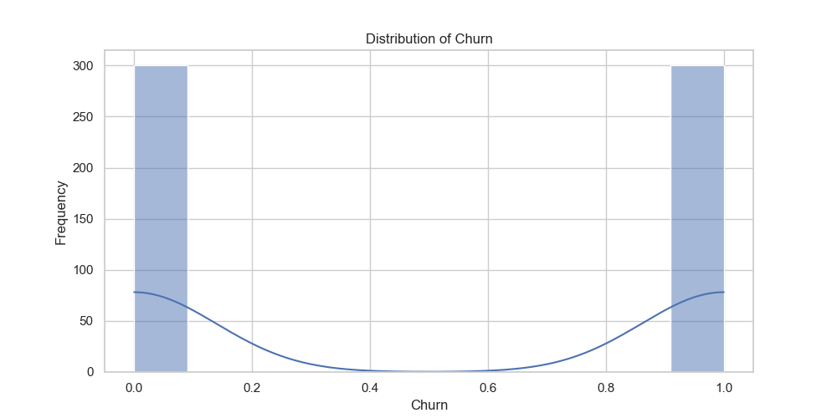
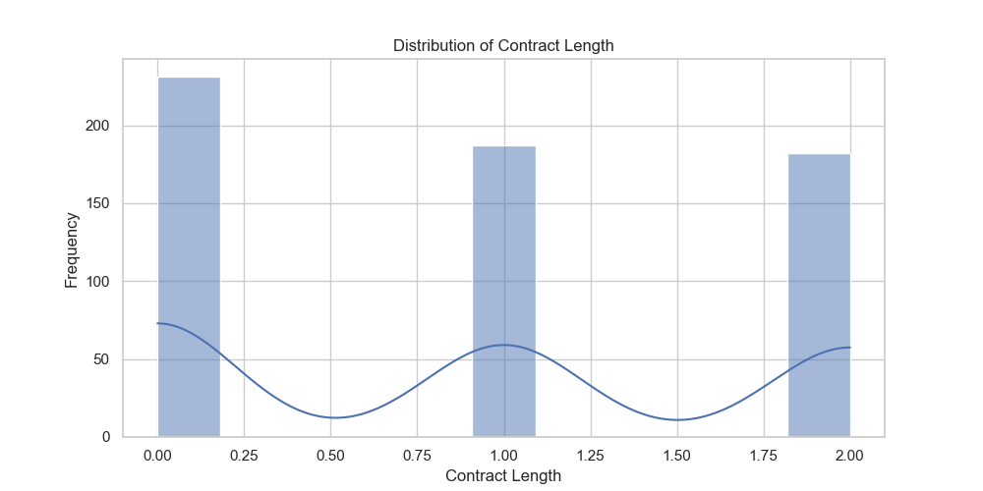
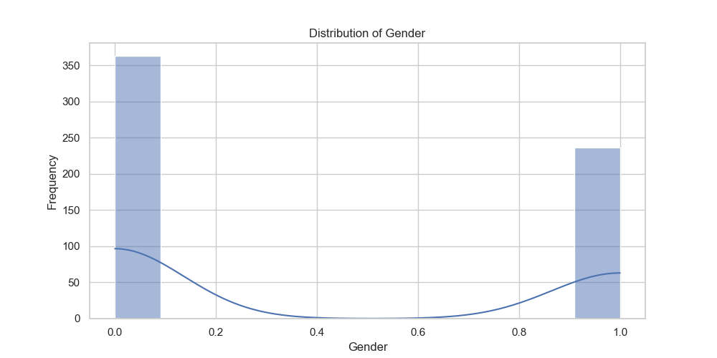
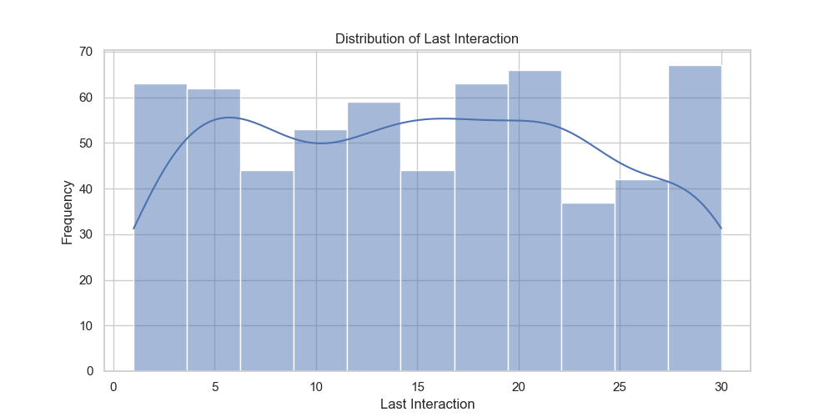
Appedix: Other Distribution(600 rows)
Notes:
3

Slide 24
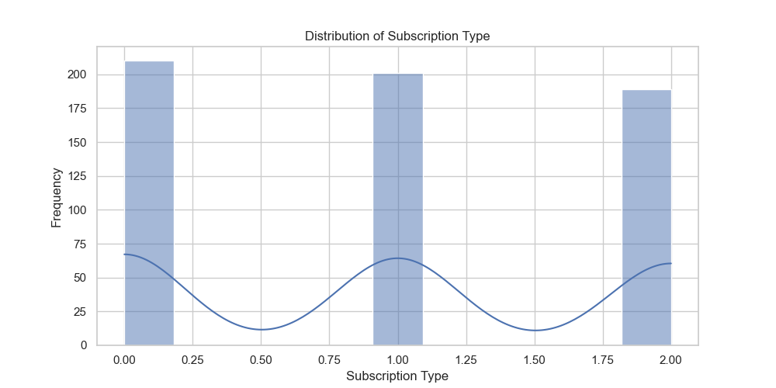
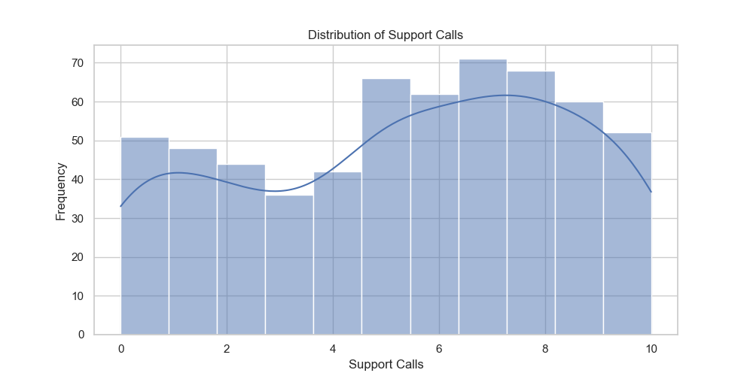
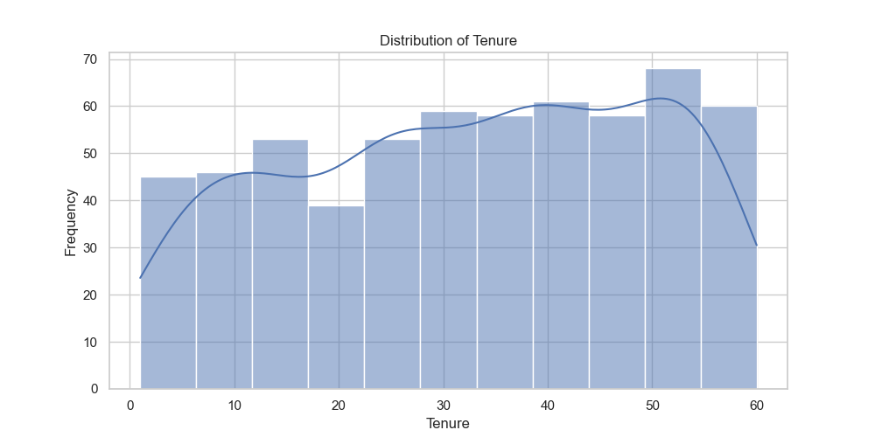
Notes:
3

