Slide 1

Using ChatBot in Karma
Peter Huang
Moofon Lee
Notes:
1

Slide 2
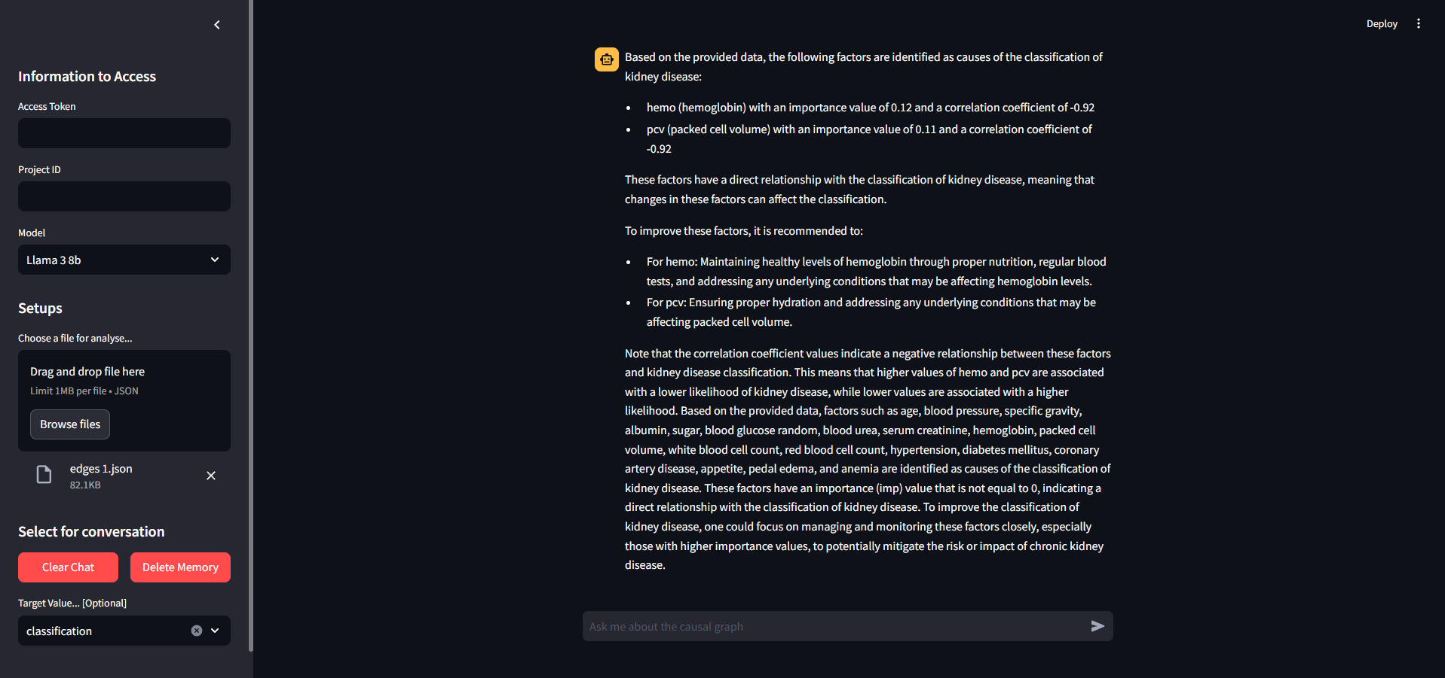
Introduction
Notes:
we have built a Chatbot that combine with LLM domain knowledge to interpret. Additionally, it also enables users to directly knows the relationships and importance value between various nodes.

Slide 3
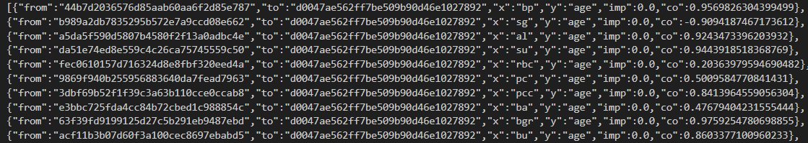
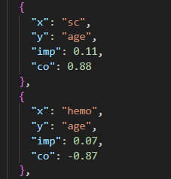
Json Flie
Before Cleaning
After Cleaning
Remove first 2 key, Round to 2nd decimal place
Remove objects that imp value is 0
Notes:
2

Slide 4
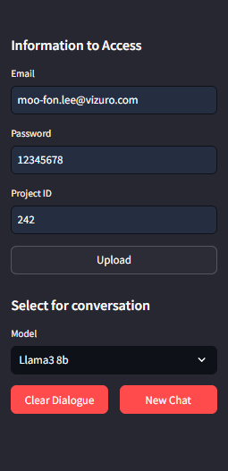
Side bar
User can choose the project here
Here to choose the model { llama3 8b, GPT 4-o mini, GPT 4-o }
User can clear the chat and remove memory

Slide 5
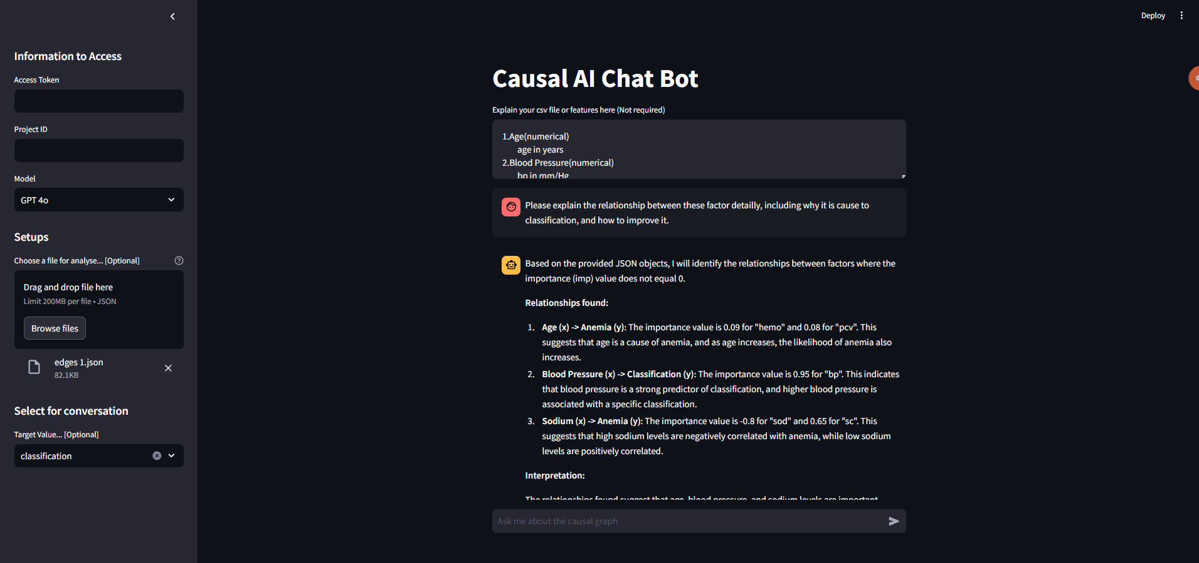
User can type metadata here
Memorable(8 messages only)
Here to ask qusetion

Slide 6
Service
Streamlit:
A UI framework that use to build Chatbot website.
Langflow:
A GUI for LangChain
Ollama:
A service that can enable llama3 in local.
Notes:
LangFlow is a platform that simplifies AI application creation using a visual interface with components and APIs. Users can build functional applications with basic API knowledge and parameter settings.

Slide 7
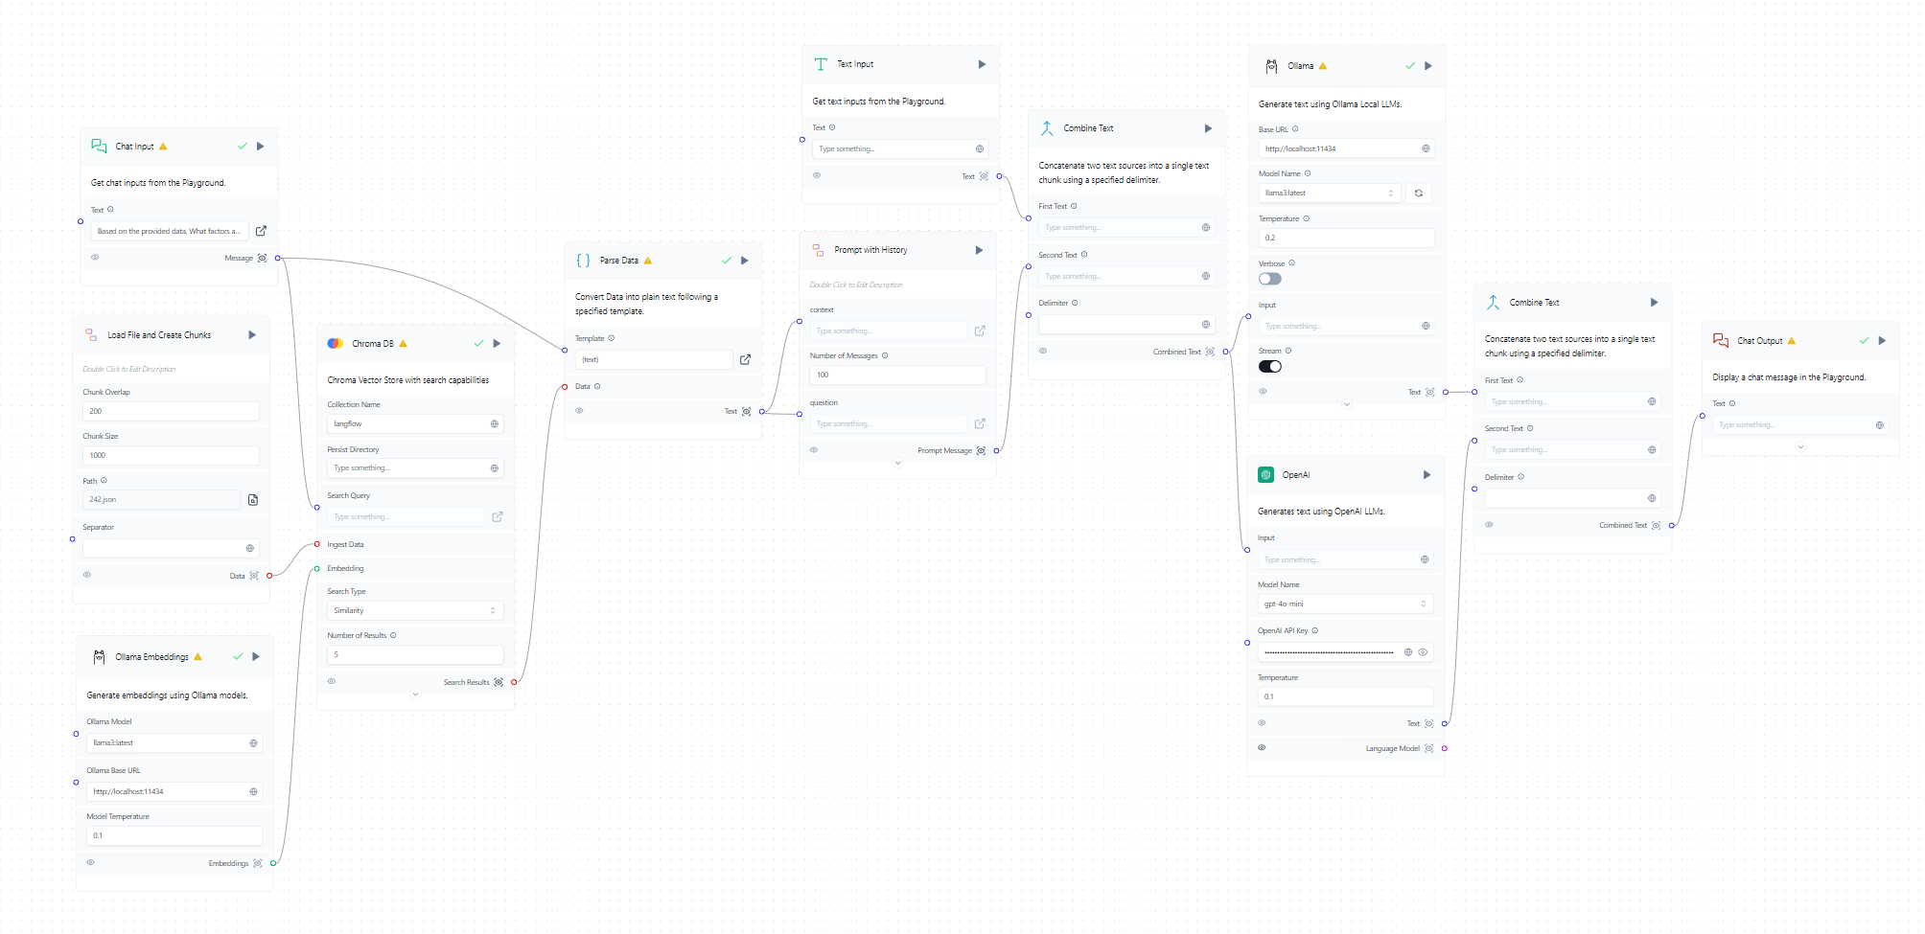
Langflow

Slide 8
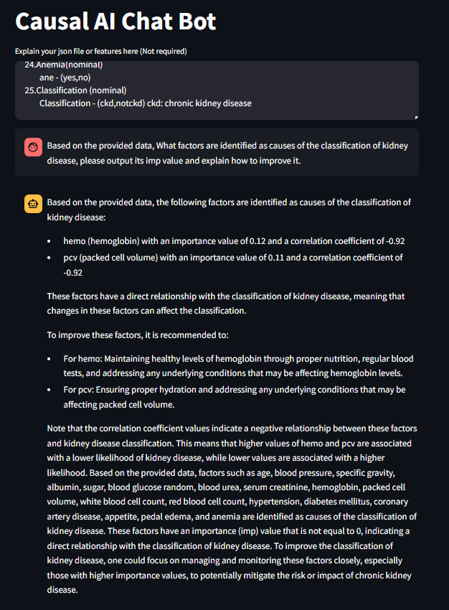
Ask
Llama 3b
Output the most significant factors
and output their imp, co value
Explain how to imporve it
Other significant factors
that have correlation with “CKD”
Notes:
2

Slide 9
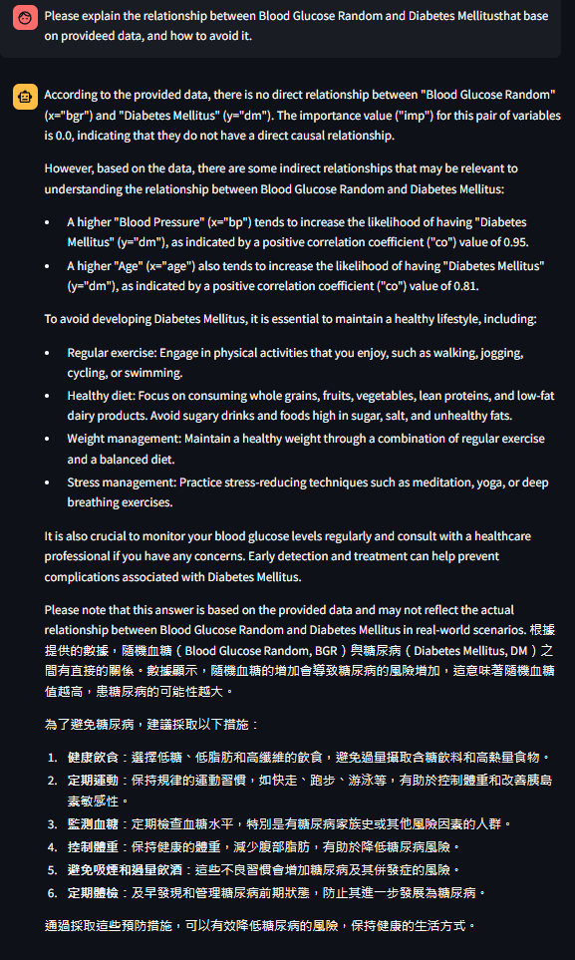

Memorical
Translate
Notes:
2

Slide 10

LLM Compare Task 1: Output the whole file
Question:
Performance:
The output is correct
2. Repeat the output factors (sc and hemo)
Response Time: 25 sec
Notes:
2

Slide 11
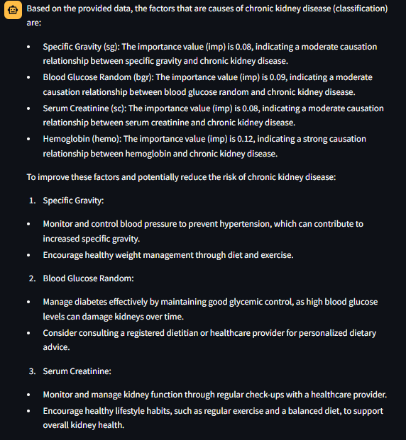
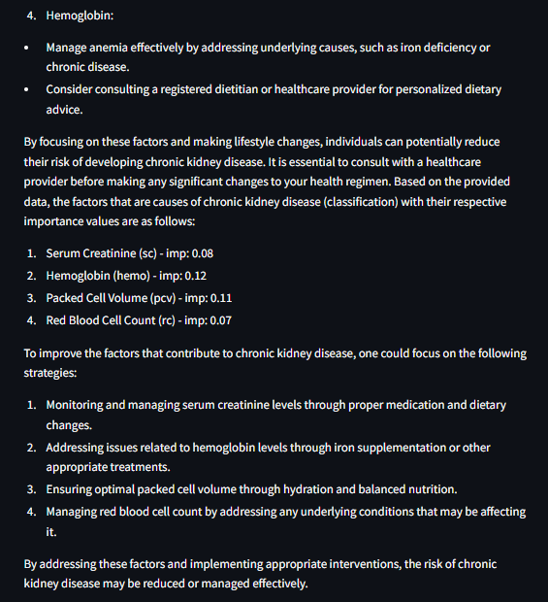
LLM Compare (Llama 3b)
Notes:
2

Slide 12
LLM Compare (GPT 3.5-turbo)
Question:
Performance:
The output is correct
2. One factor haven’t explained
Response Time: 32 sec
Notes:
2

Slide 13
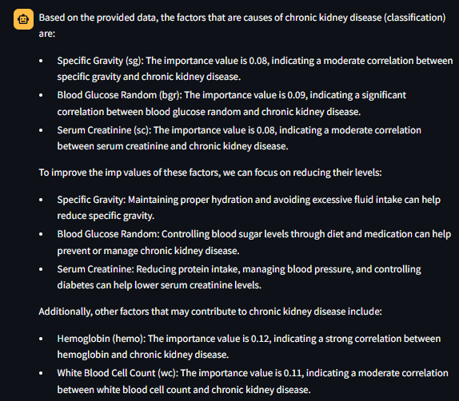
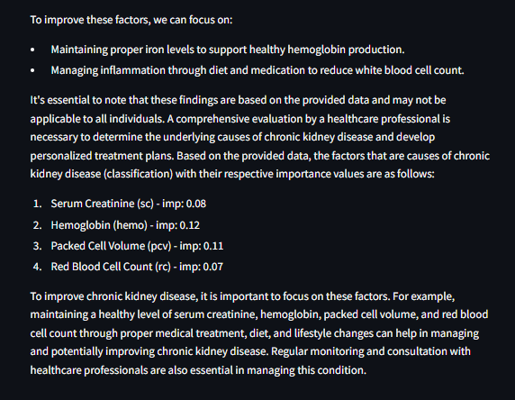
LLM Compare (GPT 3.5-turbo)
Notes:
2

Slide 14
LLM Compare (GPT 4o)
Question:
Performance:
The output is perfect
2. Explain detaily
Response Time: 19 sec
Notes:
2

Slide 15
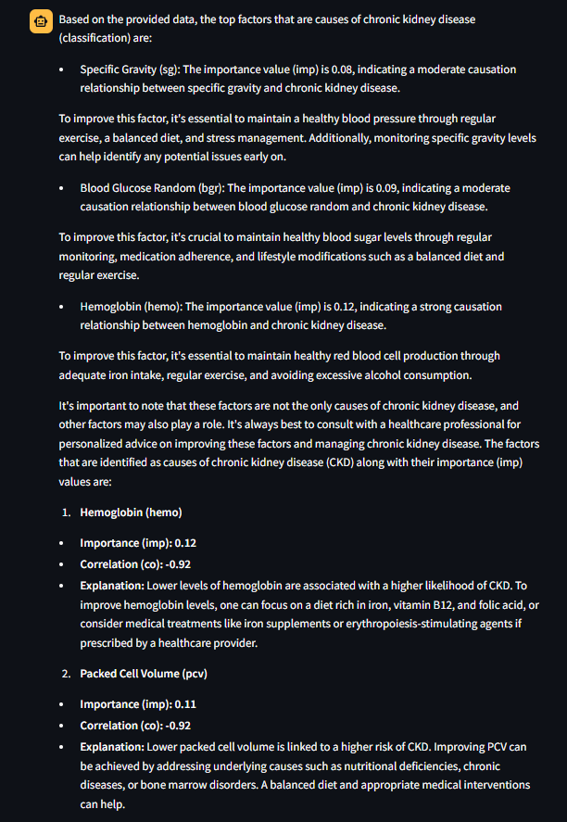
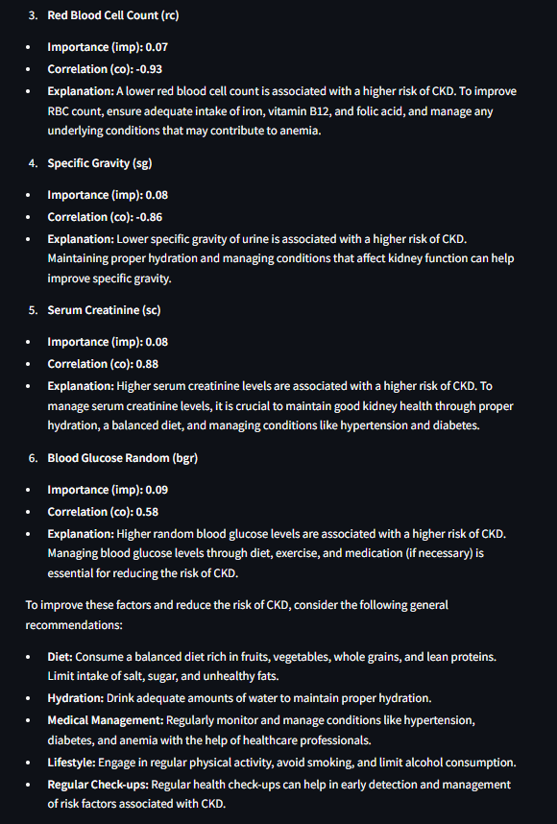
LLM Compare (GPT 4o)
Notes:
2

Slide 16
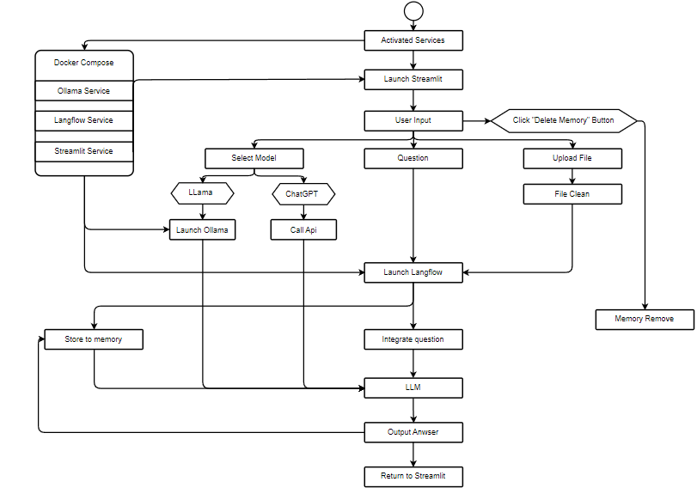
UML Graph
Notes:
2

Slide 17
RAG vs Non-RAG

Slide 18
Future Work
建立Knowledge Graph，並用RAG
回應時間太久，主要都是呼叫api與langflow的時間，也許可以不借用langflow
Notes:
2

