Slide 1

Using ChatBot in Karma
Peter Huang
Moofon Lee
Notes:
1

Slide 2
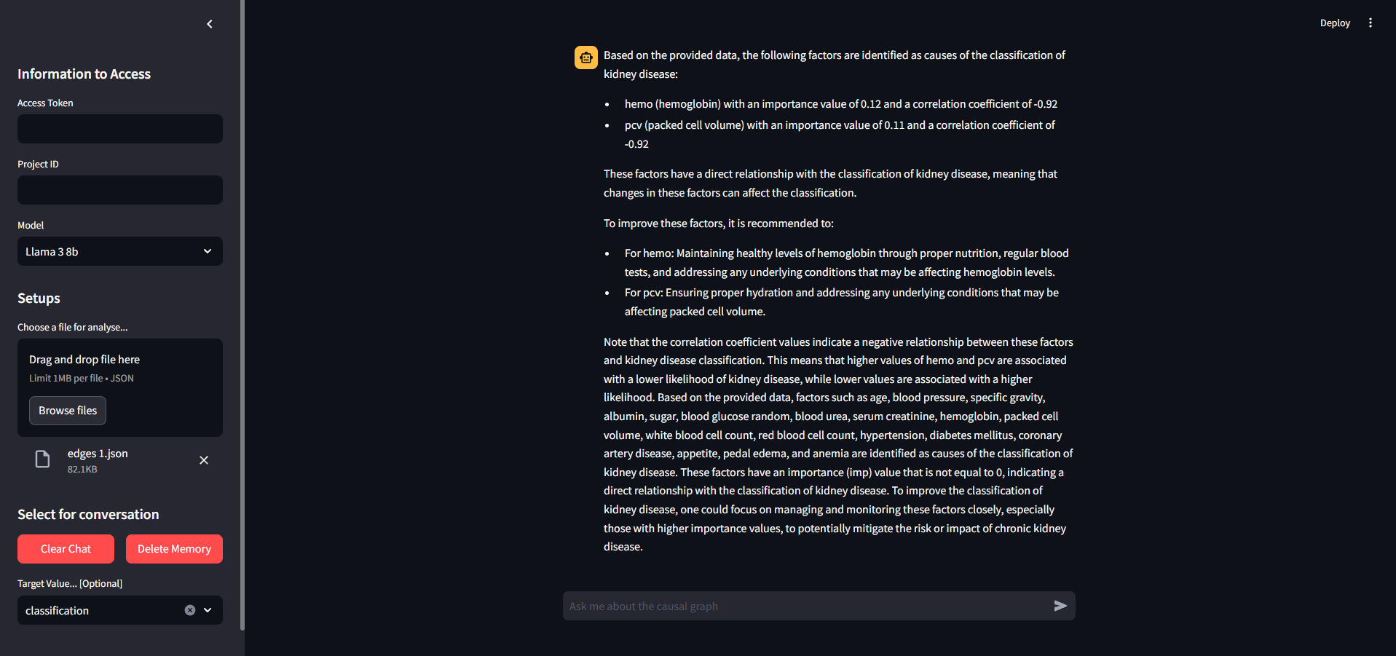
Introduction
Notes:
we have built a Chatbot that combine with LLM domain knowledge to interpret. Additionally, it also enables users to directly knows the relationships and importance value between various nodes.

Slide 3
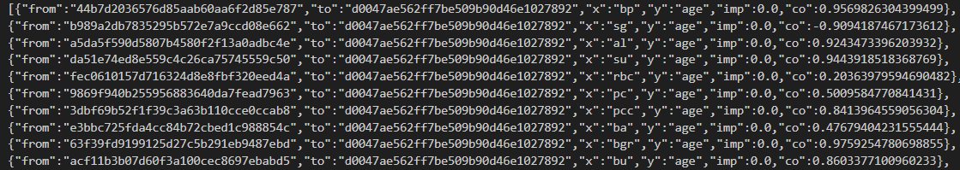
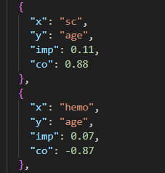
Json Flie
Before Cleaning
After Cleaning
Remove first 2 key, Round to 2nd decimal place,
Notes:
2

Slide 4
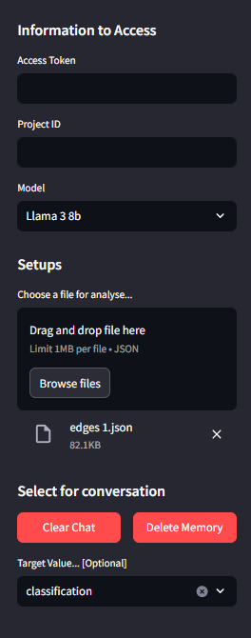
Here is the project token and Id from Karma 360
Here to choose the model
{1. llama3 70b, 2. llama3 8b, 3. GPT3.5-turbo, 4. GPT4-o}
User can choose the file here (json file only)
User can clear the chat and remove memory
User can choose the target value
(Answer questions against Target value)

Slide 5
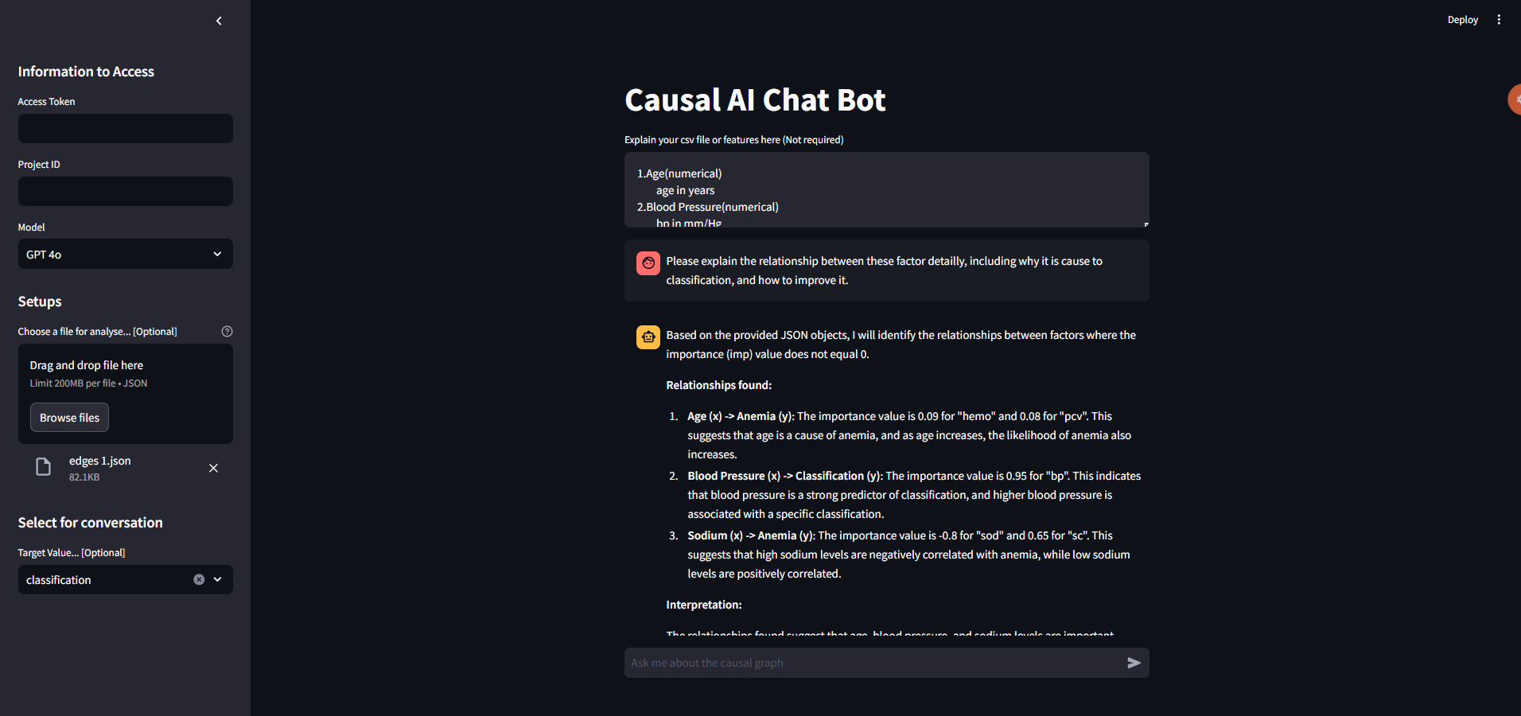
User can also use text to explain the json file or features here
Memorable(8 messenges only)
Here to ask qusetion

Slide 6
Service
Langflow:
Simplifies AI application creation using a visual interface with components and API.
Streamlit:
A UI framework that use to build Chatbot website.
Ollama:
A service that can enable llama3 in local.
Notes:
LangFlow is a platform that simplifies AI application creation using a visual interface with components and APIs. Users can build functional applications with basic API knowledge and parameter settings.

Slide 7
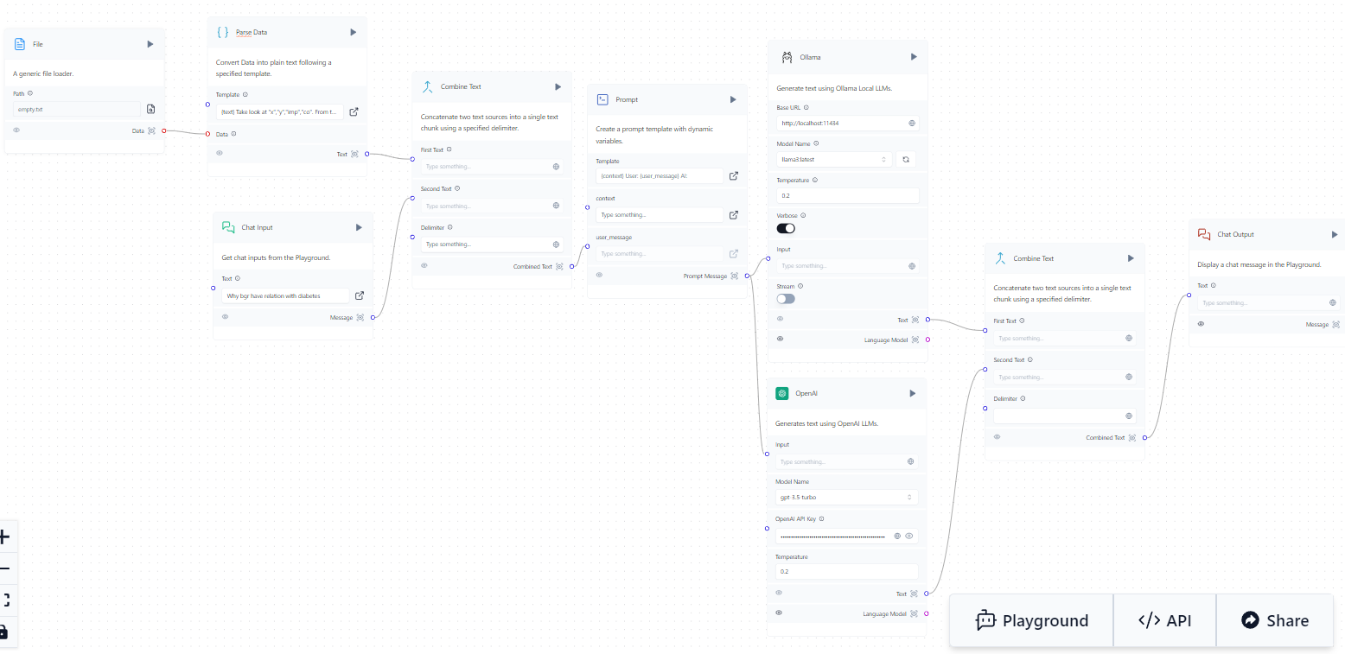
Langflow
Notes:
它是用於開發由語言模型支援的應用程式的框架，LangChain 就像膠水一樣，有各種接口可以將 LLM 模型與其他工具和數據源連接

Slide 8
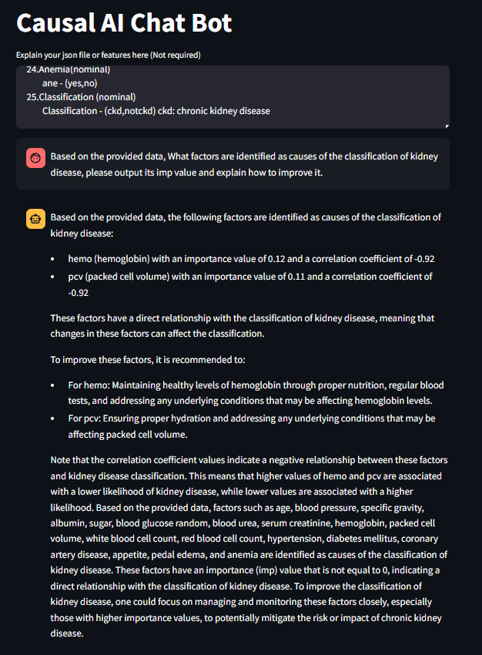
Ask
Llama 3b
Output the most significant factors
and output their imp, co value
Explain how to imporve it
Other significant factors
that have correlation with “CKD”
Notes:
2

Slide 9
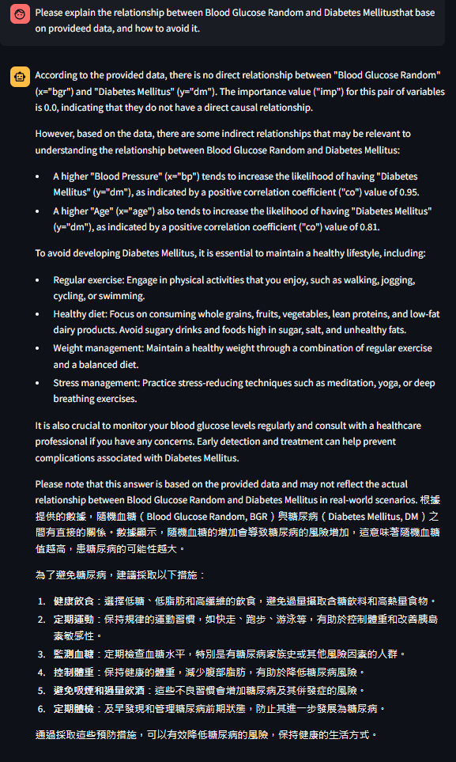

Memorical
Translate
Notes:
2

Slide 10

LLM Compare Task 1: Output the whole file
Question:
Performance:
The output is correct
2. Repeat the output factors (sc and hemo)
Response Time: 25 sec
Notes:
2

Slide 11
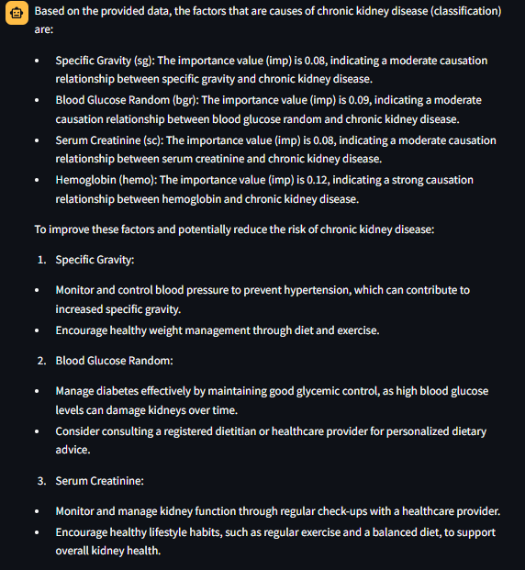
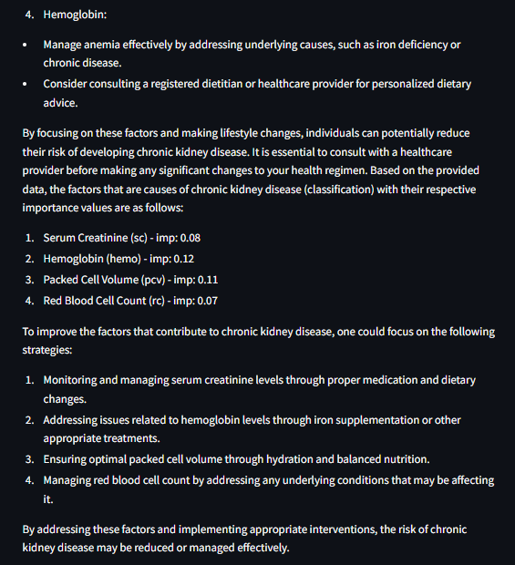
LLM Compare (Llama 3b)
Notes:
2

Slide 12
LLM Compare (GPT 3.5-turbo)
Question:
Performance:
The output is correct
2. One factor haven’t explained
Response Time: 32 sec
Notes:
2

Slide 13
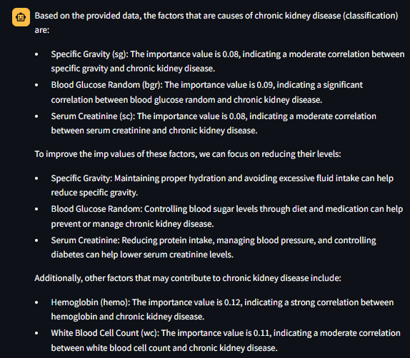
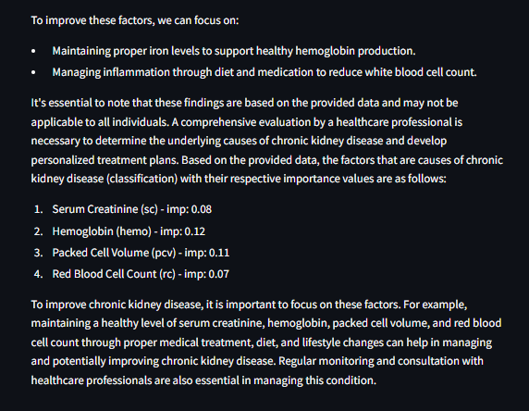
LLM Compare (GPT 3.5-turbo)
Notes:
2

Slide 14
LLM Compare (GPT 4o)
Question:
Performance:
The output is perfect
2. Explain detaily
Response Time: 19 sec
Notes:
2

Slide 15
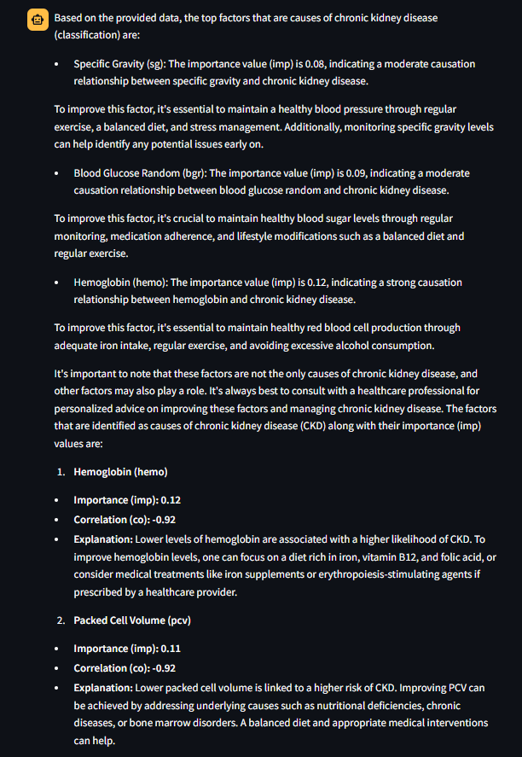
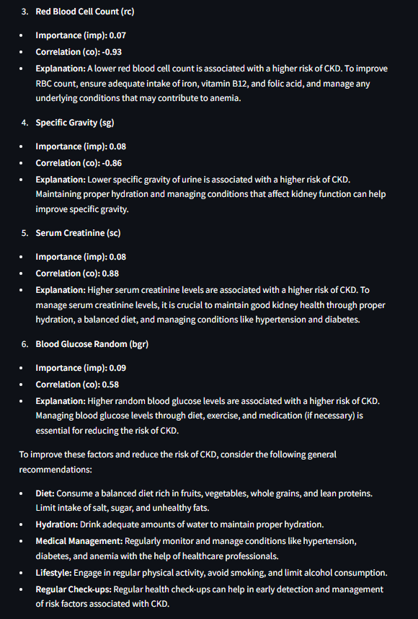
LLM Compare (GPT 4o)
Notes:
2

Slide 16
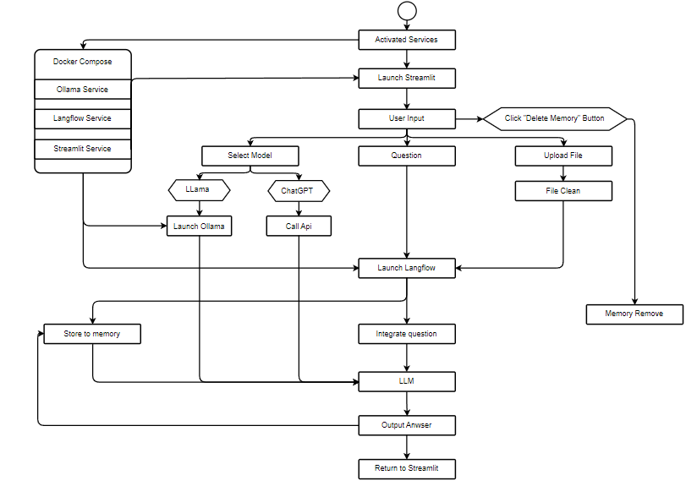
UML Graph
Notes:
2

Slide 17
RAG vs Non-RAG

Slide 18
Future Work
建立Knowledge Graph，並用RAG
回應時間太久，主要都是呼叫api與langflow的時間，也許可以不借用langflow
Notes:
2

