Slide 1

Chronic Kidney Disease
Dataset to Karma 360
Peter Huang
Moo-Fon Lee
Dataset URL
Notes:
1

Slide 2
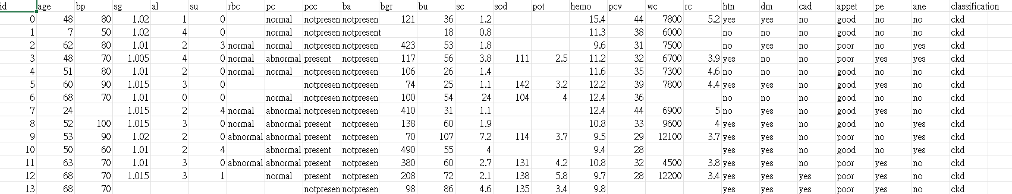
Original Dataset
400 rows and 25 features
taken over 2-month period in India
rc - red blood cell count
pcv - packed cell volume
sc - serum creatinine
sg - specific gravity
al - albumin
bgr - blood glucose random
hemo - hemoglobin
classification – ckd/nockd
Notes:
1

Slide 3
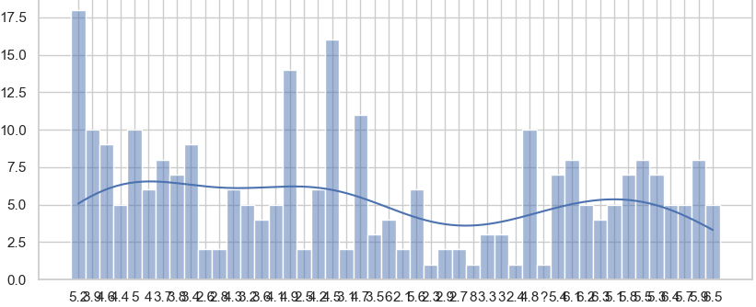
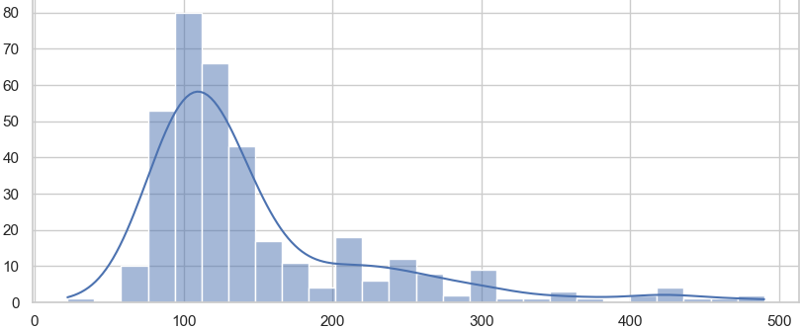
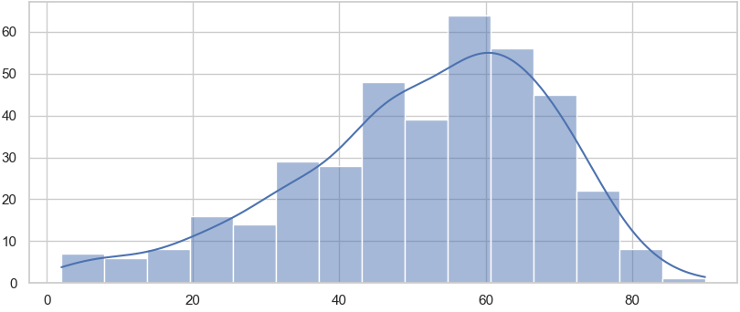
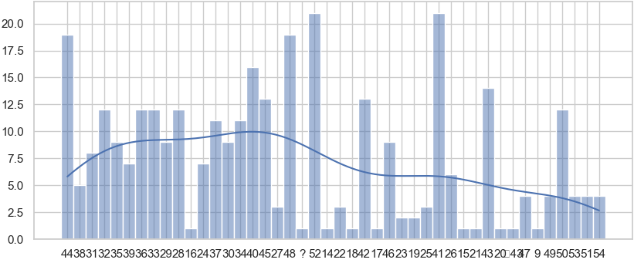
Distribution (Before Data Cleaning)
rc
bgr
age
pcv
Notes:
1

Slide 4
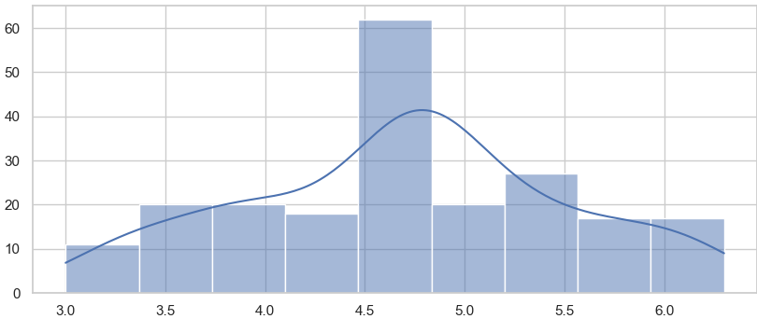
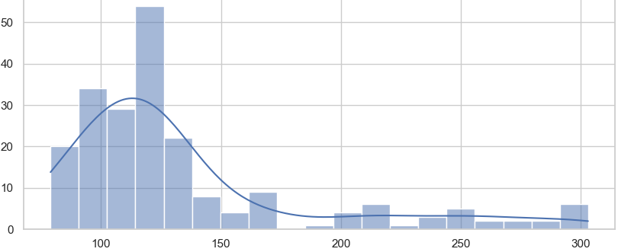
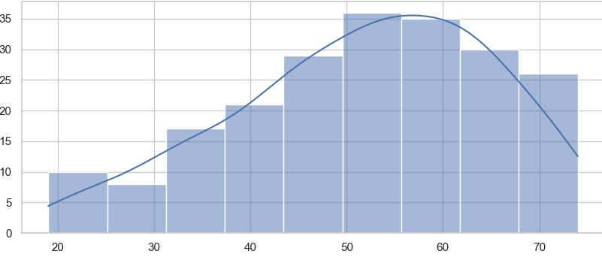
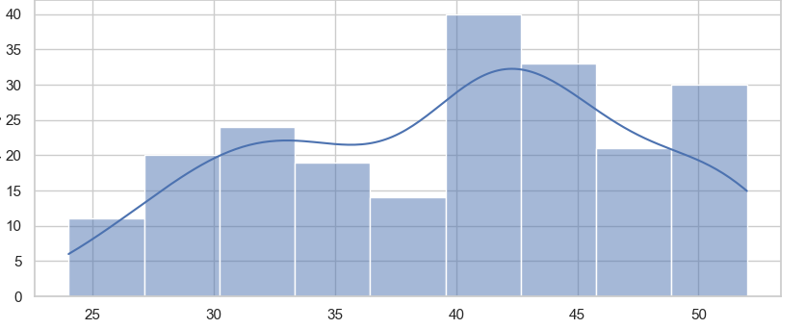
Distribution (After Data Cleaning)
rc
bgr
age
pcv
Notes:
1

Slide 5
Data processing
1
Missing Value
Use mean and mode to fill up.
When there are more than 3 missing values in a row, delete the entire row.
When the data is a question mark, convert it to a null value.
2
Outliers
Define the normal range for human body values
Define upper and lower boundaries
Replace outliers with other values.
3
Data type conversion
Convert some data from continuous to discrete.
Convert some features from strings to numbers.
Notes:
2

Slide 6
Missing value
Delete Row
Mode
Mean
When there are more than 3 missing values in a row, delete the entire row.
Fill missing values in categorical data with the mode.
Fill missing values in continuous data with the mean.
Notes:
3

Slide 7
Outliers
Quartile
Convert string features to numbers.
Over 90%
Divide the numbers into four equal parts. Values exceeding Q1 and Q3 are considered outliers. Correct them to the values of Q1 or Q3.
To make these features easier to train, I will convert string features into numerical representations. For example, htn (高血壓), dm (糖尿病), cad (冠狀動脈疾病), pe (肺水腫), and ane (貧血). Can balance the data.
When data exceeds the upper and lower bounds (5% and 95%), consider it as an outlier and convert it to a null value.
Notes:
3

Slide 8
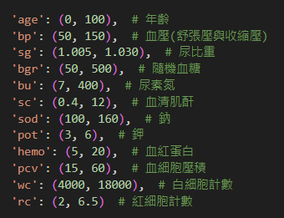
Outliers(human normal range)
Notes:
3

Slide 9
Outliers
Quartile
Normal range for human
Over 90%
Divide the numbers into four equal parts. Values exceeding Q1 and Q3 are considered outliers. Correct them to the values of Q1 or Q3.
When data exceeds the predefined normal range for the human body, consider it as an outlier and convert it to a null value.
When data exceeds the upper and lower bounds (5% and 95%), consider it as an outlier and convert it to a null value.
Notes:
3

Slide 10
Data type conversion
Convert specific feature values
Convert string features to numbers.
Delete the ID column
Convert the features 'al' (白蛋白) and 'su' (糖). Specifically, we will set all values in these two features that are not equal to zero to 1, because for a healthy person, the values of these two features should be 0."
To make these features easier to train, I will convert string features into numerical representations. For example, htn (高血壓), dm (糖尿病), cad (冠狀動脈疾病), pe (肺水腫), and ane (貧血). Can balance the data.
It 's unrelated to other features.
Notes:
3

Slide 11
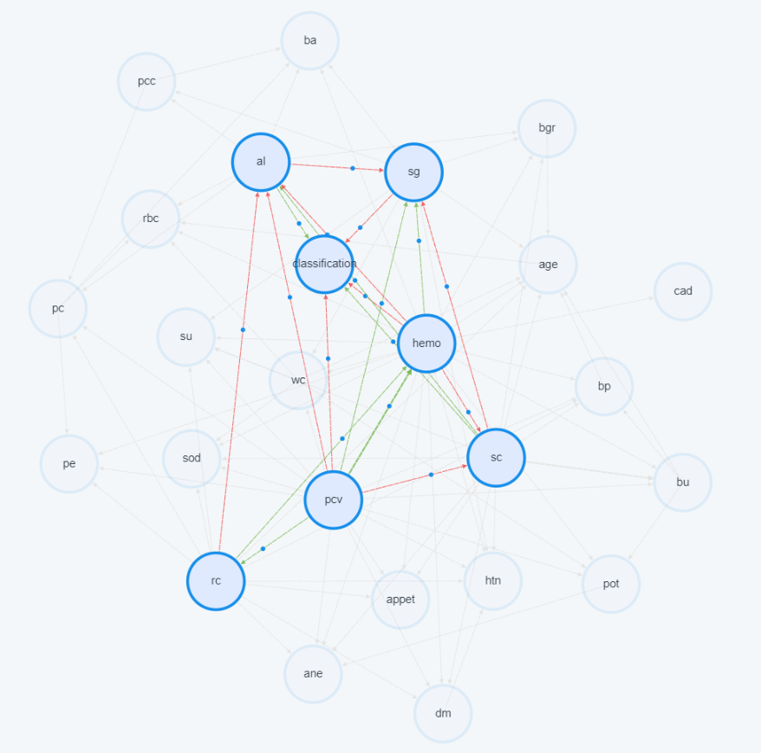
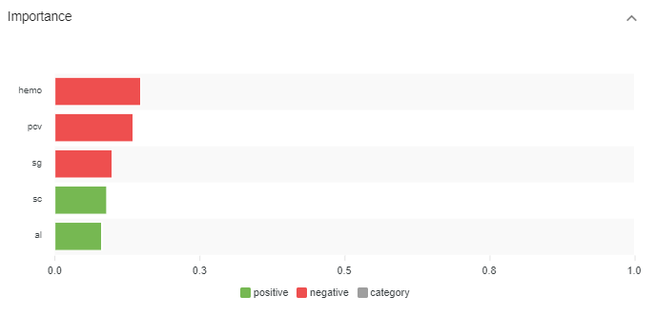
Change outliers to Q1 or Q3. Fill with mean values.
balance data(random)
Notes:
1

Slide 12
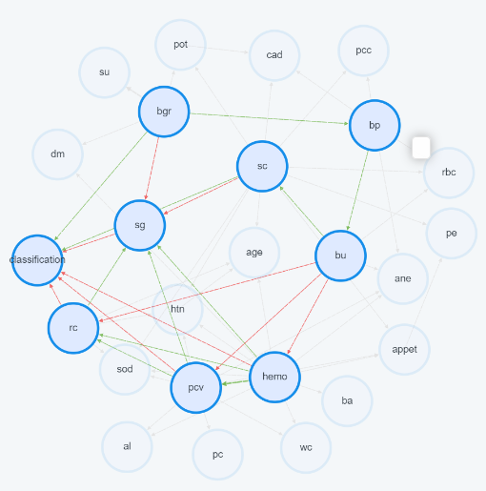
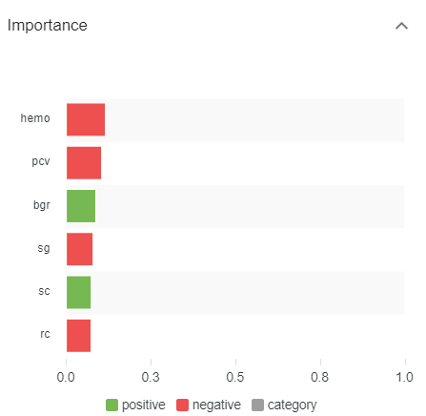
Change outliers to empty value(normal range). Delete row(Over 3 empty).
balance data(random)
Notes:
1

Slide 13
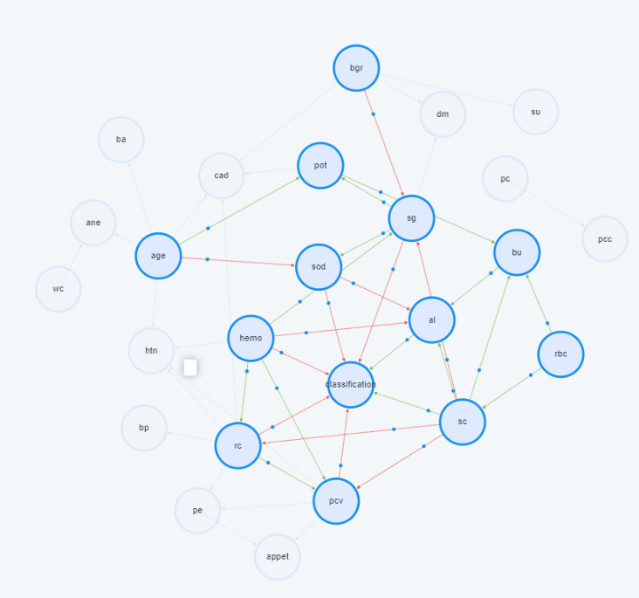
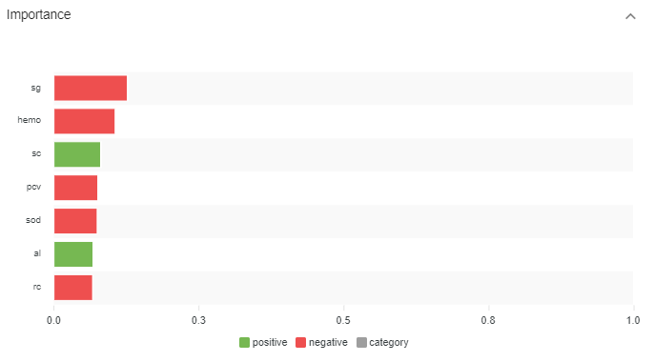
Change outliers to empty value(90%). Delete row(Over 3 empty).
balance data. Best of three version.
Notes:
1

Slide 14
Common Factors
Negative: hemo(hemoglobin) 、 pcv(packed cell volume)、sg(specific gravity)
Positive: sc(serum creatinine)
Notes:
1

Slide 15
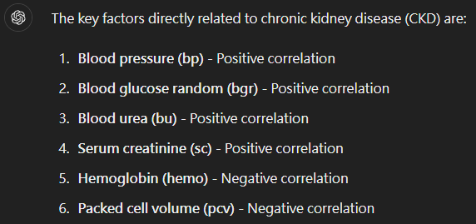
Operate with LLM
Notes:
3

Slide 16
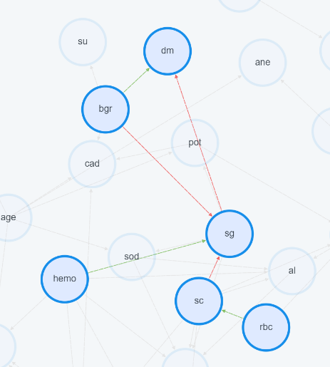
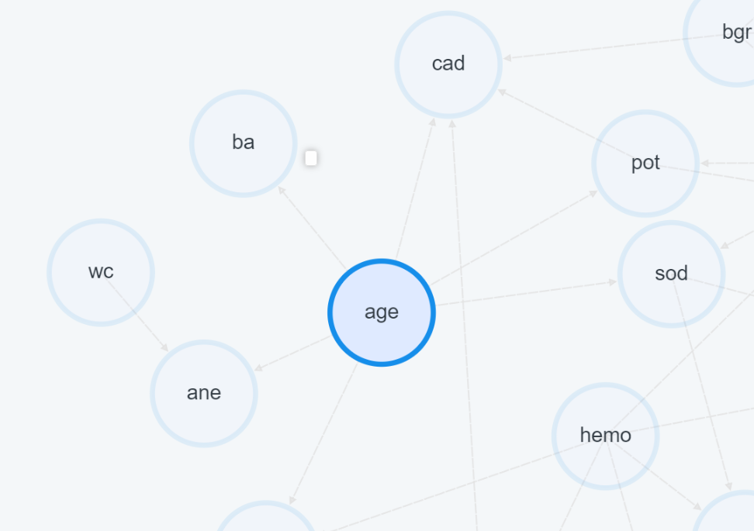
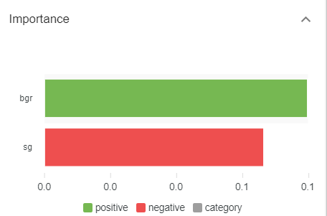
Make Sense
No factor affect the “age” (haven’t imply prior knowledge)
The main causes of diabetes is
Blood Glucose Random
Notes:
1

Slide 17
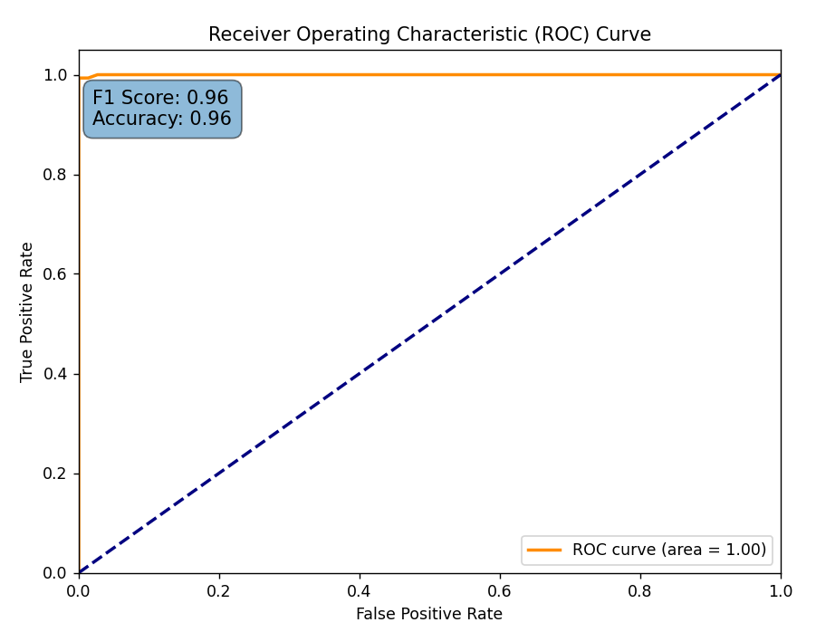
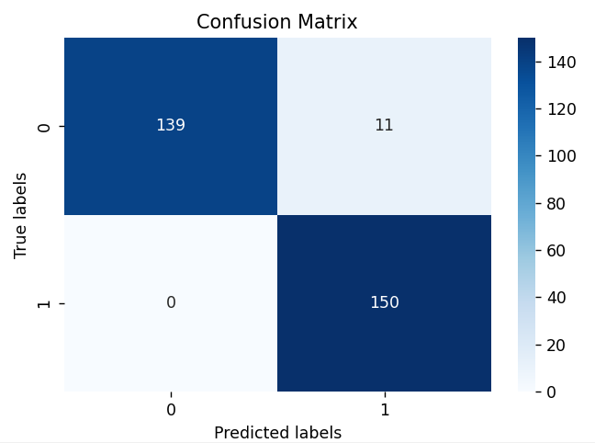
Accuracy(Causal Prediction)
Change outliers to empty value(90%). Delete row(Over 3 empty). Balance data.
Train/Test = 70%/30%
Notes:
3

Slide 18
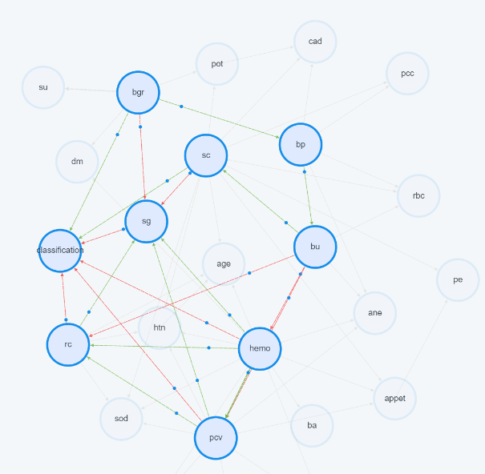
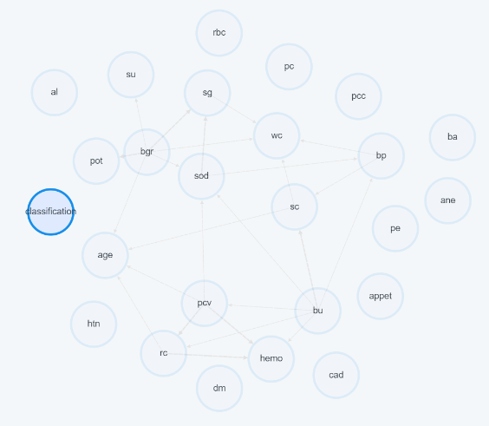
String value vs Numeric value
Numeric
String(13 columns)
Change outliers to empty value(normal range). Delete row(Over 3 empty).
Notes:
3

Slide 19
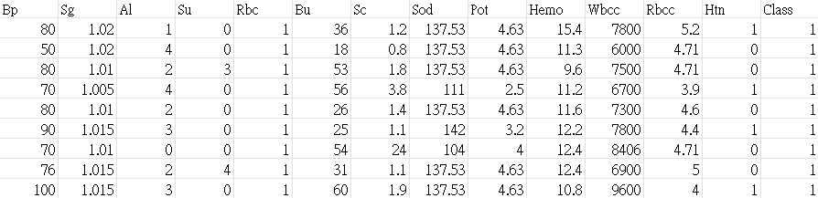
Another Dataset
401 rows and 13 features
Data had been cleaned
Notes:
1

Slide 20
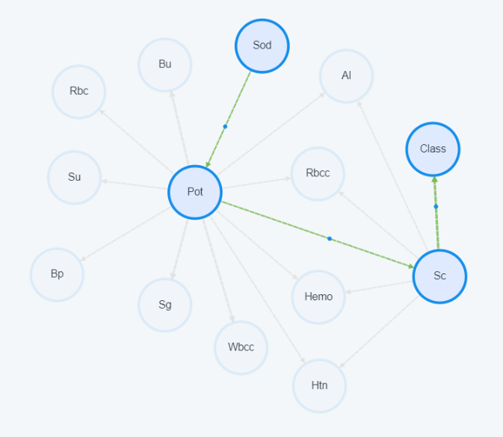
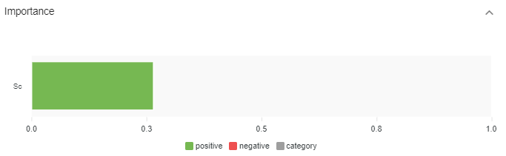
Another dataset
Use Oringinal dataset. Delete row to balance data(random). ckd 5:3
Notes:
3

Slide 21
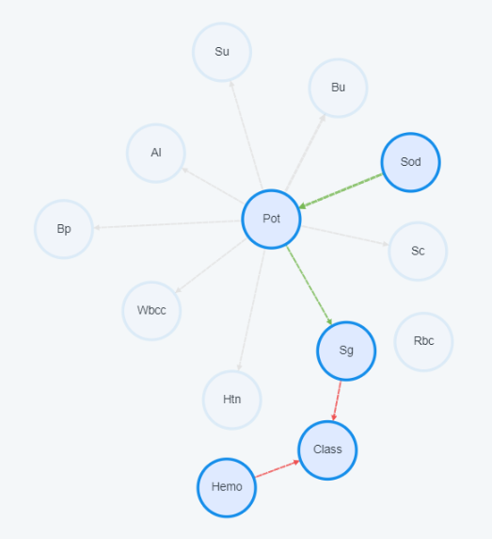
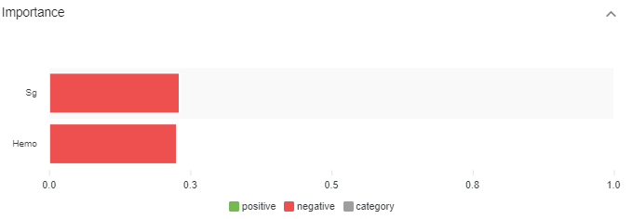
Another dataset (balance vs unbalanced)
Use Oringinal dataset. Delete row to balance data(random). ckd 1:1
Notes:
3

Slide 22
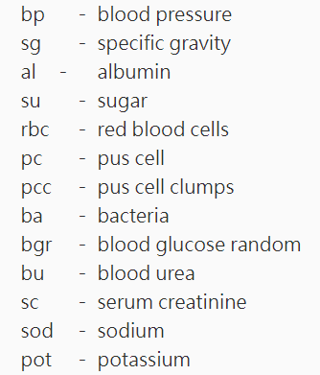
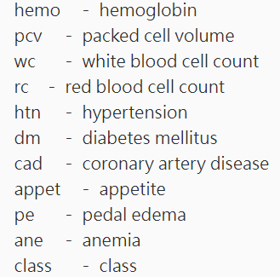
Appendix: Variable Information
Notes:
3

Slide 23
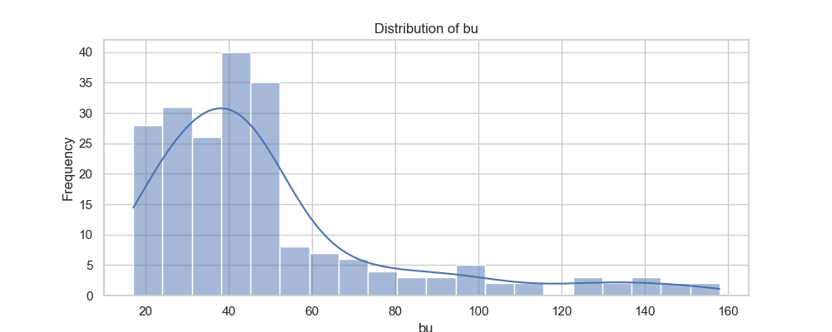
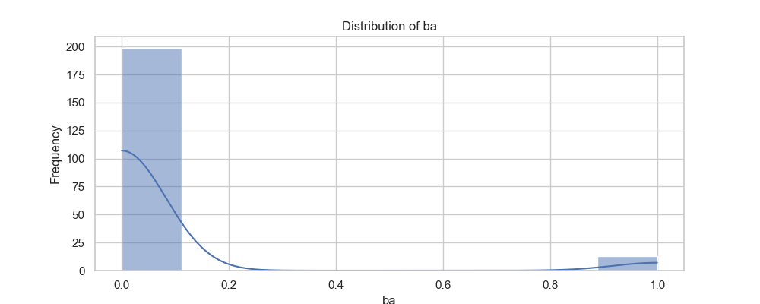
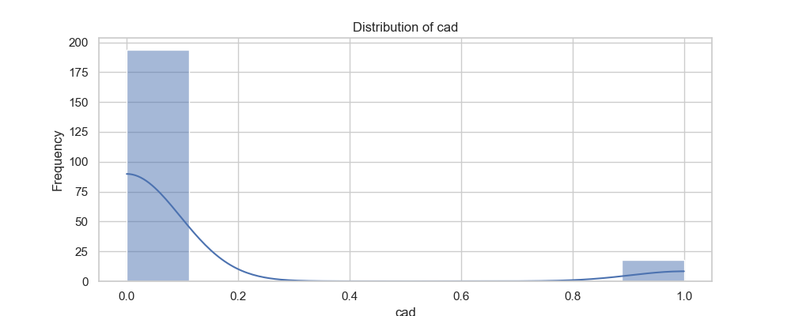
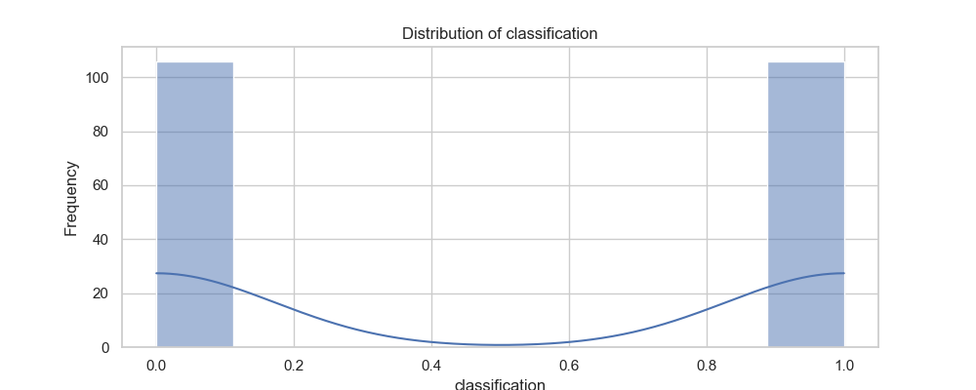
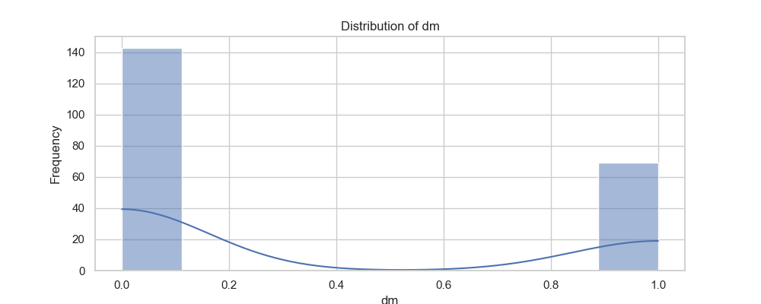
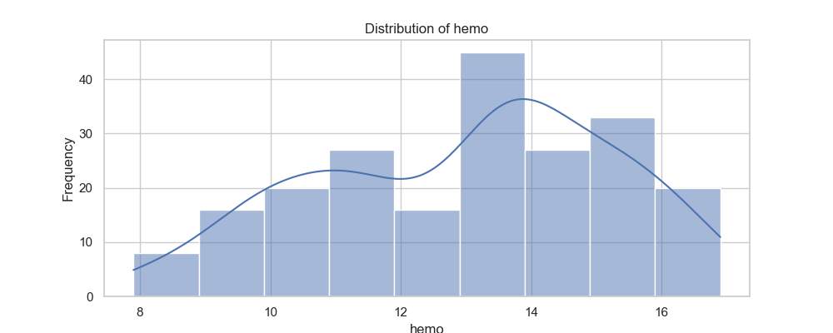
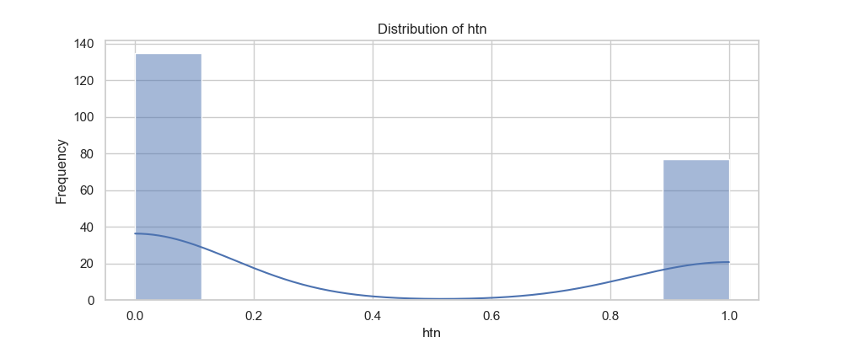
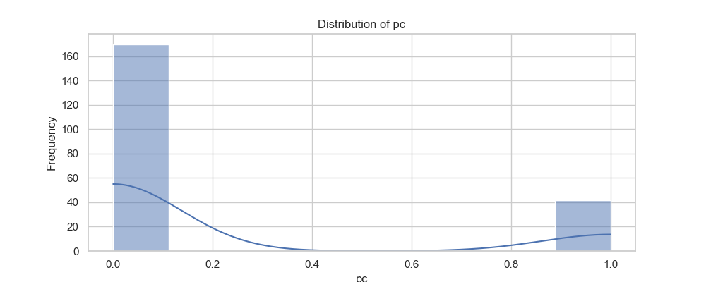
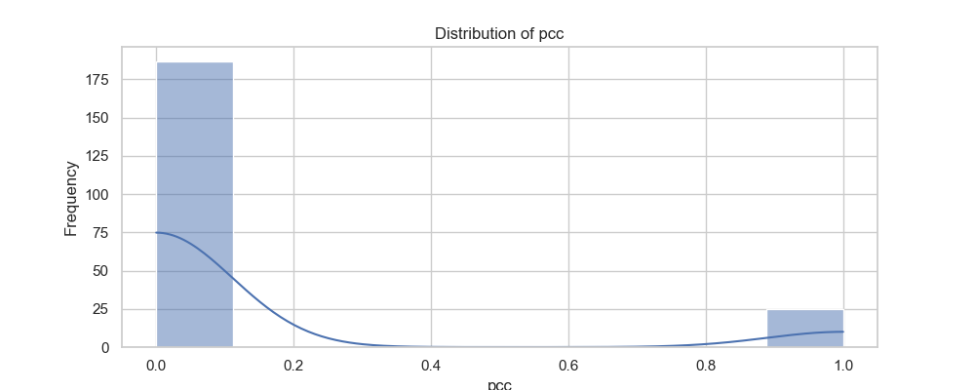

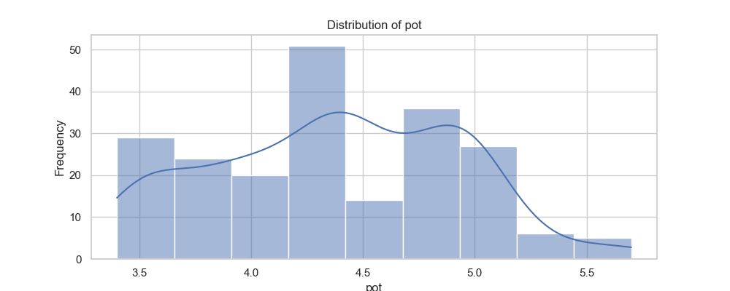
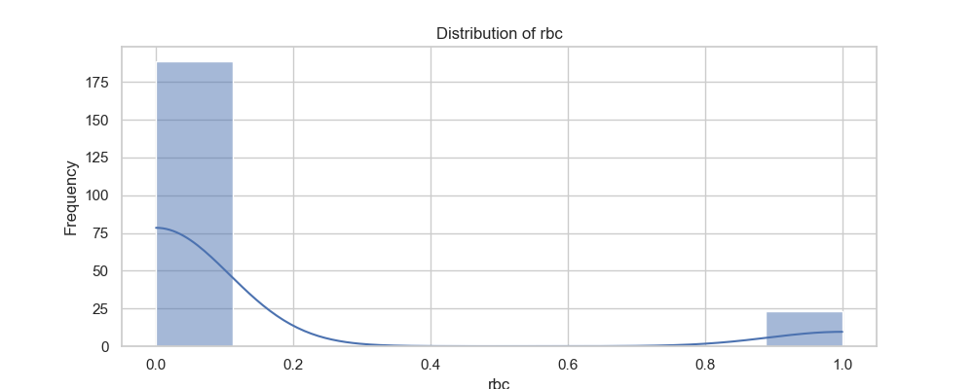
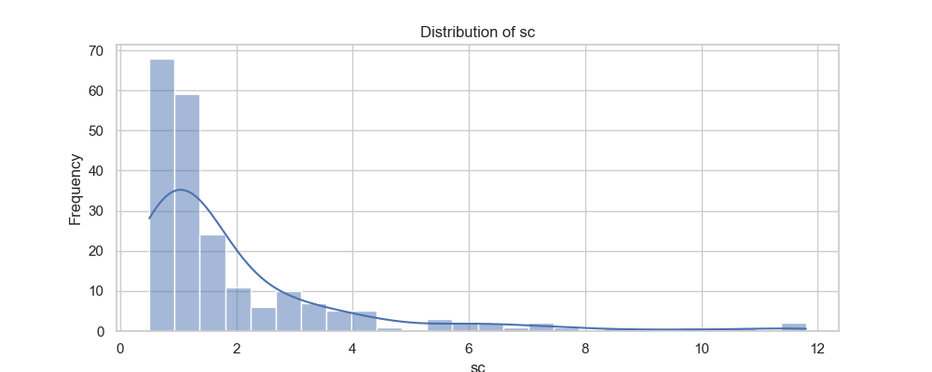
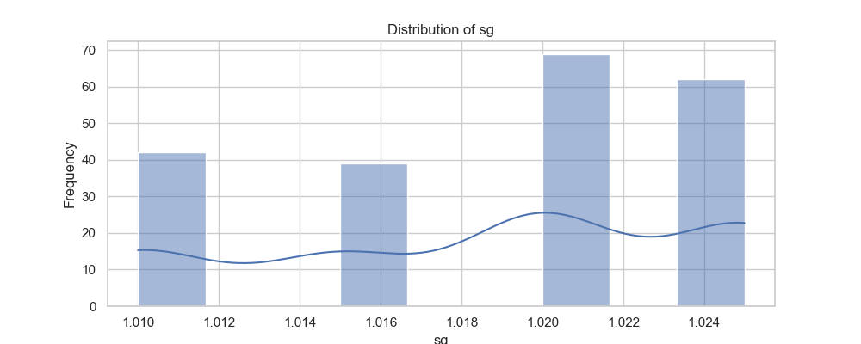
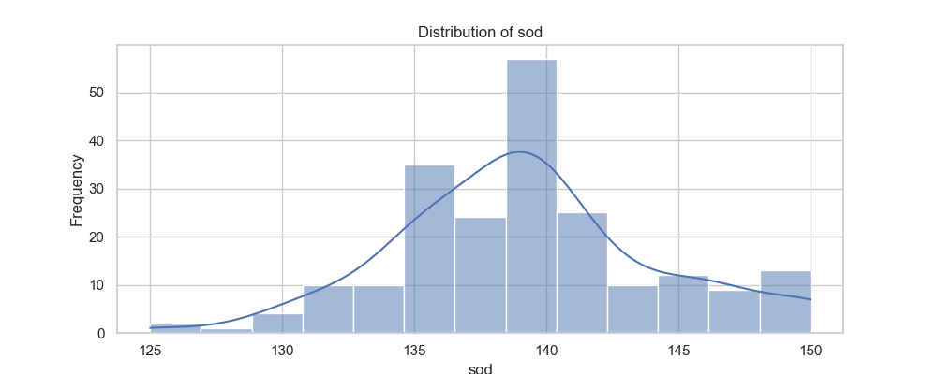
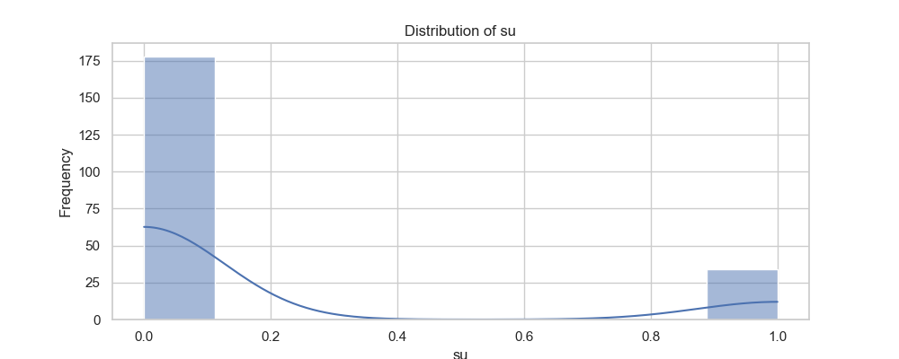
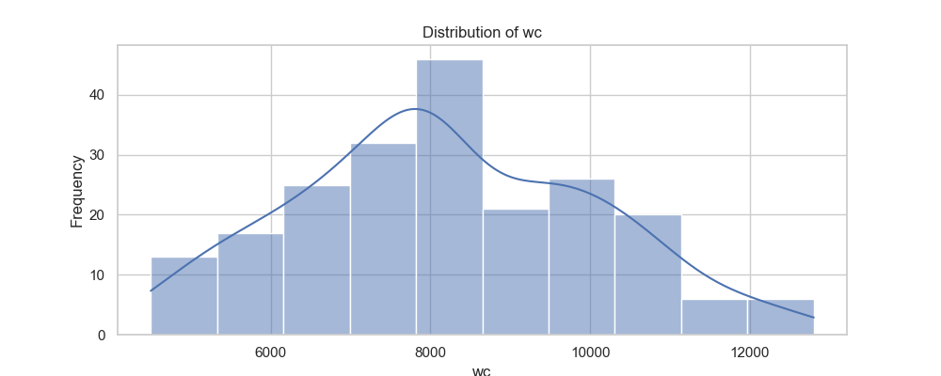


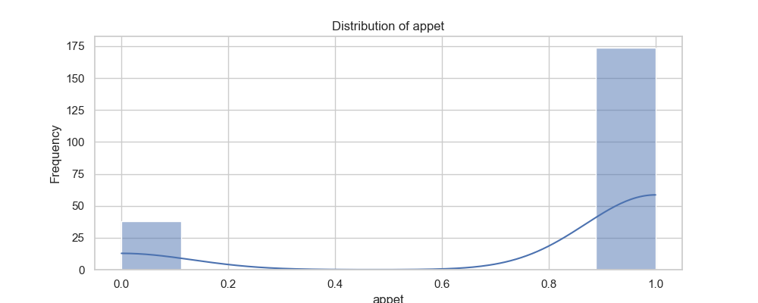
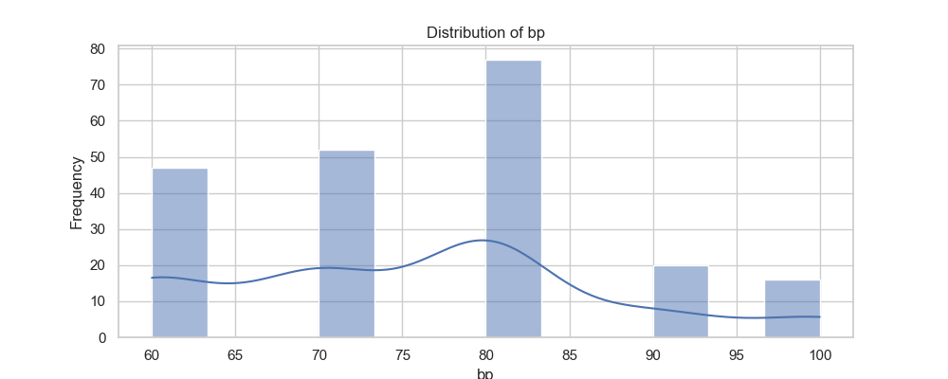
Appendix: Other Distribution
(After Data Cleaning)
Notes:
3

Slide 24
Appendix: Other Distribution
(After Data Cleaning)
Notes:
3

Slide 25
Appendix: Other Distribution
(After Data Cleaning)
Notes:
3

Slide 26
Appendix: Other Distribution
(After Data Cleaning)
Notes:
3

Slide 27
Appendix: Other Distribution
(After Data Cleaning)
Notes:
3

Slide 28
Appendix: Other Distribution
(After Data Cleaning)
Notes:
3

Slide 29
Appendix: Operate with Chatgpt
Hemoglobin (hemo)
Importance: 0.12
Correlation: -0.92
Interpretation: Low hemoglobin levels could indicate anemia, a common complication in CKD patients.
Packed Cell Volume (pcv)
Importance: 0.11
Correlation: -0.92
Interpretation: Decreased packed cell volume can also indicate anemia, further supporting a diagnosis of CKD.
Serum Creatinine (sc)
Importance: 0.08
Correlation: 0.88
Interpretation: An increase in serum creatinine is commonly associated with kidney damage and is a significant marker for CKD.
Blood Glucose Random (bgr)
Importance: 0.09
Correlation: 0.58
Interpretation: Elevated random blood glucose levels may be associated with the development of CKD, as impaired kidney function can lead to reduced glucose excretion.
Specific Gravity (sg)
Importance: 0.08
Correlation: -0.86
Interpretation: A lower specific gravity might indicate CKD, suggesting a reduced ability of the kidneys to concentrate urine.
Notes:
3

Slide 30
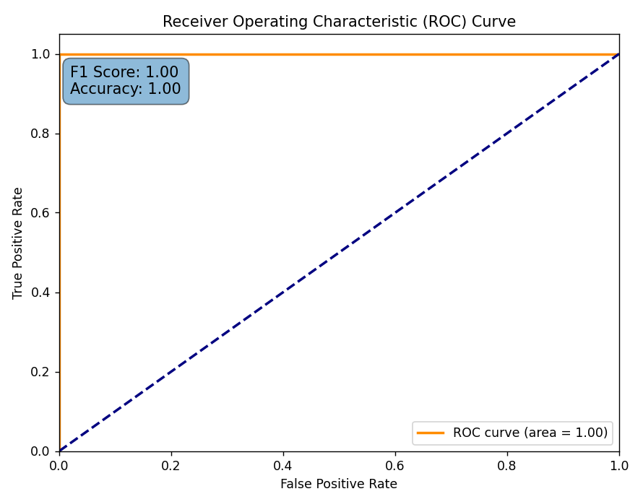

Accuracy(random forest)
Change outliers to Q1 or Q3. Fill with mean values. Rows not deleted.
Overflow?
70/30 split for Train and Test.
Notes:
3

Slide 31


Accuracy(random forest)
Change outliers to Q1 or Q3. Fill with mean values. Rows not deleted.
Use another dataset for Test.
Notes:
3

Slide 32


Accuracy(random forest)
Change outliers to empty value(normal range).
Delete row when it exsist over 3 empty values. Exist empty value.
Use another dataset for Test.
Notes:
3

