Slide 1

Using ChatBot in Karma
Peter Huang
Moofon Lee
ChatBot URL
Notes:
1

Slide 2
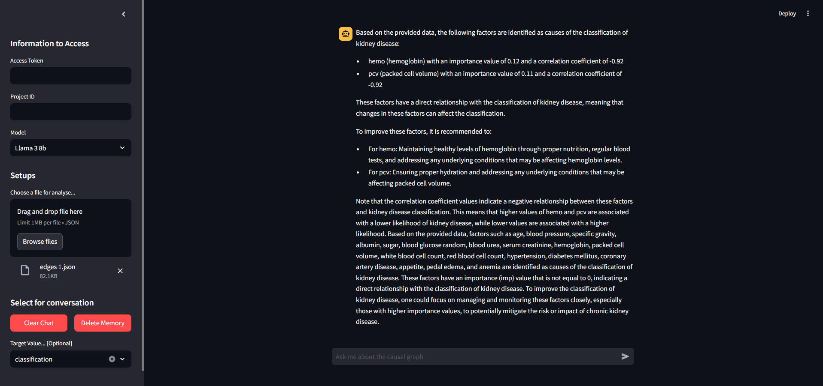
Introduction
The chatbot is to help users understand the practical significance of causal graphs,
Notes:
we have built a Chatbot that combine with LLM domain knowledge to interpret. Additionally, it also enables users to directly knows the relationships and importance value between various nodes.

Slide 3
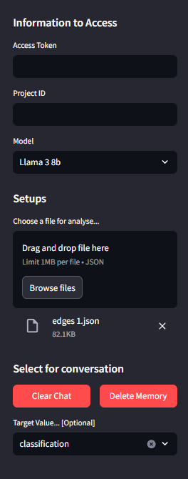
Here is the project token and Id from Karma 360
Here to choose the model
{1. llama3 70b, 2. llama3 8b, 3. GPT3.5-turbo, 4. GPT4-o}
User can choose the file here (json file only)
User can clear the chat and remove memory
User can choose the target value
(Answer questions against Target value)

Slide 4
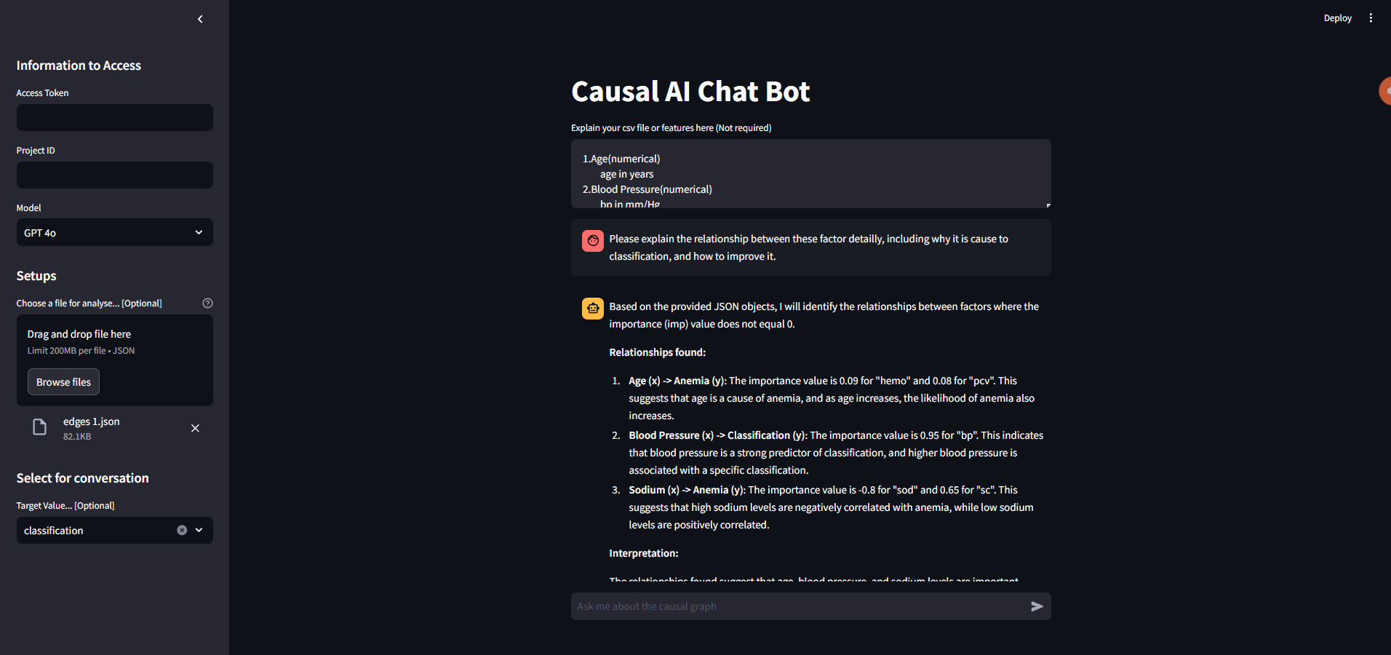
User can also use text to explain the json file or features here
Memorable(8 messenges only)
Here to ask qusetion

Slide 5
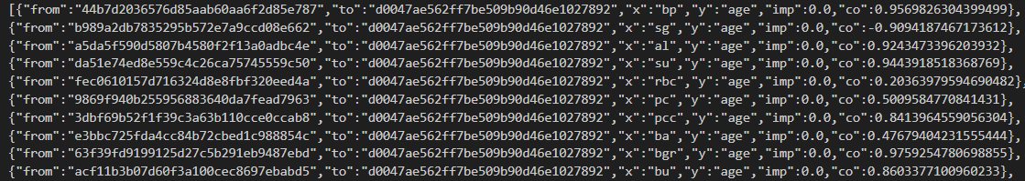
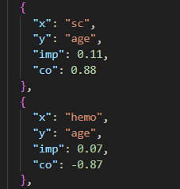
Json Flie
Before Cleaning
After Cleaning
Remove first 2 key, Round to 2nd decimal place,
Notes:
2

Slide 6
Service
Langflow:
Simplifies AI application creation using a visual interface with components and API.
Streamlit:
A UI framework that use to build Chatbot website.
Ollama:
A service that can enable llama3 in local.
Notes:
LangFlow is a platform that simplifies AI application creation using a visual interface with components and APIs. Users can build functional applications with basic API knowledge and parameter settings.

Slide 7
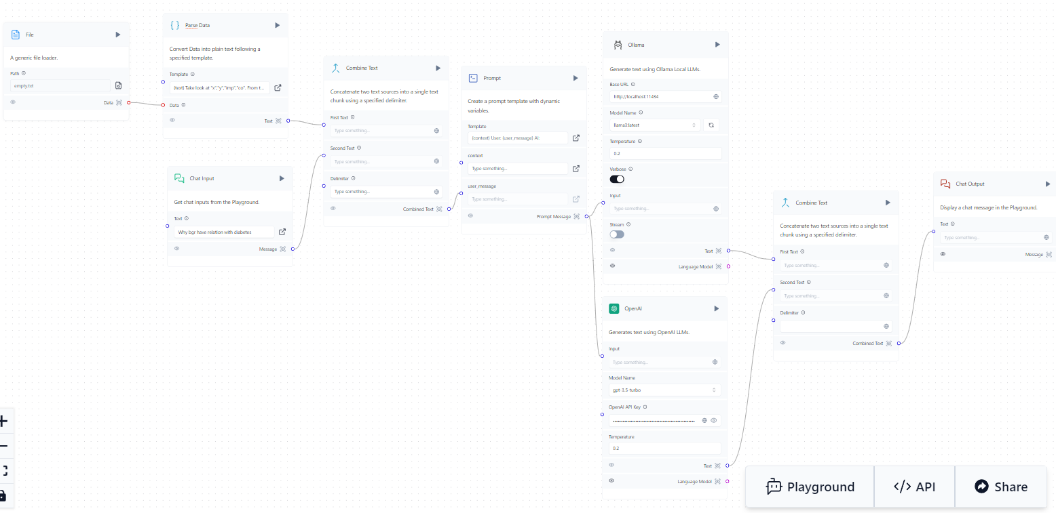
Langflow
Notes:
Langflow is a visual framework for building multi-agent and RAG applications. It is open-source, Python-powered, fully customizable, LLM and vector store agnostic.
Its intuitive interface allows for easy manipulation of AI building blocks, enabling developers to quickly prototype and turn their ideas into powerful, real-world solutions.

Slide 8
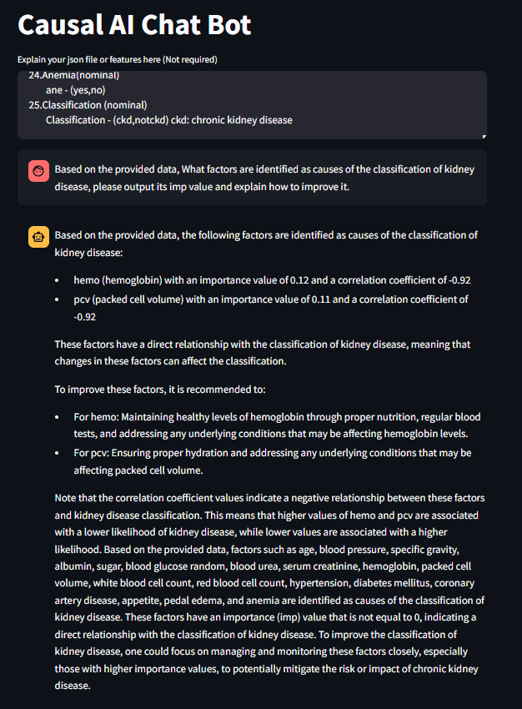
Ask
Llama 3b
Output the most significant factors
and output their imp, co value
Explain how to imporve it
Other significant factors
that have correlation with “CKD”
Notes:
2

Slide 9
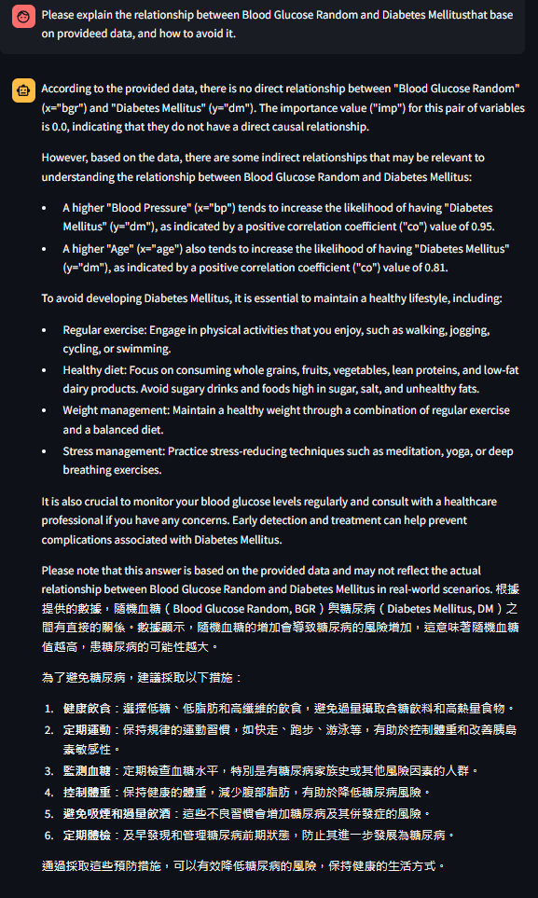

Memorical
Translate
Notes:
2

Slide 10

LLM Compare (Llama 8b)
Question:
Performance:
The output is correct
2. Repeat the output factors (sc and hemo)
Response Time: 25 sec
Notes:
2

Slide 11
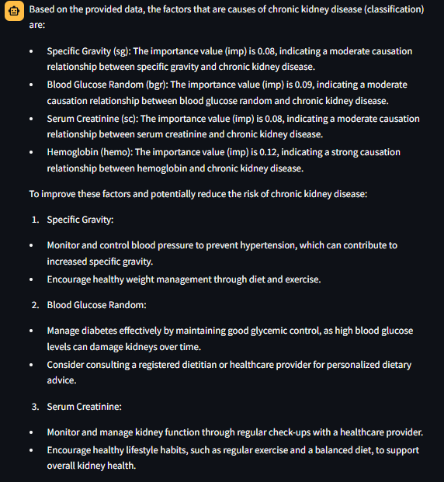
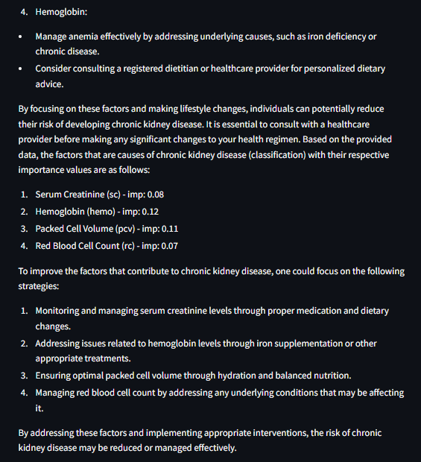
LLM Compare (Llama 3b)
Notes:
2

Slide 12
LLM Compare (GPT 3.5-trubo)
Question:
Performance:
The output is correct
2. One factor haven’t explained
Response Time: 32 sec
Notes:
2

Slide 13
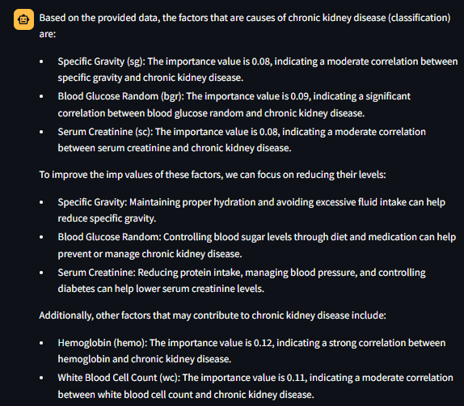
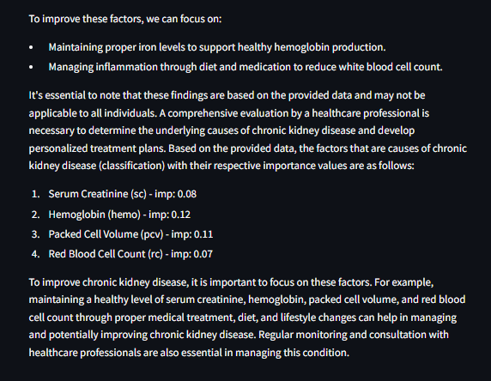
LLM Compare (GPT 3.5-turbo)
Notes:
2

Slide 14
LLM Compare (GPT 4o)
Question:
Performance:
The output is perfect
2. Explain detaily
Response Time: 19 sec
Notes:
2

Slide 15
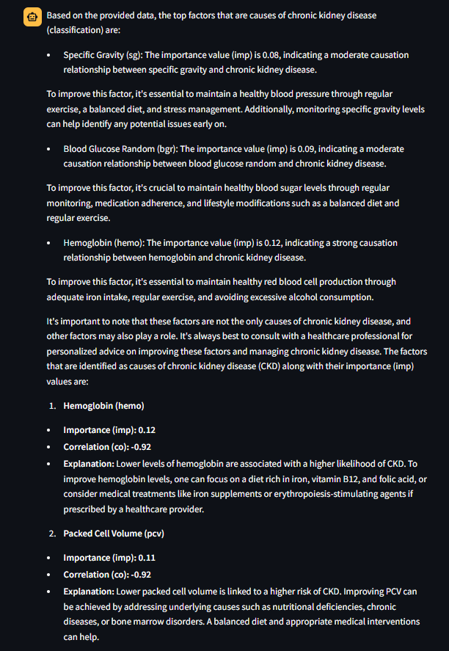
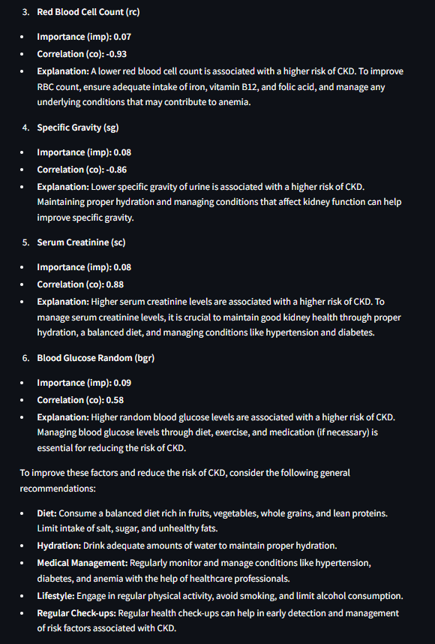
LLM Compare (GPT 4o)
Notes:
2

Slide 16
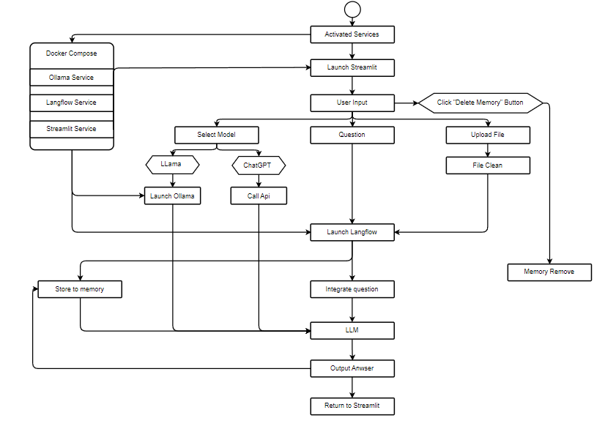
UML Graph
Notes:
2

