Slide 1

Using ChatBot in Karma
Peter Huang
Moofon Lee
Notes:
1

Slide 2
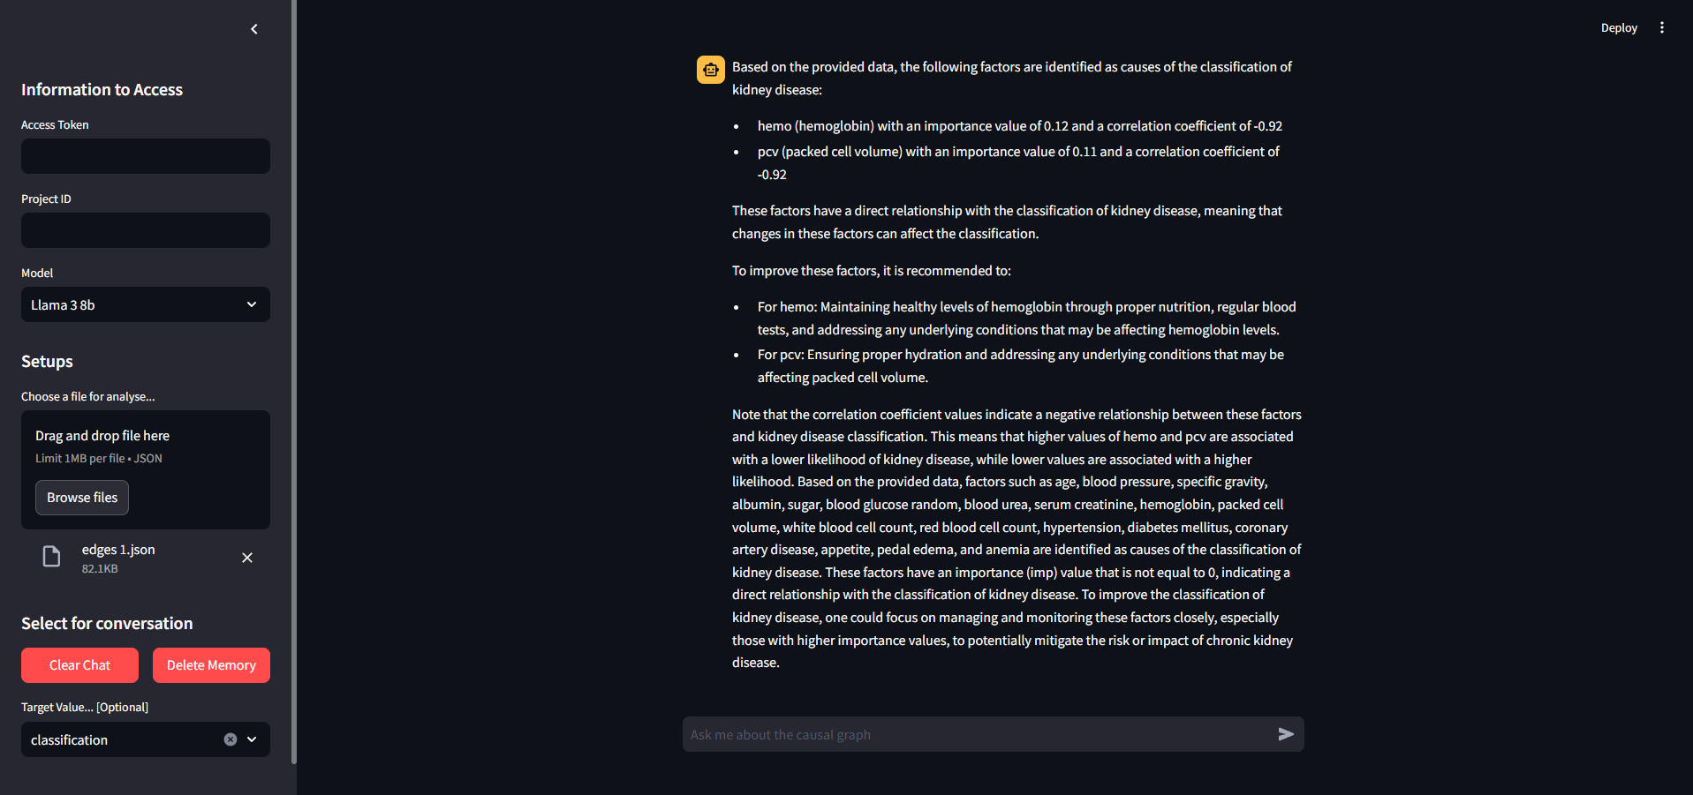
Introduction
Notes:
we have built a Chatbot that combine with LLM domain knowledge to interpret. Additionally, it also enables users to directly knows the relationships and importance value between various nodes.

Slide 3
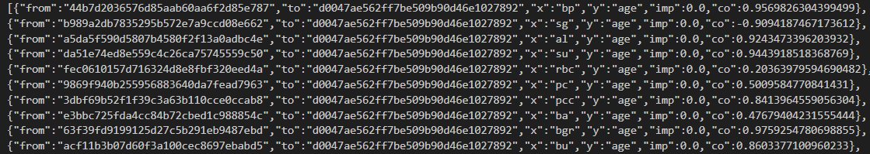
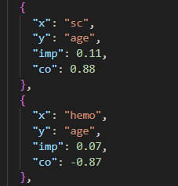
Json File
Before Cleaning
After Cleaning
Remove first 2 key, Round to 2nd decimal place
Remove objects that imp value is 0
Notes:
2

Slide 4
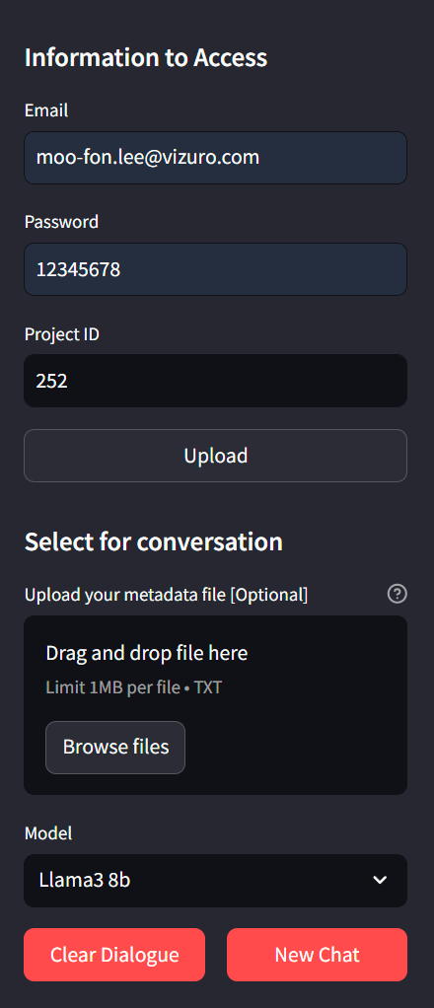
Side bar
User can choose the project here
User can upload metadata here
Here to choose the model { llama3 8b, GPT 4-o mini, GPT 4-o }
User can clear the chat and remove memory

Slide 5
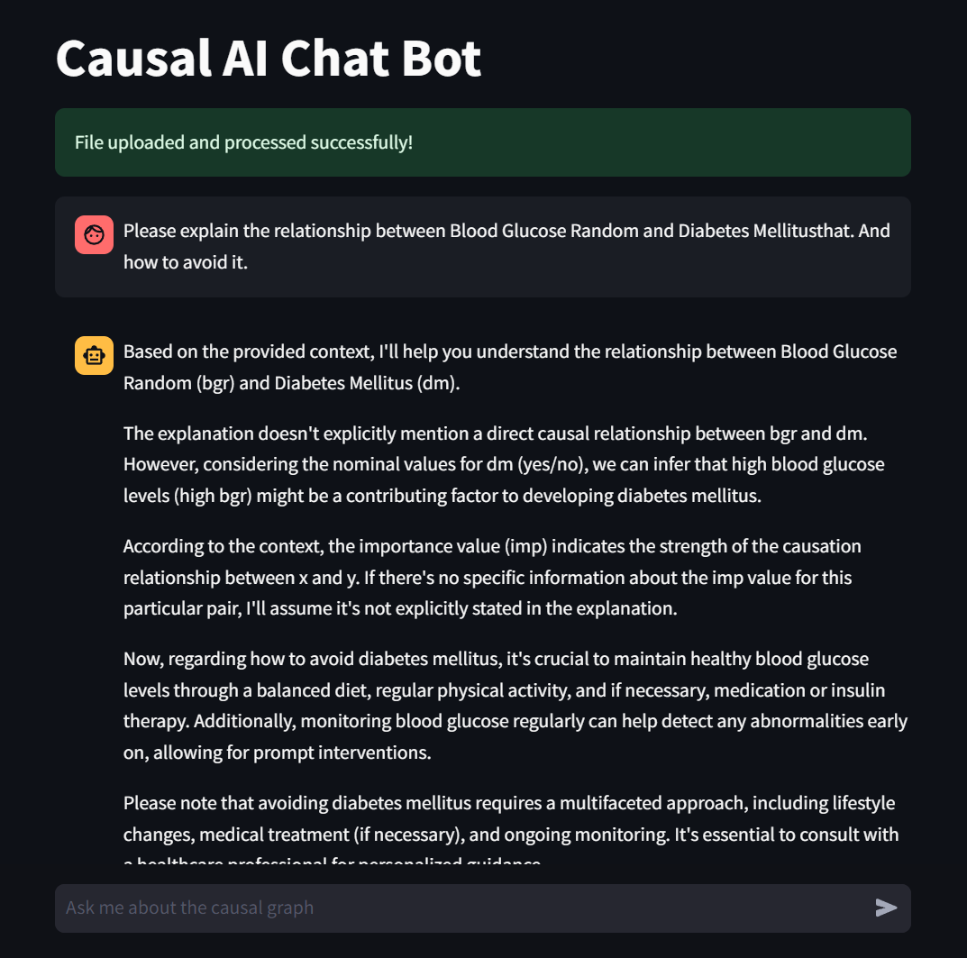
Memorable(8 messages only)
Here to ask qusetion

Slide 6
Service
Streamlit:
A UI framework that use to build Chatbot website.
Langflow:
A GUI for LangChain
Ollama:
A service that can enable llama3 in local.
Notes:
LangFlow is a platform that simplifies AI application creation using a visual interface with components and APIs. Users can build functional applications with basic API knowledge and parameter settings.

Slide 7
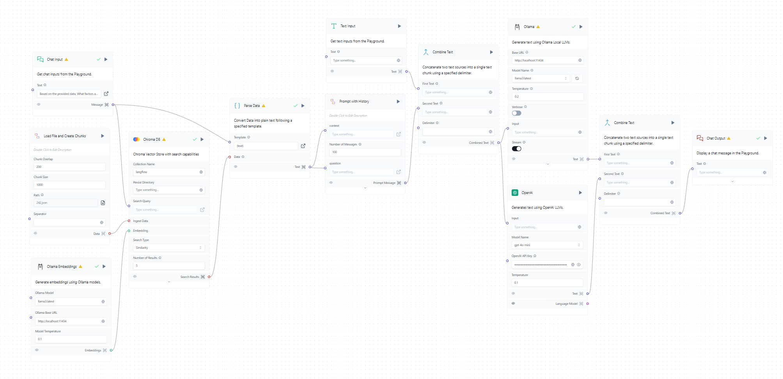
Langflow

Slide 8
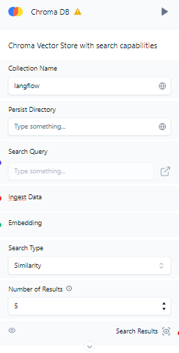
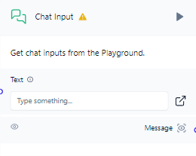
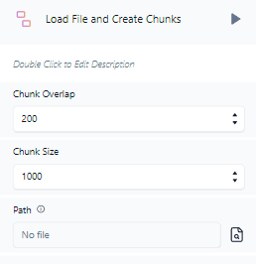
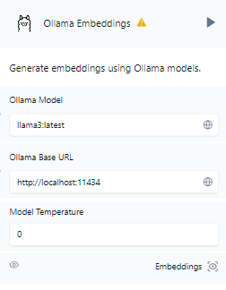
RAG
Notes:
2

Slide 9
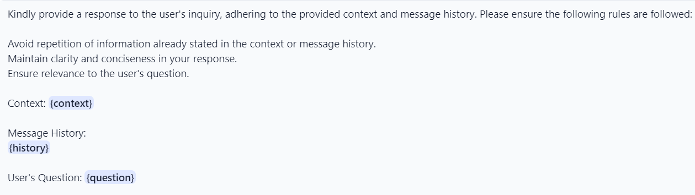
Template
Notes:
請針對使用者的詢問提供回應，遵循提供的上下文和訊息歷史。請確保遵守以下規則：
避免重複上下文或訊息歷史中已經陳述的資訊。 保持回應的清晰和簡潔。 確保回應與使用者的問題相關。

Slide 10
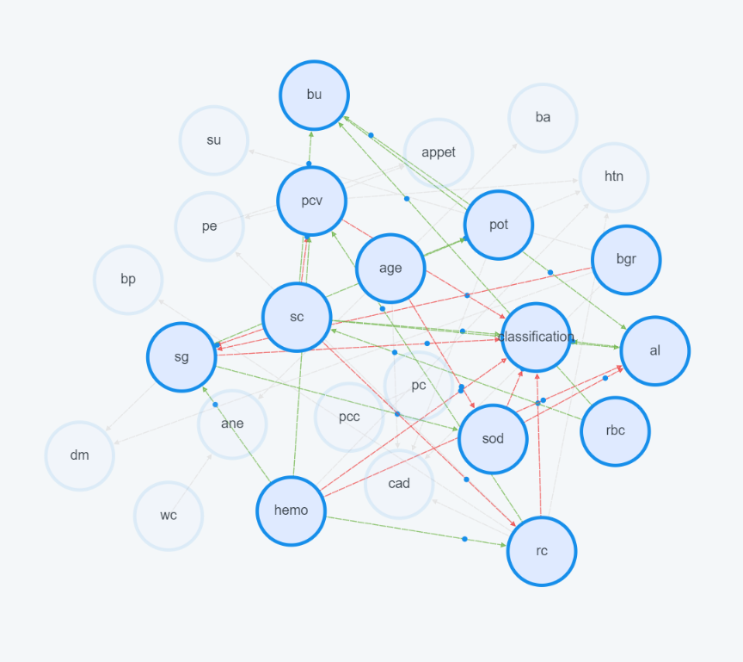
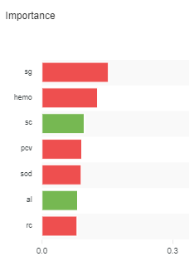
Ask
hemo: -0.106
sg: -0.127
sc: 0.081
pcv: 0.076
sod: 0.075
al: 0.068
rc: 0.067
Notes:
2

Slide 11
LLM Compare Task 1: Output the entire file
 | RAG |  |  | Non-RAG
Model Name | Llama 3 8b | GPT 4 mini | GPT 4o | Llama 3 8b | GPT 3.5 turbo | GPT 4o
Performance | 4 | 3 | 1 | 5 | 6 | 2
Correct Anwser | Y | Y | Y | Y | Y | Y
word count | 2475 | 2646 | 3945 | 3373 | 4030 | 4221
Response Time | 1:30 | 1:28 | 0:52 | 0:55 | 0:50 | 1:25
Notes:
2

Slide 12
LLM Compare Task 2:
Rank the factors by imp value and output it
 | RAG |  |  | Non-RAG
Model Name | Llama 3 8b | GPT 4 mini | GPT 4o | Llama 3 8b | GPT 3.5 turbo | GPT 4o
Performance | 4 | 3 | 2 | 6 | 5 | 1
Correct Anwser | Y | Y | Y | N | Y | Y
word count | 911 | 1075 | 1470 | 1698 | 1550 | 2115
Response Time | 0:31 | 0:28 | 0:30 | 0:27 | 0:29 | 0:35
Notes:
2

Slide 13
LLM Compare Task 3:
Base on the provided data, how to reduce the risk of ckd
 | RAG |  |  | Non-RAG
Model Name | Llama 3 8b | GPT 4 mini | GPT 4o | Llama 3 8b | GPT 3.5 turbo | GPT 4o
Performance | 4 | 3 | 1 | 6 | 5 | 2
Correct Anwser | Y | Y | Y | Y | Y | Y
word count | 2891 | 3163 | 3788 | 2425 | 3001 | 3294
Response Time | 0:45 | 0:43 | 0:50 | 0:40 | 0:35 | 0:34
Notes:
2

Slide 14
Future Work
1.
Upload to server
2.
The response time takes too long. Most of it is due to calling the LangFlow API, perhaps using LangChain directly would be better.
Notes:
2

Slide 15
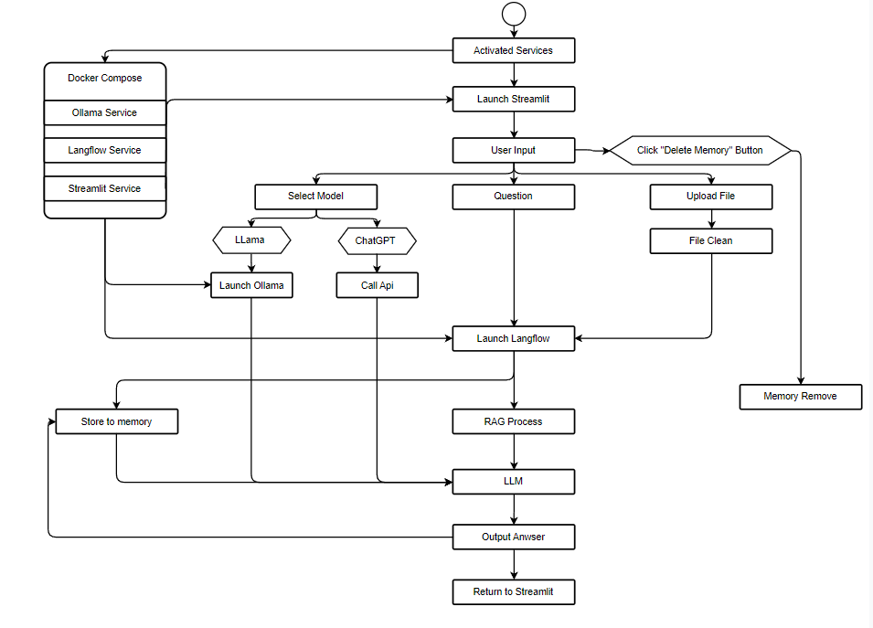
UML Graph
Notes:
2

Slide 16
Appidex 1
Question:
Please output the entire context
1.Age(numerical) age in years 2.Blood Pressure(numerical) bp in mm/Hg 3.Specific Gravity(nominal) sg - (1.005,1.010,1.015,1.020,1.025) 4.Albumin(nominal) al - (0,1,2,3,4,5) 5.Sugar(nominal) su - (0,1,2,3,4,5) 6.Red Blood Cells(nominal) rbc - (normal,abnormal) 7.Pus Cell (nominal) pc - (normal,abnormal) 8.Pus Cell clumps(nominal) pcc - (present,notpresent) 9.Bacteria(nominal) ba - (present,notpresent) 10.Blood Glucose Random(numerical) bgr in mgs/dl 11.Blood Urea(numerical) bu in mgs/dl 12.Serum Creatinine(numerical) sc in mgs/dl 13.Sodium(numerical) sod in mEq/L 14.Potassium(numerical) pot in mEq/L 15.Hemoglobin(numerical) hemo in gms 16.Packed Cell Volume(numerical) 17.White Blood Cell Count(numerical) wc in cells/cumm 18.Red Blood Cell Count(numerical) rc in cells/cumm 19.Classification(nominal) classification - (1,2,3) And the context is: [{"x": "Age", "y": "htn", "imp": 0.07, "co": 0.94}, {"x": "Hemoglobin", "y": "htn", "imp": 0.06, "co": -0.92}, {"x": "Packed Cell Volume", "y": "htn", "imp": 0.07, "co": -0.93}, {"x": "Red Blood Cell Count", "y": "htn", "imp": 0.08, "co": -0.94}, {"x": "Age", "y": "cad", "imp": 0.07, "co": 0.99}, {"x": "Blood Glucose Random", "y": "cad", "imp": 0.08, "co": 0.83}, {"x": "Potassium", "y": "cad", "imp": 0.07, "co": 0.76}, {"x": "Red Blood Cell Count", "y": "cad", "imp": 0.07, "co": -0.96}, {"x": "Packed Cell Volume", "y": "appet", "imp": 0.07, "co": 0.91}, {"x": "Pe", "y": "appet", "imp": 0.06, "co": -0.87}, {"x": "Packed Cell Volume", "y": "pe", "imp": 0.07, "co": -0.92}, {"x": "Red Blood Cell Count", "y": "pe", "imp": 0.07, "co": -0.94}, {"x": "Age", "y": "ane", "imp": 0.08, "co": -0.0}, {"x": "White Blood Cell Count", "y": "ane", "imp": 0.08, "co": 0.65}, {"x": "Specific Gravity", "y": "classification", "imp": 0.13, "co": -0.93}, {"x": "Albumin", "y": "classification", "imp": 0.07, "co": 0.87}, {"x": "Serum Creatinine", "y": "classification", "imp": 0.08, "co": 0.92}, {"x": "Sodium", "y": "classification", "imp": 0.07, "co": -0.96}, {"x": "Hemoglobin", "y": "classification", "imp": 0.11, "co": -0.92}, {"x": "Packed Cell Volume", "y": "classification", "imp": 0.08, "co": -0.93}, {"x": "Red Blood Cell Count", "y": "classification", "imp": 0.07, "co": -0.94}] Let me know if you have any specific questions or need further clarification! I've already provided the entire context in my previous response. If you have any specific questions or need clarification on any part of the data, please let me know!
Notes:
2

Slide 17
Appidex 2
Question:
Please output the entire context
Based on the provided context and message history, I will provide a response to your inquiry.
The given context is a list of JSON objects that represent relationships between different variables. Each object has four attributes: "x", "y", "imp", and "co". The "x" attribute represents the cause variable, the "y" attribute represents the effect variable, the "imp" attribute represents the importance of the relationship (i.e., how strong the causation is), and the "co" attribute represents the coefficient of the relationship.
The user's question is to output the entire context. Therefore, I will simply reiterate the provided context:
[{"x":"rc","y":"bp","imp":0.07,"co":-0.63},{"x":"bgr","y":"sg","imp":0.07,"co":-0.91},{"x":"sc","y":"sg","imp":0.07,"co":-0.9},{"x":"hemo","y":"sg","imp":0.08,"co":0.95},{"x":"bu","y":"al","imp":0.08,"co":0.96},{"x":"sc","y":"al","imp":0.08,"co":0.93},{"x":"sod","y":"al","imp":0.07,"co":-0.93},{"x":"hemo","y":"al","imp":0.07,"co":-0.91},{"x":"bgr","y":"su","imp":0.15,"co":0.89},{"x":"pc","y":"pcc","imp":0.09,"co":0.88},{"x":"age","y":"ba","imp":0.06,"co":-0.7},{"x":"rbc","y":"bu","imp":0.06,"co":0.95},{"x":"sc","y":"bu","imp":0.07,"co":0.94},{"x":"pot","y":"bu","imp":0.08,"co":0.78},{"x":"rbc","y":"sc","imp":0.06,"co":0.96},{"x":"hemo","y":"rc","imp":0.14,"co":0.95},{"x":"age","y":"htn","imp":0.07,"co":0.94},{"x":"hemo","y":"htn","imp":0.06,"co":-0.92},{"x":"pcv","y":"htn","imp":0.07,"co":-0.93},{"x":"rc","y":"htn","imp":0.08,"co":-0.94},{"x":"sg","y":"dm","imp":0.07,"co":-0.93},{"x":"bgr","y":"dm","imp":0.08,"co":0.94},{"x":"age","y":"cad","imp":0.07,"co":0.99},{"x":"bgr","y":"cad","imp":0.08,"co":0.83},{"x":"pot","y":"cad","imp":0.07,"co":0.76},{"x":"rc","y":"cad","imp":0.07,"co":-0.96},{"x":"pcv","y":"appet","imp":0.07,"co":0.91},{"x":"pe","y":"appet","imp":0.06,"co":-0.87},{"x":"pcv","y":"pe","imp":0.07,"co":-0.92},{"x":"rc","y":"pe","imp":0.07,"co":-0.94},{"x":"age","y":"ane","imp":0.08,"co":-0.0},{"x":"wc","y":"ane","imp":0.08,"co":0.65},{"x":"sg","y":"classification","imp":0.13,"co":-0.93},{"x":"al","y":"classification","imp":0.07,"co":0.87},{"x":"sc","y":"classification","imp":0.08,"co":0.92},{"x":"sod","y":"classification","imp":0.07,"co":-0.96},{"x":"hemo","y":"classification","imp":0.11,"co":-0.92},{"x":"pcv","y":"classification","imp":0.08,"co":-0.93},{"x":"rc","y":"classification","imp":0.07,"co":-0.94}]
Please let me know if you have any further questions or if there's anything else I can help you with! The context has already been provided in your previous request. If you have any specific questions or need further information about the data, please let me know!
Notes:
2

Slide 18
Appidex 3
Question:
Please output the entire context
Based on the provided context and message history, I will provide a response to your inquiry.
Since you have asked for the entire context, I will summarize the key points:
The given context is a list of JSON objects representing relationships between various factors. Each object has four attributes: x, y, imp, and co.
x and y represent two factors where x is a cause of y.
imp (importance) represents the strength of the relationship between x and y, with higher values indicating stronger causation.
co (coefficient) indicates the direction of the relationship. If co is less than 0, increasing x will lead to decreasing y; if co is greater than 0, increasing x will lead to increasing y.
Please let me know what specific information you would like me to extract or analyze from this context. Certainly! Here is the entire context provided:
Age (numerical)
age in years
Blood Pressure (numerical)
bp in mm/Hg
Specific Gravity (nominal)
sg - (1.005, 1.010, 1.015, 1.020, 1.025)
Albumin (nominal)
al - (0, 1, 2, 3, 4, 5)
Sugar (nominal)
su - (0, 1, 2, 3, 4, 5)
Red Blood Cells (nominal)
rbc - (normal, abnormal)
Pus Cell (nominal)
pc - (normal, abnormal)
Pus Cell clumps (nominal)
pcc - (present, not present)
Bacteria (nominal)
ba - (present, not present)
Blood Glucose Random (numerical)
bgr in mgs/dl
Blood Urea (numerical)
bu in mgs/dl
Serum Creatinine (numerical)
sc in mgs/dl
Sodium (numerical)
sod in mEq/L
Potassium (numerical)
pot in mEq/L
Hemoglobin (numerical)
hemo in gms
Packed Cell Volume (numerical)
White Blood Cell Count (numerical)
wc in cells/cumm
Red Blood Cell Count (numerical)
rc in millions/cmm
Hypertension (nominal)
htn - (yes, no)
Diabetes Mellitus (nominal)
dm - (yes, no)
Coronary Artery Disease (nominal)
cad - (yes, no)
Appetite (nominal)
appet - (good, poor)
Pedal Edema (nominal)
pe - (yes, no)
Anemia (nominal)
ane - (yes, no)
Classification (nominal)
Classification - (ckd, notckd) ckd: chronic kidney disease
Causation Data:
{"x":"rc","y":"bp","imp":0.07,"co":-0.63}
{"x":"bgr","y":"sg","imp":0.07,"co":-0.91}
{"x":"sc","y":"sg","imp":0.07,"co":-0.9}
{"x":"hemo","y":"sg","imp":0.08,"co":0.95}
{"x":"bu","y":"al","imp":0.08,"co":0.96}
{"x":"sc","y":"al","imp":0.08,"co":0.93}
{"x":"sod","y":"al","imp":0.07,"co":-0.93}
{"x":"hemo","y":"al","imp":0.07,"co":-0.91}
{"x":"bgr","y":"su","imp":0.15,"co":0.89}
{"x":"pc","y":"pcc","imp":0.09,"co":0.88}
{"x":"age","y":"ba","imp":0.06,"co":-0.7}
{"x":"rbc","y":"bu","imp":0.06,"co":0.95}
{"x":"sc","y":"bu","imp":0.07,"co":0.94}
{"x":"pot","y":"bu","imp":0.08,"co":0.78}
{"x":"rbc","y":"sc","imp":0.06,"co":0.92}
{"x":"age","y":"sod","imp":0.08,"co":-0.85}
{"x":"sg","y":"sod","imp":0.08,"co":0.94}
{"x":"age","y":"pot","imp":0.07,"co":0.29}
{"x":"sg","y":"pot","imp":0.08,"co":0.93}
{"x":"sc","y":"pcv","imp":0.07,"co":-0.95}
{"x":"hemo","y":"pcv","imp":0.14,"co":0.96}
{"x":"rc","y":"pcv","imp":0.13,"co":0.96}
{"x":"sc","y":"rc","imp":0.08,"co":-0.95}
{"x":"hemo","y":"rc","imp":0.14,"co":0.95}
{"x":"age","y":"htn","imp":0.07,"co":0.94}
{"x":"hemo","y":"htn","imp":0.06,"co":-0.92}
{"x":"pcv","y":"htn","imp":0.07,"co":-0.93}
{"x":"rc","y":"htn","imp":0.08,"co":-0.94}
{"x":"sg","y":"dm","imp":0.07,"co":-0.93}
{"x":"bgr","y":"dm","imp":0.08,"co":0.94}
{"x":"age","y":"cad","imp":0.07,"co":0.99}
{"x":"bgr","y":"cad","imp":0.08,"co":0.83}
{"x":"pot","y":"cad","imp":0.07,"co":0.76}
{"x":"rc","y":"cad","imp":0.07,"co":-0.96}
{"x":"pcv","y":"appet","imp":0.07,"co":0.91}
{"x":"pe","y":"appet","imp":0.06,"co":-0.87}
{"x":"pcv","y":"pe","imp":0.07,"co":-0.92}
{"x":"rc","y":"pe","imp":0.07,"co":-0.94}
{"x":"age","y":"ane","imp":0.08,"co":-0.0}
{"x":"wc","y":"ane","imp":0.08,"co":0.65}
{"x":"sg","y":"classification","imp":0.13,"co":-0.93}
{"x":"al","y":"classification","imp":0.07,"co":0.87}
{"x":"sc","y":"classification","imp":0.08,"co":0.92}
{"x":"sod","y":"classification","imp":0.07,"co":-0.96}
{"x":"hemo","y":"classification","imp":0.11,"co":-0.92}
{"x":"pcv","y":"classification","imp":0.08,"co":-0.93}
{"x":"rc","y":"classification","imp":0.07,"co":-0.94}
0.99}
{"x":"bgr","y":"cad","imp":0.08,"co":0.83}
{"x":"pot","y":"cad","imp":0.07,"co":0.76}
{"x":"rc","y":"cad","imp":0.07,"co":-0.96}
{"x":"pcv","y":"appet","imp":0.07,"co":0.91}
{"x":"pe","y":"appet","imp":0.06,"co":-0.87}
{"x":"pcv","y":"pe","imp":0.07,"co":-0.92}
{"x":"rc","y":"pe","imp":0.07,"co":-0.94}
{"x":"age","y":"ane","imp":0.08,"co":-0.0}
{"x":"wc","y":"ane","imp":0.08,"co":0.65}
{"x":"sg","y":"classification","imp":0.13,"co":-0.93}
{"x":"al","y":"classification","imp":0.07,"co":0.87}
{"x":"sc","y":"classification","imp":0.08,"co":0.92}
{"x":"sod","y":"classification","imp":0.07,"co":-0.96}
{"x":"hemo","y":"classification","imp":0.11,"co":-0.92}
{"x":"pcv","y":"classification","imp":0.08,"co":-0.93}
{"x":"rc","y":"classification","imp":0.07,"co":-0.94}
Notes:
2

Slide 19
Appidex 4
Question:
Please output the entire context
Here are all the JSON objects:
[{"x":"rc","y":"bp","imp":0.07,"co":-0.63},{"x":"bgr","y":"sg","imp":0.07,"co":-0.91},{"x":"sc","y":"sg","imp":0.07,"co":-0.9},{"x":"hemo","y":"sg","imp":0.08,"co":0.95},{"x":"bu","y":"al","imp":0.08,"co":0.96},{"x":"sc","y":"al","imp":0.08,"co":0.93},{"x":"sod","y":"al","imp":0.07,"co":-0.93},{"x":"hemo","y":"al","imp":0.07,"co":-0.91},{"x":"bgr","y":"su","imp":0.15,"co":0.89},{"x":"pc","y":"pcc","imp":0.09,"co":0.88},{"x":"age","y":"ba","imp":0.06,"co":-0.7},{"x":"rbc","y":"bu","imp":0.06,"co":0.95},{"x":"sc","y":"bu","imp":0.07,"co":0.94},{"x":"pot","y":"bu","imp":0.08,"co":0.78},{"x":"rbc","y":"sc","imp":0.06,"co":0.92},{"x":"age","y":"sod","imp":0.08,"co":-0.85},{"x":"sg","y":"sod","imp":0.08,"co":0.94},{"x":"age","y":"pot","imp":0.07,"co":0.29},{"x":"sg","y":"pot","imp":0.08,"co":0.93},{"x":"sc","y":"pcv","imp":0.07,"co":-0.95},{"x":"rc","y":"htn","imp":0.08,"co":-0.94},{"x":"sg","y":"dm","imp":0.07,"co":-0.93},{"x":"bgr","y":"dm","imp":0.08,"co":0.94},{"x":"age","y":"cad","imp":0.07,"co":0.99},{"x":"bgr","y":"cad","imp":0.08,"co":0.83},{"x":"pot","y":"cad","imp":0.07,"co":0.76},{"x":"rc","y":"cad","imp":0.07,"co":-0.96},{"x":"pcv","y":"appet","imp":0.07,"co":0.91},{"x":"pe","y":"appet","imp":0.06,"co":-0.87},{"x":"pcv","y":"pe","imp":0.07,"co":-0.92},{"x"," [{"x":"rc","y":"bp","imp":0.07,"co":-0.63},{"x":"bgr","y":"sg","imp":0.07,"co":-0.91},{"x":"sc","y":"sg","imp":0.07,"co":-0.9},{"x":"hemo","y":"sg","imp":0.08,"co":0.95},{"x":"bu","y":"al","imp":0.08,"co":0.96},{"x":"sc","y":"al","imp":0.08,"co":0.93},{"x":"sod","y":"al","imp":0.07,"co":-0.93},{"x":"hemo","y":"al","imp":0.07,"co":-0.91},{"x":"bgr","y":"su","imp":0.15,"co":0.89},{"x":"pc","y":"pcc","imp":0.09,"co":0.88},{"x":"age","y":"ba","imp":0.06,"co":-0.7},{"x":"rbc","y":"bu","imp":0.06,"co":0.95},{"x":"sc","y":"bu","imp":0.07,"co":0.94},{"x":"pot","y":"bu","imp":0.08,"co":0.78},{"x":"rbc","y":"sc","imp":0.06,"co":0.92},{"x":"age","y":"sod","imp":0.08,"co":-0.85},{"x":"sg","y":"sod","imp":0.08,"co":0.94},{"x":"age","y":"pot","imp":0.07,"co":0.29},{"x":"sg","y":"pot","imp":0.08,"co":0.93},{"x":"sc","y":"pcv","imp":0.07,"co":-0.95},{"x":"hemo","y":"pcv","imp":0.14,"co":0.96},{"x":"rc","y":"pcv","imp":0.13,"co":0.96},{"x":"sc","y":"rc","imp":0.08,"co":-0.95},{"x":"hemo","y":"rc","imp":0.14,"co":0.95},{"x":"age","y":"htn","imp":0.07,"co":0.94},{"x":"hemo","y":"htn","imp":0.06,"co":-0.92},{"x":"pcv","y":"htn","imp":0.07,"co":-0.93},{"x":"rc","y":"htn","imp":0.08,"co":-0.94},{"x":"sg","y":"dm","imp":0.07,"co":-0.93},{"x":"bgr","y":"dm","imp":0.08,"co":0.94},{"x":"age","y":"cad","imp":0.07,"co":0.99},{"x":"bgr","y":"cad","imp":0.08,"co":0.83},{"x":"pot","y":"cad","imp":0.07,"co":0.76},{"x":"rc","y":"cad","imp":0.07,"co":-0.96},{"x":"pcv","y":"appet","imp":0.07,"co":0.91},{"x":"pe","y":"appet","imp":0.06,"co":-0.87},{"x":"pcv","y":"pe","imp":0.07,"co":-0.92},{"x":"rc","y":"pe","imp":0.07,"co":-0.94},{"x":"age","y":"ane","imp":0.08,"co":-0.0},{"x":"wc","y":"ane","imp":0.08,"co":0.65},{"x":"sg","y":"classification","imp":0.13,"co":-0.93},{"x":"al","y":"classification","imp":0.07,"co":0.87},{"x":"sc","y":"classification","imp":0.08,"co":0.92},{"x":"sod","y":"classification","imp":0.07,"co":-0.96},{"x":"hemo","y":"classification","imp":0.11,"co":-0.92},{"x":"pcv","y":"classification","imp":0.08,"co":-0.93},{"x":"rc","y":"classification","imp":0.07,"co":-0.94}]
Notes:
2

Slide 20
Appidex 5
Question:
Please output the entire context
The user wants me to output the entire JSON object. Here it is:
[{"x":"rc","y":"bp","imp":0.07,"co":-0.63},{"x":"bgr","y":"sg","imp":0.07,"co":-0.91},{"x":"sc","y":"sg","imp":0.07,"co":-0.9},{"x":"hemo","y":"sg","imp":0.08,"co":0.95},{"x":"bu","y":"al","imp":0.08,"co":0.96},{"x":"sc","y":"al","imp":0.08,"co":0.93},{"x":"sod","y":"al","imp":0.07,"co":-0.93},{"x":"hemo","y":"al","imp":0.07,"co":-0.91},{"x":"bgr","y":"su","imp":0.15,"co":0.89},{"x":"pc","y":"pcc","imp":0.09,"co":0.88},{"x":"age","y":"ba","imp":0.06,"co":-0.7},{"x":"rbc","y":"bu","imp":0.06,"co":0.95},{"x":"sc","y":"bu","imp":0.07,"co":0.94},{"x":"pot","y":"bu","imp":0.08,"co":0.78},{"x":"rbc","y":"sc","imp":0.06,"co":0.92},{"x":"age","y":"sod","imp":0.08,"co":-0.85},{"x":"sg","y":"sod","imp":0.08,"co":0.94},{"x":"age","y":"pot","imp":0.07,"co":0.29},{"x":"sg","y":"pot","imp":0.08,"co":0.93},{"x":"sc","y":"pcv","imp":0.07,"co":-0.93},{"x":"rc","y":"htn","imp":0.08,"co":-0.94},{"x":"sg","y":"dm","imp":0.07,"co":-0.93},{"x":"bgr","y":"dm","imp":0.08,"co":0.94},{"x":"age","y":"cad","imp":0.07,"co":0.99},{"x":"bgr","y":"cad","imp":0.08,"co":0.83},{"x":"pot","y":"cad","imp":0.07,"co":0.76},{"x":"rc","y":"cad","imp":0.07,"co":-0.96},{"x":"pcv","y":"appet","imp":0.07,"co":0.91},{"x":"pe","y":"appet","imp":0.06,"co":-0.87},{"x":"pcv","y":"pe","imp":0.07,"co":-0.92},{"x":"rc","y":"pe","imp":0.07,"co":-0.94},{"x":"age","y":"ane","imp":0.08,"co":-0.0},{"x":"wc","y":"ane","imp":0.08,"co":0.65},{"x":"sg","y":"classification","imp":0.13,"co":-0.93},{"x":"al","y":"classification","imp":0.07,"co":0.87},{"x":"sc","y":"classification","imp":0.08,"co":0.92},{"x":"sod","y":"classification","imp":0.07,"co":-0.96},{"x":"hemo","y":"classification","imp":0.11,"co":-0.92},{"x":"pcv","y":"classification","imp":0.08,"co":-0.93},{"x":"rc","y":"classification","imp":0.07,"co":-0.94}]
Please note that I'm not interpreting or analyzing the data, just outputting it as requested. [{"x":"rc","y":"bp","imp":0.07,"co":-0.63},{"x":"bgr","y":"sg","imp":0.07,"co":-0.91},{"x":"sc","y":"sg","imp":0.07,"co":-0.9},{"x":"hemo","y":"sg","imp":0.08,"co":0.95},{"x":"bu","y":"al","imp":0.08,"co":0.96},{"x":"sc","y":"al","imp":0.08,"co":0.93},{"x":"sod","y":"al","imp":0.07,"co":-0.93},{"x":"hemo","y":"al","imp":0.07,"co":-0.91},{"x":"bgr","y":"su","imp":0.15,"co":0.89},{"x":"pc","y":"pcc","imp":0.09,"co":0.88},{"x":"age","y":"ba","imp":0.06,"co":-0.7},{"x":"rbc","y":"bu","imp":0.06,"co":0.95},{"x":"sc","y":"bu","imp":0.07,"co":0.94},{"x":"pot","y":"bu","imp":0.08,"co":0.78},{"x":"rbc","y":"sc","imp":0.06,"co":0.92},{"x":"age","y":"sod","imp":0.08,"co":-0.85},{"x":"sg","y":"sod","imp":0.08,"co":0.94},{"x":"age","y":"pot","imp":0.07,"co":0.29},{"x":"sg","y":"pot","imp":0.08,"co":0.93},{"x":"sc","y":"pcv","imp":0.07,"co":-0.95},{"x":"hemo","y":"pcv","imp":0.14,"co":0.96},{"x":"rc","y":"pcv","imp":0.13,"co":0.96},{"x":"sc","y":"rc","imp":0.08,"co":-0.95},{"x":"hemo","y":"rc","imp":0.14,"co":0.95},{"x":"age","y":"htn","imp":0.07,"co":0.94},{"x":"hemo","y":"htn","imp":0.06,"co":-0.92},{"x":"pcv","y":"htn","imp":0.07,"co":-0.93},{"x":"rc","y":"htn","imp":0.08,"co":-0.94},{"x":"sg","y":"dm","imp":0.07,"co":-0.93},{"x":"bgr","y":"dm","imp":0.08,"co":0.94},{"x":"age","y":"cad","imp":0.07,"co":0.99},{"x":"bgr","y":"cad","imp":0.08,"co":0.83},{"x":"pot","y":"cad","imp":0.07,"co":0.76},{"x":"rc","y":"cad","imp":0.07,"co":-0.96},{"x":"pcv","y":"appet","imp":0.07,"co":0.91},{"x":"pe","y":"appet","imp":0.06,"co":-0.87},{"x":"pcv","y":"pe","imp":0.07,"co":-0.92},{"x":"rc","y":"pe","imp":0.07,"co":-0.94},{"x":"age","y":"ane","imp":0.08,"co":-0.0},{"x":"wc","y":"ane","imp":0.08,"co":0.65},{"x":"sg","y":"classification","imp":0.13,"co":-0.93},{"x":"al","y":"classification","imp":0.07,"co":0.87},{"x":"sc","y":"classification","imp":0.08,"co":0.92},{"x":"sod","y":"classification","imp":0.07,"co":-0.96},{"x":"hemo","y":"classification","imp":0.11,"co":-0.92},{"x":"pcv","y":"classification","imp":0.08,"co":-0.93},{"x":"rc","y":"classification","imp":0.07,"co":-0.94}]
Notes:
2

Slide 21
Appidex 6
Question:
Please output the entire context
Based on the explanation, I understand that the provided data is a list of JSON objects, where each object represents a relationship between two factors (x and y). The "imp" value indicates the importance of this relationship, while the "co" value represents the direction of causation.
To answer your request, here are all the JSON objects:
[{"x":"rc","y":"bp","imp":0.07,"co":-0.63},{"x":"bgr","y":"sg","imp":0.07,"co":-0.91},{"x":"sc","y":"sg","imp":0.07,"co":-0.9},{"x":"hemo","y":"sg","imp":0.08,"co":0.95},{"x":"bu","y":"al","imp":0.08,"co":0.96},{"x":"sc","y":"al","imp":0.08,"co":0.93},{"x":"sod","y":"al","imp":0.07,"co":-0.93},{"x":"hemo","y":"al","imp":0.07,"co":-0.91},{"x":"bgr","y":"su","imp":0.15,"co":0.89},{"x":"pc","y":"pcc","imp":0.09,"co":0.88},{"x":"age","y":"ba","imp":0.06,"co":-0.7},{"x":"rbc","y":"bu","imp":0.06,"co":0.95},{"x":"sc","y":"bu","imp":0.07,"co":0.94},{"x":"pot","y":"bu","imp":0.08,"co":0.78},{"x":"rbc","y":"sc","imp":0.06,"co":0.92},{"x":"age","y":"sod","imp":0.08,"co":-0.85},{"x":"sg","y":"sod","imp":0.08,"co":0.94},{"x":"hemo","y":"dm","imp":0.07,"co":-0.93},{"x":"bgr","y":"dm","imp":0.08,"co":0.94},{"x":"age","y":"cad","imp":0.07,"co":0.99},{"x":"bgr","y":"cad","imp":0.08,"co":0.83},{"x":"pot","y":"cad","imp":0.07,"co":0.76},{"x":"rc","y":"cad","imp":0.07,"co":-0.96},{"x":"pcv","y":"appet","imp":0.07,"co":0.91},{"x":"pe","y":"appet","imp":0.06,"co":-0.87},{"x":"pcv","y":"pe","imp":0.07,"co":-0.92},{"x":"rc","y":"pe","imp":0.07,"co":-0.94},{"x":"age","y":"ane","imp":0.08,"co":-0.0},{"x":"wc","y":"ane","imp":0.08,"co":0.65},{"x":"sg","y":"classification","imp":0.13,"co":-0.93},{"x":"al","y":"classification","imp":0.07,"co":0.87},{"x":"sc","y":"classification","imp":0.08,"co":0.92},{"x":"sod","y":"classification","imp":0.07,"co":-0.96},{"x":"hemo","y":"classification","imp":0.11,"co":-0.92},{"x":"pcv","y":"classification","imp":0.08,"co":-0.93},{"x":"rc","y":"classification","imp":0.07,"co":-0.94}]
]
Please note that I did not interpret or analyze the data in any way, but simply output the entire list of JSON objects as requested. Here is the entire JSON object as requested:
[
{"x":"rc","y":"bp","imp":0.07,"co":-0.63},
{"x":"bgr","y":"sg","imp":0.07,"co":-0.91},
{"x":"sc","y":"sg","imp":0.07,"co":-0.9},
{"x":"hemo","y":"sg","imp":0.08,"co":0.95},
{"x":"bu","y":"al","imp":0.08,"co":0.96},
{"x":"sc","y":"al","imp":0.08,"co":0.93},
{"x":"sod","y":"al","imp":0.07,"co":-0.93},
{"x":"hemo","y":"al","imp":0.07,"co":-0.91},
{"x":"bgr","y":"su","imp":0.15,"co":0.89},
{"x":"pc","y":"pcc","imp":0.09,"co":0.88},
{"x":"age","y":"ba","imp":0.06,"co":-0.7},
{"x":"rbc","y":"bu","imp":0.06,"co":0.95},
{"x":"sc","y":"bu","imp":0.07,"co":0.94},
{"x":"pot","y":"bu","imp":0.08,"co":0.78},
{"x":"rbc","y":"sc","imp":0.06,"co":0.92},
{"x":"age","y":"sod","imp":0.08,"co":-0.85},
{"x":"sg","y":"sod","imp":0.08,"co":0.94},
{"x":"age","y":"pot","imp":0.07,"co":0.29},
{"x":"sg","y":"pot","imp":0.08,"co":0.93},
{"x":"sc","y":"pcv","imp":0.07,"co":-0.95},
{"x":"hemo","y":"pcv","imp":0.14,"co":0.96},
{"x":"rc","y":"pcv","imp":0.13,"co":0.96},
{"x":"sc","y":"rc","imp":0.08,"co":-0.95},
{"x":"hemo","y":"rc","imp":0.14,"co":0.95},
{"x":"age","y":"htn","imp":0.07,"co":0.94},
{"x":"hemo","y":"htn","imp":0.06,"co":-0.92},
{"x":"pcv","y":"htn","imp":0.07,"co":-0.93},
{"x":"rc","y":"htn","imp":0.08,"co":-0.94},
{"x":"sg","y":"dm","imp":0.07,"co":-0.93},
{"x":"bgr","y":"dm","imp":0.08,"co":0.94},
{"x":"age","y":"cad","imp":0.07,"co":0.99},
{"x":"bgr","y":"cad","imp":0.08,"co":0.83},
{"x":"pot","y":"cad","imp":0.07,"co":0.76},
{"x":"rc","y":"cad","imp":0.07,"co":-0.96},
{"x":"pcv","y":"appet","imp":0.07,"co":0.91},
{"x":"pe","y":"appet","imp":0.06,"co":-0.87},
{"x":"pcv","y":"pe","imp":0.07,"co":-0.92},
{"x":"rc","y":"pe","imp":0.07,"co":-0.94},
{"x":"age","y":"ane","imp":0.08,"co":-0.0},
{"x":"wc","y":"ane","imp":0.08,"co":0.65},
{"x":"sg","y":"classification","imp":0.13,"co":-0.93},
{"x":"al","y":"classification","imp":0.07,"co":0.87},
{"x":"sc","y":"classification","imp":0.08,"co":0.92},
{"x":"sod","y":"classification","imp":0.07,"co":-0.96},
{"x":"hemo","y":"classification","imp":0.11,"co":-0.92},
{"x":"pcv","y":"classification","imp":0.08,"co":-0.93},
{"x":"rc","y":"classification","imp":0.07,"co":-0.94}
Notes:
2

Slide 22
Use imp value to rank the factors that will cause to ckd.
Appidex 7
Question:
To answer your question, I'll first filter out the JSON objects where y is equal to "classification" (since you're asking about causing Chronic Kidney Disease (CKD)). Then, I'll sort the remaining objects based on their imp values in descending order.
Here are the top factors that will cause CKD:
x: sg, imp: 0.13
x: al, imp: 0.07
x: sc, imp: 0.08
x: hemo, imp: 0.11
These factors have the highest importance values, indicating that they are strongly related to causing CKD. Based on the provided importance (imp) values, here are the factors ranked by their potential to cause chronic kidney disease (CKD):
sg (Specific Gravity) - imp: 0.13
sc (Serum Creatinine) - imp: 0.08
al (Albumin) - imp: 0.07
hemo (Hemoglobin) - imp: 0.11
rc (Red Blood Cell Count) - imp: 0.07
sod (Sodium) - imp: 0.07
pcv (Packed Cell Volume) - imp: 0.08
These factors are ranked from highest to lowest based on their importance in relation to CKD.
Notes:
2

Slide 23
Use imp value to rank the factors that will cause to ckd.
Appidex 8
Question:
To rank the factors that will cause Chronic Kidney Disease (CKD), we can sort the JSON objects by their importance (imp) values in descending order, considering only those with "y" equal to "classification". Here's the ranking:
{"x": "sg", "y": "classification", "imp": 0.13, "co": -0.93}
{"x": "al", "y": "classification", "imp": 0.07, "co": 0.87}
{"x": "sc", "y": "classification", "imp": 0.08, "co": 0.92}
{"x": "hemo", "y": "classification", "imp": 0.11, "co": -0.92}
{"x": "pcv", "y": "classification", "imp": 0.08, "co": -0.93}
These factors are the most important in causing CKD, with Specific Gravity (sg) being the top factor. Based on the provided context, here are the factors ranked by their importance (imp) values that may cause chronic kidney disease (CKD):
sg (Specific Gravity) - imp: 0.13
sc (Serum Creatinine) - imp: 0.08
al (Albumin) - imp: 0.07
hemo (Hemoglobin) - imp: 0.11
sod (Sodium) - imp: 0.07
pcv (Packed Cell Volume) - imp: 0.08
rc (Red Blood Cell Count) - imp: 0.07
These factors are ranked from highest to lowest based on their importance in relation to CKD.
Notes:
2

Slide 24
Use imp value to rank the factors that will cause to ckd.
Appidex 9
Question:
To answer your question, I can use the importance (imp) values to rank the factors that are most likely to cause Chronic Kidney Disease (CKD). Here is the ranking:
sg (Specific Gravity): With an imp value of 0.13, Specific Gravity has the highest likelihood of causing CKD.
al (Albumin): With an imp value of 0.07, Albumin is also a strong predictor of CKD.
sc (Serum Creatinine): With an imp value of 0.08, Serum Creatinine is another important factor in the development of CKD.
sod (Sodium): With an imp value of 0.07, Sodium levels may also contribute to the risk of developing CKD.
hemo (Hemoglobin): With an imp value of 0.11, Hemoglobin levels are also associated with the likelihood of developing CKD.
These rankings are based solely on the importance values provided in the JSON object and do not take into account any other factors that may be relevant to the development of CKD. Based on the provided importance (imp) values, here are the factors ranked by their potential to cause chronic kidney disease (CKD):
Blood Glucose Random (bgr) - imp: 0.15
Specific Gravity (sg) - imp: 0.13
Hemoglobin (hemo) - imp: 0.11
Blood Urea (bu) - imp: 0.08
Serum Creatinine (sc) - imp: 0.08
Albumin (al) - imp: 0.07
Red Blood Cell Count (rc) - imp: 0.07
Sodium (sod) - imp: 0.07
Potassium (pot) - imp: 0.07
Packed Cell Volume (pcv) - imp: 0.07
Age - imp: 0.07
White Blood Cell Count (wc) - imp: 0.08
These factors are ranked from highest to lowest based on their importance in relation to CKD.
Notes:
2

Slide 25
Use imp value to rank the factors that will cause to ckd.
Appidex 10
Question:
Based on the provided data, I can use the importance (imp) values to rank the factors that will cause Chronic Kidney Disease (CKD). The ranking is based on the magnitude of the relationship between each factor and CKD.
Here are the top-ranked factors that may contribute to CKD, in order of their importance:
sg (Specific Gravity): With an imp value of 0.13, this factor has a strong positive correlation with CKD.
al (Albumin): The imp value is 0.07, indicating a moderate positive relationship between Albumin and CKD.
sc (Serum Creatinine): This factor has an imp value of 0.08, suggesting a moderate positive correlation with CKD.
hemo (Hemoglobin): With an imp value of 0.11, Hemoglobin shows a strong negative relationship with CKD (i.e., lower Hemoglobin levels are associated with a higher likelihood of developing CKD).
rc (Red Blood Cell Count): The imp value is 0.07, indicating a moderate positive correlation between Red Blood Cell Count and CKD.
These factors can be considered the most influential in predicting the development of Chronic Kidney Disease based on the provided data. Based on the provided JSON objects, we can rank the factors that will cause chronic kidney disease (ckd) based on their importance (imp) values. The factors in descending order of importance are as follows:
Blood Glucose Random (bgr)
Hemoglobin (hemo)
Serum Creatinine (sc)
Packed Cell Volume (pcv)
Red Blood Cell Count (rc)
Sodium (sod)
Albumin (al)
White Blood Cell Count (wc)
Specific Gravity (sg)
Potassium (pot)
Age
Red Blood Cells (rbc)
Blood Urea (bu)
Blood Pressure (bp)
Pus Cell clumps (pcc)
Pus Cell (pc)
Pedal Edema (pe)
Hypertension (htn)
Diabetes Mellitus (dm)
Coronary Artery Disease (cad)
Anemia (ane)
Bacteria (ba)
Notes:
2

Slide 26
Use imp value to rank the factors that will cause to ckd.
Appidex 11
Question:
Please note that this ranking is based solely on the provided data and should not be taken as medical advice. Based on the provided data, the factors that have the highest importance in causing chronic kidney disease (CKD) are:
Blood Glucose Random (bgr)
Hemoglobin (hemo)
Serum Creatinine (sc)
Packed Cell Volume (pcv)
Red Blood Cell Count (rc)
Sodium (sod)
Albumin (al)
White Blood Cell Count (wc)
Specific Gravity (sg)
Potassium (pot)
Age
Red Blood Cells (rbc)
Blood Urea (bu)
Blood Pressure (bp)
Pus Cell clumps (pcc)
Pus Cell (pc)
Appetite (appet)
Pedal Edema (pe)
Hypertension (htn)
Diabetes Mellitus (dm)
Coronary Artery Disease (cad)
Anemia (ane)
Bacteria (ba)
Based on the provided data, I can help you rank the factors that will cause Chronic Kidney Disease (CKD) using the importance (imp) values.
From the JSON objects, I found the following factors that are related to CKD:
sg (Specific Gravity)
al (Albumin)
sc (Serum Creatinine)
sod (Sodium)
hemo (Hemoglobin)
pcv (Packed Cell Volume)
rc (Red Blood Cell Count)
To rank these factors, I will use the importance (imp) values:
sg: imp = 0.13
al: imp = 0.07
sc: imp = 0.08
sod: imp = 0.07
hemo: imp = 0.11
pcv: imp = 0.08
rc: imp = 0.07
Based on these values, the top-ranked factors that will cause CKD are:
sg (Specific Gravity) with an importance value of 0.13
hemo (Hemoglobin) with an importance value of 0.11
sc (Serum Creatinine) with an importance value of 0.08
These factors are likely to have a strong causal relationship with CKD, and their values may be used as indicators for the development or progression of the disease.
Notes:
2

Slide 27
Use imp value to rank the factors that will cause to ckd.
Appidex 12
Question:
Based on the provided data, I can help you rank the factors that will cause Chronic Kidney Disease (CKD) using the importance (imp) values. Here's the ranking:
sg (Specific Gravity): With an imp value of 0.13, Specific Gravity has the highest importance in causing CKD.
al (Albumin): Albumin is ranked second with an imp value of 0.07, indicating a moderate level of importance in causing CKD.
sc (Serum Creatinine): Serum Creatinine is ranked third with an imp value of 0.08, suggesting a moderate level of importance in causing CKD.
sod (Sodium): Sodium is ranked fourth with an imp value of 0.07, indicating a moderate level of importance in causing CKD.
hemo (Hemoglobin): Hemoglobin is ranked fifth with an imp value of 0.11, suggesting a relatively high level of importance in causing CKD.
The remaining factors have lower imp values and are less likely to cause CKD:
rc (Red Blood Cell Count), pcv (Packed Cell Volume), age, bgr (Blood Glucose Random), bu (Blood Urea), pot (Potassium), rbc (Red Blood Cells), pc (Pus Cell), pcc (Pus Cell Clumps), ba (Bacteria), htn (Hypertension), dm (Diabetes Mellitus), cad (Coronary Artery Disease), appet (Appetite), pe (Pedal Edema), and ane (Anemia) have imp values ranging from 0.06 to 0.08, indicating a relatively low level of importance in causing CKD.
Please note that these rankings are based solely on the provided data and should not be used as a definitive guide for diagnosing or treating CKD. To rank the factors that will cause chronic kidney disease (CKD) based on their importance (imp) values, we can list them in descending order of their imp values:
Specific Gravity (sg): imp = 0.13, co = -0.93
Hemoglobin (hemo): imp = 0.11, co = -0.92
Packed Cell Volume (pcv): imp = 0.08, co = -0.93
Serum Creatinine (sc): imp = 0.08, co = 0.92
Red Blood Cell Count (rc): imp = 0.07, co = -0.94
Sodium (sod): imp = 0.07, co = -0.96
Albumin (al): imp = 0.07, co = 0.87
So, the ranking of factors that will cause CKD from most to least important is:
Specific Gravity (sg)
Hemoglobin (hemo)
Packed Cell Volume (pcv)
Serum Creatinine (sc)
Red Blood Cell Count (rc)
Sodium (sod)
Albumin (al)
Notes:
2

Slide 28
Base on the provided data, how to reduce the risk of ckd.
Appidex 13
Question:
To reduce the risk of Chronic Kidney Disease (CKD), we can analyze the factors that are strongly correlated with CKD and identify potential interventions. Based on the provided data, there are a few key takeaways:
Age: As age increases, the risk of CKD also increases (coefficient = -0.85). This suggests that older individuals may be more prone to developing CKD.
Serum Creatinine (sc): Higher sc levels are strongly associated with an increased risk of CKD (coefficient = 0.92).
Sodium (sod): Lower sod levels are associated with a decreased risk of CKD (coefficient = -0.96). This may indicate that maintaining healthy sodium levels is important for kidney health.
Hemoglobin (hemo): Higher hemo levels are positively correlated with a reduced risk of CKD (coefficient = 0.95).
To reduce the risk of CKD, it's essential to:
Maintain healthy blood pressure through lifestyle changes and medication, if necessary.
Monitor serum creatinine levels and address any increases promptly.
Ensure adequate sodium intake through a balanced diet and consider consulting with a healthcare professional for personalized guidance.
Additionally, regular health check-ups and monitoring of factors like age, hemoglobin levels, and sodium levels can help identify potential issues early on, allowing for timely interventions to reduce the risk of CKD.
Please note that this analysis is based on the provided data and should not be taken as medical advice. It's essential to consult with a healthcare professional for personalized guidance and treatment. To reduce the risk of chronic kidney disease (CKD) based on the provided data, consider the following factors:
Monitor Blood Glucose Levels: High blood glucose (BGR) is positively correlated with diabetes mellitus (DM), which is a risk factor for CKD. Maintaining blood glucose levels within a healthy range can help mitigate this risk.
Manage Blood Pressure: Blood pressure (BP) is influenced by several factors, including red blood cell count (RC) and serum creatinine (SC). Keeping blood pressure under control is crucial for kidney health.
Maintain Healthy Sodium and Potassium Levels: Sodium (SOD) and potassium (POT) levels can impact kidney function. Regular monitoring and maintaining these electrolytes within normal ranges can help reduce CKD risk.
Monitor Hemoglobin Levels: Hemoglobin (HEMO) levels are associated with various health conditions. Ensuring adequate hemoglobin levels can support overall health and potentially reduce CKD risk.
Regular Check-ups: Regular health check-ups can help identify and manage conditions like hypertension (HTN) and diabetes mellitus (DM) early, which are significant risk factors for CKD.
Healthy Lifestyle Choices: Adopting a balanced diet, staying hydrated, and engaging in regular physical activity can contribute to overall kidney health.
By focusing on these areas, you can help reduce the risk of developing CKD.
Notes:
2

Slide 29
Base on the provided data, how to reduce the risk of ckd.
Appidex 14
Question:
To reduce the risk of Chronic Kidney Disease (CKD), let's analyze the relationships between various factors and CKD classification.
From the provided data, we can see that:
Age has a positive correlation with CKD classification (co = 0.99). This suggests that as age increases, the likelihood of developing CKD also increases.
Hemoglobin (hemo) has a negative correlation with CKD classification (co = -0.92). This implies that higher hemoglobin levels may be associated with a lower risk of CKD.
Serum Creatinine (sc) has a positive correlation with CKD classification (co = 0.92). This suggests that increased serum creatinine levels may be indicative of CKD.
Packed Cell Volume (pcv) has a negative correlation with CKD classification (co = -0.93). This implies that higher pcv values may be associated with a lower risk of CKD.
To reduce the risk of CKD, consider the following strategies:
Maintain healthy age: As age is positively correlated with CKD, it's essential to take care of your overall health and manage any age-related factors that could increase your risk.
Monitor hemoglobin levels: Regularly check your hemoglobin levels to ensure they remain within a healthy range. If you have low hemoglobin levels, consider consulting a healthcare professional for guidance on improving them.
Manage serum creatinine levels: Keep an eye on your serum creatinine levels and work with your healthcare provider to manage any increases that may indicate CKD.
Maintain a healthy pcv: Ensure your pcv values remain within a healthy range, as higher values may be associated with a lower risk of CKD.
By focusing on these factors and maintaining overall health, you can reduce the risk of developing CKD. It's essential to consult with a healthcare professional for personalized guidance and to monitor any changes in your condition. To reduce the risk of chronic kidney disease (CKD) based on the provided data, consider the following factors:
Monitor Blood Glucose Levels: High blood glucose (BGR) is positively correlated with diabetes mellitus (DM), which is a risk factor for CKD. Keeping blood glucose levels in check can help mitigate this risk.
Manage Blood Pressure: Blood pressure (BP) is influenced by various factors, including red blood cell count (RC) and serum creatinine (SC). Maintaining a healthy blood pressure can reduce the risk of CKD.
Maintain Healthy Sodium and Potassium Levels: Sodium (SOD) and potassium (POT) levels are associated with kidney function. Monitoring and managing these electrolytes can help in reducing CKD risk.
Address Anemia: Hemoglobin (HEMO) levels and packed cell volume (PCV) are related to anemia, which can impact kidney health. Ensuring adequate hemoglobin levels may help in reducing CKD risk.
Regular Health Check-ups: Regular monitoring of kidney function indicators such as blood urea (BU) and serum creatinine (SC) can help in early detection and management of potential kidney issues.
Lifestyle Modifications: Adopting a healthy lifestyle, including a balanced diet, regular exercise, and avoiding smoking, can contribute to overall kidney health.
By focusing on these areas, you can help reduce the risk of developing CKD.
Notes:
2

Slide 30
Base on the provided data, how to reduce the risk of ckd.
Appidex 15
Question:
Based on the provided data, it appears that there are several factors that can influence the risk of chronic kidney disease (CKD). To reduce the risk of CKD, I would recommend focusing on the following:
Maintain a healthy blood sugar level: The data suggests that high blood glucose levels (bgr) have a strong positive correlation with the risk of CKD (classification). Keeping blood sugar under control can help mitigate this risk.
Monitor and manage blood pressure: High blood pressure (bp) is also linked to an increased risk of CKD. Maintaining a healthy blood pressure through lifestyle changes or medication can help reduce this risk.
Maintain a healthy serum creatinine level: Elevated serum creatinine levels (sc) are associated with an increased risk of CKD. Keeping sc levels within a healthy range can help reduce this risk.
Manage sodium intake: High sodium levels (sod) have a negative correlation with the risk of CKD. Reducing sodium intake through dietary changes or supplements can help mitigate this risk.
Maintain a healthy packed cell volume: A high packed cell volume (pcv) is associated with an increased risk of CKD. Maintaining a healthy pcv through regular blood tests and lifestyle changes can help reduce this risk.
In terms of specific actions, I would recommend:
Regularly monitoring blood sugar, blood pressure, serum creatinine, and packed cell volume levels
Maintaining a healthy diet that is low in sodium and high in fiber
Engaging in regular physical activity to help manage blood pressure and blood sugar levels
Avoiding excessive alcohol consumption, which can increase the risk of CKD
By focusing on these factors and taking proactive steps to manage them, individuals may be able to reduce their risk of developing chronic kidney disease. To reduce the risk of chronic kidney disease (CKD) based on the provided data, you should focus on managing the factors that have a strong causative relationship with CKD. Here are some key points:
Specific Gravity (sg): Since a higher specific gravity is associated with a lower risk of CKD (co = -0.93), maintaining a balanced fluid intake to ensure proper hydration can help manage specific gravity levels.
Albumin (al): Higher levels of albumin are associated with an increased risk of CKD (co = 0.87). Monitoring and managing protein intake can help control albumin levels.
Serum Creatinine (sc): Elevated serum creatinine levels are strongly associated with an increased risk of CKD (co = 0.92). Regular monitoring of kidney function and managing conditions that affect kidney health, such as hypertension and diabetes, can help control serum creatinine levels.
Sodium (sod): Higher sodium levels are associated with a lower risk of CKD (co = -0.96). However, excessive sodium intake can lead to other health issues, so it's important to maintain a balanced sodium intake.
Hemoglobin (hemo): Lower hemoglobin levels are associated with an increased risk of CKD (co = -0.92). Ensuring adequate iron intake and managing conditions that affect hemoglobin levels can help.
Packed Cell Volume (pcv): Lower packed cell volume is associated with an increased risk of CKD (co = -0.93). Regular blood tests to monitor and manage packed cell volume can be beneficial.
Red Blood Cell Count (rc): Lower red blood cell count is associated with an increased risk of CKD (co = -0.94). Ensuring proper nutrition and addressing any underlying conditions that affect red blood cell count can help.
In summary, to reduce the risk of CKD, focus on maintaining proper hydration, managing protein and sodium intake, monitoring kidney function, and ensuring adequate levels of hemoglobin, packed cell volume, and red blood cell count. Regular check-ups and managing underlying health conditions such as hypertension and diabetes are also crucial.
Notes:
2

Slide 31
Base on the provided data, how to reduce the risk of ckd.
Appidex 16
Question:
A great question!
To reduce the risk of Chronic Kidney Disease (CKD), based on the provided data and domain knowledge, I would recommend the following:
Maintain a healthy blood sugar level: The correlation between Blood Glucose Random (bgr) and Classification (ckd) suggests that controlling blood sugar levels may help reduce the risk of CKD.
Monitor Sodium levels: The negative correlation between Sodium (sod) and Classification (ckd) implies that maintaining low sodium levels or reducing sodium intake may be beneficial in preventing CKD.
Maintain a healthy Hemoglobin level: The positive correlation between Hemoglobin (hemo) and Classification (ckd) suggests that having a normal hemoglobin level may help reduce the risk of CKD.
Control Blood Urea levels: The correlation between Blood Urea (bu) and Classification (ckd) implies that maintaining low blood urea levels or reducing urea production may be beneficial in preventing CKD.
Monitor Packed Cell Volume (PCV): The negative correlation between PCV and Classification (ckd) suggests that maintaining a normal PCV level may help reduce the risk of CKD.
Additionally, considering the correlations with other factors, it's also important to:
Maintain a healthy age (age) by reducing the risk factors associated with aging.
Manage Appetite (appet) to prevent malnutrition and maintain overall health.
Monitor Pedal Edema (pe) to prevent complications related to fluid retention.
Control Anemia (ane) by maintaining healthy red blood cell production.
Please note that these recommendations are based on the provided data and should be considered in conjunction with a comprehensive medical evaluation and professional advice. To reduce the risk of chronic kidney disease (CKD) based on the provided data, you can focus on the following factors:
Maintain a healthy blood glucose level (bgr) and specific gravity (sg).
Monitor and manage serum creatinine (sc) and albumin (al) levels.
Pay attention to sodium (sod) levels and hemoglobin (hemo) levels.
Keep an eye on red blood cell count (rc) and packed cell volume (pcv).
Consider factors such as age, hypertension (htn), diabetes mellitus (dm), and coronary artery disease (cad) in your overall health management.
Ensure good appetite and watch for symptoms like pedal edema (pe) and anemia (ane).
By addressing these factors and maintaining a healthy lifestyle, you can potentially reduce the risk of developing chronic kidney disease.
Notes:
2

Slide 32
Base on the provided data, how to reduce the risk of ckd.
Appidex 17
Question:
Based on the provided data and domain knowledge, I can interpret the relationships between various factors and chronic kidney disease (CKD).
From the data, we can see that:
Age is a significant factor in predicting CKD, with a high importance value (0.07) and a negative correlation coefficient (-0.85). This suggests that as age increases, the risk of developing CKD decreases.
Blood Glucose Random (BGR) has a moderate importance value (0.15) and a positive correlation coefficient (0.89). This indicates that higher BGR levels are associated with a lower risk of CKD.
Serum Creatinine (SC) has a high importance value (0.08) and a negative correlation coefficient (-0.95). This suggests that as SC levels increase, the risk of developing CKD decreases.
Hemoglobin (Hemo) has a moderate importance value (0.11) and a negative correlation coefficient (-0.92). This indicates that higher Hemo levels are associated with a lower risk of CKD.
To reduce the risk of CKD based on these findings, I would recommend:
Maintaining a healthy age: As age increases, the risk of developing CKD decreases. Therefore, maintaining a healthy lifestyle and managing age-related factors can help reduce the risk.
Managing blood glucose levels: Higher BGR levels are associated with a lower risk of CKD. Maintaining good blood sugar control through diet, exercise, or medication (if necessary) can help reduce the risk.
Monitoring serum creatinine levels: As SC levels increase, the risk of developing CKD decreases. Regular monitoring and management of SC levels can help identify potential issues early on.
Maintaining healthy hemoglobin levels: Higher Hemo levels are associated with a lower risk of CKD. Maintaining good iron intake, managing anemia, and avoiding excessive blood loss can help reduce the risk.
Additionally, other factors such as:
Appetite: A positive correlation between appetite and CKD classification suggests that maintaining a healthy appetite may be beneficial in reducing the risk.
Pe: A negative correlation between pe (edema) and appetite suggests that managing edema and maintaining a healthy appetite may also contribute to reducing the risk.
By considering these factors and taking proactive steps to manage them, individuals can reduce their risk of developing CKD. To reduce the risk of chronic kidney disease (CKD) based on the provided data, you can focus on the following factors:
Maintain a healthy blood glucose level (bgr) and specific gravity (sg).
Monitor and manage serum creatinine (sc) and albumin (al) levels.
Pay attention to sodium (sod) levels and hemoglobin (hemo) levels.
Keep an eye on red blood cell count (rc) and packed cell volume (pcv).
Consider factors such as age, hypertension (htn), diabetes mellitus (dm), and coronary artery disease (cad) in your overall health management.
Ensure good appetite and avoid pedal edema (pe).
Address anemia (ane) if present. By focusing on these factors and maintaining a healthy lifestyle, you can potentially reduce the risk of developing CKD.
Notes:
2

Slide 33
Base on the provided data, how to reduce the risk of ckd.
Appidex 18
Question:
Based on the provided data, I can analyze the relationships between various factors and Chronic Kidney Disease (CKD). To reduce the risk of CKD, we should focus on the factors that have a strong negative correlation with CKD.
From the data, I found that:
Age has a moderate positive correlation with CKD (co = 0.99), which means that as age increases, the risk of CKD also increases.
Serum Creatinine (SC) has a strong positive correlation with CKD (co = 0.92), indicating that higher SC levels are associated with a higher risk of CKD.
Hemoglobin (Hemo) has a moderate negative correlation with CKD (co = -0.92), suggesting that lower Hemo levels may reduce the risk of CKD.
To reduce the risk of CKD, we can focus on the following strategies:
Maintain healthy age: As age increases, the risk of CKD also increases. Maintaining a healthy lifestyle and managing age-related factors can help reduce this risk.
Monitor Serum Creatinine levels: Keeping SC levels under control can help prevent or delay the progression of CKD.
Promote Hemoglobin production: Maintaining healthy Hemo levels through adequate iron intake, regular blood transfusions (if necessary), and addressing underlying anemia can help reduce the risk of CKD.
Additionally, considering other factors that have a strong negative correlation with CKD, such as:
Albumin (AL) levels: Higher AL levels are associated with a lower risk of CKD.
Sugar (SU) levels: Lower SU levels may be beneficial in reducing the risk of CKD.
It is essential to note that these findings are based on the provided data and should not be considered as definitive recommendations. A comprehensive evaluation by a healthcare professional is necessary to determine an individual's risk of developing CKD and develop personalized prevention strategies. To reduce the risk of chronic kidney disease (CKD), consider the following strategies based on the provided data:
Maintain Healthy Specific Gravity (sg):
Specific gravity is negatively correlated with CKD. Keeping it within a normal range can help reduce CKD risk.
Control Albumin Levels (al):
Elevated albumin levels are positively correlated with CKD. Managing conditions that cause high albumin, such as hypertension and diabetes, can help.
Monitor Serum Creatinine (sc):
High serum creatinine levels are associated with CKD. Regular monitoring and managing factors that affect kidney function can help keep creatinine levels in check.
Regulate Sodium Intake (sod):
Lower sodium levels are associated with a reduced risk of CKD. Reducing dietary sodium can help maintain kidney health.
Maintain Healthy Hemoglobin Levels (hemo):
Lower hemoglobin levels are linked to CKD. Ensuring adequate iron intake and managing anemia can help maintain healthy hemoglobin levels.
Monitor Packed Cell Volume (pcv):
Lower packed cell volume is associated with CKD. Regular blood tests to monitor and manage PCV can be beneficial.
Maintain Healthy Red Blood Cell Count (rc):
Lower red blood cell count is linked to CKD. Addressing underlying causes of low RBC count, such as nutritional deficiencies or chronic diseases, can help.
By focusing on these factors, you can take proactive steps to reduce the risk of developing chronic kidney disease. Regular check-ups and a healthy lifestyle are essential in managing these parameters effectively.
Notes:
2

