Slide 1
California Fires (2013-2019)
Overall Statistics
Statistics | Acres Burned | Injuries | Engines | Personnel | Structures Damaged | Structures Destroyed | Structures Threatened
mean | 4,813 | 3.52 | 23.66 | 329 | 68 | 275 | 523
std | 27,905 | 3.82 | 41.09 | 523 | 156 | 1,566 | 740
max | 410,203 | 26 | 256 | 3,100 | 783 | 18,804 | 2,600
var | 167 | 1.95 | 6.41 | 23 | 12 | 40 | 27

Slide 2
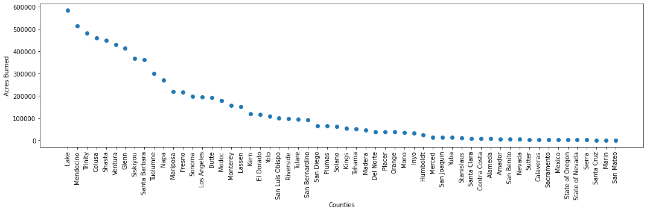
California Fires (2013-2019)
Acres Burned per County
Future investigation:
Import County size from other dataset
Investigate correlation between County size and burned acreage

Slide 3
California Fires (2013-2019)
Correlation between County parameters
High correlation
Injuries vs. Personnel: 0.7
Injuries vs. Crews: 0.7
Scatter plots were used to investigate Pearson correlation and trendline
between pairs of parameters for each County
Low correlation
Injuries vs. Acres Burned : 0.3
Structures Destroyed vs. Personnel: 0.3
Engines per Acre Burned: 0.4
Structures Destroyed vs. Personnel: 0.4
Structures Damaged vs Personnel:
for all data: 0.06 (Low)
for Counties with < 250 structures
damaged: 0.63 (High)

Slide 4
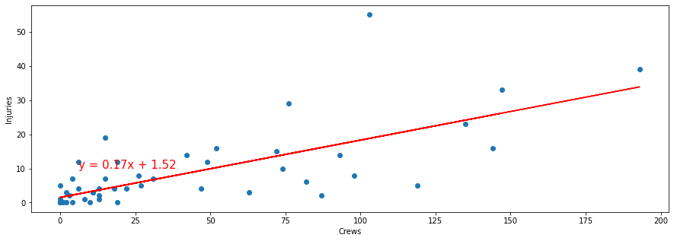
California Fires (2013-2019)
Correlation between County parameters
High correlation
Injuries vs. Personnel: 0.7
Injuries vs. Crews: 0.7
Conclusion
Estimate the number of future injuries (y) based on the size of the crew (x).
Note: Future work should investigate the impact of the fire acreage on the number of crews and injuries

Slide 5
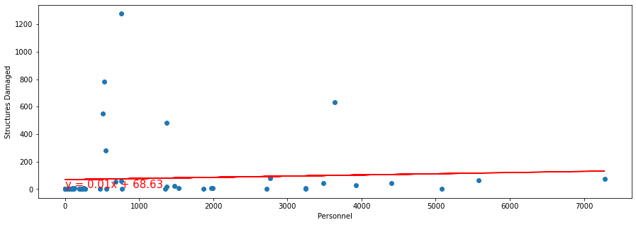
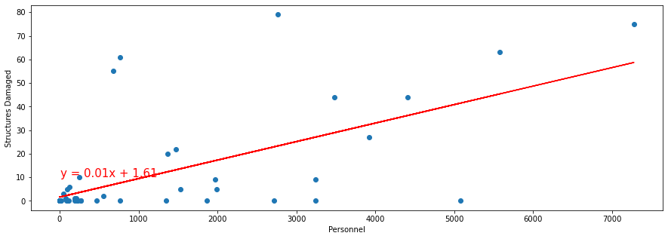
California Fires (2013-2019)
Structures Damaged vs Personnel
For all data (including outliers): correlation = 0.06 (low)
Conclusions
Estimate number of structures damaged in future fires(y) based on number of personnel involved (x).
Further investigated this correlation in view of the number of acres burned and other parameters.
“Outliers” defined herein as > 250 damaged
“Outliers”
For Counties with < 250
structures damaged:
correlation = 0.63 (high)

