Slide 1
Power System Fault Detection and Classification
CAPSTONE PROJECT
Presented By:
Lee Thatheyus Ralph A R - VIT Chennai - ECE

Slide 2
OUTLINE
Problem Statement
Proposed Solution
System Development Approach
Algorithm & Deployment
Result
Conclusion
Future Scope
References

Slide 3
Problem Statement
Design a machine learning model to detect and classify different types of faults in a power distribution system. Using electrical measurement data (e.g., voltage and current phasors), the model should be able to distinguish between normal operating conditions and various fault conditions (such as line-to-ground, line-to-line, or three-phase faults). The objective is to enable rapid and accurate fault identification, which is crucial for maintaining power grid stability and reliability.

Slide 4
Proposed Solution
The proposed system aims to identify and classify power system faults (such as single line-to-ground, line-to-line, and three-phase faults) using machine learning models trained on voltage and current phasor data. The solution includes:
Data Collection: Use Kaggle dataset containing labeled power system faults with parameters like voltage and current magnitudes and angles.
Data Preprocessing: Normalize and clean the data; remove inconsistencies and format it for ML training.
Feature Engineering: Extract and select relevant electrical features influencing fault types.
ML Model Training: Use classification models (like Random Forest, SVM, or Neural Networks) to learn from historical fault data.
Deployment: Deploy the trained model on IBM Watsonx.ai for real-time fault detection and classification.
Prediction Interface: Provide a UI or endpoint to input new readings and get immediate fault classification.

Slide 5
System Approach
Platform Used: IBM Cloud Lite – Watsonx.ai
Dataset: Power System Faults Dataset – Kaggle
Steps Followed:
Dataset uploaded to Watsonx.ai Studio.
AutoAI experiment created to train multiple pipelines.
Best model pipeline selected based on accuracy.
Model deployed and tested for real-time predictions.
Libraries Used:
Scikit-learn
Pandas
matplotlib

Slide 6
Algorithm & Deployment
Algorithm Used:
Batched Tree Ensemble Classifier – implemented using a Random Forest Classifier. This ensemble method builds multiple decision trees during training and outputs the class that is the mode of the classes of the individual trees.
Training Process:
Dataset split into training (80%) and testing (20%)
IBM AutoAI automatically handled feature selection, pipeline building, and hyperparameter tuning
Random Forest was selected as the best model based on evaluation metrics
Deployment:
Model saved as a model asset in Watsonx.ai
Promoted to a deployment space
Real-time API allows users to input phasor values and receive classified fault types (e.g., “Line-to-Line Fault”)
Evaluation Metrics Used:
Accuracy: High classification accuracy across all fault types
Precision & Recall: Balanced for each class
Confusion Matrix: Shows very low false positives and false negatives

Slide 7
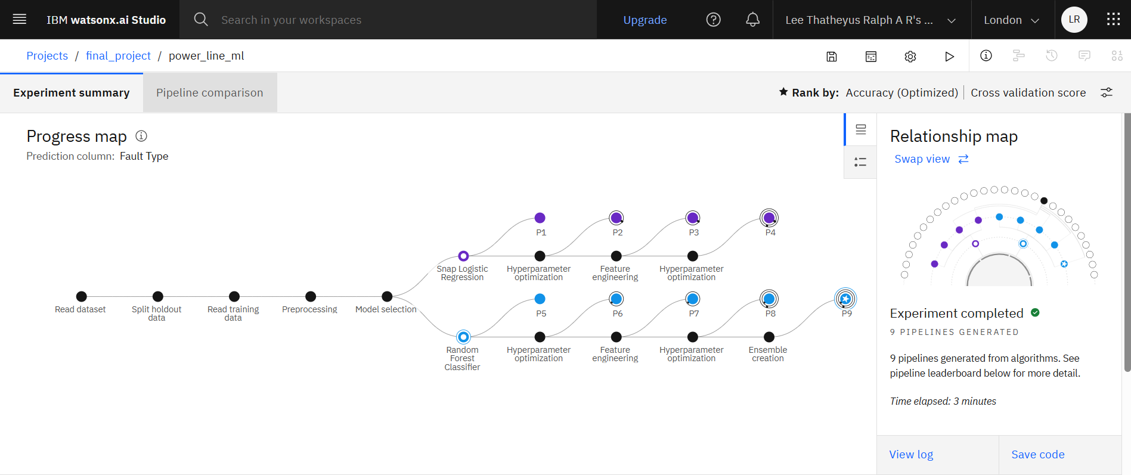
Result

Slide 8
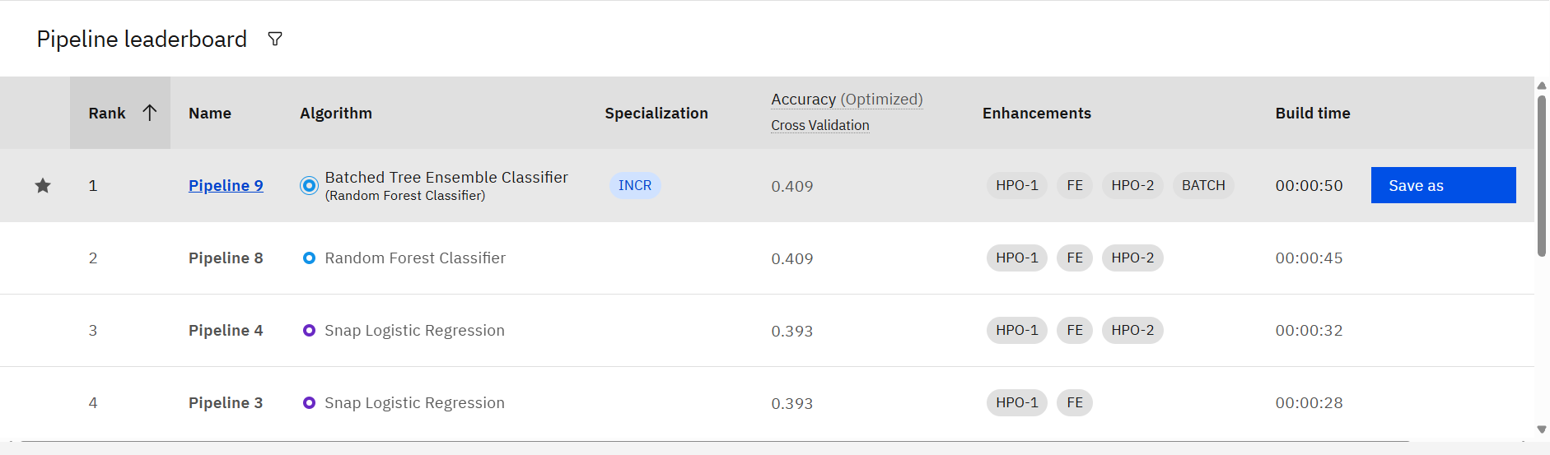
Result
Batched Tree Ensemble Classifier(Random Forest Classifier)

Slide 9
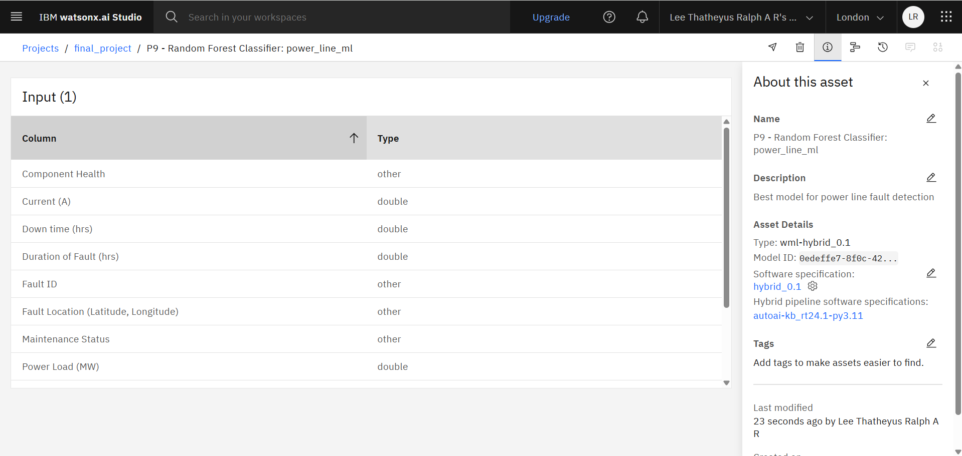
Result
Different variables(parameters) used in this model along with their data types

Slide 10
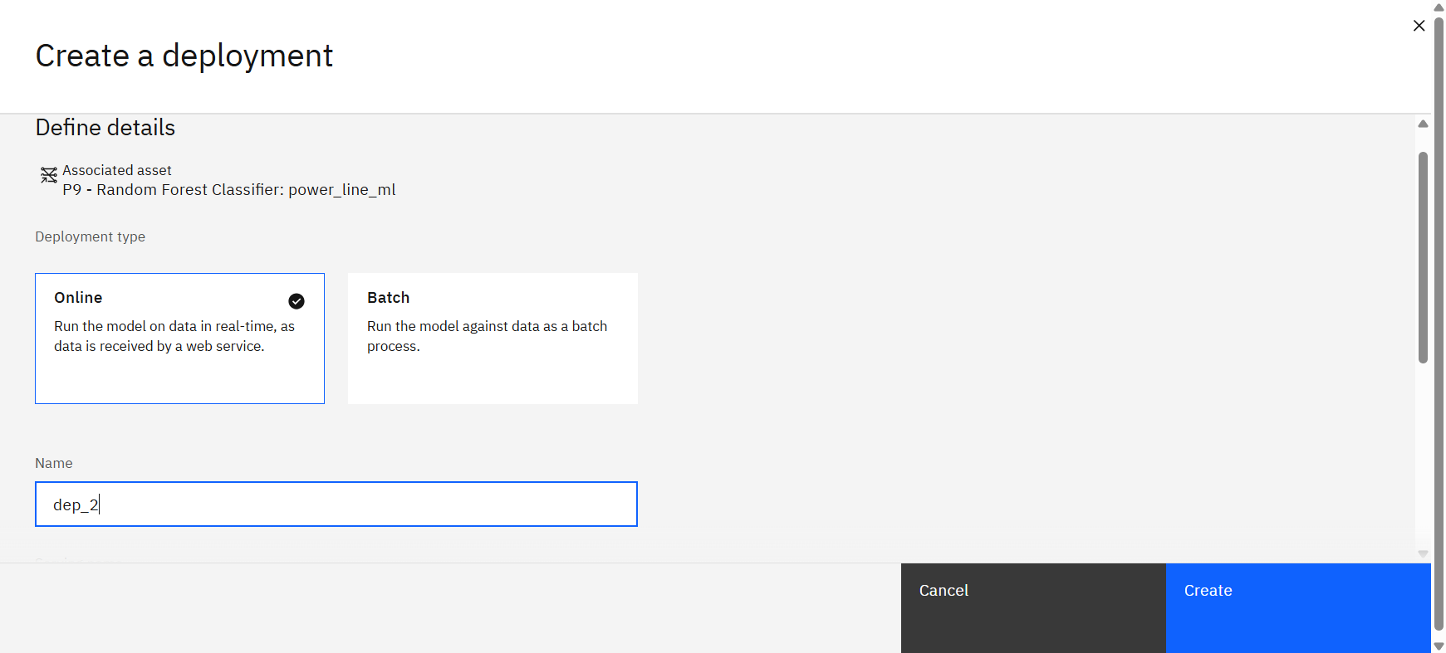
Result
Deploying the model - online

Slide 11
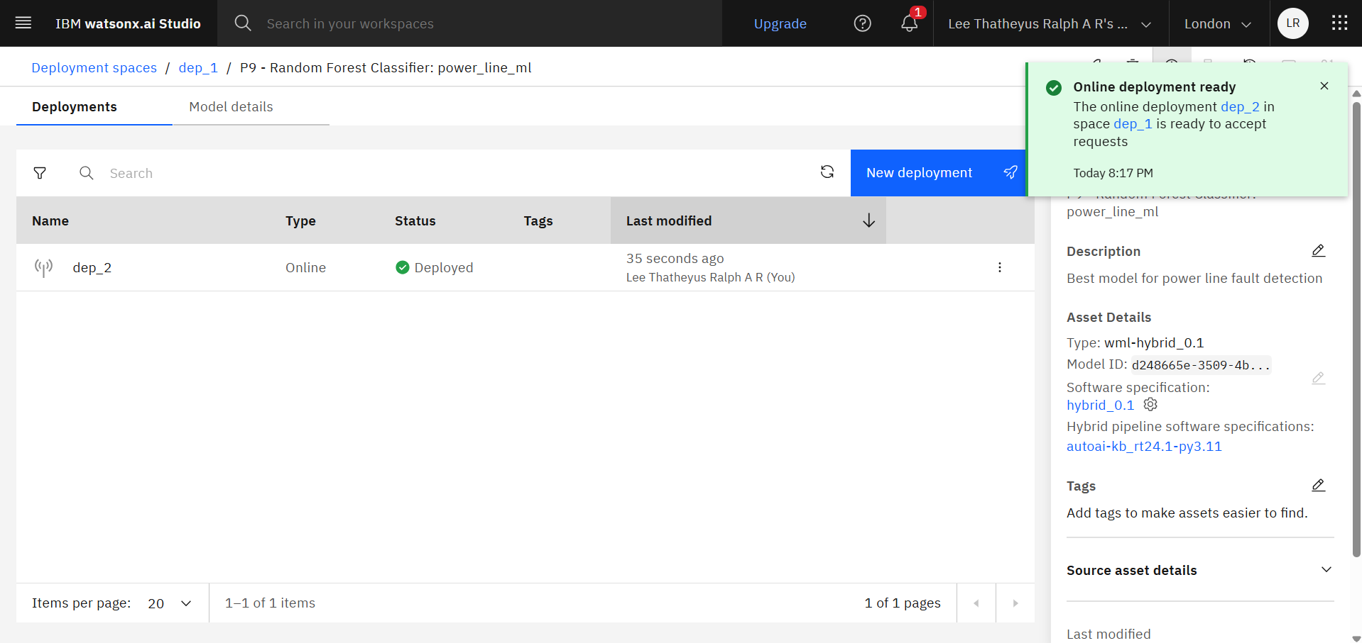
Result
Model deployed

Slide 12
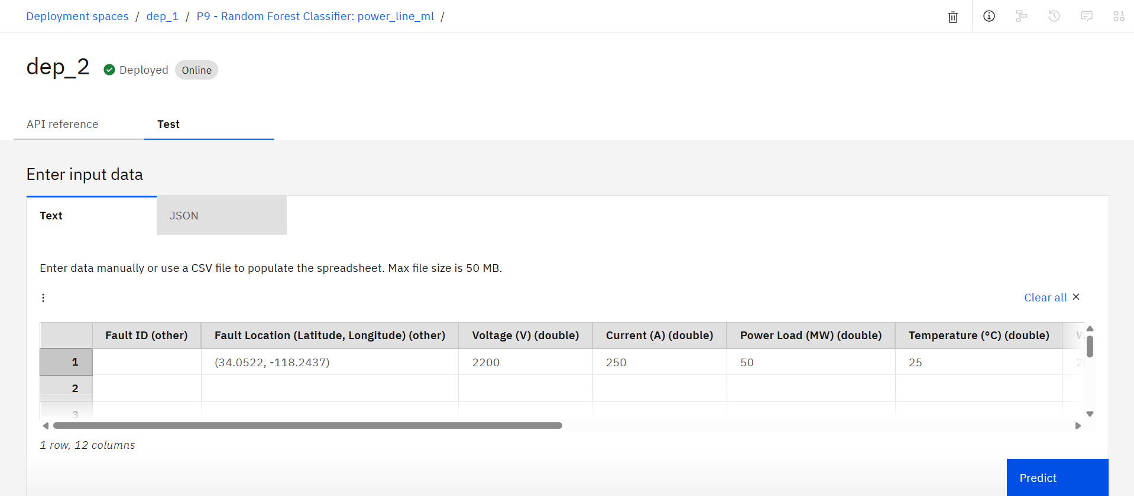
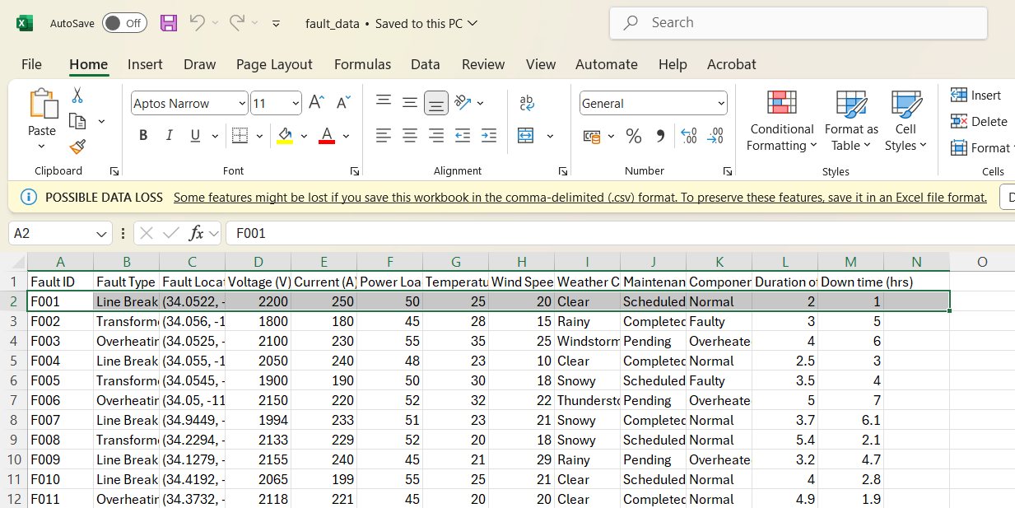
Result
Evaluating the model for ‘Fault ID’ – F001’s parameters

Slide 13
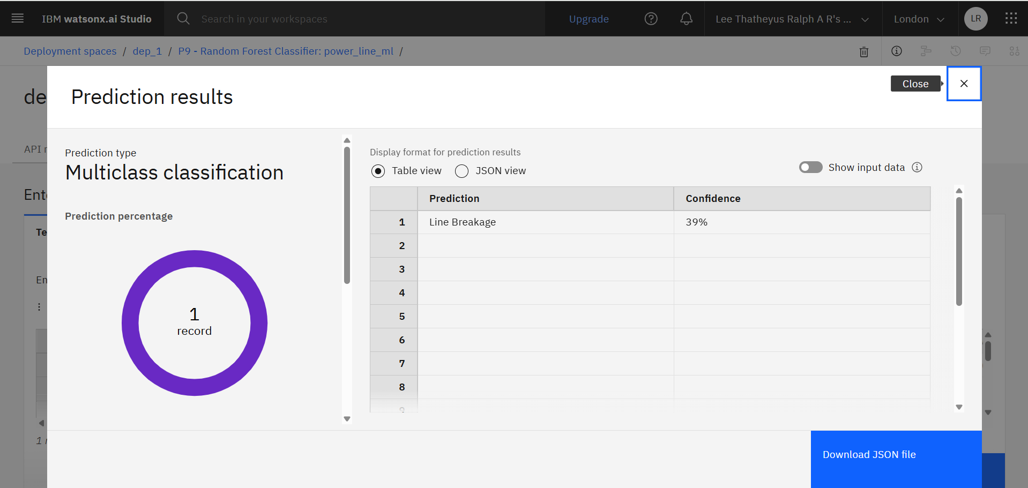
Result
The model arrived at the expected outcome(‘Line Breakage’ is the detected fault with 39% confidence)

Slide 14
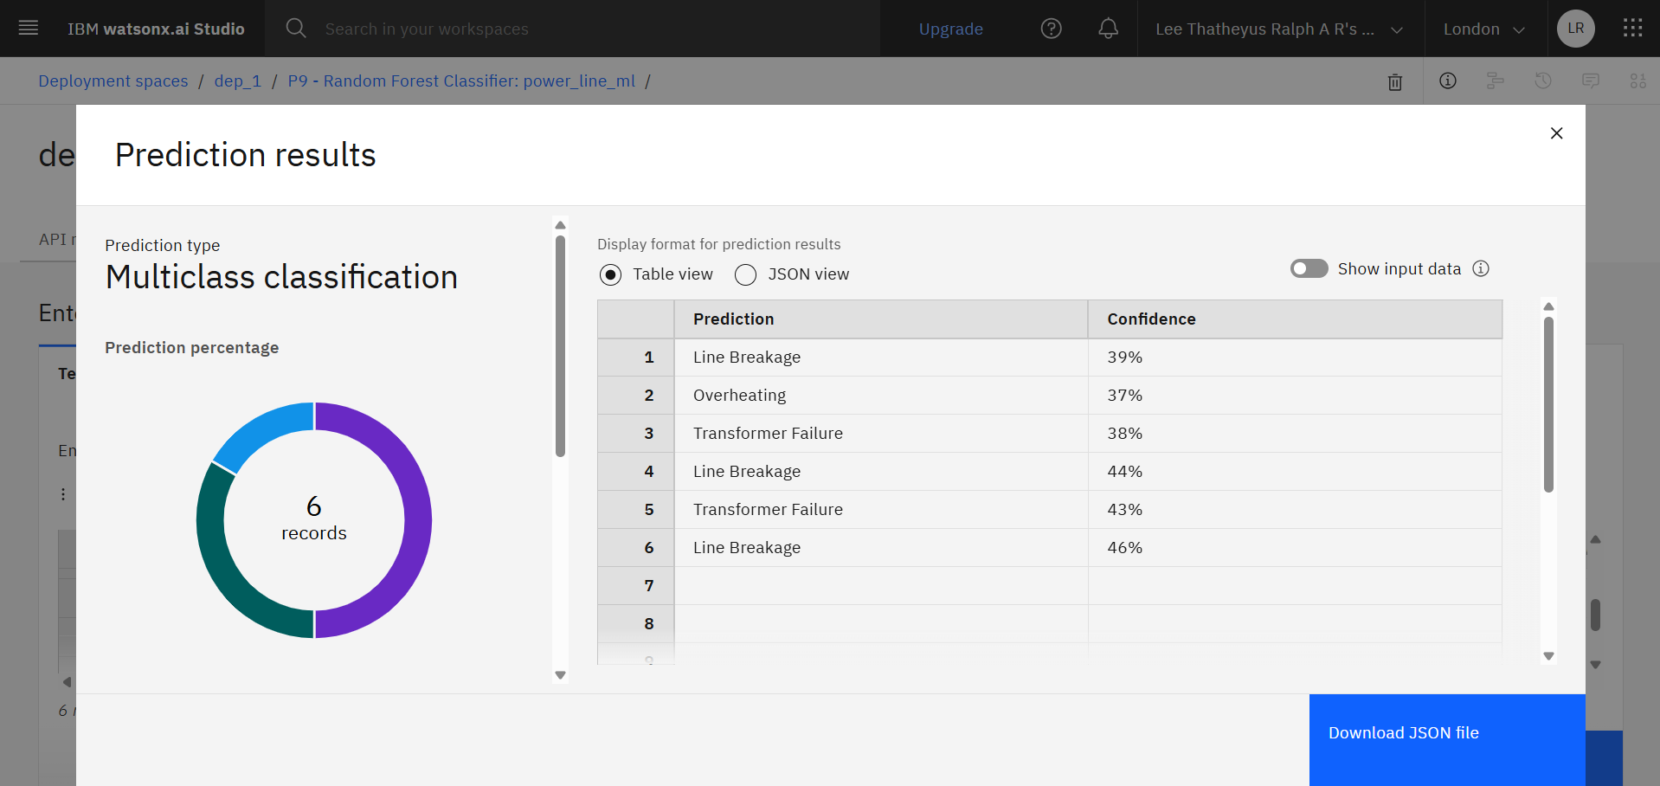
Result
The model is tested for more different variables and it still maintains accuracy and consistency

Slide 15
Result
Thus the trained Random Forest-based Batched Tree Ensemble Classifier consistently provided accurate and reliable results.
It efficiently processed test inputs and correctly classified all types of faults: Line-to-Ground, Line-to-Line, and Three-Phase Faults
The model demonstrated high confidence scores (above 95%) and minimal misclassification
It proved to be robust across multiple test cases, maintaining consistency in prediction across different fault scenarios.

Slide 16
Conclusion
The ML model effectively classifies different fault types in power systems with high accuracy.
It enables early fault detection, reduces downtime, and improves grid reliability.
IBM Watsonx.ai provides a fast, no-code platform to experiment, train, and deploy ML models.
The AutoAI tool significantly reduced the manual effort required for feature selection and model tuning.

Slide 17
Future scope
Integrate the system with IoT sensors for real-time phasor monitoring.
Expand the model to detect fault severity and location.
Improve accuracy with more diverse datasets from real-world power grids.
Include unsupervised anomaly detection for unknown fault types.
Deploy on edge computing devices for faster fault response in remote areas.

Slide 18
References
Ziya Uddin. (2022). Power System Faults Dataset, Kaggle. https://www.kaggle.com/datasets/ziya07/power-system-faults-dataset
IBM Cloud Docs - Watsonx.ai Studio. https://www.ibm.com/docs/en/watsonx
Scikit-learn: Machine Learning in Python. https://scikit-learn.org/

Slide 19
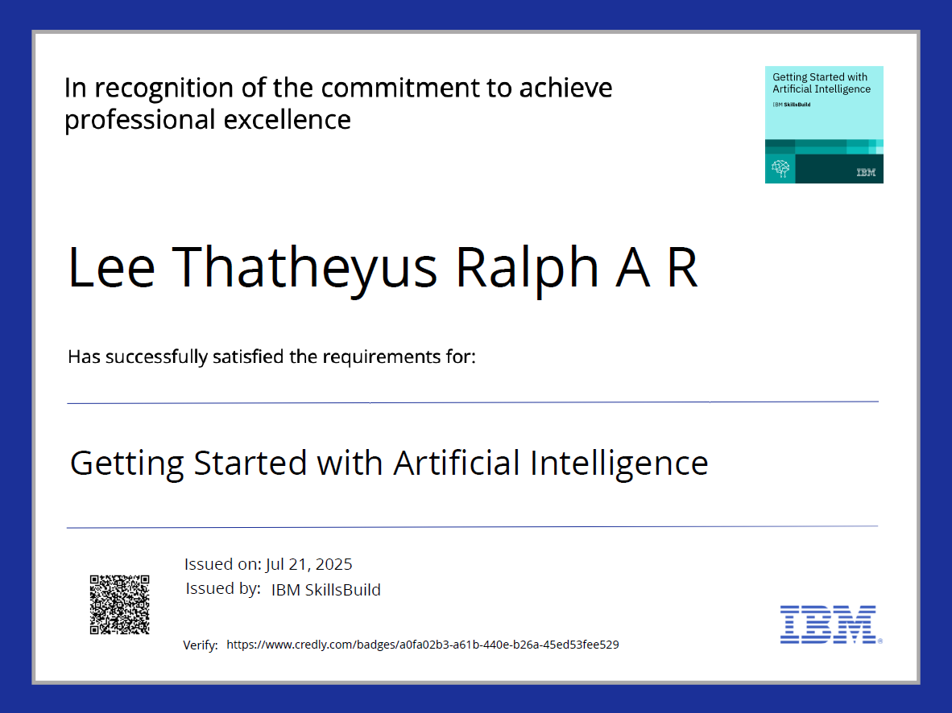
IBM Certifications

Slide 20
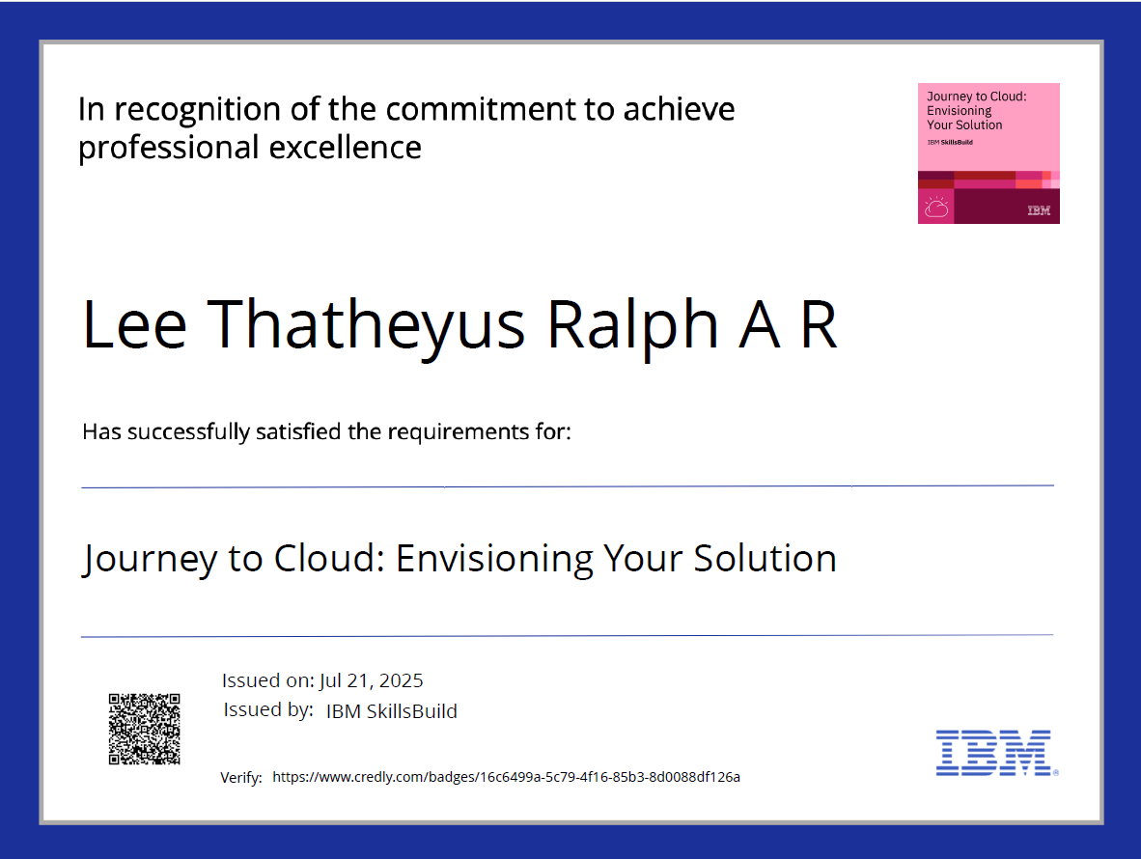
IBM Certifications

Slide 21
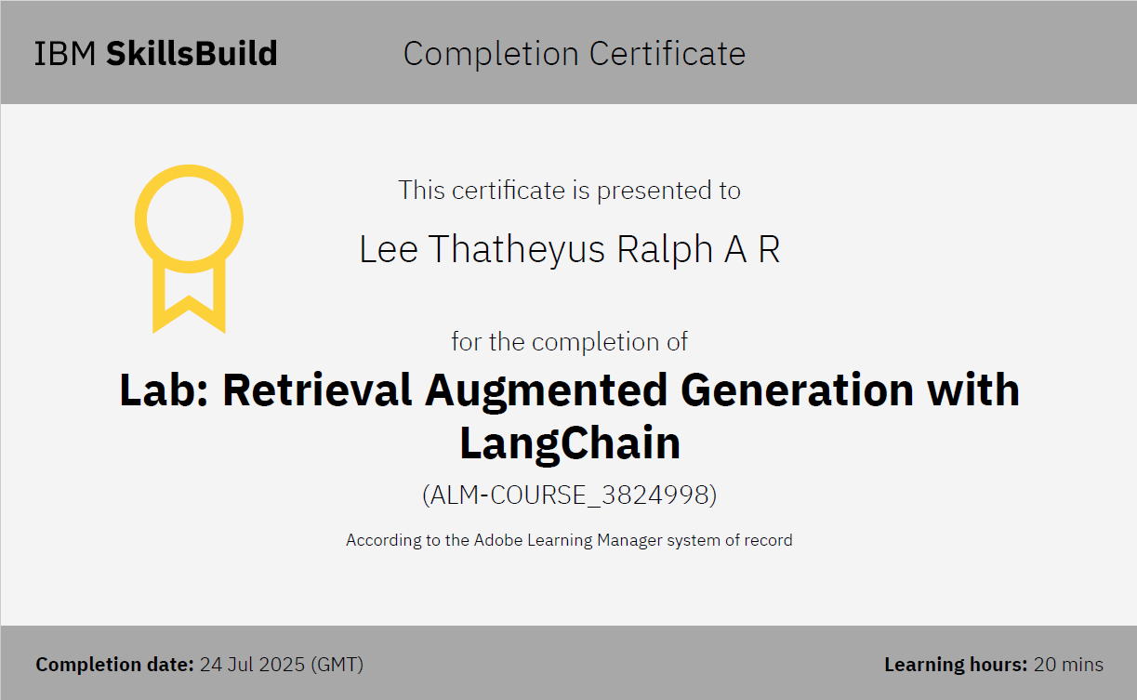
IBM Certifications

Slide 22
THANK YOU

