Slide 1
USAD : UnSupervised Anomaly Detection on Multivariate Time
Series
2020

Slide 2
Background
1.IT system monitoring is a supervision process on measurable events and outputs of a system, which is used as a reference specifyingthe system’s proper functioning.
2.In the past,deviations from the reference are analyzed to determine if there exists a fault.If a measurement exceeds its associated expert-defined threshold, it is considered that the system is not behaving as expected.
3.Because of the size and complexity of today’s IT operations at Orange, the
number of sensors needed to obtain measurements over time has increased dramatically making traditional expert-defined thresholdbased methods no longer usable as they are not scalable.

Slide 3
Introduction
1.(Detecting unexpected behavior ).The most commonly used techniques include distance-based techniques such as k-nearest neighbors [3],clustering such as K-means[9], classification with One-Class SVM [11].
2..Indeed, as the number of dimensions increases, these techniques generally suffer from sub-optimal performance due to the curse of dimensionality.The ability of unsupervised anomaly detection methods based on deep learning to infer correlations between time series which allow identifying anomalous behaviors has received a lot of attention
3.RNN:high costs associated to time;GAN: GAN training is not always easy, due to problems such as mode collapse and non-convergence;The intuition behind USAD is that the adversarial training of its encoder-decoder architecture allows it to learn how to amplify the reconstruction error of inputs containing anomalies, while gaining stability compared to methods based on GANs architectures.

Slide 4
Contributions
1.We propose an encoder-decoder architecture within an adversarial training framework that allows to combine the advantages of autoencoders and adversarial training, while compensating for the limitations of each technique.
2.We perform an empirical study on publicly available datasets to analyze robustness, training speed and performance of the proposed method
3.We perform a feasibility study with Orange’s proprietary data to analyze if the proposed method meets the company’s requirements on scalability, stability, robustness, training speed and high performance.

Slide 5
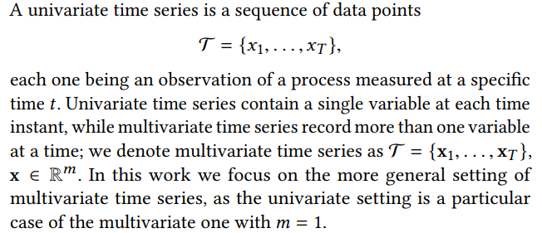
Methods

Slide 6
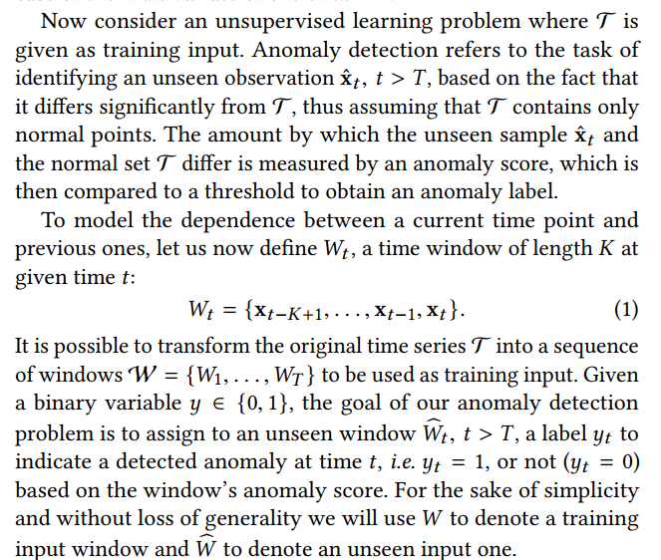
Methods

Slide 7
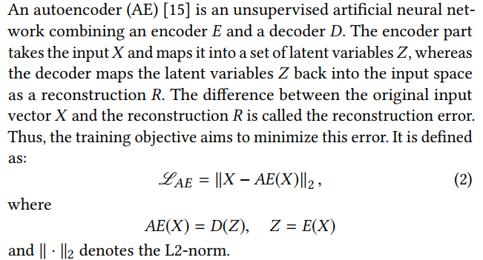
Unsupervised Anomaly Detection
Autoencoder-based anomaly detection uses the reconstruction error as the anomaly score. Points with a high score are considered to be anomalies.
However, if the anomaly is too small, i.e. it is relatively close to normal data, the reconstruction error will be small and thus the anomaly will not be detected
To overcome this problem, the AE should be able to identify if the input data contains no anomaly before doing a good reconstruction.

Slide 8
Unsupervised Anomaly Detection
GAN: The training objective of G is to maximize the probability of D making a mistake, whereas the training objective D is to minimize its classification error.
Similarly to AE-based, GAN-based anomaly detection uses normal data for training. After training the discriminator is used as an anomaly detector. If the input data is different from the learned data distribution, the discriminator considers it as coming from the generator and classifies it as fake, i.e. as an anomaly.(mode collapse and non-convergence)

Slide 9
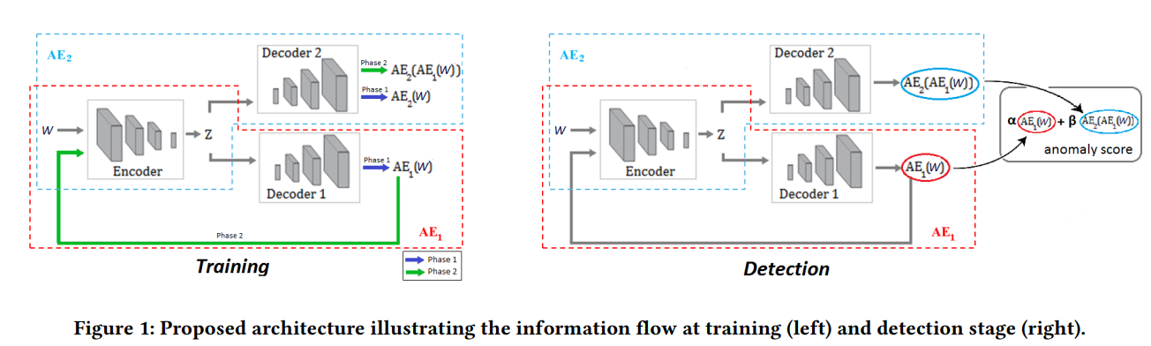
Unsupervised Anomaly Detection

Slide 10
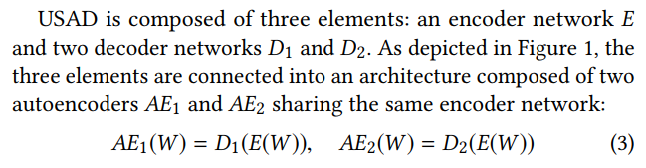
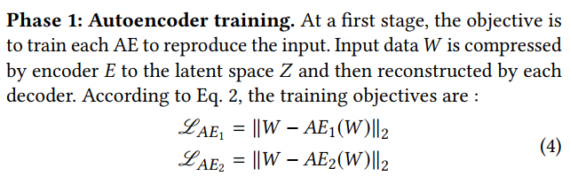
Unsupervised Anomaly Detection
The architecture from Eq. 3 is trained in two phases. First, the two AEs are trained to learn to reconstruct the normal input windows W . Secondly, the two AEs are trained in an adversarial way, where AE1 will seek to fool AE2 and AE2 aims to learn when the data is real (coming directly from W ) or reconstructed (coming from AE1) .

Slide 11
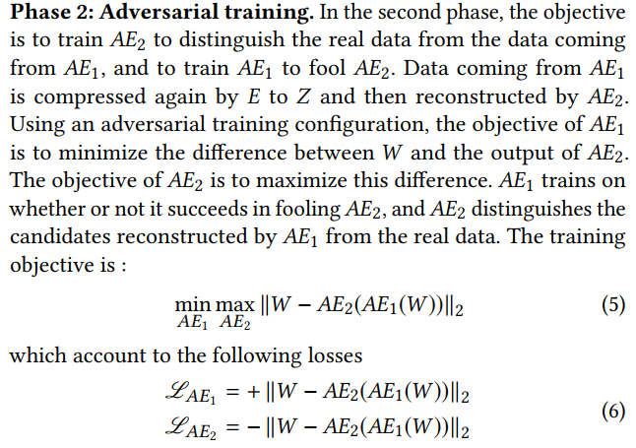
Unsupervised Anomaly Detection

Slide 12
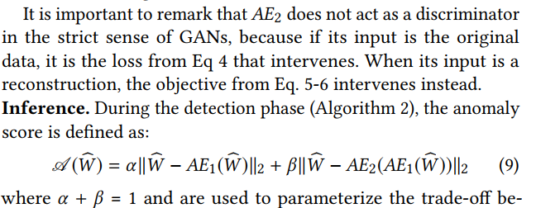
Unsupervised Anomaly Detection
We denote α < β a high detection sensitivity scenario and α > β a low detection sensitivity one. This parametrization scheme is of great industrial interest. It allows, using a single trained model, to obtain during the inference a set of different sensitivity anomaly scores.

Slide 13
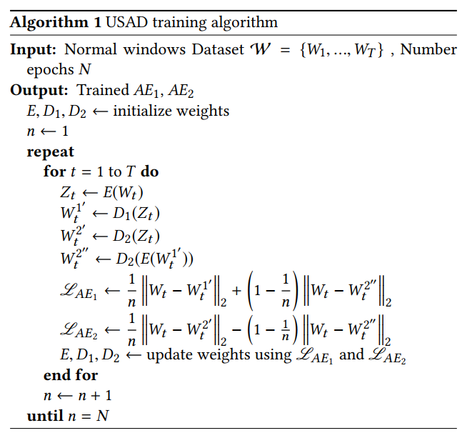
Unsupervised Anomaly Detection

Slide 14
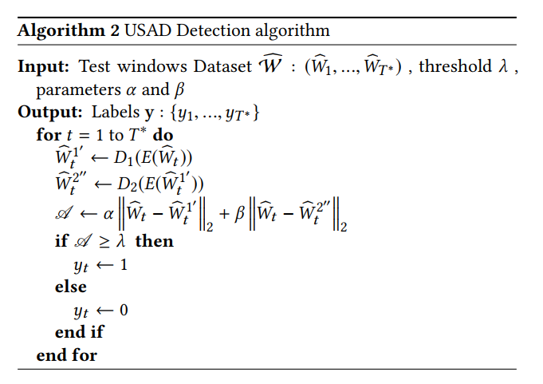
Unsupervised Anomaly Detection

Slide 15
Implementation
1.Our method of anomaly detection is divided into three stages. There is a first data pre-processing stage common to training and detection where data is normalized and split into time windows of length K.
2.The second stage is used for training the method. The training is offline and aims to capture the normal behaviors of predefined portions (a few weeks/months) of multivariate time series and to produce an anomaly score for each time window.
3.The last stage is anomaly detection. It is performed online using the model trained at the second stage. As a new time window arrives, the model is used
to obtain an anomaly score. If the anomaly score of a window is higher than a defined anomaly threshold, the new time window is declared as abnormal

Slide 16
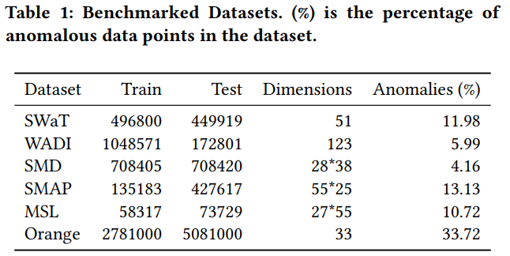
EXPERIMENTAL SETUP

Slide 17
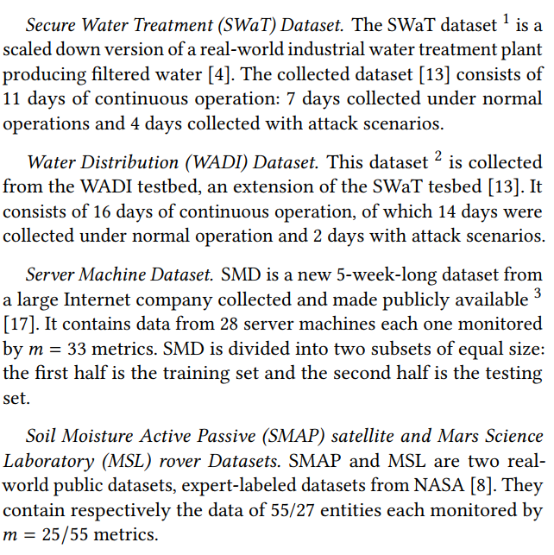


EXPERIMENTAL SETUP

Slide 18
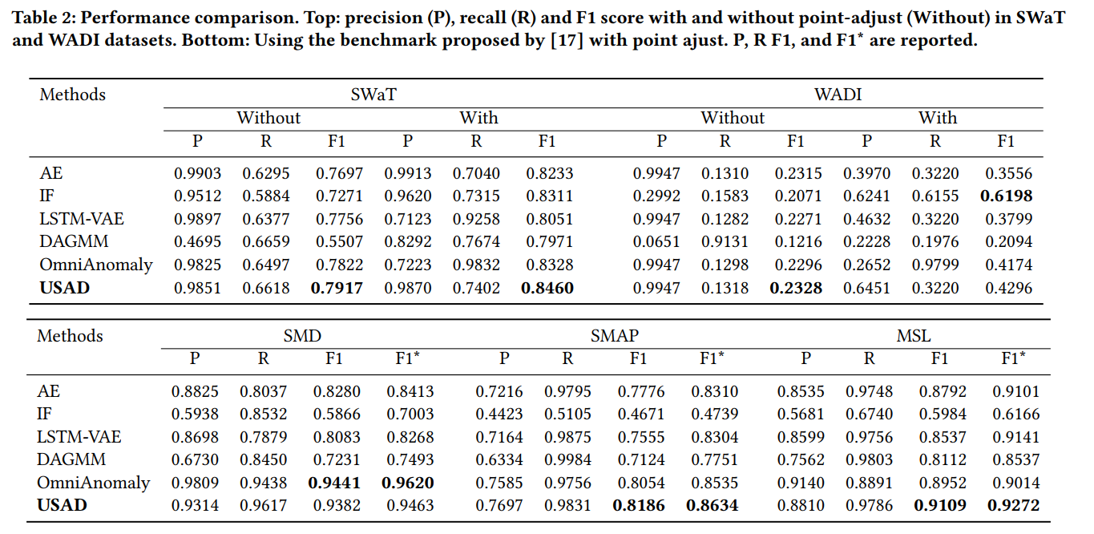
EXPERIMENTAL SETUP
如果一个异常段的至少一个观测值被正确检测到，那么该段的所有其他观测值也被认为是正确检测到的，即使它们没有被正确检测到。地面真值异常段以外的观测数据照常处理。我们表示这种方法为点调整。我们还在不属于基准[17]的两个数据集(SWaT和WADI)上不进行点调整的情况下评估性能。
1.USAD保留了时间序列信息，不像IF只能单点检测
2.USAD能够放大重构误差，发现轻微异常

Slide 19
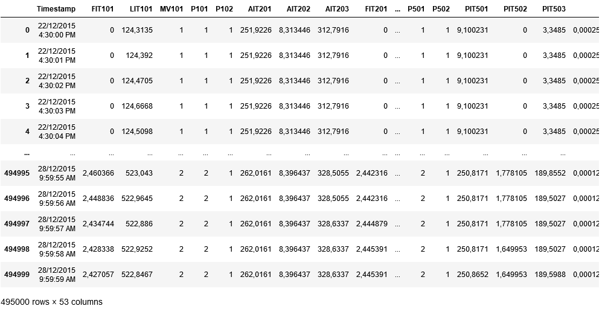
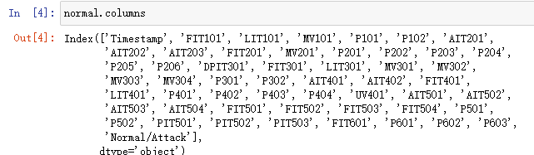
EXPERIMENTAL SETUP
SWaT

Slide 20
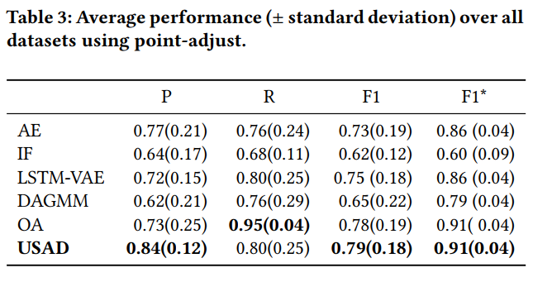
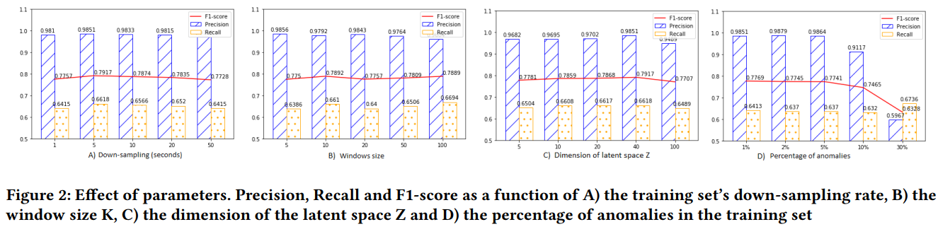

EXPERIMENTAL SETUP
随着噪声开始增加，USAD不再能够正确地学习训练集中存在的最复杂的行为。结果，测试集中的假阳性数量增加，因为
USAD将复杂的正常行为检测为异常。最后，在高噪音水平(30%)下可以观察到性能的显著下降

Slide 21
EXPERIMENTAL SETUP
1.下采样
结果表明，USAD的性能对下采样相对不敏感，在不同采样率下性能相对稳定。这说明下采样率的选择对该方法并不重要。在我们的实验中，我们选择了5的速率
2.加噪声
随着噪声开始增加，USAD不再能够正确地学习训练集中存在的最复杂的行为。结果，测试集中的假阳性数量增加，因为
USAD将复杂的正常行为检测为异常。最后，在高噪音水平(30%)下可以观察到性能的显著下降。USAD在Orange的生产环境中进行培训时，不太可能遇到如此高的异常率。
3.窗口步长
窗口大小影响可以检测到的异常行为类型，直接影响异常检测的速度，因为检测的速度是由窗口的持续时间来定义的
4.调损失权重
α越大，表示在异常评分中更重视AE1自动编码器的重建，而α越大，表示在异常评分中更重视AE1自动编码器的重建，β对应于更加重视AE2自动编码器的重建(见图1)。对于Orange来说，无需重新训练模型就可以调整检测灵敏度的可能性非常重要。
5.隐层Z维度
结果表明，很小的Z维数会导致编码时大量的信息丢失这时解码器就无法恢复，从而导致性能低下。另一个极端是，使用较大的m值会导致记忆训练数据，导致性能下降。相反，m的中档值对表现的影响似乎不强，F1得分相对较高且稳定。

Slide 22
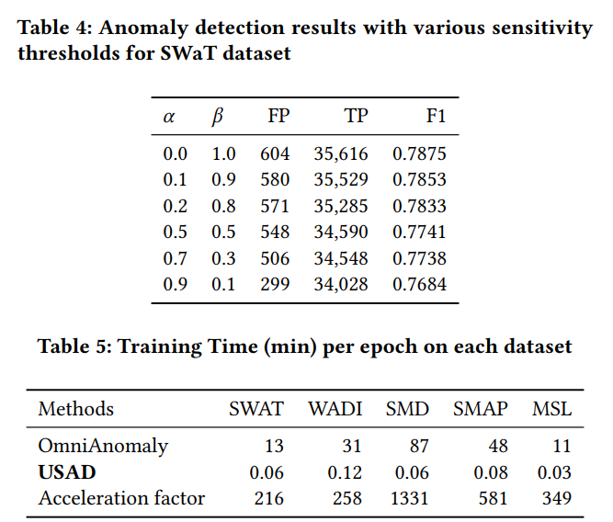
EXPERIMENTAL SETUP

Slide 23
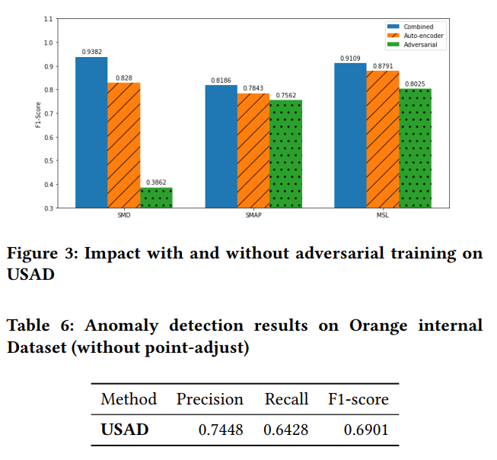
EXPERIMENTAL SETUP

Slide 24
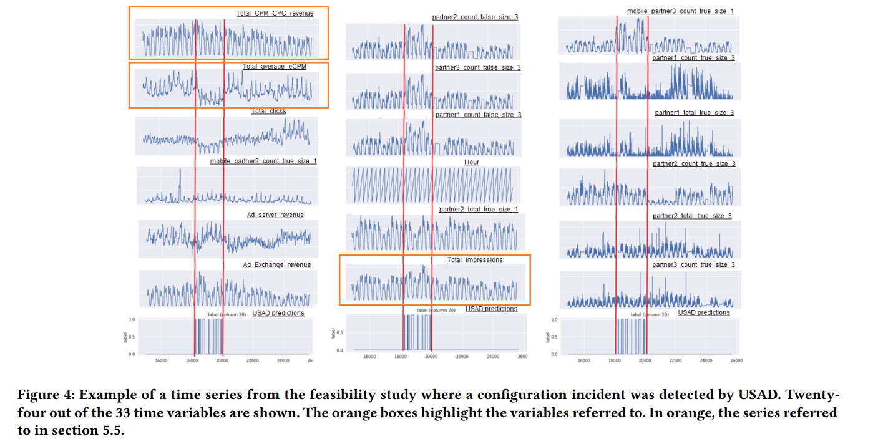
EXPERIMENTAL SETUP

Slide 25
Contributions
1.We propose an encoder-decoder architecture within an adversarial training framework that allows to combine the advantages of autoencoders and adversarial training, while compensating for the limitations of each technique.
2.We perform an empirical study on publicly available datasets to analyze robustness, training speed and performance of the proposed method
3.We perform a feasibility study with Orange’s proprietary data to analyze if the proposed method meets the company’s requirements on scalability, stability, robustness, training speed and high performance.

Slide 26
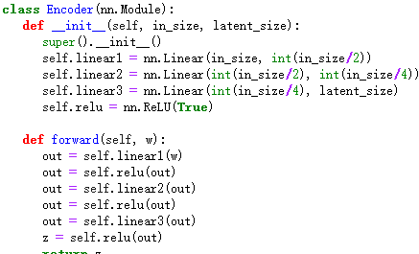
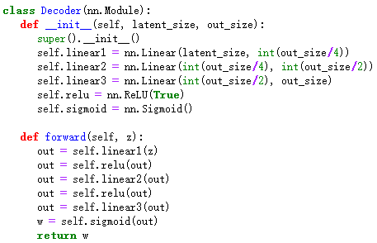

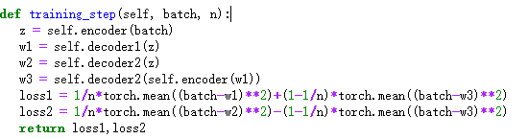
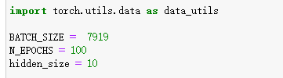
Experiment（SWaT）
1.D1、D2网络结构相同
2.训练集只选择正常数据
3.编码权重共用,解码权重不同

Slide 27
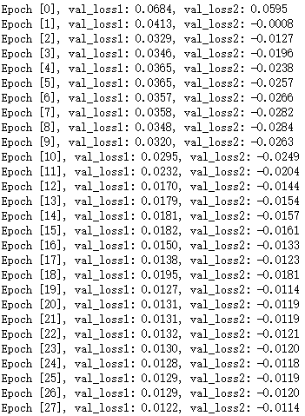
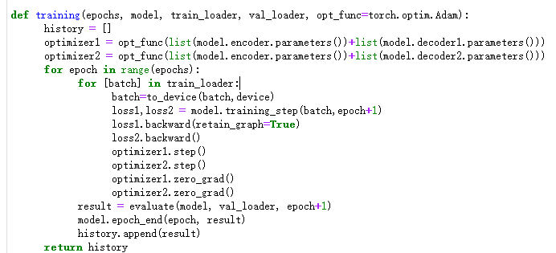
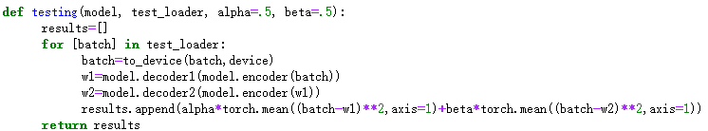
Experiment（SWaT）

Slide 28
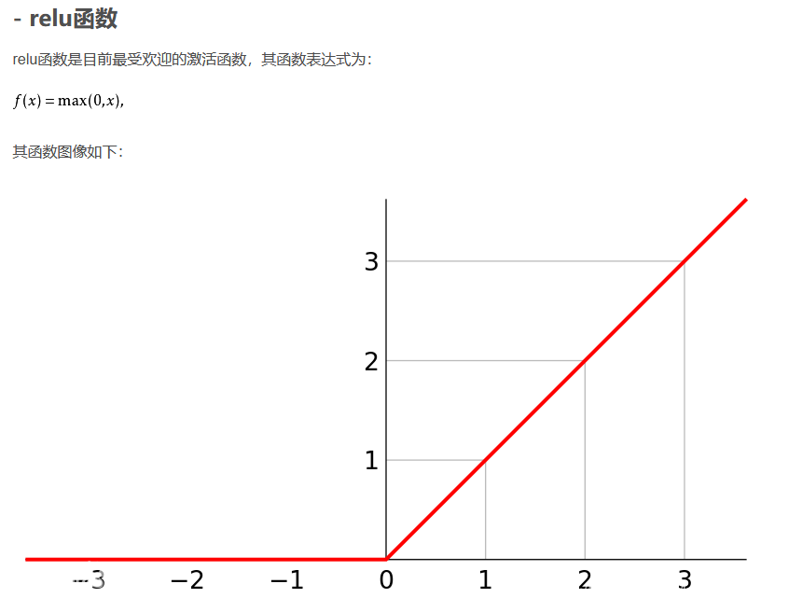
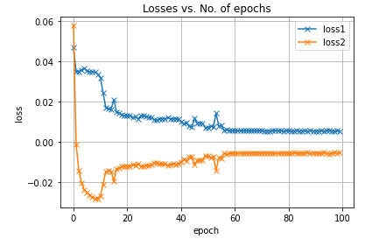
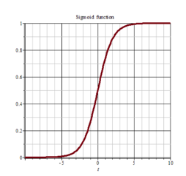
Experiment（SWaT）

Slide 29
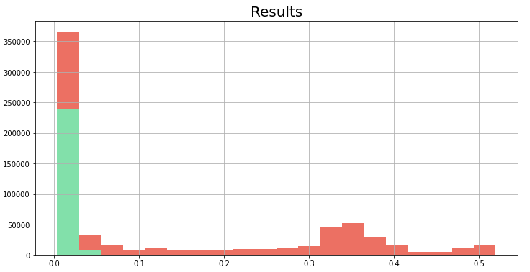
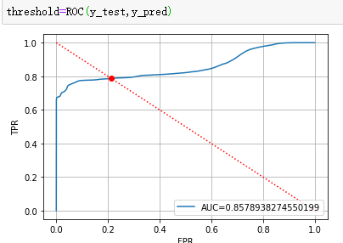
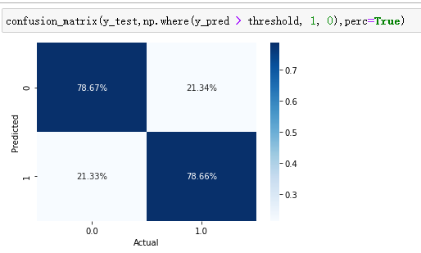
Experiment（SWaT）

