Slide 1
CBE 333 - Adsorption
Adsorption Isotherms

Slide 2
Sorption Background
Adsorption process:
Solutes (aka sorbate) selectively transferred to insoluble solid surface (aka sorbent or resin)
Absorption process:
Solutes selectively transferred into bulk of solid or liquid (aka absorbent)

Slide 3
Adsorption
What binds solutes on the sorbent?
Chemical bonds
Weak molecular interactions
Hydrophobic interactions
Entropic effects
Van Der Waals forces
Electrostatic interactions
+ cations attracted to – anions
Basis for ion exchange

Slide 4
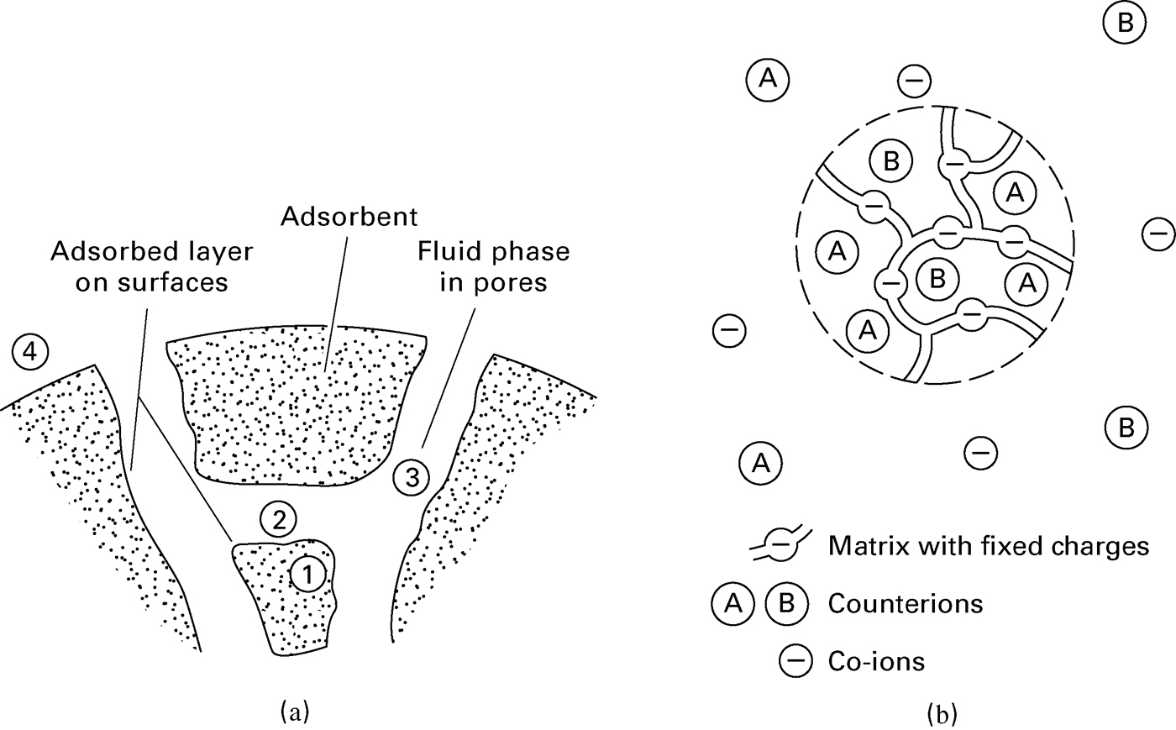
Adsorption and Ion Exchange

Slide 5
Applications
Demineralization/deionization
Water softening
Chromatography
Analytical tool – identify compounds in mixture
Processing – purify compounds, like proteins
Bulk filtration
Removal of salt/vapors from gas with bone char
Clarify water with charred wood

Slide 6
Important Features
Capacity – how much solute the sorbent can adsorb
Increases with surface area
Porous materials attractive
Lots of small pores better than a few big pores
Selectivity
Stability
T, P, chemical contact
Regeneration/cleaning
Cost, availability, reproducibility
Good transport characteristics
Low pressure drop across bed
Quick adsorption/desorption possible
Limited fouling
Ease of handling/packing into bed

Slide 7
Adsorption of Liquid
Consider bulk liquid of known composition:
Different components
interact with surface differently
amount adsorbed varies
So surface composition is different than bulk composition

Slide 8
Surface Area
Consider a spherical sorbent particle
Surface/Vol ↑ as r↓
Consider a cylindrical pore
Surface/Vol ↑ as d_{P}↓

Slide 9
Surface Area to Volume Ratio
Improves with small particles, small pores
r ~ 50 μm to 1.2 cm
d_{P} < 20 Å to ~ 500 Å
Note: 10 Å = 1 nm = 10⁻⁹ m

Slide 10
Bed Porosity: ε_{b}
Consider a packed bed of porous particles:
V_{bed} = V_{particles} + V_{voids}
m_{bed} = m_{particles}
Bed density:
ρ_{b} = m_{particles}/V_{bed}
Particle density:
ρ_{p} = m_{particles}/V_{particles}

Slide 11
Particle Porosity: ε_{P}
Consider a porous particle:
V_{particle} = V_{solid} + V_{pores}
m_{particle} = m_{solid}
Particle density:
ρ_{P} = m_{solid}/V_{particle}
True solid density or crystalline density:
ρ_{S} = m_{solid}/V_{solid}

Slide 12
Specific Surface Area, S_{g} [m²/g]
Typical values of S_{g} ~ 300 to 1200 m²/g

Slide 13
Equilibrium Considerations
Solute molecules moving between fluid (liq or gas) and solid surface
Dynamic equilibrium established
Need to relate fluid phase concentration to solute loading on the adsorbent
Fluid concentration: x_{i}, c_{i}, etc.
Solute loading: mass, moles or volume of solute per unit of surface area or unit of volume or unit of mass of the adsorbent

Slide 14
Partitioning between fluid and solid
Few predictive tools
Rely on experimental data for adsorbate/adsorbent of interest
Measure adsorption isotherms showing:
Amount adsorbed versus amount in fluid phase at constant T

Slide 15
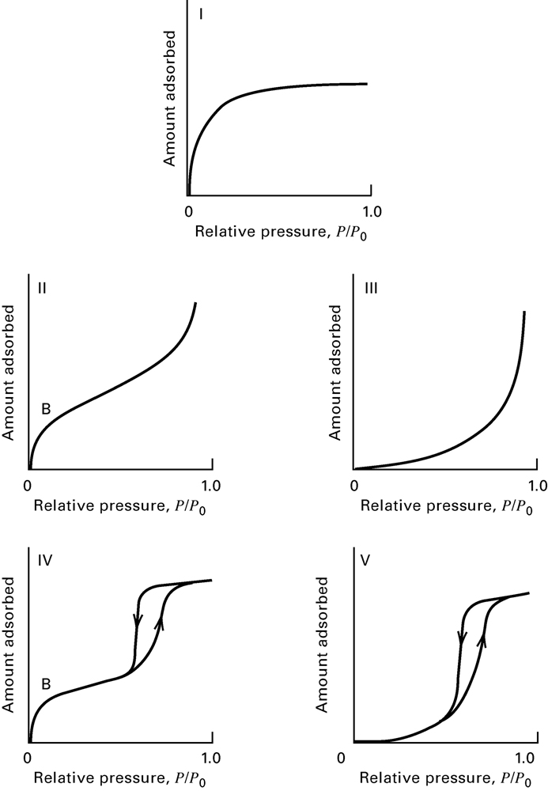
Adsorption of Gas
Monolayer limited
Multilayer model
(as in BET)
ΔH_{ads}>ΔH_{cond}
Convex multilayer
undesirable
ΔH_{ads}<ΔH_{cond}
Multilayer with hysteresis
filling vs emptying pores, or strong adsorption of impurities
Convex multilayer with hysteresis

Slide 16
Liquid Adsorption
Binary mixture – solute & solvent
Generally assume
Solvent does not adsorb
Δ in composition of bulk liquid is due to adsorption of solute
Assumptions OK for dilute solutions
But give odd isotherms for concentrated systems

Slide 17
Surface excess of solute, q₁e
Assume solid attracts solute, decreasing the solute concentration of the bulk liquid
Let
q₁e = apparent moles of solute (1) adsorbed per unit mass of adsorbent
n₁⁰ = moles of 1 in solution before solid added
n₁ = moles of 1 in bulk solution after solid added
n⁰ = total moles of solution
M = mass of adsorbent
x₁⁰ =mole fraction of 1 in solution before solid added
x₁ = mole fraction of 1 in solution after solid added

Slide 18
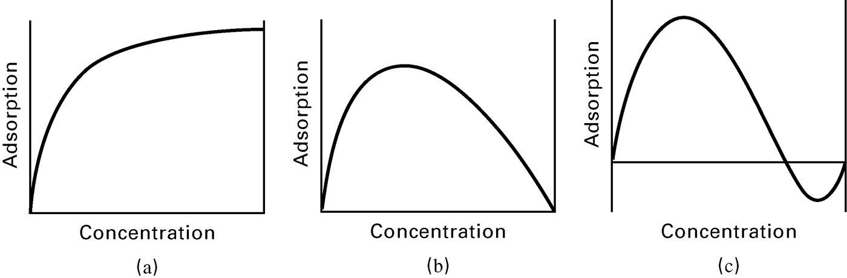
Typical Isotherms for Liquid Adsorption
q increases with c, similar to gas system; Seen if dilute solute in solvent that doesn’t adsorb or where adsorption is constant.

Slide 19
Typical Isotherms for Liquid Adsorption
Seen if solvent not adsorbed; Initially solute adsorbed increases with concentration. But once the surface is saturated, increasing the moles in solution without increasing moles adsorbed lowers the surface excess.

Slide 20
Typical Isotherms for Liquid Adsorption
Solvent adsorbs. Surface excess goes negative if amount of solute adsorbed isn’t high enough to compensate.

Slide 21
Surface Excess Examples for n_{ads} = 100 moles
n⁰ moles | x₁⁰ | n_{1,ads} moles | n_{2,ads} = 100 - n_{1,ads} moles | x₁ | q₁e
1000 | 0.5 | 10 | 90 | 490/900= 0.54 | <0
1000 | 0.5 | 50 | 50 | 450/900 = 0.5 | =0
1000 | 0.5 | 90 | 10 | 410/900= 0.46 | >0

Slide 22
Modeling Liquid Adsorption
Familiar models
Henry’s Law
Langmuir
Freundlich
OK for limited range of conditions
q_{i} = k_{i}C_{i}

Slide 23
Adsorption Isotherm Experiments
Obtain isotherms for 2 proteins
Bovine Serum Albumin (BSA), Hemoglobin (Hb)
On 4 resins
Cation exchange (negative binding sites)
Toyopearl SP-650S (35 μm), Toyopearl CM-650S (35 μm)
Anion exchange (positive binding sites)
Toyopearl Super Q-650S (35 μm), Toyopearl DEAE-650S (35 μm)
In buffers of 2 different pH values
pH = 4.7 or 8
At 2 temperatures
25 °C, 35 °C

Slide 24
Adsorption Isotherm Experiments
Each team collects data for 4 isotherms
→ Hb and BSA at 25 °C and 35 °C
Pools data with team from the other sections.
→ 4 different resins
Plots adsorption isotherms for 16 conditions, and fits each data set with a Langmuir model.
Compares Q_{max} and K values.
Identifies best system for separating mixtures of BSA & Hb.

