Slide 1
CBE 333 - Distillation
Exploiting differences in volatilities.
Key Concepts:
Material & Energy Balances
Vapor-Liquid Equilibrium

Slide 2
Distillation Overview
Separation by phase creation
2 phases – liquid and vapor
More volatile components enrich vapor
Less volatile components enrich liquid
Advantages:
Well-developed technology
Can produce high purity product(s)
No new mass separating agent to remove
Disadvantages:
Energy intensive
Costly

Slide 3
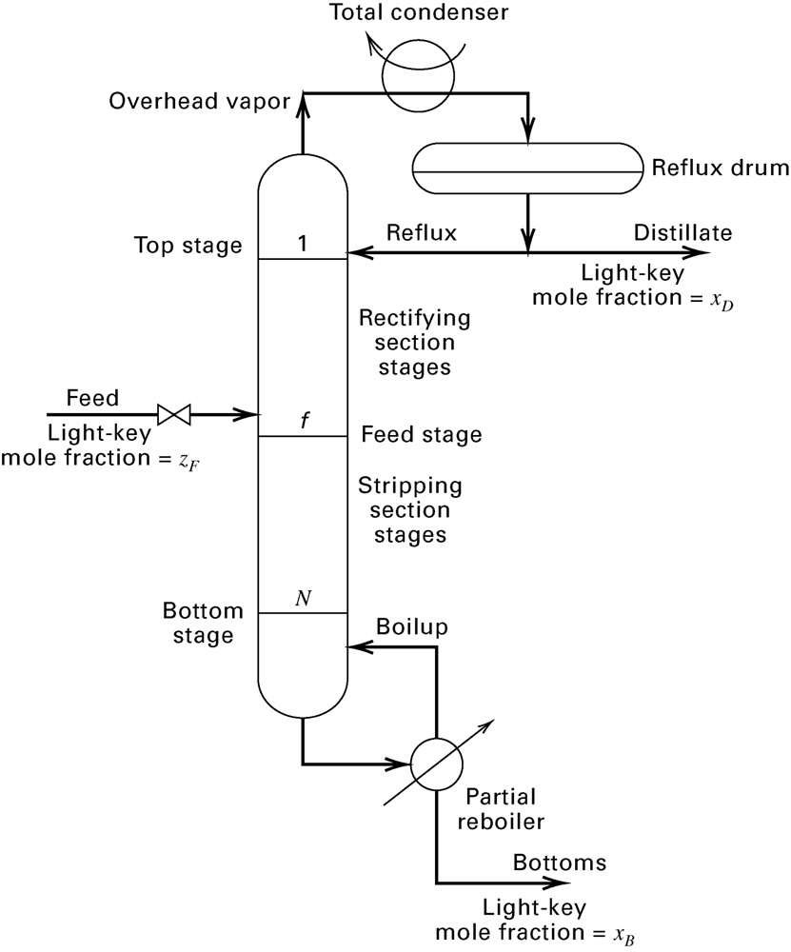
Distillation Column
Figure 7.2, Seader et al, Separation Process Principles, 3rd ed., John Wiley & Sons, New York (2011)
Equipment:
Column
Condenser – total vs. partial
Reboiler – total vs. partial
Streams:
In: Feed (F)
Out: Distillate (D) & Bottoms (B)
Reflux (L)
Boilup (V’)

Slide 4
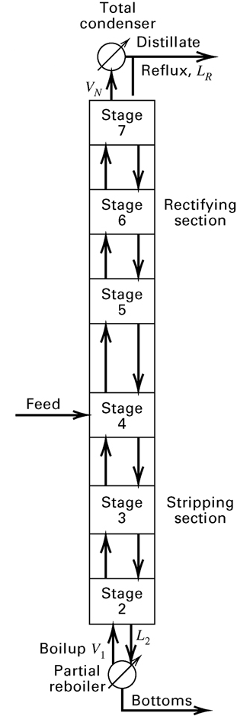
Series of Equilibrium Stages
Figure 5.12 (c), Seader et al, Separation Process Principles, 3rd ed., John Wiley & Sons, New York (2011)
Each stage (n) is at equilibrium:
T_{V,n} = T_{L,n} = T_{n}
P_{V,n} = P_{L,n} = P_{n}
μ_{i,Vn} = μ _{i,Ln} = μ_{i,n}
Basic Idea:
More volatile components increase in V,
and V_{n} fed to stage above
Less volatile components increase in L,
and L_{n} fed to stage below
Separation of components amplified by series of equilibrium stages

Slide 5
Equilibrium Stage:
V_{n}
y_{i,n}
L_{n} and V_{n} produced at each stage are in equilibrium:
L_{n+1} and V_{n-1} fed to stage and L_{n} and V_{n} produced at the stage are linked by SS material balances:
L_{n+1}
x_{i,n+1}
V_{n-1}
y_{i,n-1}
L_{n}
x_{i,n}

Slide 6
Our Distillation Experiment
Our Column:
6 trays
Partial reboiler
Total condenser
Total of 7 stages
We select:
Feed tray location
Reflux ratio

Slide 7
Feed Tray Location
Above feed tray
Rectification or enriching section
Vapor is enriched with more volatile components
Below feed tray
Stripping section
Liquid is depleted of more volatile components
Feed tray belongs to both sections

Slide 8
Reflux versus Reflux Ratio
V = L + D
Distillate (D) = liquid product from the top
Reflux (L) = liquid returned to the column
Reflux ratio (R) = ratio of reflux flow rate to distillate flow rate

Slide 9
Values of R
As L → 0, R → 0
Lots of distillate!
No liquid flow to top of column
No absorption of less volatile species by liquid
As D → 0, R → ∞
Lots of liquid flow in top of column
Good removal of less volatile species
No product!
Good operation: R ~ 1.1 to 1.5 x R_{min}

Slide 10
Distillation Column: Material Balances on Top of Column
SS total material balance over top of column to n^{th} plate:
SS material balance on solute over top of column to n^{th} plate:
Solve for y_{n+1}:
Counting plates from top:

Slide 11
Constant Molar Overflow Assumption
Constant flow of liquid and vapor if:
ΔH_{A,vap}≈ ΔH_{B,vap} ≈ constant
and ΔH_{mix} << ΔH_{i,vap}
Q ≈ 0 (OK for a well-insulated column)
P ≈ constant

Slide 12
Operating Line for Top of Column
With the constant molar overflow assumption:
Generates line linking y_{n+1} and x_{n}
Slope:
Intercept:

Slide 13
Distillation Column: Material Balances on Bottom of Column
SS total material balance over bottom of column to m^{th} plate:
SS material balance on solute over bottom of column to m^{th} plate:
Solve for y_{m}:
Counting plates from bottom:

Slide 14
Operating Line for Bottom of Column
With the constant molar overflow assumption:
Where V_{B} is the boil-up ratio defined by
Analogous to reflux ratio. Both a ratios of flow rate of material returned to column to flow rate of product withdrawn.

Slide 15
McCabe Thiele Diagram
Graphical method showing
# of stages
Stream compositions
Operating conditions
Allows determination of
Number of theoretical trays, N_{t}
Minimum Number of theoretical trays, N_{t,min}
Minimum reflux ratio, R_{min}
Optimal feed tray location

Slide 16
Construction of a McCabe-Thiele Diagram
Consider a binary system, where species 1 is the more volatile component
x = mole fraction of species 1 in the liquid phase
y = mole fraction of species 1 in the vapor phase

Slide 17
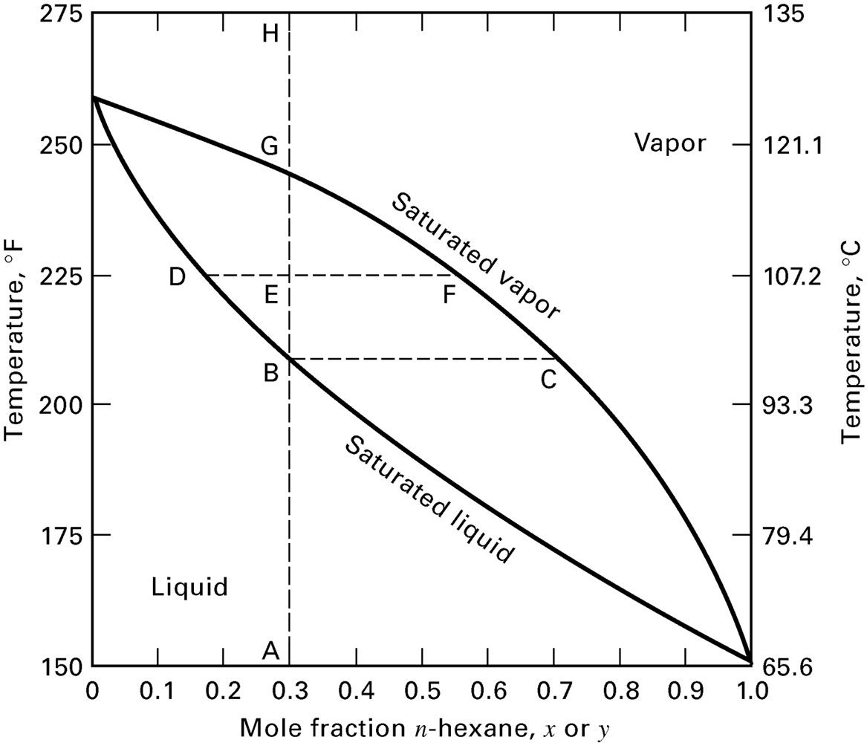
Distillation Requires VLE
Workable operating conditions set by thermo!
If column P is fixed, need T_{bub}<T<T_{dew}

Slide 18
Construction of a McCabe-Thiele Diagram
McCabe-Thiele Diagram is an xy diagram with 5 parts:
45° reference line, y = x
Vapor-liquid equilibrium curve, y = Kx
Known concentrations of streams (x_{F}, x_{B}, x_{D}) or trays (x₁,x₂…x_{n})
q line, depicting phase or thermal condition of the feed
Two operating lines
(top section of column, and bottom section of column)
Recognize that the Feed Tray is part of both the top and the bottom of the column. So feed line and both operating lines must intersect at a common point!

Slide 19
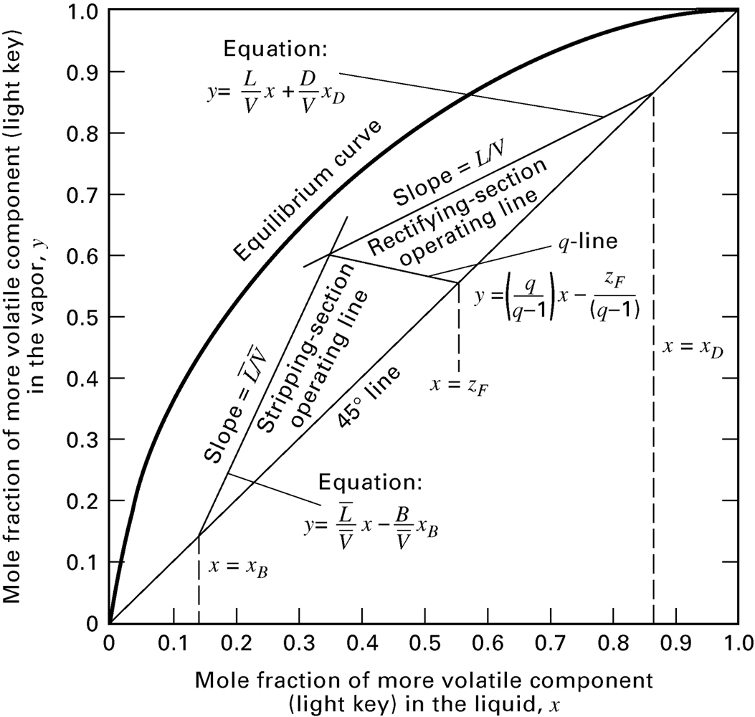
Example

Slide 20
q-line
Depicts composition and quality of feed
Feed is some combination of liquid and vapor
Material balance:
Fz_{A} = Vy_{A} + Lx_{A}
z_{A} = (V/F) y_{A} + (F-V)/F x_{A} = V y_{A} + (1- V )x_{A}
Where V = fraction vapor
Rearrange to get q-line:
y_{A} = (V - 1)/V x_{A} + 1/V z_{A}
y_{A} = q/(q – 1) x_{A} – 1/(q-1) z_{A}
Where q = 1-V = fraction liquid

Slide 21
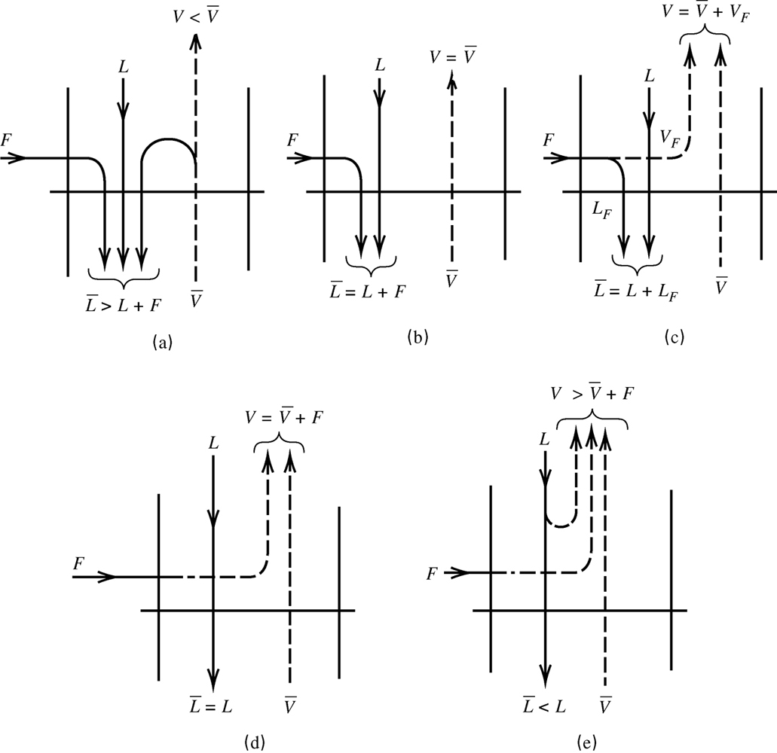
q-line and Flows at the Feed Tray
State of Feed:
Sub-cooled liquid
Saturated liquid
L-V mixture
Saturated vapor
Superheated vapor
At Feed Tray:

Slide 22
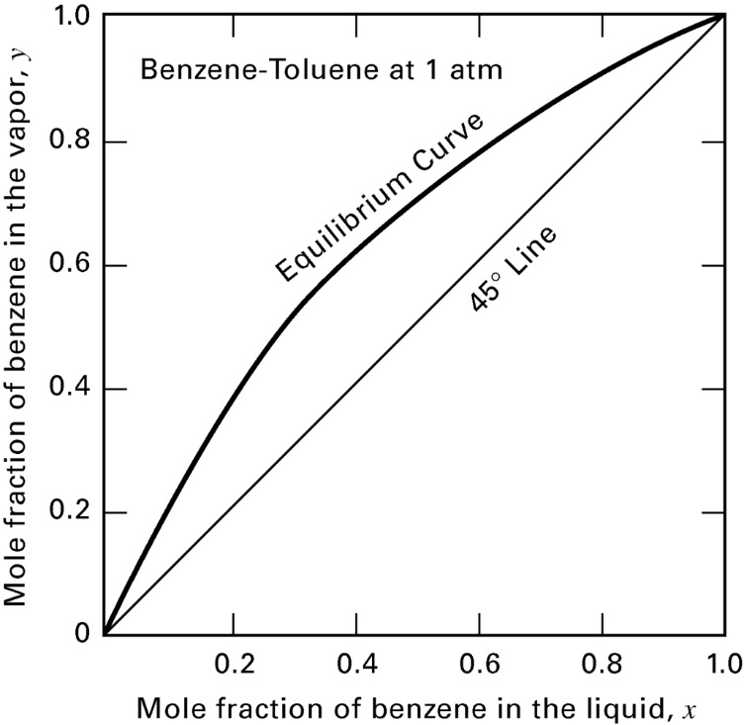
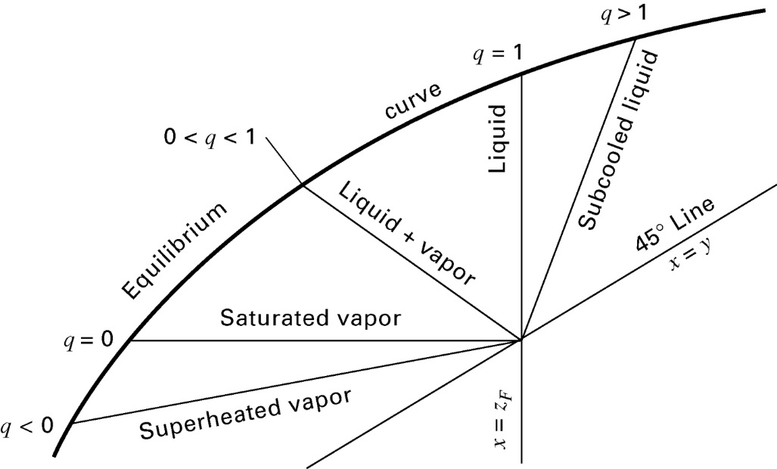
q – line slope = q/(q-1)

Slide 23
Finding N_{t,min} for a specified x_{D}, x_{B}
Fewer trays needed as R increases
Minimum trays found at max R, and max value seen when D = 0 and R = ∞
As R → ∞:
slopes of top and bottom op lines → 1
Converge on the 45° reference line
As R decreases:
Intersection of q-line and op lines moves closer to VLE curve
Separation per step drops
Number of trays required increases

Slide 24
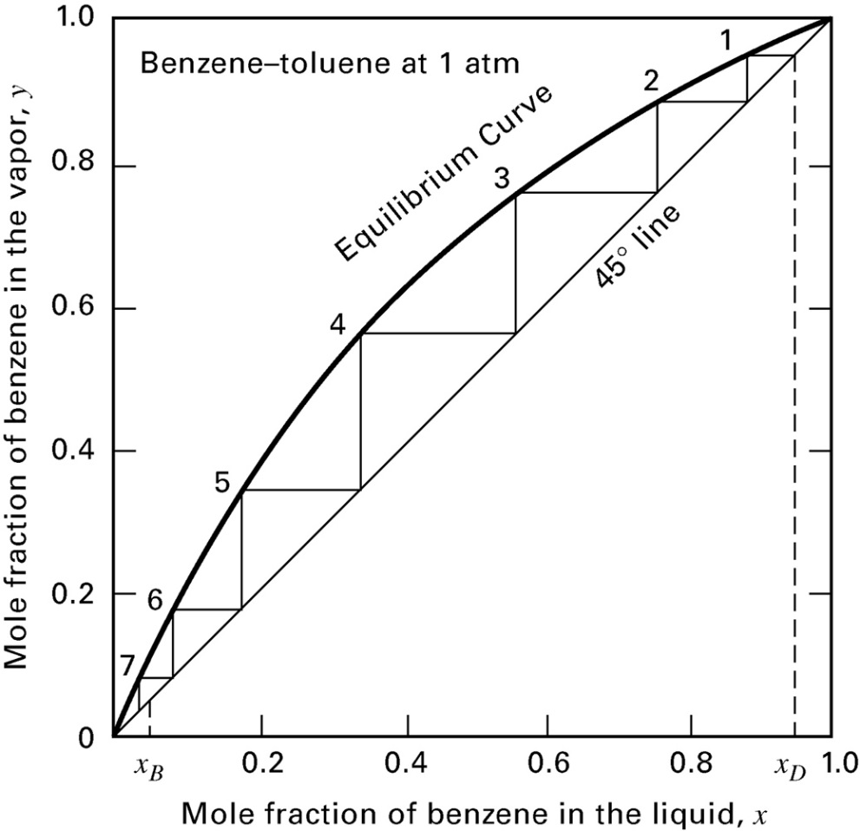
Finding N_{t,min} for a specified x_{D}, x_{B}
Step off between 45° reference line and VLE curve to get N_{t,min}

Slide 25
Finding R_{min}
The intersection of the feed line and the 2 operating lines must be between the reference line and the VLE curve.
All points on the operating lines must be between the reference line and the VLE curve.
If an operating line intersects the VLE curve, an infinite number of stages is required!

Slide 26
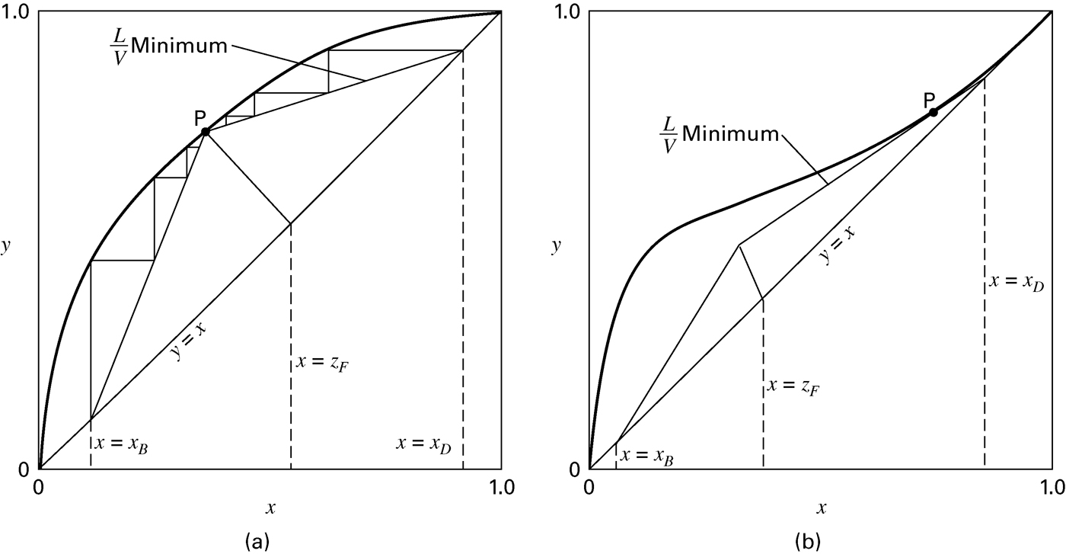
Finding R_{min}

Slide 27
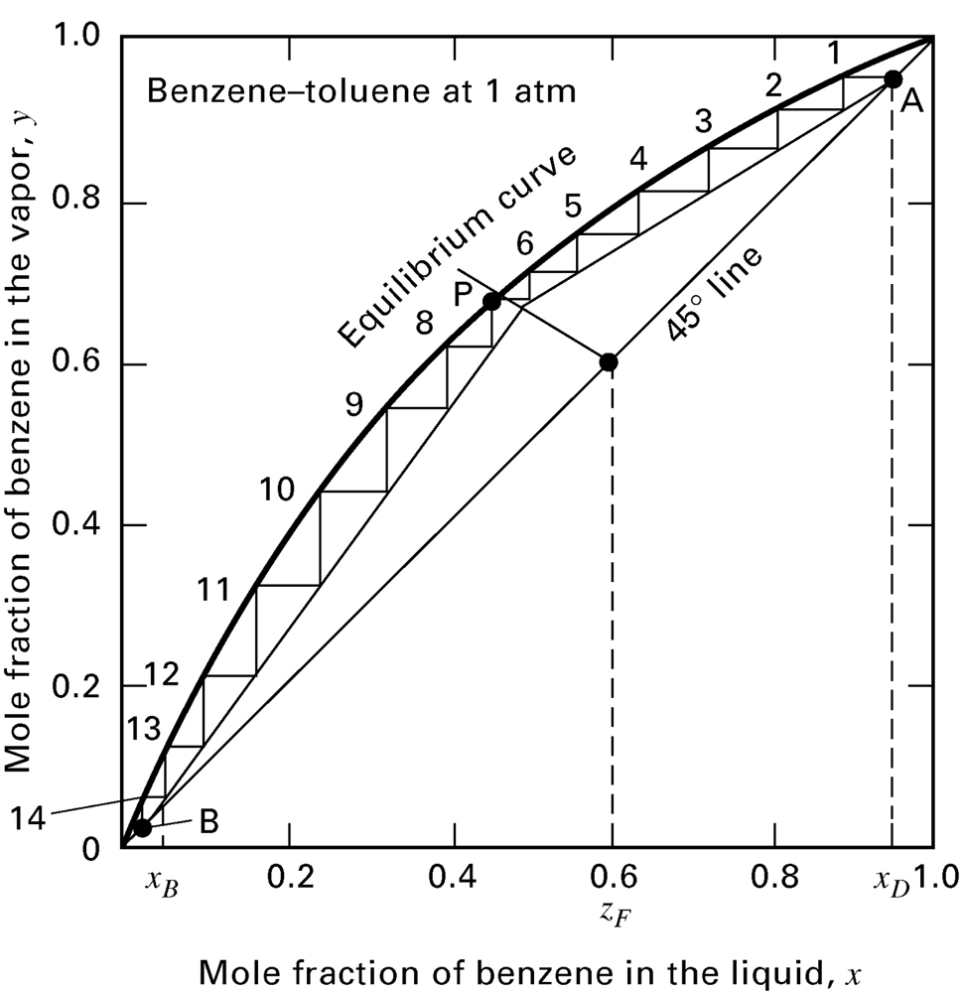
Finding Optimal Feed Tray Location for a Specific R Value
Construct McCabe-Thiele Diagram
Reference line
VLE curve
Known concentrations
q line
Two op lines
Step off trays from the top
Switch from top op to btm op as soon as the stage with the feed line has vapor on top op and liquid on btm op

Slide 28
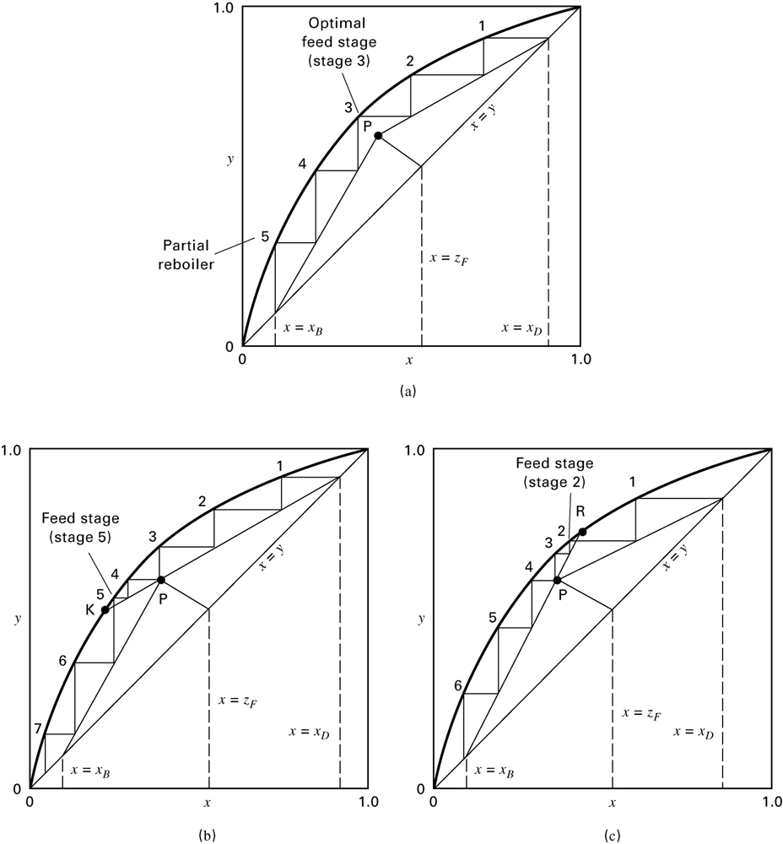
Finding N_{t} when R and Feed Tray Location is Specified
Just right
N_{t} = 5
Left: feed too low
N_{t} ↑ to 7
Right: feed too high
N_{t} ↑ to 6

Slide 29
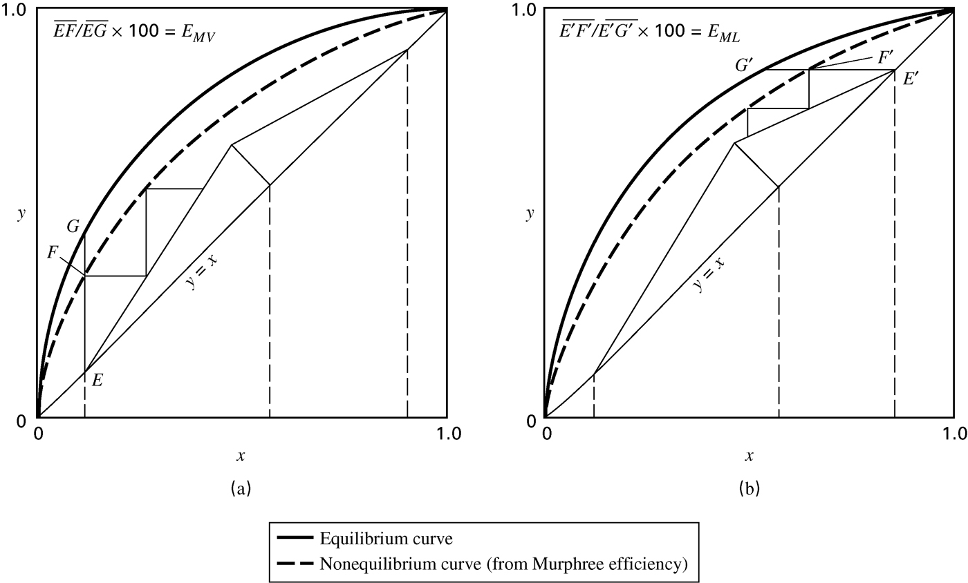
What if VLE isn’t achieved?
Can incorporate Murphree Vapor Efficiency with modified VLE curve

Slide 30
What if the reflux is subcooled?
Subcooled reflux:
Cold reflux condenses some of V before it leaves the column
So real reflux ratio in column > L/D
Beneficial!
McCabe-Thiele still works, but use real R for slope of top operating line
Real reflux ratio:

Slide 31
Tray Efficiency
E_{o} experimental = N_{t}/N_{act}
Drickamar and Bradford correlation:
Equation 7-42, Seader et al, Separation Process Principles, 3rd ed., John Wiley & Sons, New York (2011).
E_{o} = 13.3 – 66.8log(μ_{L}[cP])
Murphree Tray Efficiency

Slide 32
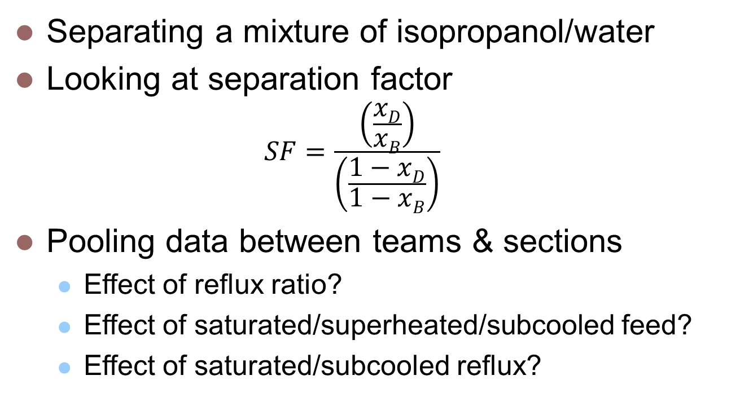
Our Experiment
Separating a mixture of isopropanol/water
Looking at separation factor
$$SF=\frac{\left(\frac{xD}{xB}\right)}{\left(\frac{1−xD}{1−xB}\right)}$$
Pooling data between teams & sections
Effect of reflux ratio?
Effect of saturated/superheated/subcooled feed?
Effect of saturated/subcooled reflux?

