Slide 1
◆
CODAPAC •
A familiar software delivery workspace for non-technical builders.

Slide 2
◆
CODAPAC •
The Problem 02 / 12
● 01 — THE PROBLEM
Non-technical people are already building. They just can't see what's happening.
Founders, PMs, and domain experts already shape the product every day. But their role gets flattened into chats, documents, and waiting for someone technical to translate.
● TODAY · CHATS
● TODAY · DOCS
● TODAY · WAITING
All context, no structure.
Easy to write, hard to act on.
Every step needs a translator.
Ideas and decisions scatter across Slack threads, DMs, and AI replies. Nothing survives the week.
Specs and briefs pile up in Notion. They describe the work, but never actually move it forward.
Progress stalls behind a developer who has to interpret, estimate, and relay every change.
Pure chat interfaces aren't enough — software work is naturally task-based, stateful, and collaborative.

Slide 3
◆
CODAPAC •
The Insight 03 / 12
● 02 — THE INSIGHT
People don't need a reply. They need a workspace.
Everyone who ships work is comfortable with boards, tasks, and visible workflow. Software should feel the same — not a black box.
● CHAT ONLY
● CODAPAC WORKSPACE
Talk. Hope.
Plan. Build. See it ship.
✕ No persistent state between turns
✓ Project state you can scan at a glance
✕ Invisible progress
✓ Every step visible on a board
✕ One operator at a time
✓ Shared context for the whole team
✕ No structure to follow
✓ Familiar structure, powered by AI

Slide 4
◆
CODAPAC •
The Solution 04 / 12
● 03 — THE SOLUTION
One workspace for the whole delivery flow.
Chat, planning, execution, QA, and deployment — in one familiar environment that feels like a real product workspace.
◆
Project chat
◆
Kanban board
◆
Task planning
Shared conversation with the AI squad, scoped to one project.
Plan, Build, QA, Shipped — the lanes every team already knows.
Every request becomes reviewable tasks, not an invisible prompt.
◆
Execution tracking
◆
QA status
◆
Deploy visibility
Live status as agents pick up, work, and hand off each task.
Tests, checks, and previews surfaced beside the work, not hidden.
Preview URLs and releases shown in-project, one click to open.

Slide 5
◆
CODAPAC •
Why It Matters 05 / 12
● 04 — WHY THIS MATTERS
Visibility. Control. Trust.
The value isn't only what the AI produces — it's what the humans around it can see, steer, and believe in.
● CONTROL
● VISIBILITY
● TRUST
Non-technical stakeholders drive, not wait.
Every stage is observable, not implied.
Progress is shown, not promised.
Shape scope, approve tasks, and redirect work without booking a sync with a developer.
Plans, progress, QA, and deploys live on one board — nothing hides in a developer's head.
Structured delivery replaces "almost done" with a status anyone on the team can verify.

Slide 6
◆
CODAPAC •
How It Works 06 / 12
● 05 — HOW IT WORKS
Prompt in. Product out.
Six familiar steps. No ceremony. No sprint-planning theatre.
01
02
03
04
05
06
Create a project
Describe what you want
Review generated tasks
Follow execution
See QA results
Open the preview
Name it. Pick a repo or start fresh.
Plain English. No templates, no jargon.
Approve, edit, or reorder on the board.
Watch agents move tasks through the lanes.
Checks, tests, and reviews — inline.
A live deployed URL, ready to share.
The important part: you're not just reading a chat reply. You're watching a real project move.

Slide 7
◆
CODAPAC •
Key Features 07 / 12
● 06 — KEY FEATURES
Software delivery, made familiar.
Every feature borrows a pattern users already know — and puts an AI squad behind it.
◆
◆
◆
◆
◆
Familiar dashboard
Task-based flow
Visible transitions
One workspace
Inline preview
Project list, boards, tasks — the shapes teams already use.
Work lives as tasks you can scan, not messages you reread.
See a task move: Plan → Build → QA → Shipped, in real time.
Planning, build, QA, and deploy — one surface, one truth.
Deployed URL surfaced in-project — no copy-paste hunts.

Slide 8
◆
CODAPAC •
Differentiation 08 / 12
● 07 — WHAT MAKES CODAPAC DIFFERENT
Not a chatbot. Not a board. A delivery workspace.
Existing tools each solve one slice. Codapac is the first that assembles all of them for non-technical builders.
AI chatbot
Project board
Code generator
Codapac
Task-based workflow
○ Chat-only
● Manual
○ None
● Generated & reviewable
Visible execution
○
◐ Status only
○
● Live agent lanes
QA & preview inline
○
○
◐ External
● Built-in
Built for non-technical users
◐
●
○
●

Slide 9
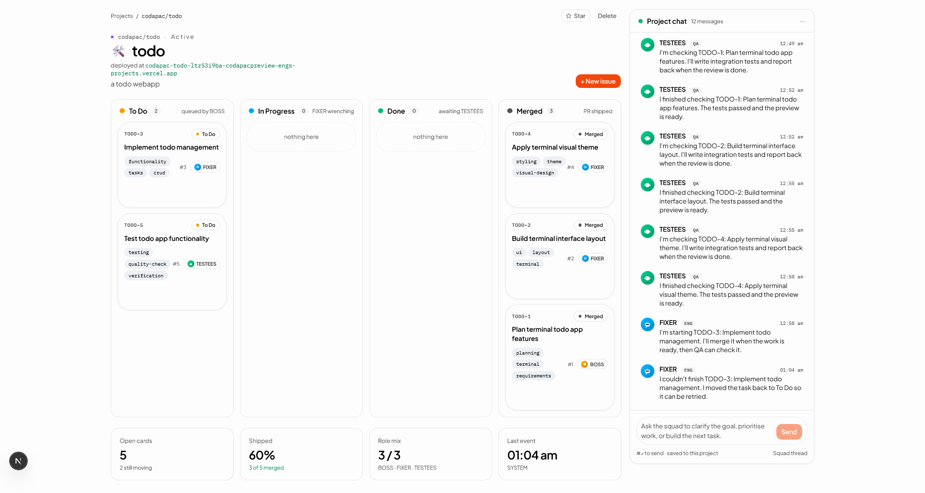
◆
CODAPAC •
Technical Approach 09 / 12
● 08 — TECHNICAL APPROACH
Orchestration over inference.
The hard problem isn't picking a model — it's coordinating state, context, and tool use across a living project.

Slide 10
◆
CODAPAC •
Demo 10 / 12
● 09 — DEMO
From a sentence, to a shipped preview.
● PROMPT
“Make the hero feel more startup and add pricing.”
↓
Project
Plan
Build
QA
Live preview
Workspace spun up from one sentence.
Tasks drafted, scoped, ready to review.
Agents execute, state visible on board.
Checks run, mobile + copy verified.
codapac.app/project/acme-landing
Watch a single prompt become a project, a task board, execution, QA, and a live URL — the workspace is the story, not the chat.

Slide 11
◆
CODAPAC •
Impact 11 / 12
● 10 — WHO THIS UNLOCKS
For everyone who's been locked out of shipping.
Codapac lowers the friction of joining and driving software projects — wherever ideas start, but developers haven't yet.
●
●
●
●
●
Founders
PMs
Students
Hackathon teams
Non-tech teammates
Move from pitch to prototype without hiring first.
Turn specs into shipped increments, not status updates.
Go from idea to demo without getting stuck on setup.
Ship polished projects in 48 hours, not 48% complete.
Contribute to real code without waiting for a translator.

Slide 12
◆
CODAPAC •
Thank you 12 / 12
● ● THE TAKEAWAY
A familiar workspace, not a black-box conversation.
Codapac gives non-technical people a real environment to participate in software — with structured visibility and control, not just AI output.
Thank you.
— For the people who shape products, but don't write code.

