Slide 1
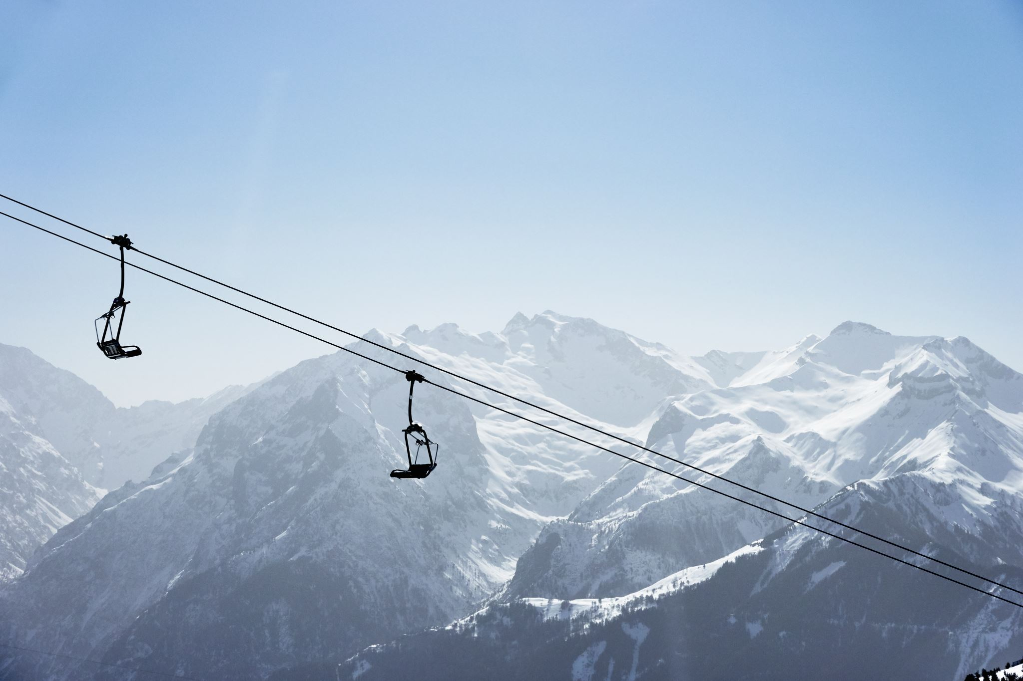
Big Mountain Resort
Springboard | Guided Capstone Project
Samantha Lee

Slide 2
Problem
Current Price is $81.00
Additional chair lift at Big Mountain Ski Resort increases their operating costs by $1,540,000 this season.
Can we increase revenue? Will Big Mountain Ski Resort maintain its reputation and competition for the season?

Slide 3
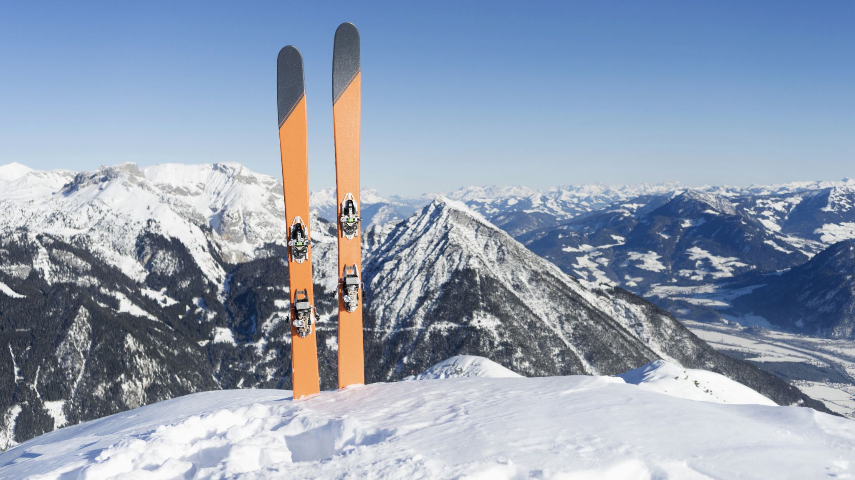
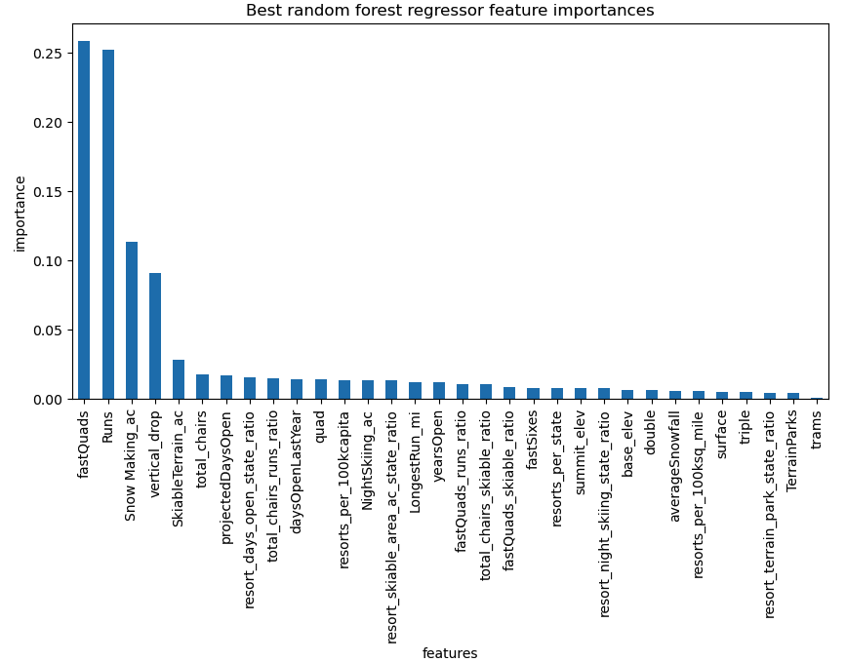
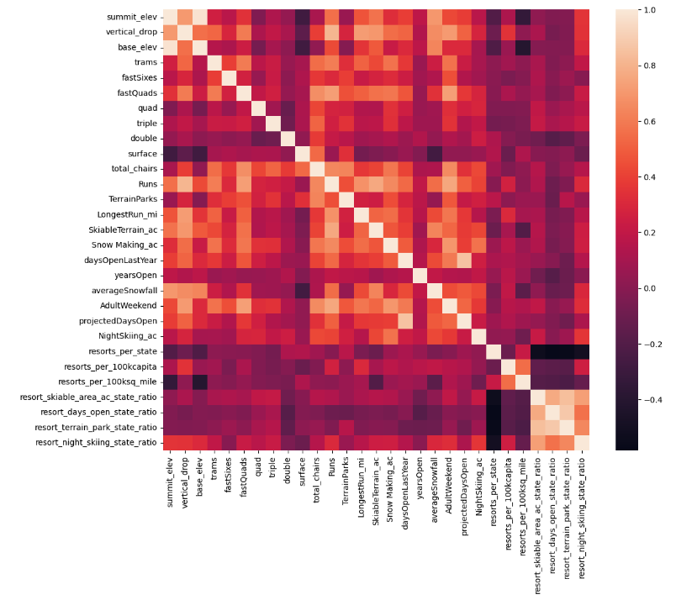
Key Findings
The linear model from Best Random Forest Regressor shares the prevalent top four features:
fastQuads
Runs
SnowMaking_ac
Vertical _drop

Slide 4
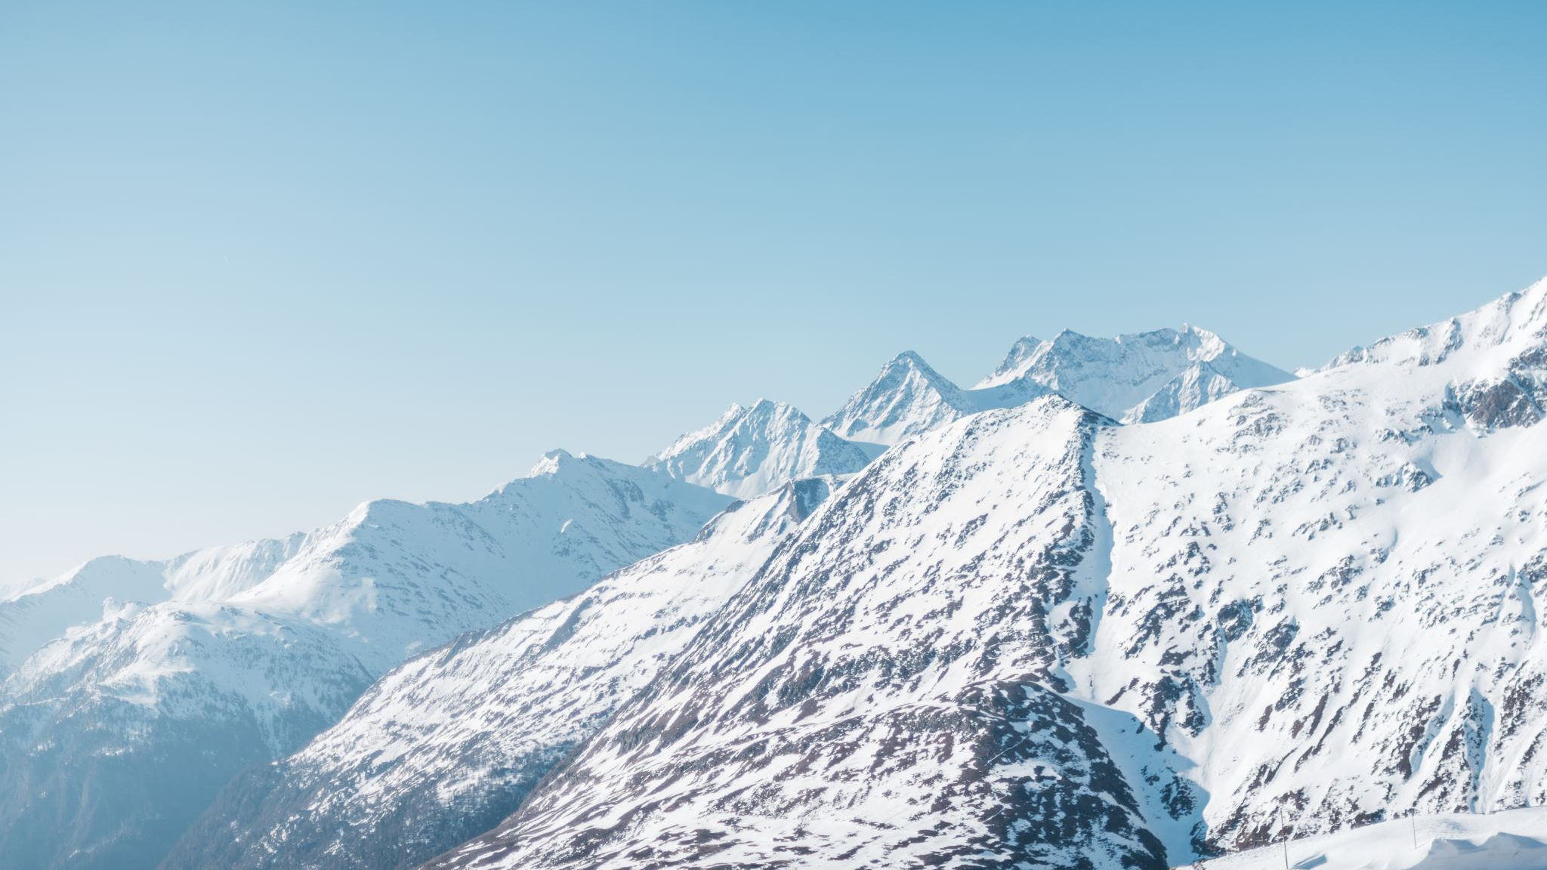
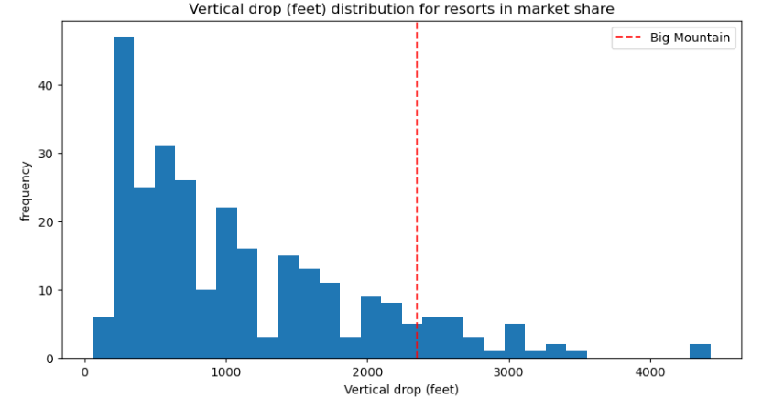
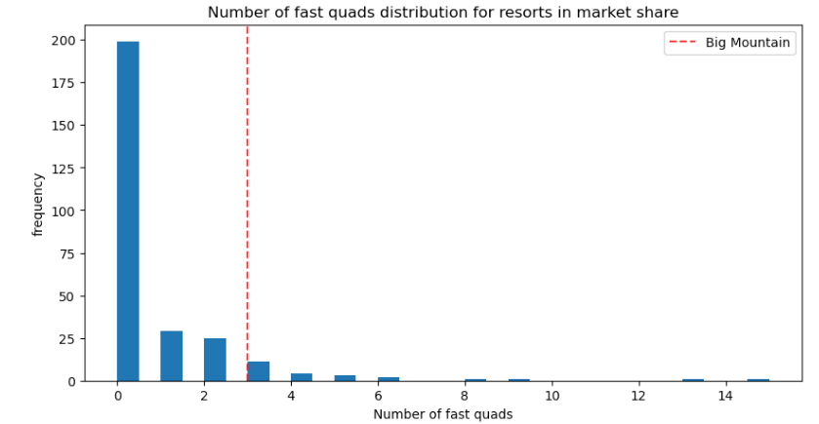
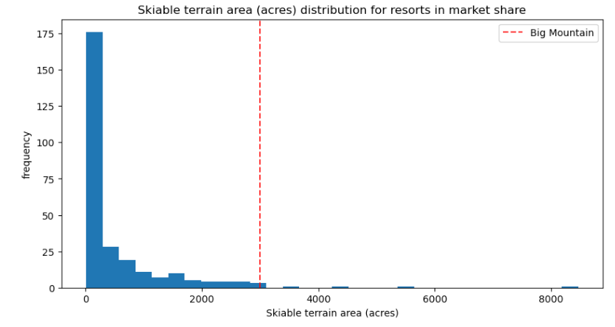
Modeling & Analysis
Big Mountain is performing well in terms of vertical drop, there are several other resorts with a larger drop.
Most ski resorts do not have fast quads. Big Mountain has three, putting it toward the top.
Most ski resorts do not have fast quads. Big Mountain has three, putting it toward the top.
• Big Mountain has one of the most skiable terrains of any resort.

Slide 5
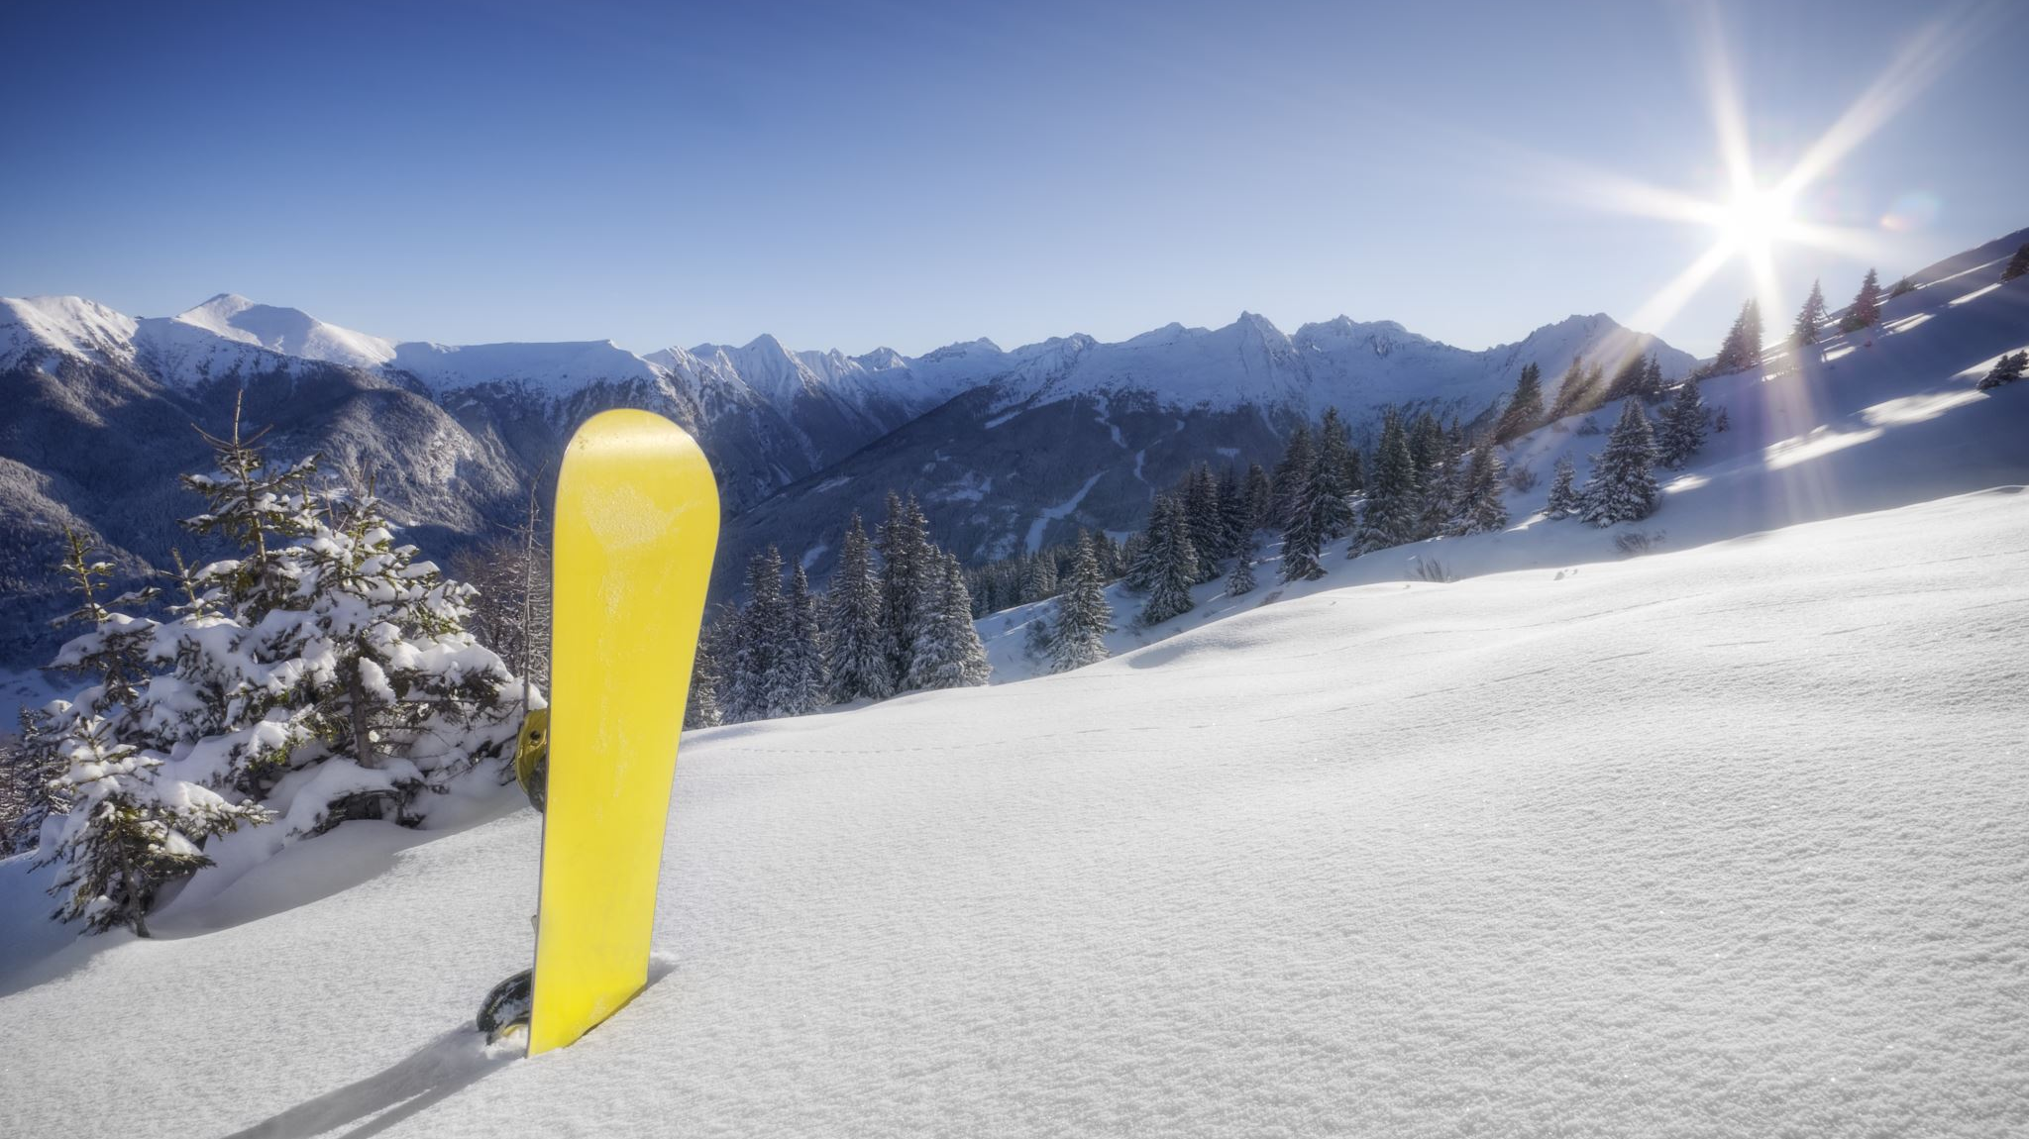
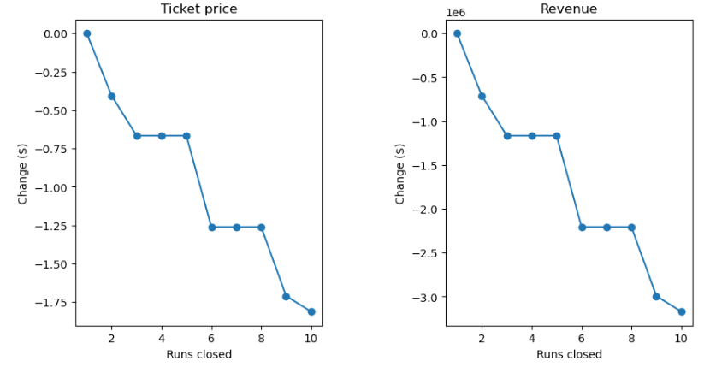
Modeling & Analysis
According to the model, shutting one run makes no effect. Closing 2 and 3 limits support for ticket prices. If Big Mountain shuts three runs, it appears they may as well close four or five because there is no additional loss in ticket price. Increasing the closures to 6 or more results in a significant reduction.

Slide 6
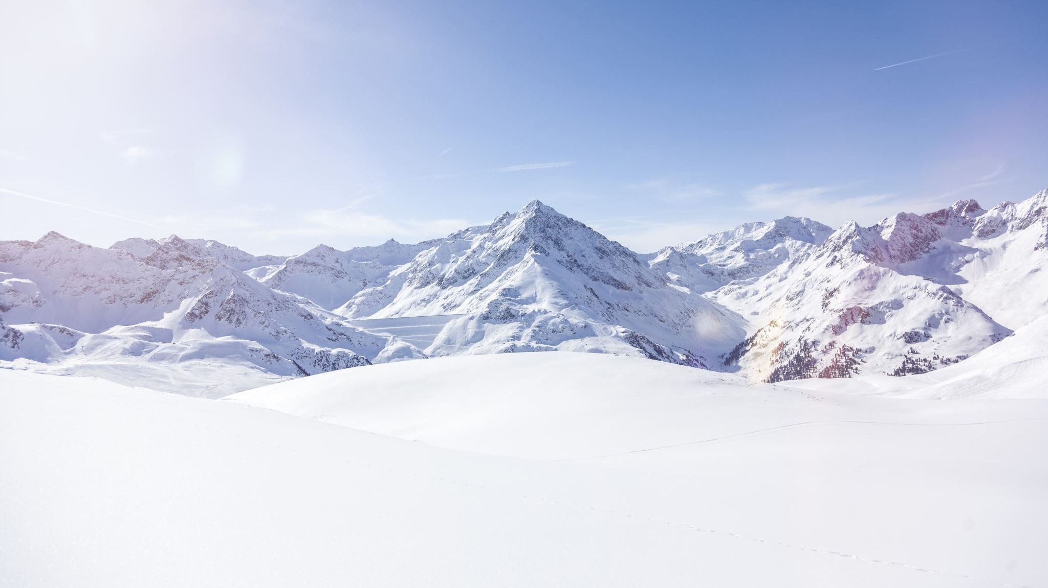
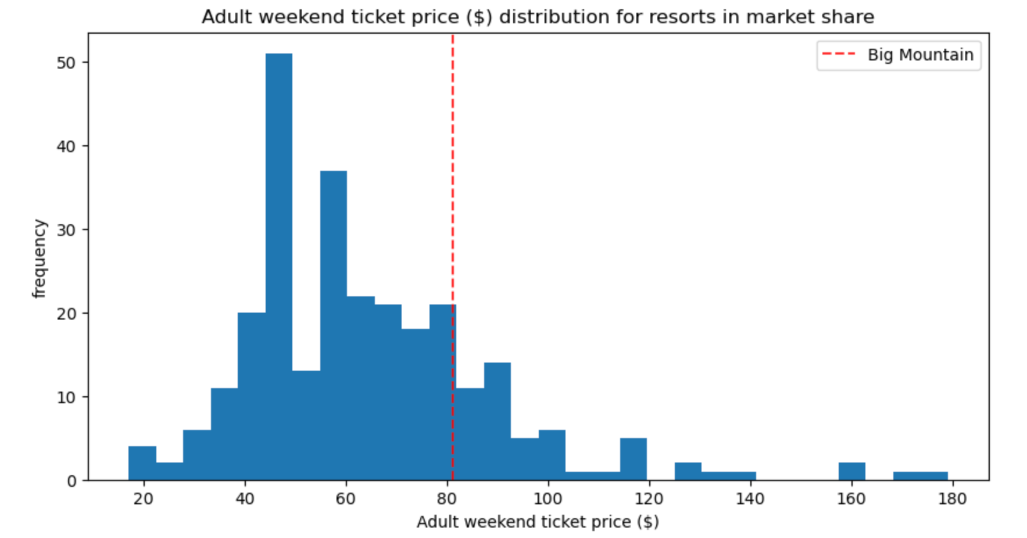
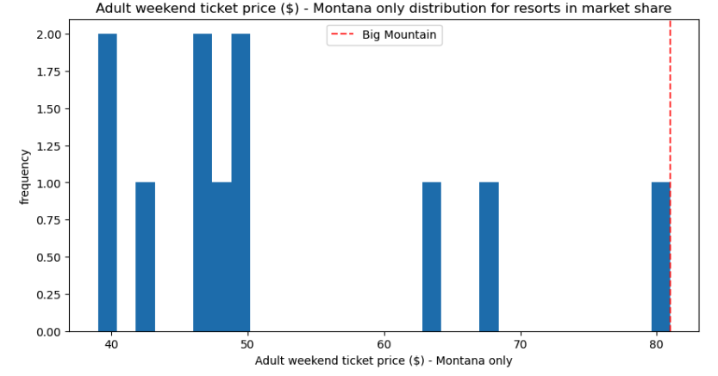
Modeling & Analysis
Look at where Big Mountain ranks generally in terms of price and just other locations in Montana.
This shows that Big Mountain has room to increase price from $ 81.00.

Slide 7
Summary
Big Mountain Currently ranks among the top resorts
fastQuads
Runs
SnowMaking_ac
Vertical _drop
Scenery Options
Closure up to 6 runs. Increasing the closures to 6 or more results in a significant reduction and loss.
Should consider increasing the longest run with snowmaking
Adding a run, increasing the vertical drop by 150 feet, and adding a new chair lift; a $1.99 USD increase that might total 3.5 million USD per year.
Adding 2 acres of snow on top of this does not appear to have an incremental effect

