Slide 1
Generative Adversarial Networks
Whie Jung
whieya@kaist.ac.kr

Slide 2
Table of Contents
Environment Setup
Colab
Pytorch (Already prepared in Colab)
Lab-1 : GANs for image generation
Lab 1-a : Unconditional GANs with MNIST dataset
Lab 1-b : Conditional GANs (Auxiliary Classifier GANs) with MNIST dataset
Lab-2 : GANs for image-to-image translation
Lab 2 : Pix2Pix model for colorization task

Slide 3

Environment Setup
Colab
Provide Cloud-based Jupyter Notebook Environment.
Free! Easy!
Pytorch
Project codes
https://drive.google.com/drive/folders/1OPAphsVSvph1GR_usn4U_4sIt2XTHi_3?usp=sharing
Make a copy on your google drive.

Slide 4
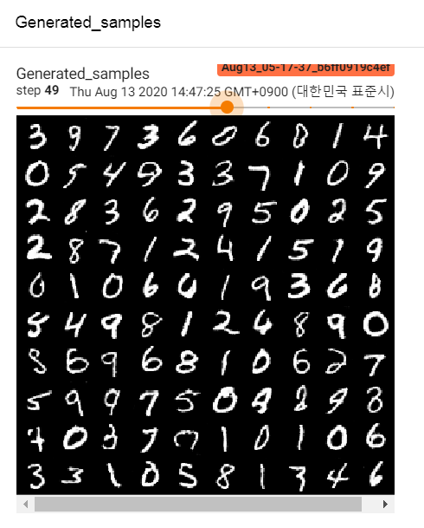
Lab 1 : GANs for image generation
Goal
Implement GANs model for generating MNIST dataset
MNIST dataset
The database of handwritten digital digits (0~9)
Resolution of 28x28
Training/Test set of 60,000/10,000 images respectively

Slide 5
Lab 1-a : Unconditional GANs
Recap of GANs framework
Noise
G
Fake Image
Real? Fake?
D
Real Image
GANs’ adversarial objective

Slide 6
Lab 1-a : Unconditional GANs
Goal
Implement unconditional GANs model for generating MNIST dataset.
Sampling latent variable z from Gaussian Distribution and generate image from z.
Flow
Prepare MNIST dataloader
Define GANs model(Generator & Discriminator)
Train GANs with adversarial objective
Instead of original minmax game, we use non-saturating loss for stability.

Slide 7
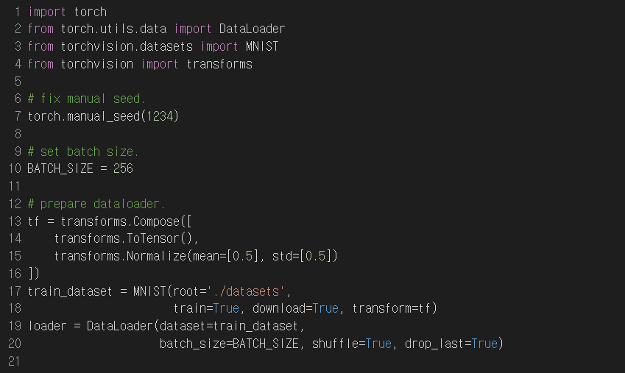
Lab 1-a : Unconditional GANs
Prepare MNIST Dataloader

Slide 8
Lab 1-a : Unconditional GANs
Define GANs Model : Generator
Architecture
z
Linear,
64→1024
BN1d, ReLU
Linear,
1024→128x7x7
BN1d, ReLU
Fully-Connected layers (self.fc)
ConvTranspose2d,
ch 64, kernel 4, stride 2, pad 1
BN2d, ReLU
ConvTranspose2d,
ch 1, kernel 4, stride 2, pad 1
tanh
G(z)
Convolutional layers (self.upconv)
* When implementing forward function, use tensor.view() function to change the shape of the tensor.

Slide 9
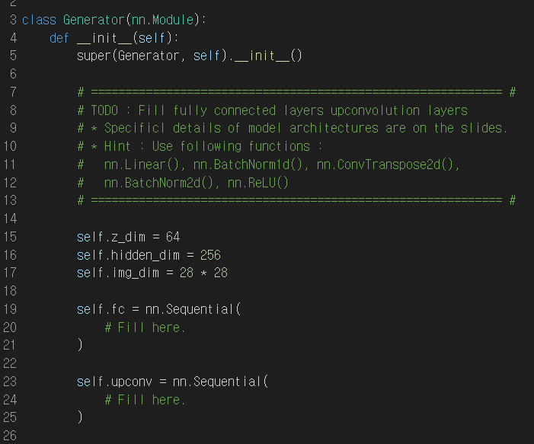
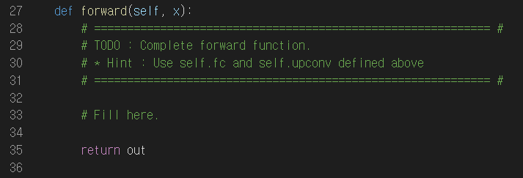
Lab 1-a : Unconditional GANs
Define GANs Model : Generator

Slide 10
Lab 1-a : Unconditional GANs
Define GANs Model : Discriminator
Architecture
(Out_dim, kernel_size, stride, padding)
x
Conv2d,
(64, 4, 2, 1)
LeakyReLU(0.2)
Conv2d,
(128, 4, 2, 1)
BN2d, LeakyReLU(0.2)
Convolutional layers (self.conv)
Linear,
128x7x7 →1024
BN1d, LeakyReLU(0.2)
Linear,
1024 →1
sigmoid
real/fake
Fully connected layers (self.fc)
Final Linear layer (self.fc_disc)
* When implementing forward function, use tensor.view() function to change the shape of the tensor.

Slide 11
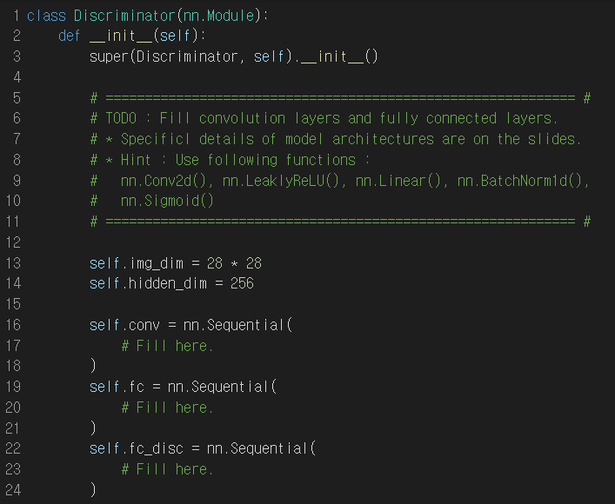
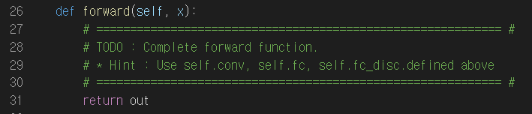
Lab 1-a : Unconditional GANs
Define GANs Model : Discriminator

Slide 12
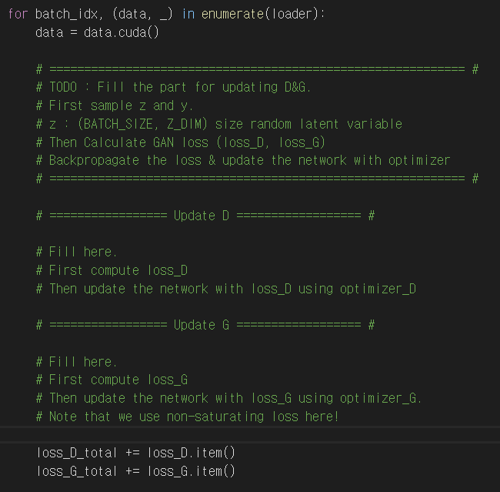
Lab 1-a : Unconditional GANs
Start training GAN
Non-Saturating Loss :
Instead of minimizing log(1-D(G(z))),
maximize log(D(G(z))) for training stability.
Hint : Use binary cross entropy loss (use BCE_criterion) for calculating loss.
After computing loss, update the network using optimizer.
You should zero_grad before step.
Use optimizer.zero_grad(), loss.backward(), optimizer.step()

Slide 13
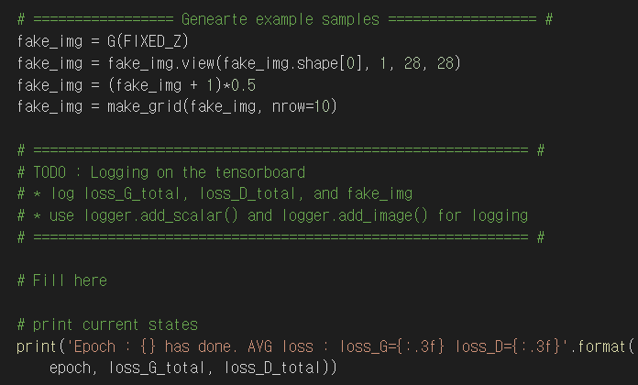
Lab 1-a : Unconditional GANs
Logging on tensorboard
Logging loss and generated samples
Hint
Use following functions
add_scalar(‘variable_name’, value, iterations)
add_image(‘variable_name’, img, iterations)

Slide 14
Lab 1-a : Unconditional GANs
Expected Results

Slide 15
Lab 1-b : AC-GANs
Goal
Implement auxiliary classifier GANs model for generating MNIST dataset.
Sampling latent variable z from Gaussian Distribution, and conditioning with label y, to generate image from (z, y).
Flow
Prepare MNIST dataloader
Define GANs model(Generator & Discriminator)
Train GANs with adversarial objective
Instead of original minmax game, we use non-saturating loss for stability.
Additionally, add auxiliary classification loss.

Slide 16
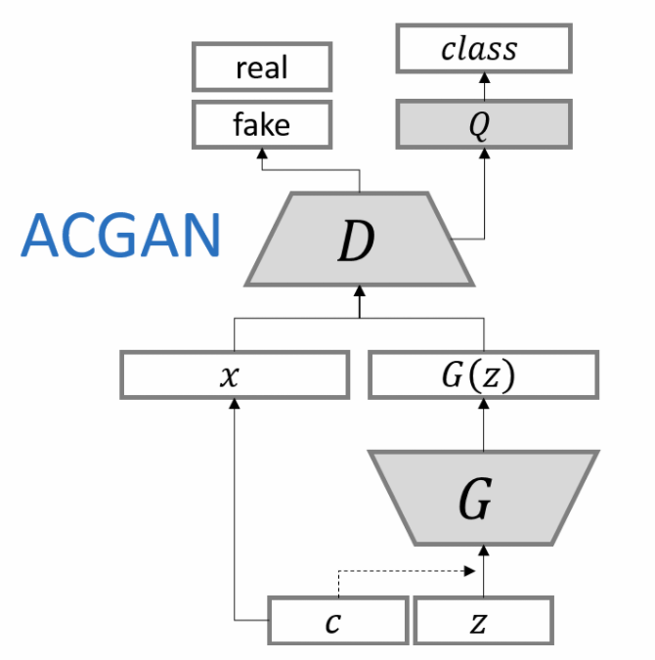
Lab 1-b : AC-GANs
GAN + Classifier
Sampling latent variable z from Gaussian Distribution, and conditioning with label y, to generate image from (z, y).

Slide 17
Lab 1-b : AC-GANs
Define GANs Model : Generator
Architecture
Before input y into G, convert it to one-hot vector (ex, y=2 -> y_onehot = (0,0,1,0,...,0)
(z, y)
Linear,
64+10→1024
BN1d, ReLU
Linear,
1024→128x7x7
BN1d, ReLU
Fully-Connected layers (self.fc)
ConvTranspose2d,
ch 64, kernel 4, stride 2, pad 1
BN2d, ReLU
ConvTranspose2d,
ch 1, kernel 4, stride 2, pad 1
tanh
G(z,y)
Convolutional layers (self.upconv)
* When implementing forward function, use tensor.view() function to change the shape of the tensor.

Slide 18
Lab 1-b : AC-GANs
Define GANs Model : Discriminator
Architecture
(Out_dim, kernel_size, stride, padding)
x
Conv2d,
(64, 4, 2, 1)
LeakyReLU(0.2)
Conv2d,
(128, 4, 2, 1)
BN2d, LeakyReLU(0.2)
Convolutional layers (self.conv)
Linear,
128x7x7 →1024
BN1d, LeakyReLU(0.2)
Linear,
1024 →1
sigmoid
real/fake
Fully connected layers (self.fc)
Final Linear layer (self.fc_disc)
Linear,
1024 →10
Classification
Final Linear layer (self.fc_cls)

Slide 19
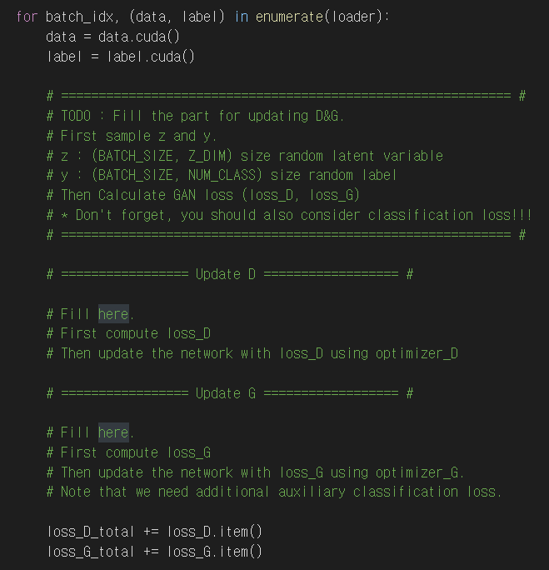
Lab 1-b : AC-GANs
Start training GAN
Discriminator Loss :
Disc_Fake + Disc_Real + Cls_Fake + Cls_Real
Generator Loss :
Disc_Fake + Cls_Fake
Loss function
Binary Cross Entropy Loss for disc_loss.
Cross Entropy Loss for classification loss.

Slide 20
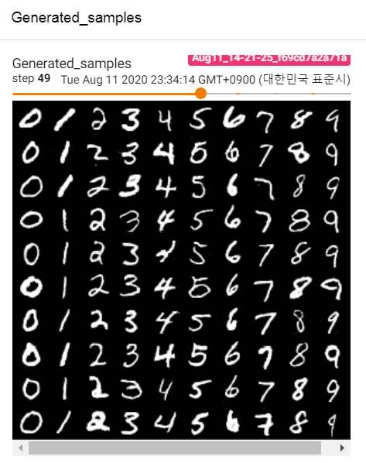
Lab 1-b : AC-GANs
Expected Results

