Slide 1

Android Develop
Made by. 43516ED4405CCDFCC07FD09668726ECD

Slide 2
Install
Made by. 43516ED4405CCDFCC07FD09668726ECD

Slide 3

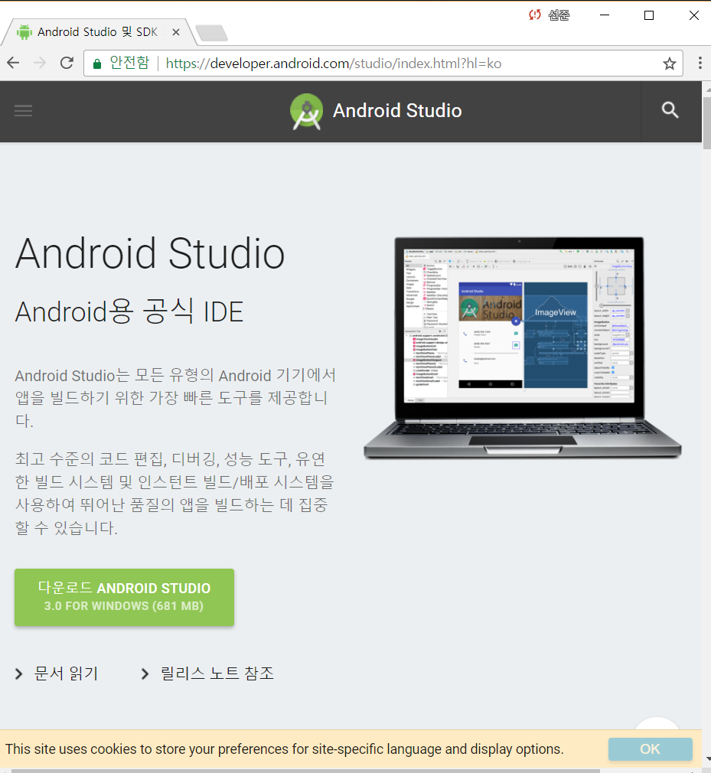
Hacking Tools
Install
Install Android Studio
Downloads URL : https://developer.android.com/studio/index.html?hl=ko
Made by. 43516ED4405CCDFCC07FD09668726ECD

Slide 4
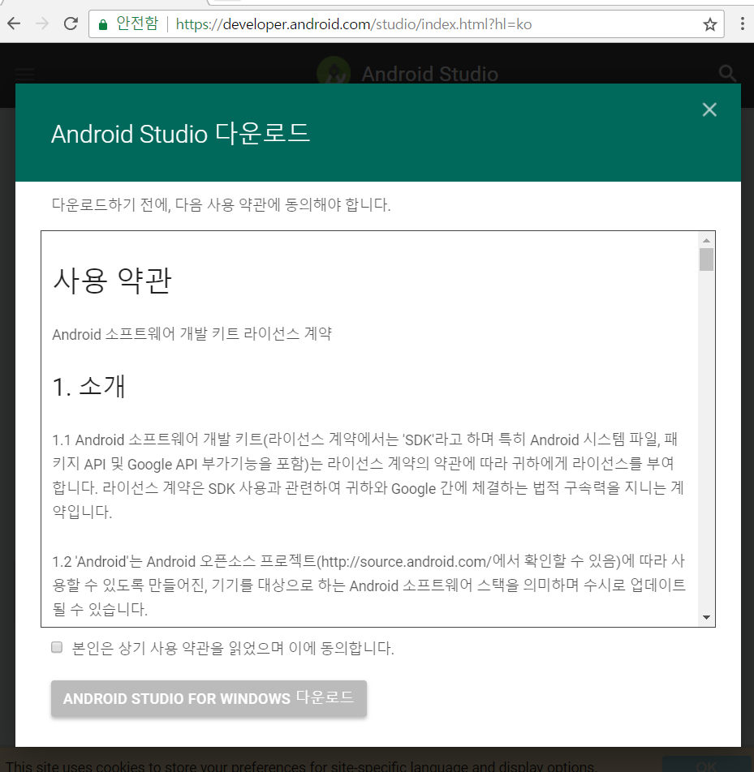
Hacking Tools
Install
Check the agreement
Click ‘Download Android Studio’
Execute *.exe File
Made by. 43516ED4405CCDFCC07FD09668726ECD

Slide 5
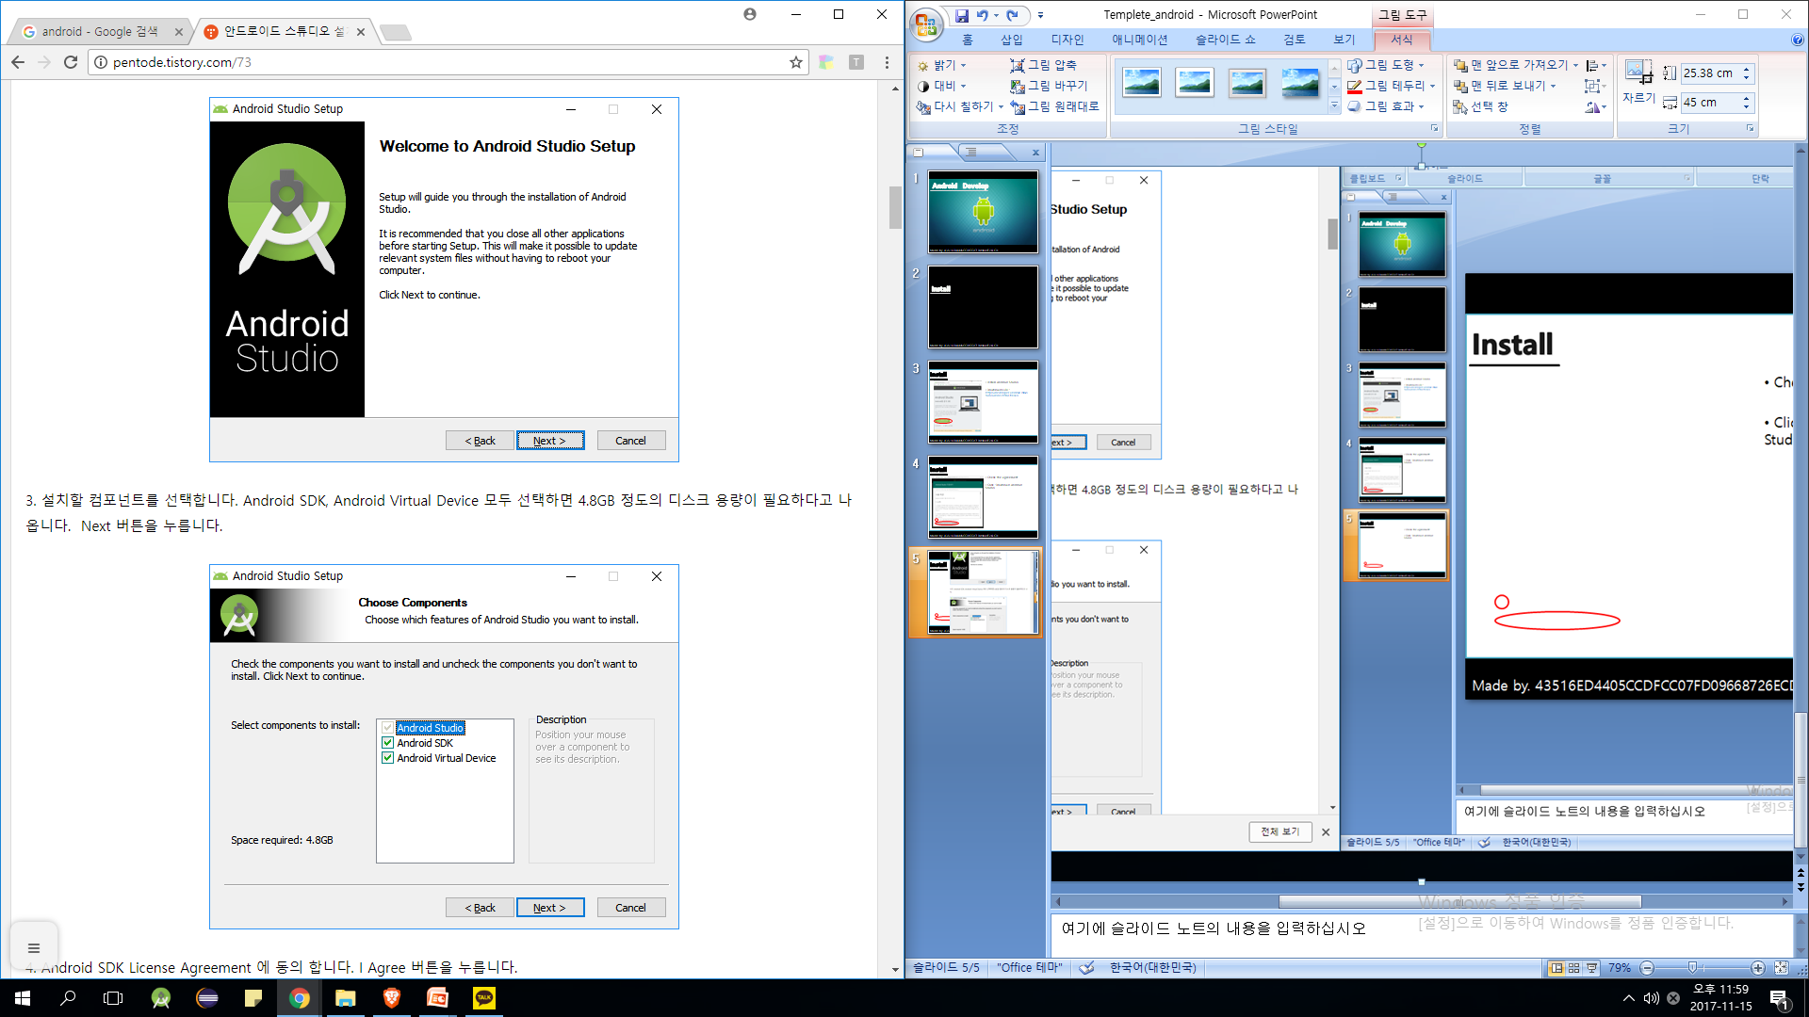
Hacking Tools
Install
Check the agreement
Click ‘Download Android Studio’
Made by. 43516ED4405CCDFCC07FD09668726ECD

Slide 6
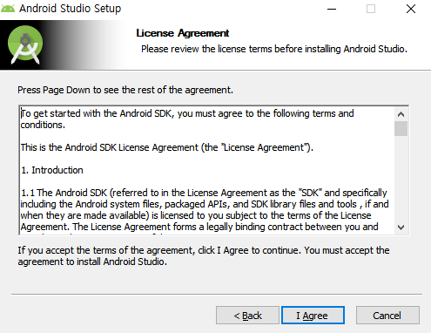
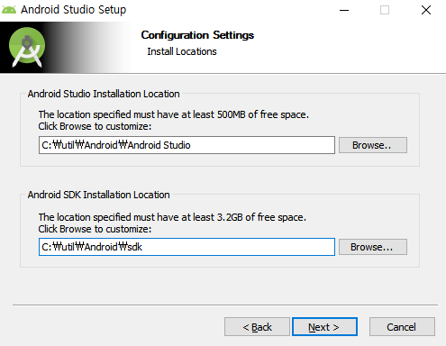
Hacking Tools
Install
Studio’s location
SDK’s location
Made by. 43516ED4405CCDFCC07FD09668726ECD

Slide 7
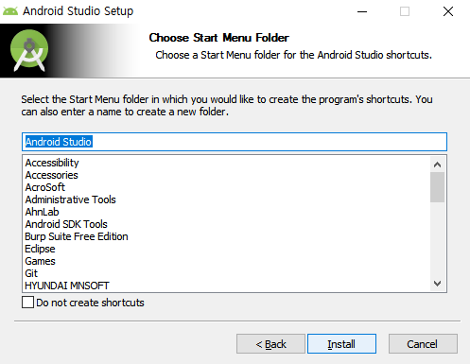
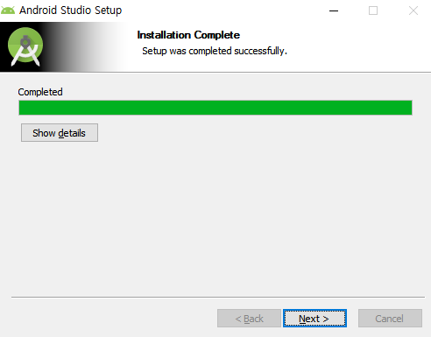
Hacking Tools
Install
Made by. 43516ED4405CCDFCC07FD09668726ECD

Slide 8
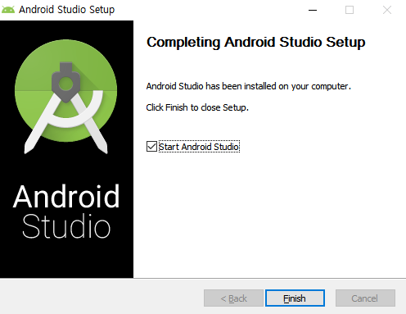
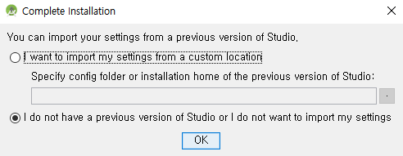
Hacking Tools
Install
Made by. 43516ED4405CCDFCC07FD09668726ECD

Slide 9

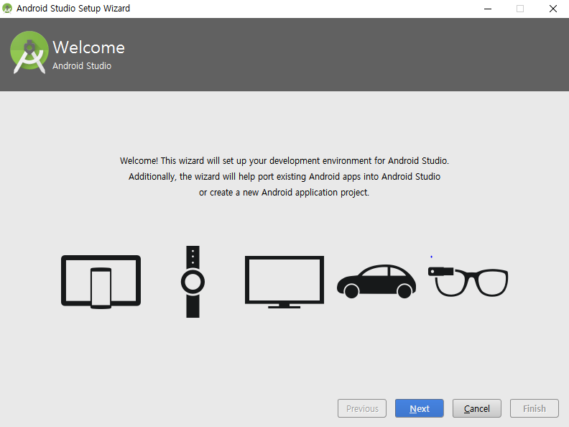
Hacking Tools
Install
Made by. 43516ED4405CCDFCC07FD09668726ECD

Slide 10
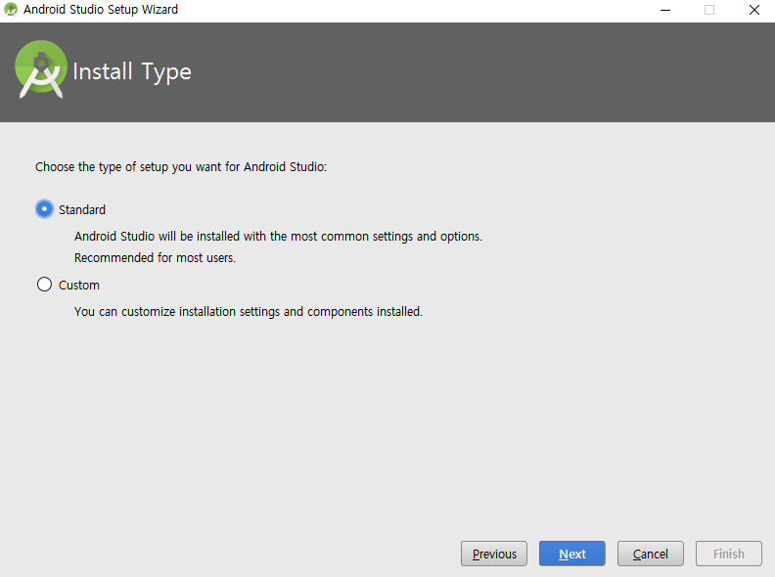
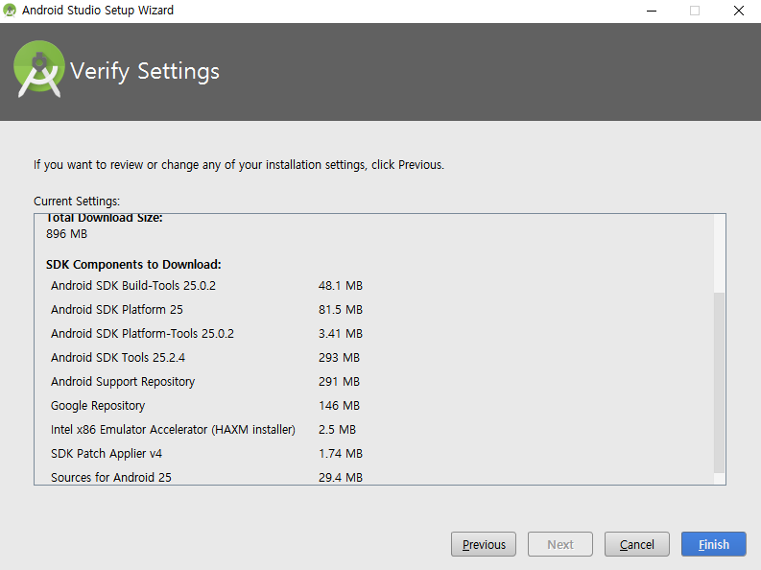
Hacking Tools
Install
Made by. 43516ED4405CCDFCC07FD09668726ECD

Slide 11
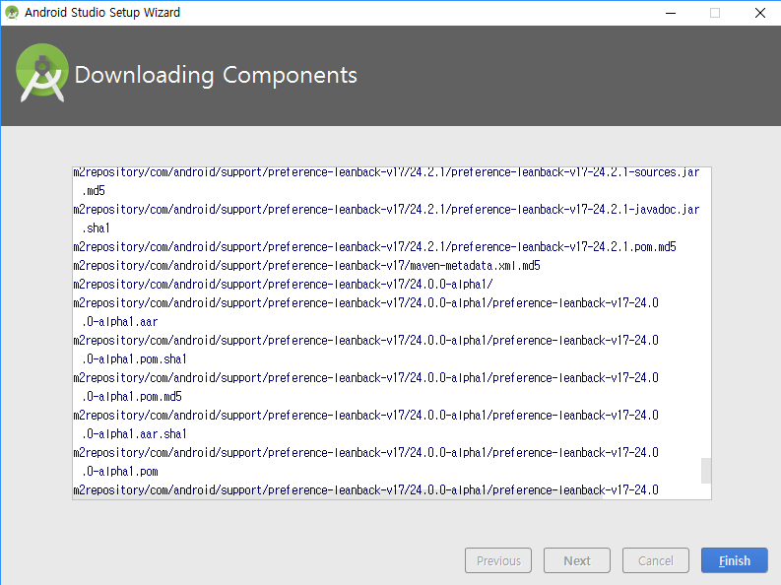
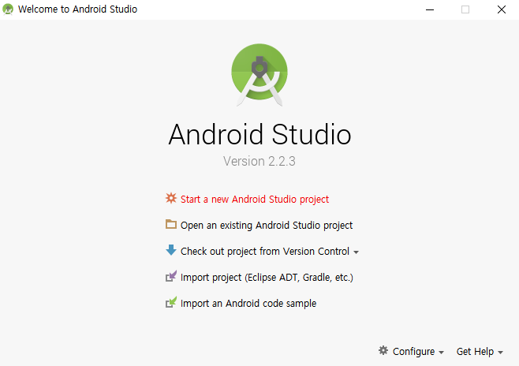
Hacking Tools
Install
Made by. 43516ED4405CCDFCC07FD09668726ECD

