Slide 1

Android Develop
Made by. 43516ED4405CCDFCC07FD09668726ECD

Slide 2
New Project
Made by. 43516ED4405CCDFCC07FD09668726ECD

Slide 3

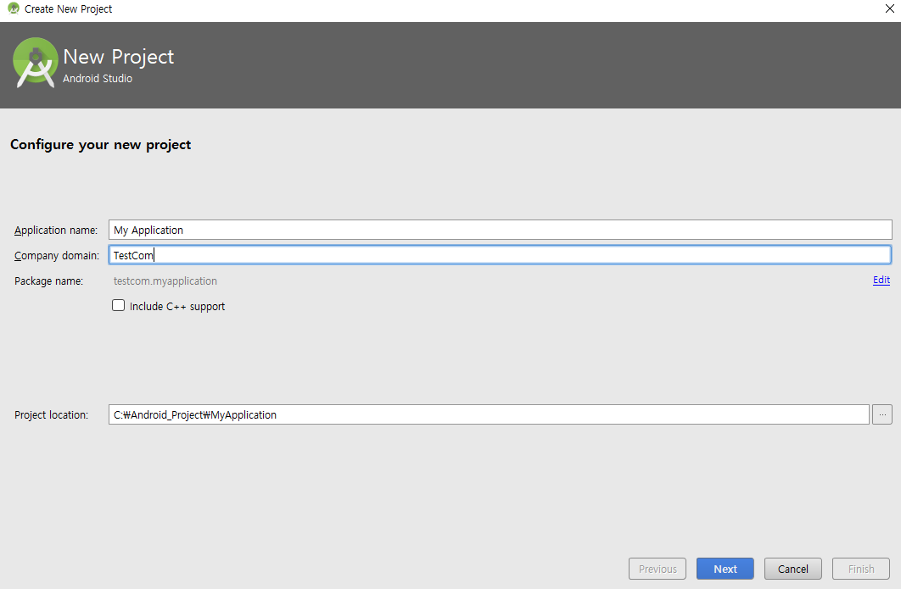
Hacking Tools
New Project
Set your package name
Made by. 43516ED4405CCDFCC07FD09668726ECD

Slide 4
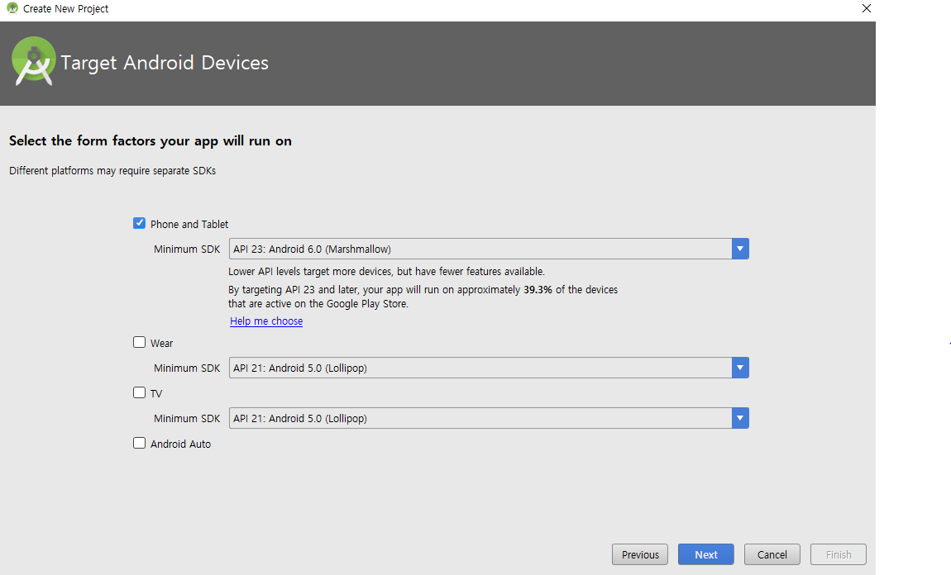
Hacking Tools
New Project
Version of OS for the project
( *6.0 can’t execute in lower than 6.0 )
Made by. 43516ED4405CCDFCC07FD09668726ECD

Slide 5
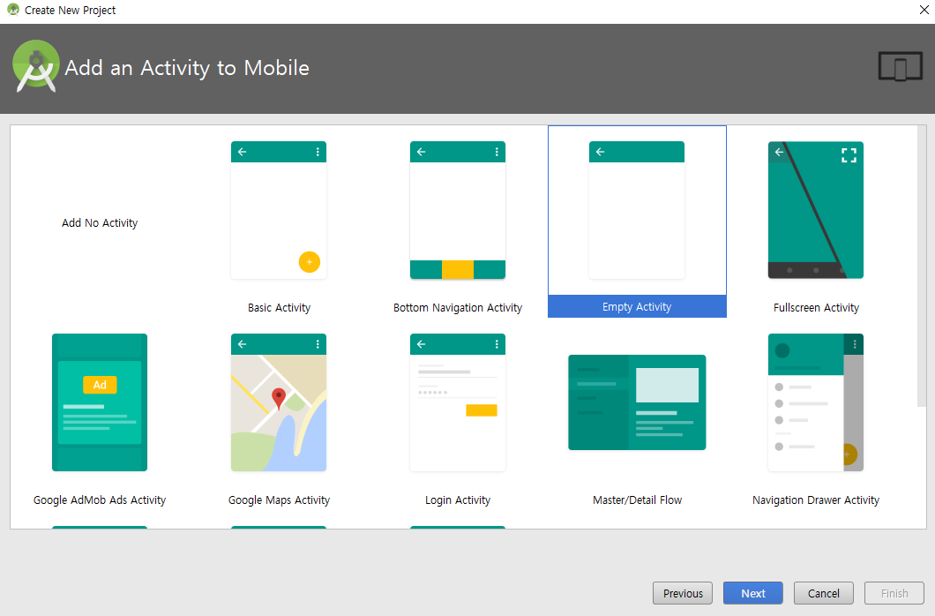
Hacking Tools
New Project
Made by. 43516ED4405CCDFCC07FD09668726ECD

Slide 6
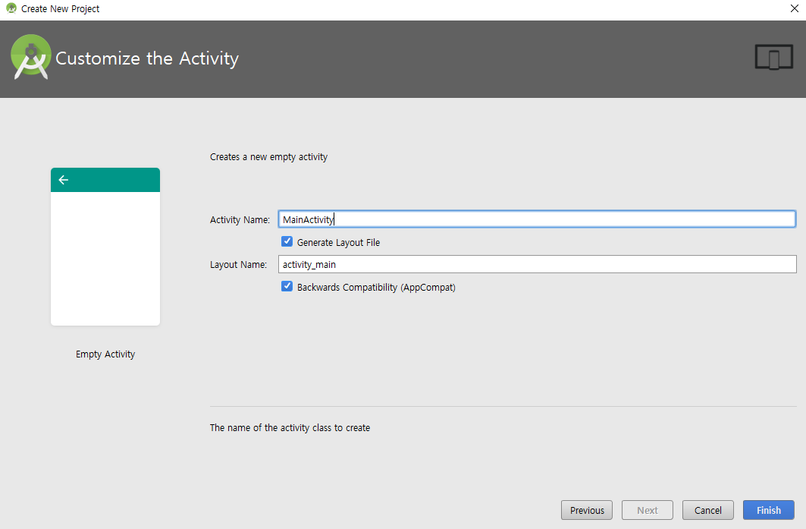
Hacking Tools
New Project
Main Activity’s name
Main Layout’s name
Made by. 43516ED4405CCDFCC07FD09668726ECD

Slide 7
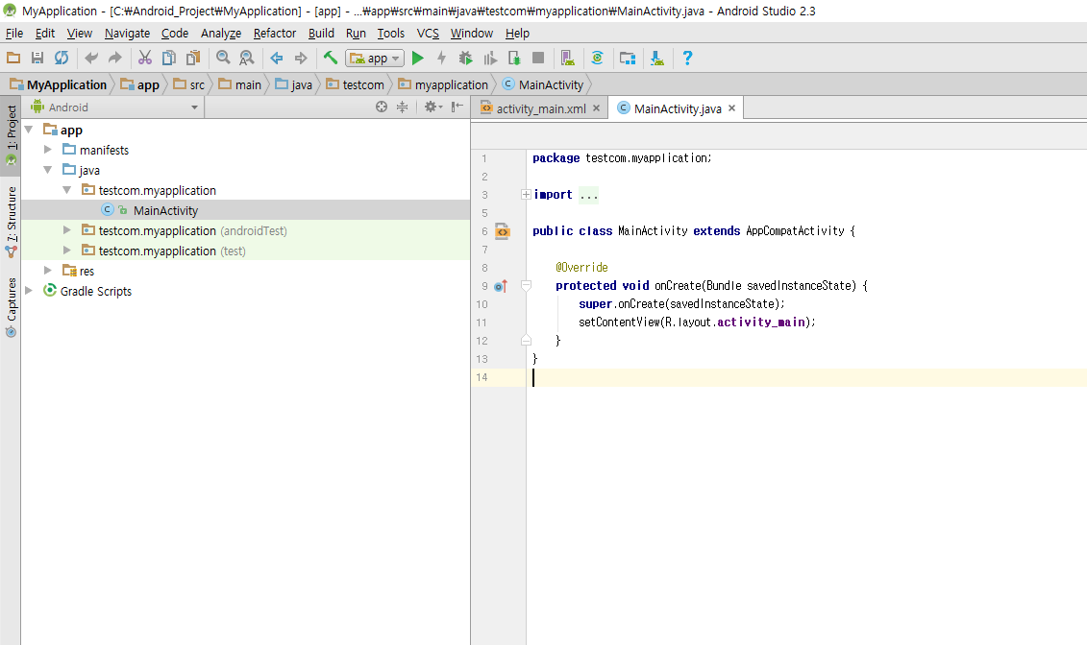
Hacking Tools
New Project
Made by. 43516ED4405CCDFCC07FD09668726ECD

Slide 8
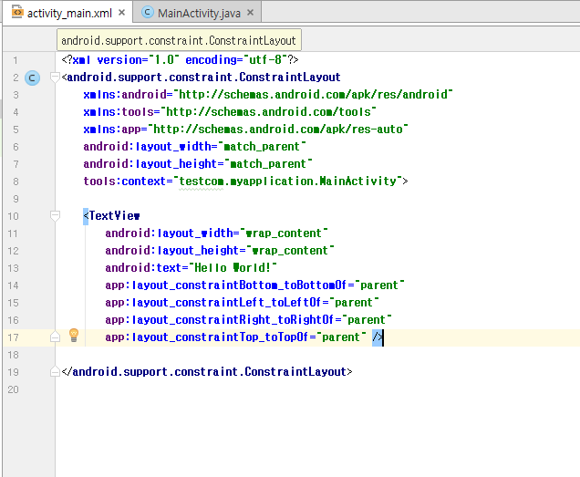
Hacking Tools
New Project
Made by. 43516ED4405CCDFCC07FD09668726ECD

Slide 9
Execute project
Made by. 43516ED4405CCDFCC07FD09668726ECD

Slide 10
Hacking Tools
Execute Project
Click this button for compile and execute
Key Command : Shift + F10
Made by. 43516ED4405CCDFCC07FD09668726ECD

Slide 11
Implements
Made by. 43516ED4405CCDFCC07FD09668726ECD

Slide 12
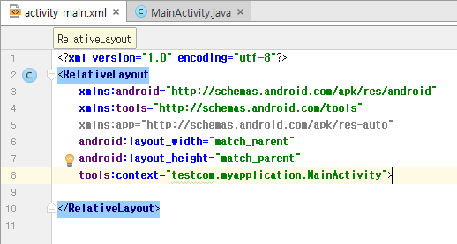
Hacking Tools
Implements
Change the Layout to “Relativelayout”
RelativeLayout is the easiest way to set views
Made by. 43516ED4405CCDFCC07FD09668726ECD

Slide 13
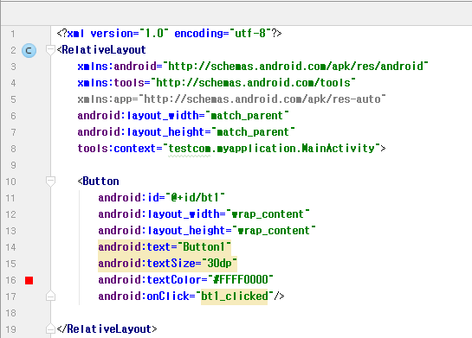
Hacking Tools
Implements
Implement “Button” code in RelativeLayout
id : name of this view
layout_width : size of width
layout_height : size of height
text : text in this view
textSize : textSize (dp, sp, etc)
textColor : color of text
[format = #AABBCCDD]
AA : transparency
BB : Red
CC : Green
DD : Blue
onClick : invoking function name when this button clicked
Made by. 43516ED4405CCDFCC07FD09668726ECD

Slide 14
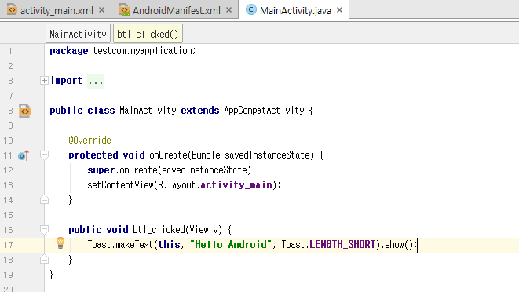
Hacking Tools
Implements
Implement “Button” onclick handler
(If do not handle onClick function, null pointer exception will be occur)
parameter should be (View v)
Modifier should be public
‘Toast’ make a text toast
This : context of this func
“ “ : toasting text
Made by. 43516ED4405CCDFCC07FD09668726ECD

Slide 15
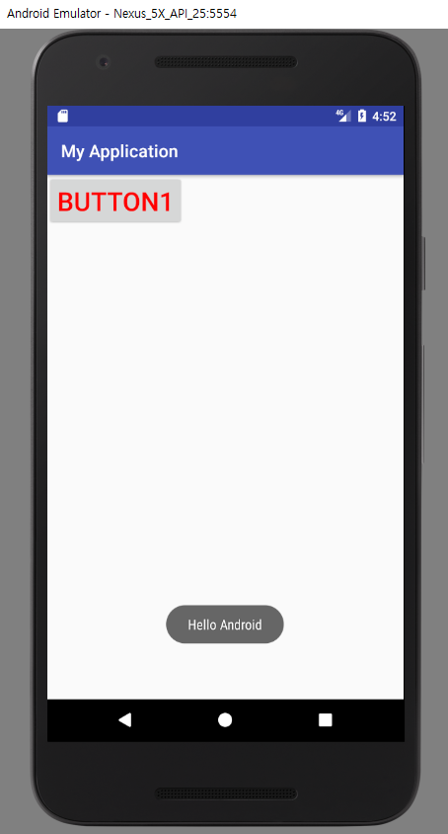
Hacking Tools
Implements
Executing Program
Click the button and Check Toasting Text “Hello Android”
Made by. 43516ED4405CCDFCC07FD09668726ECD

Slide 16
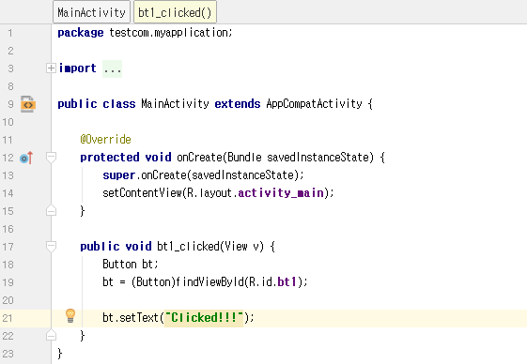
Hacking Tools
Implements
Implement “Button” onclick handler
Make a bt (Button Variable)
Connect bt to bt1 in *.xml
Call method in Button class
setText : change text of button
Made by. 43516ED4405CCDFCC07FD09668726ECD

Slide 17
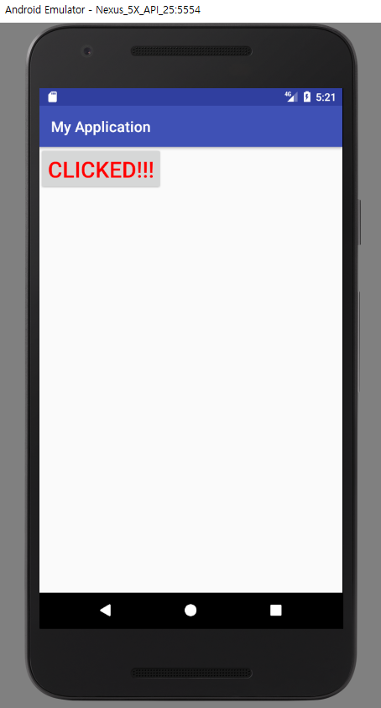
Hacking Tools
Implements
Executing Program
Click the button and Check The text change to “CLICKED!!”
Made by. 43516ED4405CCDFCC07FD09668726ECD

Slide 18
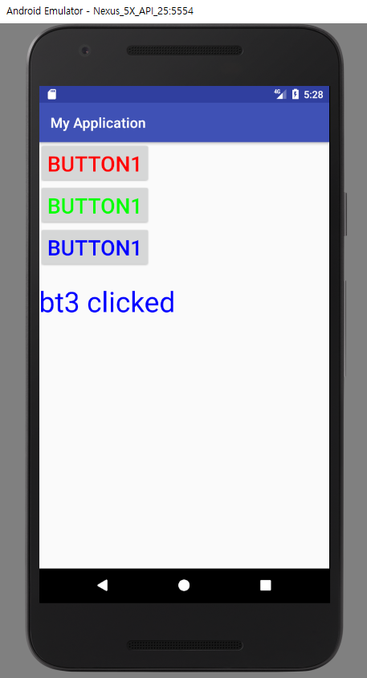
Hacking Tools
Assignment 1
3 Button & 1 TextView
when button 1 clicked, TextView’s text will be “bt1 clicked” and the color will turn Red
when button 2 clicked, TextView’s text will be “bt2 clicked” and the color will turn Green
when button 3 clicked, TextView’s text will be “bt3 clicked” and the color will turn Blue
Made by. 43516ED4405CCDFCC07FD09668726ECD

Slide 19
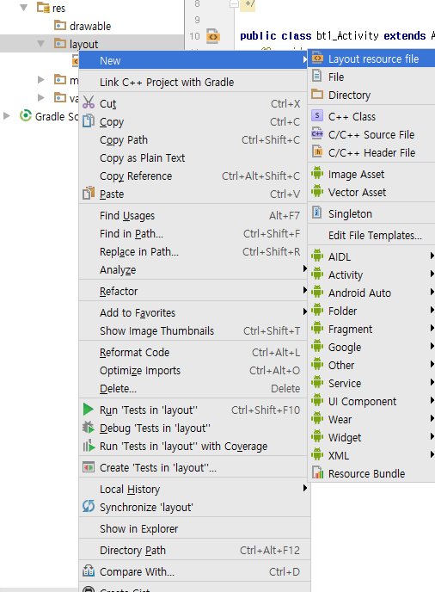
Hacking Tools
Implements
Create new Layout file
(in res.layout)
Made by. 43516ED4405CCDFCC07FD09668726ECD

Slide 20
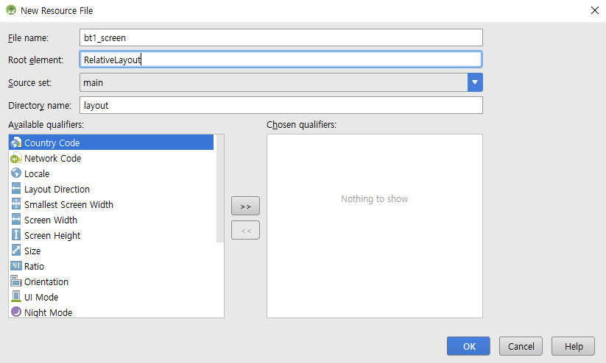
Hacking Tools
Implements
Create new Layout file(in res.layout)
Set name
Set Root element : RelativeLayout
Made by. 43516ED4405CCDFCC07FD09668726ECD

Slide 21
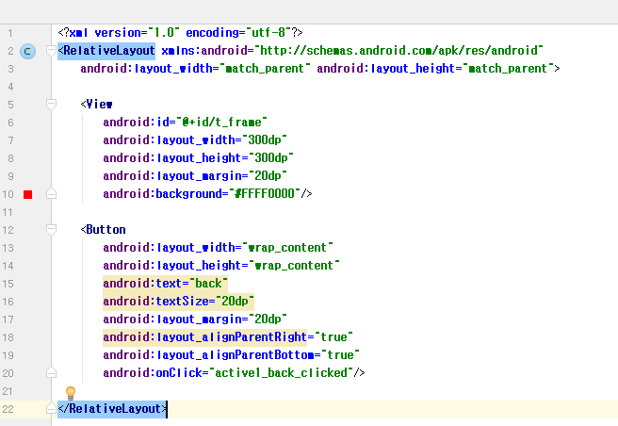
Hacking Tools
Implements
Make View & Button
View just show a rect with red color (coz, bt1 has red)
Button located in right & bottom of screen
Made by. 43516ED4405CCDFCC07FD09668726ECD

Slide 22
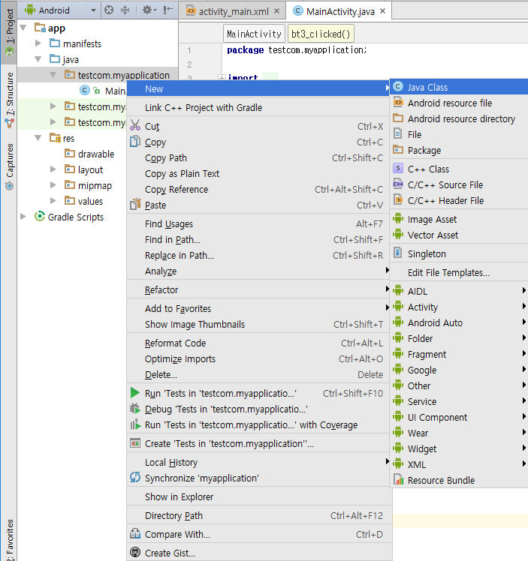
Hacking Tools
Implements
Create new Java Class file
(in current working space)
Made by. 43516ED4405CCDFCC07FD09668726ECD

Slide 23
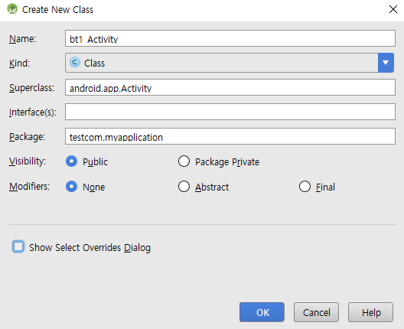
Hacking Tools
Implements
Creating a new Java class
Set the name
Superclass should be android.app.Activity
click OK
Made by. 43516ED4405CCDFCC07FD09668726ECD

Slide 24
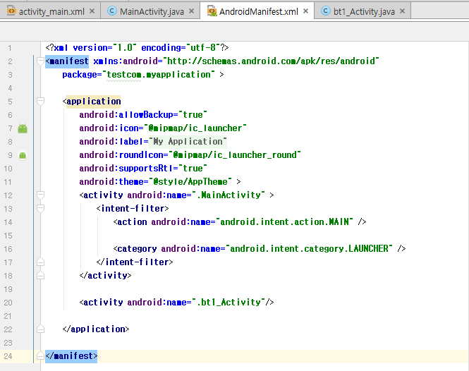
Hacking Tools
Implements
Add just 1 line in application area (line 20)
Manifest file controls the permission of everything in this project
If the Activity (bt1_Activity) didn’t get permission the app will be stopped
Made by. 43516ED4405CCDFCC07FD09668726ECD

Slide 25
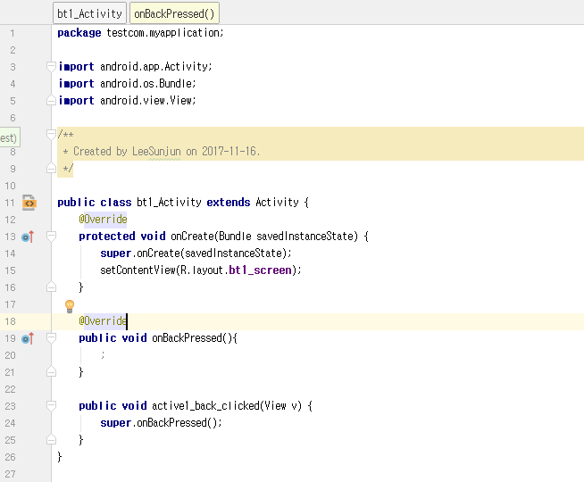
Hacking Tools
Implements
Implement onCreate( ) (Override Activity’s method)
Implement onBackPressed( )
(Override Activity’s method)
Handle the button
onBackPressed( ) in Activity
: operation of back button in navigation bar
Made by. 43516ED4405CCDFCC07FD09668726ECD

Slide 26
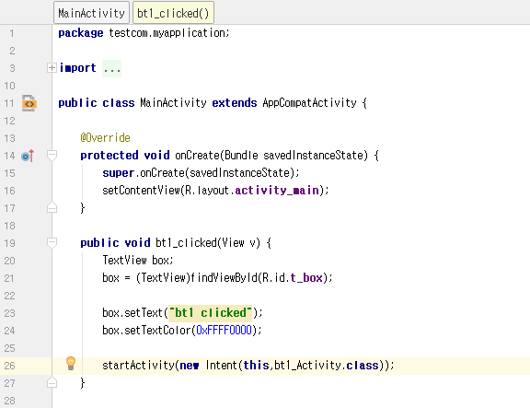
Hacking Tools
Implements
Return to MainActivity
Add 1 line (line 26)
startActivity(Intent I)
startActivity
:start another activity
:input param = intent
Intent(this, activity_a)
:from this to activity_a
Made by. 43516ED4405CCDFCC07FD09668726ECD

Slide 27
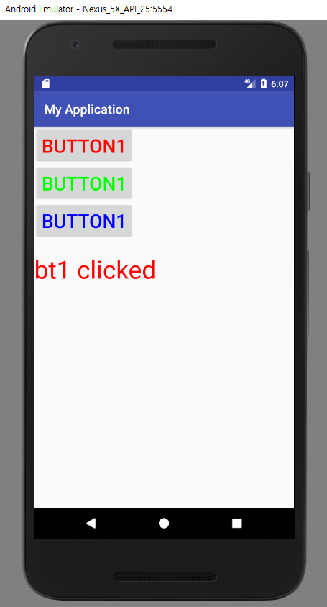
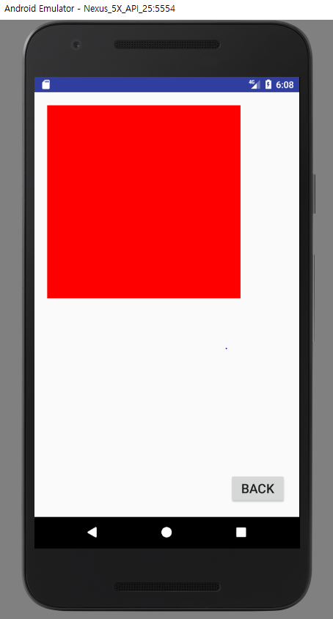
Hacking Tools
Implements
Click BUTTON1 then, another page will be appear(we made right before)
Click BACK in appeared screen, screen will return to original one
Made by. 43516ED4405CCDFCC07FD09668726ECD

Slide 28

Hacking Tools
Assignment 2
3 Button & 1 TextView
when button 1 clicked, Screen will change to another one(bt1’s screen)
when button 2 clicked, Screen will change to another one(bt2’s screen)
when button 3 clicked, Screen will change to another one(bt3’s screen)
Made by. 43516ED4405CCDFCC07FD09668726ECD

Slide 29
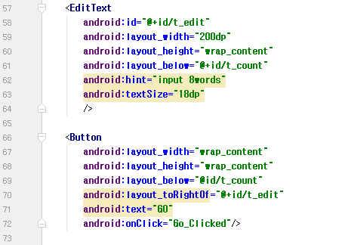
Hacking Tools
Implements
Add 2 Views
Edit Text & Button
Edit Text is for getting String from user
hint attribute
:show example words (this view get focus the words will disappear)
Button is just a trigger to send String
Made by. 43516ED4405CCDFCC07FD09668726ECD

Slide 30
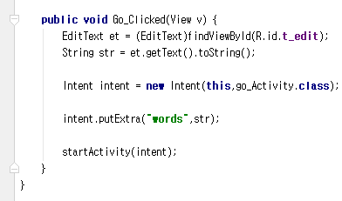
Hacking Tools
Implements
Add new func for handling newly made button
Set EditText variable and get string
getText( ) return Charsequence
toString( ) convert other type to Stirng
Made by. 43516ED4405CCDFCC07FD09668726ECD

Slide 31
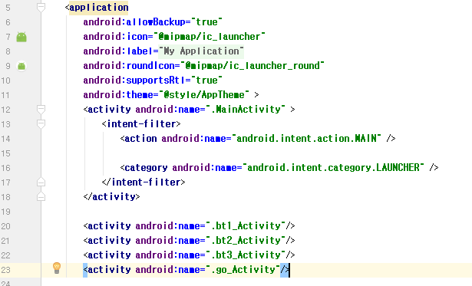
Hacking Tools
Implements
Add just 1 line in application area (line 23)
Manifest file controls the permission of everything in this project
If the Activity (go_Activity) didn’t get permission the app will be stopped
Made by. 43516ED4405CCDFCC07FD09668726ECD

Slide 32
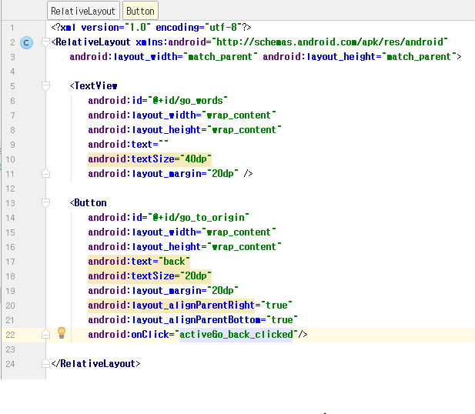
Hacking Tools
Implements
Make a new .xml for go_Activity
It contains 1 TextView & 1 Button
TextView just show the info that receive from original activity
Button’s operation is just back to original activity
Made by. 43516ED4405CCDFCC07FD09668726ECD

Slide 33
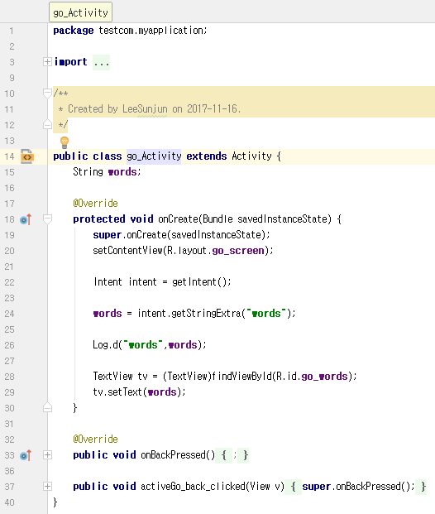
Hacking Tools
Implements
Set a String variable.
get string from original activity by Intent
Change Text for textview by String variable(which is getting from original activity)
Made by. 43516ED4405CCDFCC07FD09668726ECD

Slide 34
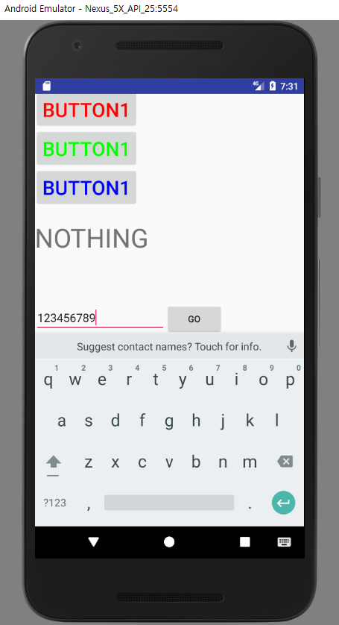
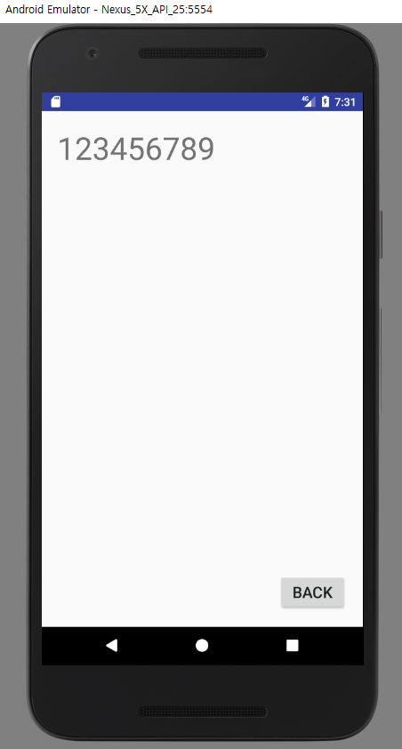
Hacking Tools
Implements
Click GO then, another page will be appear with Text(which is user inserted)
Click BACK in appeared screen, screen will return to original one
Made by. 43516ED4405CCDFCC07FD09668726ECD

Slide 35
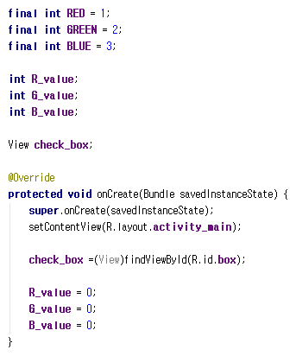
Hacking Tools
Implements
Adding 3 final value & 3 value
Add 1 view for visualize color value
Initialize 3 color values
Made by. 43516ED4405CCDFCC07FD09668726ECD

Slide 36
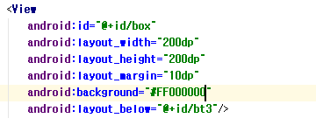
Hacking Tools
Implements
Add 1 Views
This View is present color value
Made by. 43516ED4405CCDFCC07FD09668726ECD

Slide 37
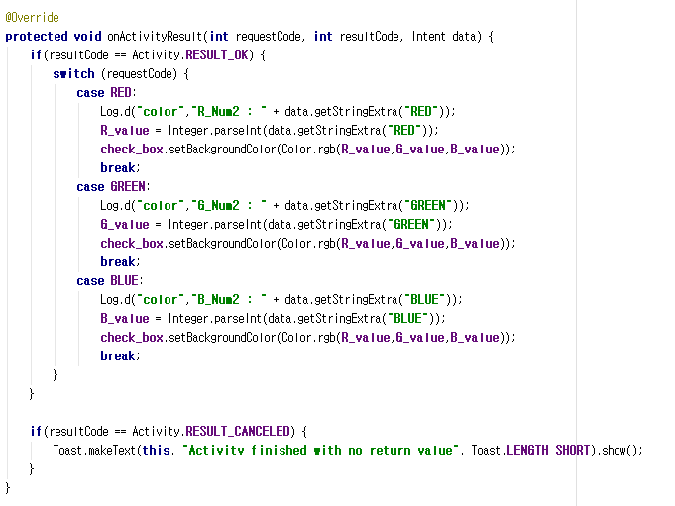
Hacking Tools
Implements
Override ‘onActivityResult’ function
onActivityResult make main activity to get some info from custom Activity
resultCode : Check the Activity ended correctly
requestCode : classify specific Activity for getting data
Made by. 43516ED4405CCDFCC07FD09668726ECD

Slide 38
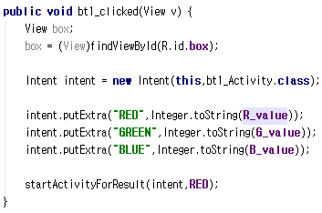
Hacking Tools
Implements
Modify bt1_clicked( )
startActivity -> startActivityForResult
Send R,G,B Value by intent
Made by. 43516ED4405CCDFCC07FD09668726ECD

Slide 39
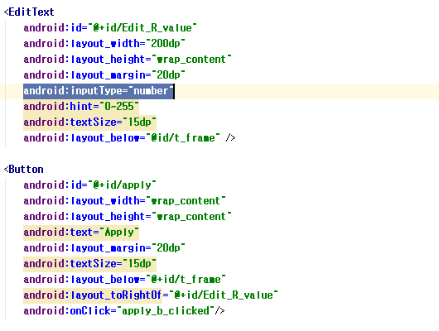
Hacking Tools
Implements
Add 2 Views
EditText for getting int value of R( RGB’s R)
Button apply the value for EditText to View (Square shaped)
Made by. 43516ED4405CCDFCC07FD09668726ECD

Slide 40
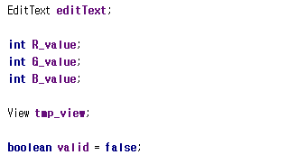
Hacking Tools
Implements
Add 1 EditText
Add 3 int value for getting RGB value from MainActivity
Add boolean value for checking validation
Made by. 43516ED4405CCDFCC07FD09668726ECD

Slide 41
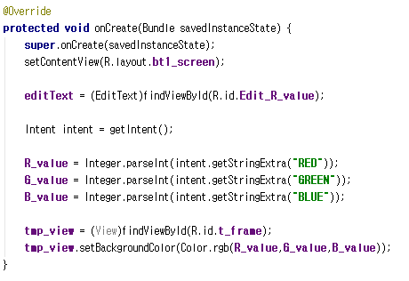
Hacking Tools
Implements
Override ‘onCreate’ Function
Connect EditView from .xml to java file
Get R,G,B Value from mainActivity by intent
Apply R,G,B Value to View (Square shaped)
Made by. 43516ED4405CCDFCC07FD09668726ECD

Slide 42
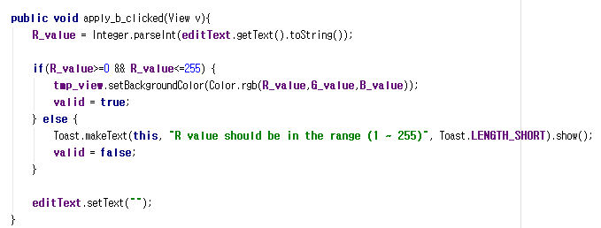
Hacking Tools
Implements
Edit apply_b_clicked( ) : get R value from editText and apply it to View
Exception Handling (R value’s range is (1 ~ 255))
Made by. 43516ED4405CCDFCC07FD09668726ECD

Slide 43
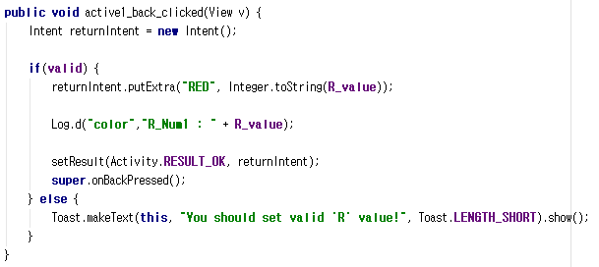
Hacking Tools
Implements
Modify active1_back_clicked( ) : sendData to the Activity that call this Activity
Send resultCode by setResult( )
Made by. 43516ED4405CCDFCC07FD09668726ECD

Slide 44
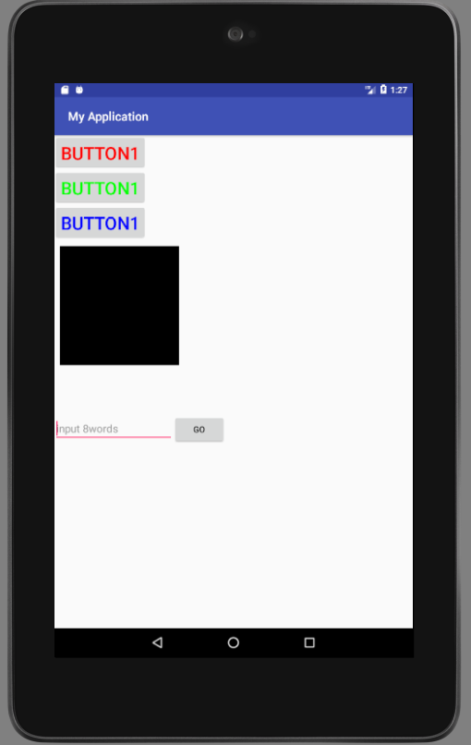
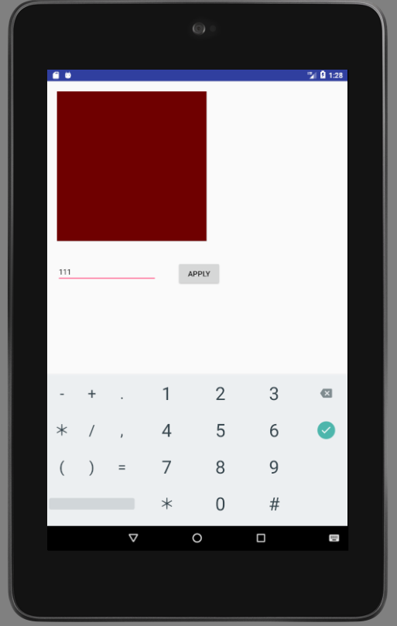
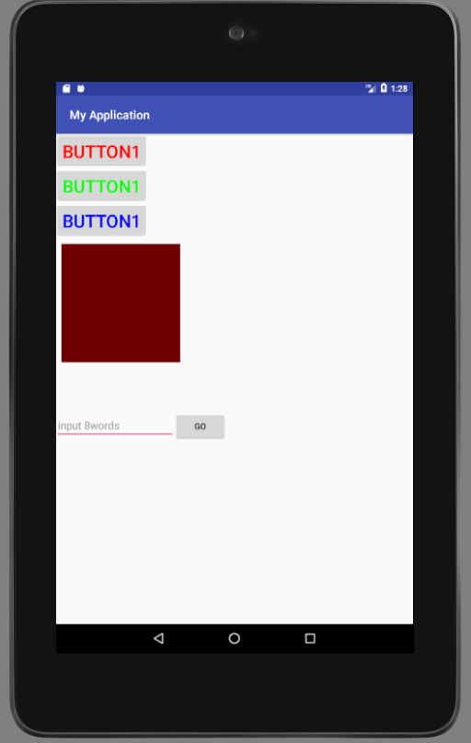
Hacking Tools
Implements
Made by. 43516ED4405CCDFCC07FD09668726ECD

Slide 45

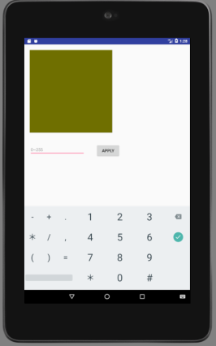
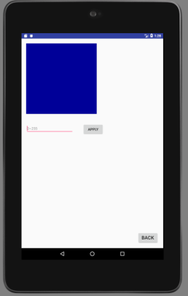
Hacking Tools
Assignment 3
?
Made by. 43516ED4405CCDFCC07FD09668726ECD

