Slide 1
CellExpress Examples
A Comprehensive Microarray-Based Cancer Cell Line and Clinical Sample Gene Expression Analysis Online System
172.16.0.66:8080
NTU CGM Bioinformatics & Biostatistics Core Lab.

Slide 2
CellExpress Examples
We provided examples for each functions of CellExpress. Follow the steps and you will get the same results as the slides.
This is a quick start to use CellExpress. For more detailed information, please see the “CellExpress Tutorial”
If you have any questions, feel free to contact us:)

Slide 3
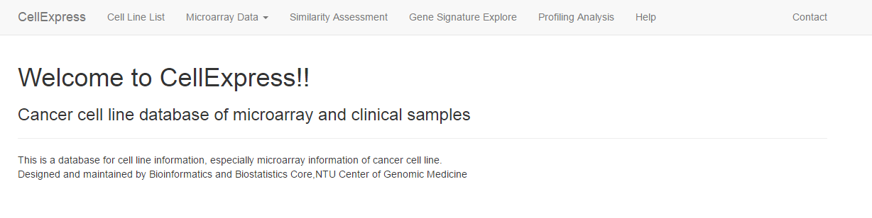

Function 1— Gene Expression Search
Example1
Search the gene expression of TP53 and BRCA2 in breast cancer cell line HCC38 and CAMA-1 in Sanger human cell line project with GAPDH-normalized
Click here for expression search
Click here!

Slide 4

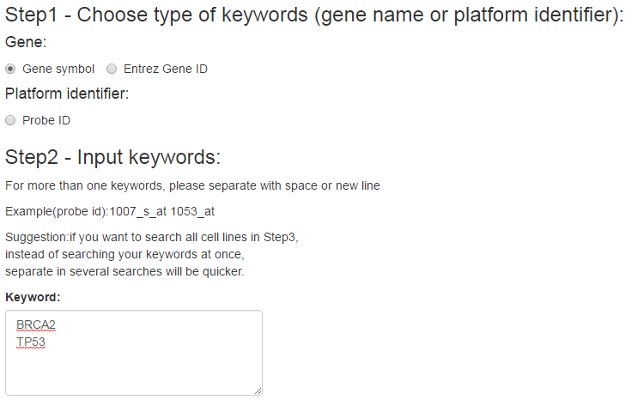
Choose the keyword type. Click Gene symbol here
Choose the keyword type in Step 1,
the keywords input in Step 2 should be based on this choice.
Input the keywords here.
Separate each keyword with space(s) or new line. Input BRCA2 and TP53.

Slide 5
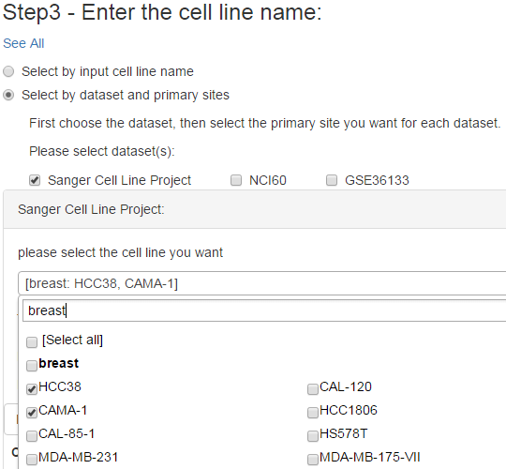
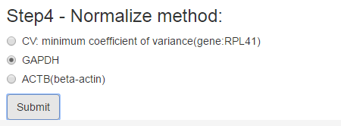
The selection block for each dataset will appear individually below (the red block in this plot.)
Select Sanger project here.
Input keyword to search breast cell lines.
Select the cell line HCC38 and CAMA-1.
Normalization will be done with the gene you selected. Choose the gene GAPDH here, then click submit. You will see the result page.

Slide 6
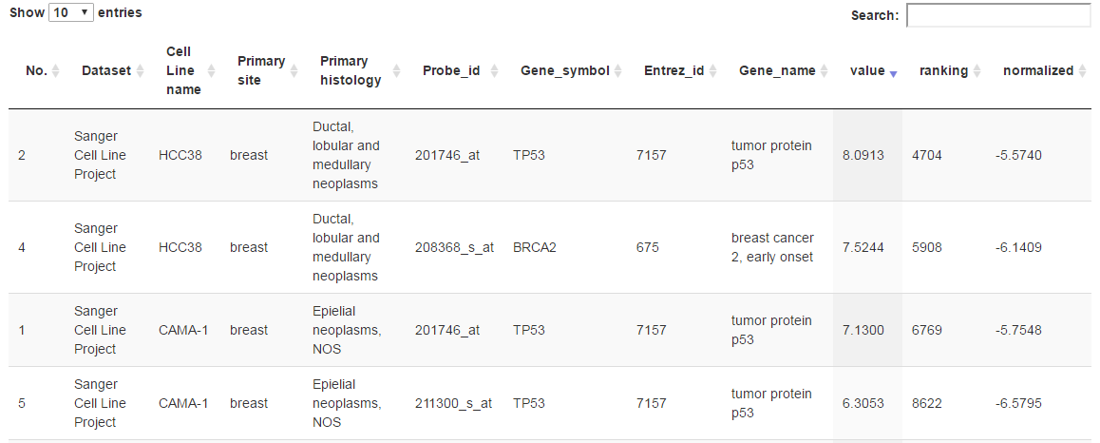

Result Page
Value: the quantiled expression value.
Ranking: the rank of the expression value in the array platform of the dataset.
Normalized: value normalized based on the gene you selected in Step 4.
Basic information of cell lines and genes/probes
Click here to download the table as excel file

Slide 7
Function 1— Gene Expression Search
Example2
Search the gene expression of TP53 and BRCA2 in breast adenocarcinoma clinical samples in expO dataset with GAPDH-normalized
Click here for expression search
Click here!

Slide 8

Choose the keyword type: Gene symbol
Choose the keyword type in Step 1,
the keywords input in Step 2 should be based on this choice.
Input the keywords BRCA2 and TP53 here.
Separate each keyword with space(s) or new line.

Slide 9
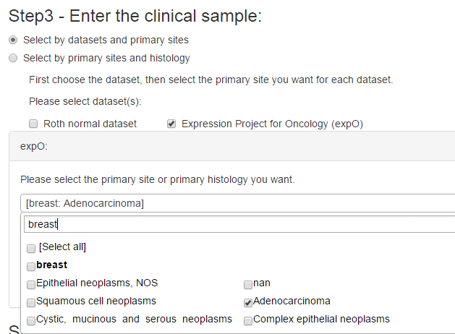
The selection block for the dataset will appear individually below (the red block in this plot.) Choose ExpO .
Input keyword to search primary site of breast
Select the primary histology: Adenocarcinoma
Normalization will be done with the gene you selected. Choose the gene GAPDH, then click submit. You will see the result page.

Slide 10
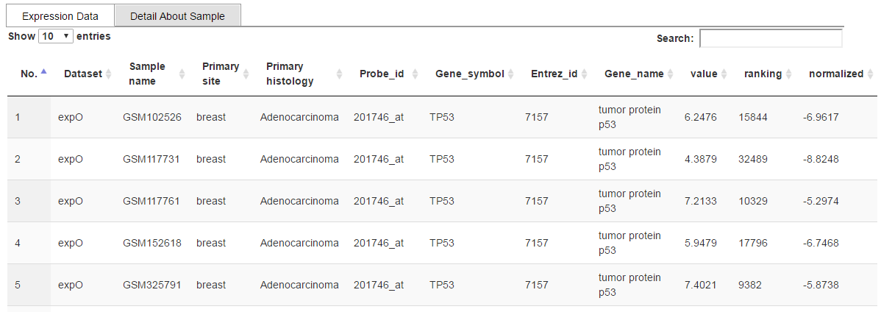
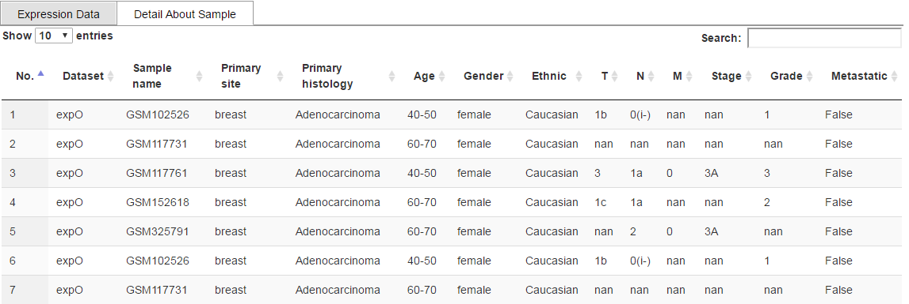
Result Page
Value: the quantiled expression value.
Ranking: the rank of the expression value in the array platform of the dataset.
Normalized: value normalized based on the gene you selected in Step 4.
Basic information and expression value of the samples and genes/probes
Detail information of the samples

Slide 11
Function 2— Gene Signature Explorer
Example
-Compare the breast tissue cell lines and central nervous system cell lines in NCI60 dataset with Student’s t-test
-All probe level comparison
-Cluster heatmap with statistical significant probes filtered by the p-value evaluated real time

Slide 12
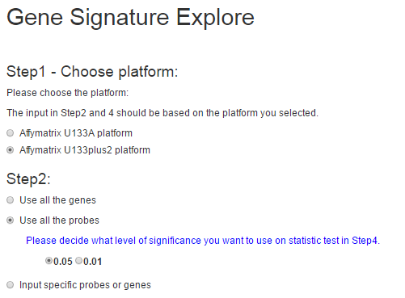
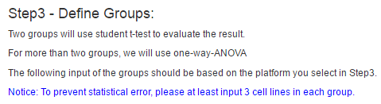
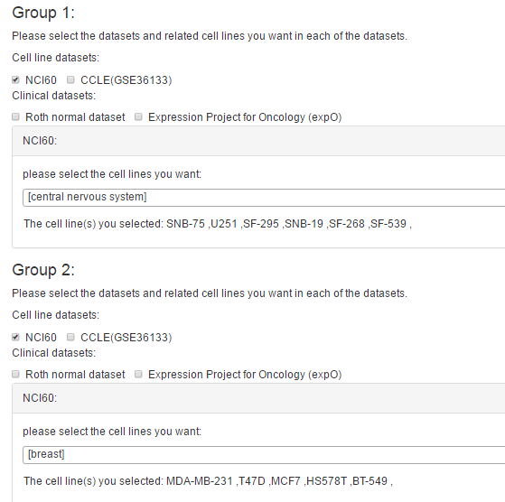
Select NCI60 then the cell line selection block below will show.
Search central nervous system and select the cell lines.
Filter from all the genes or probes in the platform you selected in Step 1 with the p-value threshold you decided.
Select NCI60 then the cell line selection block below will show.
Click submit when you finish these three steps.
Search breast and select the cell lines.

Slide 13
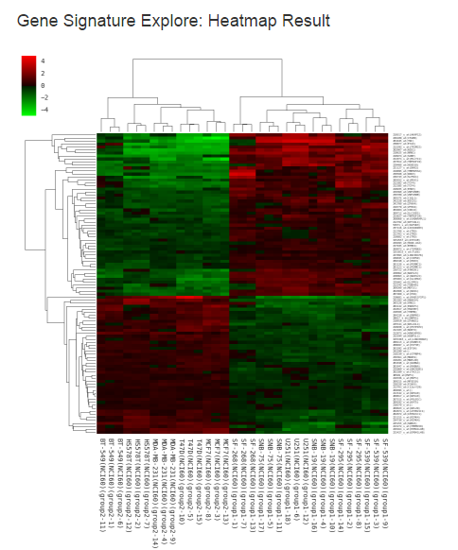
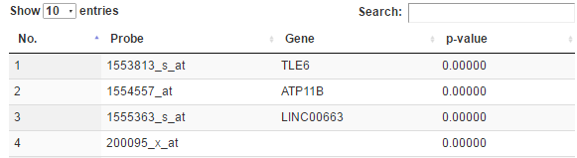

Result Page
Show significant probes ‘ name
P-value table
Click here to download excel file of p-value table
Cell line names and the group they belong to.

Slide 14
Function 3— Similarity Assessment
Example:
Compare the similarity between breast cancer cell lines and skin tissue cancer cell lines in Sanger Cell Line Project.
Display method:
-one dot represents the centroid of the cell line
3 samples of
the same cell line
Only one dot to
represent the cell line
centroid
Click here for similarity assessment

Slide 15
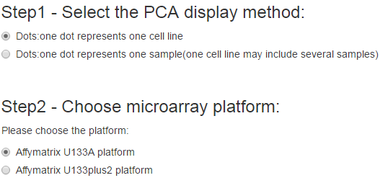
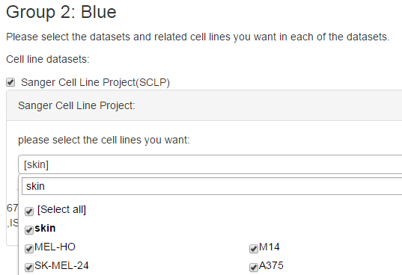
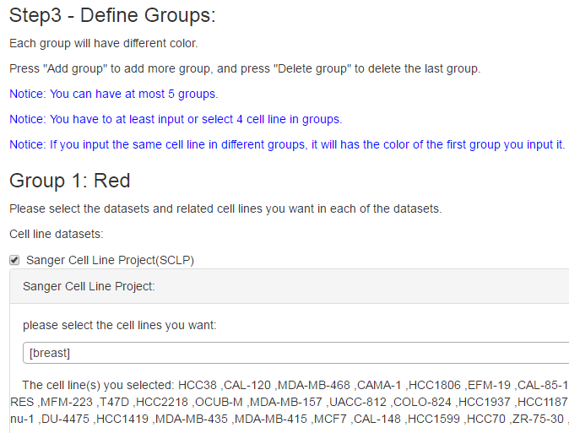


Select the dataset Sanger, and search “skin” in the selection block. Select the skin cancer cell lines.
Select one dot represent one cell line(centroid)
Choose the array platform of datasets in Step 3. Click U133A here
Select the dataset Sanger, and search “breast” in the selection block. Select the breast cancer cell lines.
Submit when you finish the three steps above. Then you will see the result page
Click “Add Group” to add one more group for skin tissue

Slide 16

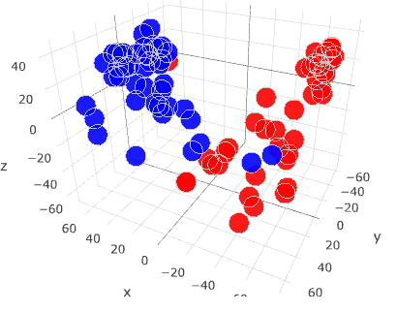
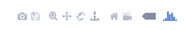
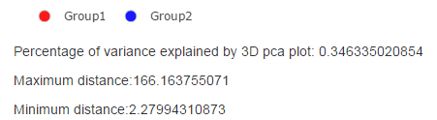

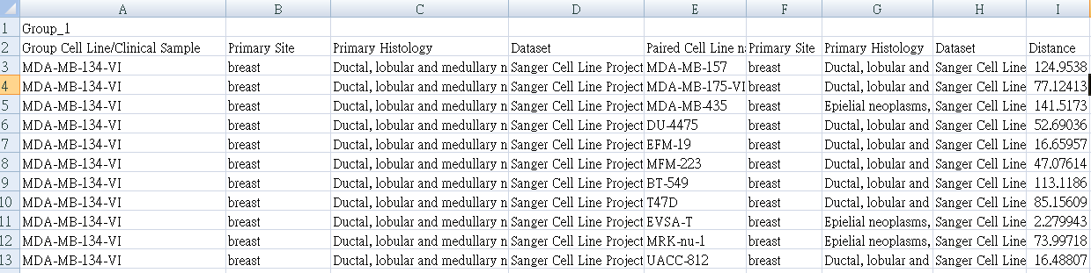
Result Page
Tools for screen capture est..
Possible misclassification
Click the circle to decide which group to display or hide
3D PCA plot. Rotation, zoom in/out are supported.
Information about the PCA plot
Download link provided for big distance table
Downloaded distance table

Slide 17
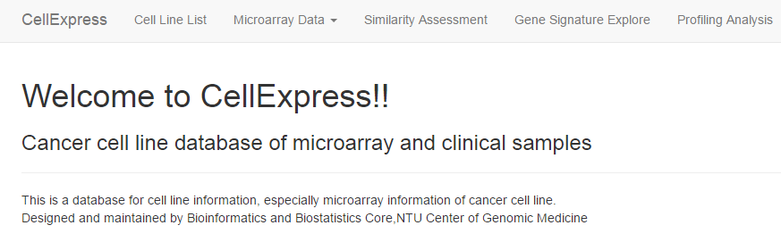
Function 4— Profiling Analysis
Upload NGS GSE93385 brain neural tissue stem cells expression file and analyze the similarity with central nervous cell lines and autonomic ganglia tissue cell lines in CCLE
Gene level comparison
-At most 1 user group(file)
-NGS or microarray data
-All zero rows will be removed
-Rank invariant normalization
Click here for profiling analysis

Slide 18
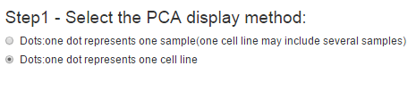
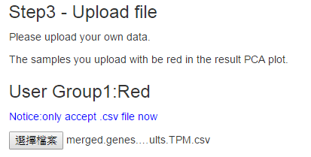
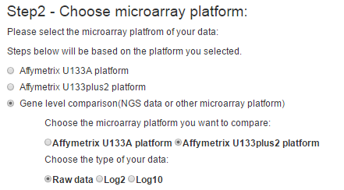
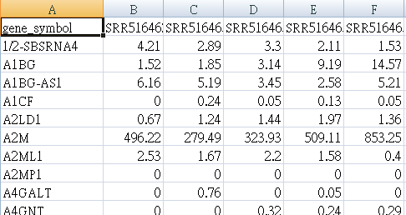
Select one dot represents one cell line (centroid)
Gene level: Select the array platform of dataset to compare in Step 3. Click U133Plus2.0 here
We provide the example file “merged.genes.results.TPM.csv” sorted from GSE93385 as below
Sample name
Gene level comparison
csv file format:
Official gene symbol
Select the type of your data. Select “Raw data” here.

Slide 19
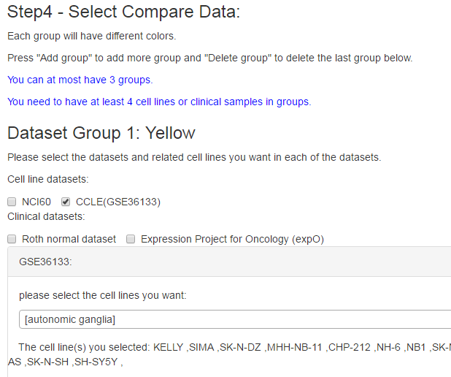
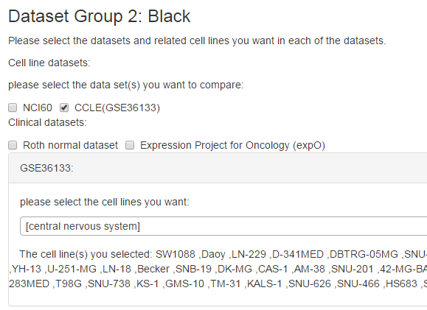


Select the dataset first, then the selection block for the set will appear individually. Click CCLE here.
Selection block:
Search autonomic ganglia and select the cell lines below it.
Do the same procedure for central nervous cell lines in CCLE dataset in Group2, too. Then, click “Submit”
Click this to add one more group for central nervous cell lines

Slide 20
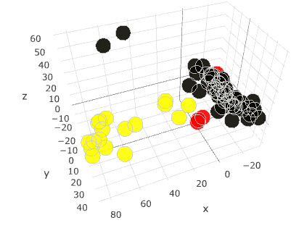
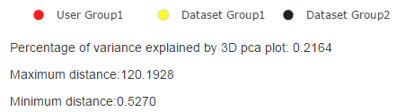
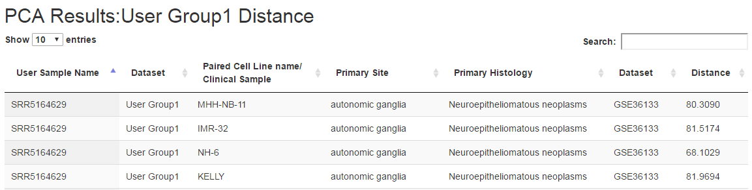
Result Page
Tools for screen capture est..
Display method
Click the circle to decide which group to display or hide
3D PCA plot. Rotation, zoom in/out are supported.
Distance table for each group showed in page.
Information about the PCA plot

