Slide 1
CellExpress Tutorial
A Comprehensive Microarray-Based Cancer Cell Line and Clinical Sample Gene Expression Analysis Online System
172.16.0.66:8080
NTU CGM Bioinformatics & Biostatistics Core Lab.

Slide 2
Characteristics
Feature :
Provides comprehensive gene expression profiles analysis both for cell lines and clinical samples
User friendly interface and visualized results
User data upload supported
All data and figures can be downloaded
A Python Django and SQLite based website with jQuery and javascripts front end
Four functions:
Gene expression search
Gene signature explorer
Similarity assessment
Profiling analysis
NTU CGM Bioinformatics & Biostatistics Core Lab.

Slide 3
Dataset Information
Dataset Name | Type | Sample Number | Cell Line number | Tissue Origin Number | Platform
Sanger Cell Line Project (GSE68950) | cancer cell line | 798 | 732 | 32 | Affymetrix U133A
CCLE (GSE36133) | cancer cell line | 917 | 917 | 24 | Affymetrix U133 Plus2.0
NCI-60 (GSE32474) | cancer cell line | 174 | 60 | 9 | Affymetrix U133 Plus2.0
expO(GSE2109) | clinical sample | 2152 | N/A | 74 | Affymetrix U133 Plus2.0
Roth Normal Dataset(GSE7307) | normal tissue | 353 | N/A | 62 | Affymetrix U133 Plus2.0
Total(without duplication) |  | 4394 | 1319 | 128 | -

Slide 4
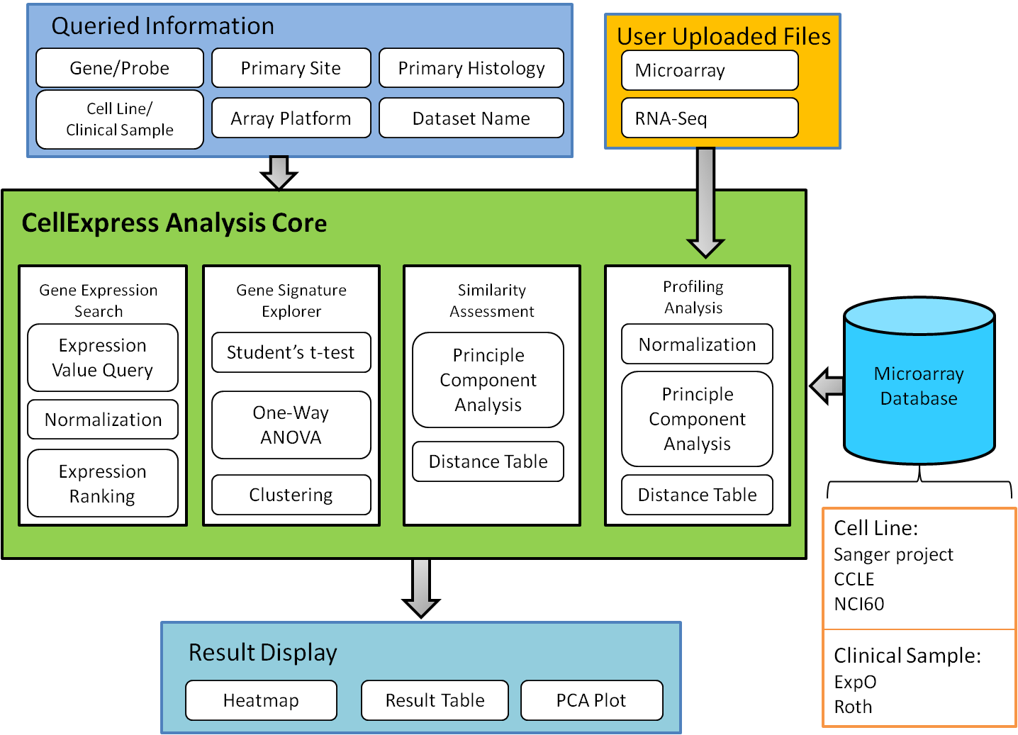
Workflow Structure

Slide 5
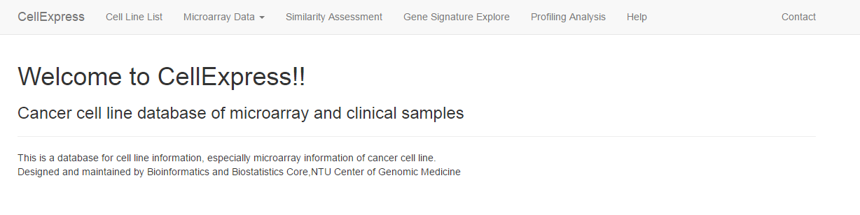
Home Page
List of all available cell lines in CellExpress
Tutorial and example for usage
Link to four analysis functions’ pages
Feel free to contact us when you found bugs or having any questions :)
Link to CellExpress: 172.16.0.66:8080

Slide 6
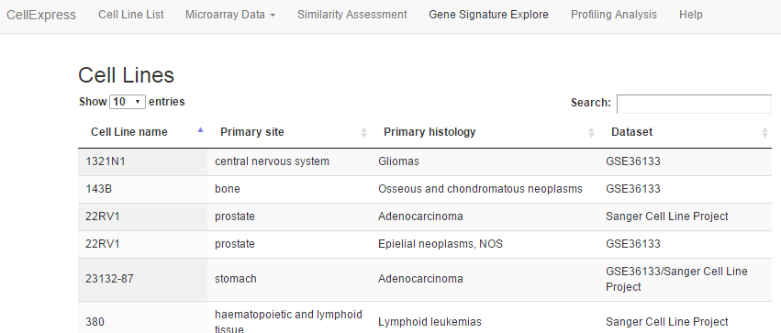
Avaliable Cell Lines
List of all available cell lines in CellExpress

Slide 7
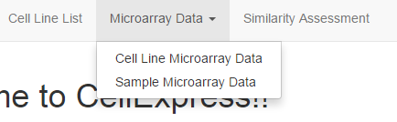
Function 1— Gene Expression Search
Search for gene expression data with probe ID, Entrez Gene ID or official gene symbol
Normalization will be done based on:
-House keeping gene: GAPDH, ACTB
-Gene with minimum coefficient of variance: RPL41
Cell Line Microarray Data
-Search for cell line gene expression data
Sample Microarray Data
-Search for clinical sample gene expression data
(Only the Step 3 is different in this two modes )
Click here!

Slide 8
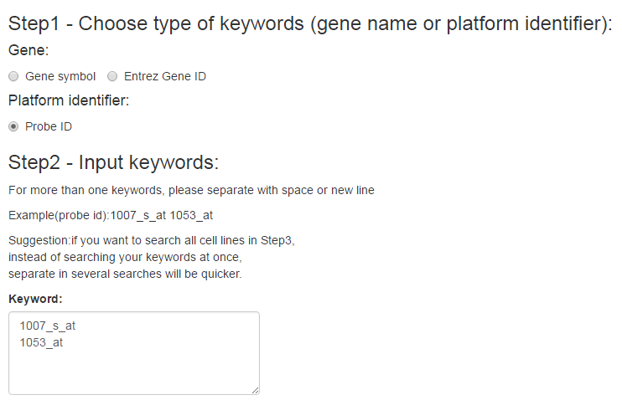
Step 1 & 2
Choose the keyword type
Choose the keyword type in Step 1,
the keywords input in Step 2 should be based on this choice.
Input the keywords here.
Separate each keyword with space(s) or new line.

Slide 9
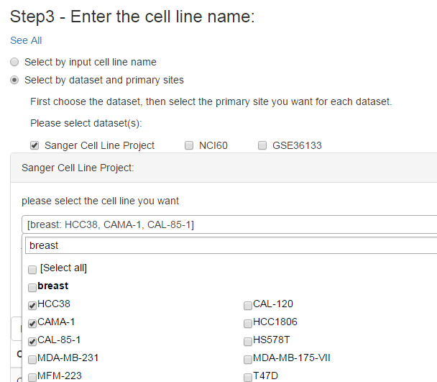
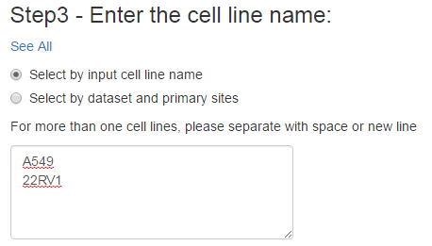
Cell Line Microarray Data—Step3
Step 3 of “cell line microarray” has two different choices
If you choose to select the cell line by dataset and primary sites, select the dataset first. The selection block for each dataset will appear individually below (the red block in this plot.)
Input the cell line names directly. Separate each with space(s) or new line.
Input keyword to search cell line name or primary site.
Select the cell line you want.

Slide 10
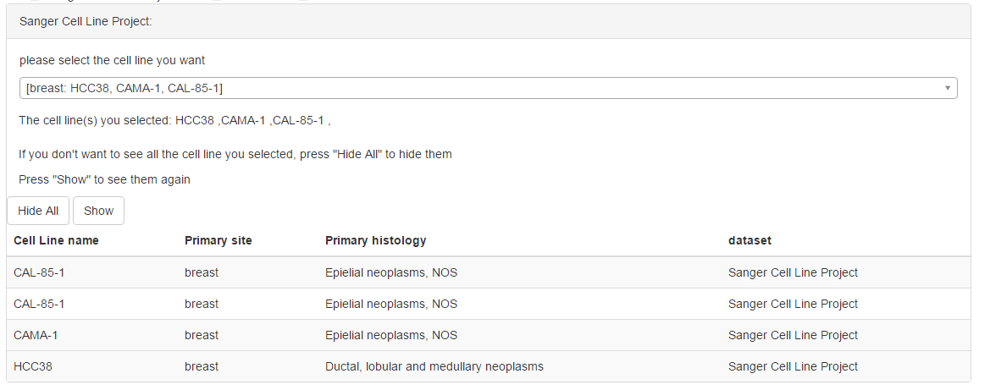
Cell Line Microarray Data—Step3
After you select the cell line, you will see the following
Notice: Input cell line names directly will not see this
Click this, return to selection part of p.8
Dataset name
The cell line you selected
Click this, hide or show the red block table below
The selected cell lines’ information

Slide 11
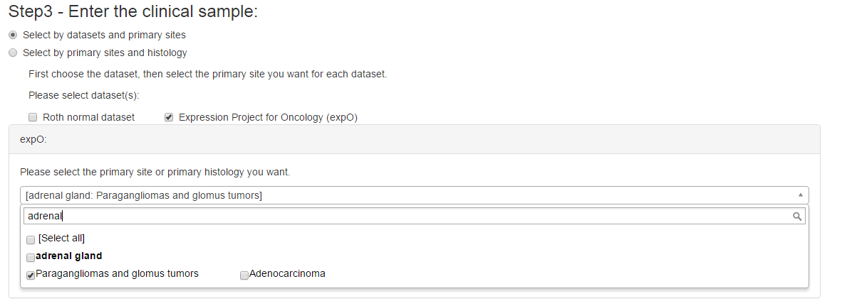
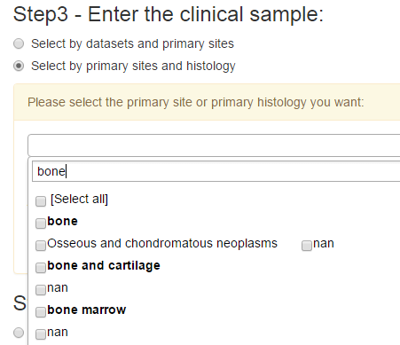
Sample Microarray Data—Step3
Step 3 of “cell line microarray” has two different choices
If you choose to by dataset and primary sites, select the dataset first. The selection block for each dataset will appear individually below (the red block in this plot.)
If you choose to select by primary sites and histology, the search will be done on all clinical datasets.
Input keyword to search primary site or histology.
Select the primary histology.
Nan:
Normal tissues do not have primary histology .
Same samples do not have the information about primary histology.

Slide 12
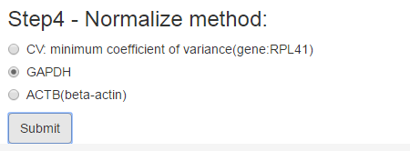
Step 4
Normalization will be done with the gene you selected. Choose the gene you want, then click submit. You will see the result page.

Slide 13
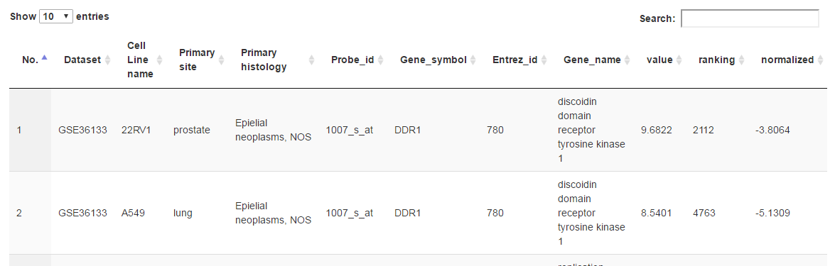

Cell Line Microarray Data—Result
Value: the quantiled expression value.
Ranking: the rank of the expression value in the array platform of the dataset.
Normalized: value normalized based on the gene you selected in Step 4.
Basic information of cell lines and genes/probes
Click here to download the table as excel file

Slide 14
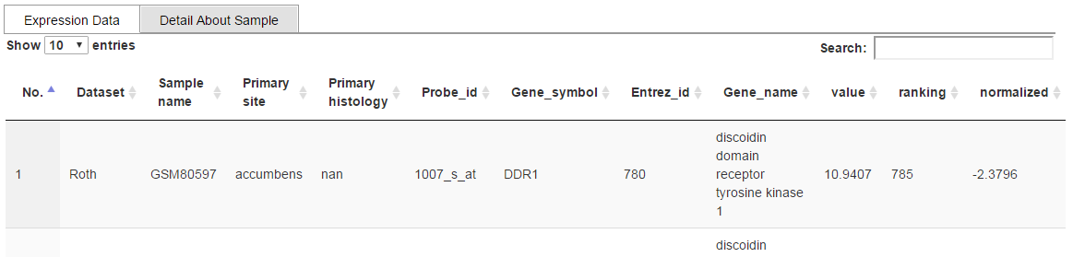
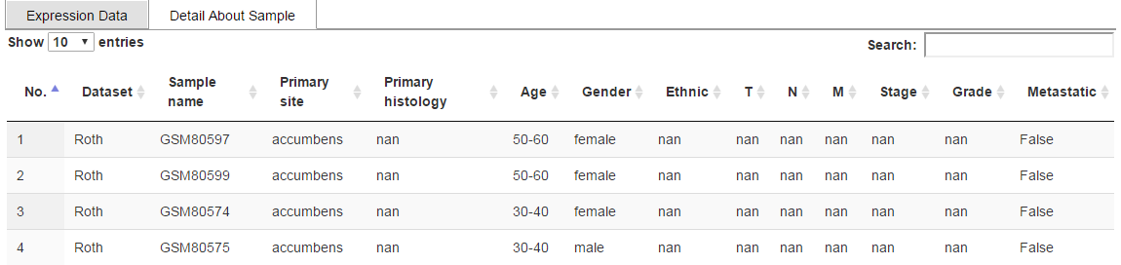
Sample Microarray Data—Result
Basic information and expression value of the samples and genes/probes
Value: the quantiled expression value.
Ranking: the rank of the expression value in the array platform of the dataset.
Normalized: value normalized based on the gene you selected in Step 4.
Detail information of the samples

Slide 15
Function 2— Gene Signature Explorer
Cluster heatmap with statistical significant genes/probes filtered by the p-value evaluated real time
User define groups
-Two groups: Student t-test
-More than two groups: one-way-ANOVA
P-value table provided
P-value evaluated
Expression data -Mean
Clustering
Heatmap display

Slide 16
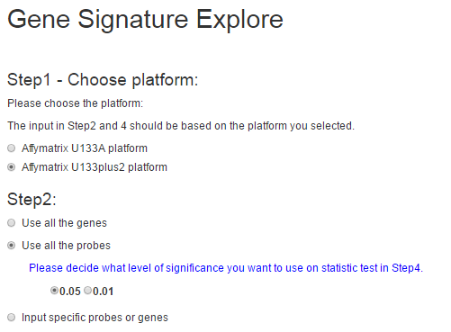
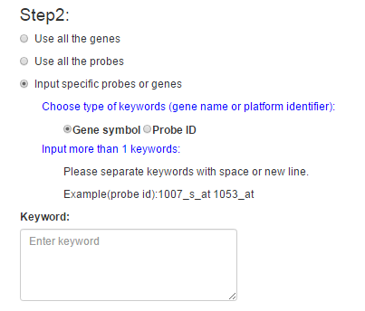
Step 1 & 2
Choose the keyword type,
the keywords input should be based on this choice.
OR
Filter from all the genes or probes in the platform you selected in Step 1 with the p-value threshold you decided.
Filter from specific genes or probes you input here in the platform you selected in Step 1. Won’t filter with any p-value threshold. If you input more than 600 probes or genes, show the top significant 600 ones.

Slide 17
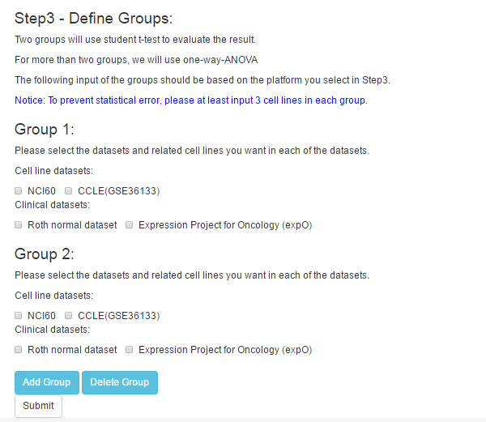
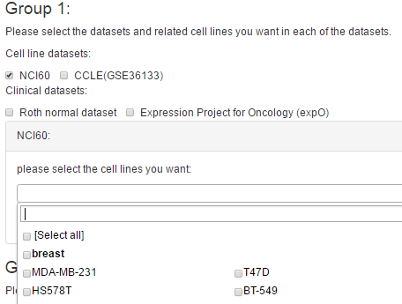
Step 3
You need to have at least two groups for the Student’s t-test. Select the dataset first, then select the cell lines or primary sites in the selection block for the dataset.
Select at least 3 cell lines in each group to prevent statistical error.(no matter from what datasets)
Click here to add or delete the last group. 2<=group number<=5

Slide 18
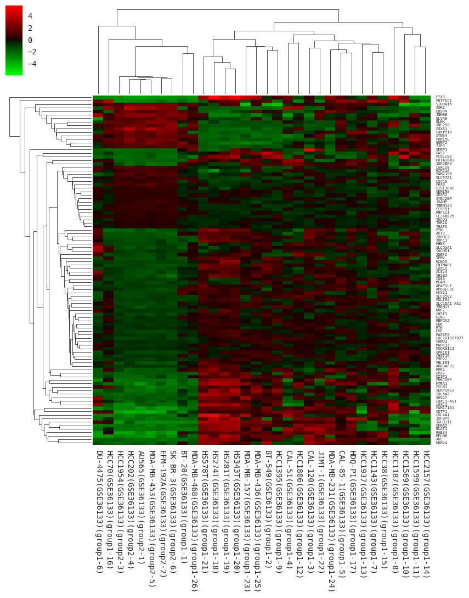
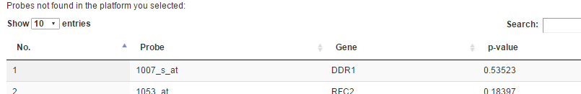
Result
Show at most 600 probes or genes
1. Statistically significant probes or genes that passed the p-value threshold in “all genes” or “all probes” mode
2. All the specific genes or probes you input
Genes or probes not found will be showed here in input mode
P-value table
Cell line names or sample names and the group they belong to.

Slide 19

Function 3— Similarity Assessment
Compare the similarity between cell lines or clinical samples
Display the PCA plot and Euclid distance table
Two different display method:
-one dot represents one sample
-one dot represents the centroid of the cell line
PC1 will be removed to reduce the batch effect when more than two datasets are selected
If there are too many samples, the distance table will be provided as download link
3 samples of
the same cell line
Only one dot to
represent the cell line
centroid

Slide 20
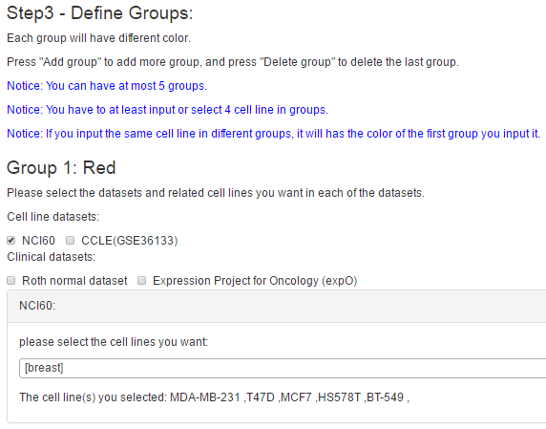
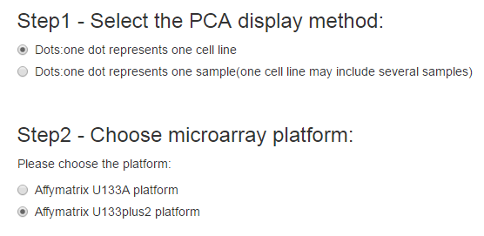

Important notice here. Read before you select.
Select one of the display method as P. 14 described
The dots in the same group will have the same color.
Select the dataset first, then the selection block (green) for the set will appear individually.
Choose the array platform of datasets in Step 3
Selection block:
Select the cell lines. Need to select at least four cell lines totally (no matter in what group) .
Click here to add or delete the last group. 1<=group number<=5

Slide 21
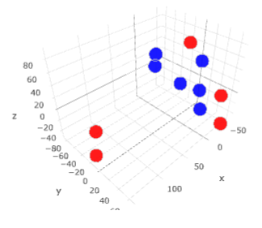

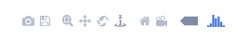
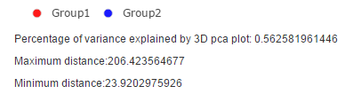
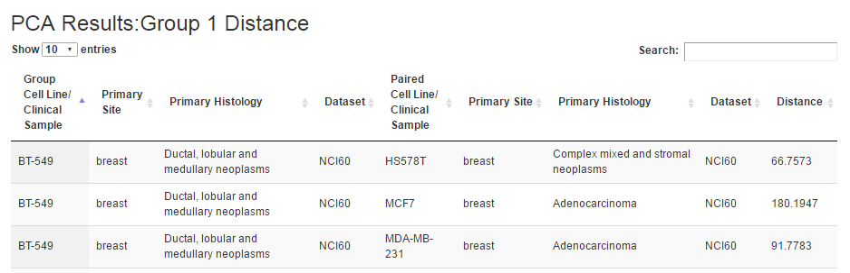
Result
Tools for screen capture est..
Display method
Click the circle to decide which group to display or hide
3D PCA plot. Rotation, zoom in/out are supported.
Information about the PCA plot
Distance table for each group

Slide 22
Function 4— Profiling Analysis
Upload your own csv files and analyze the similarity with database of CellExpress
Gene level comparison
-At most 1 user group(file)
-NGS or microarray data
-All zero rows will be removed
-Rank invariant normalization
Probe level comparison
-At most 2 user groups(files)
-Only support Affymetrix U133A and U133Plus 2.0 platform
-Quantile normalization

Slide 23
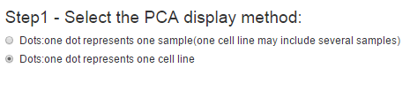
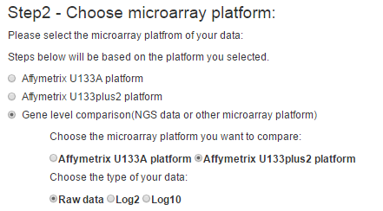
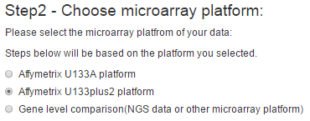
Step 1 & 2
Select one of the display method as P. 14 described
OR
Probe level: Select the array platform of dataset to compare in Step 3.
Gene level: Select the array platform of dataset to compare in Step 3.
Select the type of your data.

Slide 24
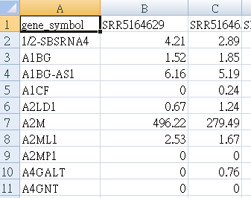
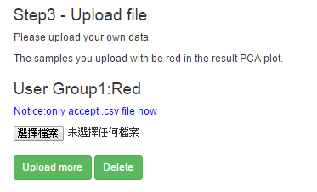
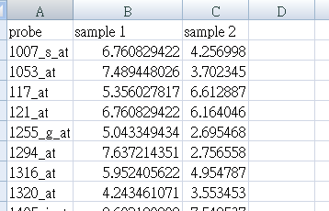
Step 3 & Upload File Format
Gene level comparison
csv file format:
Sample name
Official gene symbol
Probe level comparison
csv file format:
Sample name
Only for probe level comparison. Can have at most 2 groups .
Probe ID

Slide 25
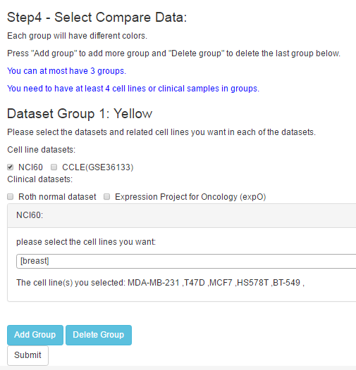
Step 4
The dots in the same group will have the same color.
Select the dataset first, then the selection block for the set will appear individually.
Selection block:
Select the cell lines. Need to select at least four cell lines totally (no matter in what group) .
Click this to add or remove the last group. 1<=group number<=3

Slide 26
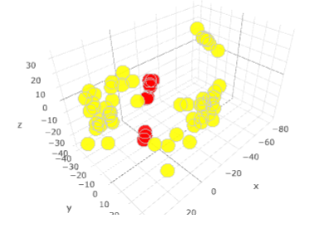

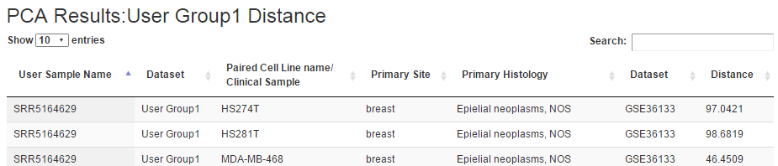
Result
Tools for screen capture est..
Display method
Click the circle to decide which group to display or hide
3D PCA plot. Rotation, zoom in/out are supported.
Distance table for each group
Information about the PCA plot

