Slide 1
Online Visual Localization APP
Li Yizhou (M1)
July 21, 2020

Slide 2
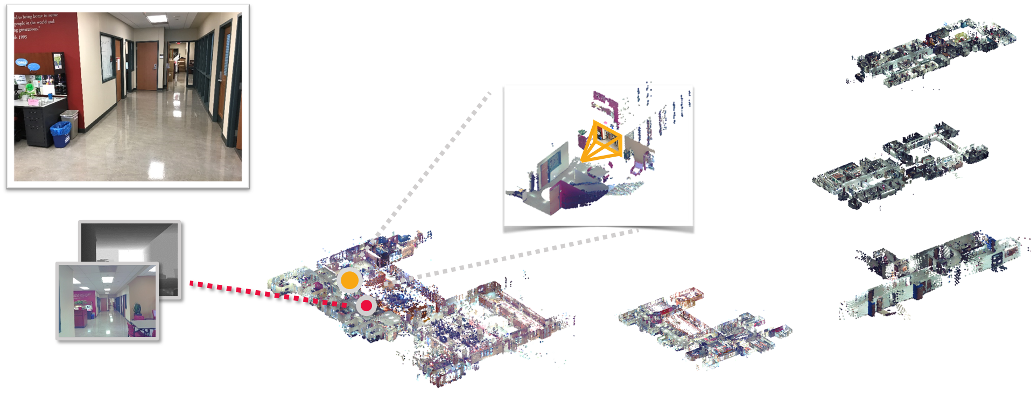
Introduction
What is visual localization
Input: single RGB image query
Output: The 3D location where this image is captured
Input: Single RGB image
Output: 3D locations in the 3D map
DB: RGB image set

Slide 3
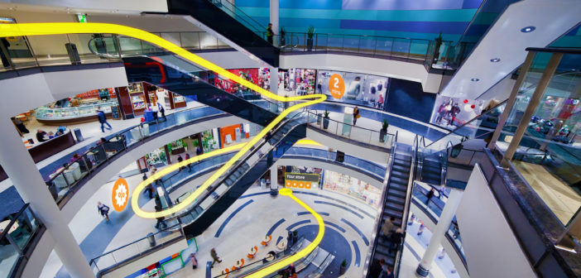
Introduction
Where it can be used
Indoor environments, where GPS is limited
The additional information that GPS cannot give you:
which floor am I?

Slide 4
Introduction
Our target
For most users, they will use the visual localization, by simply inputting single image
For the contributing users, we provide the tools for them to reconstruct the 3D model of a scene online
This is the basic of visual localization algorithm
Single Image
Online Visual Localization
3D location of User (x, y, z)
Image …
Image 2
Online 3D Reconstruction
3D Model of the Scene
Image 1

Slide 5



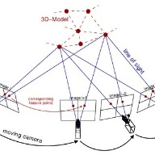

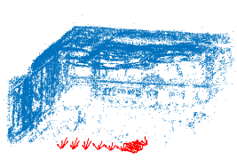




Introduction
The pipeline of the APP
Multiple images
of a scene
Online 3D Reconstruction
Online SfM
Request
3D model
downloading
Download
Server
User end
3D Point Cloud
X1,y1,z1
Single query image
？
。
。
。
3D Visual
Localization
？
User Coordinate:
Correct x, y, z
Image Searching
Xn,yn,zn
Android APP
Python Flask Server

Slide 6
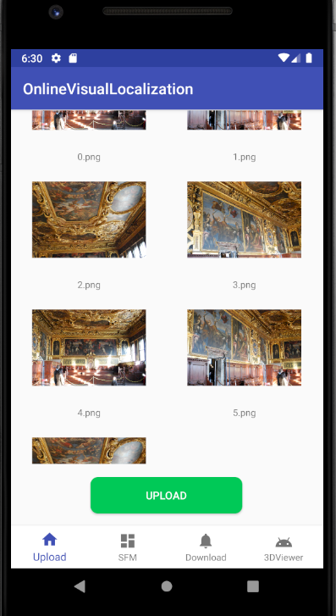
Introduction
Online 3D Reconstruction - Image Uploading
Function: Upload the images of a scene to the server, for online SfM 3D reconstruction
Layout: ConstraintLayout + GridView + BottomNavigationView
Network Client: OkHttp 3.10.0
Server: Python Flask
AsyncTask: Used to prevent time-consuming operations in main thread

Slide 7
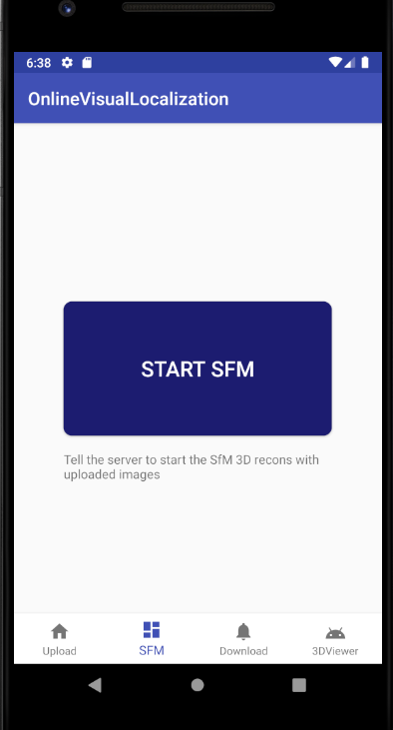
Introduction
Online 3D Reconstruction – Request SfM
Function: Tell the server to start SfM 3D reconstruction
3D Reconstruction: COLMAP (Structure-from-motion)
Layout: ConstraintLayout
Network Client: OkHttp 3.10.0
Server: Python Flask
AsyncTask: Used to prevent time-consuming operations in main thread

Slide 8
Introduction
The pipeline of the APP
Multiple images
of a scene
Online 3D Reconstruction
Online SfM
Request
3D model
downloading
Download
Server
User end
3D Point Cloud
X1,y1,z1
Single query image
？
。
。
。
3D Visual
Localization
？
User Location:
Correct x, y, z
Image Searching
Xn,yn,zn
Android APP
Python Flask Server

Slide 9
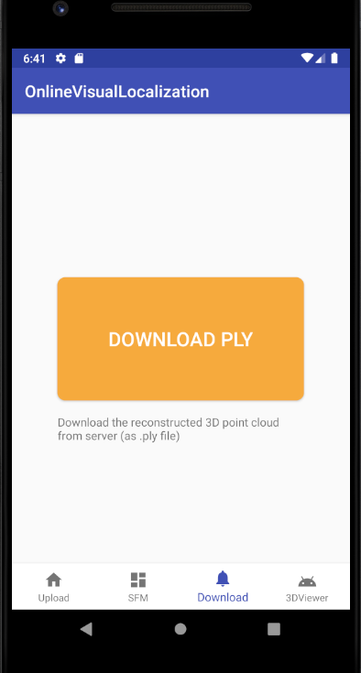
Introduction
3D Model Downloading
Function: Download the reconstructed 3D point cloud (.ply) from server
Layout: ConstraintLayout
Network Client: OkHttp 3.10.0
Server: Python Flask
AsyncTask: Used to prevent time-consuming operations in main thread

Slide 10
Introduction
The pipeline of the APP
Multiple images
of a scene
Online 3D Reconstruction
Online SfM
Request
3D model
downloading
Download
Server
User end
3D Point Cloud
X1,y1,z1
Single query image
？
。
。
。
3D Visual
Localization
？
User Coordinate:
Correct x, y, z
Image Searching
Xn,yn,zn
Android APP
Python Flask Server

Slide 11
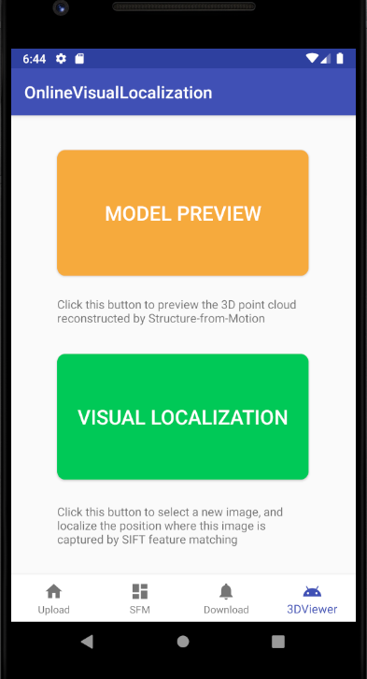
Introduction
Online Visual Localization - Interface
Function: UI to start the preview of downloaded 3D point cloud / the visual localization
Layout: ConstraintLayout
AsyncTask: Used to prevent time-consuming operations (Model loading) in main thread

Slide 12
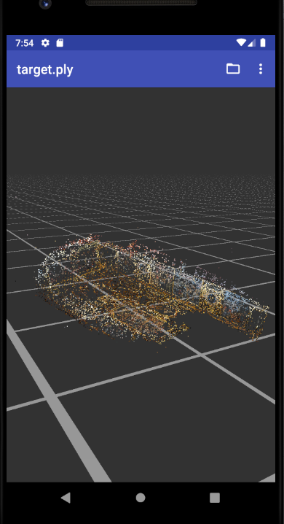
Introduction
Online Visual Localization – 3D Viewer
Function: 3D Viewer
Renderer: OpenGL ES 2.0
Rotation/Zoom: Supported
AsyncTask: Used to prevent time-consuming operations (Model loading) in main thread

Slide 13
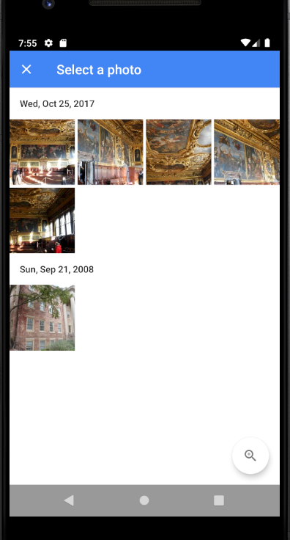
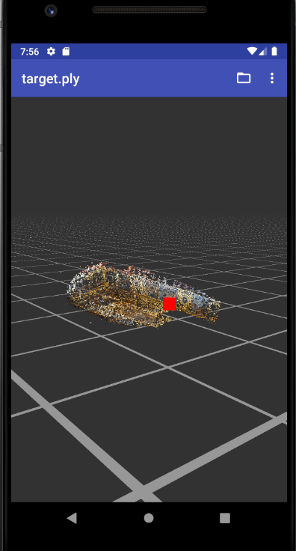
Introduction
Online Visual Localization – Visual Localization
Function: The red dot tells the 3D location of the user. Users know clearly where they are by inputting single image
Image Searching: SIFT feature + Cosine Simularity
Renderer: OpenGL ES 2.0
Rotation/Zoom: Supported
AsyncTask: Used to prevent time-consuming operations (Model loading) in main thread

Slide 14
Introduction
Demo

Slide 15
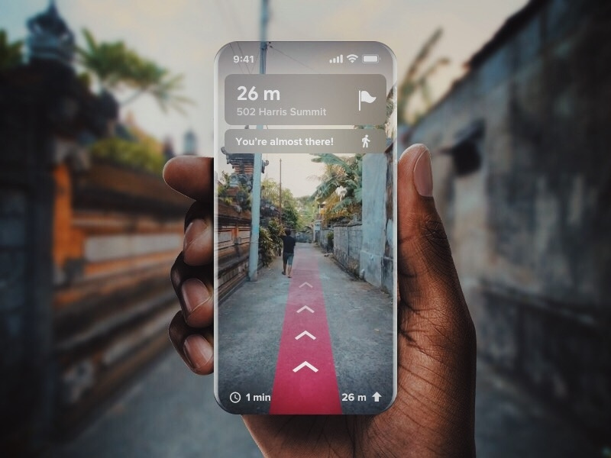
Introduction
Future work
Extend the 3D model database size under different scenes
Connect our APP with AR (Augmented Reality), for better navigation visualization

Slide 16
Introduction
Thank you for listening

