Slide 1
Architecture and UML Diagrams
Team 2- Collection$

Slide 2
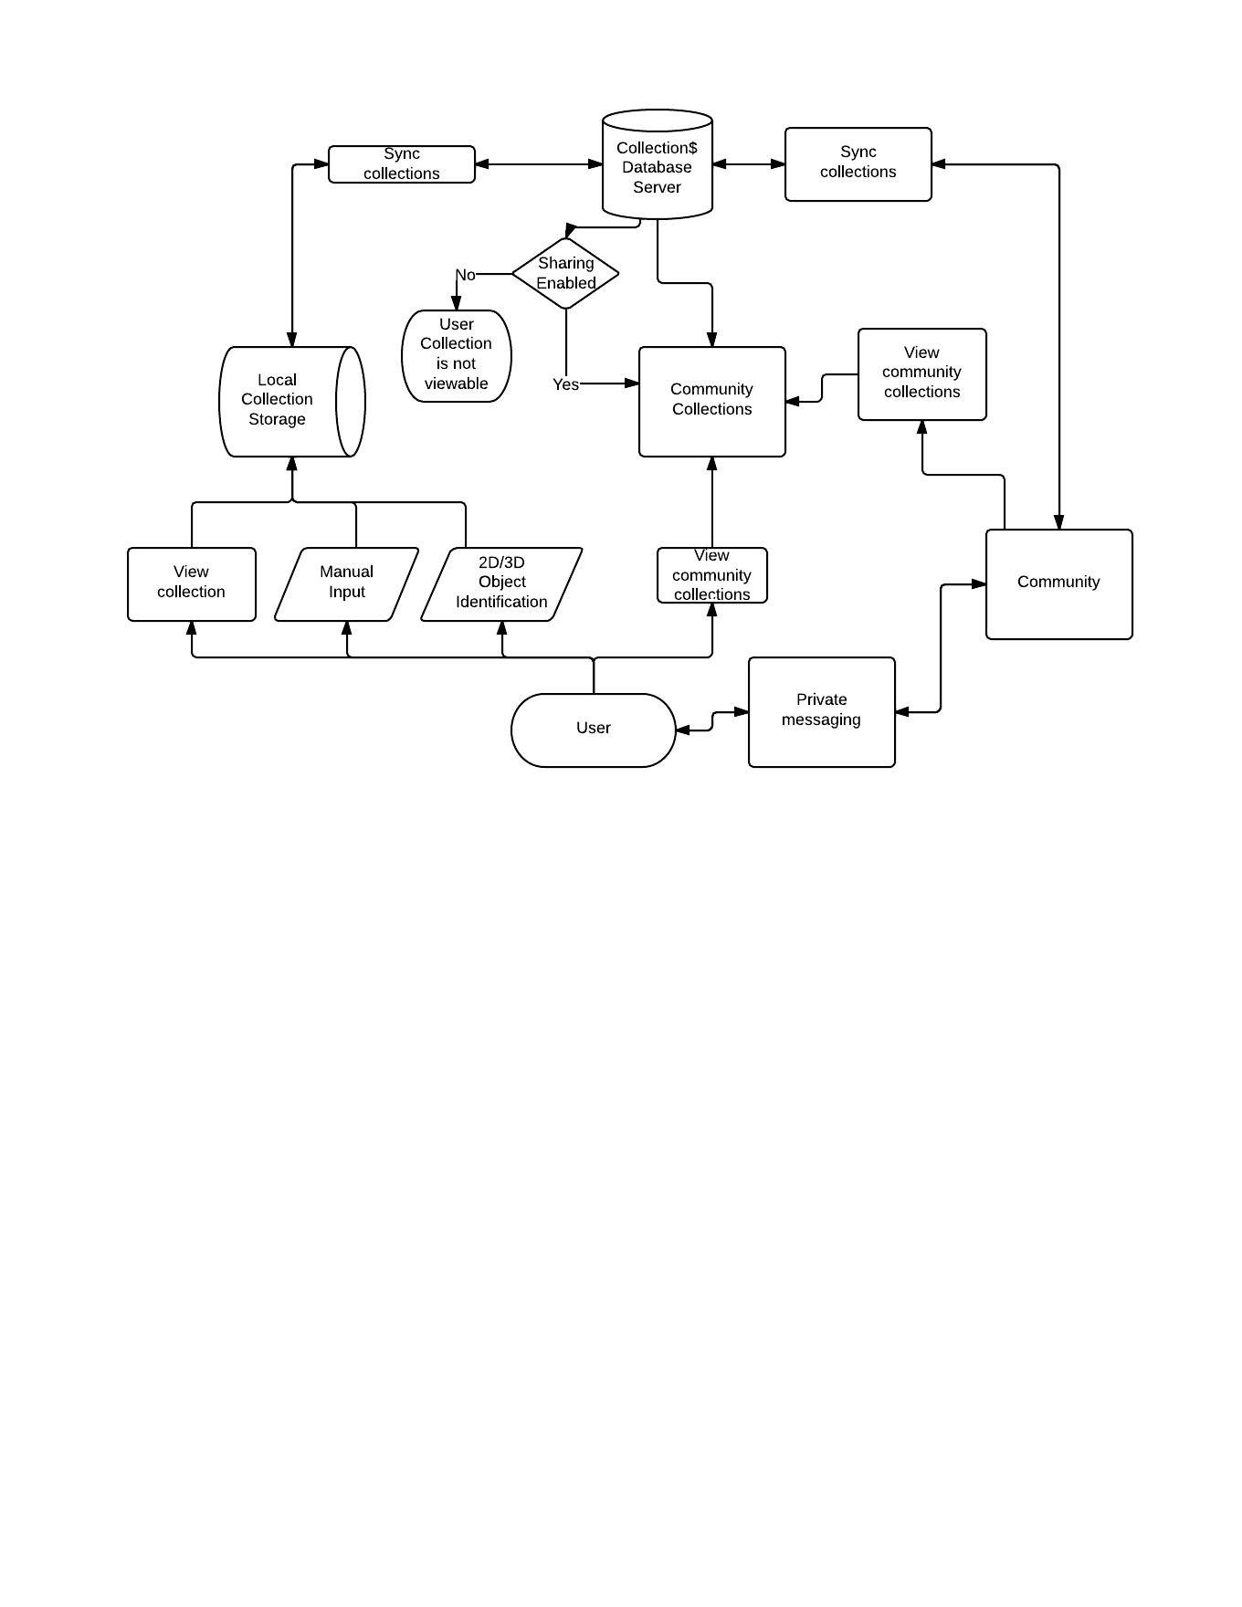
Entire Project’s Architecture

Slide 3
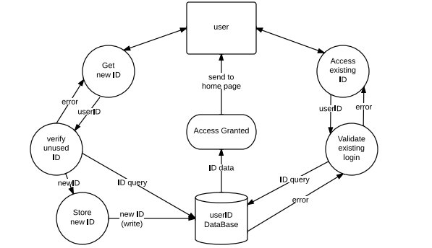
Architecture: Login Mechanism

Slide 4
UML: Class vs. Object Diagrams
Class Diagram
Used to describe:
Type of objects
Their attributes and operations
The static relationships between objects
Reveal compile-time relationships
Object Diagram
Implements the class diagram for a particular set of objects
Reveal run-time relationships

Slide 5
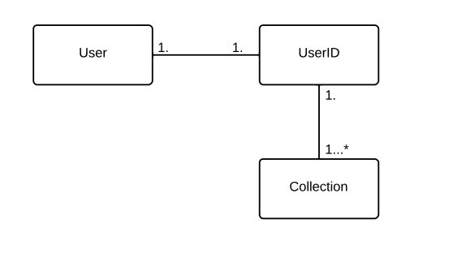
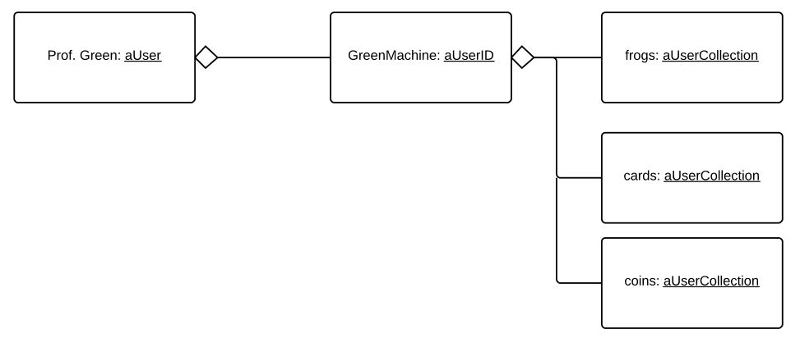
UML: Class Model and Object Model
Class Model
Particular Derived Object Model

Slide 6
UML: State Diagram
Reveal states and events.
state: state of the application (i.e. a new screen/display/interface the app is pushed into. A transition is caused by an event).
event: actions that affect state (i.e. clicking/selecting).
States are indicated by boxes, substates are indicated by box-in-a-box, and events are indicated by arrows.
**To reduce complexity of the diagram, substates within substates are not presented; therefore, some substates may involve additional features that are not shown in the state diagram.

Slide 7
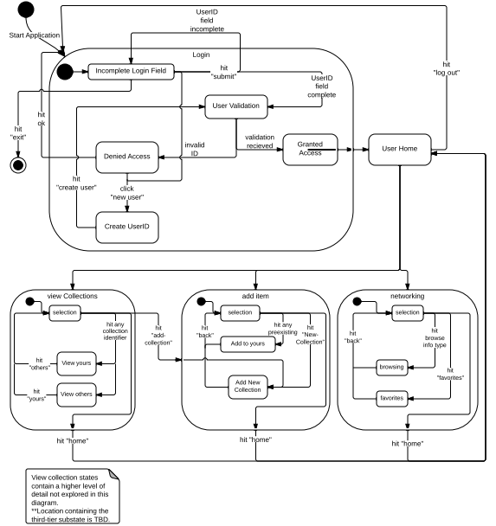
State Diagram (App Side)

Slide 8
Thoughts on Future Detailed Design…. (Objects, Instance Variables, and Methods)
Items
Properties: Name<string>, Date from <date>, Condition<string>, Description<String>, Viewable <Boolean>, Image <???>, etc....
Methods: getName, getDateFrom, getCondition, getDescription, isViewable, setName, setDateFrom,setCondition, setViewable, getImage, setImage…
Collection
Properties: Name <String>, Date created<date>, Items<ArrayList/Collection/?>, Viewable<Boolean>, User <User>, Subscribers<List<Users>>,
Owned<Boolean>
Methods: getName, getDate, getItems, getItem, isViewable, setViewable, setUser, getUser, isOwned, addItem, editItem, removeItem…
MyCollectionHolder
Properties: OwnedCollections<Collection>, SubscribedCollections<Collection>,
Methods: TBD

