Slide 1

Functional
OO

Slide 2
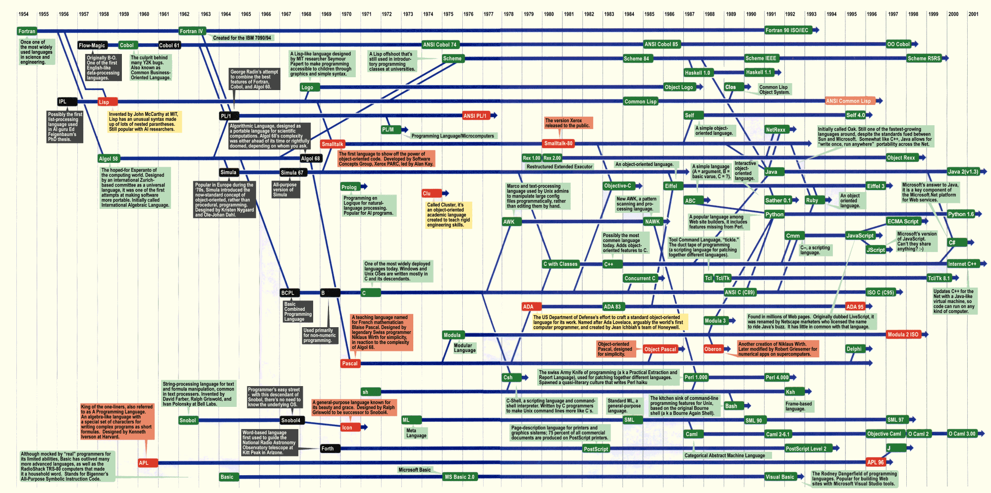

Slide 3
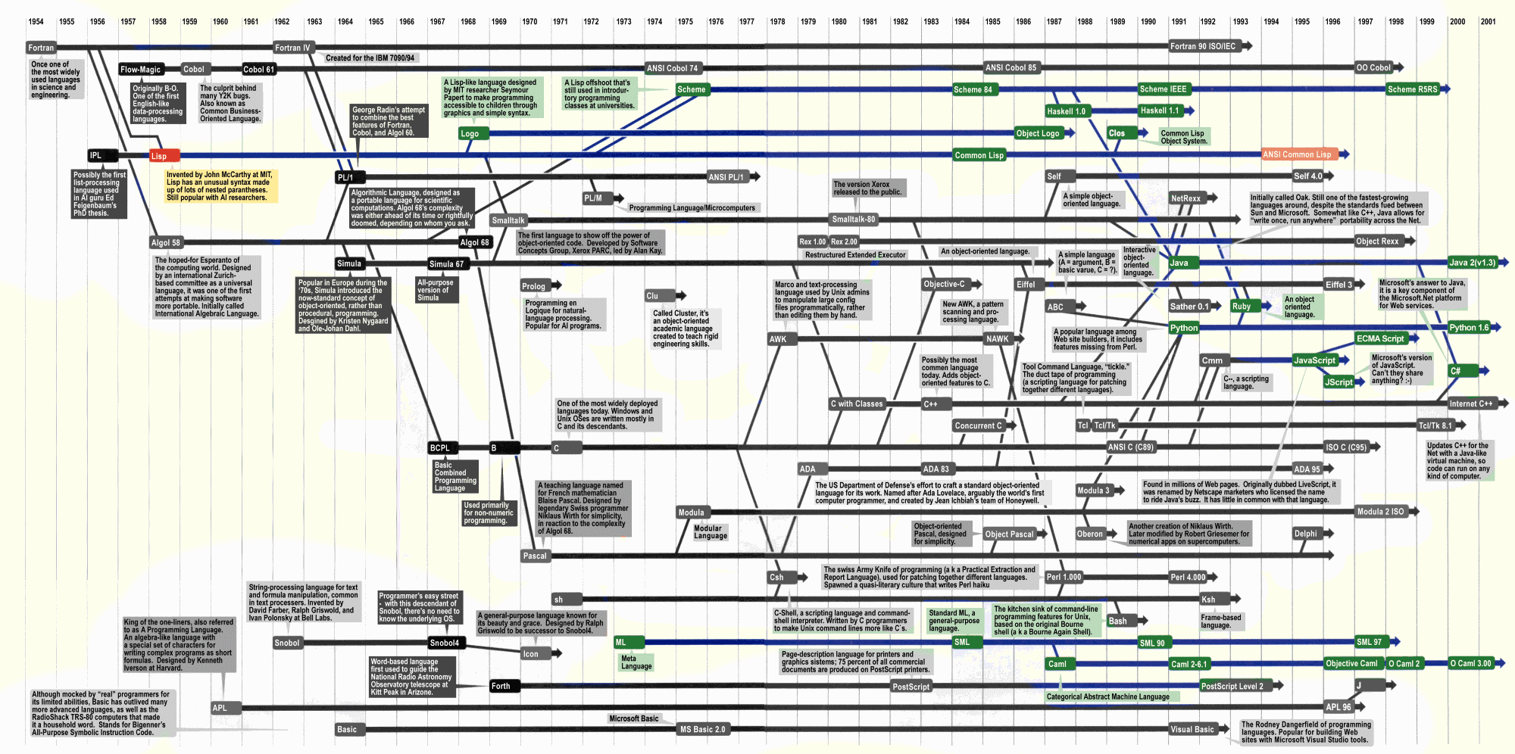

Slide 4
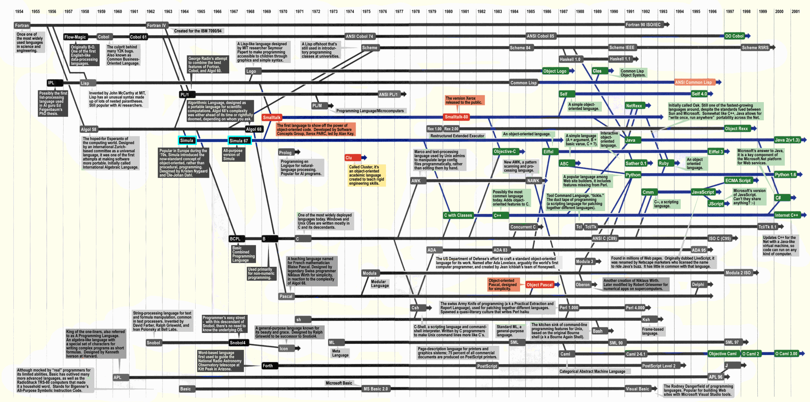

Slide 5
What is FP?
Programs composed of functions.
Tend to have:
First-class functions let evens(num) = num % 2 == 0
Higher-order functions let evenNums = myIntegers.Filter(evens)
Declarative syntax let evenSum = myIntegers.Filter(evens).Sum()
Expression-based code let result = if(x=y) then 1 else 2
And is more likely to have:
Immutable state
Pattern Matching
Discriminated Unions
Good type inference

Slide 6
What is OO?
Programs composed of objects.
Tend to have:
Class-based object templating Person jim = new Person(“Jim”)
Inheritance Sailor extends Person
Polymorphism
ForEach(Person p in [new Person(“Jim”); new Sailor(“Blackbeard”)]) {p.Save()}
A focus on Encapsulation private string name;
And is more likely to have:
Mutable state

Slide 7
What else is there?!
Procedural/Imperative:
Top-to-bottom list of statements and procedures
Logic:
Declarative statement of problem
Program works out the result(s)
Most programs are a mix of multiple paradigms. Code in OO and FP programs is often procedural.
But not today! ;-)

Slide 8
Pros & Cons
FP | OOP
Good when the operations will change | Good when the data will change
Good for concurrency | Not so good for concurrency
Good for back ends | Good for front ends
Good for algorithms & analysis | Good for modelling
… | …

Slide 9

Time for SCIENCE!
Split into groups: OO & FP
Within each group, split into pairs
Solve a problem following the rules
See, inconclusively, which approach is best*

Slide 10
The Rules
FP
Side effects can only occur at the top level
No mutable state
Functions should have no more than 2 arguments
Maximum level of abstraction
Always use infinite sequences
No ifs
No Loops
No Classes, aside from what's demanded by your language

Slide 11
The Rules
OOP
Only One Level Of Indentation Per Method
Don’t Use The ELSE Keyword
Wrap All Primitives And Strings
One Dot Per Line
No More Than Two Instance Variables
No Setters/Properties
Explicit inheritance must be used at least once
No Functional code
First-class functions
High-order functions
Declarative code (e.g Linq)

Slide 12
The Rules
Points will be deducted for breaking the rules
Feel free to check other team's adherence to the rules and tell the teacher about any wrongdoing!

Slide 13
The Problem: Bowling
10-Pin Bowling Scorer
10 pins to knock down, worth one point each
10 frames, each consisting of up to two attempts
‘Strike’ – all 10 pins down on first attempt
No second attempt
Score for this frame is 10 + pins from next two balls
‘Spare’ – all 10 pins knocked down on second attempt
Score for this frame is 10 + pins from next ball
If you get a Strike or Spare on the last frame, you get an additional 1 or 2 balls
See handouts for end game cases

Slide 14
The Problem: Bowling
Examples
Frame 1: [3,5] 8
Frame 2: [2,4] 6
Score: 14
Frame 1: [10,-] 13
Frame 2: [2,1] 3
Score: 16
Frame 1: [5,5] 16
Frame 2: [6,3] 9
Score: 25
Frames: [10,-] [10,-] [10,-] [10,-] [10,-] [10,-] [10,-] [10,-] [10,-] [10,-] 10 10 <- extra balls to calculate Frame 10 score
Score: 300

Slide 15
The Problem: Bowling
Write a program which takes a partial or full set of frames and calculates the score.
Input will always be full frames (+ bonus balls if needed)
Assume input always valid
Input will be no more than one game*
Input format is up to you
Prepare to accept different inputs during scoring
* Note functional rules RE infinite sequences

Slide 16
Go!
FAQ

Slide 17
Scoring the solutions
Swap with a pair in the other group
Give a mark for each successful test case passed
Deduct a mark for each case of a broken rule
Any uncertainly, ask a Judge
Scores will be aggregated
See handouts for details

Slide 18


Slide 19
Remember!
Put your solutions here:
https://github.com/LeedsCodeDojo/FPvsOOP
Next Dojo:
Wednesday 7th June - TBD

