Slide 1

Static
Dynamic

Slide 2
Types
int x = 3;
if x , y then “no” else “yes”
A type is a label applied to part of your program which helps the type system reason about it.
Types help constrain your program so as to not be susceptible to certain kinds of bugs.

Slide 3
Static Typing*
Types are known and checked at compile time. Once the type of something is set, it cannot become a different type.
int x = 3;
x = “hi mum!”;
error CS0029: Cannot implicitly convert type 'string' to 'int‘
int y = 4;
y = y + “Hi Dad!”;
error CS0029: Cannot implicitly convert type 'string' to 'int‘

Slide 4
Dynamic Typing*
Types are checked at runtime. The type of something can change.
x = 3
x = "Hello Mum!“
y = 4
y = y + "Hi Dad!"
Traceback (most recent call last): File "python", line 5, in <module> TypeError: unsupported operand type(s) for +: 'int' and 'str'

Slide 5
*
It’s more complicated than that..
See The Internet for further info.

Slide 6
Explicit vs Implicit Typing
Statically typed languages do not necessarily require the programmer to include type annotations.
int x = 3; // explicit type annotation
var y = 4; // basic type inference
// more complete type inference
let add x y = x + y
add “a” “b”
> val it : string = "ab"

Slide 7
Strong vs Weak Typing
Some type systems allow conversion between different types more freely than others.
int x = true; // OK in some languages
5u = 5L
error FS0001: This expression was expected to have type 'uint32' but here has type 'int64'

Slide 8
Static vs Dynamic Typing Benefits
Static | Dynamic
Better correctness guarantees | Easier to code
Performance? | More useful errors?
Less testing needed? | Some problems much simpler
‘Documentation’?

Slide 9
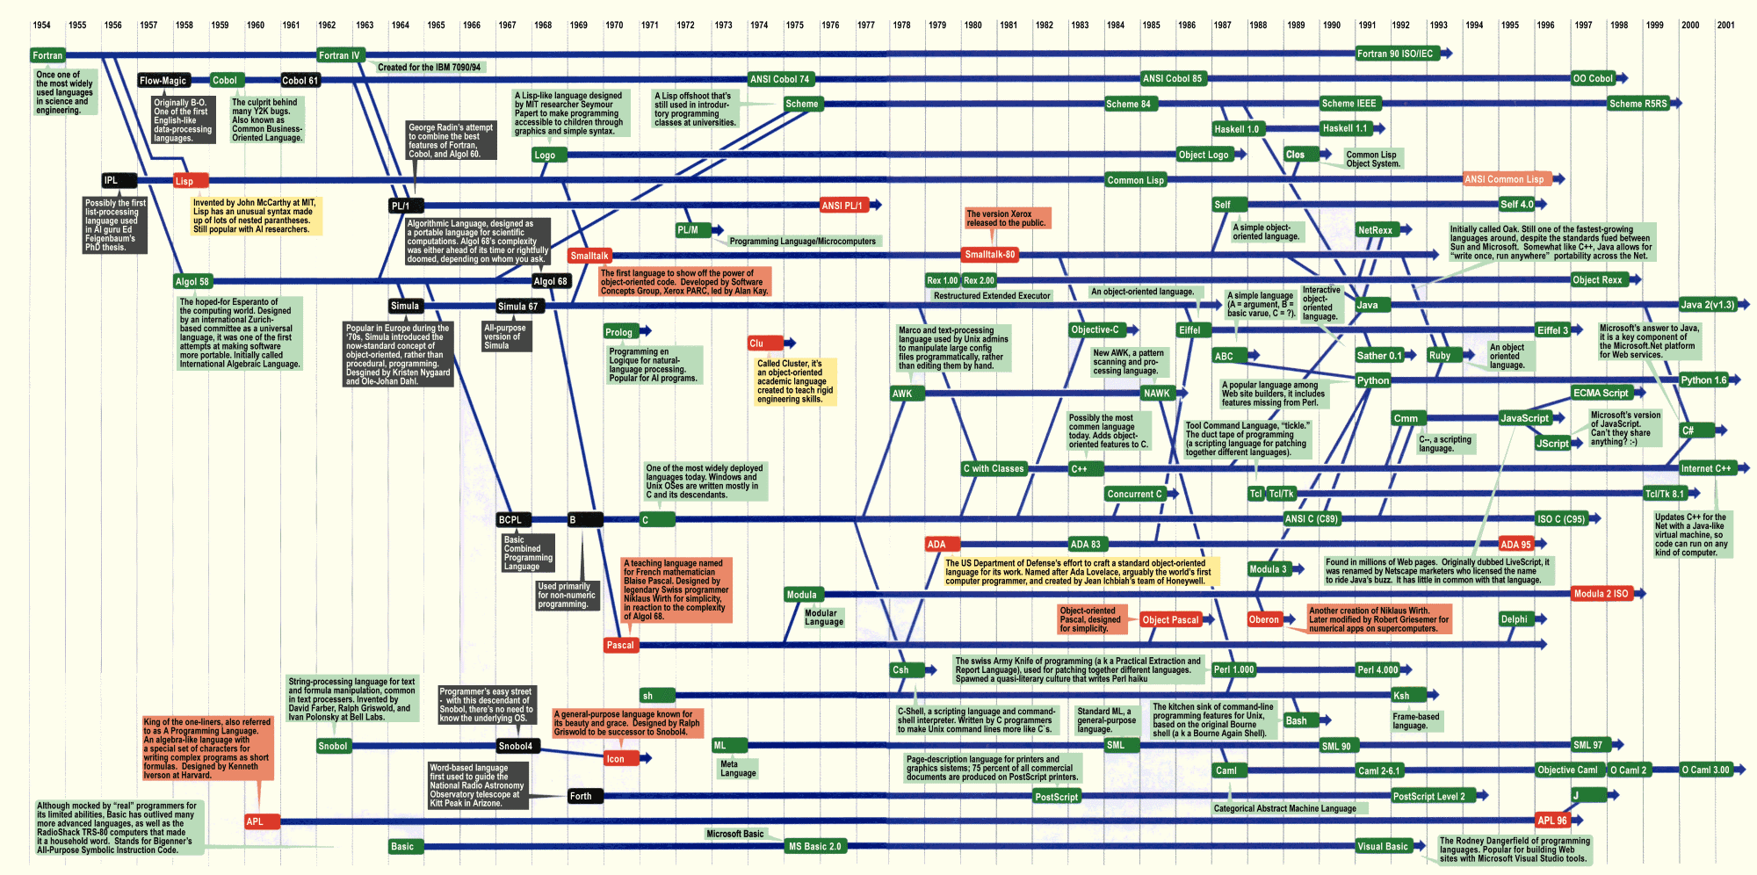

Slide 10

Time for SCIENCE!
Split into groups: Static & Dynamic
Within each group, split into pairs
Solve a problem
See, inconclusively, which approach is best*

Slide 11
The Problem: Bowling
10-Pin Bowling Scorer
10 pins to knock down, worth one point each
10 frames, each consisting of up to two attempts
‘Strike’ – all 10 pins down on first attempt
No second attempt
Score for this frame is 10 + pins from next two balls
‘Spare’ – all 10 pins knocked down on second attempt
Score for this frame is 10 + pins from next ball
If you get a Strike or Spare on the last frame, you get an additional 1 or 2 balls
See handouts for end game cases

Slide 12
The Problem: Bowling
Examples
Frame 1: [3,5] 8
Frame 2: [2,4] 6
Score: 14
Frame 1: [10,-] 13
Frame 2: [2,1] 3
Score: 16
Frame 1: [5,5] 16
Frame 2: [6,3] 9
Score: 25
Frames: [10,-] [10,-] [10,-] [10,-] [10,-] [10,-] [10,-] [10,-] [10,-] [10,-] 10 10 <- extra balls to calculate Frame 10 score
Score: 300

Slide 13
The Problem: Bowling
Write a program which takes a partial or full set of frames and calculates the score.
Input will always be full frames (+ bonus balls if needed)
Assume input always valid
Input will be no more than one game
Input format is up to you
Prepare to accept different inputs during scoring

Slide 14
Go!
FAQ

Slide 15
Scoring the solutions
Swap with a pair in the other group
Give a mark for each successful test case passed
Deduct a mark for each case of a broken rule
Any uncertainly, ask a Judge
Scores will be aggregated
See handouts for details

Slide 16


Slide 17
Remember!
Put your solutions here:
https://github.com/LeedsCodeDojo/StaticVsDynamic
Next Dojo:
Wednesday 7th Feb - TBD

