Slide 1
The Best Language in the
Whole World Ever
A subjective opinion of
and tour through APL
by
Darren Drapkin

Slide 2
A brief history of APL
Devised in the late1950's by Ken Iverson
In the book 'A Programming Language'
First implemented by IBM as a formal method
for hardware design
Now available on all sorts of platforms

Slide 3
Design Goals of APL
Concise description of algorithms
A new notation for mathematics
To deal with large complex data structures
using simple notation
Not to have to change programmes because
your data structures do
Say goodbye to looping variables &c.

Slide 4
An example session
Followed by explanation

Slide 5
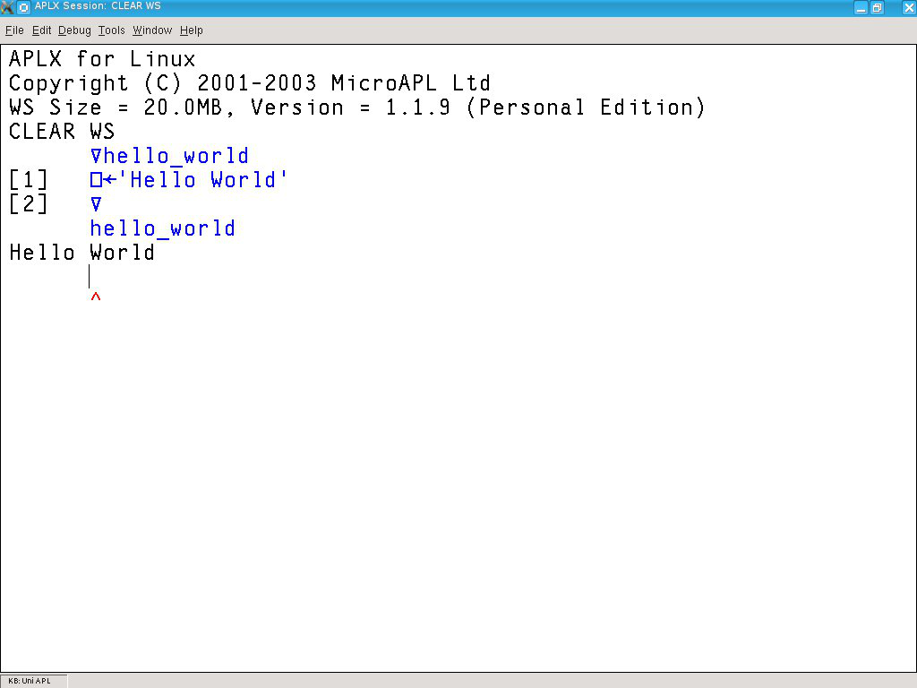
Hello World in APL

Slide 6
Hello World explained
APLX is started and gives a prompt
The hello_world programme is entered
The programme is run and gives output
As an exercise modify it to print out the
same output five times

Slide 7
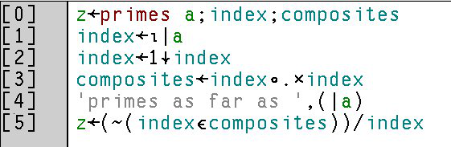
A longer Prog.

Slide 8
A Prime Number Calculator
create a series from 1 to the magnitude of 'a',
called 'index‘
drop off the initial 1
form a set of products of these, giving the
composite numbers as far as index squared
label our output
return the numbers from 2 to index that are
not in the set of composite numbers

Slide 9
Finally
Could We write this programme with no variables at all ?
Could we find the sum of the numbers from one to a thousand without doing a thousand additions?
Could we look at the Euler Problems site with new eyes ?

