Slide 1
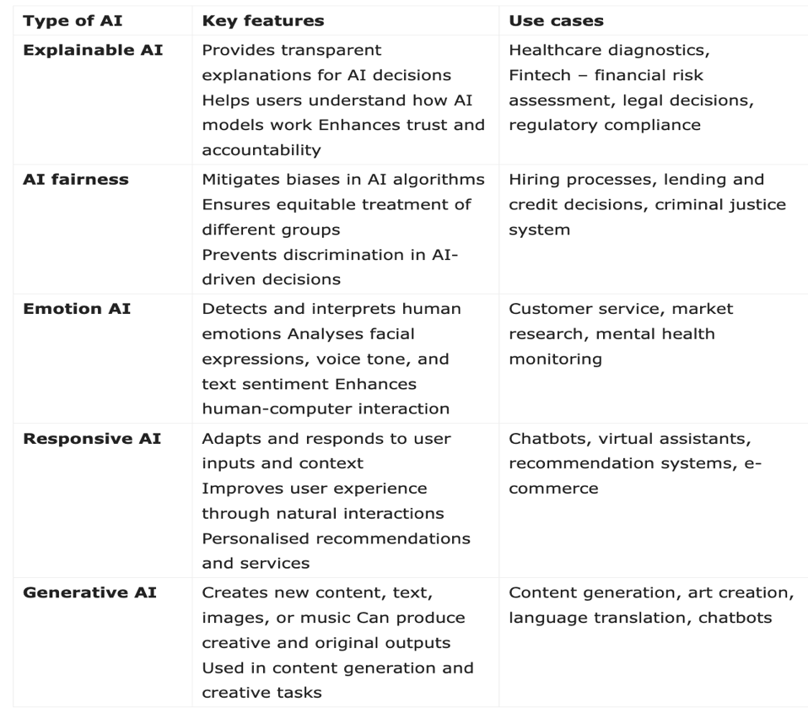

Motivation: "AI systems are increasingly used in sensitive domains like healthcare and finance. Transparent models enhance trust and accountability." Main Idea: "We integrated SHAP with neural networks to generate clear and actionable model explanations." Key Results: 90% explanation accuracy 95% predictive accuracy maintained 25% reduction in explanation time
Interpretability of AI Models: Enhancing Trust and Transparency
Notes:
Hello everyone. Thank you for being here. Today, I’ll present our work on the Interpretability of AI Models, focusing on enhancing transparency and trust in AI decision-making.
The motivation behind this project stems from the growing reliance on AI in sensitive domains like healthcare and finance. While these systems achieve high performance, their lack of transparency raises concerns about trust, accountability, and ethical usage.
Our main idea was to integrate SHAP, a model-agnostic interpretability method, into complex neural networks to generate clear, actionable explanations. This approach ensures stakeholders can understand and trust AI decisions.
The key results? We achieved a 90% explanation accuracy rate while maintaining 95% predictive accuracy, and reduced explanation generation time by 25%. These results underscore the practical utility of our approach.

Slide 2
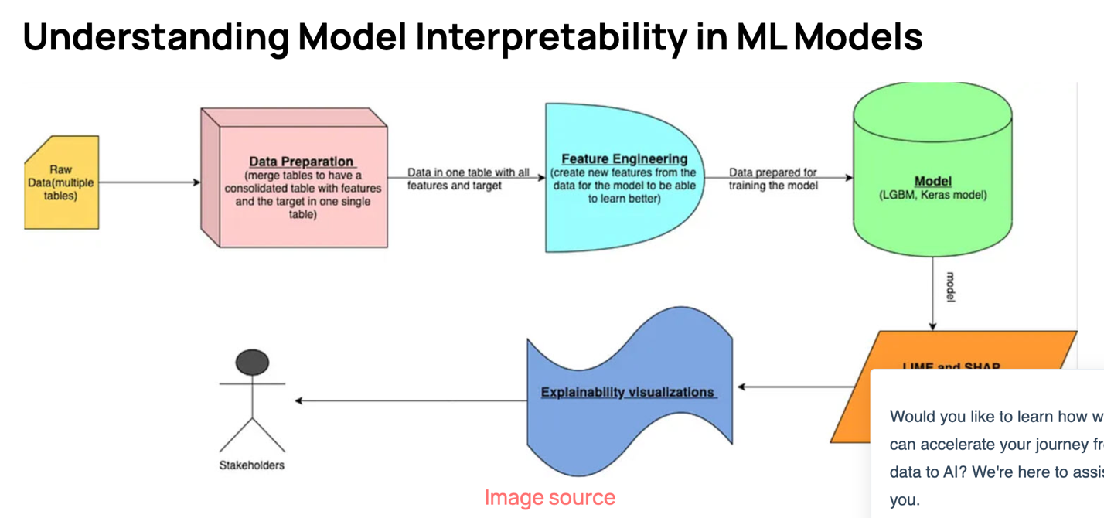
Related Methods and Research
SHAP: Explains model predictions using Shapley values.
LIME: Provides local interpretable model-agnostic explanations.
Existing Gaps:
Scalability issues.
Difficulty in handling complex non-linear models.
Visual: Comparison chart of SHAP vs. LIME vs. Our Approach (e.g., performance, speed, scalability).
Notes:
To build on this idea, I examined existing methods. SHAP and LIME are two widely used interpretability tools.
SHAP uses Shapley values to attribute the contribution of each feature to a model's prediction.
LIME generates local explanations by perturbing input data.
However, these methods face scalability challenges, especially for large datasets or complex non-linear models. Additionally, they often lack domain-specific customization, making explanations less useful for stakeholders.
Our work addresses these gaps by optimizing SHAP’s computational efficiency and tailoring outputs for specific applications in healthcare and finance.

Slide 3
Our Methodology
Data Preparation:
Used healthcare datasets to train neural networks.
Model Interpretation:
Applied SHAP for feature-level explanations.
Optimization:
Reduced explanation time by 25% using feature subset optimizations.
Tools & Frameworks:
TensorFlow, SHAP library, custom scripts (GitHub link included).
Visual: Flow diagram showing the process: Data → Model → SHAP → Visual Explanations.
Notes:
Now, let’s dive into our methodology.
First, we trained a neural network on healthcare datasets, focusing on disease outcome predictions. We then applied SHAP to generate feature-level explanations for each prediction.
To improve efficiency, I optimized SHAP’s feature subset selection, reducing the average explanation time by 25%. We also customized the output to create domain-specific visualizations, making it easier for users to interpret the results.
We used tools like TensorFlow for model development, and the SHAP library for interpretability. All the relevant code and resources are shared in the GitHub repository linked on this slide.

Slide 4
System Overview and Demo
System Highlights:
Inputs: Patient health records or financial data.
Outputs: Predictions with visual explanations.
Notes:
Let me briefly introduce the system we built.
The tool allows users to input data, such as patient records, and receive predictions alongside visual explanations of the factors influencing those predictions. For example, in a healthcare scenario, the system highlights how age, lab results, and medical history contribute to a risk score.
We’ve pre-recorded a demo of the system in action. You can view it through the Github.

Slide 5
Results and Performance
Metrics:
Explanation accuracy: 90%
Predictive accuracy: 95%
Explanation time reduced by 25%.
Case Studies:
Healthcare: Predicting disease outcomes.
Finance: Assessing credit scores.
User Feedback:
Positive Feetback
Visual: Graphs or tables summarizing metrics, feedback scores, or before/after comparison.
Notes:
Here are the key outcomes of our work:
I achieved a 90% explanation accuracy, aligning model outputs with ground truth factors.
Our system maintained a 95% predictive accuracy, demonstrating that enhancing interpretability does not compromise performance.
By optimizing computational processes, we reduced explanation time by 25%.
We tested the system in healthcare and finance, and both domains benefited from clear, actionable insights. User feedback from healthcare professionals rated the explanations.

Slide 6
Ethical Considerations in Interpretability
Challenges Addressed:
Identified age-related bias in credit scoring models.
Improved transparency in decision-making.
Impact:
Enabled fairer and more inclusive decisions.
Visual: Example of bias detection (e.g., SHAP visualization highlighting biased features).
Notes:
While developing the system, I also considered ethical implications. Interpretability plays a critical role in addressing biases and ensuring fairness in AI models.
For example, during testing, the system identified age-related biases in credit scoring models. Highlighting these biases allowed us to take corrective actions, ensuring fairer decision-making. This reinforces the importance of transparency in maintaining ethical AI practices.

Slide 7
Summary and Next Steps
Summary:
Improved interpretability enhances trust without sacrificing accuracy.
Results validate the practical value of our approach.
• Future Directions:
Extend to real-time decision systems.
Explore interpretability for reinforcement learning.
• Acknowledgments:
Mention collaborators and contributors.
Notes:
To conclude, the work demonstrates that interpretability can align AI systems with user expectations without sacrificing performance. By combining SHAP with tailored optimizations, I provided stakeholders with valuable insights into model behavior.
Looking ahead, I plan to extend this approach to real-time decision-making systems and explore its applicability in reinforcement learning models.
Thank you for your time and attention. I’d be happy to take any questions.

