Slide 1
EEE 335 Principles of Operating Systems
Operating Systems in General
(Modern Operating Systems 1.1 and 1.3)

Slide 2
Outline
Components of a computer
What is an Operating System?
Why have an Operating System?
Roles of an OS
Where does the Operating System Exist?
Operating System Types

Slide 3
Components – Abstract View
Computer
CPU
Memory
I/O - Peripherals
Bus
Other Peripherals
Notes:
At a very high level, the components of a computer include:
Central processing unit
Memory
IO peripherals – display, printer, disk storage
Other peripherals -

Slide 4
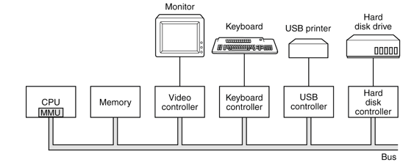
Components Overview
An operating system is intimately tied to the hardware on which it operates. Of course it is more complicated than this.
Notes:
This is an abstracted view...modern PC are much more complicated with multiple busses such as cache, memory, PCI, SATA, etC)
Memory Management Unit – for paging.

Slide 5
Processors
Brain of the computer
CPU Functions:
Fetch an instruction from memory
Decode the instruction and operands
Execute the instruction
Repeat
More complicated in practice...
Notes:
Think about it, A processor as complex as it is, is only an electrical device, transistor gates linked by electrical conduits. It takes electrical signals on its pins and by closing and opening gates, the state of the CPU changes (the registers change). The CPU also gives electrical signals as answers to its state and results of instructions.

Slide 6
Processors (parts)
The “core” of a CPU contains
Control Unit or CU
Arithmetic and Logic Unit or ALU
Other resources inside the CPU:
Generic registers
Used to hold variables during work
Program counter
Points to the next instruction
Notes:
Control Unit
Directs the system to execute instructions
Arithmetic Logic Unit
– arithmetic and logic operations
- what are some examples of arithmetic operations?
- also equal to, less then, greater then conditions
Program Counter – points to the next instruction to be fetched

Slide 7
Processors (parts)
Other resources inside the CPU:
Stack pointer
Points to the top of the stack of the current process
Program Status Word (PSW)
Condition code bits
CPU priority
Mode
Other control bits
Cache memory
Notes:
Stack Pointer (another register):
Points to the top of the current stack in memory
One frame for each stack that has been entered but not exited
What does a stack hold? Input parameters, local variables, etc...
Program status word:
Bits are set by comparison instructions (see upcoming Assembly example), CPU priority, mode(user; kernel), etc...
It is important to know how the hardware works in order to understand what the OS can and must do.
Old PCs did not run more than one process (program) at once.
New PC’s and other computers run many processes… but on a single core CPU, there is only one set of hardware registers!!!
The OS like any other program must be “loaded” on the CPU to execute. So if I want my OS to be able to save the status of a program, it needs help from the hardware. If the OS simply overwrote the registers of the CPU to get “on” the machine, the status of the program previously running would be lost!
So the CPU must save the registers and its state before the Program Counter is loaded with the address of one of the instructions in the OS. This happens automatically.
If you take the analogy of a desk and a chair. Put some pens, eraser, chalk and say that the desk is the CPU, only one student can use the desk. If I do not save the status of the desk (picture with my phone), I will not know the status of the desk of the departing student for when he comes back.
PC – program counter
SP – stack pointer
PSW – program status word
https://software.intel.com/sites/default/files/managed/39/c5/325462-sdm-vol-1-2abcd-3abcd.pdf
Condition codes are extra bits kept by a processor that summarize the results of an operation and that affect the execution of later instructions. These bits are often collected together in a single condition or indicator register (CR/IR) or grouped with other status bits into a status register (PSW/PSR). John Hennessy, et al., in the paper "Hardware/Software Tradeoffs for Increased Performance," ASPLOS-1, Palo Alto, March 1982, pp. 2-11, identified four uses of condition codes:
1) conditional control flow (branching)
2) evaluation of boolean expressions
3) overflow detection
4) multiprecision arithmetic
From: https://people.cs.clemson.edu/~mark/conditioncodes.html
What information is in the PSW?
You can find a detailed list of the fields in the PSW in the yellow card. We use the "BC Mode" of the PSW. Here is a list of some common fields:
Bytes Contents
1 & 2: assorted data we can ignore for now
3 & 4: Interruption Code
5: 2 bits = Instruction Length Code (ILC) 2 bits = Condition Code (CC) 4 bits we can ignore for now
6 - 8: Address of the next instruction

Slide 8
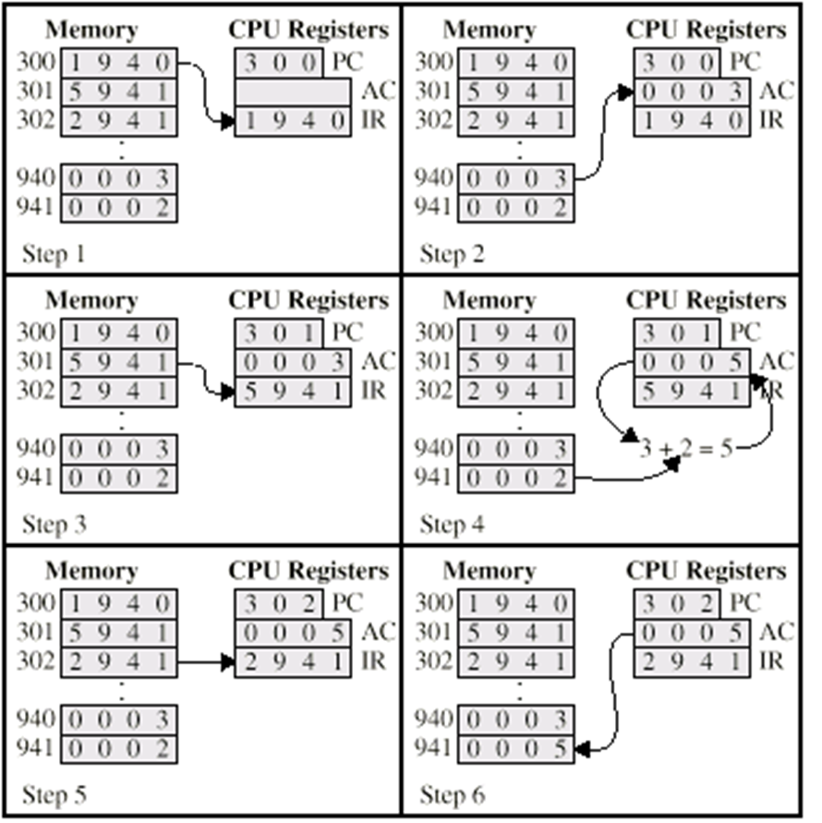
Simple CPU Function Example
Recall:
Fetch-Decode-Execute Cycle
PC | Program counter, holds address of instruction
AC | Accumulator, Processor Register
IR | Instruction Register, holds instruction code
1. Fetch/Decode instruction @ 300
2. Execute – Load data at 940 to AC
3. Fetch/Decode instruction @ 301
4. Execute - Add content of 941 to AC
5. Fetch/Decode instruction @302
6. Execute – Store value in AC to 941
Notes:
1### = load addr
5### = add addr
2### = Store AC to addr

Slide 9
Instruction Set(1/2)
Dependent on manufacturer and version
Intel 64 bit instruction set divided into the following instruction categories
Data Transfer Instructions
Binary Arithmetic Instructions
Decimal Arithmetic Instructions
Logical Instructions
Shift and Rotate Instructions
Bit and Byte Instructions
Control Transfer Instructions
String Instructions
I/O Instructions
Enter and Leave Instructions
Flag Control Instructions
Segment Register Instructions
Miscellaneous Instructions
User Mode Extended Save/Restore Instructions
Random Number Generator Instructions
BMI1, BMI2
Source: https://software.intel.com/sites/default/files/managed/39/c5/325462-sdm-vol-1-2abcd-3abcd.pdf
Notes:
Taken from IA 64 Architecture Software Developer’s Manual at link at bottom of page
~945 different instructions (X86 had 663 back in 2014)

Slide 10
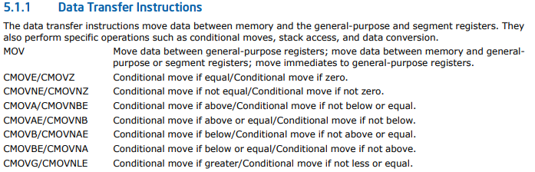
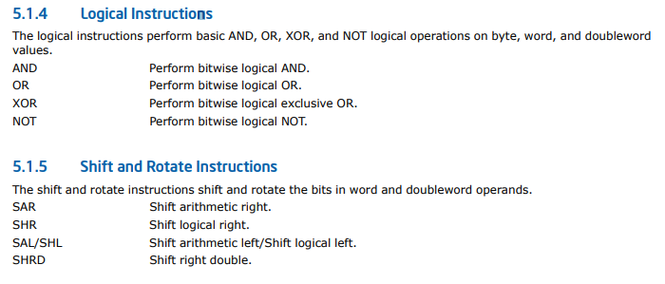
Instruction Set(2/2)
Another view available at: https://www.felixcloutier.com/x86/
Notes:
Sample set of instructions

Slide 11
Processors (modes)
Two modes:
Kernel
Every instruction available
OS runs in this mode
Program can enter this mode to have an instruction processed by using a trap
User
Programs only usually “see” a restricted area of memory
Only a subset allowed for access
Usually I/O and memory functions forbidden
Notes:
Make sure they realize that I am talking about machine language instructions being disallowed.
Just because they can use the malloc() function doesn’t mean that they have access to supervisory mode.
The compiler will add the necessary instructions to trap to kernel mode so that the instruction may be executed.
The information that the user program wants executed will be provided to the kernel

Slide 12
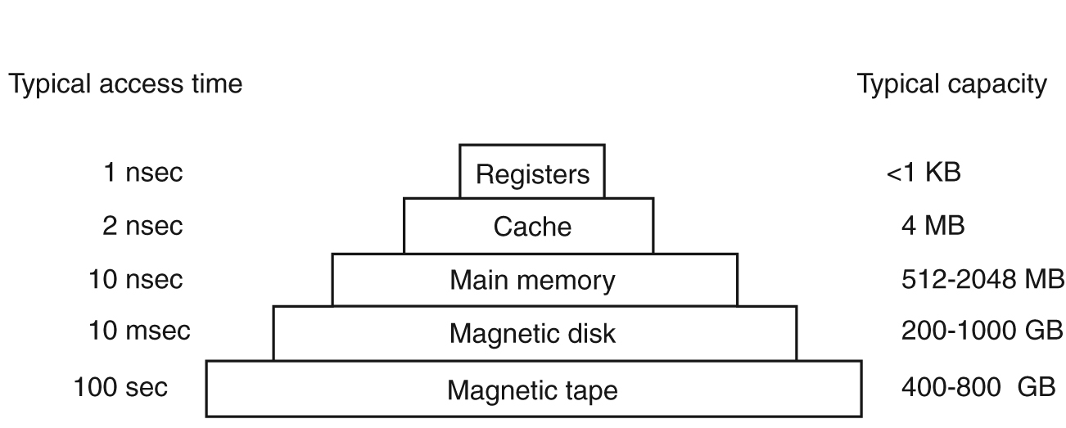
Memory Types (and Hierarchy)
Multiple memory types give balance of speed, size and cost but... adds to complexity
Notes:
Here is an abstract view of a memory hierarchy. You do not see mass storage devices or USB sticks or multi-level caches. It is the concept of hierarchy that counts here. The concepts covered here can actually be applied on the web. Think about the cache for your web browser and think that there is not only one layer of computers serving you on the internet, there is also a hierarchy of memory.
Registers
Are embedded into the CPU and are typically just as fast
Registers are managed by the program (even if the compiler made the final decisions)
Cache
Very fast but expensive memory
Potentially many “levels” of cache
Lives “near” CPU
Usually hardware controlled
Main memory is divided into cache lines (eg: 0-63; 64-127; etc)
Draw an example
When a program needs a bit of memory it looks to the cache first
If there, a cache hit!
If not, a miss-> Go to main memory
L1 – inside CPU 16 or 32 KB
L2 – 1 MB, may be built in or shared between multi-core systems
RAM
The work horse of the computer
Capacity is increasing very fast and cost is going down.
1990 $200 would buy 1-4Meg
Now - 16GB for less then $150
Magnetic Tape
Used for backup storage/large data sets
Since usually in storage, it must be loaded into a reader before access (human or robot performed)
Very slow but exceedingly cheap! (sequential access no seek).
Although the slide says 800 GB they now make tapes that are 4 TB. Many organization use tape backups

Slide 13
Main Memory Management
Multi-tasking implies multiple programs in memory simultaneously
Problems:
How to protect programs from one another
How to protect the kernel from programs
How to relocate programs
Notes:
When the microprocessor completes the execution of a set of instructions, and is ready to carry out the next task, it retrieves the information it needs from RAM. Typically, the directions include the address where the information, which needs to be read, is located. The CPU transmits the address to the RAM's controller, which goes through the process of locating the address and reading the data.
SRAM, DRAM

Slide 14
I/O Devices
I/O devices consist of:
The device itself
A controller (with registers)
The controller simplifies the interface
Tell it you want a track
Converts this to cylinder, sector, and head
OS sees this interface
Software that talks to this controller is the Device Driver
Notes:
Quickly explain that when a user asks for a file, they use a logical name for the file. My_Assignment.doc. This logical name is given to the OS, the file system which executes the appropriate manipulations to load the driver and get the track…

Slide 15
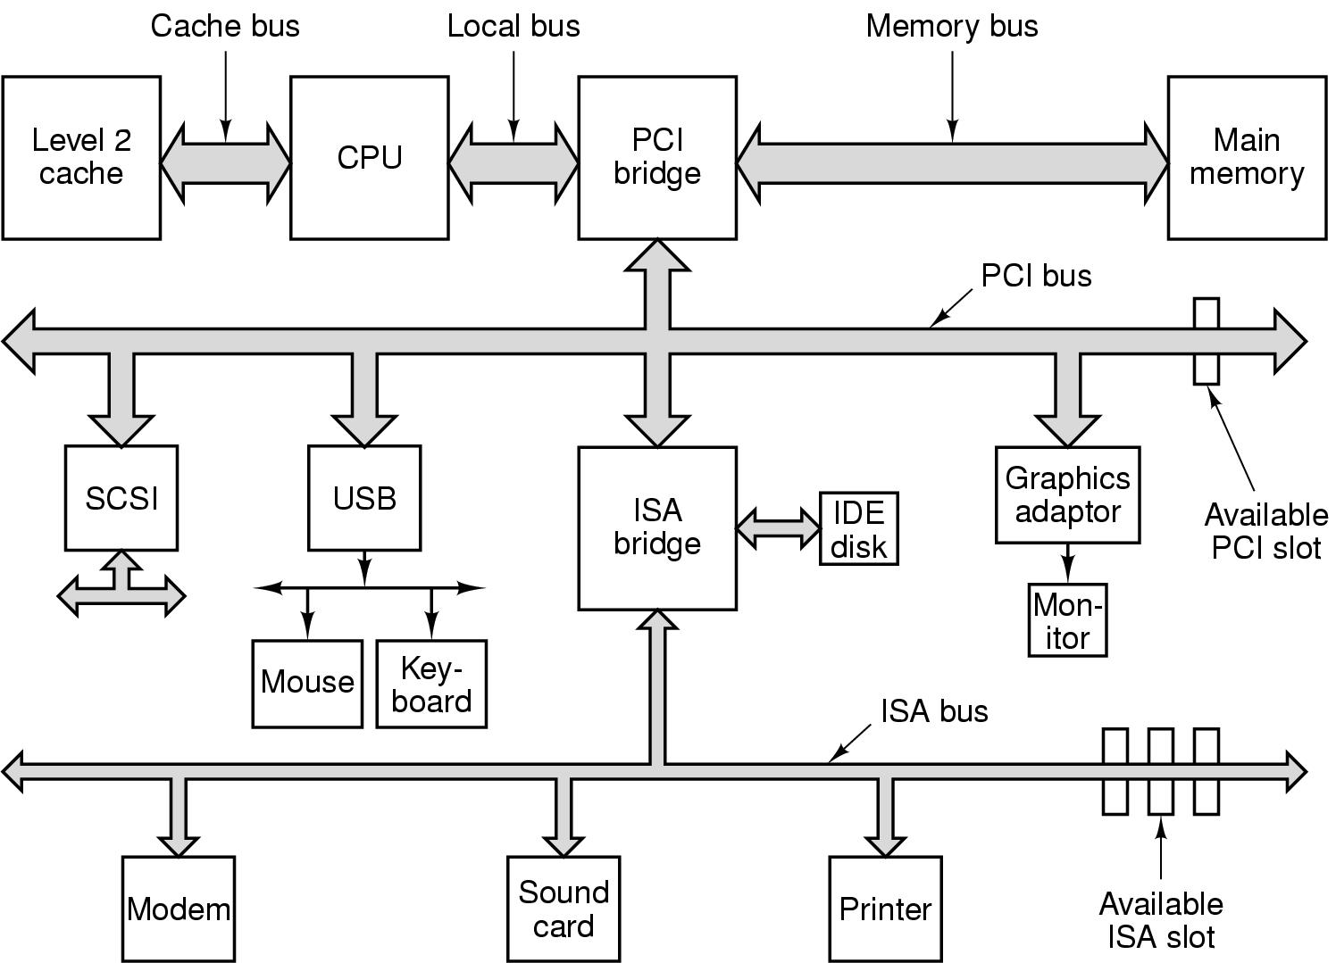
Bus
Allows the transfer of information between the CPU, main memory and peripherals
Notes:
A bus is simply a circuit that connects one part of the motherboard to another.
Don’t expect them to memorize this...but tell them they may want to add some notes.
This is an example of a bus you might find in a typical PC
A number of busses required as CPUs have become more powerful and devices have provided higher throughput.
AGP (Acclerated Graphics Port) bus is missing – pretty much phased out by PCI and PCIe
ISA: Industry Standard Architecture (original IBM PC/AT bus – 8.33 MHz with 2 bytes for 16.66 MB/s)
PCI: Peripheral Component Interconnect PCIe 5.0 128GB/s (32 GHz, duplex)
IDE: Integrated Drive Electronics
SCSI: Small Computer System Interface (fast devices) - Ultra-640 SCSI: Uses a 16-bit bus, supports data transfer speeds of 640 MBps.
USB: Universal Serial Bus (attaches a number of slower devices and polls each every 1ms. No interrupts from these devices, but from the USB controller)
Now consider the large number of devices shown here...and most have the ability to raise an interrupt and use DMA. Before plug and play they had to be assigned manually.
The OS used to simply tell you there was a conflict (if you got any info other than a lock)
With plug and play the BIOS assigns interrupt/DMA addresses around any legacy hardware
Now, the OS must use information collected by the BIOS (Basic Input Output System) at boot to get configuration information and prompt for drivers

Slide 16
Why Have an OS?
How else would all the devices communicate?
Each application would be responsible for running the computer!
Each device even if similar would have to be entirely re-written disregarding commonalities
Programmers need not worry about low level stuff
Notes:
*****Go to this link before hitting each of the bullets, highlighting the complexity and challenge of writing drivers for any thing that may be connected to the computer
-> https://github.com/microsoft/Windows-driver-samples/blob/master/gpio/samples/simgpio/simgpio.c
Ask the class for ideas:
What exists without an OS? Just a collection of devices.
How do they communicate? Each Program would be responsible for coordinating the communication between every required device.
So a programmer would not be freed from the complexity of the machine.
Show example of driver, discuss complexity of creating similar collection for every device one may connect to a computer - http://amigadev.elowar.com/read/ADCD_2.1/Devices_Manual_guide/node0063.html

Slide 17
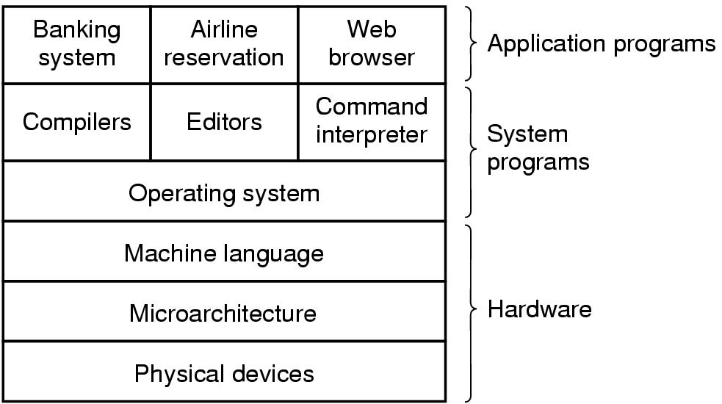
Where does the OS Exist?
User mode
Kernel mode
The Kernel runs in kernel mode (supervisor mode) to protect it from tampering.
Applications generally run in User mode.
Notes:
Microarchitecture is where physical devices are grouped into logical units, ie: registers, alu, and connections. Instructions each clock cycle move instructions and data.
Machine language is a way of issuing instructions to directly control data movement, registers, calculations, etc. MC68000? A disk could be commanded to read a byte at this level by filling the required registers with info such as disk address, main memory address, direction, etc.
Operating system hides this complexity so that application can be easily written.
The KERNEL is the core of the system. It’s the part of the software that runs in supervisor mode.
eg: Users can write their own compiler, word processors, database programs, ... They are not usually free to write their own interrupt handler.

Slide 18
Abstract View of an OS
The programmer uses
applications such as
compilers to write other
applications so she/he must
understand the interface (API)
to call the OS. He is also a user
of the OS (think roles in OO).
Applications
Users normally use
programs or applications
that run on an OS and use
the OS through an interface
shells and/or widgets
API
Interface
Operating System
Hardware
Notes:
Notice here that neither the application programmer or the user “see” the hardware.
The machine is hidden. Similar to a car, the controls inside the cabin where the driver sits moves the operator away from directly controlling the engine, transmission and brakes. Because the programmer or user cannot access the hardware directly the OS also has the responsibility of assigning and controlling the devices. To continue the analogy of the car, the driver does not control certain resources such as the firing sequence of the engine or the fuel mixture depending on the air mass flow, or the anti-skid that is coupled with the antilock.
Also there are programmers that write OS’s.

Slide 19
What is an Operating System?
Name things that operating systems do:
Hide details of work (ie: how to access a disk or print to a printer).
Abstraction of hardware and device drivers
Access to resources, disks, printers, comm ports
Multi-task
Allow programs to share resources in time (ie: you have the scanner; now YOU have the scanner)
Allow programs to share resources in space (ie: you have this much memory in which to work).

Slide 20
What is an Operating System?
It is an Extended Machine
Also called Virtual Machine
Provides services to make the machine much easier to program than at the level of the underlying hardware
It is a Resource Manager
Each program give time with the resource
Each program given space on the resource
Operating System is the scheduler
Notes:
Extended machine:
Disk access example, page 4
Resource manager:
Example of multiple programs accessing the printer
This is a best case example! What about a program that writes critical data in memory, such as the next instruction!
Good example then is the division of main memory.

Slide 21
Types of Operating Systems
Mainframe
Huge I/O capacity due to number of users
Becoming more popular as network speed increases
Oriented to processing many jobs at once
batch (routine jobs such as processing a report)
transaction (such as booking a reservation)
timesharing (such as remote users querying a database)
Notes:
We now will quickly cover the various types of OS. We do this because each computer system and their user(s) have different requirements and require different services from the OS.
One size does not fit all !
You would not want Windows on an aircraft’s control system.
Explain batch jobs: The kind of job done by insurance companies to calculate life expectancy and actuarial values of various policies it sells to different people. Banks and stock companies also balance their books in this fashion.
A transaction is a specific kind of job. It requires that several computers agree and commit to transfers of funds and or services. A transaction is not complete until all computers have committed.
Large database reports are also treated in batch systems.

Slide 22
Types of Operating Systems
Server
Allow sharing of hardware and software resources
Print servers, file servers, web servers
Multiprocessor
Usually a variation on a server OS
Allow multiple CPUs to work together
Notes:
Servers are there to help share some physical and logical resources (db, files, web…). We will see that servers require a special kind of service from the OS hosting them.
Multiprocessors and multicores are not the same. This course does not deal with multicore computers. So when we cover material we will talk single core as we are introducing principles of OS.
Multiprocessor OS’s must treat several problems that are specific to them such as memory sharing, treating of interrupts, synchronization of tasks and protection of resources that are a magnitude more complex than we will cover in this course.

Slide 23
Types of Operating Systems
Personal Computer OSs
Provide a good interface to a single user
Windows, Linux, Macintosh, FreeBSD
Real-Time Operating Systems
Unique in that they have important deadlines: either hard (robot welding) or soft (MP3 player, video services)
Usually embedded technology

Slide 24
Types of Operating Systems
Embedded Operating Systems
Similar to real-time
Personal Digital Assistants PDAs, car dash system, Gameboy, tanks, planes…
Have concerns that other operating systems do not, such as size, memory, and power.
Smart Card Operating Systems
Similar to embedded
Run on credit-card size devices with CPU
Severe memory constraints and CPU power

Slide 25
Quiz Time!
Describe the two views of an operating system?
State and describe the two ‘modes’ of an operating system?
Notes:
Describe the two views of an operating system and ask for an example to support that view.
-Extended/Virtual Machine
-Resource Manager
What is another name for the operating system...the part of the software that runs in kernel mode/supervisor mode.

Slide 26
Operating System Concepts

