Slide 1
EEE 335 Principles of Operating Systems
Operating System Concepts
(Modern Operating Systems 1.3 and 1.5)
Notes:
Today we are taking a view of what we will see during the semester. These topics will be covered in more details later. The reason for doing this kind of lecture is that OS are quite complex. If you were to print the source code for Windows or 43556664 amongst others, you would have about 100 books thicker than the MOS book. This 100 000 page printout of the source code.
So to start addressing the concepts of an OS, there are many subjects that are inter-related. Here we present these so you have right off the start a global view of where the course is going.

Slide 2
Quick Review
What are the two main high level functions of an operating system?
What are the two modes within an operating system?
What are the two key differences between cache and main memory?
Notes:
Manage resources & hide complexity of hardware
User & kernel
1. Speed: Because cache is closer to the CPU, it is much faster than RAM. Each read access on the primary memory has to travel via the Memory Bus while the CPU cache is right there.
2. Size: The size of the cache is much less compared to that of primary memory. The size of Primary Memory or RAM in today's computers is a few GBs while the size of cache is a few MBs.

Slide 3
Outline
Processes
Inter-Process Communications
Memory Management
Input/Output
Files
Security
The Shell
Notes:
This class touches upon a number of operating system concepts because it is often impossible to discuss one of them without the other. Further classes will visit most of these subjects in more detail.

Slide 4
Processes
A Process is a program in execution to which we have given resources.
Associated resources:
The process’ address space
Executable program
Program Data
Stack
Set of registers: generic, PC, SP
Priority (to be examined in Scheduling)
Opened files
Signals awaiting by the process…
Notes:
Ask them what’s in the stack to see if they have a general feel for it.
Emphasize the first bullet. They have to understand that a process and a program are two different things. A program sits on the hard drive or other mass storage device until it is activated by the OS either by a user action, another program or on a time elapsed basis.
A process is a program in execution. This means that the program is loaded in RAM, the process also has resources such as what is described on this slide.
A process is fundamentally a container that holds all the information needed to run a program

Slide 5
Processes
In a timesharing system the operating system will suspend processes and wake others
All information about the process must be saved for later restoration
Much of the information is put into a structure called a Process Table
An entry in the Process Table will exist for each process and they are grouped together as an array or a linked list
Notes:
Could potentially draw some of this out; the linked list, etc.
Remember that to change from one process to another the CPU must do some work (saving the registers) prior to the OS getting the CPU itself. If this is not done, you would loose the information about the process that was running.
So as a process is taken off the CPU, the registers that the CPU has saved are written to its process table by the OS when it takes the CPU over. This is done by a part of the OS that is called the dispatcher.
This only makes sense as there is only one set of hardware registers. So each process must have a virtual copy of the CPU that details its state. This state is also called a context in the literature. Notice that this is not a lot of memory on the process table, it is only as big as the number of registers there are on the CPU.
It may look like this:
typedef struct
{ int PC,
int SP,
int PSW,
int A, \\data register
int B,
int X, \\address register
int y, …
} ProcessControlBlock;
The OS decides which process will run (scheduling to be discussed later) in order for processes to take turns on the CPU.
So the OS needs to load the CPU with the new context, which is the state of the process being given the CPU.
Ask them what register is the last one to change: The Program Counter is because the next action is to execute the next command, which is where the other process was during its execution.

Slide 6
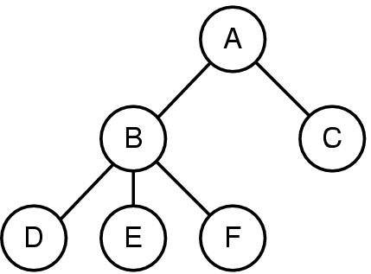
Processes
Many operating systems allow for the creation of Child Processes
When those processes also create children a tree structure of processes forms:
Notes:
The parent may or may not have control over its child processes
In Unix, you do a fork(), in Windows createProcess(); to create a process. It is a very elegant and simple system call as we will see soon.
As in the real world, parents could have the ability to kill a child or not.

Slide 7
Processes
Process cooperating to complete a chore must communicate to synchronize their activities
Referred to as Inter-Process Communication
Some Operating Systems allow processes to receive signals from the OS
These are referred to as Alarm Signals and can be caused by:
timers controlled by the OS; or
hardware interrupts from illegal operations
For example, when in a linux terminal, Ctrl-C causes the OS to send an INT signal to the running process.
By default, this causes the process to immediately terminate
https://github.molgen.mpg.de/git-mirror/glibc/blob/master/sysdeps/unix/sysv/linux/bits/signum.h
Notes:
For most applications in order to achieve something significant, processes must communicate.
On the same processor -> shared memory at some point
Remote process communication -> message passing between platforms
What is meant by synchronization is that the processes need not pass information other than “releasing” another process that was waiting (a precedence constraint) or ensuring that data is not corrupted by simultaneous interleaved access (a process excludes another from access).
Signals – sent from

Slide 8
Processes
Many operating systems assign User Identifications (UIDs) to each person (ie: a login name)
Processes have the UID of the person who started it
This can affect what features of the operating system the process is allowed to access.
Users can be members of groups, each of which has a GID (Group Identification)
Notes:
Windows 98 really only has one user, the superuser
Windows xp, 2000, nt have various access levels

Slide 9
Inter-Process Communications
Processes often have to communicate with each other for a variety of reasons, example include:
Coordinate their work
Share resources
Share results
Notes:
Consider a common situation – multiple processes running and potentially sharing resources – how does the OS ensure data is not changed when being used by another process.
Ask – what can go wrong?
Race Conditions - lightswitch example
Deadlocks – kids fighting over toys example (two toys, they each want the others’ but will not give up theirs until they have what they want).

Slide 10
Inter-Process Communications
Mechanisms are needed to synchronize the operations of multiple process on shared resource in order to maintain data consistency
Semaphores
Mutexes
Barriers
Notes:
Describe concept of atomicity: An atomic transaction is an indivisible and irreducible series of database operations such that either all occur, or nothing occurs.
Semaphores: Semaphore is signaling mechanism (“I am done, you can carry on” kind of signal). For example, if you are listening songs (assume it as one task) on your mobile and at the same time your friend calls you, an interrupt is triggered upon which an interrupt service routine (ISR) signals the call processing task to wakeup.
Mutexes - Mutual Exclusion Object: Only one task (can be a thread or process based on OS abstraction) can acquire the mutex. It means there is ownership associated with mutex, and only the owner can release the lock (mutex).
Barriers - A memory barrier (also known as a fence) is a hardware operation, which ensures the ordering of different reads and writes to the globally visible store. On a typical modern processor, memory accesses are pipelined, and may occur out of order. A memory barrier ensures that this doesn't happen.

Slide 11
Memory Management
From the review of computer hardware, we saw that multiple programs can be in memory simultaneously
How much memory is allocated per process? One solution for a max of N processes:
If this much memory is allocated then there will be enough for each process.
Notes:
Before going to the next slide get them to discuss the possible problem with this solution.
This actually used to be done because the hardware could not support another model so the OS had to deal with the hardware limitation.
If the program does not fit in the space, it must be re-written, or overlaid in two parts in the same partition (run the first part then call a special instruction from the OS to load the second part ensuring the registers and variables are available for the second overlay).
The other points are well discussed on the slide but the students should pause here and draw these points from them. It is useful to draw a diagram on the board to represent the memory so they can see it as you talk indicate empty slots, small and too large programs.

Slide 12
Memory Management
Problems?
This wastes memory when less than N processes are running
Limits all processes to an artificially small size
Limits the number of process that may execute
Solution?
Virtual memory: part of the address space is maintained on the disk. Processes or part of processes are moved between disk and main memory when required
Notes:
You also waste memory if the process does not fill the entire block.
If you limit the number of processes that you can execute, this really limits your multiprogramming and use of valuable resources (time and space: which are always no matter how big or fast a computer is, a problem).
Explain how Windows xp gives each program 4GB in which to execute...how many systems out there have that much RAM? I use the example of a funnel trying to fit something too big into a small space… It cannot be done.

Slide 13
Input/Output
The OS must manage the large number of devices connected to the computer
An I/O subsystem exists for this purpose
Some of this system is device independent
Some (the drivers) is specific to specific devices
Examined further much later in the course
Notes:
Remember from the lecture on the hardware some I/O devices are controlled by registers mapped to ports and others are memorry mapped.
Regardless of where the file (logical file *.doc …) is located (HDD, CD, USB,…) the logical name is the same. The Device Driver portion of the OS takes care of the translation from logical to physical location. (drawing on the copies)

Slide 14
Interrupts
Interrupt signal
CPU goes into kernel mode
The Interrupt Handler address is determined
Interrupt Vector
The flow of the program changes to the interrupt handler (part of device driver)
When the handler has finished, the normal flow of the program resumes
Notes:
Provide context, describe the situation where a user wants to read something from a file on the hard drive.
While that is happening the CPU passes control to another process.
In the meantime, the file has been read, the disk controller notifies the interrupt controller which signals the CPU
Grey is kernel mode
The device number is used to index in the interrupt vector
Interrupt controller, when not busy, asserts a pin to the CPU informing it of the interrupt
Interrupt controller puts the index of the device on the bus for the CPU
CPU switches to kernel mode and uses the index of the interrupt to determines the address of the Interrupt Handler from the Interrupt Vector
When interrupt completed, flow returns to previously running program.

Slide 15
Files
File system of some sort supported by virtually all operating systems
Operating systems hide the peculiarities the system to provide the operator with a device-independent abstract model
Most operating systems use the concept of a directory to group files together
Notes:
Ask what OS do not necessary have a file system: Real-Time embedded.

Slide 16
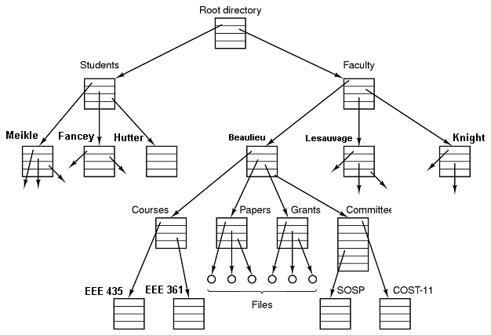
Files
Notes:
Should seem familiar to them
Directory entries may be files or other directories, giving rise to a hierarchy.
Some OS use a directory structure like the one above. Notice there are no cycles (arrows pointing upwards to a parent) they are acyclic however, there exists some OS where the file system is cyclical. Deleting files and directories in these OS’s can be very problematic to resolve. (you could draw this on the board.

Slide 17
Files
System calls required for:
File opening, closing, creation, deletion, reading, and writing
Directory creation and deletion
Addition/removal of files to and from directories
The root directory is the top of the hierarchy
Path name can always be specified relative to the root directory
Windows: c:\winnt\system32\ftp
Unix - /root/user/EE435/myFiles
Notes:
This of course is given that we are currently accessing the C drive
The OS does not only have to keep track of what file is open but of where the pointers are in the files for reading and writing and how many programs have the same file open.

Slide 18
Files
Each process has a Working Directory
Path names not beginning with a slash look for the file relative to the working directory
cd \winnt
system32\ftp
File systems can often be mounted (*NIX)
DOS solution is not elegant; exposes the specifics of the device to the user
Windows: d:\setup.exe
In Unix, /dev/sda1/setup.exe

Slide 19
Security
Different operating systems offer varying levels of security
Files in Unix protected by a 9-bit code
USER GROUP WORLD
rwx rwx rwx
In a directory, x indicates search permission
This is just the beginnings of concerns in the creation of a secure system!
Notes:
So, the code rwx r-x --x means that the owner can read, write, and execute, the group can read and execute, and the world can execute a particular file.
Ask them what the x would mean for a directory instead of a simple file (search permission)

Slide 20
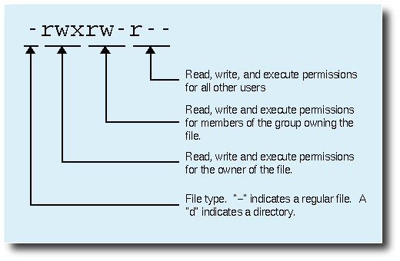
Security
Source: http://linuxcommand.org/lts0070.php

Slide 21
The Shell
Is it part of the operating system?
No, but closely linked
On non-GUI systems the shell is where commands are interpreted and is the primary user interface
The cmd window we use in the labs is a shell for the Windows OS
Notes:
a shell is a user interface for access to an operating system's services.

Slide 22
Quiz Time
What is the name of the structure that holds information about each executing program?
What is the difference between a program and a process?
Notes:
What is the name of the structure that holds information about each executing program? Process Table
What is the difference between a program and a process.
A program lives in memory, a process is a program in execution that has been given resources.

Slide 23
System Calls

