Slide 1
EEE 335 Principles of Operating Systems
System Calls
(Modern Operating Systems 1.6)

Slide 2
Outline
System Calls
Selected Specific System Calls
fork( )
execve( )
link( )
*NIX to Windows comparison

Slide 3
System Calls
System calls are the interface between user programs and the operating system
Procedure libraries are provided to make it possible to make system calls from higher level languages such as C
Example: stdio.h provides the functions necessary to open, close, and manipulate files.
DOS and UNIX systems both have a stdio.h, though their implementations are different
https://pubs.opengroup.org/onlinepubs/7908799/xsh/stdio.h.html

Slide 4
Recall: Memory Model
Stack
myFunction (int a, char b)
}
Unused memory
Heap
Data
(variables)
Text
(executable instructions)
Notes:
What causes the stack to grow?
Parameters in a function MyFctn (int a, char b) { \\grows the stack by 3 bytes and it moves the pointer to the last one.
A block of code, can either the block of the entire function or a block for an if, while, for,…
{ int a; … } \\
The stack shrinks when the block closes “}” or when the function returns.

Slide 5
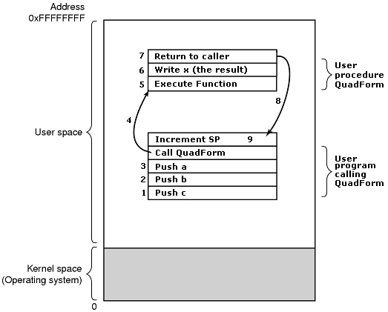
System Calls
What happens during a regular function call?
Consider following function:
float QuadForm(float a, float b, float c)
{
x= (-b+/- Sqrt(B^2-4ac)) /2a;
return x;
}
Notes:
This is for a specific compiler, say a C program compiled for DOS, but is very typical
This follows from the example in Tanenbaum.
Fictional function float QuadForm(float a, float b, float c)
So we have the function main() which calls QuadForm which is calculating the Quadratic Formula
x= (-b+/- Sqrt(B^2-4ac)) /2a
On return the value of x is written directly where the calling procedure will expect it (ie: directly to a memory location)
NOTE: some things such as restoration of registers, program counter, etc not shown

Slide 6
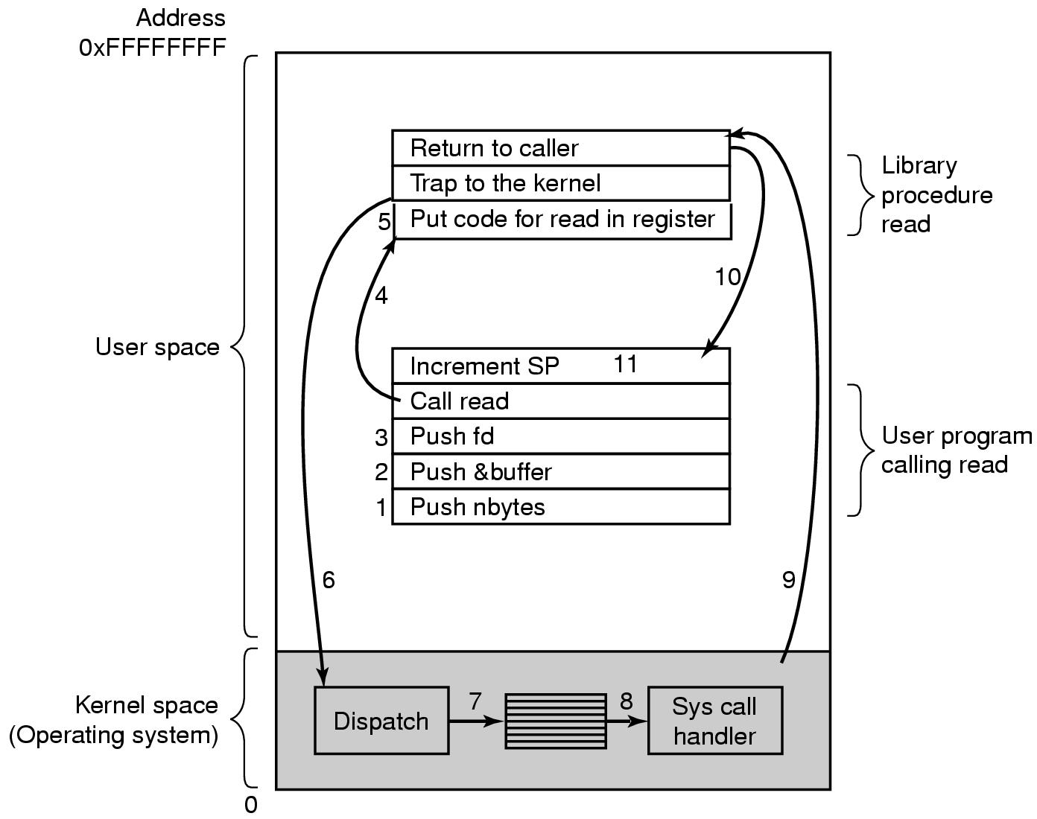
System Calls
How is a system call different?
Consider the ‘read’ system call:
int read(fd, buffer, nbytes)
Notes:
Function is: int read(fd, buffer, nbytes) where:
fd is the file descriptor,
buffer is a pointer to where the read will put the file’s data; and
nbytes is the number of bytes actually read.
1,2,3. Calling program pushes the values onto the stack
C and C++compilers push parameters onto the stack in reverse order
Question: How are these parameters passed?
1st and 3rd are passed by value
Buffer is passed by reference, noted by the &
4. Call to the library procedure is made.
5. The library procedure puts the system call number and any arguments into a register,
6. Then the library procedure executes a trap function to start execution in kernel mode at a specific address in the kernel
7. Following the trap, the kernel code that runs first examines the system call number in the register, looks up the system call handler in a table and dispatches to a system call handler
8. System Call Handler runs
9. Returns to the library procedure
10. Returns to user program
11. Carries on with the program
So thinking about it: How many languages can be used on top of an OS? A lot. But there is only 1 OS: So we must have an API in the OS and a library for the language that interfaces to the API.
Also think of a programmer that takes his software across platforms: The library must be also available in Win, Unix, Linux, MacOS,…
The defined software interrupt on x86 is interrupt number 128, which is incurred via the int 0x80 instruction. It triggers
a switch to kernel mode and the execution of exception vector 128, which is the system
call handler.

Slide 7
Specific System Calls
A brief description of some system calls in the *NIX environment is useful to demonstrate what services the OS offers
Actually, these are a description of library function calls
In general, these functions invoke system calls to accomplish their task
http://man7.org/linux/man-pages/man2/syscalls.2.html

Slide 8
The fork( ) System Call
pid = fork(); /*Example of call*/
In *NIX, the only way to create a new process is with fork()
fork() creates an exact duplicate of the calling process at the point of the call including file descriptors, register state, stack, etc
Same program text is shared
Return value is different for the two processes:
Parent receives the PID of the child
Child receives 0
Notes:
Same program text is shared...as in the example of base and limit registers where the Base-1 marked the program text

Slide 9
The fork( ) System Call
If everything is the same, how do the child process do different work from the parent?
Consider shell command:
cp file1 file2
while (TRUE) /* repeat forever */
{
type_prompt(); /* display prompt */
read_command(command, parameters) /* input from terminal */
if (fork() != 0) /* fork off child process */
waitpid( -1, &status, 0); /* Wait for child to end */
else
execve (command, parameters, 0); /* execute command */
}
Parent code waits
Child code executes
Notes:
This is “sort of” the code they might see in a shell, Ask them what the heck execve is???
int main(int argc, char *argv[], char *env[])
{
int i;
for (i=0; env[i]!=NULL; ++i)
{
printf("%s\n",env[i]);
}
return 0;
}

Slide 10
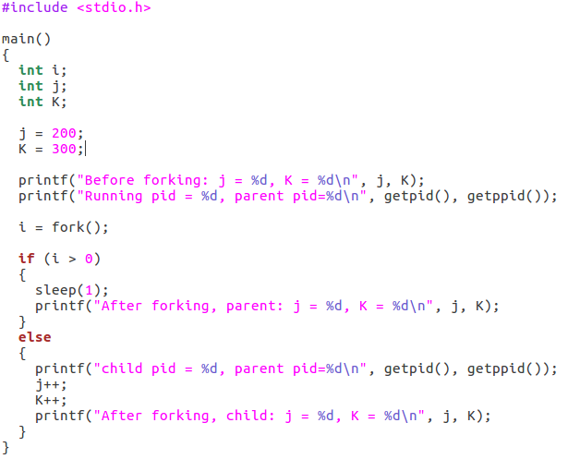
fork() example
1. Before forking: j = 200, K = 300
2. Running pid = 18460, parent pid=15447
5. After forking, parent: j = 200, K = 300
3. Child pid = 18461, parent pid=18460
4. After forking, child: j = 201, K = 301

Slide 11
After the Call to fork()
Segments
Stack
Parent
PID = 18460
Text
Stack
Segments
Child
PID = 18461
Data
Data
Notes:
What is the right-most structure supposed to represent? No idea.

Slide 12
The execve( ) System Call
Now that the child process has started we want it to do something completely different
s=execve(name, argv, environp)
Replaces the current process’ core image with the program specified by name
argv a pointer to an array of characters passed to the new program
environp is an array of environment information such as home directory, working directory, etc
Notes:
Execve is the lone system call in the family of exec functions. The others are simply wrappers around the system call in the C library. These include:
execl
execlp
excele
execv
execvp
l and v – delineate whether the arguments are provided via a list or an array
P – denotes user’s full path is searched for the given file
e – denotes new environment is also supplied for the new environment

Slide 13
The link( ) System Call
link( ) is interesting because it illustrates how files are stored in *NIX systems
Are files physically located on the disk in terms of files within directories?
No
Files are simply groupings of related data
Information on each file is a data structure
Each file has a number called an inode
The data structure maps this inode to a physical disk location
Notes:
Notes:
this “table” structure is actually more complicated in practice
Much more information about the files is stored
Explain the difference between link and Windows shortcuts.

Slide 14
Inodes
The inode is a data structure in a Unix-style file system which describes a filesystem object such as a file or a directory.
Each inode stores the attributes and disk block location(s) of the object’s data
File system object attributes may include metadata (times of last change, access, modification), as well as owner and permission data
You can see the inode numbers using the ls command (e.g. ls –i)

Slide 15
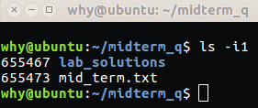
Inodes
Consider a directory called midterm_q with one directory, lab_solutions and one file, mid_term.txt
Lets see what the inode numbers are that reference these two file system objects:
Inode numbers

Slide 16
The link( ) System Call
What is a directory?
In *NIX, directories are files mapped to inode numbers
So how does link() work?
~/435$ ls -i1A
948629 codingIsCool.txt
949491 deadlocks.txt
949492 iLoveC.txt
949493 scheduling.txt
Notes:
Name to-inode mapping is called a link.

Slide 17
The link( ) System Call
link(oldpath, newpath)
Both oldpath and newpath refer or point to the same file
There is no way to tell which was the “original” link
link(~/435/codingIsCool , ~/Documents/466/makesnosense.txt);
Before
link()
System Call
~/435$ ls -i1A
948629 codingIsCool.txt
949491 deadlocks.txt
949492 iLoveC.txt
949493 scheduling.txt
~/466$ ls -i1A
949489 iLovePython.txt
949490 protobuf.txt
949494 socketTutorial.txt
After
link()
System Call
~/435$ ls -i1A
948629 codingIsCool.txt
949491 deadlocks.txt
949492 iLoveC.txt
949493 scheduling.txt
~/466$ ls -i1A
949489 iLovePython.txt
948629 makesnosense.txt
949490 protobuf.txt
949494 socketTutorial.txt

Slide 18
Hard and Soft (Symbolic) Links
In linux, one can create both:
hard links, using the system call link() and
soft or symbolic links, using the system call symlink()
In BASH, the link (ln) command enables one to create hard and soft links
this is not the link() system call
it is a bash utility that helps illustrate the differences between soft and hard links

Slide 19
Hard Links
Hard links are really just other names for files in a linux operating system
Hard links cannot be created for directories
Consider a directory called midterm_q with one directory, lab_solutions and one file, mid_term.txt

Slide 20
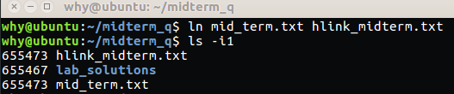
Hard Links
Hard links are really just other names for files in a linux operating system
Hard links cannot be created for directories
So lets create a hard link for our mid_term.txt file and take a look at the inode numbers
Again, note that with the hard link, the inode numbers are the same

Slide 21

Symbolic Links
Symbolic links can be created in a similar manner, lets create one and see what the listing looks like
Note that in the Ubuntu version used for this example, the soft link is identified by a different colour

Slide 22
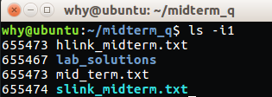
Symbolic Link
More importantly, lets look at the inode numbers:
Note that the soft or symbolic link has a different inode number
It does not contain the data in the target file but rather points to another inode entry in the data table

Slide 23

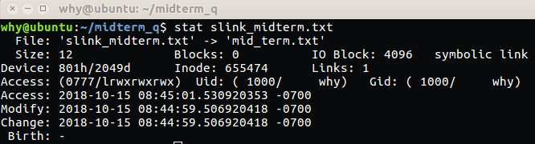
Symbolic Links
There are several ways (e.g. ls, file and stat commands) to see what a symbolic link actually points to:

Slide 24
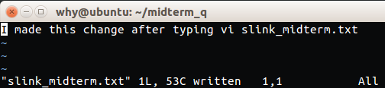
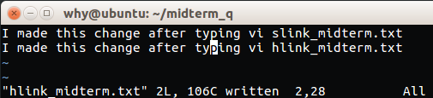
Making file changes
Changes can be made to the ‘original’ file using either soft or hard links
Each of the following lines was written by separately accessing the file through the two types of links

Slide 25

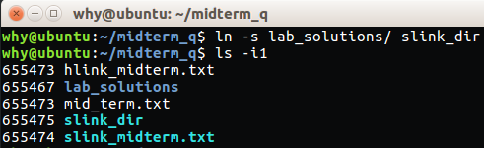
Links to Directories
As stated, hard links cannot be used to link to directories
But you can link to directories with soft links
Note the new inode entry for the recently created directory

Slide 26

Deleting Linked Files
Another difference between the two different types of links is what happens when files are deleted
Let delete the original file using rm mid_term.txt, and see what happens
Note the soft link entry still exists, but is now in red text
This is because the file to which it points, no longer exists

Slide 27
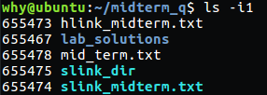
Deleting Linked Files
However, the hard link file still exists and can be opened to reveal the same information
Another interesting test that you can try, is using vi to open the soft link, type something in it and save it
You will find that the mid_term.txt file gets recreated with a new inode number, but only contains the new information you typed in from the link and that the contents are now out of sync with the other hard linked file (hlink_midterm.txt) that you created
This mid_term.txt file was created by again using vi slink_midterm.txt
Note the new inode number

Slide 28
Link Summary
A few key summary points regarding hard and symbolic links
Soft Links
A soft link does not contain the data in the target file
A soft link points to another entry somewhere in the file system
A soft link has the ability to link to directories, or to files on networked systems
Deleting a target file for a symbolic link makes that link useless
Hard Links
A hard link preserves the contents of the file
A hard link cannot be created for directories, and they cannot span across partitions
If the original file is deleted, the hard link (see first bullet) can still be accessed

Slide 29
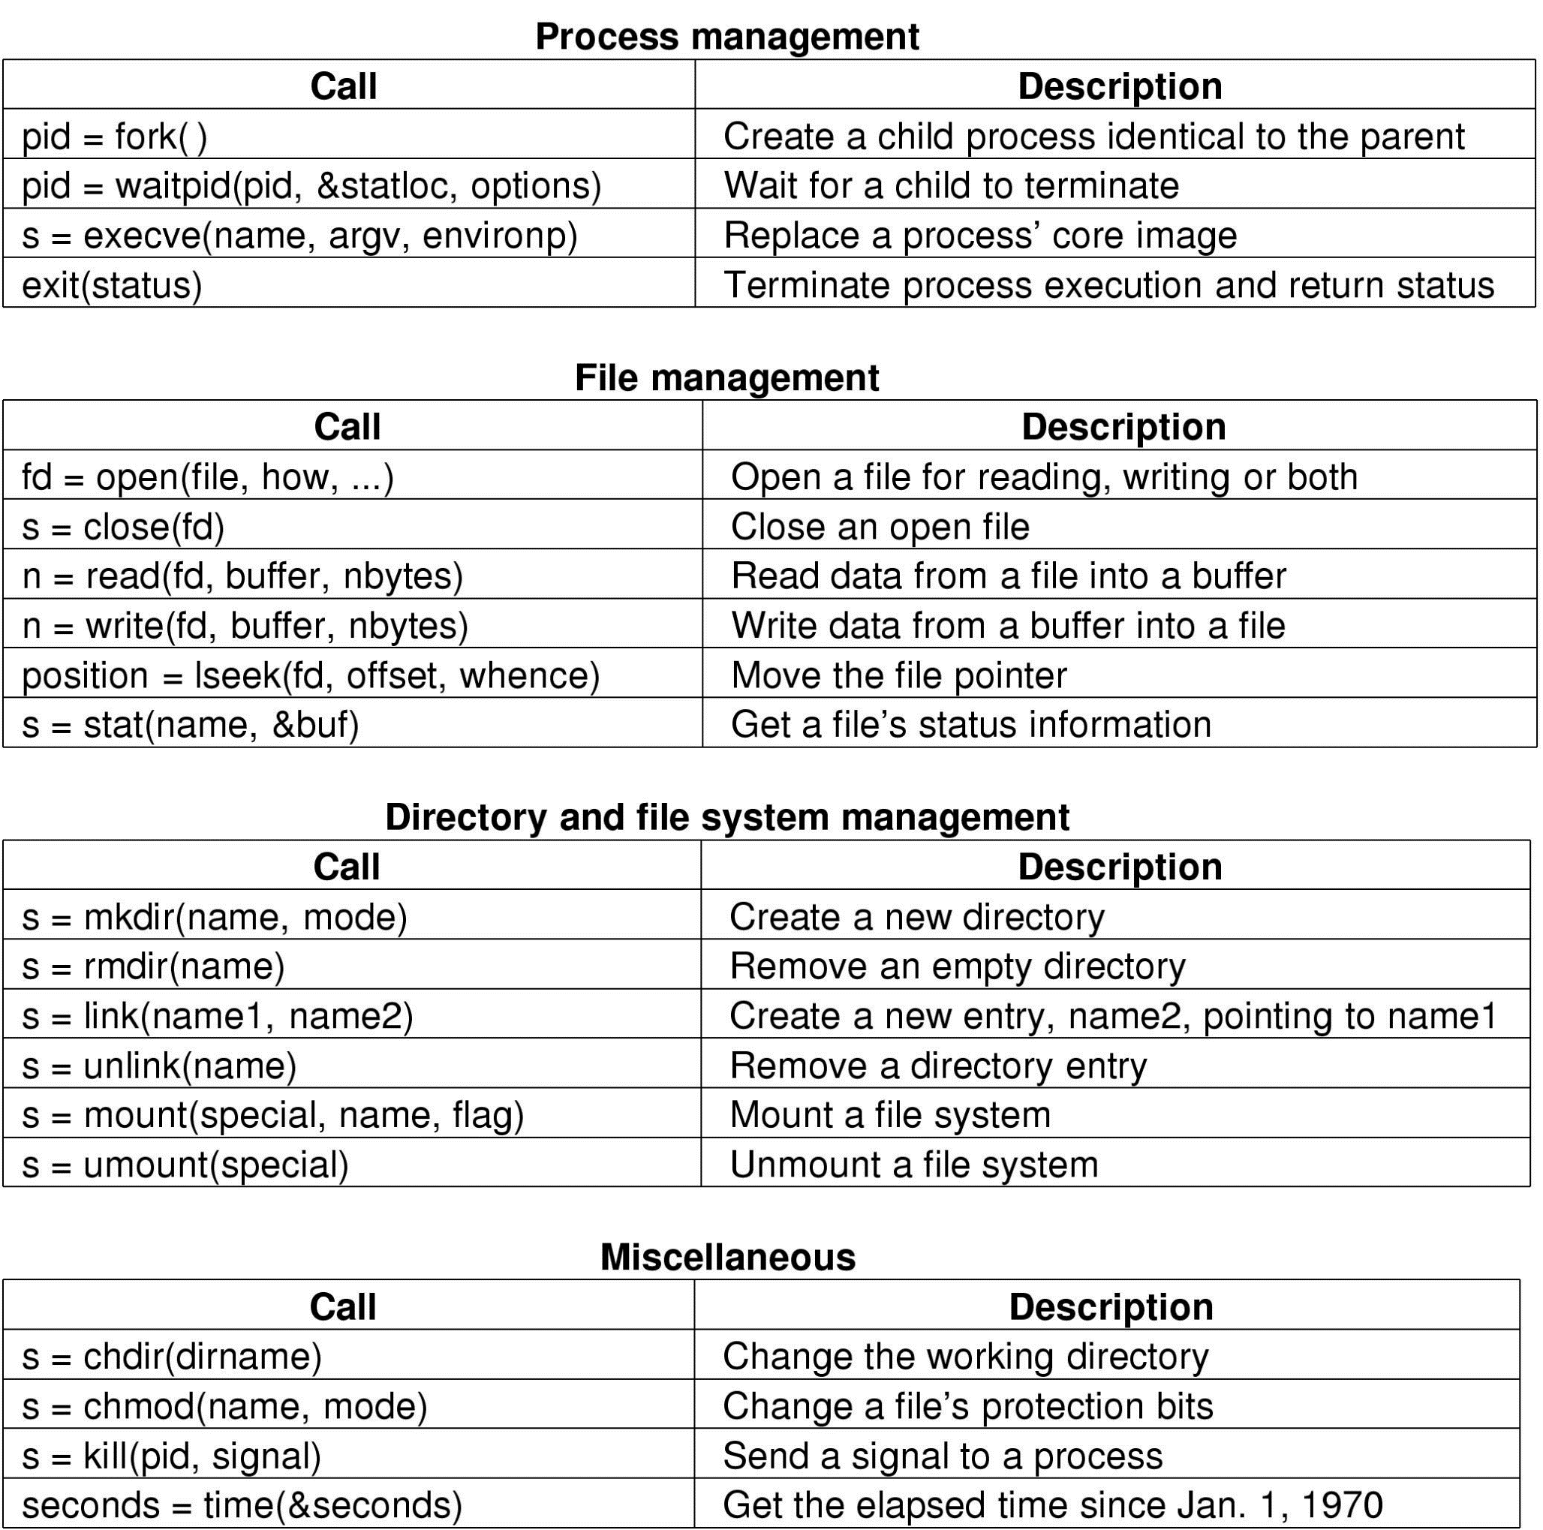
System Call Summary

Slide 30
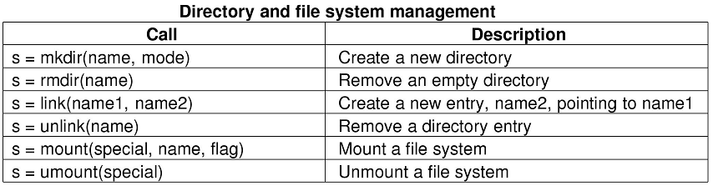
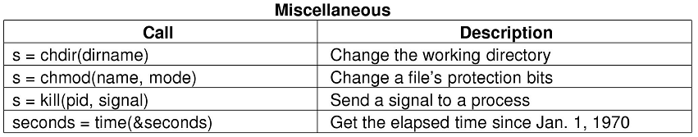
System Call Summary

Slide 31
*NIX vs Windows
Windows provides a more removed interface known as the Win32 API
Number of API calls are in the thousands!
Many invoke system calls, many more in user space...impossible to tell them apart. It may even vary from one edition of Windows to the next
Windows has different system calls as some features supported differently or not at all
For example:
CreateProcess() in Windows is similar to fork() + execve() in Linux
Notes:
Explain how shortcuts are really a “fake”, ie: you couldn’t specify them in a path name. You’d just overwrite the shortcut with bad data.

Slide 32
Quiz Time!
Why is a system call different from a regular function call?

Slide 33
Questions?
Notes:
Why is a system call different from a regular function call?

Slide 34
Structure of Operating Systems

