Slide 1
EEE 335 Principles of Operating Systems
Operating System Structure
(Modern Operating Systems 1.7)
Notes:
So far we have been looking at a high level overview of the various topics we will be diving into throughout the remainder of this course. Now that we have seen what operating systems look like on the outside (i.e., the programmer’s interface), it is time to take a look inside.
Once we are done this section, we then starting going deeper into various topics, starting with processes.

Slide 2
Outline
Operating System Structure
Monolithic Systems
Layered Systems
The THE System
MULTICS
Microkernels
Client-Server
Virtual Machines
Exokernels
Windows and Linux Structure
Summary of Chapter One

Slide 3
OS Structure
To this point our examination of operating systems has been from the point of view of the programmer
Concerned mainly with interfaces and underlying OS functionality
How are operating systems structured?
Monolithic
Layered
MicroKernel
Client-Server Model
Virtual Machines
Exokernels

Slide 4
Monolithic Systems
In this type, OSs are nothing more than a collection of functions to provide services to the programmer
The OS is basically a collection of procedures, compiled and linked together, into a single executable file running in kernel mode
Each procedure is free to call any other procedure without restriction
Very little information hiding
Notes:
Guide them through this...make them come up with the idea of “just a bunch of procedures” if possible.
Essentially no information hiding – ask them about this in previous courses.
They learned Information hiding (abstraction!) in second year. Ask them what it is and why we use it:
Hide the algorithms, machine, data structure and behaviours and expose a stable interface. It is there to prevent ripple effects by hiding what is likely to change while having a stable composition mechanism for the system under development. Also good for reuse and the content of the modules are coherent not accidental (bunch of code put together without thinking about it.)
A crash in any one of the procedures could take down the entire system
Can still be structured and modular -> ask them what this means or give an example

Slide 5
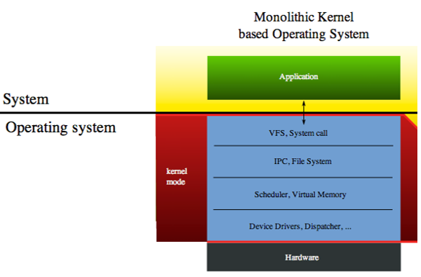
Monolithic Systems
Source: wikipedia.org
Notes:
Service provided by the OS are through system calls.
During execution, parameters are put in a well defined location like the stack
A trap is executed to switch the machine into kernel mode
OS fetches parameters and determines system call to use.
As a number of service calls may need some common work done, they will call on a set of utility procedures that are not called requested directly by the user.

Slide 6
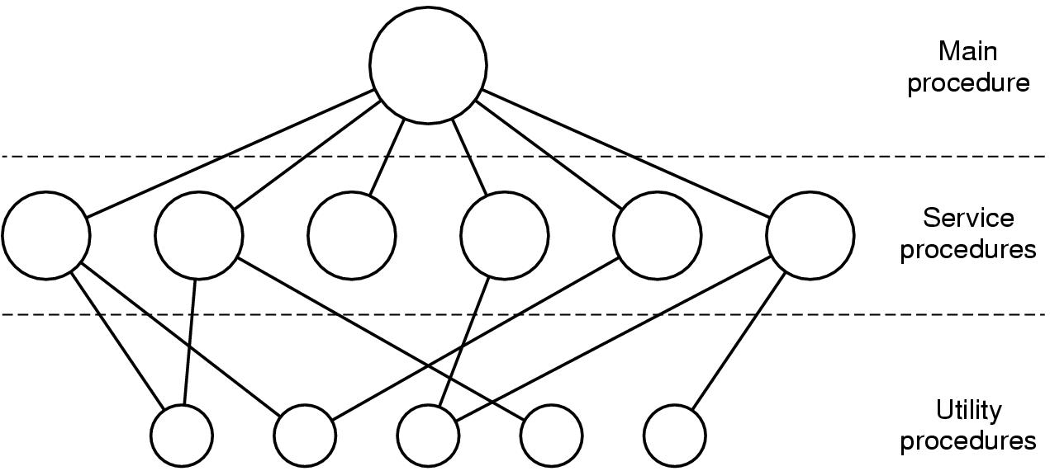
Monolithic Systems
Is some structure implied by the way such an OS would operate?
A main program that invokes the requested service procedure
A set of service procedures that carry out the system calls
A set of utility procedures that help the service procedures
Notes:
As a number of service calls may need some common work done, they will call on a set of utility procedures that are not called requested directly by the user.
THIS IS MAINLY A RESEARCH OS.
There are three kinds of KERNEL designs (do not mix this with types of OS) :
Those that are micro-kernels
Monolitic kernels
And exokernels

Slide 7
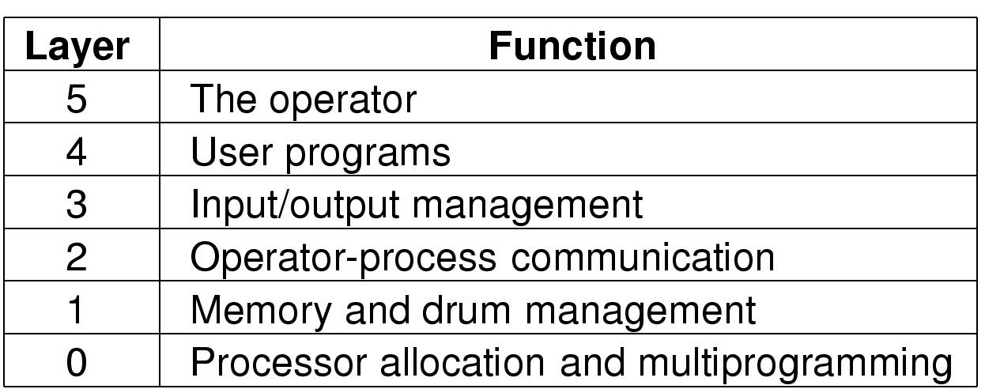
Layered Systems
Each layer in a layered system provides services to the layer above it and requests services from the layer below
Example: the Technische Hogeschool Eindhoven (THE) operating system
Notes:
THE is Technische Hogeschool Eindhoven, in English - Eindhoven University of Technology - late 1960s, created by Dijkstra (same guy as Dijkstra Algorithm).
It is kind of a bunch of client servers, the higher level is a client the lower a server
Layer 4 did not have to worry about process management, I/O, memory – data abstraction and information hiding
More of a design aid, the layers were not enforced

Slide 8
Layered Systems
The THE system was essentially a design aid since there was no enforcement of separation of layers
No hardware support to force the use of the design
Future systems added hardware to keep processes in their own memory space
required the use of TRAPs to call functions from a lower layer

Slide 9
Layered Systems (MULTICS)
Equivalent of a system call or trap from outer to inner layers
Though entire address in same user space, hardware was used to protect specific memory segments (rwx)
Multiplex Information and Computing Service
- similar to layered approach
Notes:
MULTICS was the first OS to do this; this is where the term kernel comes from, the center of the rings that were concentric.
Created by MIT, GE and Bell Labs. Taken over by Honeywell in 1970.
Project started in 1964 last running version of MULTICS was shutdown on Oct 30th 2000. Department of National Defence Halifax.

Slide 10
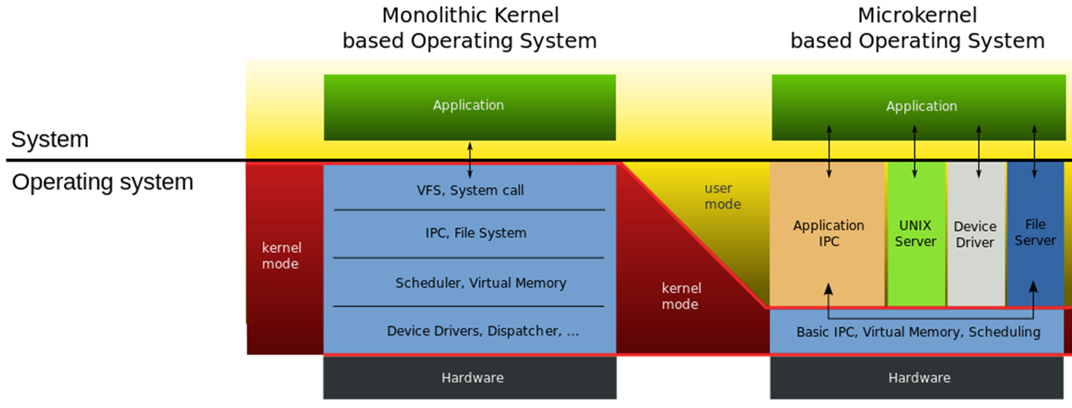
Microkernel
Only the modules that must be in the kernel are there
Communication between modules use messages
Notes:
Traditionally, all the layers were in the kernel, but that is not necessary
-> bug in kernel can bring down system, bug in user process will have a lesser impact
Think of number of coding errors per 1000 lines of code:
Early 80’s, 2-10 bugs per KLOC
Code complete – 10-20 bugs per KLOC
Consider 5 million lines of code, between 10,000 and 5,000 kernel bugs
Basic idea: split OS into small well defined, reliable modules, only run a few of them in kernel mode to ahieve higher reliability
Embedded systems
QNX – Blackberry, Ford -> only CPU scheduling, interprocess communication, interrupt redirection and timers run in kernel mode

Slide 11
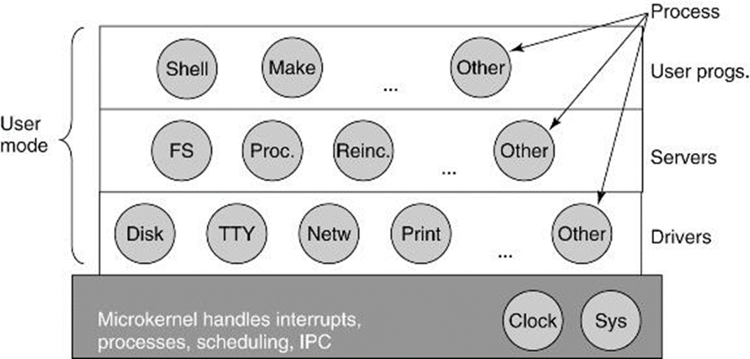
Microkernel
Less danger of crashing the complete system
May be Slower
Popular in embedded systems
Some examples of microkernel Oss:
http://www.microkernel.info/
Simplified Structure of the MINIX Operating System
Notes:
Highlight layered approach – kernel mode at the bottom and various user mode layers above
Drivers do not have physical access to IO devices, needs to make kernel calls.
What is advantage of this -> kernel can check authorizations
Servers do most of the work – file system, processes
User programs obtain OS services by sending messages

Slide 12
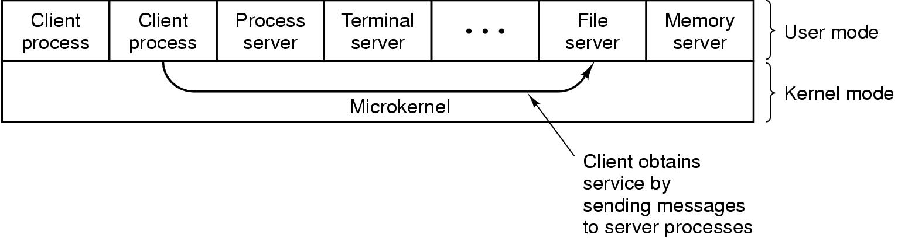
Client-Server Model
The kernel is now a messaging service between various servers
Each “service” is segmented and manageable
A crash of one server won’t crash the whole kernel
Adaptable to distributed systems
Notes:
a slight variation on the monolithic is the client server
Processes are either client or server (consume or create)
Note: some OS functions won’t be runnable purely from user space
eg: loading commands into physical I/O device registers
2 ways to deal with it:
Put a few critical server processes into the kernel, but have them communicate using the same system
Put the required mechanism into the kernel, but have the servers make the policy decision, ie: the file server asks the kernel for a file. The kernel doesn’t verify the request to ensure validity, access, etc but does its job blindly (except of course limiting such requests

Slide 13
Virtual Machines
What are the two functions of an OS?
Resource management
Provide extended machine (an interface, abstraction)
Virtual machines separate these ideas and simply focus on sharing the resources
An entire virtual copy of the underlying hardware is provided to the upper layers.
Example: VM/370
Notes:
NOTE: this name is very very very confusing. It is not the same as the EXTENDED machine with the nice interface. In this case the virtual machine is an exact copy of the underlying hardware.

Slide 14
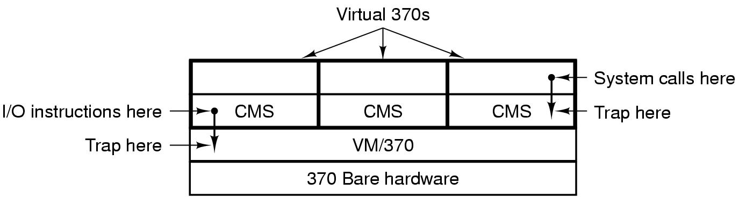
Virtual Machines
Advantages:
each virtual machine can run any operating system that can run on the bare hardware
separating virtual machine and multiprogramming makes each easier to maintain
Disadvantage: multiple layers of TRAPS
Note: VM/370 is quite historical, this is the 1970’s version, z/VM is IBM’s newest virtualization technology
Notes:
Note: in this example, CMS (Conversational Monitor System) is not a multi-threading OS (but I suppose it could be)
Can ask them if this is like MS-DOS programs running in Windows XP.
It’s similar, but not the same. The underlying hardware that will emulated in that case will be an 8086, which is what DOS expects, not a full Pentium model. You couldn’t run Windows in this emulation mode.
Can VM/370 be run on top of VM/370?
YES!
Is Java like a Virtual Machine in this sense?
Well, it doesn’t provide the underlying hardware to the upper level, but it does provide the same interface. The JVM is more like providing the same extended machine rather than acting as a resource manager...it’s more the opposite.

Slide 15
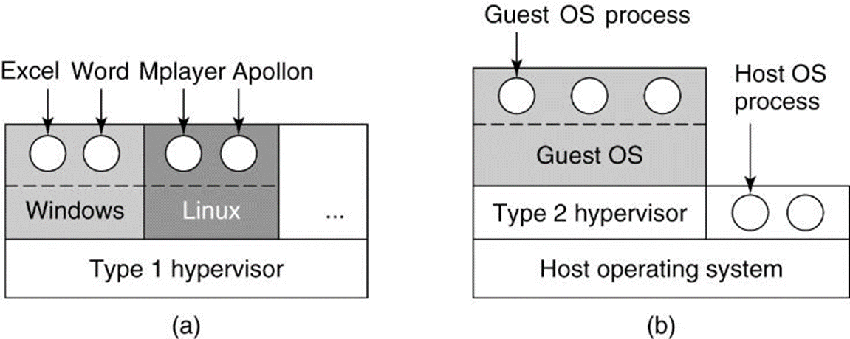
Virtual Machines
Type 1 example – VMWare ESXi, IBM z/VM, Citrix XenServer
Type 2 example – VMware Desktop, Oracle VirtualBox, MS Hyper-V

Slide 16
JAVA – Abstract Vision of an OS
Applications
API
Interface
JVM
Operating System
Hardware
Notes:
From your 321 course you have learned that the JVM helps with the portability of the system, it is a further extension of the machine so it really implements the vision of moving away … extending the machine further.
The Java compiler produces code for JVM, which then typically is executed by a software JVM interpreter. The advantage of this approach is that the JVM code can be shipped over the Internet to any computer that has a JVM interpreter and run there.

Slide 17
Exokernels
The Exokernel provides a number of virtual machines above the hardware
Though different concept from virtual machines
Exokernels provide only a subset of the underlying hardware to each VM:
Memory
Disk blocks
“Physical” partitioning of the machine
Imposes few abstractions to the developer
Separates protection (exokernel) and management (developer or user’s code)
Notes:
Exo in Latin is for “outside of” This kernel sort of exposes the machine interior by breaking it up into chunks
Intent is to impose fewer abstractions
Exokernels are smaller – functionality is geared towards protection and multiplexing of resources
Provides more choice to the programmer to implement custom abstractions and choose what level of abstraction they want the users to have
Developed by MIT parallel and distributed operating system group, the concept has been around since 1994

Slide 18
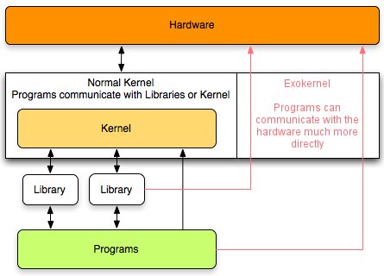
Exokernel
Advantages
Performance increase
Ease of development and testing of new OS ideas
e.g. scheduling, memory management
Disadvantages
Complexity of interface design
Image Source: https://medium.com/@vithushaaarabhi/exokernels-an-operating-system-architecture-for-application-level-resource-management-32d0daaeeab0

Slide 19
Linux
Linus Torvalds at the time college student wrote original Linux.
Evolved from MINIX which was developed as a teaching aid by Tanenbaum the same author as the text used in this course.
Linux evolved away from MINIX due to license agreement and some design considerations
Linux is API compliant with UNIX (Posix)
Torvalds-Tanebaum Debate: https://www.oreilly.com/openbook/opensources/book/appa.html
Notes:
Notes below come from Linux Kernel Development 3rd edition
Linus, then a student at the University of Helsinki, was perturbed by the lack of a powerful yet free Unix system.
Linus began by writing a simple terminal emulator, which he used to connect to larger Unix systems at his school. Over the course of the academic year, his terminal emulator evolved and improved. Before long, Linus had an immature but full-fledged Unix on his hands. He posted an early release to the Internet in late 1991.
Linus did use Minix, a low-cost Unix created as a teaching aid, but he was discouraged by the inability to easily make and distribute changes to the system’s source code (because of Minix’s license) and by design decisions made by Minix’s author.
Use of Linux took off, with early Linux distributions quickly gaining many users. More important to its initial success, however, is that Linux quickly attracted many developers— hackers adding, changing, improving code. Because of the terms of its license, Linux swiftly evolved into a collaborative project developed by many.

Slide 20
Structure of Linux
Linux is a monolithic kernel; that is, the Linux kernel executes in a single address space.
Runs entirely in kernel mode.
Concurrently, Linux also leverages positive aspects of microkernels
Modular design as explained before a structure emerges from the design of the monolithic structure
It can preempt itself
Can dynamically load separate kernel modules
So Linux avoids message communication delays of microkernels with direct function invocation.
Source: Linux Kernel Development 3rd edition
Notes:
Notes below come from Linux Kernel Development 3rd edition
Linux supports Kernel threads, but we will cover that during the threads lecture
Windows – hybrid (though mostly monolithic) – key processes run in user mode:
- Session Manager Sub-System (SMSS)
Local Security Authority Sub-System Service (LSASS)
Client Runtime SubSystem (CSRSS) – win32 console and shutdown
Windows – monolithic in the basic sense, but also a bit of a hybrid with microkernels in that certain processes
The architectures of the x86 and x64 processors define four privilege levels (or rings) to protect system code and data from being overwritten either inadvertently or maliciously by code of lesser privilege. Windows uses privilege level 0 (or ring 0) for kernel mode and privilege level 3 (or ring 3) for user mode.

Slide 21
Summary of Chapter 1
Where are we now?
We have seen an overview of the concepts which we will explore in more detail for the rest of the course
Views of an operating system
Operating system types (mainframe, etc)
Review of computer hardware (processors, memory, I/O, Buses, etc)
Operating system concepts (processes, deadlocks...)
System Calls
Operating system structure
Notes:
Operating systems can be viewed from two viewpoints: resource managers and extended machines. In the resource-manager view, the operating system’s job is to manage the different parts of the system efficiently. In the extended-machine view, the job of the system is to provide the users with abstractions that are more convenient to use than the actual machine. These include processes, address spaces, and files.
Operating systems have a long history, starting from the days when they replaced the operator, to modern multiprogramming systems. Highlights include early batch systems, multiprogramming systems, and personal computer systems.
Since operating systems interact closely with the hardware, some knowledge of computer hardware is useful to understanding them. Computers are built up of processors, memories, and I/O devices. These parts are connected by buses.
The basic concepts on which all operating systems are built are processes, memory management, I/O management, the file system, and security.
The heart of any operating system is the set of system calls that it can handle. These tell what the operating system really does. For UNIX, we have looked at four groups of system calls. The first group of system calls relates to process creation and termination. The second group is for reading and writing files. The third group is for directory management. The fourth group contains miscellaneous calls.
Operating systems can be structured in several ways. The most common ones are as a monolithic system, a hierarchy of layers, microkernel, client-server, virtual machine, or exokernel.

Slide 22
Quiz Time!
Why is a process table needed in a timesharing system?
Is it needed in a computer system where only one process exists, that process taking over the entire machine until finished?
To a programmer, a system call looks like any other call to a C library procedure. Is it important that the programmer know which library procedures result in system calls?
Notes:
To allow the OS to switch between tasks and restore the next process to its previous state.
No
Yes because system calls cause 4 context switches as opposed to 2 for library calls. Also two changes of mode.

Slide 23
Quiz Time!
Which of the following instructions should be allowed only in kernel mode:
a) Disable all interrupts
b) Read the time-of-day clock
c) Set the time-of-day clock
d) Change process memory maps
Name a virtual machine solution (other then one we use in the lab).
Notes:
Everything except b)
VMWare, VirtualBox, BootCamp

Slide 24
Quiz Time!
What is the difference between a TRAP and an interrupt?
Notes:
Traps are software calls to the OS, interruptions are hardware generated to get attention from the OS

Slide 25
Processes

