Slide 1
EEE 335 Principles of Operating Systems
Processes
(Modern Operating Systems 2.1)

Slide 2
Quick Review
What are the six operating system structures discussed last class?
What is the difference between an Vmware/Oracle-like virtual machine and the Java Virtual Machine (JVM)?
What OS model does Linux use?
Notes:
Monolithic
Layered
Microkernel
Virtual Machine
Exokernel
Client-Server
The IBM virtual machine (VM/370) is there to do resource management by providing virtual copy of the underlying hardware. The JVM has two primary functions: to allow Java programs to run on any device or operating system (known as the "Write once, run anywhere" principle), and to manage and optimize program memory. It virtualizes the processor, but not all the other hardware.
Linux is a monolithic microkernel. It is a mix between the layered OS as there is a structure that emerges from the design and of course the monolithic OS.
Linux uses function calls to reduce the time taken by the messaging system of the client server architecture.

Slide 3
Outline
Processes
The Process Model
Process Creation
Process Termination
Process States
Process Implementation
Processes in Linux
Quick Interrupt Review

Slide 4
Processes
The process is the most central concept in an operating system
A process is an abstraction of a running program
To which we have given resources
A number of processes (at least more than one) executing at the same time is referred to as: multitasking, multithreading, multiprogramming
For single CPU systems, are these programs truly running in parallel?
Notes:
As we mentioned, processes are not really running in parallel if we have a single processor (pseudo-parallelism). In multi-core (one CPU with multiple execution units) or in multiprocessor (multiple CPU), there is real multi-tasking (true parallelism).

Slide 5
The Process Model
The process model is simply the idea that all running software on the computer (including the OS) is organized into a number of sequential processes
Notes:
Processes = Instance of an executing program = {program counter, stack pointer, variables, and registers)

Slide 6
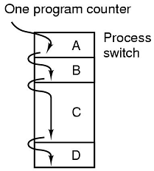
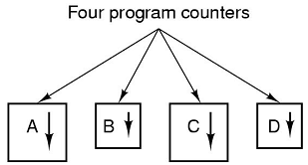
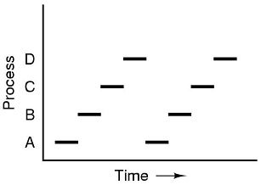
Processes
Conceptual
Program Text Flow
Process Execution in Time
Notes:
Top left: four processes in memory
Top right: four “logical” program counters
Bottom left: True sequence. As you can see, the CPU switches between processes
This is a “Pseudo-parallelism”
Is the rate at which a process performs its computation uniform?
Almost certainly not...CPU is interrupted for all sorts of things like interrupt requests and other processes may use more or less of their slice on each pass.
What is the implication for this when using a for...next loop to insert a delay. Could you use it to insert delays when reading from a disk?
The conceptual view (top left figure) is that each process is at some point in its execution.
The figure on the top right is kind of incomplete: Show them the line between processes A to B, B to C… Tell them that the OS is involved here. Ask them the causes of the OS taking the CPU over.
The process executes an OS system call. This produces a software interrupt or a SWI/TRAP. So if the process needs attention to get hardware or virtual resources or synchronization with another process, it executes these system calls.
The hardware causes the OS to be called. The hardware asserts an interrupt on the CPU which causes the change in kernel mode and the OS takes over to service this interrupt. A network card receives a packet.
Finally ask them in principle what part of the OS is involved in deciding which process will run next. They should already have a good idea about the scheduler.

Slide 7
Processes
Pseudo-parallelism is sometimes used to refer to multiple processes sharing a single processor
This differentiates itself from parallelism on multiprocessor systems
It is also different when you consider multicore processors
Notes:
What is the difference between multiprocessor and multicores ?
Multicore = single CPU + multiple cache memory + multiple ALU
Multiprocessor = Multiple CPUs

Slide 8
Process Creation
General purpose systems need to create new processes during operation. When?
System Initialization
Execution of a process creation system call by a running process
A user request to create a new process
Initialization of a batch job
Some operating systems may be able to create all required processes that will ever be needed during initialization
Notes:
In general purpose computers, creation of processes happens according to specific scenario
Specific purpose computer systems commonly have all processes created in initialization. Embedded Systems are good examples
Microwave oven
MP3 player
The point is these systems have very specific purposes, not general purpose
All processes are descendants of the init process, whose PID is one. The kernel starts init in the last step of the boot process.
The init process, in turn, reads the system initscripts and executes more programs, eventually completing the boot process.

Slide 9
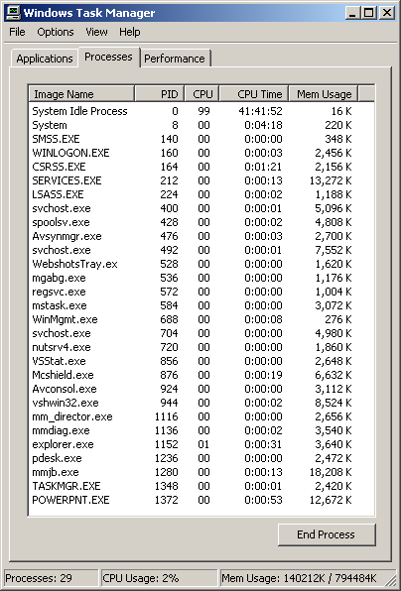
Proc Creation
System Initialization
User Request
Notes:
Batch requests only happen on batch systems on large mainframes. Users submit jobs that have no immediate requirement to be done and the OS decides when it has the resources to run the next request. Batch jobs can be compared to virus scans in the middle of the night so it does not slow your computer when you need it.
wmic os get numberofprocesses
wmic process get Caption,ParentProcessId, ProcessId, ThreadCount | find "chrome.exe"

Slide 10
Process Creation
*NIX
fork
execve
Windows
CreateProcess
Notes:
Batch requests only happen on batch systems on large mainframes. Users submit jobs that have no immediate requirement to be done and the OS decides when it has the resources to run the next request. Batch jobs can be compared to virus scans in the middle of the night so it does not slow your computer when you need it.
wmic os get numberofprocesses
wmic process get Caption,ParentProcessId, ProcessId, ThreadCount | find "chrome.exe"

Slide 11
Process Termination
Reasons of termination
Normal (voluntary)
*NIX: exit
Windows: ExitProcess
Error (voluntary)
Fatal Error (involuntary)
Killed by another process (involuntary)
*NIX: kill
Windows: TerminateProcess
Notes:
Volutary error exit is when the program finds the error and decides to exit. Example:
myImage = LoadImage(“ahnold.jpg”)
if(myImage = 0)
notify(“Error in loading image. Program will exit.”)
end
end if
Fatal error is caused by things like accessing memory out of bounds ore dividing by zero, referencing nonexistent memory, or executing an illegal instruction. Sometimes languages can catch errors like this themselves (try...catch) instead
A process with the right authorization can kill another process. This may or may not destroy the chain of process below it in the tree.

Slide 12
Process Hierarchies
In systems where the parent process and child process are associated a process hierarchy exists
In *NIX, a process and all its descendants form a process group. Signals (such as key hits on the keyboard) may be shared with every member of this process group.
Windows does not implement process hierarchy in the same manner as Linux
Process groups not created by default
Handles to children can be passed to other processes
Notes:
The concept of a process group in UNIX-like systems.
Process group can share signals such as key-board hits.

Slide 13
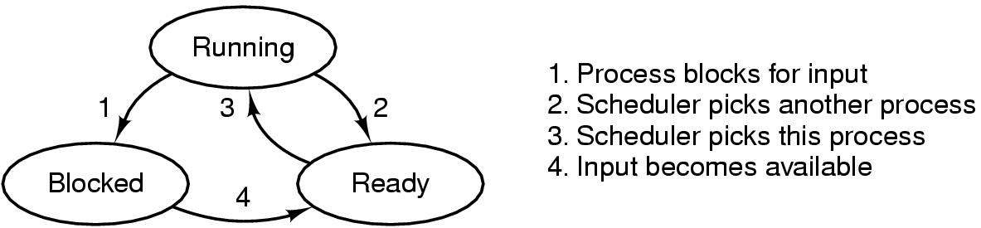
Process States
When running, the process is using the CPU to perform work
When ready, the process would like to be running, but the CPU is allocating cycles elsewhere.
Notes:
Go through all the transitions and ask them what could cause each.
Also remind them of the desk and chair analogy. Only one student can sit at a desk at any given time with its state. The chair and desk represent the CPU; what is on the desk such as each students notes, books open at a given page represent the status of the process (student in execution)
How does a process get the CPU? A software or hardware interrupt and the scheduler decides what process executes next.
Transition 1 is caused by a process asking for synchronization or some resource (virtual or hardware) that is not available because another process has it and the resource is not sharable.
Transition 2 is that the CPU is taken away by a hardware interrupt (i.e higher priority process). Clock or other hardware. The clock is if a process has got to the end of its share of the CPU or another process requested to be awaken after some unit of time.
Transition 3 is caused by the scheduler which picks the process to execute.
The transition from ready to blocked does not exist because if the process is not executing it can obviously not ask for resources. Although some real-time operating systems do allow a process to block another one. This is not the norm.
The transition between blocked to running does not occur because the scheduler looks at the queue of ready processes to decide what to run next; not at the queue of blocked processes.
You may wish to draw all this on the blackboard. Try to draw these conclusions from the students. Insist that they learn all this. It is important that they understand that the OS is not omni present and must gain the CPU to make decisions.
Transition 4 is caused by a resource becoming available be it a virtual or hardware resource that cannot be shared is now available. The OS is made aware of this resource and moves the process to the ready queue.

Slide 14
Process States
When blocked, the process cannot run
because it is waiting on some condition (e.g. input, expiration of a timer)
System calls such as pause() or sleep()) can also be used to enter a blocked state
For a simple blocking example, consider:
cat chapter1.txt chapter2.txt chapter3.txt | grep “lorum ipsum dolor”
Implementation view of states: http://man7.org/linux/man-pages/man1/ps.1.html

Slide 15
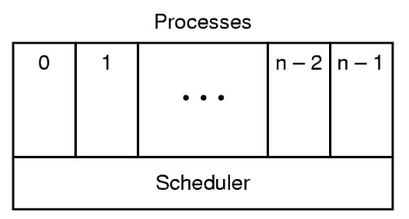
Process States
When the OS’s primary purpose is considered to be scheduling processes for execution, what abstract model do we get?
A layer of sequential processes on top of a scheduler

Slide 16
Implementation of Processes
How does the OS implement the process model?
The Process Table, an array (or linked list) of structures with one entry per process.
Typical information:
Process’ state
Program counter
Stack pointer
Memory allocation
Status of open files
Accounting/Scheduling Information...
...and more
Notes:
How processes management (running, blocking, switching, …etc) is done
Some students will think that having the state of a process takes a lot of memory.
Make them understand that really you are talking in the order of several bytes for the status of the CPU and several KB for the other process information such as the process table (what is actually used in the process table to be covered later in the course.
They also include a set of resources such as:
open files
pending signals,
internal kernel data,
processor state,
a memory address space with one or more memory mappings,
one or more threads of execution,
a data section containing global variables.
Processes, in effect, are the living result of running program code. The kernel needs to manage all these details efficiently and transparently.

Slide 17
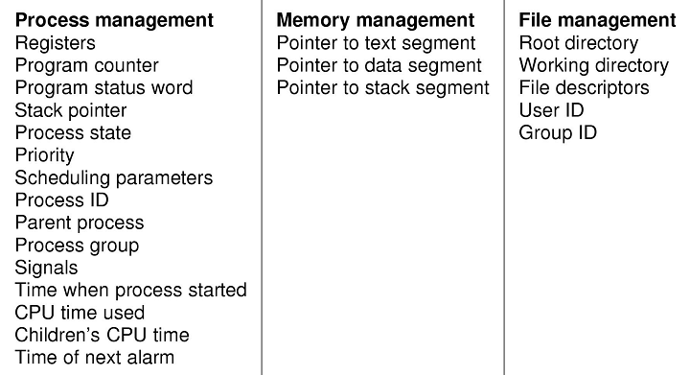
Implementation of Processes
Typical Fields in a Process Table Entry
Notes:
Here they should get a feel for what is in the process table. Not a regurgitation but a sense of the information needed to manage a set of processes to allow for multiprogramming.
It is important, however, for them to retain the three categories of information; namely process management, memory management and file management. These separations allow for modularity.

Slide 18
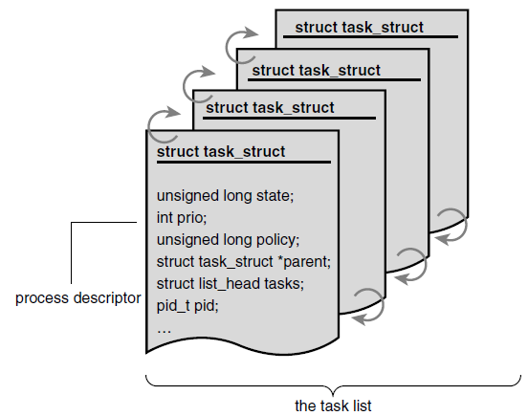
Linux Processes – task structure
Process tables are described by the task_struct structure defined in sched.h
List of processes are stored in a circular doubly linked list called the task list
Image source: Linux Kernel Development, 3rd Edition, Love
See sched.h code at https://github.com/torvalds/linux/blob/master/include/linux/sched.h
See https://www.tldp.org/LDP/tlk/ds/ds.html
Notes:
The task_struct is a relatively large data structure, at around 1.7 kilobytes on a 32-bit machine.This size, however, is quite small considering that the structure contains all the information that the kernel has and needs about a process

Slide 19
Linux Processes – fork()
Processes in Linux are created by the fork() command.
The process calling the fork() is the parent the other created process is the child.
In recent Linux releases, the fork() command is implemented by a series of system calls
As the image of the processes are the same, the child must change its status by executing the execve() command.
This will fetch the new program text to be executed.
Notes:
fork() + execve = creation of a “new process” in parallel with the current “parent” processes.
Situation in windows is more straight forward, just call something like “CreateProcess()”
The fork(), vfork(), and __clone() library calls all invoke the clone() system call with the requisite flags.The clone() system call, in turn, calls do_fork().

Slide 20
Linux Processes – fork(2)
The fork() command initiates a series of system calls to create the process
fork()
1
return pid of child process
2
do_fork()
return pointer to the new child, start child process
3
clone()
return pointer to the new child
4
copy_process()
5
dup_task_struct()
alloc_pid()
7
6
copy_flags()
Notes:
fork() + execve = creation of a “new process” in parallel with the current “parent” processes.
Situation in windows is more straight forward, just call something like “CreateProcess()”
The fork(), vfork(), and __clone() library calls all invoke the clone() system call with the requisite flags.The clone() system call, in turn, calls do_fork().
https://elixir.bootlin.com/linux/v4.2/ident/copy_process
vfork() – same as fork except page table entries are not copied.

Slide 21
Linux Processes – Copy-on-write
Traditionally on fork()being called, all parent resources are duplicated and a copy is given the child
This approach is inefficient, as data can be shared and copying can be avoided
e.g. data segment
Copy-on-write is a technique to delay or avoid copying all resources, the data is shared read only until it needs to be modified or written to
If exec() called immediately, these resources never need to be copied so why bother copying it
Notes:
Recall that the data segment contains global variable and static local variables
Copy-on-write (or COW) is a technique to delay or altogether prevent copying of the data.

Slide 22
Linux Processes – exit() and wait()
A process can execute some commands to yield or terminate a process and give the processor to the OS
The exit() command will terminate the process, frees all its resources
Also unblocks all processes waiting for it
The parent that executed the fork() command must have executed a wait() command
A process that executes a wait() goes to blocked state
Notes:
From Linux Kernel Development
The concept of “waiting” for another process to finish. You used this concept while you are doing your shell program.
What will happen if you did not use “waitpid(-1…)” ? .. Try it in the lab 2 and report the answer ☺
A parent process can inquire about the status of a terminated child via the wait4() system call, which enables a process to wait for the termination of a specific process. When a process exits, it is placed into a special zombie state that represents terminated processes until the parent calls wait() or waitpid().
Wait is for listening to state changes and obtaining information about the child. A state change is child termination, stopping or resuming by a signal. Wait allows the system to release the resources associated with the child. If a wait is not performed, then the terminated child remains in a "zombie" state.

Slide 23
Revisiting Hardware Interrupts
Now that we have seen the process table and its entries we can re-visit interrupts
Consider an I/O device completing its task, and needs to get the attention of the CPU
The I/O device asserts a signal on a bus line that it has been assigned, this signal is received by the interrupt controller
The interrupt controller than puts an IRQ number on the address line (corresponding to the I/O device) and asserts a signal to the CPU
This interrupt causes the CPU to store the current process’ PC, PS, PSW and other registers onto the stack of the running process
Where this information is stored is CPU dependent
Notes:
Important to understand: If the hardware did not push the information on the stack, when the OS gets the CPU, it will fill the registers. This would have for effect to lose the state of the previously running process.
An interrupt is physically produced by electronic signals originating from hardware devices and directed into input pins on an interrupt controller, a simple chip that multiplexes multiple interrupt lines into a single line to the processor.
Upon receiving an interrupt, the interrupt controller sends a signal to the processor.
The processor detects this signal and interrupts its current execution to handle the interrupt
I/O device causes an interrupt by asserting a signal on the bus line assigned for interrupts to the interrupt controller
To handle this, the interrupt controller then puts number on the address line (which specifies which device want attention) and assets a signal to interrupt the CPU

Slide 24
Revisit Hardware Interrupts
The CPU reads the IRQ number on the address line, maps it to a program counter stored in the interrupt vector
The interrupt vector is at a pre-defined location in memory
The program counter points to the address of the Interrupt Service Procedure
The OS (in kernel mode) creates new stack and starts the Interrupt Service Procedure which then:
Acknowledges interrupt to interrupt controller
Executes assembly language procedure to save the relevant details of the interrupted process to the process table of the interrupted process
Executes a C procedure called to handle the specific details of the interrupt
Scheduler is called to see which process should be run next
An assembly language procedure loads the new process’ details (e.g. registers, memory map) to start the new process running
Notes:
Tell them that they must know this information. This is important! It is one of the main teaching point in the course. That is how does multiprogramming occur in an OS.
Interruption – The hardware CPU saves the registers somewhere; the somewhere depends on the architecture of the CPU each having its own context saving method which is published for the OS manufacturer to know where the CPU state is so that the OS can fetch the state of the process and write it in the appropriate Process Table node.
Some CPU cache the information. During the context saving process, the interruptions are disabled by the CPU. Why? Because the CPU registers need to be loaded with the proper device driver or software to handle the interrupt, again we would lose the status of the process that was executing.
At the end of the interrupt, the scheduler is called to decide what process to execute, it will fetch the state of this process from the process table and load the CPU with the state of the process to execute when it last ran.

Slide 25
Quiz Time
What is a process?
What are the three categories of process information?
Without looking at your notes draw the three process states and the transitions that are possible.
Notes:
A process is a program in execution to which we have given resources
Process management
Memory management and
File management
You should then draw it on the blackboard and draw the information from the class

Slide 26
Threads

