Slide 1
EEE 335 Principles of Operating Systems
Threads – Part I
Modern Operating Systems 2.2

Slide 2
Quick Review
When are processes created?
When are processes terminated?
Notes:
When are process created?
System Initialization
When a user requests it (cmd line, double click, etc.)
When a process starts another process (to get help with a task)
When the system runs a batch job
When are processes terminated?
When completed (voluntary)
On an error (voluntary)
On an error (involuntary)
When killed by another process

Slide 3
Outline
The Thread Model
Thread Usage
pthreads

Slide 4
The Thread Model
Traditional operating systems have a number of processes each with an address space and a single thread of control
The process model discussed previously was based on two independent concepts:
Resource grouping
Address space (program text & data), open files, child processes, pending alarms, signal handlers, etc.
Execution (Thread of Execution or Thread)
The part of the program text that is running
Notes:
A thread has:
a program counter
registers
stack (contains the execution history with a frame for each procedure called but not yet returned from)
While a thread must execute in a process, they are different concepts and can be treated separately

Slide 5
The Thread Model
It can sometimes be useful to separate these two concepts
Allow multiple threads of execution to occur within a single process
Multiple threads running in parallel within a single process is analogous to....?
...multiple processes running in parallel within a single computer.
Threads sharing a process are sometimes called lightweight processes
Notes:
How does the analogy work?
Processes share physical memory, disks, printers, and other resources.
Threads share an address space, open files, and other resources

Slide 6
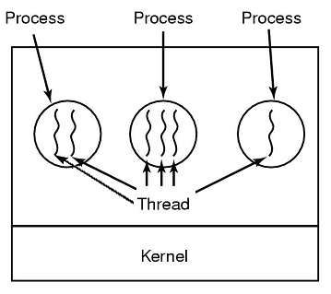
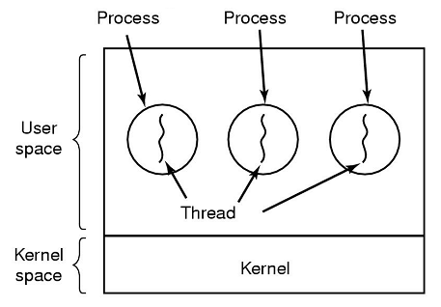
The Thread Model
The CPU now switches rapidly between threads to give the illusion that they are executing in parallel
Notes:
Goes from old concept to new
Note that the difference between the left picture and the middle process in the right picture is that the three threads in the single process share an address space.

Slide 7
The Thread Model
Considerations:
Threads within a single process are not as independent as different processes:
Shared address space
Shared global variables
One thread can read/write another thread’s stack
There is not protection between threads because:
It would be difficult, if not impossible to implement
It should not be necessary...why?
Notes:
Why should it not be necessary?
Threads in different processes may be from different users and almost certainly have different purposes
may even be hostile to one another
A process is always owned by a single user
threads exist to cooperate, not compete

Slide 8
The Thread Model
Processes vs. Threads:
Per Process Items | Per Thread Items
Address Space Global Variables Open Files Child Processes Pending Alarms Signals and Signal Handlers Accounting Information | Program Counter Registers Stack State
Notes:
Having things like shared files in a process makes sense since the process is the level of resource management
What we are trying to achieve with threads is to allow the sharing of resources to accomplish a common task!

Slide 9
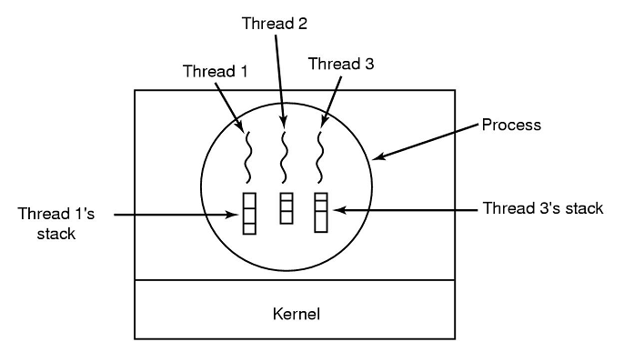
The Thread Model
Thread Properties:
Like processes, threads can be in one of three states: blocked, ready, or running
Though memory is shared, each thread requires its own stack:
Notes:
Ask them for an example of what blocked and ready mean
running: has the cpu and is executing
blocked: waiting for some event to unblock it, like reading from the keyboard
ready: ready to run and waiting for CPU
Ask: why do they require their own stack?
Each thread’s stack contains one frame for each procedure called but not yet returned from
Each thread may be calling different functions and it keep track of those instructions being executed on its stack

Slide 10
The Thread Model
Thread Operation:
Usually a process will start with a single thread
New thread created with a library procedure
thread_create()
Threads exit by using a library call
thread_exit()
Thread vanishes and is no longer schedulable
Notes:
Sometimes threads exist in a hierarchal structure, but usually they are equal
Note that these function names are fictional
Is the thread_create a system call ?

Slide 11
The Thread Model
Thread Operation:
Some operating systems allow threads to wait on another to exit:
thread_wait()
Threads can yield to one another
thread_yield()
Gives up the CPU to allow another thread within the process execute
Important since switching from one thread to another is not enforced by hardware such as with processes

Slide 12
The Thread Model
What complications do threads introduce? Consider the use of the fork() system call:
If the parent has multiple threads, should the child also have them?
If a thread was blocked in a process, does the child process also have a blocked thread?
If the thread was blocked on, say, keyboard input...do both threads get the input after the fork()?
Resource management: a thread may close a file another is using, making memory management is more complicated, etc...
Notes:
For the memory management example...one thread may request more memory only to have another notice memory is low and do the same.
In general these problems can be solved, but it requires forethought and effort.

Slide 13
Thread Usage
Why do we want multiple threads within a single process?
Many applications have multiple actions occurring simultaneously, with some of those uses blocking occasionally
Performance(1): Because less resources are allocated for threads, they can be one-two orders of magnitude faster to create than a process
Performance(2): If there is substantial I/O then much other work can occur simultaneously with blocking I/O calls
Notes:
Do they understand the 2nd performance reasoning? Try to get an example such as a web browser that can start formatting a page as the information comes in from the modem.

Slide 14
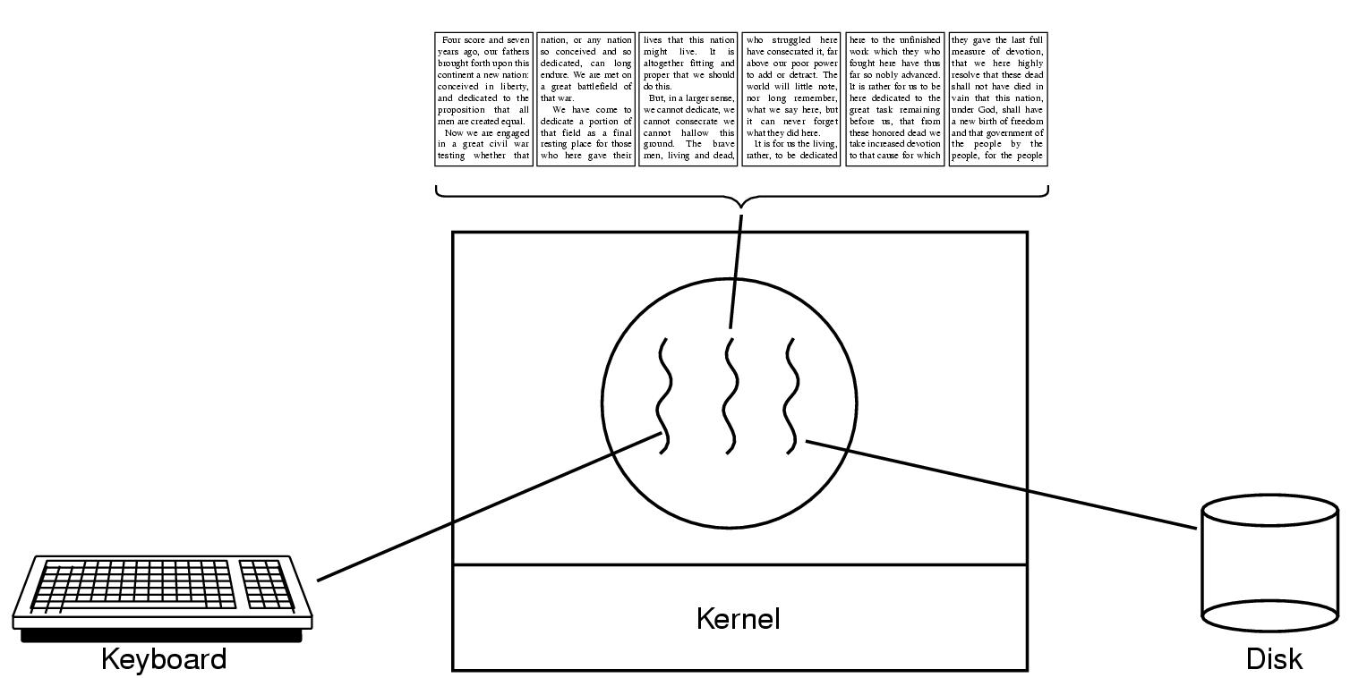
Thread Usage
Example: A Word Processor
Notes:
Good example...
If the reformatting is going on after every key press the wait on a 600 page document would be unacceptable!
If it reformatted as you scrolled, there would be one very long wait as you started
Same with background saves, background printing and even the spell checker that underlines words!

Slide 15
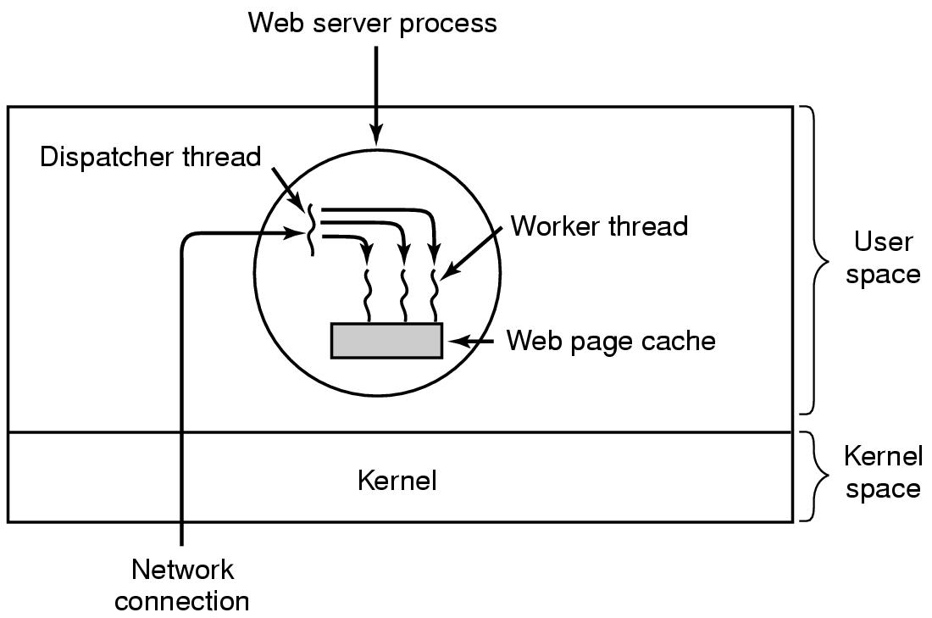
Thread Usage
Example: A Web Server
Notes:
Multiple threads allow the dispatcher to read incoming requests and hand them off to idle worker threads
The worker sees if it can satisfy the request through the cache. If it can, it returns the page. If not, it starts to read it from the disk into the cache and blocks

Slide 16
Thread Usage
Example: A Web Server - Could this be implemented without threads?
Solution one: Web server gets a request, checks the cache, reads from disk (blocks), provides the page, waits for next request
Problem? No work is being done while information is read
Results in far fewer requests satisfied per second

Slide 17
Thread Usage
Example continued: A Web Server
Solution two: A non-blocking read call
Problem? Information return must come through interrupts or other means. The thread must also remember what information returned was for which request
Results in a much more complicated structure that is essentially a state machine. Multi-threading has been “custom-built” at the expense of a very complicated program
Looking at these other two options, using multi-threading is most elegant and efficient

Slide 18
Thread Benefits
Allow sequential operations to achieve parallelism (for better performance) but retain blocking system calls (for simplicity of form)
Processes can get the performance at the cost of simplicity of form and vice versa

Slide 19
What are pthreads?
Historically, different vendors implemented proprietary versions of threads
The differences made portability challenging
In mid-1990’s, POSIX standard on threads created, referred to as pthreads
Most linux variants offer pthreads in addition to their own version of threads
Notes:
Explain what POSIX is: Portable Operating System Interface (POSIX)
A family of standards specified by the IEEE for maintaining compatibility between operating systems, it defines:
defines the application programming interface (API),
along with command line shells; and
utility interfaces,
for software compatibility with variants of Unix and other operating systems

Slide 20
POSIX Threads
Functions | Description
pthread_create | Create a new thread
pthread_exit | Terminate calling thread
pthread_join | Wait for thread termination
pthread_yield | Yield the processor
pthread_attr_init | Create and initialize thread attribute object
pthread_attr_destroy | Destroy thread attribute object
Notes:
The pthread_create() function is used to create a new thread, with attributes specified by attr, within a process. If attr is NULL, the default attributes are used. I
The pthread_exit() function terminates the calling thread and makes the value value_ptr available to any successful join with the terminating thread. Any cancellation cleanup handlers that have been pushed and not yet popped are popped in the reverse order that they were pushed and then executed.
The pthread_join() function shall suspend execution of the calling thread until the target thread terminates, unless the target thread has already terminated.
The pthread_join() function suspends execution of the calling thread until the target thread terminates, unless the target thread has already terminated.
pthread_yield() causes the calling thread to relinquish the CPU. The thread is placed at the end of the run queue for its static priority and another thread is scheduled to run.
The function pthread_attr_init() initialises a thread attributes object attr with the default value for all of the individual attributes used by a given implementation.
The pthread_attr_destroy() function is used to destroy a thread attributes object. An implementation may cause pthread_attr_destroy() to set attr to an implementation-dependent invalid value.

Slide 21
Hello World (with errors)
#include <pthread.h>
#include <stdio.h>
#include <stdlib.h>
#define NUMBER_OF_THREADS 10
void *print_hello_world(void *tid)
{
// This function prints the thread’s identifier and then exits.
printf("Hello World. Greetings from thread %d\n", tid);
pthread_exit(NULL);
}
int main(int argc, char *argv[])
{
// The main program creates 10 threads and then exits.
pthread_t threads[NUMBER_OF_THREADS];
int status, i;
for(i=0; i < NUMBER_OF_THREADS; i++) {
printf("Main here. Creating thread %d\n", i);
status = pthread_create(&threads[i], NULL, print_hello_world, (void*)i);
if (status != 0) {
printf("Oops. pthread create returned error code %d\n", status);
exit(-1);
}
}
exit(NULL);
}
Notes:
Textbook example has some errors

Slide 22
Hello World
#include <pthread.h>
#include <stdio.h>
#include <stdlib.h>
#define NUMBER_OF_THREADS 10
void *print_hello(void *arg)
{
int tid = *((int*)arg);
printf("Hello World. Greetings from thread %d\n", tid);
pthread_exit(NULL);
}
int main(int argc, char *argv[])
{
pthread_t threads[NUMBER_OF_THREADS];
int tids[NUMBER_OF_THREADS];
for(int i=0; i < NUMBER_OF_THREADS; i++) {
tids[i] = i;
printf("Main here. Creating thread %d\n", i);
int status = pthread_create(&threads[i], NULL, print_hello, (void*)&tids[i]);
if (status != 0) {
printf("Oops. pthread create returned error code %d\n", status);
exit(-1);
}
}
for(int i=0; i < NUMBER_OF_THREADS; i++) {
pthread_join(threads[i], NULL);
}
exit(0);
}
Notes:
int pthread_create(pthread_t *thread, const pthread_attr_t *attr, void *(*start_routine) (void *), void *arg);
The attr argument points to a pthread_attr_t structure whose contents are used at thread creation time to determine attributes for the new thread; this structure is initialized using pthread_attr_init(3) and related functions. If attr is NULL, then the thread is created with default attributes.
A thread may either be joinable or detached. Default is joinable.
Libraries are typically named with the prefix "lib". This is true for all the C standard libraries. When linking, the command line reference to the library will not contain the library prefix or suffix.Consider the following compile and link command: gcc src-file.c -lm -lpthread
The libraries referenced in this example for inclusion during linking are the math library ("m") and the thread library ("pthread"). They are found in /usr/lib/libm.a and /usr/lib/libpthread.a
In Mint 19, it is in /usr/lib/x86_64-linux-gnu/libpthread.a

Slide 23
Main here. Creating thread 0
Main here. Creating thread 1
Main here. Creating thread 2
Main here. Creating thread 3
Main here. Creating thread 4
Main here. Creating thread 5
Main here. Creating thread 6
Main here. Creating thread 7
Main here. Creating thread 8
Main here. Creating thread 9
Hello World. Greetings from thread 6
Hello World. Greetings from thread 5
Hello World. Greetings from thread 7
Hello World. Greetings from thread 4
Hello World. Greetings from thread 8
Hello World. Greetings from thread 3
Hello World. Greetings from thread 9
Hello World. Greetings from thread 2
Hello World. Greetings from thread 1
Hello World. Greetings from thread 0

Slide 24
Quiz Time!
Questions?
Notes:
In their own words, explain the three benefits of threads
Allow multiple actions to be taken simultaneously
Performance(1): quicker to create
Performance(2): allow blocking on I/O while other work is done

Slide 25
Threads II

