Slide 1
EEE 335 Principles of Operating Systems
Threads - Part II
Modern Operating Systems 2.2

Slide 2
Quick Review
Describe the differences between processes and threads
Notes:
Primary: shared address space between threads within a single process
A thread is how flow of execution is separated. Processes separate resources
Typically, threads need to relinquish control to yield to other threads within the same process. Hardware schedules processes
Threads really only care about PC, stack, registers and state
Processes care about address space, global variables, open files, pending alarms, signals and signal handlers, and accounting information

Slide 3
Outline
Thread Implementation Theory
User Space
Kernel
Hybrid Implementations
Making Single-Threaded Code Multithreaded

Slide 4
Thread Implementation Theory
How are thread packages implemented?
Two possible places:
User space
Kernel
Choice is controversial: complexity vs. efficiency

Slide 5
Threads in User Space
Put the concept of the thread entirely in user space
The kernel knows nothing about them
Kernel thinks it is just organizing single-thread processes
Structure:
The threads run on top of a run-time system
A collection of procedures that manage threads
thread_create(), thread_exit(), thread_wait(), thread_yield(), and more...
Notes:
Run-time system is a software that supports your program by injecting ready-made code that handles low-level commands. Example, the memory management. When you allocate a new pointer using malloc. The language run-time will replace your code with some low-level code that will talk to the OS to allocate your memory.
More on run-time systems: Every programming language specifies an execution model, and many implement at least part of that model in a runtime system. Runtime system behavior is, arguably, defined as any behavior not directly attributable to the program itself. This definition includes, as part of the runtime system, things such as putting parameters onto the stack before a function call, the behavior of disk I/O, and parallel execution of related behaviors.
By this definition, essentially every language has a runtime system, including compiled languages, interpreted languages, and embedded domain-specific languages. Even API invoked stand alone execution models such as Pthreads have a runtime system that is the implementation of execution model's behavior.
One explanation of run-time system: As a simple example of a basic runtime system, the runtime system of the C language is a particular set of instructions inserted into the executable image by the compiler. Among other things, these instructions manage the processor stack, create space for local variables, and copy function-call parameters onto the top of the stack. There are often no clear criteria for deciding which language behavior is considered inside the runtime system versus which behavior is "compiled". In this case, the reason that C's stack behavior is part of the runtime system, as opposed to part of a keyword of the language, is that it is systematic, maintaining the state of the stack throughout a program's execution. The systematic behavior implements the execution model of the language, as opposed to implementing semantics of particular keywords which are directly translated into code that computes results.
Another: The standardized functions are usually shipped within a core system library (libc in Unix-like OSes). It is implicitly linked into your binary software, unless you explicitly inhibits its linking, with special flags to the compiler or link-editor. An OS kernel, for example, won't use libc, so it's no use linking it in the final binary image. The loader performs a bunch of system-specific procedures in order to get your binary program running. It will perform symbol-version checks to ensure the environment has minimal versions of versioned symbols (functions tagged in a special way as to indicate API/ABI compatibility level). It will also interface with the operating system to set up all the required libraries, bringing them into memory, setting up basic memory mappings (sort of memory pre-allocation), and other system-specific tasks. Finally, it will call _start() which will eventually call the main() function.
The C preprocessor modifies a source file before handing it over to the compiler, allowing conditional compilation with #ifdef, defining constants with #define, including header files with #include, and using builtin macros such as __FILE__. This page lists the preprocessor directives, or commands to the preprocessor, that are available:
#include
#define
#undef
#if
#ifdef
#ifndef
#error
__FILE__
__LINE__
__DATE__
__TIME__
__TIMESTAMP__
pragma
# macro operator
## macro operator

Slide 6
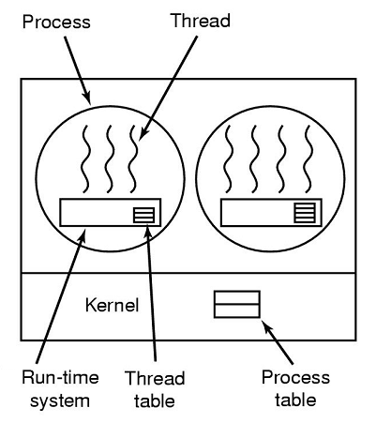
Threads in User Space
Each process needs a thread table
Similar to a process table, but tracks only:
Program Counter
Stack Pointer
Registers
State
Table managed by the run-time system
Notes:
When a thread is moved between states, the information needed to restore it is saved in the table by the run-time system in the same way that the process table saves information when processes change state.

Slide 7
Threads in User Space - Advantages
Advantages:
Allows the implementation of threads on an operating system that does not support them
Very fast as no TRAP to the kernel is required... the implementation is entirely in user space
Each process can have a customized scheduling algorithm by altering the run-time library
Easily scaled as only more memory allocation is required rather than table/stack space in the kernel

Slide 8
Threads in User Space - Disadvantages
Disadvantages:
Runaway threads can hijack a process and never return control to the run-time system
How are blocking system calls implemented? For example if a thread calls getKey(), the whole process will block...this is unacceptable. Solutions involve:
altering the operating system to create non-blocking calls
This would be undesirable
making system library calls to first determine if a block will occur
If the call will be blocked, it won’t be made
Inefficient and inelegant
Notes:
Altering the OS is especially undesirable in this case as the whole point of user-space threads was to avoid altering the OS
The altering involves potentially making system calls that don’t block, but don’t return data if they’re not ready...confusing!
Wrapping (select() or poll()) the system calls might involve adding a call to a function which will reveal if a call to a particular function will block or not...that’s just a mess...
Page faults: Refer to the fact that not all of the program text is necessarily in memory. If the OS has to load part of the program back into memory it will block that process. We have no way of telling it just to switch to a different thread instead
Requiring voluntary relinquishing of control means that if one thread has an error, it may never pass control to another thread

Slide 9
Threads in User Space - Disadvantages
Disadvantages:
Page Faults block the calling process
Consider a thread executing part of the program that is still on disk
Again, entire process is blocked
Threads are usually wanted for applications where they will block often, such as a web server
Blocking occurs on all system calls - recall TRAP instructions switch execution into kernel mode
Notes:
This last point is a bit annoying in the way that Tannenbaum writes. This is not so much a new disadvantage, but rather a design consideration.
https://httpd.apache.org/docs/2.4/mod/worker.html

Slide 10
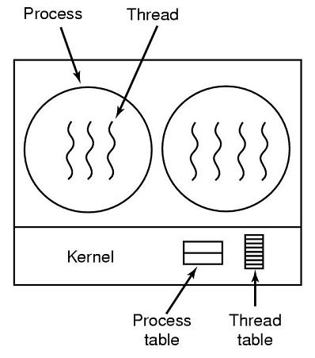
Threads in Kernel Space
Put the concept of the thread in the kernel
There is no need of a run-time system
The kernel has a thread table
Threads make calls to the kernel for thread creation/termination
Kernel holds each thread’s registers, state, etc...

Slide 11
Threads in Kernel Space
Design considerations:
When a thread blocks, the kernel must choose whether to run another thread from the same process or a different process
which might be less desirable as far as the losing process is concerned
Some systems will not delete threads, but will save them to be recycled
Notes:
Recycled threads are quicker to create as the data storage is already allocated...it just has to be filled in with the relevant information

Slide 12
Threads in Kernel Space
Advantages:
Much less complicated
No new non-blocking calls required
Page faults or other blocked system calls do not stop other threads in a process from executing
Disadvantages:
Cost of a system call is substantial
If thread operations (e.g. creation, termination) are common, this will incur much more overhead

Slide 13
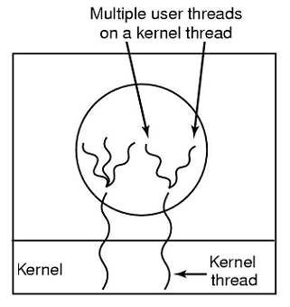
Hybrid Implementations
Tries to get advantages of both designs
User threads and kernel threads implemented where they will be the most efficient
Now a page fault won’t necessarily block an entire process
Advantage: Most efficient
Disadvantage: by far the most complicated solution
Notes:
Note that the picture is showing a single process. It has two kernel-level threads that have a number of user level threads on them

Slide 14
Scheduler Activations
Virtual CPUs given to the process
Runtime system manages thread scheduling
Process threads blocked & waiting on other threads need not be managed by the kernel
Blocked threads from system calls are reported back to the process by the kernel
Upcalls
Notes:
When scheduler activations are used, the kernel assigns a certain number of virtual processors to each process and lets the (user-space) run-time system allocate threads to processors. This mechanism can also be used on a multiprocessor where the virtual processors may be real CPUs. The number of virtual processors allocated to a process is initially one, but the process can ask for more and can also return processors it no longer needs. The kernel can also take back virtual processors already allocated in order to assign them to more needy processes.
Scheduler Activations is a solution that provides kernel support for user level threads, enabling better performing execution of N:M threading. Scheduler Activations allow user space control of and insight into the kernel’s process scheduling, which makes the hybrid model more efficient and fixes several issues that can crop up in an implementation unassisted by the kernel. Both FreeBSD and NetBSD have abandoned Scheduler Activations in preference for simpler 1:1 threading. You can view this as both a rejection of the complexity of the N:M model and a response to the ubiquity of the x86 architecture, which allows for relatively efficient context switches.
An objection to scheduler activations is the fundamental reliance on “upcalls” (a kernel notification to the process’ runtime system), a concept that violates the structure inherent in any layered system.

Slide 15
Implementation in Linux
Linux does not support threads specifically
Threads are merely processes that share resources
Since processes are already pretty light in Linux, only resource sharing is really important (already feasible without a new concept)
There are special threads that only exist in Kernel mode, by and for the Kernel
Notes:
http://manpages.ubuntu.com/manpages/trusty/man7/pthreads.7.html

Slide 16
Single Threaded Code → Multi
What are the difficulties with converting a single-threaded program to a multi-threaded one?
Global variables
Non-reentrant library procedures
Signals, such as keyboard
Stack management
Notes:
A program or function is called reentrant if multiple invocations can safely run concurrently.
Non-reentrant library = not thread-safe

Slide 17
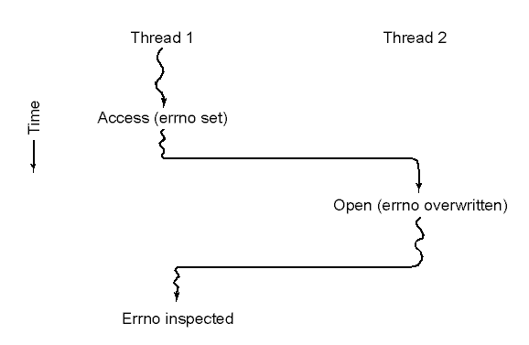
Single Threaded Code → Multi
Global Variables
Multiple threads that use the same variable will cause problems
Notes:
errno is a global variable included with libraries that you would include in a C program in UNIX
If a user space run-time library was managing the threads, then errno can easily be overwritten at inconvenient moments...
ie: using the open call on a file
In the figure, thread 1 executes the system call access to find out if it has permission to access a certain file. The operating system returns the answer in the global variable errno. After control has returned to thread 1, but before it has a chance to read errno, the scheduler decides that thread 1 has had enough CPU time for the moment and decides to switch to thread 2. Thread 2 executes an open call that fails, which causes errno to be overwritten and thread 1’s access code to be lost forever. When thread 1 starts up later, it will read the wrong value and behave
incorrectly.
Solutions:
No global variables (unlikely – too much use in existing software)
New scoping of global variables at the thread level, but no language offer this, so new library procedures required such as:
create_global(“bufptr”);
set_global(“bufptr”, &buf);
But this would require new library procedures that creates new overhead as well.

Slide 18
Single Threaded Code → Multi
Non-Reentrant Library Procedures
Remember, libraries are compiled for each program and exist in each process
What happens if a library is assembling a network message in a buffer, and then another call is made to it from another process?
Fixing these problems can require entire library re-writes
Notes:
Reentrant – some procedures were not designed to have a second call made to them while a previous call has not yet finished.
Draw a small diagram showing where library procedures live.
asctime.c -- contains time formatting information that can be changed by a call to setlocale, plus the default time string buffer [TLS]
atexit.c -- contains the stack of functions to call at exit time [MALLOC]
exit.c -- pops the stack of functions to call at exit time [UNPROTECTED]
fclose.c -- contains the list of files to close at exit time [UNPROTECTED]
localeco.c -- contains numeric, monetary, and message information that can be changed by a call to setlocale [TLS]
localtim.c -- contains timezone information that can be changed by a call to setlocale [TLS]
malloc.c -- contains the root of the heap [MALLOC]
mbrlen.c -- contains a default mbstate_t object [TLS]
mbrtowc.c -- contains a default mbstate_t object [TLS]
mbsrtowc.c -- contains a default mbstate_t object [TLS]
mbtowc.c -- contains a default mbstate_t object [TLS]
rand.c -- contains the seed for random numbers [TLS]
setlocal.c -- contains current locale information that can be changed by a call to setlocale [TLS]
signal.c -- contains a table of signal handlers that can be changed by a call to signal [MALLOC]
strtok.c -- contains a pointer to the string currently being parsed [TLS]
tmpnam.c -- contains the current temporary file name [MALLOC]
wcrtomb.c -- contains a default mbstate_t object [TLS]
wcsrtomb.c -- contains a default mbstate_t object [TLS]
wctomb.c -- contains a default mbstate_t object [TLS]
xfiles.c -- contains the FILE objects [fclose/fflush/fopen STREAM]
xgetloc.c -- contains locale information that can be changed by a call to setlocale [LOCALE]
xgetzone.c -- contains timezone information that can be change by a call to setlocale [LOCALE]
xisdst.c -- contains timezone information that can be changed by a call to setlocale [TLS]
xstrerro.c -- contains the default buffer used by strerror [TLS]
xctype.c -- contains ctype information that can be changed by a call to setlocale [TLS]
xdefloc.c -- contains default locale information that can be changed by a call to setlocale [LOCALE]
xlocterm.c -- contains locale parsing information that can be changed by a call to setlocale [TLS]
xstate.c -- contains ctype information that can be changed by a call to setlocale [TLS]
xtolotab.c -- contains ctype information that can be changed by a call to setlocale [TLS]
xtouptab.c -- contains ctype information that can be changed by a call to setlocale [TLS]
xttotm.c -- contains default tm structure used by gmtime and localtime [TLS]
xwctrtab.c -- contains ctype information that can be changed by a call to setlocale [TLS]
xwctytab.c -- contains ctype information that can be changed by a call to setlocale [TLS]

Slide 19
Single Threaded Code → Multi
Signals
If a thread asks for a kernel service, such as a timer, how does it get delivered to the correct thread?
Kernel knows nothing about the disparate threads
With multiple threads, which one gets notification of a keyboard press?
Stacks
Normally, stack growth is automatic
Kernel will not know about the individual stacks

Slide 20
Quiz Time! Why are threads in user space more dangerous than those managed by a kernel?
Questions?
Notes:
It is up to the programmer to properly implement the threads. It is easy for a runaway thread to hijack control of the process and never return control to the runtime system to schedule a different thread.
Without a special library or operating system build for the purpose, a blocking call (system call) will result in the entire process being blocked, and no other threads being run.

Slide 21
Inter-Process Communications

