Slide 1
EEE 335 Principles of Operating Systems
Inter Process Communication I
(Modern Operating Systems 2.3)

Slide 2
Quick Review
What are our three main choices in deciding where to implement threads?
Name some of the advantages in having threads in user space over the kernel.
Notes:
Three choices: User space, kernel, hybrid
Advantages:
Each process can have its own scheduling algorithm
Fast as less TRAPS to the kernel have to be made
Can be implemented on an OS without its knowledge
Easily scaled as the run-time system can allocate memory for the threads

Slide 3
Outline
InterProcess Communication (IPC) Overview
Race Conditions
Critical Regions
Mutual Exclusion
Mutual Exclusion Methods

Slide 4
IPC Overview
To achieve useful work, many times processes may need to communicate with one another
How do processes send information to each other?
How do we prevent processes from interfering with one another’s activities?
How do we have one process wait on another’s activities? (ie: Process A produces data for use by Process B)
Notes:
Note that the second two concerns listed here apply equally well to threads as well, but we’ll generalize to processes. The first concern isn’t as big of a problem as threads share memory space.
We don’t want to use interrupts to solve this.
We’ll look at how messages are passed later on...but these are the things we want to solve during the section on IPC.

Slide 5
Race Conditions
Applies to systems where process are working together but share some area of common storage for read/write
main memory
shared file
device register
Notes:
This potential to share a spot of main memory contradicts our original discussion of processes, but they’ll just have to accept that it’s possible depending on the implementation of the OS

Slide 6
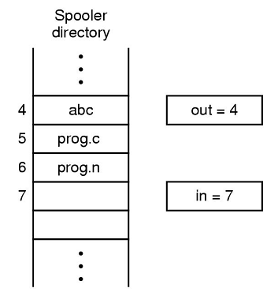
Race Conditions
Example: a print spooler
When a process wants to print, it places the file name in a spooler directory in an appropriate slot
Each slot holds a file name
Two shared variables:
out points to next file to be printed
in points to the next free slot
A printer daemon periodically checks to see if there are any files to be printed
Is there a problem with this?
Notes:
Note that the user processes are responsible for updating in, the next free slot.
Ask them to think about a two process system and see if they can think of any potential problems with such a system.

Slide 7
Race Conditions
Print Spooler Example
A switch to another process at an inopportune moment causes Process B to lose its print job...
Process A | Process B
freeSlot = in; writeName(freeSlot); in = freeSlot+1; doMoreStuff(); | freeSlot = in; writeName(freeSlot); in = freeSlot+1; doMoreStuff();
Notes:
A process replaces the file name in the spooler directory, but before it can update the in value the OS gives control to another process who also writes a filename to the same element. When control is returned to the original process, it will now update the in variable, but the filename will have been lost and subsequently never printed.

Slide 8
Race Conditions
A Race Condition is a situation where two or more processes are accessing shared data and the final result depends on the order in which the processes execute
Therefore, the place in code where it is possible that race conditions could be created is of particular interest to us and is referred to as a Critical Region (or critical section)
Notes:
Note that this is really for the case where you expected the result to be determinable, but this is more random. Therefore, it doesn’t count as a race condition if you expect the behavior to be non-deterministic.

Slide 9
Critical Regions
Ideally, we avoid having areas of code where race conditions can occur, but this is not always possible
Programs must be arranged/designed in such a way such that no two processes may be operating in their (related) critical regions at the same time
The critical regions must be Mutually Exclusive
Notes:
I say (related) to indicate that it’s OK for processes A and B to be in their critical sections if the shared memory which they are accessing is not related, ie: Process A might have a conflict with Process C and B with D, therefore A and B can be in the critical region at the same time.

Slide 10
4 Conditions to Prevent Race Conditions
It is now obvious that critical regions must operate in mutual exclusion, but that is not a sufficient definition for our needs. The solution to prevent race conditions must meet these requirements:
1) No two processes may be simultaneously inside their critical regions
2) No assumptions may be made about speed or number of CPUs
3) No process running outside its critical regions may block other processes
4) No process should have to wait forever to enter its critical region

Slide 11
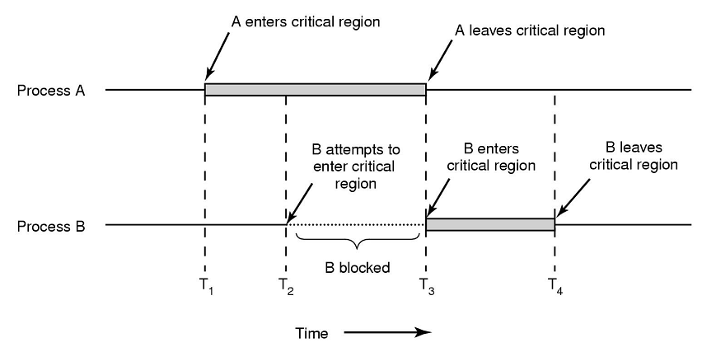
Mutual Exclusion
A pictorial representation of our requirements for mutual exclusion
Notes:
Here two processes, A and B, share a critical region.
Meets our requirements:
It shows how they’re not in at the same time
(no assumptions made about speed/num CPUs)
A’s entering of the critical region did not immediately block B
B got into the critical region as soon as A was done with it (didn’t wait forever).

Slide 12
Mutual Exclusion Methods
Potential solutions:
Disable interrupts
Lock Variables
Strict Alternation
Peterson’s Solution
TSL Instruction
Sleep and Wake Up
Producer/Consumer Problem
Semaphores
Mutexes

Slide 13
Mutual Exclusion Methods
Disabling interrupts:
Each process disables interrupts as they enter their critical region. With interrupts disabled, no context switching to other processes will occur
Problem: If the user thread locks/goes into an endless loop the OS locks/crashes
Problem: What happens with multiple CPUs?
Problem: If the critical region is large, what if an I/O device needs attention
Viable solution?
No
Notes:
Note on first problem: is disabling interrupts the kind of power an OS should give the average user program?
The reality is that most modern systems are multi-core, muli-processor, so not feasible to implement

Slide 14
Mutual Exclusion Methods
Lock variables:
Share a lock variable (called, say, lock)
When a process wants to enter its critical region it examines lock, and if it’s 0, sets it to 1 and enters its critical section
Problem: this has simply moved the race condition elsewhere
A switch to another process at an inopportune moment results with both processes in their critical regions simultaneously
Viable solution?
No.
Notes:
Note that people sometimes think that you can simply test the lock variable again to ensure that a context switch didn’t just result in another process changing the lock variable, but this is an infinitely recursive idea.

Slide 15
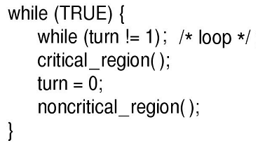
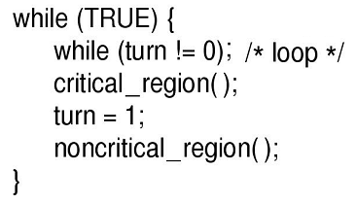
Mutual Exclusion Methods
Strict Alternation
Note the semicolon after the while() statements – creates a mini-loop
Continuously testing a variable until some value appears is called Busy Waiting
Process A
Process B
Notes:
Explain that loop structure! Draw it out with turn on the blackboard!

Slide 16
Mutual Exclusion Methods
Strict Alternation
processes take turns entering their critical regions
The mini while loop is used as a lock to prevent entry into the critical region
A lock that uses busy waiting is called a spin lock
Is there a problem?
Condition 3 violated – if A executes faster than B then A waits to enter its critical region while B executes non-critical code
Viable solution?
No
Notes:
Put differently: taking turns is not a good idea when one of the processes is much slower than the other.
Also: just plain old not practical: Word can’t print until Powerpoint does? What kind of a system is that?
Races avoided, but not useful.

Slide 17
Mutual Exclusion Methods
Peterson’s Solution
Notes:
Note an error in the book that places a semicolon at the end of void enter_region(int process); {
Hard to wrap your head around this but it works!
Before entering their critical region each process will call enter_region and will call leave_region when they’re done
Two conditions to enter: if either the other process isn’t interested OR if the other process has changed the variable turn
Means that if the context switches occur such that both are interested it’s ok, as whoever set turn=process last won’t get in!
Should draw this one out and make sure they get it!

Slide 18
Peterson’s – a quick run through
Interested array, elements set to zero -> [0,0]
Process 0
Process 1
Enter Critical Region
other = 1 – process = 1
other = 1 – process = 0
interested[0]=TRUE
// Element 0=1
interested[1]=TRUE
// Element 1=1
turn=0
while (turn==0 && interested[1]==TRUE)
{
//busy wait
}
//critical region code
turn=1
while (turn==1 && interested[0]==TRUE)
{
//busy wait
}
//critical region code
time
Exit Critical Region
interested[0]=FALSE
interested[1]=FALSE

Slide 19
Mutual Exclusion Methods
Peterson’s Solution
Critical region now protected
Viable solution? Yes!
However, busy waiting is still required...a waste of precious, precious CPU time
Note also that processes must not cheat: if they don’t call enter_region and leave_region, the scheme breaks down
Also works only for two processes
If more use the baker’s algorithm

Slide 20
Mutual Exclusion Methods
Test and Set Lock (TSL)
Some help from the hardware
Many computers support an instruction like this
How is it used? TSL RX,LOCK
Read the contents of the memory word LOCK into register RX
Store a nonzero value at memory address LOCK
The actions of reading the word and storing the non-zero value and setting LOCK are indivisible, guaranteed
Atomic action
Achieves this by disabling the memory bus
Notes:
Test and Set Lock: To solve the problem of race condition, hardware helps us by guaranteeing that the read and set actions will be indivisible. This is done by locking the memory bus. Remember this is stronger than disable interrupts. If memory bus is locked, no other CPU will be allowed to work. On the other side, disabling interrupt of a CPU will not affect other CPUs at all.

Slide 21
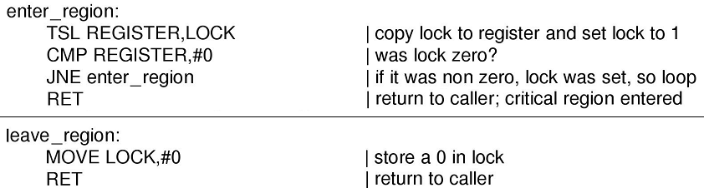
Mutual Exclusion Methods
Test and Set Lock - TSL
How do we use the TSL instruction?
Like Peterson’s solution, we surround the critical region with calls to enter_region and leave_region
Viable solution? Yes!
With busy waiting
Notes:
Non-Zero – lock is set
Check if non-zero, if yes, lock already set by another process
Note that there’s no risk in the instruction MOVE LOCK,#0 as the test/set operation is indivisible. The hardware prevents the race condition
Ask them to consider multi-processor systems. Will this function work?
Only if the CPU locks the memory bus before the TSL instruction

Slide 22
Busy Waiting
Peterson’s solution (like TSL and Strict Alternation) uses Busy Waiting and wastes many CPU cycles that could be applied to other work
Another possible effect is the Priority Inversion Problem; consider the following:
Process L(ow priority)
Process H(igh priority)
Scheduler: H runs whenever in ready state
Now consider situation where L is in critical region and H hits ready state
H now enters busy wait
L is lower priority and never leaves its critical region
Let’s look at an alternative to busy waiting
sleep() and wakeup()

Slide 23
sleep() and wakeup()
Instead of busy waiting, what if a process can be suspended while waiting to enter its critical region?
Create two system calls: sleep() and wakeup()
sleep() causes the process to block until awakened by another process
wakeup(procID) wakes up another process with the specified identification
Lets see how these can be used with the producer/consumer problem
Notes:
Note: sleep() and wakeup() aren’t part of the standard C library, but they would be available for any system that actually had those function calls

Slide 24
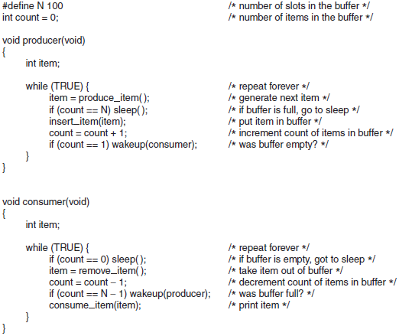
The Producer-Consumer Problem
Now, producer runs:
What problem exists here?
3.
4.
5.
6.
7.
But the consumer is not yet logically asleep
So wakeup signal is lost
So what happens now?
First, buffer is empty
Count = = 0
Then scheduler stops consumer, runs producer
Notes:
Two extreme cases
1. Count = 0 and Consumer is about to sleep but CPU switch happened
If consumer runs, it sees that the count is still 0, and goes to sleep
If producer runs, it keeps producing, sending ignored wakeups until buffer is full and it then goes to sleep
They then both sleep forever
Other extreme case:
Count = N and Producer is about to sleep but CPU switch happened
Key problem is that wakeup sent to a non-sleep entity is lost – so how can we fix this?

Slide 25
The Producer-Consumer Problem
A way exists to fix this problem: add a wakeup waiting bit that is set when an already awake process is told to wake up
A process that tries to sleep will instead decrement this bit instead of sleeping if the bit is set
Fixes this particular problem. What about with 2 consumers. 10? 1000? 10000?
We can keep adding more waking bits, but the same fundamental problem remains
Notes:
The wakeup waiting bit – when set to a process that is still awake, this bit gets set. Its like a piggy bank for storing wakeup signals. If an awake process then tries to go to sleep, it first checks this bit – if it is set, it turns it off, but stays awake.
It doesn’t scale well as it may be challenging to know how many consumers the may exist. How to manage all these waking bits?

Slide 26
Semaphores
A new variable type, a semaphore, was introduced in 1965 (by Dijkstra) to save wakeups for future use
The semaphore can have the value 0, indicating no wakeups are saved, or some positive value, indicating the number of wakeups accumulated
Use two operations called down() and up() to operate on the semaphores
Notes:
Dijkstra

Slide 27
Semaphores
Semaphore Operation:
The down() operation checks to see if the semaphore is greater than 0. If so, decrements the value and continues
If not, the process that called down() is put to sleep
Checking the value, changing it, and going to sleep (if required) is an atomic (indivisible ) action
This indivisibility is essential in solving the race condition
Notes:
If 0, go to sleep
If greater then 0, decrement

Slide 28
Semaphores
Semaphore Operation:
Conversely, the up() operation attempts to increment the semaphore. If any processes were sleeping on the semaphore, one is awakened at random and allowed to continue
Note that the semaphore value will still be 0, but there will be less processes sleeping!
If no processes were sleeping then the value is incremented; no process blocks on an up()
How can semaphores solve the Producer-Consumer problem?
Notes:
Not blocking on an up() is the same as not blocking on a wakeup()

Slide 29

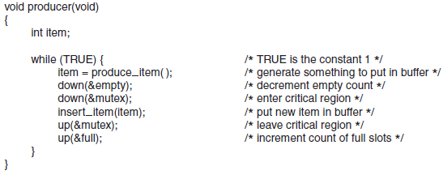
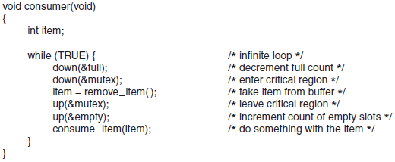
Notes:
It is essential that down() and up() (the semaphores) be implemented in an indivisible way.
We’ll discuss how next slide, for now simply consider how this works
Give them all the details...hell, make one of them explain...
There are actually three semaphores here:
One for counting the number of full slots
One for counting the number of empty slots
A semaphore to restrict access to the same area of memory as it is entirely possible that the consumer and producer could be able to proceed through their down(&empty) and down(&full) calls simultaneously

Slide 30
Solving Producer-Consumer
Note we have used semaphores for two different purposes:
The mutex semaphore is to guarantee mutual exclusion in the access of a shared resource
A semaphore with only two states is also called a binary semaphore
The full/empty semaphores are used for synchronization; they guarantee the occurrence or non-occurrence of certain even sequences, for example
The producer stops running when the buffer is full; and
The consumer stops running when the buffer is empty
Notes:
Semaphores did two things
1) Protecting shared areas
2) Synchronizing two or more threads
The thing that make this work is that the semaphore access (read and change) is ATOMIC. Who directs the O.S to do this? .. A system call. How it is done, memory lock or disable interrupts ??. If disable interrupts this will not work if more than CPU exist. Memory lock of course is the best.

Slide 31
Solving Producer-Consumer
To work, the functions up() and down() must be implemented as atomic actions... everything is based on this premise
Typically achieved by implementing them as system calls where the OS disables all interrupts
This is fine as the operation should be only a few instructions...just the semaphore is being updated, rather than executing an entire critical region as was previously discussed
Notes:
Note if multiple CPUs used, then the semaphore should be protected by a lock variable and TSL instruction use as described previously

Slide 32
Mutexes
If the counting ability of the semaphore is not needed, then a simpler form called the mutex can be used
Good only for managing mutual exclusion; they don’t communicate other information
This simplicity requires only user space commands if a TSL instruction is available
A mutex has two states: locked and unlocked
A thread that wants access to a critical region calls mutex_lock()
Notes:
Can be entirely done in USER SPACE.

Slide 33
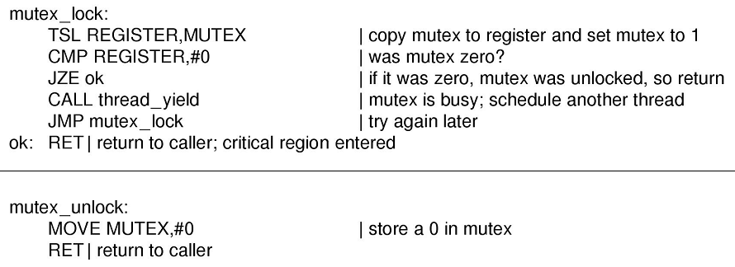
Mutexes
As the code shows, if the mutex is not locked, the thread returns and enters its critical region. Otherwise it yields the thread to allow another thread CPU access
Notes:
This is NOT busy waiting because the CPU will run another thread if mutex is currently locked.

Slide 34
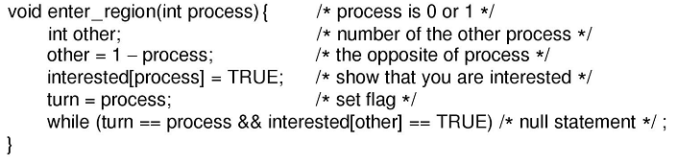
Mutexes
Wait, isn’t that the same as enter_region()?
Recall the critical region we saw earlier:
What are the two major advantages of the mutex over enter_region()?
Notes:
It’s not the same because this uses busy waiting. The CPU gets taken away from it
Two major advantages:
CPU not wasted
The call to thread_yield() means that this works with threads, not just processes. enter_region() would loop forever if a thread had control and was waiting on another thread
Plus, since it’s all in user space, it’s very fast

Slide 35
Questions
What are the four conditions for mutual exclusion?
Why is strict alternation a poor solution?
What is the name of a semaphore that only has two values?
Can up() and down() be implemented in user space?
What are the two uses of semaphores?
Notes:
What are our four conditions for mutual exclusion?
The processes must not be in their critical regions at the same time
No assumptions may be made about speed/number of CPUs
A process should not be prevented from entering its critical region by a process not in its critical region
No process should wait forever to enter its critical region
Why is strict alternation a bad idea (even if it prevents race conditions)
If one process is faster than the other you violate condition 3
What is the name of a semaphore that only has two values?
A binary semaphore
Can up() and down() be implemented in user space?
Almost certainly not as they need to disable interrupts while the value of the semaphore is being adjusted (an atomic, or indivisible, instruction)
What are the two main uses of semaphores
Mutual exclusion and synchronization of threads

Slide 36
X
✔
InterProcess Communication II

