Slide 1
EEE 335 Principles of Operating Systems
Inter-Process Communications II
(Modern Operating Systems 2.3)

Slide 2
Quick Review
What is the Producer-Consumer Problem? How is it solved?
What have we seen so far in IPC?
Race conditions and critical regions
Disabling interrupts
Lock variables
Strict Alternation
Not viable solutions
Peterson’s Solution
TSL Solution
Viable, but still had ‘busy waiting’
The Producer/Consumer Problem
Sleep/Wakeup – wakeup waiting bit
Semaphores – up and down system calls
Mutexes – binary form of semaphore
Notes:
The P-C problem is a race condition where a buffer is being added to (produced) and taken away from (consumed). It is possible, due to task switching, for a situation such as this to occur:
The producer tries to add an item to the buffer, but first checks to see if the buffer is full. It is, so the task suspends until the consumer has “eaten” some of the buffer
Just before it suspends, the consumer consumes some of the buffer and tries to wake the producer. Already awake, the call has no effect.
The consumer eats all of the buffer and suspends until the producer produces, which will never happen since the producer lost its wakeup signal
Even once these problems are solved, it must be possible not to have both tasks altering the buffer at the same time. This is solved using a binary semaphore or mutex
- sleep and wakeup (issues can arise depending on when scheduler shifts things around) – solves things with two processes, but challenging when you have many
Two synchronization semaphores
Full – counting number of full slots
Empty – counting number of empty slots
A single mutual exclusion semaphore
Mutex – binary semaphore
Full is initially 0
Empty is initialize to size of empty buffer
Mutex is initially 1
Down operation – check to see if value is greater than 0, if so decrements it and carries on
-> if 0, goes to sleep
Checking the value, changing it and possibly going to sleep are atomic actions. If one or more processes were sleeping on a semaphore, the scheduler chooses one so it can complete its down operation

Slide 3
Outline
Three more concepts in Interprocess Communication:
Monitors
Message Passing
Barriers

Slide 4
Monitors
Have semaphores solved all of our problems with Interprocess communication?
No
up()s and down()s are error-prone themselves...
Recall Producer-Consumer example
See following page

Slide 5
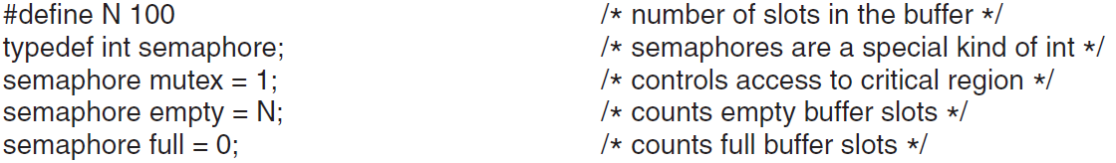
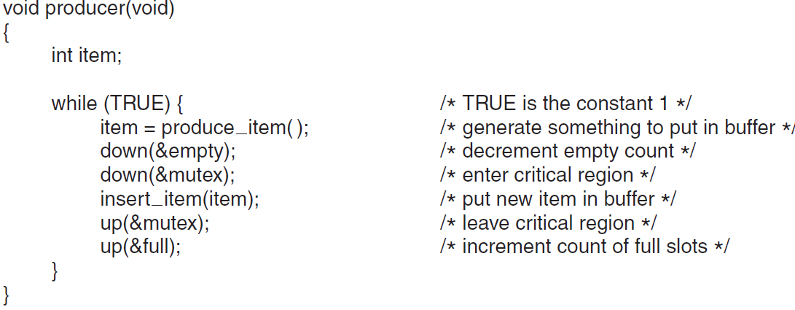


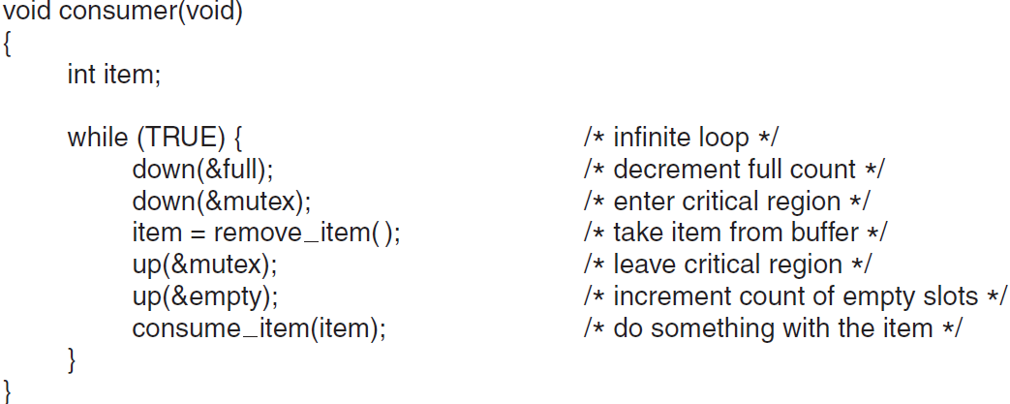

Consider:
coding error and down mutex order is switched for both
A situation where the buffer is full
Buffer is full, goes to sleep
2.
Mutex is already locked, goes to sleep
3.
Notes:
Consider what happens when the buffer is full:
-> Producer does a down on the mutex, but the buffer is full so it goes to sleep, waits for the consumer to empty it
-> Consumer comes around, does try to do a down on the mutex, but it would already be set by the consumer, so it would then go to sleep
What just happened here -> deadlock

Slide 6
Monitors
A Monitor is used to aid in the creation of correct programs
It is a collection of procedures, variables, and data structures grouped together (think: module, package, class, etc)
Processes may call procedures in a monitor, but the monitor is compiled in such a way that only one process may ever be active in the monitor at a time
Advantage: less potential for human error
Disadvantage: Must be supported by the compiler
Programming language construct, not every language has it
C programming language does not
Notes:
Compiler manage this Monitors
They work because NO multiple processes can enter (call) the Monitor at the same time.
Monitors solve the problem of lost wakeup signals by preventing the situation at which a process is a about to sleep but switch happened just before it physically sleeps.
Semaphores and mutexes are often the solution, but these are implemented by the compiler or interpreter, not the programmer -> removes human error

Slide 7
Monitors in Java
public class SynchronizedCounter {
private int c = 0;
public synchronized void increment() {
c++;
}
public synchronized void decrement() {
c--;
}
public synchronized int value() {
return c;
}
}

Slide 8
Monitors
This solution provides for mutual exclusion, but not for sleeping/waking on certain conditions
To solve this:
Include a condition variable inside the monitor along with two operations on them
wait()
signal()
This won’t create a race condition since only one process may be active in the monitor at a time
Notes:
Monitors provide a way for mutual exclusion, we also need a means for them to block when they cannot proceed
When producer finds a full buffer it does a wait on some condition variable -> full, causing the calling process to block
It also allows another process to enter the monitor now
Consumer can send a send a signal when it has removed an item from the buffer, then must leave the monitor
-> signal is always the last action before leaving monitor

Slide 9
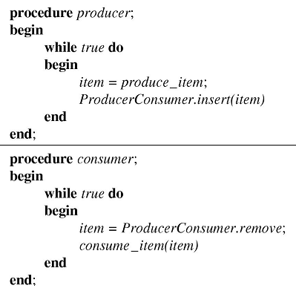
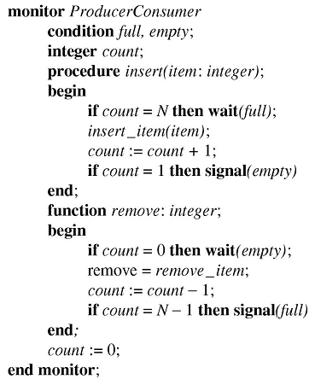
Note how the signaler exits the monitor as its next action

Slide 10
Monitors
Signals are not accumulated in this system
wait() must come before signal()
Not difficult considering only one process may be in the monitor at a time
Exiting from the monitor after a signal() is crucial to the operation
Otherwise, two process may be active in the monitor simultaneously
Other options include:
Suspending the process calling signal()
Allowing the process to finish and exit the monitor
Notes:
Not accumulating signals is in contrast to semaphores, which do accumulate.

Slide 11
Message Passing
Solutions to race conditions to this point have assumed that information is accessible through shared memory
How can this be done on a distributed system?
Message Passing is required
Notes:
Like web applications and mail services

Slide 12
Message Passing
Uses two communication primitives, send() and receive()
System calls (like semaphores), not language constructs (like monitors)
receive() can either block until a message arrives or return an error code (implementation choice...do we use timeouts?)
Considerations:
Message loss
Authentication
Performance
Addressing
Notes:
We’ll examine these consideration on the next few slides...
Message loss – how is it dealt with. What if not handled at the TCP/IP layers, but the application layer
Authentication – how can a process be certain that the sender is who they say they are. Spoofing, replay and injection attacks?
Performance – message passing - copying messages from one process to another is slower then use of semaphores

Slide 13
Message Passing
Considerations:
Message loss:
An acknowledgement is usually required
Retransmit after chosen time interval
Requires messages to have unique identifiers
Authentication
How can the client tell it is communicating with the real file server?
Notes:
Message loss:
This is a concern in any distributed system
Identifier required to ensure a retransmitted message can be properly identified when the acknowledgement is lost

Slide 14
Message Passing
Considerations:
Performance
Copying messages between processes is much slower than a semaphore (even on a single machine) How much data may be passed?
Addressing:
Messages can be addressed directly to the process or to a mailbox structure, which would buffer messages
Other option is no mailboxes:
since the message may not be buffered, the sending process must block until the receiving process is ready
this allows a synchronization of the two processes and is known as a rendez-vous
Notes:
Performance:
One suggestion is to limit message size to what will fit into a machine’s registers
uC/OS-II allows the passing of pointer-sized messages only...the data can then be accessed through the pointer.
What is the problem with this? (must maintain data statically on the remote side)
How could it be corrected? (send back a message indicating that you have grabbed that data)

Slide 15
Message Passing
Lets revisit Producer-Consumer Problem
Assume:
mailbox system exists
messages are all the same size
messages sent and not received are buffered by the OS
N messages exist
This implementation has the process block on a receive() until a message arrives
Note the consumer starts by sending out N empty messages to the producer

Slide 16
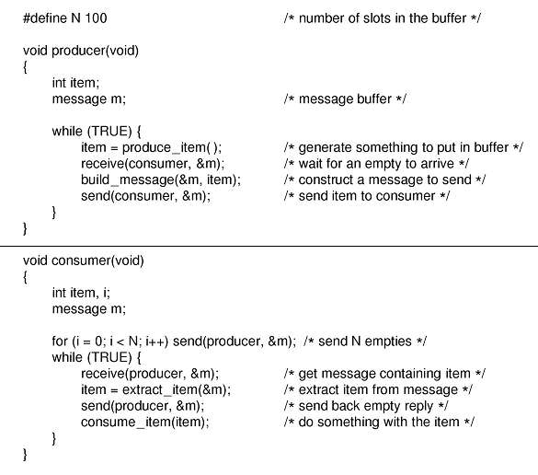
Notes:
In the problem above, an actual buffer does not exit. Instead, the producer and consumer pass messages to each other. These messages can contain the items which, in previous examples, were placed in a buffer. They can also contain empty messages, meaning that a slot in the "buffer" is ready to receive a new item. In this example, a buffer size of 100 has been chosen. The Consumer begins the process by sending 100 empty messages to the producer. The producer creates a new item for each empty message it receives, then it goes to sleep. The producer will not create a new item unless it first receives an empty message. The consumer waits for messages from the producer which contain the items. Once it consumes an item, it sends an empty message to the producer. Again, there is no real buffer, only a buffer size which dictates the number of items allowed to be produced.
Remember the assumptions for this:
mailbox system exists
messages sent and not yet received are buffered by the OS
the process blocks on a receive() until a message arrives

Slide 17
Barriers
Barriers are a synchronization mechanism to align multiple processes to the same phase of work before proceeding to the next phase
Processes done the phase of their work call a library procedure [say barrier()] to block until all processes have finished their work
Once all processes have completed the phase, the are released to perform work on the next phase
Notes:
This is another way for Synchronization

Slide 18
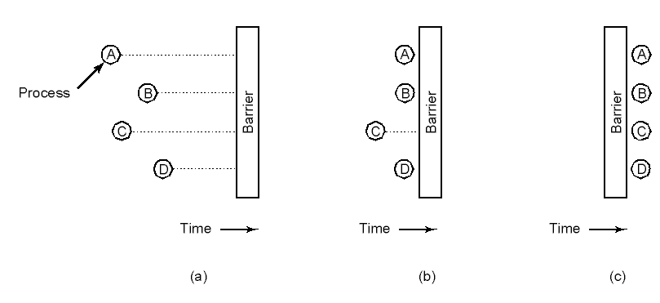
Barriers
Notes:
A good example for this is a very, very large matrix transformation. Different processes may be working on different parts of the matrix, but need to coordinate for each iteration of work on the matrix
Once all work is done of this iteration of the matrix, the processes are released to work on the next version

Slide 19
Introduction to MPI
Overview of MPI
You will be using MPI during assignment #2
Details on several key MPI functions
MPI_Send
MPI_Recv
MPI_Barrier
MPI_Bcast
MPI_Reduce
Example MPI program
https://www.mpi-forum.org/docs/mpi-3.0/mpi30-report.pdf

Slide 20
Message Passing Interface (MPI)
MPI is a portable, message passing standard designed for parallel computing environments
A de facto standard rather than once sanctioned by a formal standards body
Several different implementations exist¹:
OpenMPI (link)
MPICH (link)
Microsoft MPI (link)
Intel MPI (link)
DeinoMPI (link)
¹See the following link for additional details: https://www.mcs.anl.gov/research/projects/mpi/implementations.html

Slide 21
Open MPI
The Open MPI implementation represents a merger from three other MPI implementations
It is used on some of the worlds fastest supercomputers and has a well maintained repository and documentation
For a list of key MPI API commands
See the following: https://www.open-mpi.org/doc/v4.0/
Five key ones that may be useful for your assignment are outlined in the following pages
https://www.open-mpi.org/doc/v2.0/

Slide 22
MPI_Send
MPI_Send
Performs a standard-mode blocking send
int MPI_Send(const void *buf, int count,
MPI_Datatype datatype, int dest,int tag, MPI_Comm comm)
Parameters
buf [in] Initial address of send buffer (choice).
count [in] Number of elements send (nonnegative integer).
datatype [in] Datatype of each send buffer element (handle).
dest [in] Rank of destination (integer).
tag [in] Message tag (integer).
comm [in] Communicator (handle).
https://www.open-mpi.org/doc/v4.0/man3/MPI_Send.3.php
Notes:
Tag offers flexibility when sending/receiving messages. The source and destination are considered “ranks”.
So the rank, tag and communicator tuples need to match for the message to be sent
Rank – each process is ranked from 0 to whatever
Tag – another lightweight identifier, just and int. If not needed, just keep set to 0
Communicator – your MPI world

Slide 23
MPI_Recv
MPI_Recv
Performs a standard-mode blocking receive
int MPI_Recv(void *buf, int count, MPI_Datatype datatype, int source, int tag, MPI_Comm comm, MPI_Status *status)
Parameters
count [in] Maximum number of elements to receive (integer)
datatype [in] Datatype of each receive buffer entry (handle)
source [in] Rank of source (integer)
tag [in] Message tag (integer)
comm [in] Communicator (handle)
buf [out] Initial address of receive buffer (choice).
status [out] Status object (status).
https://www.open-mpi.org/doc/v4.0/man3/MPI_Recv.3.php

Slide 24
MPI_Barrier
MPI_Barrier
Synchronization between MPI processes
int MPI_Barrier(MPI_Comm comm)
Parameters
Comm [in] Communicator (handle).
https://www.open-mpi.org/doc/v4.0/man3/MPI_Barrier.3.php

Slide 25
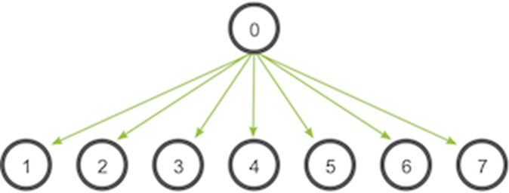
MPI_Bcast
MPI_Bcast
Broadcasts a message from the process with rank "root" to all other processes of the communicator
int MPI_Bcast(void *buffer, int count, MPI_Datatype
datatype, int root, MPI_Comm comm)
Parameters
buffer [in/out] starting address of buffer (choice)
count [in] number of entries in buffer (integer)
datatype [in] data type of buffer (handle)
root [in] rank of broadcast root (integer)
comm [in] communicator (handle)
https://www.open-mpi.org/doc/v4.0/man3/MPI_Bcast.3.php

Slide 26
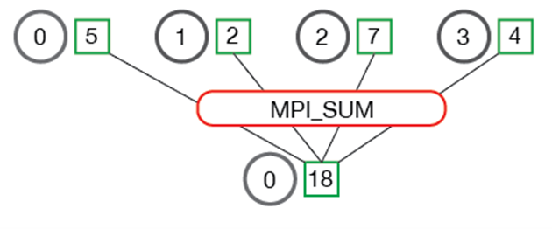
MPI_Reduce
MPI_Reduce
Reduces values on all processes to a single value
int MPI_Reduce(void *sendbuf, void *recvbuf, int count, MPI_Datatype datatype, MPI_Op op, int root, MPI_Comm comm)
Parameters
sendbuf [in] address of send buffer (choice)
count [in] number of elements in send buffer (integer)
datatype [in] data type of elements of send buffer (handle)
op [in] reduce operation (handle)
root [in] rank of root process (integer)
comm [in] communicator (handle)
recvbuf [out] address of receive buffer (choice, significant only at root)
https://www.open-mpi.org/doc/v4.0/man3/MPI_Reduce.3.php
Notes:
Data reduction involves reducing a set of numbers into a smaller set of numbers via a function.
For example, let’s say we have a list of numbers [1, 2, 3, 4, 5].
Reducing this list of numbers with the sum function would produce sum([1, 2, 3, 4, 5]) = 15.
Similarly, the multiplication reduction would yield multiply([1, 2, 3, 4, 5]) = 120.

Slide 27
MPI_Example(1/2)
/*
* Bash commands used to compile and run the program
* mpicc -o mpi_example mpi_example.c
* mpirun -n 5 ./mpi_example
*/
#include <stdio.h>
#include <mpi.h>
int main(int argc, char *argv[])
{
int myid, numprocs;
MPI_Status status;
MPI_Init(&argc, &argv);
MPI_Comm_size(MPI_COMM_WORLD, &numprocs);
MPI_Comm_rank(MPI_COMM_WORLD, &myid);
const int bufsize = 100;
char buf[bufsize];

Slide 28
MPI_Example(2/2)
if (myid == 0) {
printf("In this MPI Communications World, there are %d processes, numbered 0 through %d\n", numprocs, numprocs-1);
sprintf(buf, "Hello!!");
printf("I am process %d of %d\n", myid,numprocs-1);
for (int i = 1; i < numprocs; i++)
MPI_Send(buf, bufsize, MPI_CHAR, i, 0, MPI_COMM_WORLD);
} else {
MPI_Recv(buf, bufsize, MPI_CHAR, 0, 0, MPI_COMM_WORLD, &status);
printf("I am process %d of %d my received message is: %s, which came from process: %d\n", myid, numprocs-1, buf, status.MPI_SOURCE);
}
MPI_Barrier(MPI_COMM_WORLD);
if (myid == 0)
printf("That is all the message passing for now. Goodbye.\n");
MPI_Finalize();
return 0;
}
Notes:
Status structure:
The rank of the sender. The rank of the sender is stored in the MPI_SOURCE element of the structure. That is, if we declare an MPI_Status stat variable, the rank can be accessed with stat.MPI_SOURCE.
The tag of the message. The tag of the message can be accessed by the MPI_TAG element of the structure (similar to MPI_SOURCE).
The length of the message. The length of the message does not have a predefined element in the status structure. Instead, we have to find out the length of the message with MPI_Get_count.

Slide 29
MPI example - output
mpirun -n 5 ./mpi_eg
In this MPI Communications World, there are 5 processes, numbered 0 through 4
I am process 0 of 4
I am process 3 of 4 my received message is: Hello!!, which came from process: 0
I am process 2 of 4 my received message is: Hello!!, which came from process: 0
I am process 4 of 4 my received message is: Hello!!, which came from process: 0
I am process 1 of 4 my received message is: Hello!!, which came from process: 0
That is all the message passing for now. Goodbye.

Slide 30
Quiz Time!
What is the purpose of the monitor?
Does a monitor require only a library of system calls or further support from the compiler?
Why does it require the involvement of the compiler?
What is MPI and what is it used for?
Notes:
What is the purpose of the monitor?
Prevents race conditions by allowing only one process to execute within the monitor at a time
Does it require only a library of system calls or further support from the compiler?
Requires support from the compiler
Why does it require the involvement of the compiler?
Since it is not up to the programmer to provide the mutual exclusion, the compiler must do it. This is because the monitor is a language construct of which the compiler must be aware (like a class/polymorphism)
Message Passing Interface

Slide 31
Classical Problems in IPC

