Slide 1
EEE 335 Principles of Operating Systems
Classical Problems in IPC
(Modern Operating Systems 2.4)

Slide 2
Quick Review
What is a semaphore?
What is a monitor and why is it useful?
Notes:
Semaphore: variable type to store/decrement wakeups. Implemented as a system call in a library. Checking, decrementing, and possibly going to sleep must be an atomic action!
Monitor is a language construct that must be implemented by the compiler. It guarantees that no two processes may be active in the monitor at any time.

Slide 3
Outline
Cover two interesting problems related to synchronization and Interprocess communication
The Dining Philosophers Problem
Models I/O access
The Readers and Writers Problem
Models access to a database

Slide 4
The Dining Philosopher’s Problem
Abstraction of a philosopher: they alternate between periods of eating and thinking
Five philosophers seated around a table
One plate each; one fork between each plate
When hungry, the philosopher tries to acquire a fork from either side (in any order)
If successful, the Philosopher eats for a while and then puts down both forks
How can a program be designed to ensure that the philosophers are:
Able to eat; and
Never starve

Slide 5
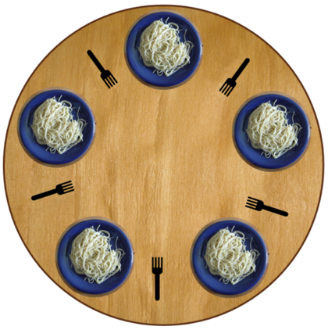
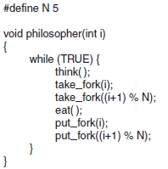
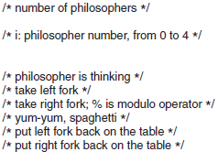
The Dining Philosophers Problem
0
1
0
1
4
take_fork() is a blocking call
What is wrong with this solution?
2
4
2
3
3
Image source: wikipedia
Notes:
1. If they all took the left forks at once, then waited for the right for to come available -> none would, so deadlock.
2. What if everyone picked up their left fork, but then first checked to see if the right was available, if not, then put down the left fork. If this all happened at the same time if would be starvation.
OK, what about if they do not all try to pick up their left fork at the same time…..think CSMA/CD back-off algorithm
What else have we learned about in the last week that we could possibly use to enable the philosophers to eat and not starve?

Slide 6
The Dining Philosophers Problem
Possible corrections:
Have philosophers acquire one fork first. If the other isn’t available, put down the fork and wait some time before trying again
Problem: If all the algorithms start simultaneously then it is possible that all the philosophers will grab their left fork, see the right one missing, put down the fork, and repeat in an infinite loop
Note: when processes are in a state that is not deadlocked, but not making any progress in their function, it is called starvation or livelock
Notes:
Because they wait the same time, they can continue wait forever if they took the first forks at once.

Slide 7
The Dining Philosophers Problem
Possible corrections:
To prevent starvation, have each philosopher wait a random amount of time before trying again
Problem: true randomness could cause the same problem to happen, however unlikely...
This may be fine for most solutions, but there may still be applications (e.g. critical infrastructure) where we do not want to leave reliability to chance where an unlikely series of random numbers can lead to failure.
Notes:
Random waiting times lower the possibility of starvation.

Slide 8
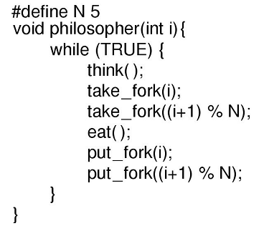
The Dining Philosophers Problem
Possible corrections:
Use a binary semaphore to protect access to the statements following the call to think()
semaphore
Mutual exclusion is achieved, but this is inefficient
Deadlock will no longer occur, but only one philosopher can eat at a time
Notes:
Only one philosopher can eat at a time. We should have two.
Ask students what a binary semaphore is.

Slide 9
#define N 5 /* number of philosophers */
#define LEFT (i+N−1)%N /* number of i’s left neighbor */
#define RIGHT (i+1)%N /* number of i’s right neighbor */
#define THINKING 0 /* philosopher is thinking */
#define HUNGRY 1 /* philosopher is trying to get forks */
#define EATING 2 /* philosopher is eating */
typedef int semaphore; /* semaphores are a special kind of int */
int state[N]; /* array to keep track of everyone’s state */
semaphore mutex = 1; /* mutual exclusion for critical regions */
semaphore s[N] = {0}; /* one semaphore per philosopher */
void philosopher(int i) { /* i: philosopher number, from 0 to N−1 */
while (TRUE) { /* repeat forever */
think( ); /* philosopher is thinking */
take_forks(i); /* acquire two forks or block */
eat( ); /* yum-yum, spaghetti */
put_forks(i); /* put both forks back on table */
}
}
void take_forks(int i) { /* i: philosopher number, from 0 to N−1 */
down(&mutex); /* enter critical region */
state[i] = HUNGRY; /* record fact that philosopher i is hungry */
test(i); /* try to acquire 2 forks */
up(&mutex); /* exit critical region */
down(&s[i]); /* block if forks were not acquired */
}
void put_forks(i) { /* i: philosopher number, from 0 to N−1 */
down(&mutex); /* enter critical region */
state[i] = THINKING; /* philosopher has finished eating */
test(LEFT); /* see if left neighbor can now eat */
test(RIGHT); /* see if right neighbor can now eat */
up(&mutex); /* exit critical region */
}
void test(i) { /* i: philosopher number, from 0 to N−1 */
if (state[i] == HUNGRY && state[LEFT] != EATING && state[RIGHT] != EATING) {
state[i] = EATING;
up(&s[i]);
}
}
This solution is deadlock free and allows for arbitrary number of philosophers
The code and solution is found on page 170.
Take time and understand how this works
Notes:
Note: only philosopher is a process here; the rest are function calls.
Recall that a mutex is a binary semaphore
s is an array of semaphores, one per philosopher
The neat thing: so far, the semaphores we have seen started with a value. In this example, the philosopher semaphores had a value of zero meaning that they have to go up before they go down on their semaphore (sort of...an individual philosopher might go down first and then another philosopher may cause it to go up)
They’re really just binary semaphores that start at zero

Slide 10
The Readers & Writers Problem
Many competing processes trying to read and write from/to a database
As many processes as desire may read from the database simultaneously
If one process is writing to the database, no other processes may have access
Notes:
In database operations.

Slide 11
The Readers & Writers Problem
Difficulties:
Simple mutual exclusion won’t work as we want many readers in the database simultaneously
Can’t use a binary semaphore on the database
A simple counting semaphore on the database makes it difficult to keep the writer out
Notes:
Concurrent readers is not a problem.

Slide 12
Readers and Writers – a reader’s preference solution
typedef int semaphore; /* use your imagination */
semaphore mutex = 1; /* controls access to rc */
semaphore db = 1; /* controls access to the database */
int rc = 0; /* # of processes reading or want to read*/
void reader(void)
while (TRUE) { /* repeat forever */
down(&mutex); /* get exclusive access to rc */
rc = rc + 1; /* one reader more now */
if (rc == 1) down(&db); /* if this is the first reader ... */
up(&mutex); /* release exclusive access to rc */
read data base( ); /* access the data */
down(&mutex); /* get exclusive access to rc */
rc = rc −1; /* one reader fewer now */
if (rc == 0) up(&db); /* if this is the last reader ... */
up(&mutex); /* release exclusive access to rc */
use data read( ); /* noncritical region */
}
}
void writer(void)
{
while (TRUE) { /* repeat forever */
think_up_data( ); /* noncritical region */
down(&db); /* get exclusive access */
write_data_base( ); /* update the data */
up(&db); /* release exclusive access */
}
}
Notes:
rc variable is for readers count
We want to allow many readers but when a writer shows up, readers must wait.
Mutex to protect access to rc counter
This allows multiple readers to enter the database simultaneously
And, at the same time, gives priority to writer if it comes to take access after the current reader is done.
The reader only goes down() on the binary semaphore db once, for the first reader in the database
This allows multiple readers to enter the database simultaneously
Since the down() on the db semaphore is protected inside the mutex, readers trying to get into the database after the first will be blocked at the mutex level, not the db

Slide 13
The Readers & Writers Problem
Several key points about this solution:
The reader only performs a down()on the binary semaphore db once, for the first reader in the database
Since the down()on the db semaphore is protected inside the mutex, readers trying to get into the database after the first will only be blocked at the mutex to increment or decrement the rc counter, not by the db semaphore
This allows multiple readers to enter the database simultaneously
Subsequent readers only increment the counter
The writer must wait until the last reader leaves in order to execute a down()on the db semaphore
What problem could this lead to?
Notes:
We still have a problem, if readers are faster, writer will not have enough chance to access the DB.
Also note that the problem may still have an error: if a reader is in the DB, more are allowed to enter even if a writer is blocked on entry. If readers arrive at a rate faster than they perform their work, the writer may never gain entry!!! An alternate solution is possible, but is non-trivial.

Slide 14
Time for a Quiz?
Questions?

Slide 15
Scheduling

