Slide 1
EEE 335 Principles of Operating Systems
Scheduling II
(Modern Operating Systems 2.4)

Slide 2
Review
When are scheduling decisions made?
What are the main categories for scheduling algorithms?
What are three scheduling goals applicable to all system types?
Notes:
When:
On process creation
On process destruction
On a block/semaphore
On an interrupt
Batch
Interactive
Real time
Fairness
Comparable processes should get comparable service
Acceptable to treat different categories of processes differently
For example, the shutdown system of a nuclear reactor has priority of mainframe minesweeper
Policy Enforcement
Actually enforce the goals of fairness
Balance
Undesirable to run all compute-bound processes together, then all the I/O bound processes

Slide 3
Recall Batch Scheduling Algorithms
First-Come First-Served
Shortest Job First
Shortest Remaining Time Next
Non-preemptive
Preemptive
Notes:
Shortest job first works out nicely if all processes are all ready to go at the same time.
-> what if shorter processes arrive at a later time -> shortest remaining time next helps in this situation.

Slide 4
Outline
Scheduling Interactive Systems
Round Robin scheduling
Priority Scheduling
Shortest Process Next Scheduling
Guaranteed Scheduling
Lottery Scheduling
Fair-Share Scheduling
Scheduling Real-Time Systems
Miscellaneous Scheduling Topics
Policy vs Mechanism
Thread Scheduling

Slide 5
Scheduling Interactive Systems
Someone, somewhere, is sitting at a keyboard entering information
Recall our objectives specific to interactive systems:
Fast response time
Proportionality (things that users think should take a short amount of time probably should)
Developing schedulers for interactive systems has been the focus of significant research and studies
Notes:
All these algorithms can be used in batch systems

Slide 6
Round Robin
Scheduling Interactive Systems
Round-Robin Scheduling
makes the implicit assumption that all processes are equally important.
Each process gets assigned a unit of time called a quantum
If the process is still running at the end of its quantum, the CPU is given to another process
If the process blocks/finishes before the end of its quantum then the CPU is immediately reassigned
Each process is given the CPU in turn
Main decision:
The value (time) of a quantum
Notes:
Like First Come First Served, but with quantums (and therefore pre-emption)

Slide 7
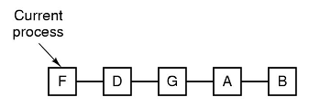
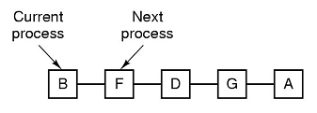
Scheduling Interactive Systems
Round Robin
Round-Robin Scheduling
How much time in a quantum?
Process switches take time: save/load registers and memory maps, update tables, flush/reload cache, etc...
For a 1ms context switch time, how much time should be in a quantum? Consider the overhead:
Quantum Size | 1ms | 4ms | 10ms | 20ms | 50ms | 100ms
Overhead | 50% | 20% | 9.1% | 4.8% | 2% | 1%
Notes:
Note that the diagram is similar to first-come first-served except that round robin is preemptive!
Lets look at 4ms - seem fairly inefficient, having 20% of the time wasted on context switching. Lets go to the other end of the extreme and go to 100 ms quantum, 1% overhead sounds good, right?

Slide 8
Scheduling Interactive Systems
Round Robin
Round-Robin Scheduling
Another argument for larger quantum: if it is longer than the average CPU burst then programs will block more often than they are preempted → Less overhead and waste
If larger quantum size is better, why not 100ms?
What if 10 users hit a key at the same time?
Long wait: last user may have to wait 1 second before seeing her/his key on the screen
Good compromise: 20 to 50ms or so
this estimate is system dependent though
Notes:
Consider a server where 50 requests are coming in, the last one could wait up to 5 secs before it gets to be used -> on an interactive system, this would seem very sluggish
Too short – inefficient,
too long -> perceived sluggishness
20ms to 50ms is reasonable, it computes to 50 to 20 context switches per second.

Slide 9
Priority Scheduling
Scheduling Interactive Systems
User based: If we shared a mainframe then the order of CPU priority might be
Dean of Engineering
ECE Dept Head
EEE435 students
EEE243 students
Process based: even on a PC with a single user there will be multiple processes.
Which is higher priority:
mouse movement or
sending mail?
Notes:
Round Robin makes an implicit assumption that are processes are equally important
-> certain individuals may disagree

Slide 10
Priority Scheduling
Scheduling Interactive Systems
How are priorities assigned?
Statically: eg: every process created by a priority ‘X’ user will be given priority ‘X’
Dynamically: React to give interactive processes a higher priority
Set the priority to 1/f where f is the fraction of the last quantum that a process used...short commands make the process higher priority
Recall that larger numbers have greater priority in this context
Notes:
For example, consider a 50 ms quantum.
Process A, is IO bound and uses only a ms of its quantum before blocking. Its priority next time around would be 1*1/f, 1 * 1/50 or 50.
Process B, executes for 25 ms, its priority next time around would be 1 * 1/(25/50) or 1 *(1/2) or 2
Process C, uses its entire quantum, its priority would be a 1

Slide 11
Priority Scheduling
Scheduling Interactive Systems
How long are processes allowed to execute? Some choices:
Forever until interrupted by a higher priority process
For a quantum of time, potentially with higher priority processes given more quanta (or more then a single quantum of time during which to execute)
Drop the priority of the process each clock tick until it is lower than another process, then switch to that process (ie: work your way down until at the lowest priority)

Slide 12
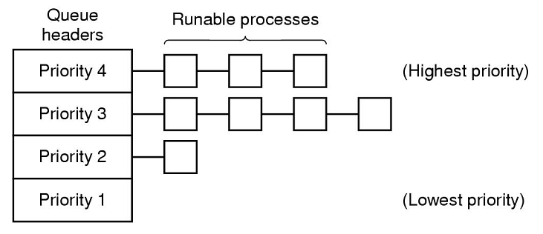
Priority Classes
Scheduling Interactive Systems
A hybrid with Round-Robin
Have Round-Robin scheduling within each priority class and run only processes within the class of the highest priority
Only when all processes in the ‘Priority 4’ class are not running, do lower class levels get scheduled
What problem could occur here?
Lower priority processes may starve
Notes:
Note how you can sort of mix and match these approaches
The 7094 could hold only one process in memory
Problem: task switching is very slow, so multiple priority classes were designated
Highest priority one for one quantum, next priority two quantum, next three quantum, etc...
Therefore, the larger the process, the less likely it’s interactive and the more contiguous time it gets to complete
However, higher priority processes get constant attention
Problem: how do you determine an interactive process?
Reset it to highest priority after an “enter” is pushed
This resulted in people sitting at their keyboards and hitting “enter” over and over to improve their CPU usage.

Slide 13
Shortest Process Next
Scheduling Interactive Systems
Shortest Process Next
Unlike many batch systems, in an interactive system we don’t know how long the user’s next command will take
For a given process, treat each command as a “job” with an estimated running time of T₀ and subsequent running time T₁
We can update our estimate of subsequent commands with a weighted average approach: aT_{n-1}+(1-a)T_{n} ; so if we take a=1/2 and apply recursively:
T₀
T₀/2 + T₁/2
(T₀/2 + T₁/2)/2 + T₂/2
T₀/4 + T₁/4 + T₂/2
T₀/8 + T₁/8 + T₂/4 + T₃/2
Enables estimation of next run time based on previous one
This weighted average approach is referred to as aging
Notes:
Recall that shortest job first for batch systems always produced the minimum average response (turnaround) time
Make sure that they can actually figure this out....Each command is added and THEN the entire sum is divided by 2. In other words, the most recent command is weighted for 50% of the value.
Other values than ½ can be used.
Easy to implement when a =1/2 add the new value to the current estimate and divide by 2 (a simple and quick bit shift)

Slide 14
Guaranteed Scheduling
Scheduling Interactive Systems
Guaranteed Scheduling
Each process will receive 1/n of the CPU when there are n active processes
This requires that the CPU time each process has used must be tracked and adjusted to ensure that no process gets more time than another
Don’t be fooled by the name, this method does not guarantee scheduling at a particular time
Problem: difficult to live up to this promise and time consuming to do so...
Notes:
Approach is to make a promise to users. For example if n users are logged in, you get 1/n of the CPU power
CPU Time entitled= (Time Since Creation)/n
•Then compute the ratio of Actual CPU time consumed to the CPU time entitled.
•A ratio of 0.5 means that a process has only had half of what it should have had, and a ratio of 2.0
means that a process has had twice as much as it was entitled to.
•The algorithm is then to run the process with the lowest ratio until its ratio has moved above its closest
competitor.

Slide 15
Fair-Share Scheduling
Fair-Share Scheduling
This method of scheduling ensures each user gets their fair share rather than each process
If I start the calculator, Word, Solitaire, and Chrome should I get 4x the CPU time of a user with one process?
In this model each user is allocated a percentage of CPU that is divided among her/his processes
ie: each get 50%. User 1 has processes ABCD and User 2 has process E. If they are using all their CPU time then the order will be: AEBECEDEAEBE...
Notes:
Of course, if user 2’s processes block early, it is very possible to give user 1 more time and run his processes more frequently.
Very similar to guaranteed scheduling but applied to users only.

Slide 16
Lottery Scheduling
Lottery Scheduling
Premise: hand out tickets and draw one at random to see which process runs next
The Prize: CPU time
Advantages:
Responsive: a new process has a chance of getting scheduled from the beginning of its life
Multiple tickets can be handed out to arrange for ratios of CPU time
Cooperating processes can give tickets to each other to increase their odds
Notes:
The ratios of CPU time can be good for near real-time constraints, eg: three processes showing video at 10, 20 and 25 frames per second could be given 10, 20 and 25 tickets each
As for cooperation, why could that happen? If a thread blocks on some work another thread needs to do, why not hand over your tickets first since they’re not much good to you?
Lottery Scheduling is a probabilistic scheduling algorithm for processes in an operating system.
Processes are each assigned some number of lottery tickets for various system resources such as CPU time and the scheduler draws a random ticket to select the next process.
The distribution of tickets need not be uniform; granting a process more tickets provides it a relative higher chance of selection.
This technique can be used to approximate other scheduling algorithms, such as Shortest job next and Fairshare scheduling.
Lottery scheduling solves the problem of starvation. Giving each process at least one lottery ticket guarantees that it has non-zero probability of being selected at each scheduling operation.
More importantly, processes can be given extra tickets to increase their odds of winning. If there are 100 tickets outstanding, & one process holds 20 of them it will have 20% chance of winning each lottery.
In the long run it will get 20% of the CPU.
A process holding a fraction of the tickets will get about that fraction of the resource in question.

Slide 17
Scheduling Real-Time Systems

Slide 18
Scheduling Real-Time Systems
In a hard real-time system, deadlines must be met
If not, significant adverse impacts are likely
In a soft real-time system, some deadlines can be missed, but it is highly undesirable
Events can be either periodic (occur at regular intervals) or aperiodic (occurring unpredictably eg: an interrupt)
Determining if it is possible for a real-time system to meet its deadlines is a significant course of study

Slide 19
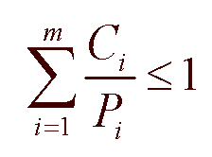
Scheduling Real-Time Systems
If there are m periodic events on a system, each requiring C seconds of CPU time and occurring with periodicity P, then consider:
If this equation is not satisfied there is more work to do than the CPU can handle in one second and deadlines will not be met...the system is not schedulable
Keep in mind this is very simplistic view which does not consider important factors such as context switching, aperiodic events and changes in periodicity
Notes:
Note that the book actually says that the system will be schedulable if the equation is true, but that was too much of a generalization to teach and Maj Smith would have shot me.
Implicit in the equation is that the time for a context switch is minimal.
Consider 3 periodic events
Period 100, 200, 500 msec
CPU time 50, 30, 100 msec of CPU time per event
Total CPU time required = (1/100)50 + (1/200)30 + (1/500)100 = 0.5 + 0.15 + 0.2 = 0.85 which is considered schedulable.

Slide 20
Miscellaneous Scheduling Topics

Slide 21
Policy vs Mechanism
Our discussion of scheduling has assumed processes in competition for the CPU with differing goals, and probably owners too
What about a real-time system where the processes cooperate
What about a process owning many child threads that need to work together?
Processes/threads working together may benefit by separating the policy decisions from the mechanism by which those policies are enforced
Notes:
In other words, the scheduler will rarely choose the best thread to activate within a number of threads owned by one process.
Consider a parent thread that can set and modify the priority of its child threads

Slide 22
Policy vs Mechanism
In this configuration there will be times in which processes can specify their scheduling policy, and the scheduler implements the policy
Consider a system call through which a process can change the priorities of its children.
In this case, the kernel controls the mechanism of the scheduler, but the policy is set by a user process

Slide 23
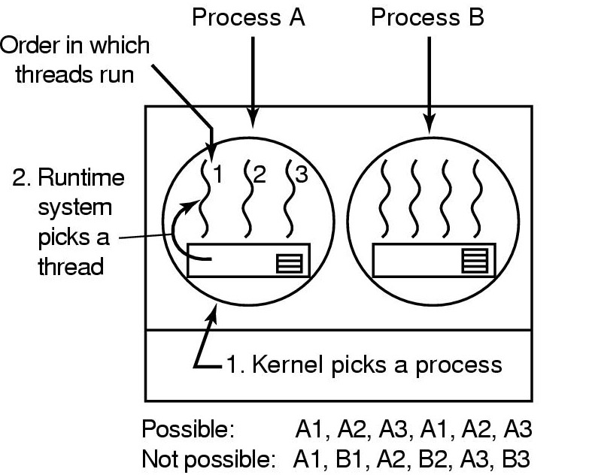
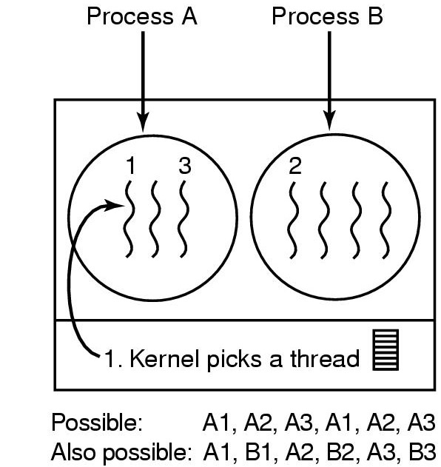
Thread Scheduling
Recall: threads can be scheduled in the kernel or in a user space run-time library
consider a 50 msec quantum
Threads with 5msec CPU bursts
Threads that block after 5 msec

Slide 24
Thread Scheduling
A kernel thread scheduler will be slower (due to TRAPs to the kernel) but will also have to consider that running a thread in the same process will, in general, be quicker than switching to a different process
A user space run-time scheduler will be more efficient, but also more complicated and will block all threads on a system call
Deciding which to use, and how to employ it, is all about trade-offs

Slide 25
Current OS implementations
Windows
https://docs.microsoft.com/en-us/windows/desktop/procthread/scheduling-priorities
Linux
http://manpages.ubuntu.com/manpages/cosmic/man7/sched.7.html

Slide 26
Quiz Time
What is round-robin scheduling?
Regarding priority scheduling, what are the two ways in which priorities may be assigned?
What are two advantages of lottery scheduling?
Notes:
Each process gets assigned a unit of time called a quantum
If the process is still running at the end of its quantum, the CPU is given to another process
If the process blocks/finishes before the end of its quantum then the CPU is immediately reassigned
Each process given the CPU in turn
Main implementation decision:
The value (time) of a quantum
Dynamically
Statically
What are three advantages of:
Responsive: a new process has a chance of getting scheduled from the beginning of its life.
Multiple tickets can be handed out to arrange for ratios of CPU time.
Cooperating processes can give tickets to each other to increase their odds.
Bonus: Prevents starvation.

Slide 27
Linux Scheduling

