Slide 1
EEE 335 Principles of Operating Systems
Scheduling Case Study
(Linux Kernel Development, Chapter 4)

Slide 2
Outline
Historical overview
Multilevel feedback queue scheduler
Problems in classic Unix implementation
Modern Linux scheduling
Completely fair scheduler (CFS) characteristics
CFS implementation
Notes:
The O(1) scheduler was based on the MFQS

Slide 3
Multilevel feedback queue scheduler
Used in Linux from 1991 until version 2.4 (2001)
Taken from unix
Remained mostly unchanged during this period
Priority levels
0-99: for soft real-time tasks
100-140: nice tasks level
Quantum size
Real-time tasks: ~200 ms
Nice tasks: ~10 ms
Notes:
Keep in mind this scheduler was designed in the early 1960’s

Slide 4
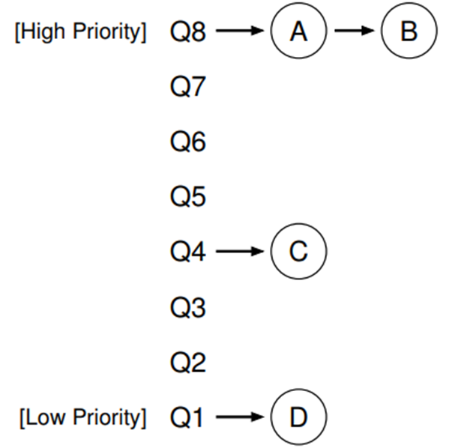
Multilevel feedback queue scheduler
An example of a system that learns from the past to predict the future
MFQS has a number of distinct queues
Each has a different priority level
A series of rules define how it operated
Rule 1: If Priority(A) > Priority(B), A runs (B doesn’t)
Rule 2: If Priority(A) = Priority(B), A & B run in RR
Notes:
Keep in mind this scheduler was designed in the early 1960’s. Defined by a set of rules. Using just these two rules, process C and D would never run

Slide 5
MFQS – More Rules
Rule 3: When a job enters the system, it is placed at the highest priority (the topmost queue).
Rule 4a: If a job uses up an entire time slice while running, its priority is reduced (i.e., it moves down one queue).
Rule 4b: If a job gives up the CPU before the time slice is up, it stays at the same priority level.
Vividly recalling the last two lectures on scheduling, how would this impact CPU and I/O bound processes?
Notes:
Consider I/O - As Rule 4b states above, if a process gives up the processor before using up its time slice, we keep it at the same priority level. The intent of this rule is simple: if an interactive job, for example, is doing a lot of I/O (say by waiting for user input from the keyboard or mouse), it will relinquish the CPU before its time slice is complete; in such case, we don’t wish to penalize the job and thus simply keep it at the same level. Short jobs get a high priority.
Longer running, CPU-bound jobs will continually be put into a lower Queue and eventually starve

Slide 6
MFQS – Still More Rules
To reduce potential for starvation, enter rule number five
Rule 5: After some time period S, move all the jobs in the system to the topmost queue.
While this solved the starvation issue, there remained other challenges with MFQS
Mapping the nice value to timeslice/quantum
Relative nice value timeslice/quantum
Absolute timeslice value/quantum
Notes:
Consider I/O - As Rule 4b states above, if a process gives up the processor before using up its time slice, we keep it at the same priority level. The intent of this rule is simple: if an interactive job, for example, is doing a lot of I/O (say by waiting for user input from the keyboard or mouse), it will relinquish the CPU before its time slice is complete; in such case, we don’t wish to penalize the job and thus simply keep it at the same level. Short jobs get a high priority.
Longer running, CPU-bound jobs will continually be put into a lower Queue and eventually starve

Slide 7
MFQS–mapping quantum to nice levels
Consider two process running:
A – nice level 0, gets 100 ms quantum
B – nice level 19 (lowest priority) gets 5 ms quantum
A
nice 0 (100 ms)
nice 20 (5 ms)
B
process A receives 20/21 (100 ms / 105 ms) of the processor’s time.
process B receives 1/21 (5 ms / 105 ms) of the processor’s time
time
Notes:
First, mapping nice values onto timeslices requires a decision about what absolute timeslice to allot each nice value. This leads to suboptimal switching behavior. For example, let’s assume we assign processes of the default nice value (zero) a timeslice of 100 milliseconds and processes at the highest nice value (+20, the lowest priority) a timeslice of 5 milliseconds. Further, let’s assume one of each of these processes is runnable. Our default priority process thus receives 20⁄21 (100 out of 105 milliseconds) of the processor, whereas our low priority process receives 1/21 (5 out of 105 milliseconds) of the processor. We could have used any numbers for this example, but we assume this allotment is optimal since we chose it.

Slide 8
MFQS–mapping quantum to nice levels
Now consider two low priority process running
One would expect they would each get 50% of the processor time, which they do
But only for their nice allotment of 5 ms, resulting in wasteful context switching
A
nice 20 (5 ms)
nice 20 (5 ms)
B
process A receives 1/2 (5 ms / 10 ms) of the processor’s time.
process B receives 1/2 (5 ms / 10 ms) of the processor’s time
time
Notes:
Now, what happens if we run exactly two low priority processes? We’d expect they each receive 50% of the processor, which they do. But they each enjoy the processor for only 5 milliseconds at a time (5 out of 10 milliseconds each)! That is, instead of context switching twice every 105 milliseconds, we now context switch twice every 10 milliseconds.
Conversely, if we have two normal priority processes, each again receives the correct 50% of the processor, but in 100 millisecond increments. Neither of these timeslice allotments are necessarily ideal; each is simply a byproduct of a given nice value to timeslice mapping coupled with a specific runnable process priority mix. Indeed, given that high nice value (low priority) processes tend to be background, processor-intensive tasks, while normal priority processes tend to be foreground user tasks, this timeslice allotment is exactly backward from ideal!

Slide 9
MFQS–relative nice levels
Consider the following two processes, each one nice value apart
Process C – nice 0, 100 ms quantum
Process D – nice 1, 95 ms quantum
Now consider two close processes, but at lower levels
Process E – nice 18, 10 ms quantum
Process F – nice 19, 5 ms quantum
Although close in nice level, can you see the problem from a fairness perspective?
5% difference
50% difference
Notes:
Twice the time on the CPU for a closely prioritized process?!

Slide 10
MFQS–absolute nice levels
The quantum levels were based on the system timer
This has the following two impacts:
The minimum quantum could range from 1ms to 10 ms
The difference between nice levels could then also differ between 1 to 10 ms
As result, vastly different scheduling outcomes were realized when implement on different hardware.

Slide 11
Modern Linux Scheduling
Completely Fair Scheduler (CFS), since version 2.6
Uses 3 separate scheduler classes
SCHED_NORMAL (traditionally written as SCHED_OTHER)
Default for common interactive systems
SCHED_FIFO
Task runs to completion, no pre-emption
SCHED_RR
Run until timeslice used up or pre-empted
Note: You can also read more on this in the linux man page for sched
Real-time
Notes:
Only SCHED_FIFO, SCHED_OTHER and SCHED_RR are part of POSIX 1003.1b Process Scheduling. The other scheduling attributes may be ignored on some systems. Source: manpage chrt. Use chrt –m to see potential policies loaded. DEADLINE, BATCH and IDLE not necessarily on every system but they are part of CFS.
/*
* Scheduling policies
*/
#define SCHED_NORMAL 0
#define SCHED_FIFO 1
#define SCHED_RR 2
#define SCHED_BATCH 3
/* SCHED_ISO: reserved but not implemented yet */
#define SCHED_IDLE 5
#define SCHED_DEADLINE 6

Slide 12
Recall perfect multitasking
n processes execute at the same time and are given 1/n^{th} of the processor’s power
2 processes would receive 50% of the processor at all time
Not possible in real implementations
What is the challenge here?

Slide 13
Completely fair algorithm
The practical application of the perfect processor
takes into account the overhead
executes the processes round-robin, selecting the process that has run the least
no set timeslice value
a function of the number of processes and target latency
minimum set to ~1 ms
weighted by the nice value
Dynamic timeslice also based on the targeted latency
The minimum amount of time required for every runnable task to get at least one turn of CPU time
Each runnable task gets 1/n time slice of the target latency
Notes:
Each process then runs for a “timeslice” proportional to its weight divided by the total weight of all runnable threads. To calculate the actual timeslice, CFS sets a target for its approximation of the “infinitely small” scheduling duration in perfect multitasking. This target is called the targeted latency. Keep in mind that CFS bases its calculations on Nanoseconds, not clock ticks.

Slide 14
A quick note on Nice levels
nice levels still exist in modern linux
nice is also a linux application that enables one to change the priority of their program
-20 most favourable to the process
19 least favourable to the process
$ nice –n -20 task-spy
See https://linux.die.net/man/1/nice or the nice man page for details.

Slide 15
Priority vs nice levels
Nice levels are used for SCHED_NORMAL policy
Focused at user level
The kernel has a priority scheme based on both real-time and normal policies and has 140 values
1-99 Priorities values under real time policy
100-139 Priorities under normal policy
Maps from -20 to 19 nice levels
View to user is calculated as follows
Normal Real-Time
Pri = 20 + nice Pri = -1 - rt_pri

Slide 16
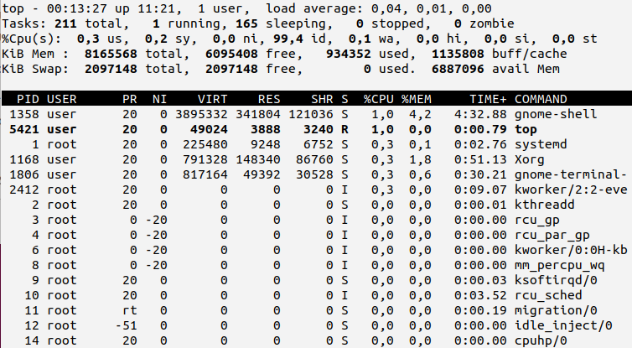
top example
Notes:
PR value is stated as "rt". This value actually corresponds to a PR value of -100.

Slide 17
Completely fair algorithm
Consider the following:
targeted latency of 20 ms
2 processes of same nice value
A
nice 0 (10 ms)
nice 0 (10 ms)
B
time
Notes:
CFS will run each process for some amount of time, round-robin, selecting next the process that has run the least. Rather than assign each process a timeslice, CFS calculates how long a process should run as a function of the total number of runnable processes.
Instead of using the nice value to calculate a timeslice, CFS uses the nice value to weight the proportion of processor a process is to receive:
Higher valued (lower priority) processes receive a fractional weight relative to the default nice value,
whereas lower valued (higher priority) processes receive a larger weight.

Slide 18
Completely fair algorithm
Consider the following:
targeted latency of 20 ms
4 processes of same nice value
A
nice 0 (5 ms)
B
nice 0 (5 ms)
C
nice 0 (5 ms)
D
nice 0 (5 ms)
time
Notes:
Each runs for 5 ms

Slide 19
Completely fair algorithm
Consider the following:
targeted latency of 20 ms
20 processes of same nice value
What is the runtime for each process in this situation?
Approximately 1ms each
A floor or lowest level called the minimum granularity is imposed by CFS
This floor value is ~1ms
Notes:
Approximately 1 ms each, challenging when n tends to infinity,
CFS imposes a floor on the timeslice assigned to each process. This floor is called the minimum granularity. By default it is 1 millisecond.
Thus, even as the number of runnable processes approaches infinity, each will run for at least 1 millisecond, to ensure there is a ceiling on the incurred switching costs.

Slide 20
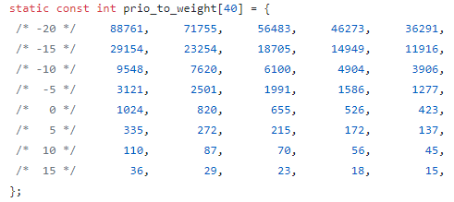
Priority across different nice levels
To understand how priorities work across different nice levels, one needs to look into the current code for the scheduler
The weighted values are calculated and provided for each nice level
https://github.com/tinganho/linux-kernel/blob/master/kernel/sched.c

Slide 21
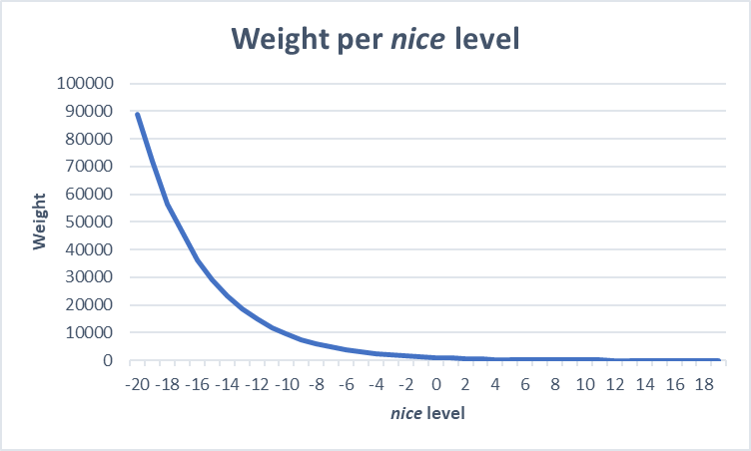
Priority at different nice levels
The weighted priority between different nice levels is not linear

Slide 22

Calculating runtimes
When calculating the run time allotted to a given process, it is based on the ratio difference between the weights of each nice level
For example, consider two processes
nice level 0
nice level 5
The ratio of their weights is calculated by the following:
Or approximately ~ 3 to make our example simple
$$\frac{1024}{335}=3.057$$

Slide 23
Completely fair algorithm
Consider the following:
targeted latency of 20 ms
2 processes of nice values 0 and 5
A
nice 0 (15 ms)
nice 5 (5 ms)
B
time
Notes:
See the previous page for how this is actually calculated. The weight for nice 5 works out to be 1/3 of nice 0, so with a targeted latency of 20 ms, the runtimes for each are approximately 15 ms and 5 ms
These nice values have dissimilar weights and thus our two processes receive different proportions of the processor’s time. In this case, the weights work out to about a 1⁄3 penalty for the nice-5 process. If our target latency is again 20 milliseconds, our two processes will receive 15 milliseconds and 5 milliseconds each of processor time, respectively. Say our two runnable processes instead had nice values of 10 and 15.What would be the allotted timeslices? Again 15 and 5 milliseconds each!

Slide 24
Completely fair algorithm
Consider the following situation:
targeted latency of 20 ms
2 processes of nice values 10 and 15
What is the runtime for each process in this situation?
Notes:
Same as previous version, 15 and 5 ms since the difference between the two is 5 nice.

Slide 25
CFS Implementation
The details of CFS can be complex, lets look at 4 high level components
Time accounting
Process selection
Scheduler Entry Point
Sleeping and Waking Up

Slide 26
Four Components of CFS
Time accounting
CFS keeps track of CPU time for each task
Each process (struct task_struct) has a struct sched_entity variable
struct sched_entity {
struct load_weight load; /* for load-balancing */
struct rb_node run_node;
struct list_head group_node;
unsigned int on_rq;
u64 exec_start;
u64 sum_exec_runtime;
u64 vruntime;
u64 prev_sum_exec_runtime;
u64 nr_migrations;
};
Notes:
CFS does not have the notion of a timeslice, but it must still keep account for the time that each process runs, because it needs to ensure that each process runs only for its fair share of the processor. CFS uses the scheduler entity structure, struct sched_entity, defined in <linux/sched.h>, to keep track of process accounting: vruntime stores the virtual time, which is the actual time a process ran normalized by the number of running processes.

Slide 27
CFS Linux Implementation
Process selection
Pick the process with the smallest vruntime.
Runnable processes are sorted based on their vruntime using a red-black tree
A type of self-balancing binary search tree
Each node is sorted by a key
left most node is the process with smallest vruntime.
Notes:
CFS uses a red-black tree to manage the list of runnable processes and efficiently find the process with the smallest vruntime. A red-black tree, called an rbtree in Linux, is a type of self-balancing binary search tree .
For now, if you are unfamiliar, you need to know only that red-black trees are a data structure that store nodes of arbitrary data, identified by a specific key, and that they enable efficient search for a given key (in this case, vruntime).

Slide 28
CFS Linux Implementation
Scheduler Entry Point
schedule() function called
schedule() calls pick_next_task()
Selects the highest priority process in the highest priority scheduler class
For the CFS scheduler, this means smallest vruntime
A quick look at CFS man page here
Notes:
Recall that linux can have different classes of scheduling (e.g real time, CFS etc)

Slide 29
CFS Linux Implementation
Sleeping and waking up
process that has to sleep (when waiting for an event)
marks itself to sleep
puts itself on the wait queue
removes itself from the red-black tree
calls schedule(), the function to select a new process to execute
Waking up
task is set as runnable and removed from the wait queue
added back to the red-black tree

Slide 30
Deadlocks

