Slide 1
EEE 335 Principles of Operating Systems
Deadlocks
(Modern Operating Systems 6.1, 6.2, 6.3)

Slide 2
Quick Review
What factors are taken into consideration when choosing the quantum size in Round-Robin scheduling? (What happens if it’s small? Big?)
How does shortest process next work in an interactive system?
Notes:
Quantum size:
If the quantum size is large then interactive processes will appear sluggish
If the quantum size is small then the overhead involved with a context switch becomes unbearable
Shortest process next can work by “aging” the time taken for previous instructions, ie: T0/₄ + T1/₄ + T₂/2

Slide 3
Outline
Resources
Deadlock introduction
Conditions for deadlock
Deadlock Modeling
Strategies for dealing with deadlock
The Ostrich algorithm
Detection and Recovery
Dynamic avoidance
Prevention

Slide 4
Resources
When performing their function, processes often need exclusive access to devices, files, memory, etc...
Could be hardware (e.g. optical or USB drive)
Could be information (e.g. database record)
Multiple copies of the resource may exist, across different media
For the section on deadlocks we will refer to this collection of objects that can be granted exclusively to a process generically as resources

Slide 5
Resources
Resources come in two flavors:
A non-preemptable resource may not be taken away from a process
eg: a CD-ROM writer in the middle of a burn
A preemptable resource can be taken away
Memory is a resource
A process running in memory can be swapped out for another process to execute
Consider two processes where only one can be in memory at a time
If the first gets the printer and is then swapped out, and then the second process needs the printer, we may have a deadlock. However, since the memory is preemptable, the situation will resolve

Slide 6
Resources
In general, non-preemptable resources are required for deadlocks to occur
This course will focus on non-preemptable resources
Our abstraction of how processes use resources:
Request the resource (block if not available)
Use the resource
Release the resource
Notes:
Not all operating systems will have a process block if the resource is not available. An error code may be returned instead and the process may sleep and/or busy wait. However, the end result as far as deadlocks are concerned is the same, and for the purposes of this course we will consider processes that request unavailable resources as blocked.

Slide 7
Deadlock Definition
Formal definition:
a set of processes are deadlocked if each process in the set is waiting for an event that only another process in the set can cause
Therefore, none of the processes in the set will wake up since they are waiting on other processes that will never wake up
Assumptions: each process has a single thread of execution and no interrupts will wake up a blocked process
Notes:
This thing about the interrupts is important because it otherwise might prevent the problem. In other words, processes will only go on the move again once they have the resource they need.

Slide 8
Conditions for Deadlock
There are four conditions required for deadlocks to occur. If any of them are absent, deadlock is not possible
Mutual exclusion condition. Each resource is either currently assigned to exactly one process or is available
Hold and wait condition. Processes currently holding resources granted earlier can request new resources
Notes:
Note that these conditions are kind of hard to get rid of.

Slide 9
Conditions for Deadlock (cont)
No preemption condition. Resources previously granted cannot be forcibly taken away from a process. They must be explicitly released by the process holding them
Circular wait condition. There must be a circular chain of two or more processes, each of which is waiting for a resource held by the next member of the chain

Slide 10
Deadlock Modeling
Directed graphs can be used to model deadlocks:
Resource ‘R’ granted to Process ‘A’
R
A
Resource ‘R’
Process ‘A’
Process ‘A’ waiting for Resource ‘R’
R
A
Notes:
Click for the resource, then the process, then the arc, then the second diagram.

Slide 11
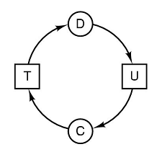
Deadlock Modeling
How is a deadlock represented graphically?
It is a closed loop within the directed graph
Process C is waiting for resource T
Resource T is is held by process D
Process D is waiting for resource U
Resource U is is held by process C
Notes:
Process C is waiting for resource T which is held by process D which is waiting for resource U which is held by process C. Ugh.

Slide 12
Deadlock Modeling
How can we use directed graphs?
They are a tool to let us see if a given request/release sequence will lead to a deadlock
Consider the following example:
Three processes, A, B, and C and three resources R, S, and T
A may use R and S,
B may use S and T, and
C may use T and R

Slide 13
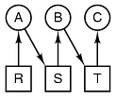
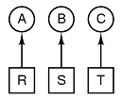
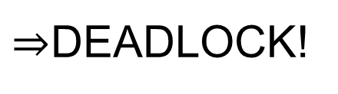
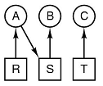
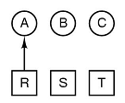
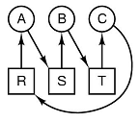
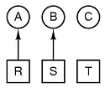
Deadlock Modeling
A requests R
B requests S
C requests T
A requests S
B requests T
C requests R
$⇒$DEADLOCK!
For the above, each process does not release the initial resource it has
Does this actually help us prevent deadlock?
Not yet; later we will see how this visual check may be implemented as an algorithm to detect deadlocks
Notes:
Arrow pointing from resource to process means the process requested it and the resource was assigned to it
Arrow point from process to resource means the process requested it, but its blocks waiting for the resource to become free.
A blocks waiting for S, then the same for B and C
The important thing to realize is that there are tools that can detect deadlock. If the Operating System was ‘watching’ this unfold then it may have blocked B until A was finished with its resources

Slide 14
Strategies for Deadlock
We know how deadlock occurs, but what can be done to stop it? Four strategies:
Ignore the problem (the Ostrich algorithm)
Detection and Recovery
Let deadlocks occur, but detect them and take action to correct them
Dynamic avoidance
Very, very carefully allocate resources
Prevention
Negate one of the four conditions required for deadlock discussed previously
Notes:
Those conditions being:
Mutual exclusion condition
Hold and wait (can hold onto a resource and wait for another)
No preemption condition
Circular wait condition

Slide 15
Strategies for Deadlock
The Ostrich algorithm
Accept that deadlocks will occur and don’t have a plan for correcting them
What’s a Blue Screen of Death between friends anyway?
Notes:
Called Ostrich algorithm from the idea of sticking your head in the sand and pretending that there is no problem at all.

Slide 16
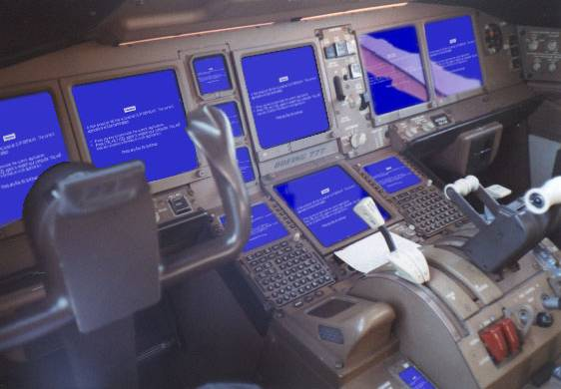
Notes:
This is all about picking your battles correctly though...this may not be a situation where a BSOD is acceptable. However, it’s not as much of a concern on a home PC.

Slide 17
Strategies for Deadlock
The Ostrich algorithm
Actually a viable solution
If the probability of a deadlock is such that one will occur twice a year, but the system has hardware failures that necessitate a reboot once per day, is a robust solution to the deadlock worth the time/money and complexity?
Whether or not some deadlocked situations get fixed comes down to a trade-off between significance (factor of impact and how often it occurs) and level of effort to fix the code in order to avoid it.

Slide 18
Quiz Time!
What are the four conditions required for deadlock?
What are our four strategies for dealing with deadlocks (by name)
Notes:
What are the four conditions required for deadlock?
Hold and wait condition (processes can request multiple resources)
Mutual exclusion condition (resources can either be available or held by only one resource)
No preemption condition
Circular wait condition
What are our four strategies for dealing with deadlocks (by name)
The ostrich algorithm
Deadlock detection
Avoidance through careful resource allocation
Prevention by disrupting one of the four conditions we have for deadlocks.

