Slide 1
EEE 335 Principles of Operating Systems
Deadlock Avoidance and Prevention
(Modern Operating Systems 6.5, 6.6 and 6.7)

Slide 2
Quick Review
How do we detect deadlocks with multiple instances of each resource?
What are our four conditions for deadlock?
Notes:
Answer: Four data structures:
Resources in existence
Available Resource
Matrix of resources allocated to processes
Matrix of resources requested by processes
Now we look to see if our available resources can satisfy the request of one of the processes. If so, mark it as “run” and add its allocated resources to those available. Repeat until all processes are marked or we cannot continue. Any process not marked as “run” are deadlocked
Four conditions for deadlock:
Mutual exclusion condition (resources either free or allocated to a process)
Hold and wait condition (processes may obtain more than one resource simultaneously)
No preemption condition (resources may not be taken away from a process)
Circular wait condition (at least two processes are waiting on events that only another process in the cycle can cause)

Slide 3
Outline
Deadlock Avoidance
Deadlock Prevention
Notes:
Ask them what these mean again:
Avoidance is the stop deadlocks through a very careful allocation of resources
Prevention is a way to avoid deadlocks by breaking one of the four conditions for deadlock.

Slide 4
Deadlock Avoidance
So far we have seen two solutions to our deadlock problem: ignoring them and recovering from them
Wouldn’t it be better if, through careful allocation of resources, we could prevent deadlocks from happening?
This is known as Deadlock Avoidance

Slide 5
Deadlock Avoidance
To avoid deadlocks, it is important not to proceed to a state that is unsafe
A state is said to be safe if there is some scheduling order in which every process can run to completion even if all of the processes were to immediately require their maximum number of resources to complete their work

Slide 6
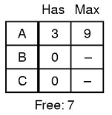
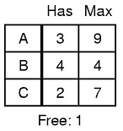
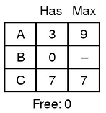
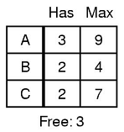
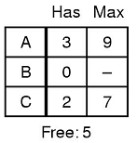
Deadlock Avoidance
If every process requests their maximum resources, is the starting state safe?
Consider the following situation:
Three processes – A, B and C
A total of 10 resources (of the same type) exist
Since every process could run to completion, the initial state was safe
Notes:
Note:
that we are dealing with a single resource type for this example
7 of the 10 resources have already been allocated, another (6+2+5) or 13 are going to be requested by each of the processes to allow them to complete their task
we are assuming that every process will next requests its maximum resources.
B requests two more resources
B receives the two additional resources
B runs to completion and releases its resources
C is next
A follows
Safe because there exists a sequence of allocations that allows all processes to complete.

Slide 7
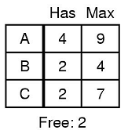
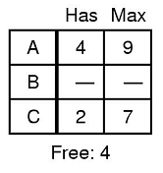
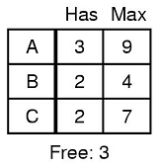
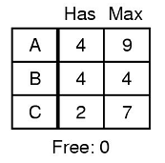
Deadlock Avoidance
What if process A requested a single resource first and it was granted?
Since not all processes could complete, the state created by allocating that single resource to Process A, was not safe
It is that move to an unsafe state that needs to be determined in advance if it is to be avoided
Notes:
Note that this did not HAVE TO lead to a deadlock. Only if all processes needed their maximum number of resources to complete was it a deadlock. If C can complete with 2, or release a single resource then everything will work out for the best. However, the state was unsafe...

Slide 8
Deadlock Avoidance
One way to avoid deadlocks for single instances of multiple resources is the Banker’s Algorithm
Based on a single resource type, in this analogy, money
Modeled on the way a Banker might grant loan requests from his customers
Idea is that the customers have a maximum amount of credit which is set
It is guaranteed that if they were allocated their maximum amount of credit that they will be able to complete the work for which the loan was needed and subsequently repay the bank
Notes:
Dijkstra again
Note the multiple instances of single resource

Slide 9
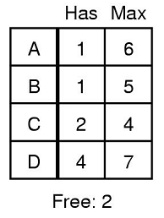
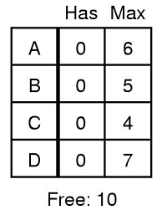
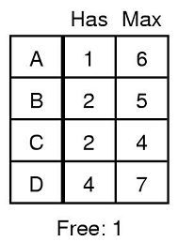
Deadlock Avoidance
Banker’s algorithm:
When a request for money from a customer is made, the algorithm checks if that would lead to an unsafe state, and if so, the request is denied
Units are in $1K, banker has $10K on hand knowing that each customer will not ask for their full amount right away
SAFE
UNSAFE
Notes:
Units are in $1K, customers may request a total of $22K
Banker has reserved only $10K on hand, knowing not everyone will ask for everything right away
Customers A,B,C and D ask for the amounts given in the second box – if you were the banker, is this safe?
Next, B asks for another $1K – if you were the banker in this situation, would you approve or deny the additional loan
So, really, the algorithm is just what we saw previously. We only give out resources if the state to which the process move is safe.
Ask them: in this analogy the banker is the? (operating system) and the customers are (processes)
Doesn’t this result in waste? We aren’t allocating all of our resources.
Yes, but it prevents deadlocks
Less waste than only allowing a process to take the maximum it will ever need at once
More concurrent activity
More resources in use (in general)
REMEMBER!!! Unsafe is not necessarily a deadlock, but we can no longer guarantee that we can prevent a deadlock either.

Slide 10
Deadlock Avoidance
The Banker’s algorithm works for single resources with multiple instances, but what about multiple resources?
The algorithm can be generalized using data structures similar to those we used to detect a deadlock
Vector E – existing resources
Vector P – possessed (allocated) resources
Vector A – available resources
Matrix C – current allocation of resources
Matrix R – maximum resources that may be needed

Slide 11
Deadlock Avoidance
Vector E – existing resources
Vector P – possessed (allocated) resources
Vector A – available resources
Matrix C – current allocation of resources
Matrix R – maximum resources that may be needed
Banker’s Algorithm for Multiple Resources:
Look for a row, R, whose unmet resource needs (ie: potential maximum) are smaller than or equal to vector A.
If no such row exists, the system is unsafe because if all processes request their maximum resources then none will be able to continue
2) Assume the process of the chosen row R requests all the resources it needs and completes its task
It then releases its resources, which are then added to vector A

Slide 12
Deadlock Avoidance
Banker’s Algorithm for Multiple Resources:
3) Repeat steps 1 and 2 until either all processes are marked as terminated (in which case the initial state was safe) or until it is shown that an unsafe state is present
Vector E – existing resources
Vector P – possessed (allocated) resources
Vector A – available resources
Matrix C – current allocation of resources
Matrix R – maximum resources that may be needed

Slide 13
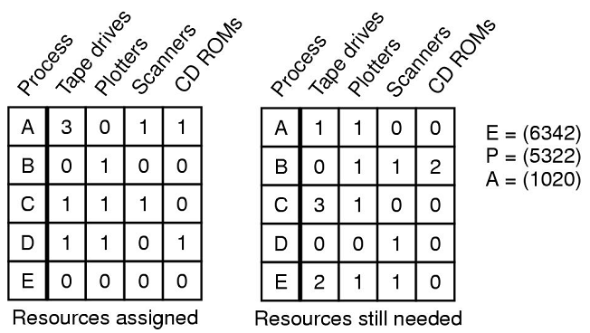
Deadlock Avoidance
Vector E – existing resources
Vector P – possessed (allocated) resources
Vector A – available resources
Matrix C – current allocation of resources
Matrix R – maximum resources that may be needed
Is this state safe?
C
R
Notes:
Note vector P is simply the sum of assigned resources to speed in our calculation of vector A.
Ask: Is this a safe state? If so, why?
- D can finish, return all it resources, then A or E and so on
Ask them if the state is still safe if B asks for a scanner (and is granted it).
- Yes, because D can still finish follow by A or E and so on
Then what if E asks for and is granted the final scanner? (no longer safe as nothing can complete so D can no longer finish and return its resources to the pool)

Slide 14
Deadlock Avoidance
Is avoiding deadlocks through careful allocation practical?
Disadvantages:
checking for every request adds overhead
processes must know all the resources they will ever possibly need in advance
processes on the system may change, further complicating the algorithm
Answer
Few, if any, existing systems use the Banker’s Algorithm for avoiding deadlocks

Slide 15
Deadlock Prevention
If we can break one of the four conditions for deadlock then they will never happen
Attacking the Mutual Exclusion Condition
This is almost impossible to remove. Instead of having deadlocks, we will have race conditions and corrupted data on CD-ROMs that accepted burn information from two processes simultaneously
Nevertheless, sometimes resources can be abstracted. Instead of writing to the printer, in Windows you write to a print spooler and your job comes out in its turn
Notes:
Note that even with the spooler the problem isn’t removed. A spooler is a finite size. It waits for a job to be completely entered before printing since if it starts and the process becomes blocked then we’ll have the same problem of mutual exclusion as before. But what if two processes write to the buffer at the same time and each fill up ½ of it and still have more data to print. Deadlock.
Four conditions for deadlock:
Mutual exclusion condition (resources either free or allocated to a process)
Hold and wait condition (processes may obtain more than one resource simultaneously)
No preemption condition (resources may not be taken away from a process)
Circular wait condition (at least two processes are waiting on events that only another process in the cycle can cause)

Slide 16
Deadlock Prevention
Attacking the Hold and Wait Condition
Require all processes to request all resources before beginning execution. This works (and is sometimes used) but it has problems
Problem: usually processes don’t know what resources they’ll need. If they always did, we could use the Banker’s algorithm without problem
Problem: if the processing of data takes a long time before the output device is used. Resources are not used optimally.
Alternative: require a process to release all of its resources before requesting new resources
Notes:
The last solution seems to be a better one, but may not be practical.

Slide 17
Deadlock Prevention (side note)
Two-Phase Locking
An avoidance method that breaks the Hold and Wait condition used in the real world with databases
A process wishing to update a number of related records tries to lock them all. If any of the records are locked, it unlocks all previously locked records and tries again
If it succeeds, it updates the records and releases the locks
Not a healthy choice for a real-time system though...

Slide 18
Deadlock Prevention
Attacking the No Preemption Condition
This is essentially not possible. Very few devices can stand being preempted during use and it would require a large amount of hardware change to allow it (if it is possible at all!)
It's the same for virtual resources. It is very difficult to preempt the databases without doing a lot of work.

Slide 19
Deadlock Prevention
Attacking the Circular Wait Condition
Allow processes to hold only 1 resource at a time
Plainly infeasible. Why?
Provide a global numbering of resources; require all programs to request resources in that order
This way a cycle can never occur...one process will always request another resource that has already been allocated and go to sleep
Problem: it may be difficult to find an ordering that suits all processes.
Notes:
Draw this one out with a couple of sample resources and processes and show how it cannot occur.

Slide 20
Deadlock Prevention
Summary
The following methods are available to us to try and prevent deadlocks. Most are difficult, if not totally impractical. Most systems will opt for the Ostrich algorithm instead...
Condition | Approach
Mutual Exclusion | Spool Everything
Hold and Wait | Request all resources initially
No Preemption | Take resources away
Circular Wait | Order resources numerically

