Slide 1
EEE 335 Principles of Operating Systems
Basic Memory Management and Swapping
(Modern Operating Systems 3.1 & 3.2)

Slide 2
Quick Review
What is a safe state?
What is the difference between deadlock avoidance and prevention?
Notes:
A safe state is one in which all processes can request their maximum resources and no deadlock will occur
The difference: in avoidance you allocate resources carefully so as to avoid a dangerous state. In prevention you try and design a system such that you break one of the four conditions required for deadlock:
mutual exclusion
hold and wait
no preemption
circular wait

Slide 3
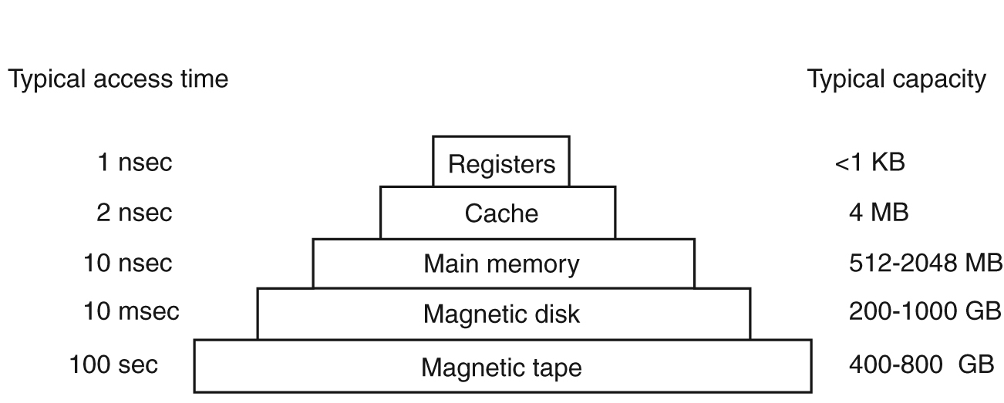
Recall from week one:
Memory Types (and Hierarchy)
Multiple memory types give balance of speed, size and cost but... adds to complexity
Notes:
L1 cache typically goes up to 256KB
L2 (Level 2) cache is slower than L1 cache, but bigger in size ~256KB to 8MB,
L3 can range between 4MB to upwards of 50MB
Some
Here is an abstract view of a memory hierarchy. You do not see mass storage devices or USB sticks or multi-level caches. It is the concept of hierarchy that counts here. The concepts covered here can actually be applied on the web. Think about the cache for your web browser and think that there is not only one layer of computers serving you on the internet, there is also a hierarchy of memory.
Registers
Are embedded into the CPU and are typically just as fast
Registers are managed by the program (even if the compiler made the final decisions)
Cache
Very fast but expensive memory
Potentially many “levels” of cache
Lives “near” CPU
Usually hardware controlled
Main memory is divided into cache lines (eg: 0-63; 64-127; etc)
Draw an example
When a program needs a bit of memory it looks to the cache first
If there, a cache hit!
If not, a miss-> Go to main memory
L1 – inside CPU 16 or 32 KB
L2 – 1 MB, may be built in or shared between multi-core systems
RAM
The work horse of the computer
Capacity is increasing very fast and cost is going down.
1990 $200 would buy 1-4Meg
Now - 16GB for less then $150
Magnetic Tape
Used for backup storage/large data sets
Since usually in storage, it must be loaded into a reader before access (human or robot performed)
Very slow but exceedingly cheap! (sequential access no seek).
Although the slide says 800 GB they now make tapes that are 4 TB. Many organization use tape backups

Slide 4
Main Memory Management
Recall from week one:
Multi-tasking implies multiple programs in memory simultaneously
Problems:
How to protect programs from one another
How to protect the kernel from programs
How to relocate programs
Notes:
Briefly describe main memory unit

Slide 5
Outline
Memory Management Overview
Basic Memory Management
No memory abstraction
May be referred to as Monoprogramming
Memory abstraction
Multiprogramming with fixed partitions
Swapping
Management via
Bitmaps
Linked Lists
Notes:
Keep in mind that mono programming is not a common term, you won’t find it in the text.
Running a single program at a time within a single address space

Slide 6
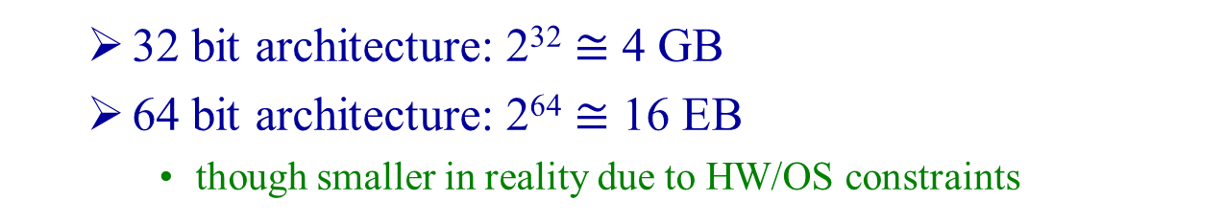
Memory Management Overview
Why do we need to manage memory?
How much memory is addressable for a program?
32 bit architecture: 2³² $≅$ 4 GB
64 bit architecture: 2⁶⁴ $≅$ 16 EB
though smaller in reality due to HW/OS constraints
What do operating systems do when they are running programs with memory requirements that exceed their capacity?
Part or all of the programs are swapped to disk
Notes:
For example, the common intel chip has 39 addressable bits (out of the 64) – but common boards may max out at 32 GB
2^39 = 549,755,813,888
1 Gb = 2^20
Divide and you get 2^9 or 512 Gb or 512/8 = 64 GB
Parkinson’s Law: The adage that "work expands so as to fill the time available for its completion". It is sometimes applied to the growth of bureaucracy in an organization.
It has numerous corollaries to apply to various situations like (some may be recognizable to your approach to academics): If you wait until the last minute, it only takes a minute to do. There are several such corollaries that are applicable to computer engineering:
Applications tend to consume all available bandwidth.
The volume of data tends to grow to fill storage capacity (one type of memory)
Software expands to use up system memory (relevant to our discussion here)
.

Slide 7
Memory Management Overview
Something is needed to manage the movement of programs between disk and memory (or, in general: to manage the memory hierarchy).
The part of the operating system that does this is known as the memory manager

Slide 8
Basic Memory Management
First consider two simple systems:
Monoprogramming
Multi-Programming with Fixed partitions
Once processes are loaded into memory they are run to completion
These methods do not involve memory abstraction
Physical memory is exposed
Programs address memory directly

Slide 9
Basic Memory Management
Monoprogramming without swapping or paging
Simplest scheme possible
Only one program will be executed at a time
The OS copies the program from disk to memory and executes it. Once finished, the OS is ready to accept a new command from the user
New commands overwrite the old program in memory with the new
Three configurations, see next slide

Slide 10
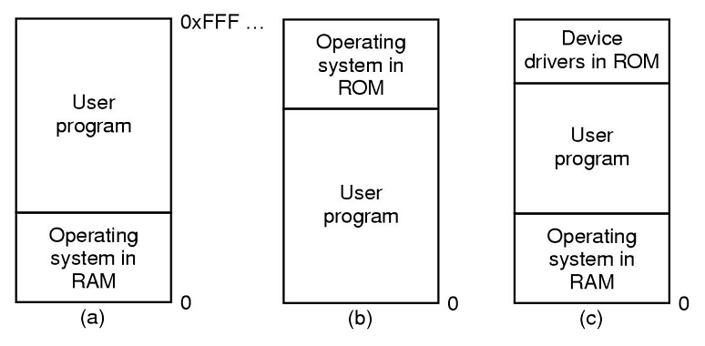
Basic Memory Management
a) is rarely used anymore
b) is in use by handheld computers, embedded devices
c) was the model of early PCs (e.g. DOS)
Notes:
Windows 3.1 was very much to DOS like my custom scheduler is to uC/OS-II
Note that for (c) that the device drivers in ROM is the BIOS (Basic Input Output System)

Slide 11
Basic Memory Management
Multiprogramming with fixed partitions
To get the benefits of multiprogramming we need to be able to have more than one program in memory at a time
Simple solution (for batch systems): divide memory into n (possibly unequal) partitions, and put arriving jobs into the smallest partition that will hold them (or in line for that partition)
Disadvantage: since partitions are fixed, any space not used by a process is a wasted resource

Slide 12
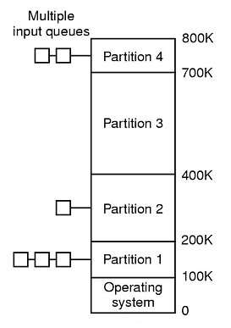
Basic Memory Management
Image shows another disadvantage:
Since we use multiple queues
There may be lineups for some partitions, and
Some partitions may go unused
A single queue usually provides superior service

Slide 13
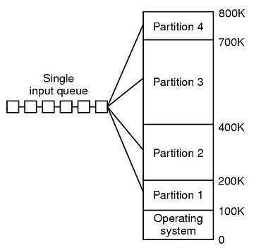
Basic Memory Management
Many strategies for choosing jobs:
Allow job closest to the front that can fit into the free partition to run
Search the whole input queue for the largest job that fits
Must keep one small partition so small jobs get to run
Notes:
That last point is important: if you always that the largest job that fits then you are discriminating against the smaller jobs....they may NEVER get to run.
Another way out of the situation would be to allow a process to be skipped over only k times and mark it each time it is skipped.
Few, if any OSs use this model for multiprogramming anymore.

Slide 14
Memory abstraction
Exposing memory directly to program has several drawbacks
Accidental or intentional damage to OS
Lack of efficiency
Notion of address space
Processes view of memory is an abstract memory space
Provides more flexibility for OS to manage memory across applications
Swapping
Virtual memory (next class)

Slide 15
Swapping
The previous systems were simpler because once programs were loaded into memory they were left to run to completion
In a timesharing system we can’t choose how many processes we keep in memory to keep the CPU busy
users largely dictate the number of processes that are executing
When not enough main memory exists to hold all the active processes we must swap them between the disk and main memory
Notes:
One solution we’ll see today is called swapping because we’ll be moving entire processes into and out of memory.
Next class we’ll see virtual memory, which will solve the problem in a superior, but more complicated, way.

Slide 16
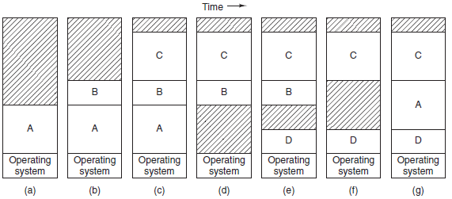
Swapping
Swapping a process consists of bringing the process into memory, from disk, in its entirety. The process is executed for some time and then placed back on the disk
Notes:
Initially, only process A is in memory.
Then processes B and C are created or swapped in from disk.
In Fig. 3-4(d) A is swapped out to disk. Then D comes in and B goes out.
Finally A comes in again. Since A is now at a different location, addresses contained in it must be relocated, either by software when it is swapped in or (more likely) by hardware during program execution.

Slide 17
Swapping
The difference between this system and fixed partitions is that the number, location, and size of the partitions vary dynamically
Advantages:
This is a much more flexible solution
Memory can be better utilized
Disadvantages:
More complicated to implement
“holes” can be left in memory which may need compacting to correct
Notes:
Note about the compaction: on a machine with 256MB that can copy 4 Bytes in 40ns, it would require about 2.7s to compact the memory
We will not study how holes are dealt with in this course.
Compaction – moving the holes downward as far as possible

Slide 18
Swapping – How much memory
How much memory should be assigned to a process when it’s swapped into memory?
If a fixed data size can be determined, then exactly that much is used
However, if the process has a growing stack and heap, then room for growth will be required to prevent having to continually move the program around in memory

Slide 19
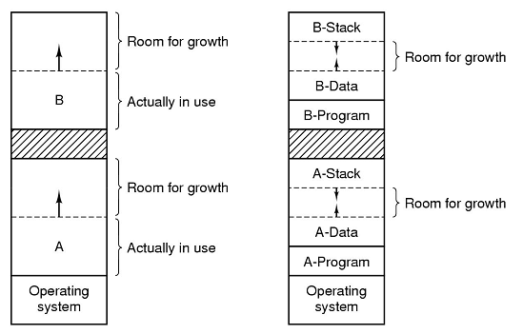
Swapping – How much memory
Allocating growth for data segment
Allocating growth for stack and data segment (heap)
Notes:
Recall from week one, the 3 main segments:
Text – executable instructions
Data – variables
Stack – normal local variables, return addresses, etc
Then we had the heap – dynamically allocated and released memory
Note that if the growth area runs out then the process will have to swapped to another location in memory or to the disk until a large enough space can be created.

Slide 20
Swapping - Management
How do we keep track of where processes are loaded and where space is available to load them?
Two methods:
Bitmaps
Linked Lists

Slide 21
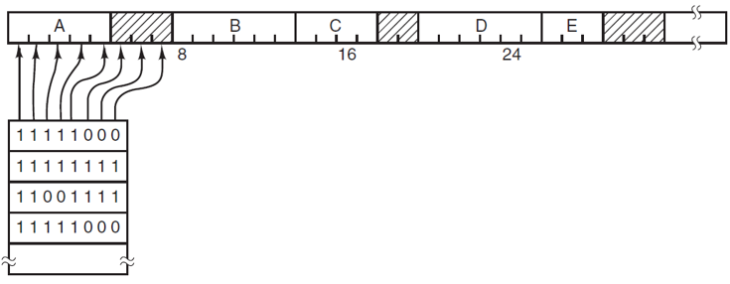
Swapping - Management
Memory management with Bitmaps:
Divide memory up into allocation “units” such as 4 bytes or up to many kilobytes
Use a bitmap with 1s to designate an allocated area of memory and 0s to represent free space
Next question, what size do we make the allocation unit?

Slide 22
Swapping - Management
Memory management with Bitmaps:
The smaller the allocation unit, the larger the corresponding bitmap, consider a 32 bit allocation unit
Memory of 32n bits will use n map bits, so bit map will only use of 1/32 of the memory
Or – one bit in the bit map for every 32 bit allocation unit
Larger units stand to waste the end of the last unit
Consider a 64KB unit, if we have a program that is 65KB, then we waste 63 kilobytes
However, we greatly reduced the bitmap size

Slide 23
Swapping - Management
Memory management with Bitmaps:
Advantages:
Easy to implement
Bitmap is a fixed size no matter how many programs are in memory
Disadvantage
can take a long time to search through the bitmap to find a consecutive series of 0’s in which to place a program

Slide 24
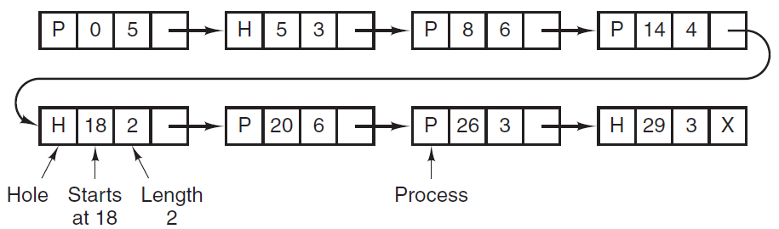
Swapping - Management
Memory management with linked lists:
Use a linked list to keep track of “segments”
Segments are either processes or a hole between two processes
Convenient to sort by addresses
Advantage: much less to search through
Notes:
Note how the list is sorted by the address at which the segment begins (“Starts at...”)

Slide 25
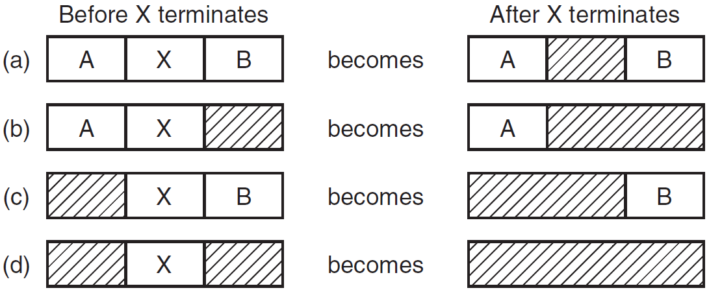
Swapping - Management
How do we use the linked list to manage processes leaving memory?
Simply combine the new hole with all adjacent holes:

Slide 26
Swapping - Management
How are new processes placed into memory?
First Fit – Find the first empty segment that is large enough to hold the process and break it into a process segment and a new hole (smaller than the previous one)
Next fit – Simple improvement on first fit. Denote the place where the last program was inserted and start looking from there
Research shows this gives slightly worse performance than first fit
Best Fit - Search entire list, find smallest hole that is adequate
Slower then first fit
Also wastes more space then First Fit and Next Fit as it creates numerous, tiny holes

Slide 27
Swapping - Management
How are new processes placed into memory?
Worst fit – Instead of taking a near fit and breaking it into a process segment and a very tiny, unusable hole, find the largest available hole to leave maximum space for other processes
Simulation has shown this to be a truly awful choice
Quick fit – Keep common entries such as 4KB, 8KB, etc in a separate table for easy hole location
Good for allocation, but slower for de-allocation as multiple lists must be reconciled

Slide 28
Swapping - Management
Final note on lists: you could keep separate lists for processes and holes
Speeds up looking for a hole
Allows one to sort holes by size for even quicker allocation!!
Lets one use the actual memory holes themselves to hold the pointer information from one hole to the next
More complicated on de-allocation as your memory has to be placed in the correct spot on the other list

Slide 29
Virtual Memory I

