Slide 1
EEE 335 Principles of Operating Systems
Virtual Memory I
(Modern Operating Systems 3.3)

Slide 2
Quick Review
What are the two methods used to keep track of what sections of memory are in use (allocated/unallocated) when swapping processes in and out of memory
Notes:
How do we keep track:
Bitmap for each “unit” of memory
Linked list keeping track of each segment of used/free memory

Slide 3
Outline
Virtual Memory background and terminology
Paging
Page Tables
Notes:
Recall our previous discussion on Parkinson’s law and the corollary relevant to computer memory.

Slide 4
Background
Recall that, in general, we will compile programs relative to address zero and addresses get mapped during execution
This remapping will be performed by a piece of hardware known as the Memory Management Unit (MMU)
The MMU will take addresses from the process and transform them into the actual address in RAM
Notes:
Memory Management Unit maps 0-based local addresses inside processes to physical real addresses in RAM.
Recall from 420…..

Slide 5
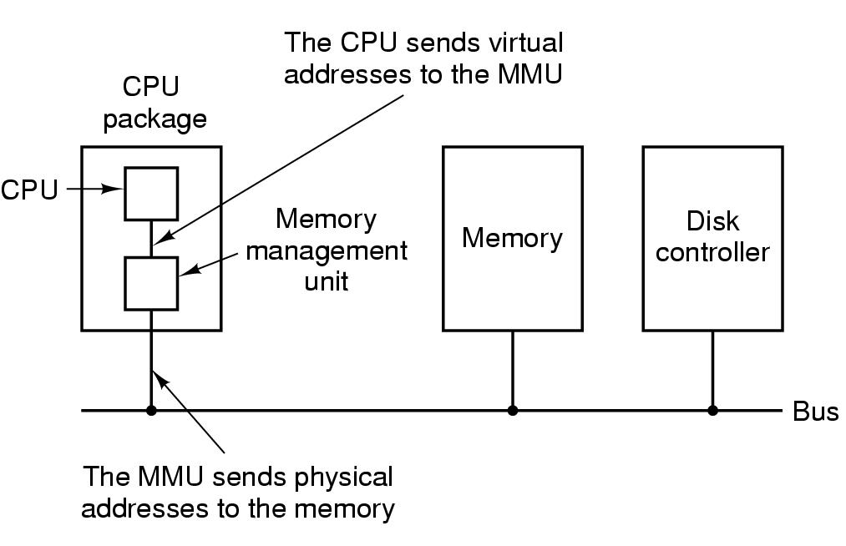
Background
Addresses provided to the MMU will be known as virtual addresses or logical addresses
These terms will be used interchangeably
The MMU will produce a physical address
The physical address is an address in RAM
Notes:
MMU is “part” of the CPU package.
MMU will decide which memory to access (RAM or Hard drive).
A request from the CPU (the processes logical “virtual” address) will result in a different physical address being put on the bus for access (either RAM or HD).

Slide 6
Background
Our use of swapping has allowed us to place multiple programs into memory concurrently, but has not addressed the problem of a program too large for memory
The solution that arose is known as virtual memory. The idea is that we will keep part of the program in memory and part on the disk
Now a 10GB program can be run on a computer with only 8GB of RAM
Notes:
The concept of the virtual memory. Take part of the hard disk as a RAM. The program will be loaded partially in RAM and Hard Disk.
This will allow too large programs to run or too many simultaneous processes to run.

Slide 7
Paging
Processes believe they can access the entire memory provided to them based on the number of address lines in the hardware
For a 32bit system, this is 2³², or 4GB
This is known as the virtual address space
“Sections” of virtual memory that can be moved between disk and physical memory are called pages
The corresponding physical page is a Page Frame
Pages and Page Frames are generally the same size
Though processors can support multiple page sizes
Transfers between RAM and disk are always in whole pages
Notes:
The concept of paging
Virtual Pages (virtual address space) vs. Page Frames (real physical memory)

Slide 8
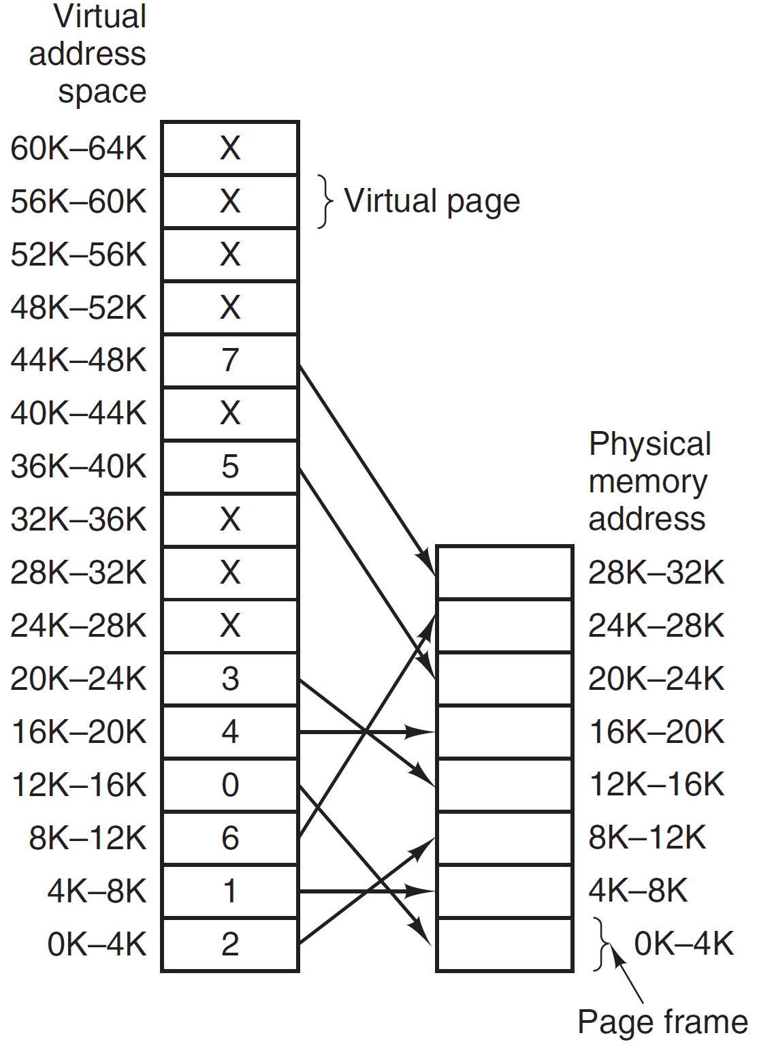
Paging
Consider a system with
64KB of virtual address space
32KB of RAM
The MMU maps virtual addresses used by the CPU into physical addresses which are put onto the bus
X means not mapped
Notes:
The pages are mapped as illustrated in this figure. This mapping is saved in “Page Table”
So, a reference to address 8192 (the first byte in 8K-12K) is transformed into 24,576 (the first byte in the 24K-28K page frame)? How ?
How big was the virtual address space: 64KB or 2^16
How big was the physical memory space: 32KB or 2^15
0K–4K ->0 to 4095
4K–8K ->4096 to 8191
Example:
mov, reg 8192 this is virtual page 2
Maps to 24-28K, which is

Slide 9
Paging
Virtual memory not mapped (X) means that the page is not in memory.
Referencing a virtual page that is not mapped in memory causes CPU to trap the operating system
This is known as a Page Fault
When this happens the OS loads the new page into a page frame (possibly evicting a page frame already in use) and updates the MMU with the new information
The place where this information is stored is known as a Page Table
Notes:
The concept of page fault. It happens when the MMU finds that the virtual page is unmapped which means it does not exit in the RAM. It must be loaded. In this case, a TRAP will be executed and the page will be loaded to RAM.
This mapping is saved in “Page Table”

Slide 10
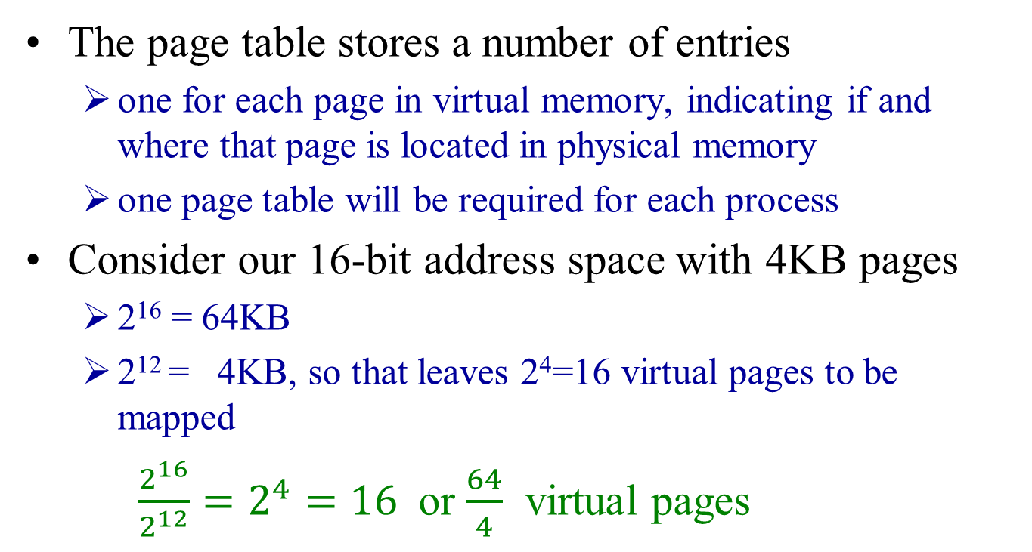
Page Tables
The page table stores a number of entries
one for each page in virtual memory, indicating if and where that page is located in physical memory
one page table will be required for each process
Consider our 16-bit address space with 4KB pages
2¹⁶ = 64KB
2¹² = 4KB, so that leaves 2⁴=16 virtual pages to be mapped
$\frac{2^{16}}{2^{12}}=2^{4}=16$or $\frac{64}{4}$ virtual pages
Now lets consider a specific virtual page address (8196 or 0010000000000100) and see how the page table maps this to a page frame
Notes:
The purpose of the page table is to map virtual pages to page frames. Before getting to the example a key point about virtual addresses is that it is split into:
Virtual address (higher order bits)
Offset (lower order bits)
So how many bits do we need to specify 16 different pages? 4, that leaves us 12 bits for the offset. Is that a useful number? 2^12 =4096, the size of our page and lets us address offsets from 0 to 4095 bytes.

Slide 11
Page Tables (Example)
page number
offset
4 bits | 12 bits
0010 | 000000000100
Incoming Virtual Address
8,196 or 0x2004
PAGE TABLE
0
1
2
3
4
5
6
7
8
9
A
B
C
D
E
F
0
0
0
0
0
0
0
0
0
0
0
0
0
0
0
present/absent bit
110
1
Each row is a page table entry
3 bits | 12 bits
Outgoing Physical Address
24,580 or 0x6004
110
000000000100
Notes:
In more details, let’s see how 8196 is transformed into physical 15 bit address.
Note how it works. They won’t have the important numbers filled in on their slides. Get them to follow the steps. Explain the Present bit, which is a good intro to the next slide on what is in a page table entry.
Refer back to the original diagram on page 8:
How big was the virtual address space: 64KB or 2^16
How big was the physical memory space: 32KB or 2^15
Note that the example in the book is upside down relative to this.
Page Number: With 4 bits, how many pages numbers can be have? 16 -> good, because we have 16 virtual pages that we need to map
Offset: 12 bits, how many bytes can we address in the page

Slide 12
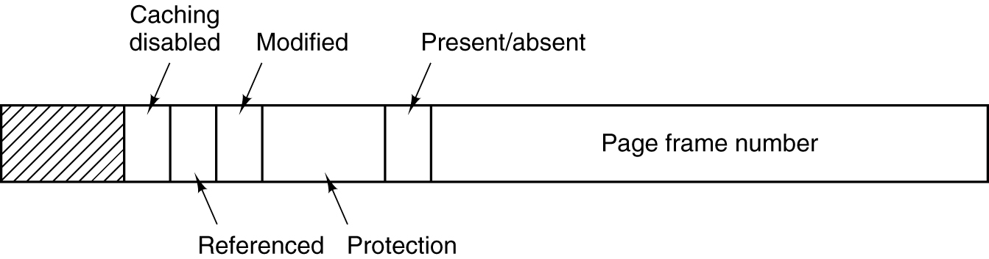
Page Tables
Page frame number: indicates where the page frame is in physical memory
Present bit: entry is valid (also called the valid bit)
Protection bit: normally 3 bits, rwx
Modified bit: if a page has been modified (dirty) it must be written back to disk, if not (clean) the page frame can be reclaimed as the disk copy is still valid, often referred to as the dirty bit
Notes:
Entry Structure of Page Tables
-page frame number
-present / absent
1 means the entry is valid and can be used
0 means the virtual page to which the entry belongs is currently not in physical memory -> results in a page fault
-Modified (written to before) – this is to reflect changes to HD when swapping
-Used (referenced),, if nobody needs it, it can be evicted

Slide 13
Page Tables
Referenced bit: helps us decide on which page to swap out (we’ll see more of that on page replacement algorithms), essentially it means that if a page hasn’t been referenced in a while, it is a good candidate to evict when a page fault occurs
Caching Disabled bit – used to indicate that references to this page should always come from memory, not the cache (used when device registers are mapped to memory)
Notes:
Entry Structure of Page Tables
-page frame number
-present / absent
-Modified (written to before) – this is to reflect changes to HD when swapping
-Used (referenced),, if nobody needs it, it can be evicted

Slide 14
Page Tables - Challenges
Two challenges:
Translation from virtual to physical address must be fast
If the address space is large, the page table will be large
The first problem is related to the fact that if an instruction refers to a memory address, the translation time should not be greater than a certain percentage of the execution time.
For example, for a 1 ns execution time, the translation time should not be greater than 0.2 ns
Notes:
Page Table can be extremely large if the virtual address is large
Example: 32-bit virtual address space with 4KB page size, we have 2³² divided by 2¹² = 2²⁰ almost one million entries.
MMU inside the CPU is fast but space is limited

Slide 15
Page Tables - Challenges
The second problem is related to the fact that a 32 bits address space with 4 KB pages requires more than a million entries in the page table
Each process has a page table because each has its own virtual address space
If each entry has 32 bits, the table for only one process is 4 MB.
Now, if we have a 64 bits address space, each table becomes really big (2⁵² entries = 4.50x10¹⁵ entries)
Two possible solutions (for now):
Loading the process’ page table into registers each time it is run
Run process table in main memory
Notes:
1 kb = 2^10 bytes
4 kb =2^2*2^10=2^12 bytes
32 bits= 2^32 memory entry (4 Go)
2^32 mem entry/ 4 kb = 2^32/2^12=2^20 = 1,048,576 page table entry
show how this is calculated: 2³² divided by 2¹² to give 2²⁰
Now show them how large an entry is with what was drawn on the blackboard as a guide. 20 bits for the page in memory. 5 other bits for information. Plus some for the disk address (if required) puts it from 32 to 64 bits for each entry!

Slide 16

An (but related) aside: recall /proc
Start an instance of vi, use ps to determine its pid
View the maps file for this pid value
logical address permissions offset device inode path
Using the virtual address starting address, one can access the pagemap_entry struct details within /proc/<id>/pagemap and /proc/kpageflags to determine actual physical address
One could also use the pmap utility to get information regarding logical memory details regarding a specific pid
Notes:
Text – readable and executable, makes sense
Data – data is readable
bss – rw - The BSS segment, also known as uninitialized data, is usually adjacent to the data segment. The BSS segment contains all global variables and static variables that are initialized to zero or do not have explicit initialization in source code.

Slide 17
Quiz
What information should be kept in the page table entries?
For a 16-bit system with 512-byte pages, how many entries do we have in the page table?
What is 2¹⁰? Ok, 2²⁰? Good numbers to know.
Notes:
What information do we need to store in a page table entry?
The page frame in memory where it’s located
Bits: Present, Dirty, Used, Caching disabled, protection
For a 16 bit system with 512Byte pages, how many entries do we have in the page table?
512 is 2⁹
So, 2¹⁶ divided by 2⁹ is 2⁷=128
2¹⁰ - 1024 bytes 1 KB
2¹² - 4096 bytes
2¹⁵ - 32768 bytes
2²⁰ - 1048576 bytes 1 MB
2²⁰? Good numbers to know

Slide 18
Virtual Memory II

