Slide 1
EEE 335 Principles of Operating Systems
Virtual Memory II
(Modern Operating Systems 3.3)

Slide 2
Quick Review
What part of the hardware converts logical addresses to physical ones?
What is it called when a TRAP is made to the OS because a page is not in physical memory?
Notes:
The MMU
A Page Fault

Slide 3
Outline
Multi-Level Page Tables
The Translation Lookaside Buffer
Inverted Page Tables

Slide 4
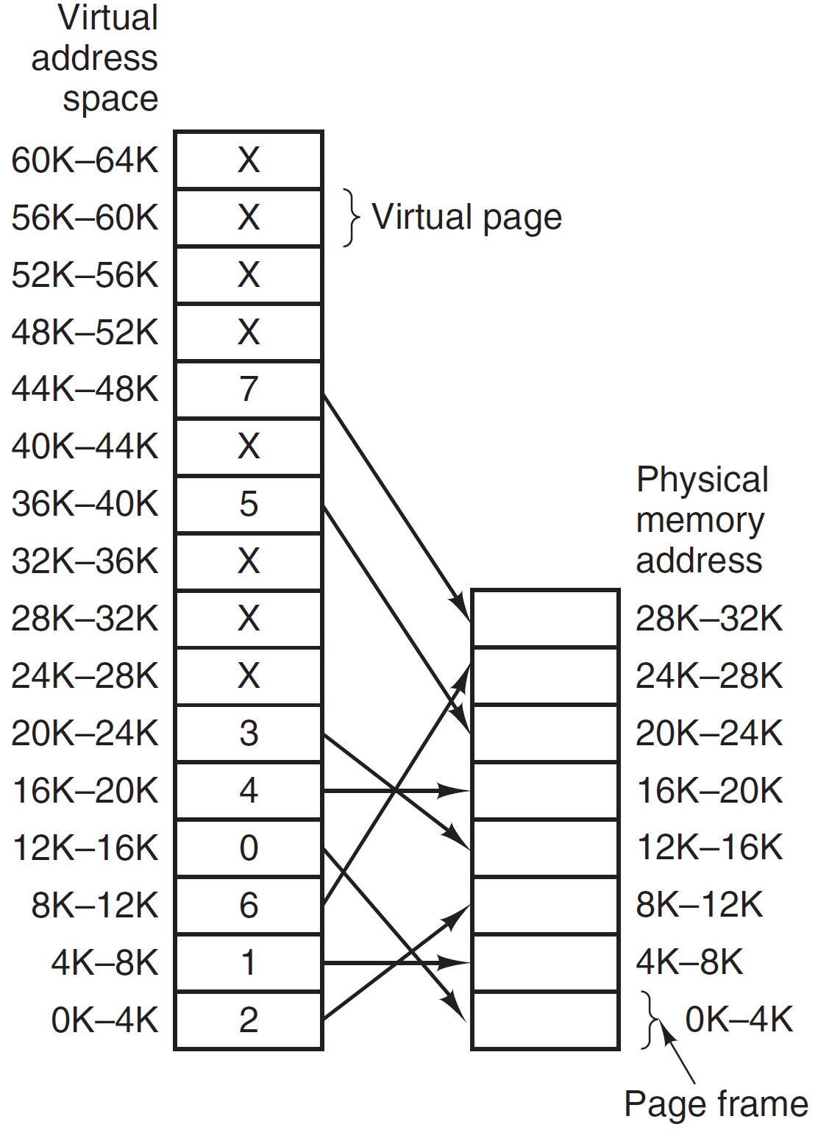
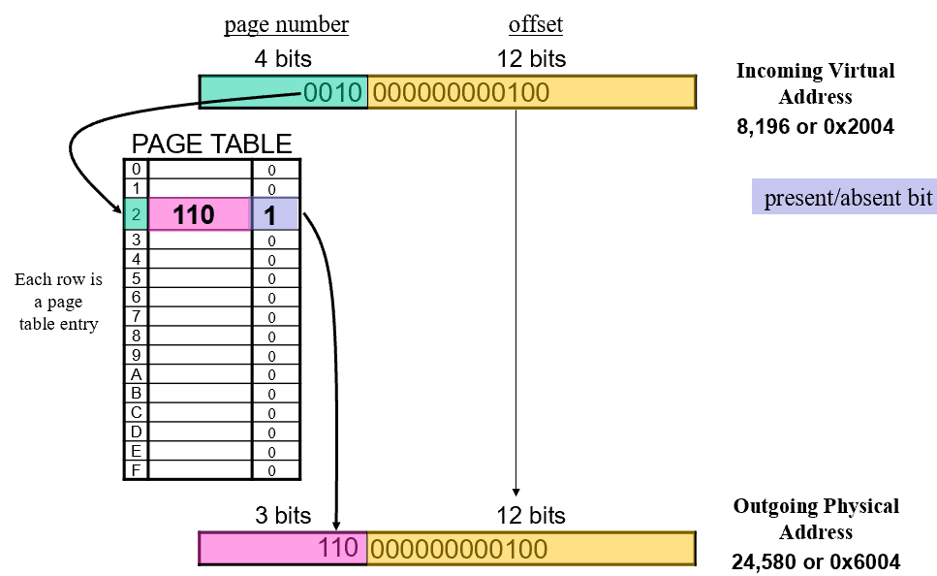
Recall: Paging
Page Frame Number
7
6
5
4
3
2
1
0
Notes:
What happens with a 32 bit address?
For a 4KB page frame there are 2²⁰=1M pages...far too many to keep in memory
Moreover, one page frame set is needed for each process!!!
Recall the two challenges mentioned last class:
Mapping between virtual and main memory must be fast; and
Dealing with large page tables sizes
For the speed challenge, there has been a lot of work and research into optimizing the best way to implement pages tables that focus on a balance of two extremes – having the entire page table for each process in registers or having the entire page table only in main memory. Given the large size of page tables, especially on 32 and 64 bit systems

Slide 5
Paging
With systems that have 32 bit addressing or greater, pages tables cannot be kept in registers
Unless, of course, we use very large pages
But, many programs won’t need their entire address space
They’ll need their text, stack, and heap, but there would still be large, unused amount of page table information
In addition, it has been observed that most programs make a large number of references to a small number of pages – only a fraction of the pages table entries are heavily used
Why not leave that unused space elsewhere... like on the disk?
This is reasonable given the large amount of disk space available in common systems
Notes:
What happens with a 32 bit address?
For a 4KB page frame there are 2²⁰=1M pages...far too many to keep in memory
Moreover, one page frame set is needed for each process!!!
Recall the two challenges mentioned last class:
Mapping between virtual and main memory must be fast; and
Dealing with large page tables sizes
For the speed challenge, there has been a lot of work and research into optimizing the best way to implement pages tables that focus on a balance of two extremes – having the entire page table for each process in registers or having the entire page table only in main memory.

Slide 6
Multi-Level Page Tables
However, to keep part of the page table on the disk, it must be broken up into parts.
Solution: page the page table
Example: 32 bit address, 4KB pages
Requires 2²⁰ entries in the page table
Break the page table into one directory page of 1024 entries and 1024 entries on each of the sub-pages (still one million entries total)
Notes:
Must be broken up into parts so that the table can be paged in memory itself and swapped like any other page in memory.

Slide 7
10 bits | 10 bits | 12 bits
PT1 | PT2 | Offset
DIRECTORY
1024 Entries
1024 Entries
1024 Page Tables
20 bits | 12 bits
Page Frame | Offset
Notes:
PTR is a page table register for this process
The directory is called such just so we don’t get its index confused with the page index.
Draw the other lines with the pen (ctrl-p) demonstrating how each entry from the directory points to a page of page table entries and from there how each one points to a page in memory (well, they can, as long as they have a “present” bit.
So why does it take Windows so frickin’ long to load? Page table creation is one of the culprits...

Slide 8
Multi-Level Page Table
Consider virtual address: 0x00403004
PT3 – 10 bits
PT2 – 10 bits
Offset – 12 bits
0000 0000 0100 0000 0011 0000 0000 0100
Directory 1
Page Table Entry 3
Offset = 4
MMU goes to the directory to determine which page table to reference
Looks at entry one, which points to the second level page table that maps 4-8 MB range
It PT2, to determine the page table entry → 3
This entry points to the page frame, offset is applied to get specific main memory address

Slide 9
Multi-Level Page Tables
This example had only two levels, but you can have as many as you need to keep the size of your page tables reasonable
By having page tables no larger than the size of pages in memory, the page tables can themselves be swapped to the disk
At a minimum, only the first level page (PT1) and one second level index page (PT2) need to be kept in memory, greatly reducing our demands
Useful to have a PT2 level page for the text, data and stack segments
However, this still comes at a cost...
Notes:
Ask them what the cost is:
The cost is the time required to get a page into memory on a fault of one of the page tables
Must go to the directory page, then see that the required page table is missing, TRAP to the OS, have the page loaded into memory, then look up the page we want, if it’s not in memory, have the OS load it in and update the page table
Very time consuming!

Slide 10
Half an illusion...
The whole point of virtual memory is to create the illusion that we have significantly more RAM than we actually do
So far we have tricked the process into thinking the memory is large, but with many levels of indirection and disk access it is very slow
To complete the illusion, we need to reduce the amount of time required to identify where a page is in RAM
Notes:
By slow, what I mean is that if going to memory one takes a certain number of nanoseconds, but we have to go through 2,3, or 4 levels of indirection to look up a page we have doubled, tripled, or quadrupled our search time through page tables!!! Then, if you have a page fault you are really screwed.

Slide 11
Translation Lookaside Buffer(TLB)
However, recall that programs execute with many loops inside the same code
This results in programs making a large number of references to a small number of pages
If we keep a list of the most recently accessed pages in memory (similar to the idea of cache) then we can greatly reduce the amount of searching through page tables
This list is kept in the Translation Lookaside Buffer
Sometimes referred to as associative memory

Slide 12
Translation Lookaside Buffer(TLB)
TLB is normally within the MMU
Small number of entries
When a virtual address requires translating, the MMU first searches the TLB
If present in physical memory, the result pops out very quickly
If the address is not in the TLB, a normal page table look-up is conducted
Common implementation is to then add this page to the TLB, evicting another entry
Notes:
TLB is inside the MMU
Consists of a small number of entries, rarely more than 256
Contains info like the virtual page number, modified bit, protection bit, page frame
For example the Intel® Core™ i7-6700 processor has two levels of TLBs:
First level
TLBs for data can map 1-GB sets of contiguous pages (4-way set associative, 4 entries) or 4-KB pages (4-way set associative, 64 entries)
TLBs for instructions can map 4-KB pages (8-way set associative, 64 entries)
Second level has TLBs for both data and instructions and can map either 4-KB or 2-MB pages (6-way associative, 1536 entries) and 1-GB pages (4-way associative, 16 entries)

Slide 13
CPU
Logical Address
Virtual Page | Offset
Physical
Memory
Page Number | Frame Number
TLB Hit
Physical Address
Page Frame | Offset
TLB
Page Table(s)
Notes:
So, we check to see if the virtual page has been accessed recently. If it has (and is still valid) we have our page frame/physical address immediately. If not, we let the search through the page tables complete. If that gives us the physical address, great. If not, page fault!

Slide 14
Translation Lookaside Buffer(TLB)
What is in the TLB?
To avoid having to search main memory, it includes the same information that is normally in the page table (page frame address, present bit, dirty bit, etc...)
Virtual page number is also included
How well does it work?
On computers with 32 entry TLBs, 98% hit rates and greater are obtainable (depending on the system)

Slide 15
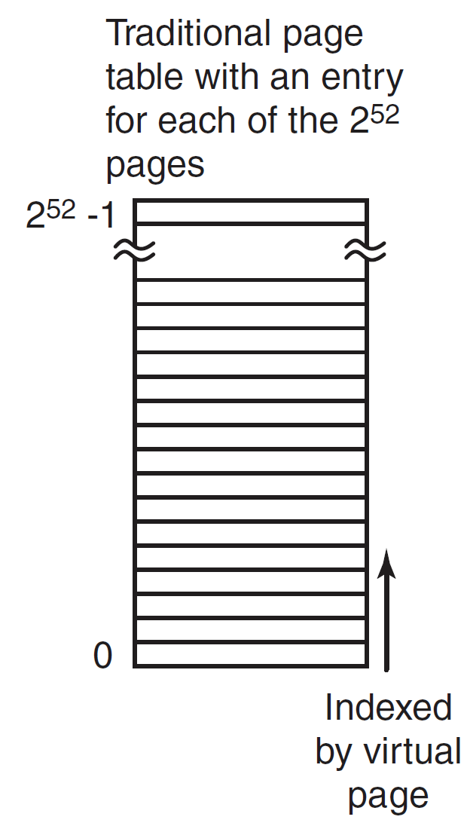
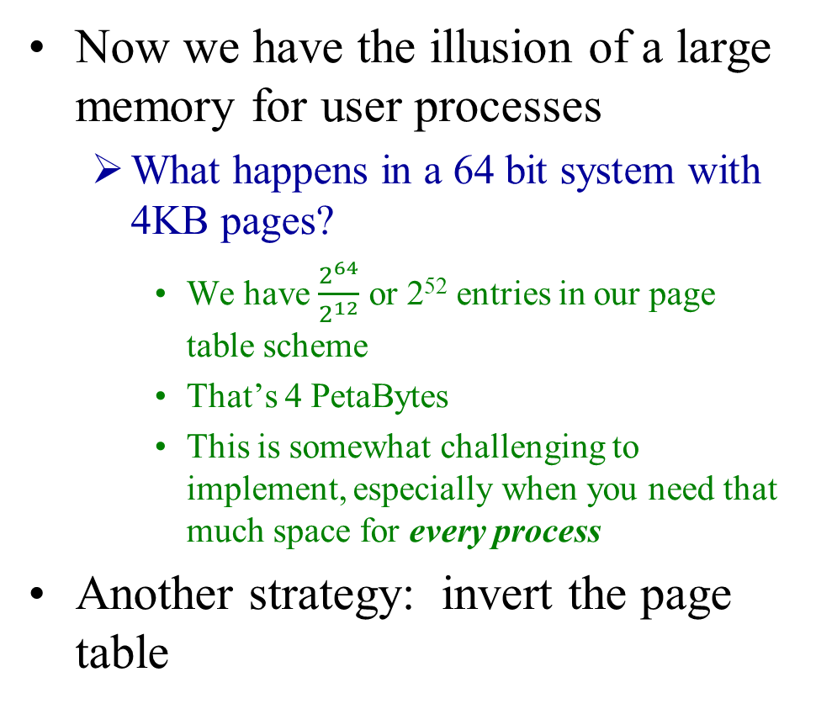
What about larger memory?
Now we have the illusion of a large memory for user processes
What happens in a 64 bit system with 4KB pages?
We have $\frac{2^{64}}{2^{12}}$ or 2⁵² entries in our page table scheme
That’s 4 PetaBytes
This is somewhat challenging to implement, especially when you need that much space for every process
Another strategy: invert the page table

Slide 16
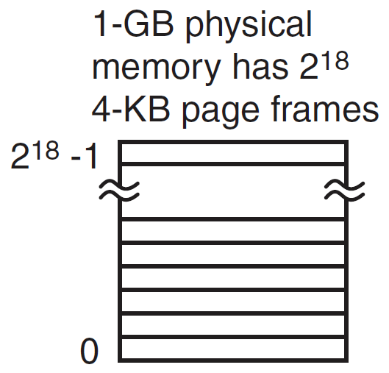
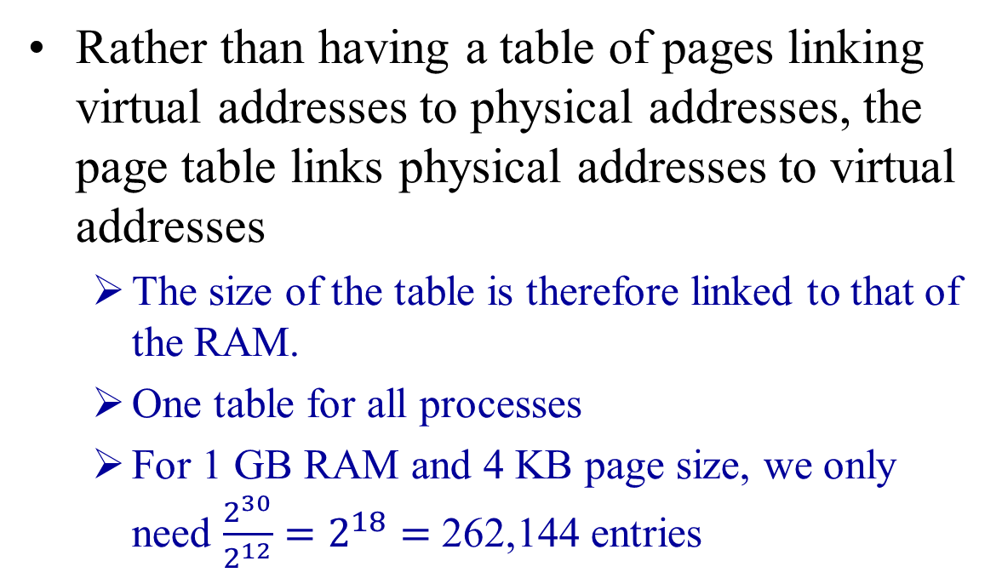
Inverted Page Tables
Rather than having a table of pages linking virtual addresses to physical addresses, the page table links physical addresses to virtual addresses
The size of the table is therefore linked to that of the RAM.
One table for all processes
For 1 GB RAM and 4 KB page size, we only need $\frac{2^{30}}{2^{12}}=2^{18}=$ 262,144 entries
Notes:
Even with 8 GB RAM,
2^30 X 2^3 = 2^33
2^33 / 2^12 = 2^21 = 2,097,152

Slide 17
Inverted Page Tables
Problem with an Inverted Page Table:
The translation from a virtual to physical address is much more difficult
The virtual page address is no longer an index into the table.
Instead, every entry in the Inverted Page Table must be checked to see if some physical page frame is holding the virtual page

Slide 18
Searching Inverted Page Tables
Recall that with page tables, an index was used
With inverted page tables, the entire table must be searched
PID | Virtual Page | Offset
1 | 2 | F00
Each page frame must be searched to find the matching PID and virtual page number
This must be done for every memory reference which is slow
Index FFFFF … 12FFB 12FFA … 00000 | PID | Virtual Page
 | 2 | 15
 | 1 | 2
 | 4 | 1
 | 2 | 13
Physical Page | Offset
12FFB | F00
Inverted Page Table

Slide 19
Inverted Page Tables
Solutions
A sufficiently accurate TLB will reduce the requirement for searching the table drastically
If there is a TLB miss, then the inverted page table needs to be searched
To speed this up, another modification to use a hash table
Needs to include an index for all virtual pages currently in memory across all processes
The simplest implementation is to use the virtual page number as the hash index
The index maps to the page frame number
Collisions may occur for virtual pages common across multiple processes in memory
In such cases, the associated index in the hash table points to a linked list
Notes:
Worst case scenario: Every process you are running has the same virtual page in memory at the same time. This would mean that all the physical page entries would be on the single entry in the hash table. Not likely, but possible. Then again, who is going to be running 64K processes?

Slide 20
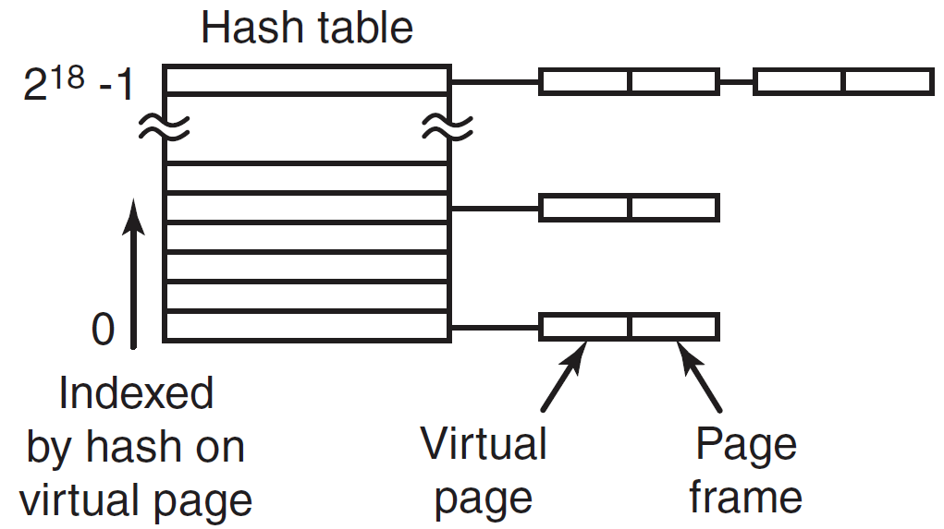
Inverted Page Tables
Hash table collisions – linked lists
Each entry in the linked list is searched to find the corresponding page frame for the given PID
Other variations include
The index based on a hash of the PID and virtual page number, not just the virtual page number
Same use of linked list for any collisions

Slide 21
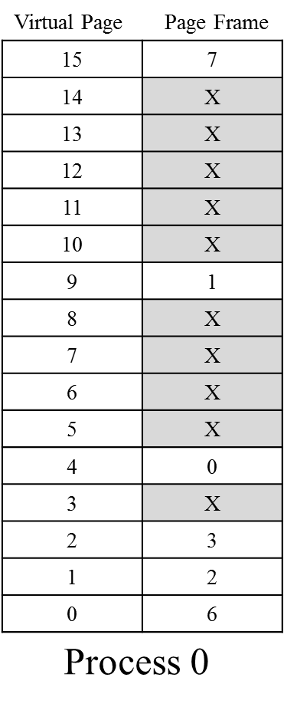
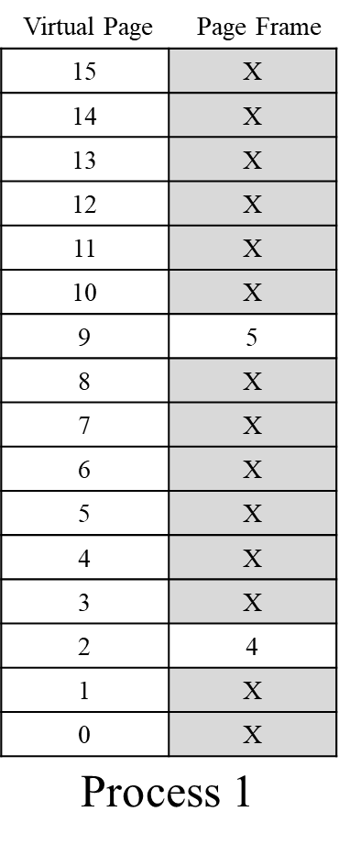
Hash Table – Simple Example
Consider two processes
Use 2 LSB as hash index
Virtual Page | Binary
15 | 1111
9 | 1001
4 | 0100
2 | 0010
1 | 0001
0 | 0000
11
10
01
00
0 | 15 | 7
0 | 2 | 3
1 | 2 | 4
0 | 1 | 2
0 | 9 | 1
1 | 9 | 5
0 | 0 | 6
0 | 4 | 0
PID
VPN
FPN
Notes:
Process 0 Process 1
Virtual page Binary Virtual Page Binary
1111
9 1001. 9 1101
4 0100. 4 0100
2 0010
1 0001
0 0000

Slide 22
Quiz Time!
Questions?
Notes:
What is the advantage to multi-level page tables?
The let us keep most of the page table on disk
What is the TLB used for?

Slide 23
Page Replacement Algorithms I

