Slide 1
EEE 335 Principles of Operating Systems
Page Replacement Algorithms I
(Modern Operating Systems 3.4)

Slide 2
Quick Review
What is the problem that multi-level page tables solve?
In a TLB, what kind of memory is required to look up the page frame of a physical address quickly?
For systems with very, very large virtual address spaces, what is our solution to the overwhelming size of the page table?
Notes:
The solve the problem of a page table that gets too large.
The memory is known as associative memory. It compares your key to all entries simultaneously and outputs the one entry that matches that key, if any.
The solution to the overwhelming size of the page table is the Inverted Page Table where we track only the physical addresses mapped to their virtual counterparts.

Slide 3
Outline
Review of paging and page faults
The need for page replacement algorithms
Page replacement algorithms
Optimal
Not Recently Used
First-In, First-Out (FIFO)
Second-Chance
Clock
Least Recently Used

Slide 4
Paging: short review
Recall: paging schemes follow a set of rules:
They allow a process to be loaded into memory one page at a time
They have some sort of table that denotes which virtual pages are in memory and the specific page frame in which they reside
When pages are requested that are not in physical memory, a page fault is generated
The OS must now load the requested page into memory
If there are no free page frames, a page frame must be evicted
Which one is evicted/removed?
The key question driving the need for page replacement algorithms
Notes:
Some considerations:
Do we pick a page from the same process or a different one?
Has the page been modified lately, if so, when was it last written to disk (if its already been written to disk, then it can just be overwritten)
How long ago was the page last used?
What about just picking one at random?

Slide 5
Page Replacement Algorithms
A set of algorithms exist which can be used to choose which page is the best candidate for eviction
Considerations:
Pages that have been modified will have to be written to the disk before eviction
Use of state information such as the modified and used bits will be helpful in making this decision
These algorithms are applicable to other areas of research: cache, web servers, etc...
Notes:
Obviously, we could choose a page at random, but we want good performance out of our system. By evicting a page at random we might find that we need that very page on our next memory reference.
Web server pages in memory cache

Slide 6
Optimal
The Optimal Page Replacement Algorithm
Theoretical algorithm which represents the absolute, without-a-doubt, best choice we could make for page eviction
Label each page frame with the number of instructions until it will next be required
Evict the page with the highest label
Essentially, kick out the page that won’t be needed for the longest time based on the pages in memory at the moment of decision
Notes:
I say to kick out the page that won’t be needed for the longest time based on the pages in memory at the moment of decision since the page you load in may not be needed ever again...but you can’t evict it yet, can you?

Slide 7
Optimal
The Optimal Page Replacement Algorithm
Can this algorithm be realistically implemented?
Absolutely not. Not possible to determine when every page would be needed in the future based on the current state
Recall shortest job first scheduling algorithm
Moreover, user input means that the future is unpredictable
However, if a program is run once for a particular set of inputs, it is possible to keep track of what pages were required and in what order
This record can be used as a benchmark to compare how close realizable algorithms come to the optimal
Keep in mind, this is only for a specific program with a specific set of inputs
Notes:
Then, if an algorithm we test for a particular system/program type comes within 1% of the optimal algorithm we know that no matter how much effort is put into improving the algorithm, the maximum gain we can hope for is a mere 1%. Time to go on to something else.
Can be used for testing, but no practical implementations

Slide 8
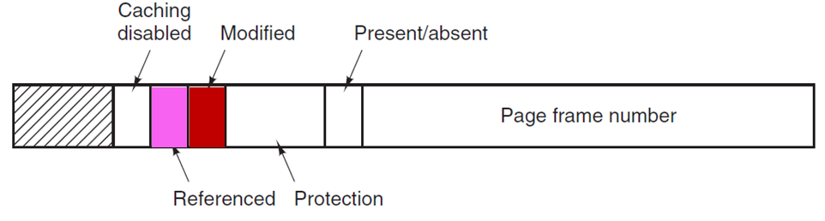
Not Recently Used
The Not Recently Used (NRU) Page Replacement Algorithm (PRA)
This algorithm uses the modified or M (dirty) bit and referenced or R (used) bit to determine the best candidate for removal
The hardware must update these bits (if required) on every memory reference and will be cleared only by the operating system
The referenced bit will be cleared periodically (e.g. each clock interrupt)
The modified bit is not cleared until the page is written back to the disk
Notes:
ie: if the page is referenced, the hardware sets the “used” bit. If the page is written to, the hardware sets the “used’ and “dirty” bits.
R bit is set every time the page is referenced (read or written to)
M bit is set when written to

Slide 9
Not Recently Used
The Not Recently Used PRA
When a page fault occurs, the OS inspects all page frames and divides them into four categories:
Class 0: not referenced, not modified
Class 1: not referenced, modified
Class 2: referenced, not modified
Class 3: referenced, modified
A random page in the lowest class is then chosen and evicted
Notes:
Perhaps I should have utilized the terms “referenced” and “modified” so it doesn’t read “used and dirty”
Ask them how we get a class 1 page? In other words, how do we have a page that we’ve never used/referenced, but yet it has been modified?
Comes about when the clock interrupt causes the OS to clear the used bit. The dirty bit is never cleared until the page is written to the disk though.

Slide 10
Not Recently Used
The Not Recently Used PRA
Implicit is the idea that it is better to evict a modified page that has not been used in the last tick (roughly 20ms) than a clean page in heavy use
Does that make sense to you?
Advantages:
Easy to understand and implement
Disadvantages:
Performance clearly not optimal, but may be adequate for many systems

Slide 11
First-In, First-Out (FIFO)
The First-In, First-Out (FIFO) PRA
Easy to implement. Keep a list of all pages in memory in the order in which they arrived
On a page fault, the oldest page is removed and the new page is added to the end of the list
Advantage:
Incredibly easy to implement
Disadvantage:
No way of telling if the page being removed is in heavy use
Age may be, but is not necessarily, a good indication of whether a page is in use

Slide 12
Second Chance
The Second Chance PRA
This algorithm is a modification of FIFO to avoid throwing out a old, but heavily used page
Before evicting the oldest page, its referenced bit is checked
If the page is in use, even if it is old, it is given a second chance and its entry moved back to the end of the list
Its used bit is cleared at this time
The search continues in this manner until an old page that has not been referenced is found
Notes:
Ask them what happens if all pages were in use.
Since the used bit is cleared when the page is moved to the end of the list, we will effectively cycle the entire list and then take the original oldest page.

Slide 13
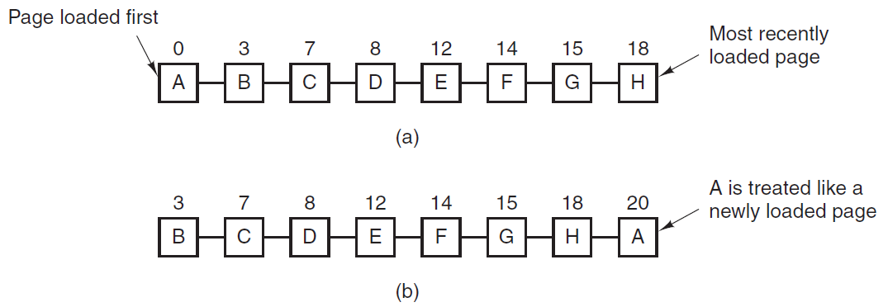
Second Chance
A is oldest page, page fault occurs
Referenced bit is checked:
If 0, remove it
If 1, R bit is cleared and it is load time is updated as it has just arrived
What issues or impacts do you see with this method?
Notes:
The numbers above the pages show their time of arrival, but that number doesn’t have to be stored or known to make the algorithm work as long as you know which page is the oldest.

Slide 14
Clock
The Clock Page Replacement Algorithm
The Second Chance PRA can be slow because page entries are constantly being linked/unlinked to keep them in the correct order
A better approach is to keep all the page entries in a circular list (can be thought of as the form of a (clock)
A ‘hand’ points to the oldest page
This hand is really just a pointer to a particular page entry

Slide 15
Clock
The Clock Page Replacement Algorithm
When a page fault occurs, the page being pointed to by the hand is inspected
If R=0 (reference bit not set)
Page is evicted
New page is inserted into clock
Hand advances one position
IF R=1 (reference bit set)
R bit is cleared and hand is advanced to the next page
This continues until a page is found for eviction

Slide 16
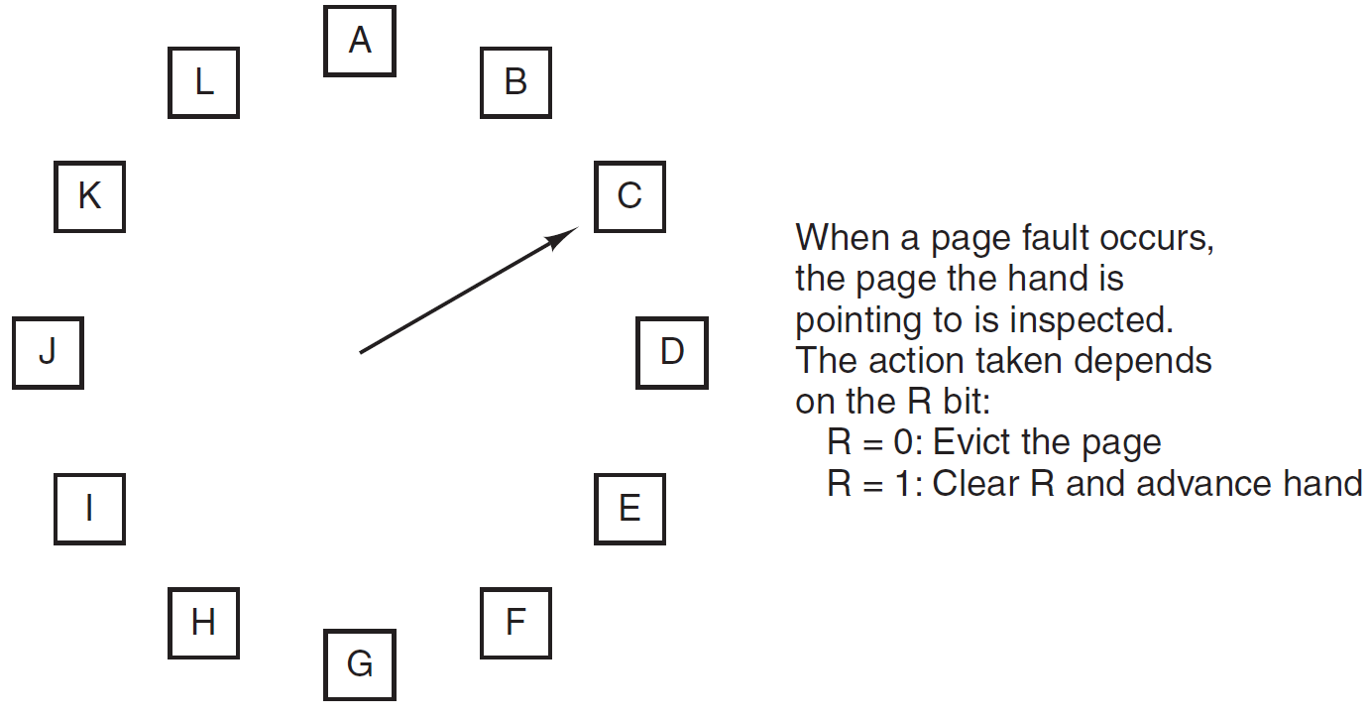
Clock
Notes:
How is this different from the Second Chance algorithm?
Only in implementation

Slide 17
Least Recently Used (LRU)
The Least Recently Used (LRU) PRA
A good approximation to the optimal algorithm is that:
Pages that have been heavily used in the last few instructions will probably be heavily used again soon; and
Pages that have not been used for a ling time will likely remain unused for a long time
Therefore, when a page fault occurs, throw out the page that has been unused for the longest time
How is this different from FIFO?
Notes:
Different from FIFO in that FIFO only cared about the page in memory the longest, not the longest unused in memory

Slide 18
Least Recently Used (LRU)
Implementation of LRU
Method 1: Every entry is maintained in linked list
Every time a page is used, it is moved to the front of the list
This is a very expensive operation
Method 2: Use a very large (64 bit) counter in hardware
Counter is incremented after every instruction
Store this number in each page table entry after every memory reference
When there is a need to replace a page, evict the page with the smallest counter value
Disadvantage is the large overhead of a 64 bit counter in every page table entry

Slide 19
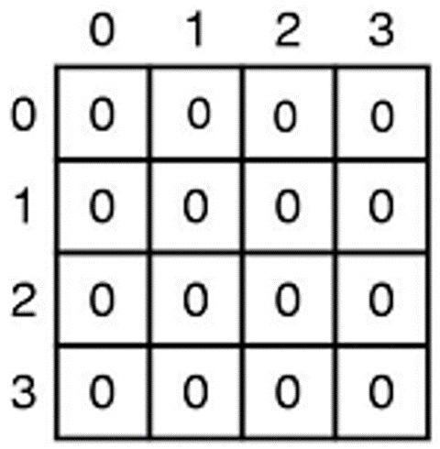
Least Recently Used (LRU)
Least Recently Used (LRU) PRA
Method 3: For a system with n page frames, maintain a hardware matrix of size n x n bits, initially set to 0
Whenever a page, k, is referenced the hardware sets all the bits of row k to 1, then sets all the bits of column k to 0
The row with the lowest binary value is the least recently used page frame and is the candidate for eviction...try it!
Consider a simple example with four pages

Slide 20
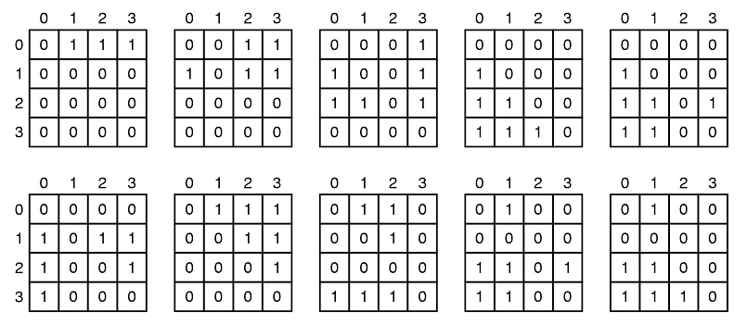
Least Recently Used (LRU)
The Least Recently Used (LRU) PRA
Accessed in order: 0,1,2,3,2,1,0,3,2,3
Notes:
Note, that as far as I can tell, one and only one entry will always be zero (after each has been reference once) since to make another row zero you would have to reference the “zeroed” page and thus make it non-zero.
Is this realizable?
Well, for 64000 pages, you would need 64000 entries in hardware of 8KB each = 512MB of registers...not so good.
But for 256 entries it’s only 8KB (256 * 256/8) Could probably do that.

Slide 21
Quiz Time!
What algorithms did we see today?
What are three ways of implementing Least Recently Used?
Notes:
What algorithms did we see today?
Optimal PRA
Not Recently Used
FIFO
Second Chance
Clock
Least Recently Used
What are three ways of implementing Least Recently Used?
A linked list
A counter of instructions stored for each page table entry
A hardware matrix of n x n bits where n is the number of page frames

Slide 22
Page Replacement Algorithms II

