Slide 1
EEE 335 Principles of Operating Systems
Paging Examples

Slide 2
Aim
The aim of these examples is to further your understanding of page tables, multi-level page tables, inverted pages tables and hash tables.

Slide 3
Consider the following:
You are working on designing memory management for an operating system
16 bit virtual memory address space
2¹⁶ = 65,536 or 64 KB
15 bit physical memory address space
2¹⁵ = 32,768 or 32 KB
Size of virtual pages and frame pages is 4KB
How many pages in your virtual address space?
How many pages in your physical memory?
Notes:
How many pages 2^16 / 2^12 = 2^4 = 16, 0-15 Physical = 64k/4k = 16 frames
2^15/2^12 = 2^3 =8, 0-7
Physical = 32k/4k = 8 frames

Slide 4
Page Tables
Consider two processes, 0 and 1 that have the following mapping of their page tables:
P0: V0-P6, V1-P2, V2- P3,V4-P0,V9-P1,V15-P7
P1: V2-P4, V9-P5
How could this be conceptually represented?

Slide 5
Process Page Tables
Virtual Page
Page Frame
Virtual Page
Page Frame
15 | 7
14 | X
13 | X
12 | X
11 | X
10 | X
9 | 1
8 | X
7 | X
6 | X
5 | X
4 | 0
3 | X
2 | 3
1 | 2
0 | 6
15 | X
14 | X
13 | X
12 | X
11 | X
10 | X
9 | 5
8 | X
7 | X
6 | X
5 | X
4 | X
3 | X
2 | 4
1 | X
0 | X
Process 0
Process 1

Slide 6
Multi-Level Paging
Now consider a 2-level page table w/ 16 bits
Top level and 2nd level page tables need to be the same size
Consider using 2 bits to represent each page table entry within each level
How large would your offset be?
How would you conceptually represent this?
PT1
PT2
Offset
2 bits | 2 bits | 12 bits
Notes:
0 00
01
10
11

Slide 7
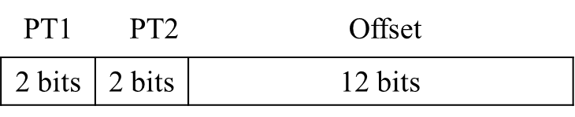
2 Level Page Table
3 | 7
2 | X
1 | X
0 | X
11
3 | X
2 | X
1 | 1
0 | X
11
10
01
00
10
01
3 | X
2 | X
1 | X
0 | 0
00
3 | X
2 | 3
1 | 2
0 | 6
11
10
01
00
Notes:
00 – PT1, lowest row
00 – PT2, lowest row

Slide 8
Inverted Page Table
Lets now consider an inverted page table
How could this be represented?
Recall the size of physical memory and the page size
Recall how the inverted page table works

Slide 9
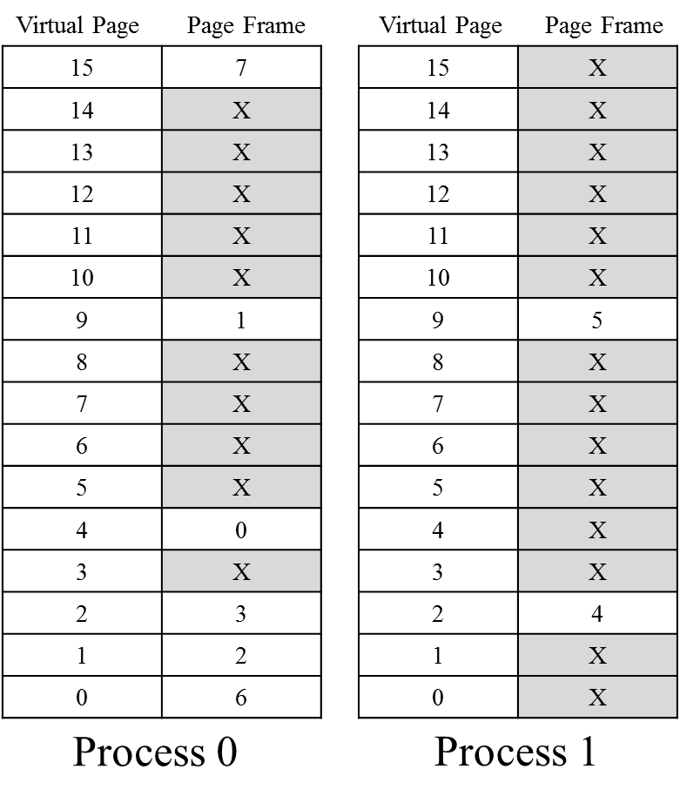
Inverted Page Table
Page Table
Inverted Page Table
Page Frame
Process
Virtual Page
7 | 0 | 15
6 | 0 | 0
5 | 1 | 9
4 | 1 | 2
3 | 0 | 2
2 | 0 | 1
1 | 0 | 9
0 | 0 | 4

Slide 10
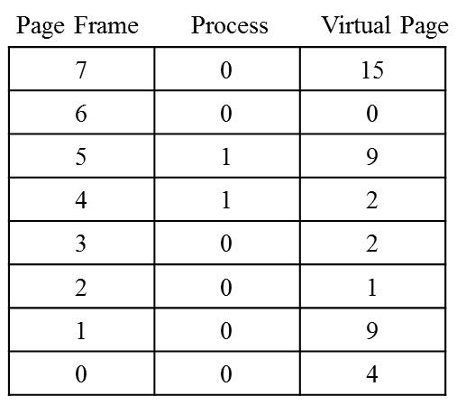
Inverted Page Table
Consider a hash table to improve the efficiency of finding the mapping between page frames and virtual pages
One method may be to use the 2 Least Significant Bits of our virtual address space
Recall how many bits are used within our virtual address space
If we are going to use the 2 LSB, how large would our hash table need to be?
How would it work with collisions?
Notes:
4 bits, 16 pages, 0-15
We are only going to use the LSB of these 4 MSB in our 16 bit address space
Our hash table in this case is only going to be 2 bits, so four entries.

Slide 11
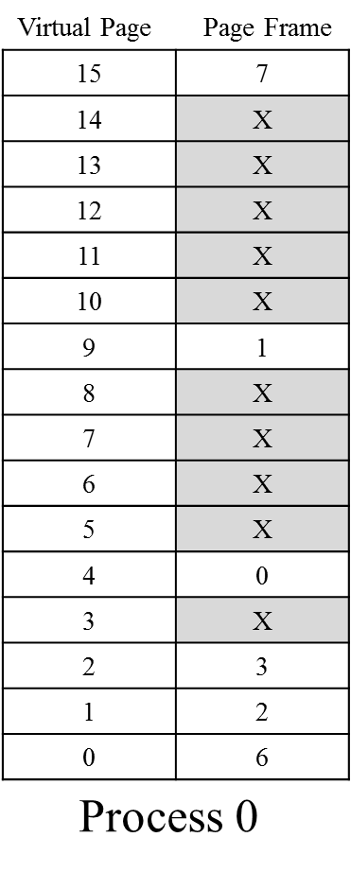
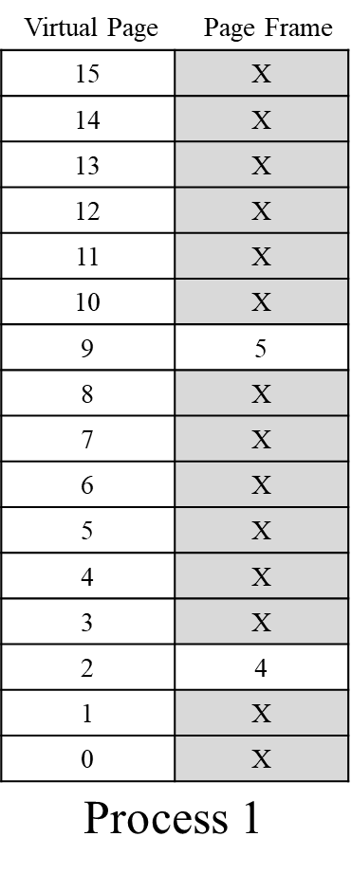
Hash Table – Simple Example
Consider two processes
Use 2 LSB as hash index
Virtual Page | Binary
15 | 1111
9 | 1001
4 | 0100
2 | 0010
1 | 0001
0 | 0000
11
10
01
00
0 | 15 | 7
0 | 2 | 3
1 | 2 | 4
0 | 1 | 2
0 | 9 | 1
1 | 9 | 5
0 | 0 | 6
0 | 4 | 0
Notes:
Process 0 Process 1
Virtual page Binary Virtual Page Binary
1111
9 1001 9 1101
4 0100 4 0100
2 0010
1 0001
0 0000

Slide 12
Page Table
Consider process 0:
What is the physical memory address for 0x9E28?
0x1E28
What is the physical memory address for 0x6330?
Page Fault
Notes:
0x9E28 = 1001 1110 0010 1000
0 to 15 (0000 to 1111) the first 4 bits are the virtual page numbers, the last 12 bits are the offset
Only 4 bits are need to address each page.

Slide 13
Multi-level Page Table
Map the following virtual address to its corresponding physical address:
0x2882 or, to make things easier:
0010 1000 1000 0010 Virtual Address

Slide 14
2 Level Page Table
3 | 7
2 | X
1 | X
0 | X
00 10 1000 1000 0010
11
3 | X
2 | X
1 | 1
0 | X
11
10
01
00
10
01
3 | X
2 | X
1 | X
0 | 0
00
3 | X
2 | 3
1 | 2
0 | 6
11
10
01
00
Notes:
00 – PT1, lowest row
00 – PT2, lowest row

Slide 15
Multi-level Page Table
Map the following virtual address to its corresponding physical address:
0x2882 or, to make things easier:
0010 1000 1000 0010 Virtual Address
0x3882
0011 1000 1000 0010
Physical Address

Slide 16
Inverted Page Table
Consider process 1, what is the physical address given the following virtual address:
0x9880?
0x5880
Now the same for process 0:
0x1000?
0x2000
0xE850?
Page Fault
Notes:
Q1

Slide 17
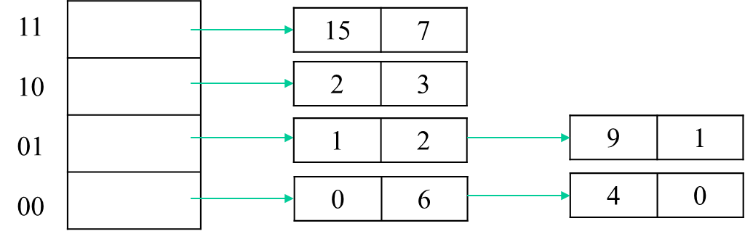
Hash Table Lookup
For Process 0, what is the physical address for each of the following virtual addresses:
0xFFFE
0x7FFE
0x90FE
0x10FE
Notes:
0xF = 1111, 2 LSB is 11
0x9 = 1001, 2 LSB is 01,

