Slide 1
EEE 335 Principles of Operating Systems
Page Replacement Algorithms II
(Modern Operating Systems 3.4)

Slide 2
Review
What page replacement algorithms did we talk about so far?
Notes:
Optimal
Not Recently Used (NRU)
FIFO
Second chance
Clock
LRU
Optimal means to evict the page that will not be needed for the most instructions
Not Recently Used is a crude algorithm that uses the used/dirty bits to sort pages into four classes to decide which page to evict.
FIFO is a list of all pages where the first page loaded is the first page evicted
Second chance is a modification of FIFO where if a page has its used bit set it isn’t evicted but is moved to the end of the FIFO list as if it just entered memory
Clock is an alternate implementation of second chance with a pointer/hand that points to an entry in a circular list of page frames. On a page fault it circles the list clearing the used bit if set and evicting the first entry with a clear used bit.
LRU is an approximation to the optimal algorithm that is based on the observation that a page that has been used heavily in the recent past is likely to be used heavily in the near future. Theoretically all pages entries must be kept in a linked list with the most recently used pages at the front of the list. Every time a page is used it is moved to the front of the list. In practice it is possible to associate a 64bit counter with each page to indicate the last instruction in which it was used. An array of nxn is also possible where n is the number of page frames.

Slide 3
Outline
Least Recently Used in software (aging)
The Working Set
WSClock
Notes:
We discussed last lecture the concept of Page Replacement Algorithms. We do page replacement when a Page Fault occurs. Today, we will discuss three mechanisms
1- Least Recently Used
2- Working Set
3- Clock Working Set

Slide 4
Problems with LRU
Recall: Least Recently Used
Last two solutions (2 and 3) we looked at required hardware
Counter incremented after every instruction, number stored with each page table entry when referenced, or
The hardware “matrix” of n x n size
The second solution is particularly expensive as the number of pages increases. In practice, neither option is used extensively due to hardware constraints.
Can LRU be performed in software?
Notes:
Performing the Least Recently Used in software means Least Frequently Used (LFU).
Recall that option 1 was a linked list, also very inefficient whether in software or hardware

Slide 5
Simulating LRU in Software
Consider this option (actually called Not Frequently Used PRA):
Each page has an associated software counter
At each clock interrupt, if the page had been used, 1 is added to this count
Are there any problems with this solution?
How can we fix this problem?
Notes:
Simulating LRU by a software counter. Each page has a counter. If referenced, increment it. If not, DO NOTHING (this is a problem!).
The problem is that it will NEVER forget the counter values. So, heavily used pages will continue have big counters even if they have not been recently referenced or used at all. Their big counters will make the OS not evicting them although they are no longer used.
The problem is that the algorithm doesn’t forget anything. As you continue to add 1 to the number a page will approach a value of 0xFFFFFF. Useful pages will be removed instead of pages no longer in use

Slide 6
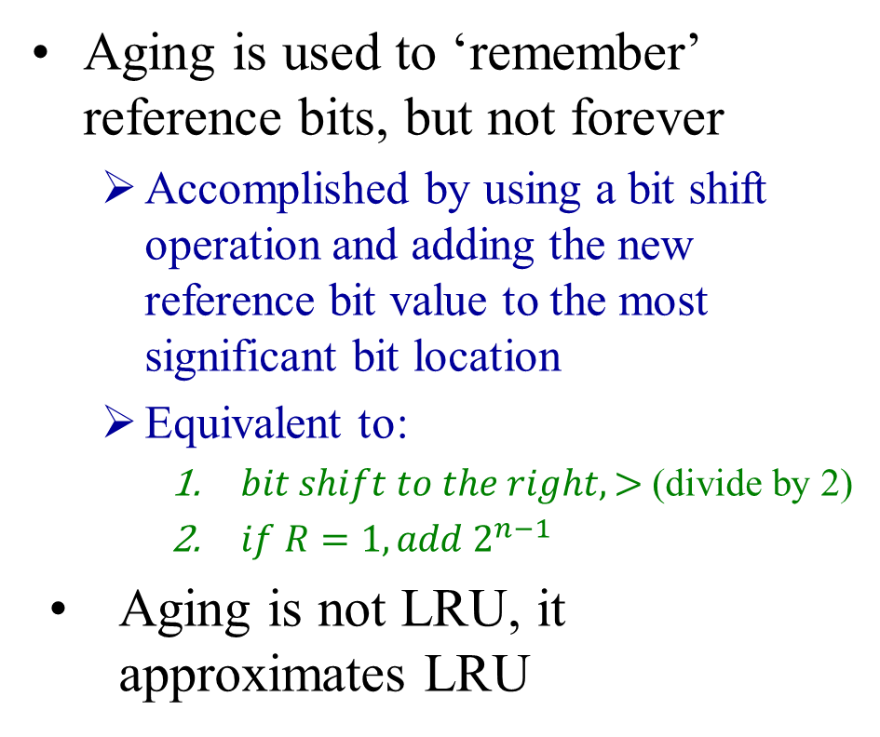
Aging
Initial state
Aging is used to ‘remember’ reference bits, but not forever
Accomplished by using a bit shift operation and adding the new reference bit value to the most significant bit location
Equivalent to:
$bit shift to the right, >$ (divide by 2)
$if R=1, add 2^{n−1}$
Aging is not LRU, it approximates LRU
0
1
2
3
4
5
Pages used
1
0
1
0
1
1
Page
Software counter
0
00000000
1
00000000
2
00000000
3
00000000
4
00000000
5
00000000
Notes:
The solution to this problem is the AGING mechanism. If a page has not been referenced for a while, we need to increment its AGE. This happens by the SHIFT right operation. Adding to leftmost means adding a count of 2^N-1. Shifting right means divide by two.

Slide 7
Aging
Initial state
Tick 0
Tick 1
0
1
2
3
4
5
0
1
2
3
4
5
Pages used
1
0
1
0
1
1
Pages used
1
1
0
0
1
0
Page
Software counter
Page
Software counter
0
0
11000000
10000000
1
1
10000000
00000000
2
2
01000000
10000000
3
3
00000000
00000000
4
4
11000000
10000000
5
5
01000000
10000000

Slide 8
Aging
Tick 2
Tick 3
0
1
2
3
4
5
0
1
2
3
4
5
Pages used
1
1
0
1
0
1
Pages used
1
0
0
0
1
0
Page
Software counter
Page
Software counter
0
11100000
0
11110000
1
11000000
1
01100000
2
00100000
2
00010000
3
10000000
3
01000000
4
01100000
4
10110000
5
10100000
5
01010000

Slide 9
Aging
Tick 4
Tick 5
0
1
2
3
4
5
0
1
2
3
4
5
Pages used
0
1
1
0
0
0
Pages used
1
0
0
0
1
0
Page
Software counter
Page
Software counter
0
01111000
0
10111100
1
10110000
1
01011000
2
10001000
2
01000100
3
00100000
3
00010000
4
01011000
4
10101100
5
00101000
5
00010100

Slide 10
Aging - Approximating LRU in Software
Are there differences between our simulation of LRU and the “ideal”?
Since we only record uses per “tick” we cannot discriminate between two pages with a similar highest bit.
In that case, the page with the lowest value is chosen
With a finite number of bits, page counts will eventually go to zero
At this point we cannot tell which page was least recently used and a page must be chosen at random (from all zero value pages)
Notes:
The first issue is that we use only one bit per tick. Between Ticks, we do not know which page has been referenced more recently or least recently.
The second issue is the amount of “past” or “memory” we can hold in the counters which depends on the size of the counter. This will happen when the counters are all ZEROs. There is no way to know which page has been recently referenced.

Slide 11
The Working Set
In the ‘purest’ form of paging, processes are started with none of their pages in memory
As soon as the CPU attempts to fetch the first instruction from a process there is a page fault
Other page faults for the stack/heap soon follow
Eventually, the process has the pages it needs and “settles down” to run with relatively few page faults
This strategy is known as Demand Paging
Pages are loaded on demand, not in advance
If entire processes are swapped to the disk, every time a process is given the CPU it will thrash terribly for its first few milliseconds
Thrashing – causing page faults every few instructions
Notes:
This slide describes how pages are loaded for a process.
Initially too many page faults occurs. When all pages currently needed by a process has been loaded, minimum page faults will occur. This pages are the Working Set.
Thrash concept refers to “too many page faults”.

Slide 12
The Working Set
To minimize thrashing, many paging systems:
attempt to keep track of the set of pages that a program is using
load it into memory before letting the process run
This set of pages is known as the working set
This approach is referred to as the Work Set Model or prepaging
This approach reduces thrashing since, at any instant, processes tend to reference a small cluster of memory addresses
So this cluster becomes part of the working set
Note that the working changes over time
Notes:
Pre-paging : Load Pages in advance to minimize page faults!

Slide 13
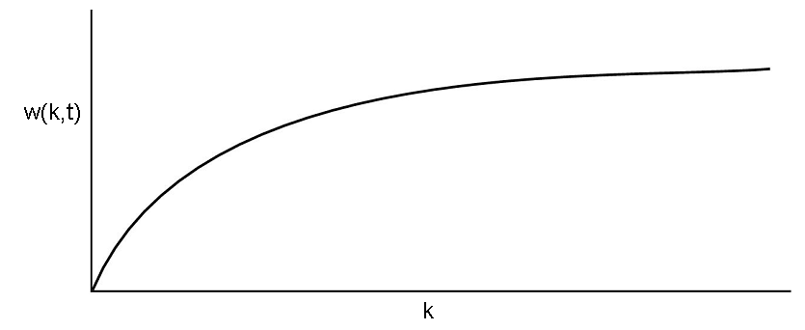
The Working Set
At any time, t, there is a set of pages used by k recent memory references, the working set is w(k,t)

Slide 14
The Working Set
The function w(k,t) is monotonically nondecreasing
As k is increased for more references, the size of the working set must stay constant or increase
w(k,t) initially rises quickly as programs generally access a small number of pages
This working set changes slowly over time
There may be a wide range of k values for which the working set remains unchanged
This behaviour makes it possible to track the contents of the working set and guess which pages a program will need when retrieved from the disk – these pages are prepaged
Notes:
Working set varies slowly with time. When a process is suspended and retrieved again, its working set pages can be pre-loaded to minimize page faults.
Function x and y , for all x lte y f(x) lte f(y)

Slide 15
The Working Set
How is the working set determined?
In “pure” form, each reference would be stored in a linked list with duplicate entries removed. The list length would be size k
This is prohibitively expensive in time (for, say, k=10,000)
An approximation can be made by defining the working set as the pages used in the past T seconds of CPU time
Since k typically increases with T this is reasonable
Each process will need its own “virtual clock”
Note that for each process, only its own execution time counts
Notes:
Option 1 : Working Set = Set of pages used in the last k memory references. List of k length (at least) with referenced page numbers are stored without duplication. Expensive Technique.
Option 2 : Working Set = Set of pages used in the past T seconds of CPU. Each process has its own time clock. This is the virtual clock.

Slide 16
The Working Set
The “virtual clock”
Each process will have a clock that measures how much execution time it has been allocated
If the process began at time 0, and has had two chunks (25ms each) of CPU time in the last 300ms then its virtual time is 50 ms
The working set is now the pages that a process has referenced in the last τ virtual seconds
Now a new PRA is apparent: when evicting a page, choose one not in the working set
How do we implement this in practice?
Notes:
Virtual clock is the clock that keeps how long a process has been running on the CPU since it has started.
Page Replacement Algorithm will chose the pages NOT in the working set to evict.

Slide 17
The Working Set PRA
To implement the WS PRA:
Each process requires a virtual clock
Normal page table details exist, for example referenced (R or used) bit and modified (M or dirty) bit
Recall that the R bit gets cleared on clock ticks
Page table entry now also contains the approximate virtual time the page was last referenced – time of last use field
When a page is referenced, the current virtual time is updated in the time of last use field
A time τ is selected (assumed to span multiple clock ticks)
Notes:
What we need is two basic pieces of information: 1) Referenced 2) Age (Age = current virtual time – virtual time of last use) . All time values here are on the virtual clock.

Slide 18
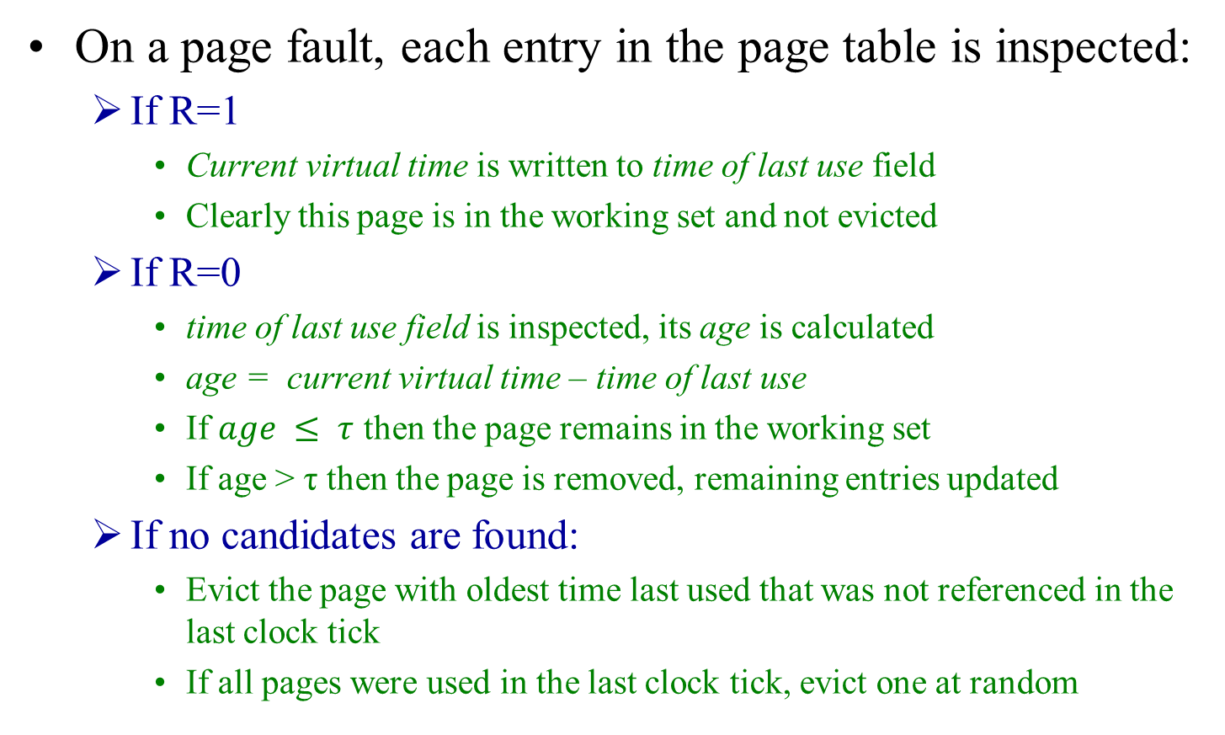
The Working Set PRA
On a page fault, each entry in the page table is inspected:
If R=1
Current virtual time is written to time of last use field
Clearly this page is in the working set and not evicted
If R=0
time of last use field is inspected, its age is calculated
age = current virtual time – time of last use
If $age ≤ τ$ then the page remains in the working set
If age > τ then the page is removed, remaining entries updated
If no candidates are found:
Evict the page with oldest time last used that was not referenced in the last clock tick
If all pages were used in the last clock tick, evict one at random
Notes:
This is how the WS PRA works.

Slide 19
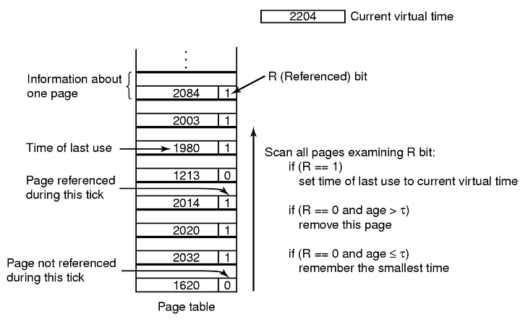
The Working Set PRA
Notes:
This diagram explains the working set.

Slide 20
The Working Set PRA
Are there any problems with this system?
The entire page table needs to be examined at each page fault until we find a candidate
Have we seen a similar problem in the recent past?
FIFO/Second chance maintained a list of pages sorted in FIFO order
We used the Clock Page Replacement Algorithm to implement a faster solution
Notes:
The problem with WS PRA is the time needed to scan the full table and do these checks. Let’s do something similar to the Clock FIF algorithm.

Slide 21
The Working Set Clock PRA
Similar to the Clock PRA, keep a circular list of all page frames with a pointer to one of those pages
On a page fault:
examine the page pointed to; if R=1, the bit is cleared, and the clock advanced to the next entry
Once an entry with R=0 is found, its time of last use is subtracted from the current virtual time. If greater than τ, and the page is clean, then the page is overwritten
Notes:
The concept is simply “Look for an OLD CLEAN” page.

Slide 22
The WS Clock PRA
On a page fault:
If the page is dirty, a write to disk is scheduled and the algorithm keeps looking for an immediately available page
Why?
If all pages are scheduled for writing then the clock hand continues moving until a page is clean
If the hand comes in a complete circle with no writes scheduled, that indicates that every page is in the working set
Simply claim the first clean page available
Notes:
Because writing to disk is time-consuming and their may be an old clean page in the next couple of entries
IF ALL PAGES are YOUNG (belongs to the working set), then chose the first CLEAN page.

Slide 23
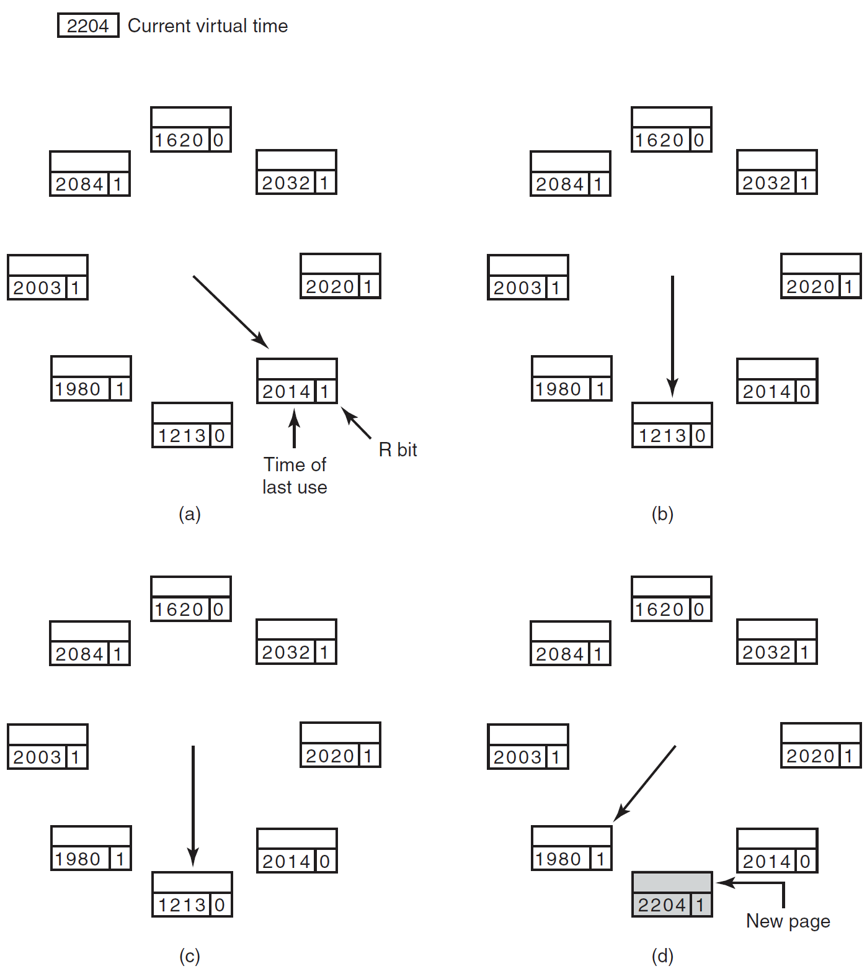
τ = 500
(a) and (b):
Example of what happens when R=1
R bit is cleared
Advance to next entry
(c) and (d):
Example of what happens when R=0
If age > τ and clean it is replaced by the new page
Notes:
This is an indication of the algorithm (Clock WS PRA). The main idea is to avoid complete scan every time a page fault occurs.

Slide 24
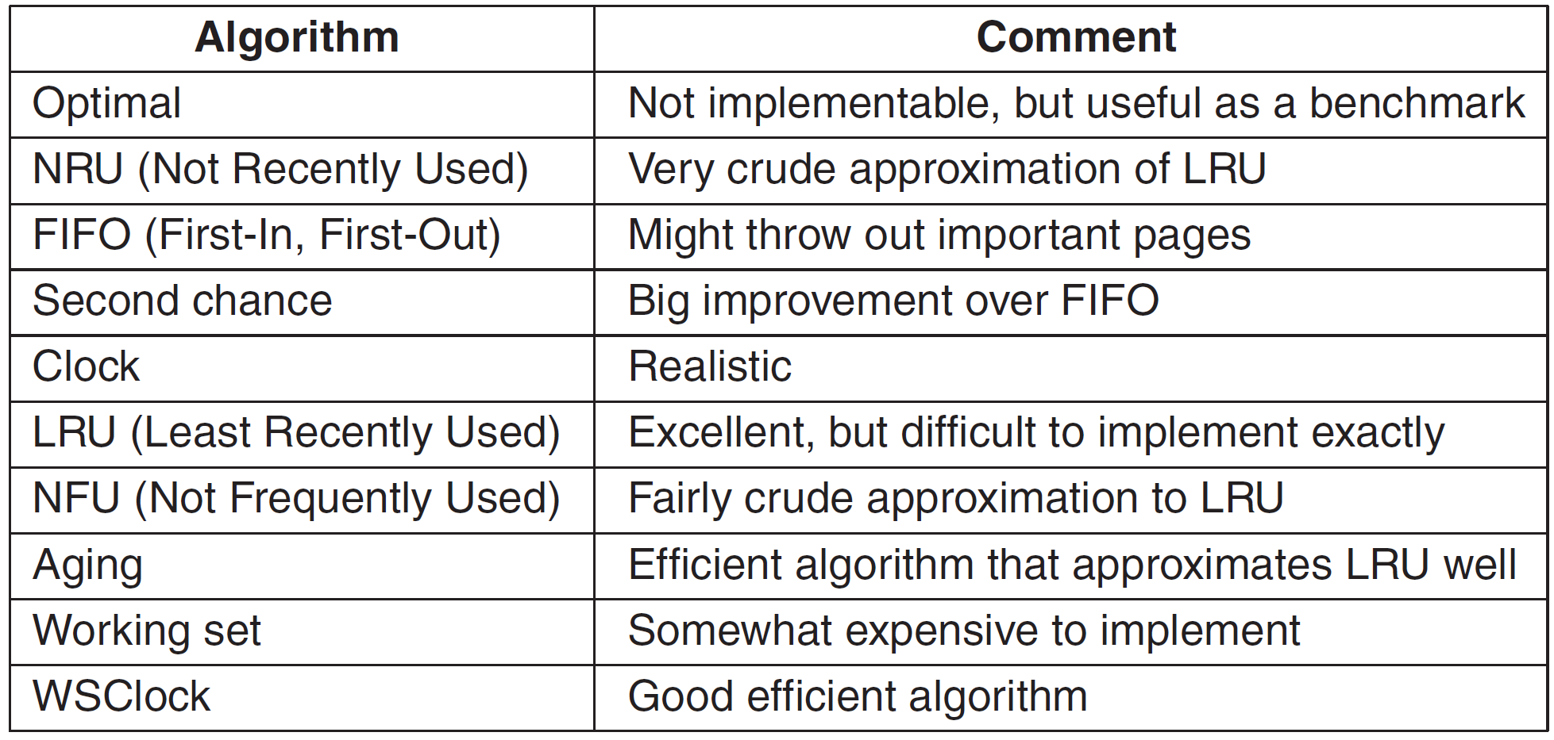
Summary of Page Replacement Algorithms
Notes:
1- The Optimal algorithm means NO page fault will occur which is impossible.
2- Not Recently Used (NRU). Performance is not good due to the full scan with each memory reference.
3- FIFO. Reduce complexity of 2.
4- FIFO with second chance
5- Clock FIFO. Reduce complexity of manipulating the FIFO.
6- Least Recently Used (LRU). Difficult to implement in Hardware.
7- Not Frequently Used (NFU). Software Simulation to LRU.
8- NFU with Aging.
9- Working Set. High complexity due to scanning the table with each page fault.
10- Working Set with Clock. Reduces complexity.

