Slide 1
EEE 335 Principles of Operating Systems
PRA Design Considerations and Paging Summary
(Modern Operating Systems 3.5 and 3.6)

Slide 2
Quick Review
How is WSClock different from Clock?
What is the optimal algorithm
Is it implementable?
Notes:
Clock is an implementation of second chance and evicts the first page it finds that doesn’t have its used or R bit set
WSClock clears used bits and updates the page frame’s time of last use, evicting pages only if they are outside of the working set of the process
Optimal – for each page, list the number of instructions until that page is used, order them according for evict – not possible to implement

Slide 3
Outline
Design Considerations
Local vs Global Allocation Policy
Load Control
Page Size
Cleaning Policy
Paging summary
OS and paging

Slide 4
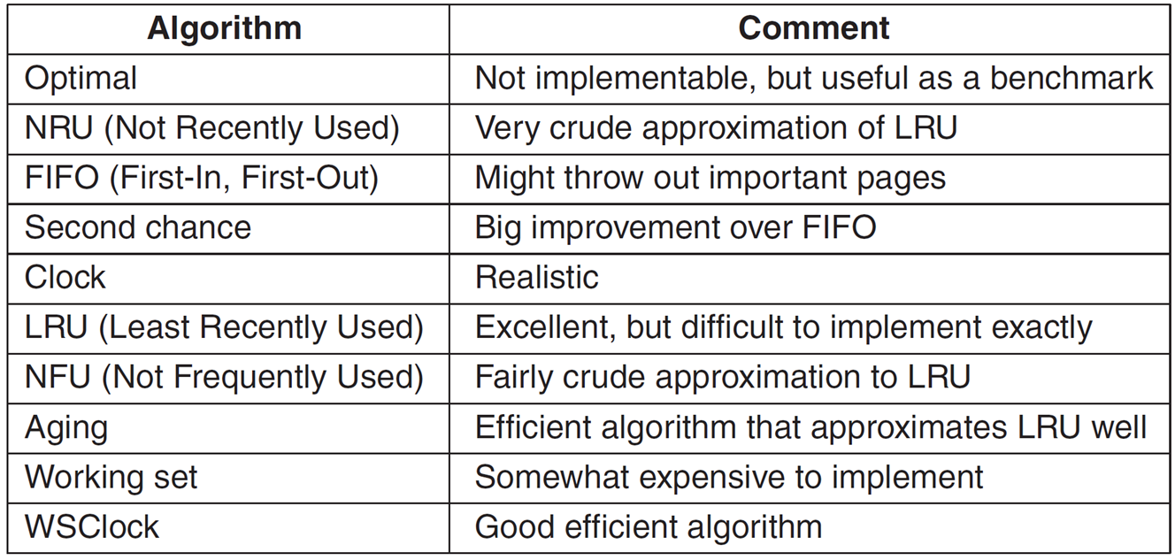
Local vs Global Allocation Policy
Design Considerations
We have looked at the following page replacement algorithms in the context of a single process
How is memory allocated with multiple competing processes?
Consider LRU and 3 processes A, B and C
If process A experiences a page fault does LRU choose to evict a page
amongst those pages associated only with process A, or
amongst all pages across all three processes?

Slide 5
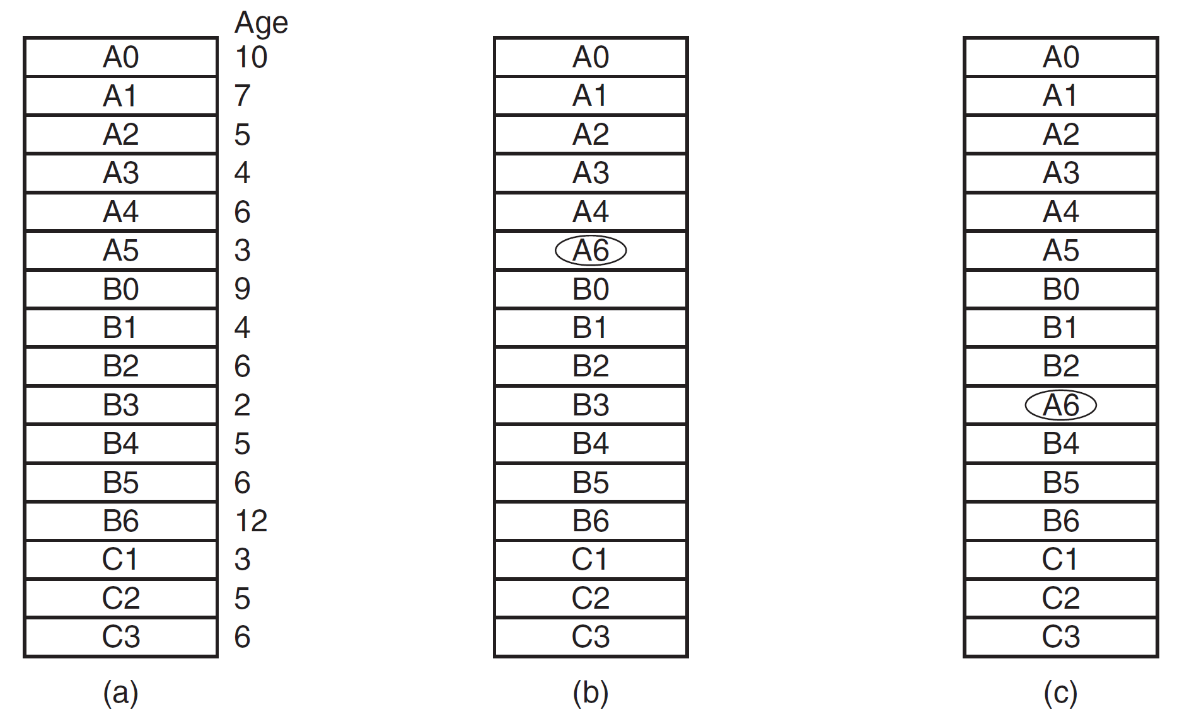
Local vs Global Allocation Policy
Design Considerations
local
global
Global algorithms dynamically allocate page frames across all runnable processes
Local algorithms effectively correspond to allocating fix fraction of memory to each process
Notes:
Using LRU, do we only consider the 6 pages related to process A or across all 16 page frames?
Consider local – which page is the oldest relative to process A?
Now take a global perspective – which page would be the lowest?

Slide 6
Local vs Global Allocation Policy
Design Considerations
Global algorithms tend to work better, especially when working set can vary a lot over the process lifetime
Alternatively, local algorithms would:
experience thrashing as the working set grows
waste memory as the working set shrinks
For both global and local algorithms, one key challenge is determining how memory is allocated to competing, running processes
Lets look at 3 potential options

Slide 7
Local vs Global Allocation Policy
Design Considerations
Allocating page frames to processes
Periodically determine number of processes and allocate each process an equal share
Not necessarily fair given likelihood of different process sizes and their respective memory requirements
Consider a 10 KB process and a 300KB process
Allocate page frame proportional to size of each running process
For example, 300 KB process gets 30 times the allotment of 10 KB process
Some minimum number must be set for smaller programs
Notes:
For example, consider 12416 page frames available (others are used by the OS) and 10 processes.
Each process gets 1241 page frames allocated
Remaining 6 go into a pool to be shared for when a page fault occurs

Slide 8
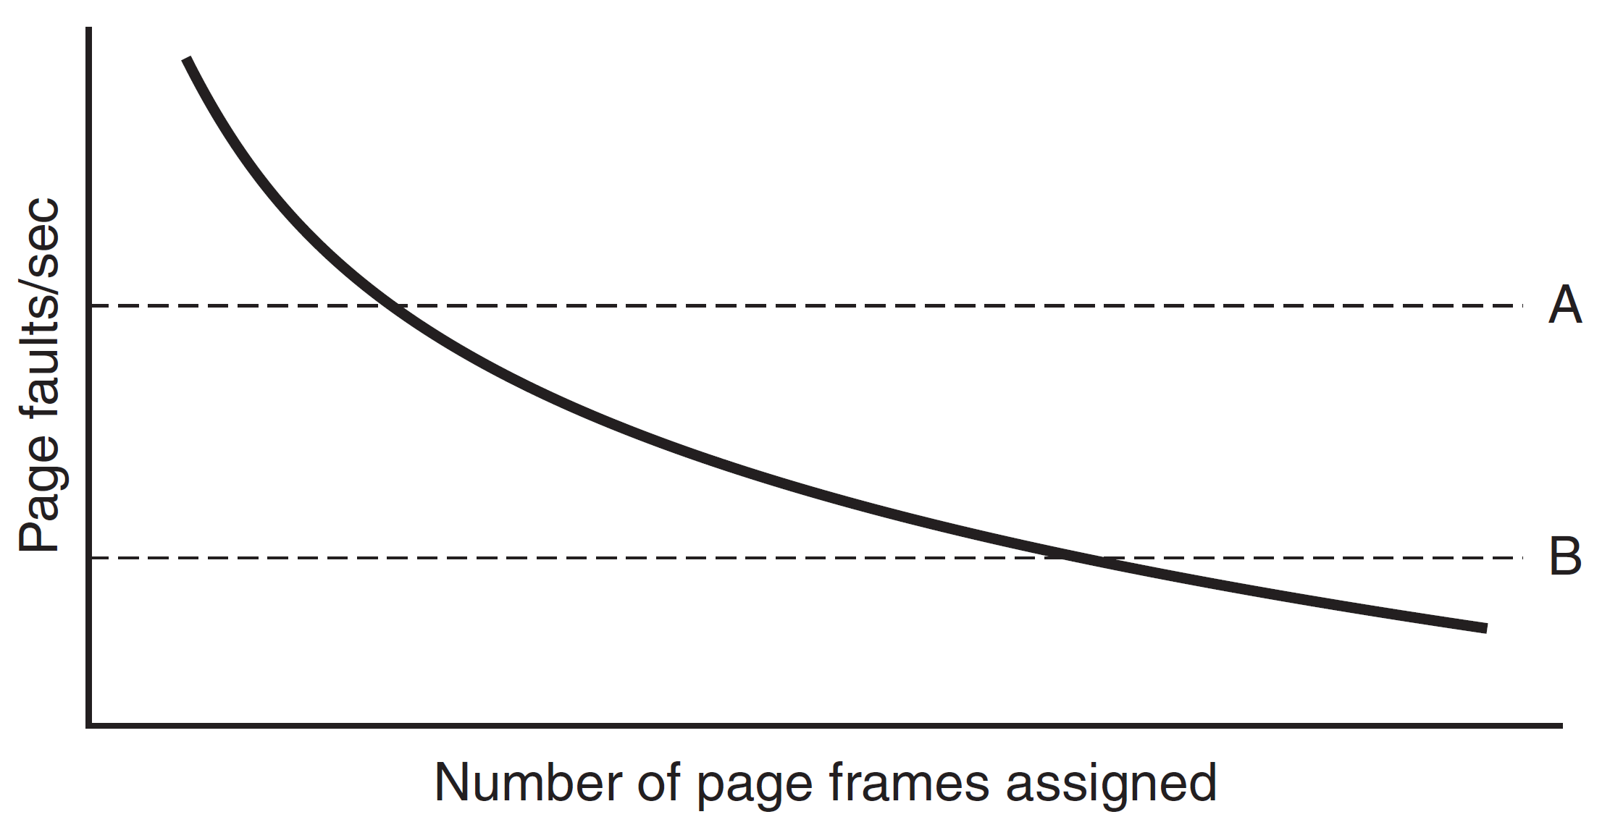
Local vs Global Allocation Policy
Design Considerations
Allocating page frames to processes
For global algorithms, use option 2 to start but over time manage allocation using Page Fault Frequency (PFF)
PFF does not indicate which page to evict, it just controls the size of the allocation set assigned to each process
Upper and lower bounds used to manage allocation of page frames to processes
Notes:
Determining PFF is simple, count the number of page faults per second, potentially use a running mean.

Slide 9
Local vs Global Allocation Policy
Design Considerations
Some PRA can work with either local or global allocations polices
FIFO and LRU are good examples
For other PRAs, only local allocation policies make sense
Working Set
WSClock
Notes:
Make students answer the one on local policies and explain why.
-> they are process specific and cannot be applied to the machine as a whole
-> recall that these two algorithms use the concept of virtual time or CPU time for each process

Slide 10
Load Control
Design Considerations
Despite most optimal PRA and global allocation, thrashing can still occur
PFF may indicate that processes need more memory, but that no processes need less memory
One solution is to swap pages to disk to free up page frames
Need to consider not only process size and paging rate but also if process is IO or CPU bound.
Why?
Notes:
Page fault frequency
To not have an idle CPU

Slide 11
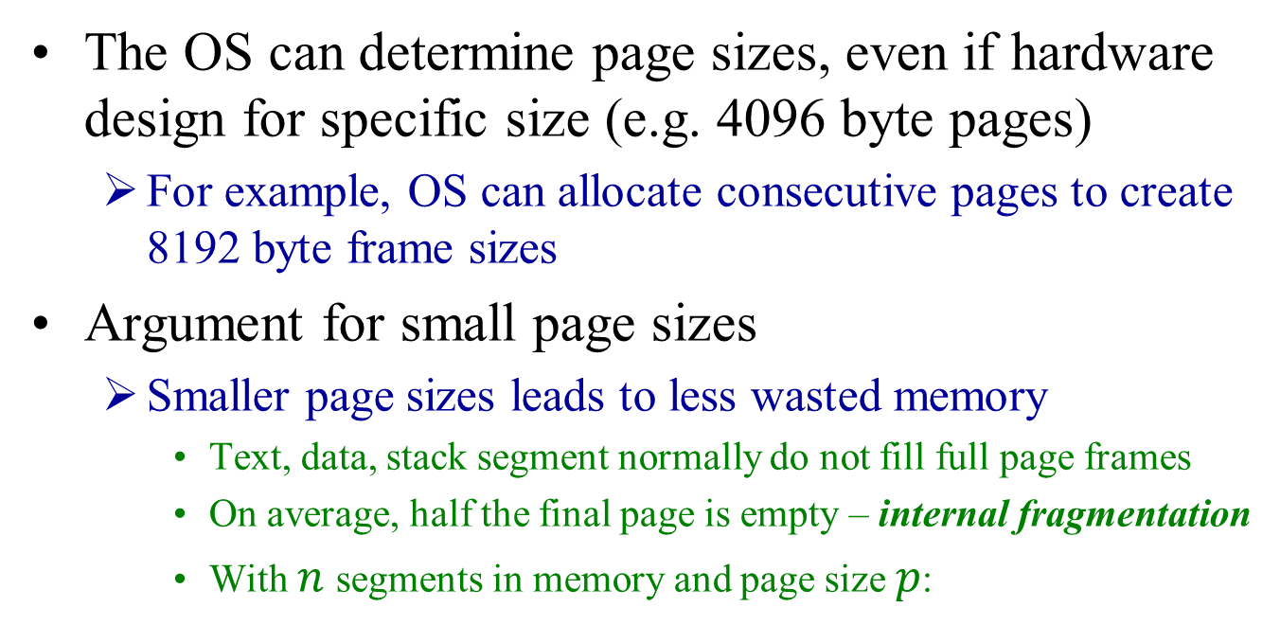

Page Size
Design Considerations
The OS can determine page sizes, even if hardware design for specific size (e.g. 4096 byte pages)
For example, OS can allocate consecutive pages to create 8192 byte frame sizes
Argument for small page sizes
Smaller page sizes leads to less wasted memory
Text, data, stack segment normally do not fill full page frames
On average, half the final page is empty – internal fragmentation
With $n$ segments in memory and page size $p$:
$$\frac{np}{2}$$
bytes are wasted on internal fragmentation

Slide 12
Page Size
Design Considerations
Argument for large pages sizes
Conversely, smaller pages sizes means larger page tables
A 32 KB program needs only four 8 KB pages but sixty-four, 512 byte pages
For transfers to/from disk, most of time is on seek and rotational delay, so nearly same amount of time to transfer pages to disk
64 X 10 ms to load 64 X 512 byte pages
4 X 12 ms to load 4 X 8 KB pages
Smaller page sizes use up more space in the TLB
Larger page sizes require fewer entries
Notes:
TLB example: Consider a program with 1 MB of memory and a working set of 64KB
- 4KB pages would require 16 entries, 32 KB would only need 2

Slide 13
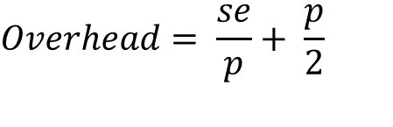
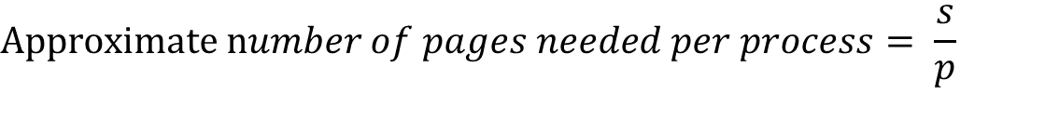


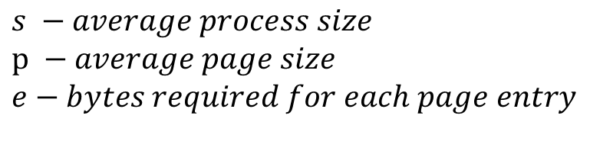
Page Size
Design Considerations
Consider memory occupied by page table
$$s −average process size$$
$$p −average page size$$
$$e−bytes required for each page entry$$
$$Approximate number of pages needed per process= \frac{s}{p}$$
$$With the page table requiring \frac{se}{p} bytes of space$$
$$Wasted space due to internal fragmentation is \frac{p}{2}$$
$$Total overhead due to page table size and internal fragmentation loss is:$$
$$Overhead= \frac{se}{p}+ \frac{p}{2}$$
Notes:
TLB example: Consider a program with 1 MB of memory and a working set of 64KB
- 4KB pages would require 16 entries

Slide 14
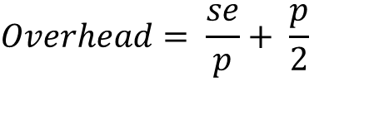
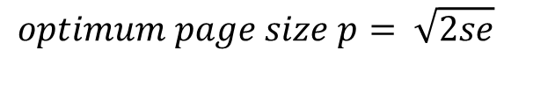
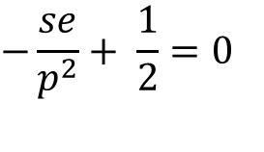
Page Size
Design Considerations
$$Overhead= \frac{se}{p}+ \frac{p}{2}$$
1st term (page table size) is large when the page is small
2nd term (internal fragmentation) is large when page size is large
We can then find the optimum page size by taking the first derivative with respect to p and equating it to zero:
$$−\frac{se}{p^{2}}+ \frac{1}{2}=0$$
$$optimum page size p= \sqrt{2se}$$
Notes:
TLB example: Consider a program with 1 MB of memory and a working set of 64KB
- 4KB pages would require 16 entries
Let s = 1 MB
E = 8 bytes
1 MB = 2^20
8 bytes = 2^3
2 = 2^1
Then multiplying them gives us 2^ (20+3+1) = 2^24, the square root is 2^12 = 4096 bytes

Slide 15
Cleaning Policy
Design Considerations
To help ensure free page frames to be used when page faults occur, paging systems have a background process
Paging daemon awakens periodically to inspect state of memory
If too few page frames free, it uses PRA to select and evict pages
If modified since being loaded, they are written to disk before being evicted
Its been found that keeping a supply of free page frames is more efficient then using all memory and trying to find frame the moment it is required

Slide 16
OS and Paging
The OS gets involved with paging in four different situations:
Process creation
Process execution
Page Fault
Process termination

Slide 17
OS and Paging
Process creation
OS needs to determine initial size of text and data segments and create corresponding page table
Memory needs to be allocated and initialized
Swap space also needs to be allocated on disk
Also initialized with text and data
Page table and swap space details written to process table
Process execution
TLB flushed
Page table or pointer to it copied to register(s)
Prepaging may also occur
Notes:
Its useful to look at the OS and paging as we can now tie together many of the topics we have studied so far: processes and process table, context switching, paging and page tables, page replacement algorithms and system calls

Slide 18
OS and Paging
Page Fault – general steps
Hardware traps the kernel
Saves program counter onto stack
State of current instruction save to registers
Assembly code routine run
Save general registers to ensure volatile information not destroyed
With key data saved, OS now needs to deal with the page fault
OS first needs to discover which virtual page is needed
Hardware register may contain this information
Else, fetch program counter, retrieve and parse instruction
OS checks to see that virtual address is valid and access is consistent with protection bit
If not, process sent a signal or killed
Else, checks for free page frame – if none free, PRA initiated

Slide 19
OS and Paging
Page Fault – general steps
If selected page frame is dirty
Page frame is scheduled for transfer to disk, context switch
Page is marked as busy to prevent it from being used
Once page frame is clean (or if step 5 not needed)
OS finds disk address (from process table) and schedules disk operation to load in the necessary information
Disk interrupt signals that page has arrived
Page tables are updated
Page frame marked as being in normal state
The instruction that caused the fault is put back to its former state
Program counter is reset to point to this instruction

Slide 20
OS and Paging
Page Fault – general steps
Faulting process is rescheduled
OS returns to assembly routine that called it
Assembly code routine reloads registers and state information
Returns to user space, process now in ready state
Scheduler selects process to execute
Process picks up where it left off

Slide 21
OS and Paging
Process Termination
OS releases
page table
virtual pages
disk space used for any pages
Any pages shared with other processes released only when last process has terminated

Slide 22
Segmentation

