Slide 1
EEE 335 Principles of Operating Systems
Segmentation
(Modern Operating Systems 3.7)

Slide 2
Outline
Memory Management Review
Segmentation
Segmentation with Paging
Real World Usage

Slide 3
The story so far...
Memory management:
Monoprogramming
Multiprogramming (fixed partitions)
Swapping (multiprogramming with variable partitions – bitmaps/linked lists)
Virtual memory
Paging and Page Tables
Multi-level Page Tables
Translation look-aside buffers (TLB)
Inverted page tables
Page Replacement Algorithms
Notes:
Mono-programming. One program in memory at a time.
Multiprogramming – more then one program executing at a time
Swapping. Consists of bringing in each process in its entirety, running it for a while, then putting it back on the disk.

Slide 4
The story so far...
The virtual memory solution so far is paging
Paging is a “flat” memory model which means that the programmer sees addresses that start at address 0 to some maximum address
For some applications, it may be useful to allow for entirely different address spaces within a single process...
For example, in a program there could be distinct address spaces for the stack, program text, and heap

Slide 5
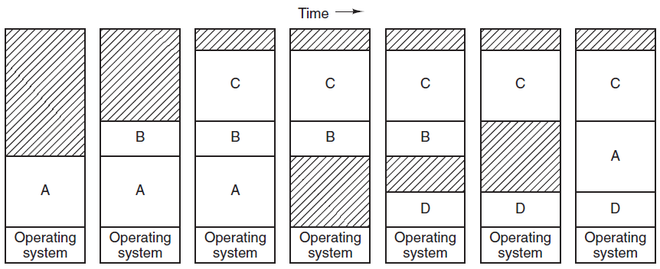
Recall: swapping
With swapping, entire processes are moved in and out of partitions in memory
Swapping create ‘holes’ in memory

Slide 6
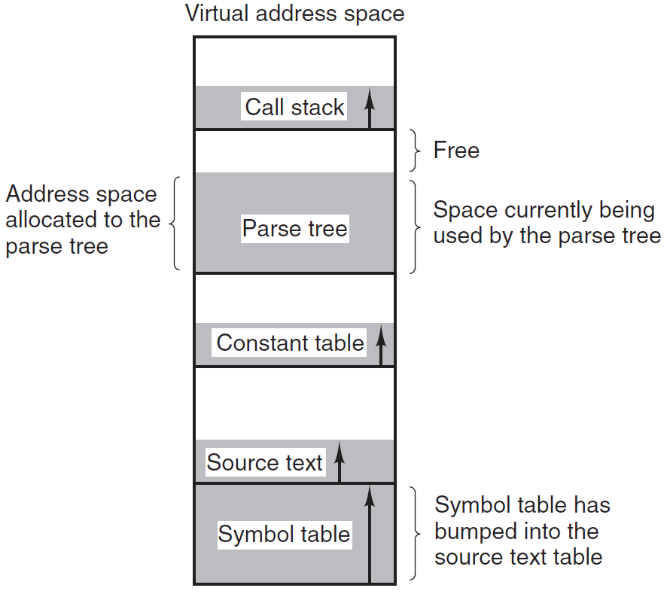
Virtual memory
So far, we have discussed virtual addresses starting at zero and going to some maximum
Consider the various types of tables that are built up during compilation:
Source text
Symbol table
Constant table
Parse tree
Stack
In a one-dimensional (contiguous) address space, the tables may bump into each other as they grow and shrink in size
Notes:
Note that in Tanenbaum, the examples used in source text, symbol table etc. Within Intel documentation, it speaks more specifically to text, data and stack segments having their own segments.

Slide 7
Segmentation
Similarly, segmentation is the division of memory into segments, each starting at some base address within physical memory. Each process can have many segments
The programmer must now specify a segment number and offset to access memory
This implies, at least at the assembly level, that the programmer must be aware of the memory model in use, unlike with paging
Referred to as “two-dimensional” memory
one dimensional memory (flat)
two dimensional memory (segments)

Slide 8
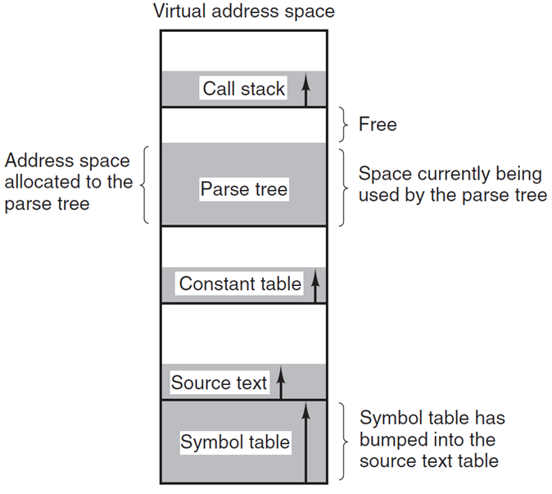
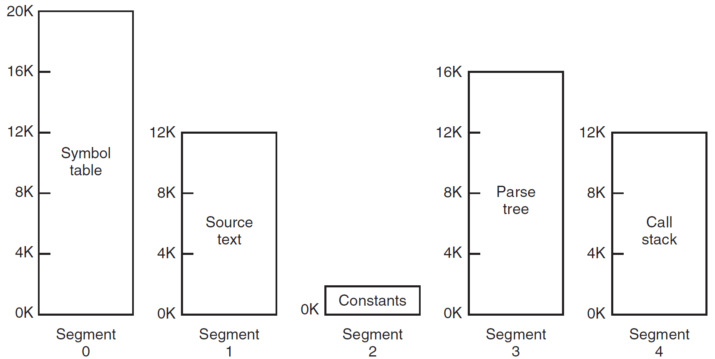
Segmentation

Slide 9
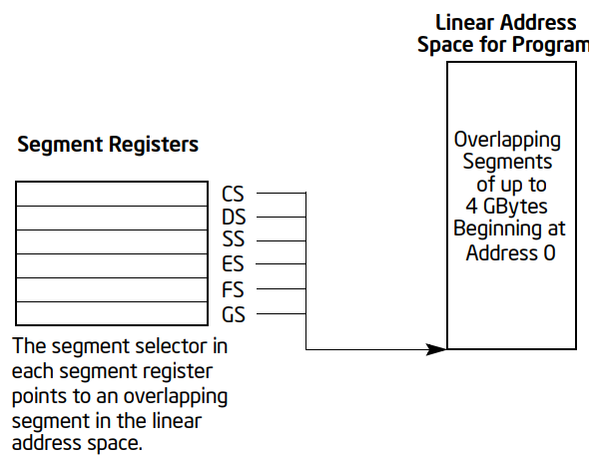
Intel example – Flat Memory Model
Memory appears to a program as a single, continuous address space called a linear address space.
Code, data, and stacks are all contained in this address space. Linear address space is byte addressable, with addresses running contiguously from 0 to 2³² - 1 (if not in 64-bit mode).
https://software.intel.com/sites/default/files/managed/39/c5/325462-sdm-vol-1-2abcd-3abcd.pdf

Slide 10
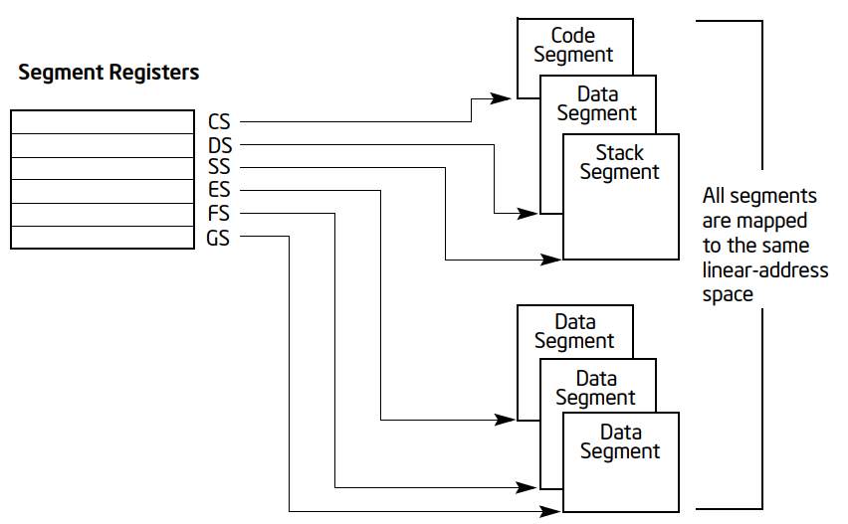
Intel example – Segmented Memory Model
Memory appears to a program as a group of independent address spaces called segments.
Code, data, and stacks are typically contained in separate segments.
https://software.intel.com/sites/default/files/managed/39/c5/325462-sdm-vol-1-2abcd-3abcd.pdf
Notes:
To address a byte in a segment, a program issues a logical address. This consists of a segment selector and an offset (logical addresses are often referred to as far pointers). he segment selector identifies the segment to be accessed and the offset identifies a byte in the address space of the segment. Programs running on an IA-32 processor can address up to 16,383 segments of different sizes and types, and each segment can be as large as 232 bytes.

Slide 11

Segmentation – another view
0
1400
2400
3200
4300
4700
5700
6300
6700
segment 0
segment 3
segment 2
segment 4
segment 1
subroutine
stack
segment 0
main
program
segment 1
sqrt
 | limit | base
0 | 1000 | 1400
1 | 400 | 6300
2 | 400 | 4300
3 | 1100 | 3200
4 | 1000 | 4700
segment 2
symbol table
segment 4
segment 3
logical address space
physical memory
Notes:
This diagram is from Silberschatz & Galvin
It shows only for a single process how memory may be divided, but of course with larger memory we could have segments from other processes in at the same time.
Note that Tanenbaum states that the advantage of segmentation is that segments can change size easily. If you run out of space in your stack, the segment can easily grow. As should be obvious from the diagram, it may not be that simple if segments are touching. They could be shuffled around in memory, but that would be at great expense...

Slide 12
Segmentation
How are addresses translated?
limit | base
segment table
Logical Address
Segment | Offset
physical
memory
offset < limit?
+
yes
no
TRAP, addressing error...
Notes:
This is another diagram from Silberschatz and Galvin.
Note how similar it is to our solution for paging. Instead of a page table, we have a segment table. The address is broken up into two pieces, just like with paging. The difference is that the addresses translated in a single segment result in linear addresses through physical memory. Increasing your virtual address when paging results in different pages continually and completely different locations in physical memory.
Note also, that just like paging, a system may be developed with a large number of pages. In this case, the segment table may need to be kept in memory or even on disk. A Translation Lookaside buffer may be employed as with paging so segment lookups do not have to occur frequently.
Finally, note that checking will have to be done to ensure a program is not trying to access another process’ memory. This can be done by having a registers (for each process) indicating where in the segment table they are to start (Segment Table Base Register) and how many entries are legal for that process (Segment Table Length Register). They should never access a segment outside of their allowed range.

Slide 13
Segmentation
Advantages:
May be possible to shrink/grow segments
Each segment can be given its own protection information...this is a much easier protection scheme than trying to protect each page of memory
Linking programs is a trivial task
Code can be shared between processes easily. Just load the code segment once. Copies of the same program access the same segment.
Notes:
For linking programs...explain how object code is created for individual files...and then put together by the linker with all the address realignment and such.

Slide 14
Segmentation
Disadvantages:
Programmer must be aware of the memory model in use (at the assembly level, anyway)
Just like with swapping systems, fragmentation can waste much memory.
Segments may be too large to fit in physical memory
What have we seen that allows us to address an address space larger than physical memory?
Notes:
The answer is paging!

Slide 15
Segmentation with Paging
To get the best of both systems, segments can be paged
Reduces the problem of memory fragmentation
Allows large segments to be partially in memory
Required:
Each process needs a segment table
This table may be segmented and paged itself
Each entry in the segment table points to the page table for that segment
Like before, this may be a multi-level page table
Notes:
This is sort of similar to multi-level paging in that we’ll have to break the address into three components. The segment, the index into the page table, and the offset within the page.

Slide 16
Logical Address
Segment | Offset
physical
memory
offset < limit?
yes
limit | page table base
segment table
Offset
no
TRAP
Pg Tbl Offset | Offset'
page frame add
page table for segment
+
page frame add | Offset'
Notes:
This demonstrates the trivial case where the segment table and page tables can fit in registers
The “limit” here is the length of the segment. Obviously, we cannot address deeper into the segment than the size we requested.
Note that while physical memory will not be fragmented in this scheme, the programmer/compiler is still able to request segments that break up their virtual address space in a terrible way. That is why systems that have segments usually provide them in discrete chunks.

Slide 17
Real-World Usage
Segmentation has been around since the 16 bit processors (8086/8088)
Paging and segmentation since Intel386
For the 386 there are 8K “shared” segments and 8K segments per process
OS/2 used the full features this allowed
For the Pentium series, Windows trivializes it by giving each process a full segment that is paged, effectively re-flattening the address space
For Intel x86-64 architectures, segmentation is not generally used

Slide 18
File System

