Slide 1

Personal Health Training – 2026
Agenda
1. Welcome and thanks
2. Heated Straightening Brush
3. Dryers
4. Straighteners
5. Feature definitions
6. Questions

Slide 2

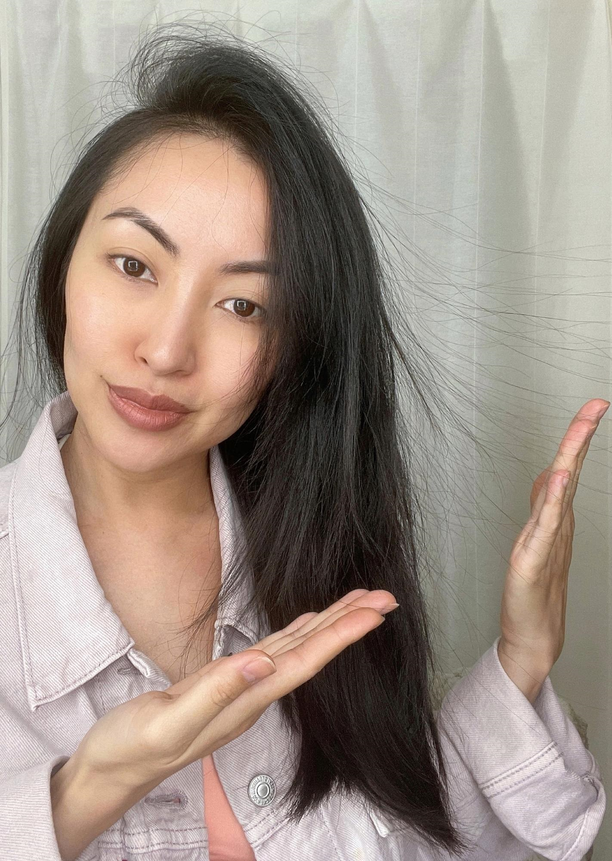
Hairdryer and Straightener features
ThermoProtect Attachment: Provides the optimal drying temperature and gives additional protection from overheating the hair with the same powerful airflow. It mixes warm and cold air together for the perfect result.
ThermoShield Technology: Gives you ultimate protection from heat damage, by actively controlling the air temperature of the dryer to an optimum level.
Ions: This technology reduces static electricity by generating negative ions. By generating these negative ions, your hair does not become static. Also, the drying time is shorter.
Keratin Infused Ceramic Plates: The straightener has a keratin
infused to keep your hair healthier, shiner and provide ultimate smooth
gliding also ceramic coated plates which allow even distribution of heat and
protects hair from heat damage.

Slide 3
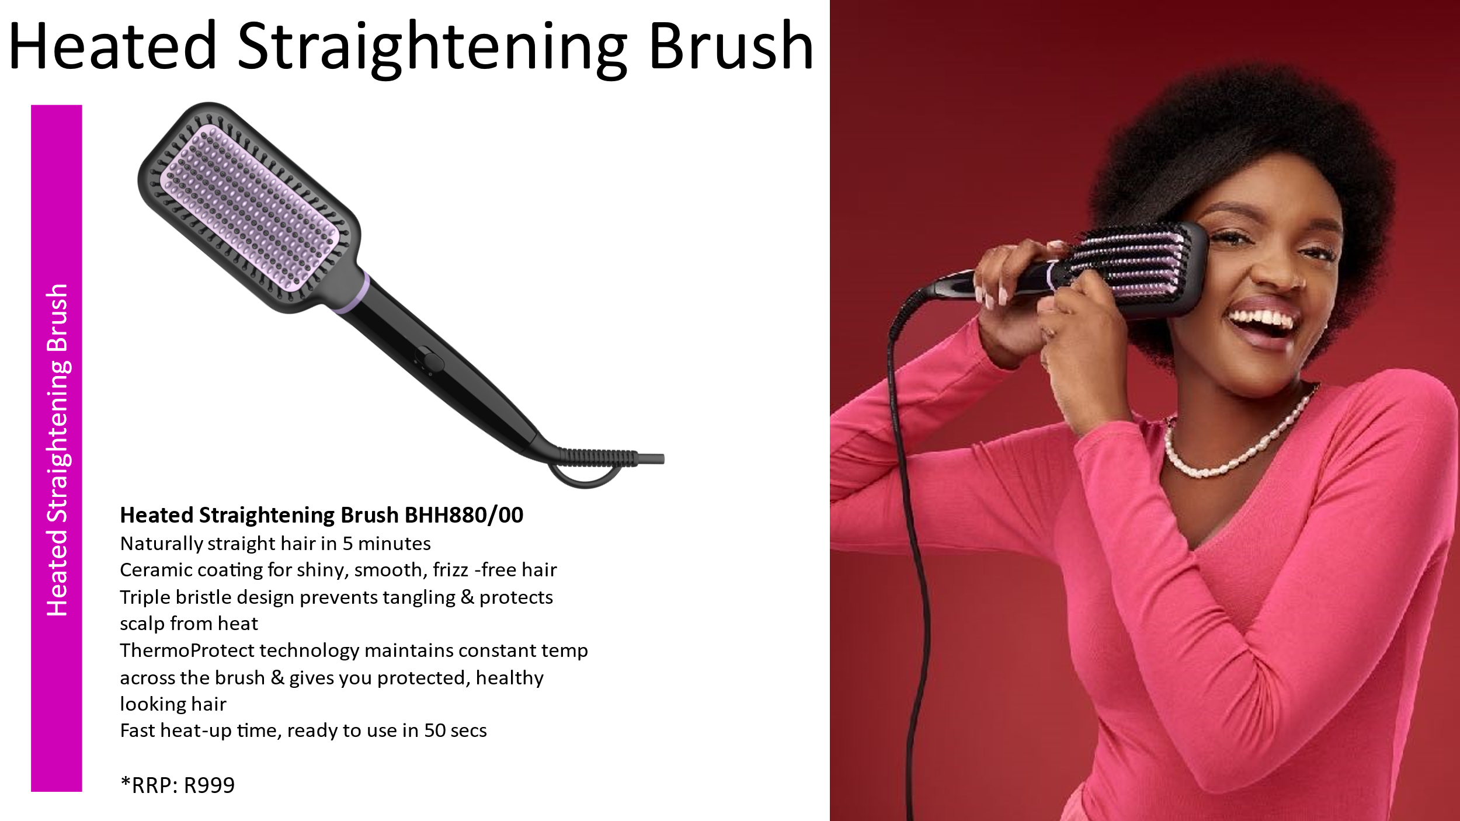
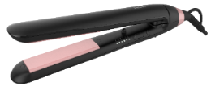
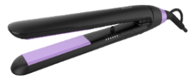

ThermoProtect BHS378/00
ThermoProtect Technology
Ionic care for shiny, frizz-free hair
Keratin-infused plates for smooth gliding & shiny hair.
6 LED temperature settings 160°C up to 230°C
100mm plates for fast & easy straightening.
Auto shut-off
Key lock function to safe storage.
ThermoProtect BHS377/00
Prevent overheating with ThermoProtect technology
Keratin ceramic plates for smooth gliding & shiny hair
10 temp settings for precise control
100mm long plates
Auto shut off

Slide 4
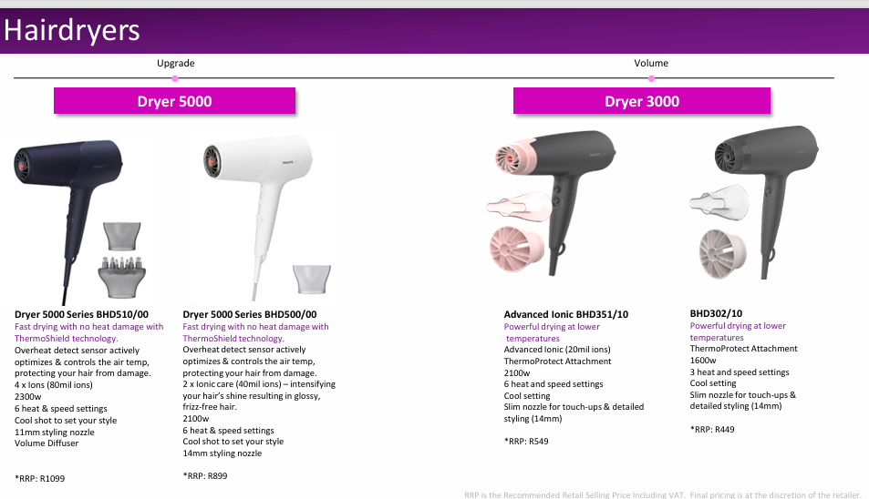
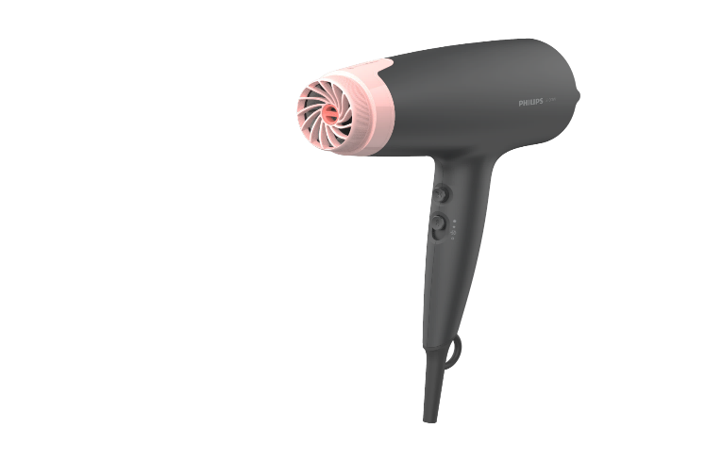
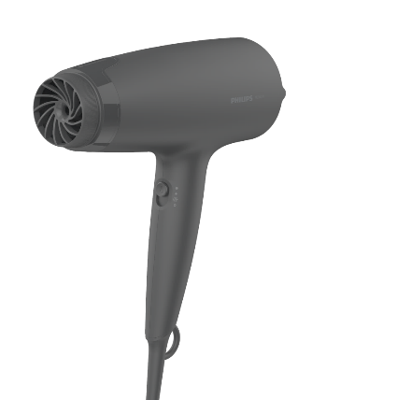
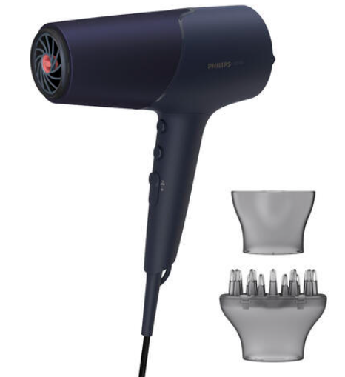
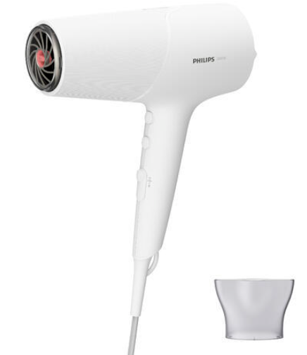
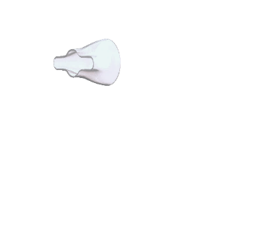
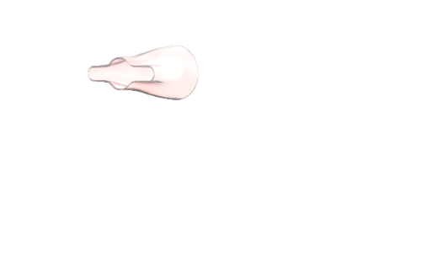
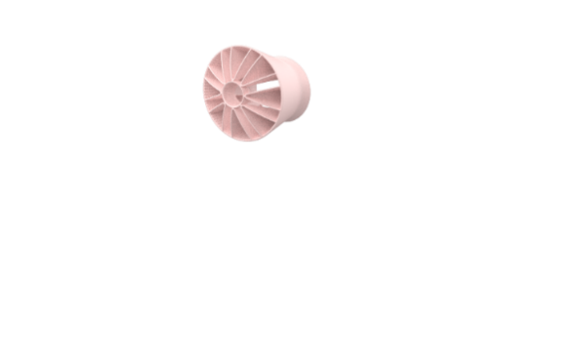

Dryer 5000
Dryer 3000
Hairdryers
Upgrade
Volume
Dryer 5000 Series BHD510/00
Fast drying with no heat damage with ThermoShield technology.
Overheat detect sensor actively optimizes & controls the air temp, protecting your hair from damage.
4 x Ions (80mil ions)
2300w
6 heat & speed settings
Cool shot to set your style
11mm styling nozzle
Volume Diffuser
*RRP: R1199
Dryer 5000 Series BHD500/00
Fast drying with no heat damage with ThermoShield technology.
Overheat detect sensor actively optimizes & controls the air temp, protecting your hair from damage.
2 x Ionic care (40mil ions) – intensifying your hair’s shine resulting in glossy, frizz-free hair.
2100w
6 heat & speed settings
Cool shot to set your style
14mm styling nozzle
*RRP: R899
Advanced Ionic BHD351/10
Powerful drying at lower
temperatures
Advanced Ionic (20mil ions)
ThermoProtect Attachment
2100w
6 heat and speed settings
Cool setting
Slim nozzle for touch-ups & detailed styling (14mm)
*RRP: R549
BHD302/10
Powerful drying at lower temperatures
ThermoProtect Attachment
1600w
3 heat and speed settings
Cool setting
Slim nozzle for touch-ups & detailed styling (14mm)
*RRP: R449
RRP is the Recommended Retail Selling Price Including VAT. Final pricing is at the discretion of the retailer.
Notes:
BHD302 – 16 euro
BHD351 – 21 euro
BHD500 – 31 euro
BHD510 – 41 euro

Slide 5
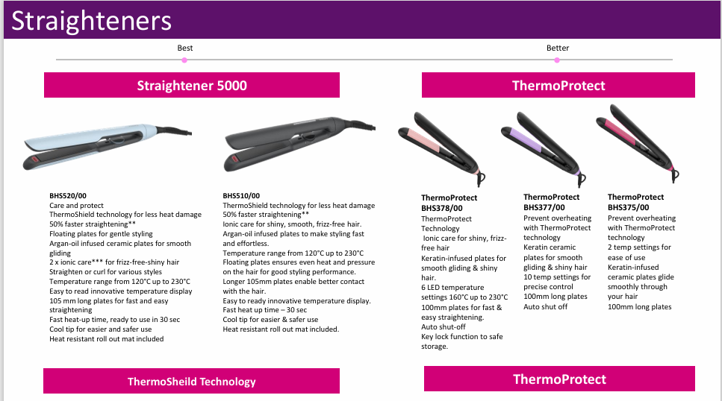
Straighteners

Slide 6
Questions?

